Slide 1
2.Streams

Slide 2
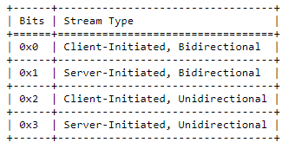
Stream types and
Identifier
LSB of Stream ID
Unidirectional
Identified by Stream ID of 2^62-1
Stream
Bidirectional

Slide 3
Sending and
Receiving Data
Application
Data produce
Ordered Byte Stream
Buffer any out of order data
STREAM Frames
Duplicate discard

Slide 4
3.Streams state

Slide 5
Sending Stream States
Create Stream (Sending)
Peer Create Bidirectional Stream
Terminal state
sending
receiving
Ready
s.RESET_STREAM
Reset Sent
r.ACK
Reset Recvd
s.STREAM
s.STRAM_DATA_BLOCKED
Peer Create Bidirectional Stream
s.RESET_STREAM
s.RESET_STREAM
Send
s.STREAM + FIN
Data Sent
rAll.ACK
Data Recvd

Slide 6
r.STREAM / r.RESET_STREAM/ r.STRAM_DATA_BLOCKED
Create Bidirectional Stream (Sending)
r.MAX_STREAM_DATA / r.STOP_SENDING (Bidirectional)
Create Higher-Numbered Stream
Receiving Stream States
Recv
r.RESET_STREAM
Reset Recvd
app.read.RST
Reset Read
r.RESET_STREAM
r.STREAM + FIN
[r.ALL data]
[r.RESET_STREAM]
Size Known
app.read.all data
Data Recvd
rAll.ACK
Data Read
Notes:
3,3 check

Slide 7
Bidirectional Stream States
idle
Reset Recvd
Reset Read
Ready
Recv
Size Known
Data Recvd
Data Read
Open
Closed
Half-Closed
(local)
Half-Closed
(remote)
Reset Sent
Reset Recvd
Send
Data Sent
Data Recvd
Notes:
3,3 check

Slide 8
10.Connection Termination

Slide 9
Immediate close
All stream closed
Closing connection
[r.CONNECTION_CLOSE
|| r.stateless_RESET]
Draining connection
r.CONNECTION_CLOSE
Signal rcv
Closing/draining
period finish
s.CONNECTION_CLOSE
Connection close
If no new socket open
(no new response allow -> close asap)
Connection close sent
Connection close (faster)
Notes:
10,1
?? Once the closing or draining period has ended, an endpoint SHOULD discard all connection state.
This results in new packets on the connection being handled generically.
For instance, an endpoint MAY send a stateless reset in response to any further incoming packets.

Slide 10
Idle timeout
max_idle_timeout (=min(max_peer1,max_peer2))
specified and exceed both peers
+ > 3 * ProbeTimeOut
idle
Closing connection
[r.CONNECTION_CLOSE
|| r.stateless_RESET]
Draining connection
Signal rcv
Closing/draining
period finish
s.CONNECTION_CLOSE
Connection close
If no new socket open
(no new response allow -> close asap)
Connection close sent
Connection close (faster)
Notes:
10,2
https://tools.ietf.org/html/draft-ietf-quic-recovery-29
LIVENESS
An endpoint that sends packets close to the effective timeout risks having them be discarded at the peer, since the peer might enter its draining state before these packets arrive
An endpoint can send a PING or another ack-eliciting frame to test the connection for liveness if the peer could time out soon, such as within a PTO; see Section 6.2 of [QUIC-RECOVERY].
This is especially useful if any available application data cannot be safely retried. Note that the application determines what data is safe to retry.

Slide 11
Stateless reset
Cancel
TOREAD
All stream closed
Closing connection
[r.CONNECTION_CLOSE
|| r.stateless_RESET]
Draining connection
If StatelessResetToken field = 1
And r.CONNECTION_CLOSE
And r.RETIRE_CONNECTION_ID
And Unpredictable Bits field > 38 bits
Signal rcv with
Connection_close
Closing/draining
period finish
s.CONNECTION_CLOSE
Connection close
If no new socket open
(no new response allow -> close asap)
Connection close sent
Connection close (faster)
Notes:
A minimum size of 21 bytes does not guarantee that a stateless reset
is difficult to distinguish from other packets if the recipient
requires the use of a connection ID. To prevent a resulting
stateless reset from being trivially distinguishable from a valid
packet, all packets sent by an endpoint SHOULD be padded to at least
22 bytes longer than the minimum connection ID that the endpoint
might use. An endpoint that sends a stateless reset in response to a
packet that is 43 bytes or less in length SHOULD send a stateless
reset that is one byte shorter than the packet it responds to.
These values assume that the Stateless Reset Token is the same length
as the minimum expansion of the packet protection AEAD. Additional
unpredictable bytes are necessary if the endpoint could have
negotiated a packet protection scheme with a larger minimum
expansion.

Slide 12
11.Error Handling

Slide 13
Connection Errors
Obvious violation entire connection
| corruption of state
Error detected
Error Signaled
s.CONNECTION_CLOSE
[May close]
Connection close

Slide 14
Stream Errors
Obvious violation 1 stream
| corruption of state
Error detected
s.RESET_STREAM |
s.STOP_SENDING
Error Signaled
[May close]
Stream close

Slide 15
12.Packet and Frames

Slide 16
Protected packet
Keys staticallly derived
Initial packets
(all exept Version Negotiation)
Keys derived from crypto handshake
All other packet

Slide 17
Coalescing packet
Length field of Initial/0-RTT/Handshake/1-RTT packets
if receiver able for a single connection (same connection id)
Coalesce multiple QUIC packet in one UDP datagram

Slide 18
Packet number
0-2^62-1
Determine the cryptographic nonce for packet protection
(enforce crypto separation)
Connection close
N° sending reach 2^62-1
(without connection_close)
Packet number
Initial space
Initial packets
Handshake packets
Handshake space
Encoded in 1 to 4 bytes
0-RTT and 1-RTT packets
Packet number in short or long header
Application data space
Notes:
Determined by the Largest Acknoledged field of Ack

Slide 19
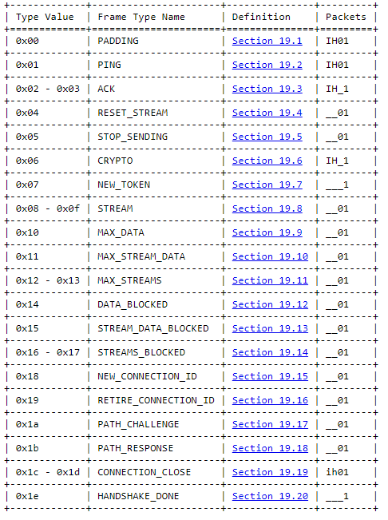
I: Initial (Section 17.2.2)
H: Handshake (Section 17.2.4)
0: 0-RTT (Section 17.2.3)
1: 1-RTT (Section 17.3)
ih: A CONNECTION_CLOSE frame of type 0x1d cannot appear in Initial or Handshake packet
Frames
If not Version Negociation | Stateless Reset | Retry packets
Contain at least 1 frame

