Slide 1



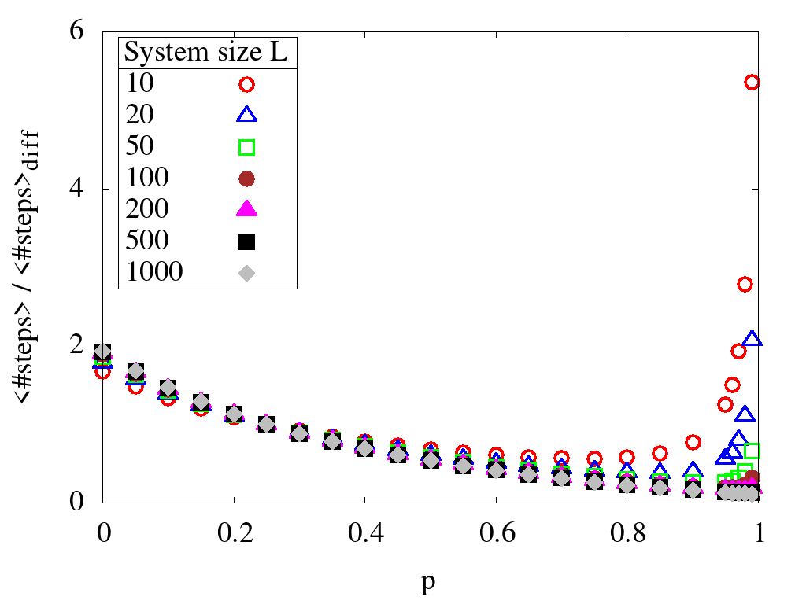
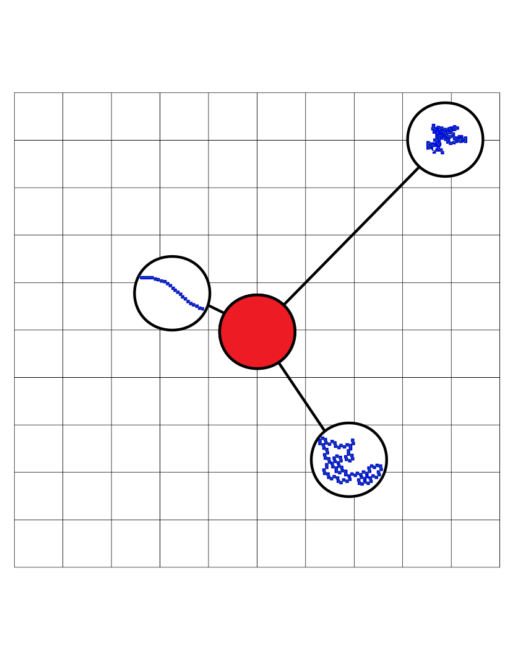
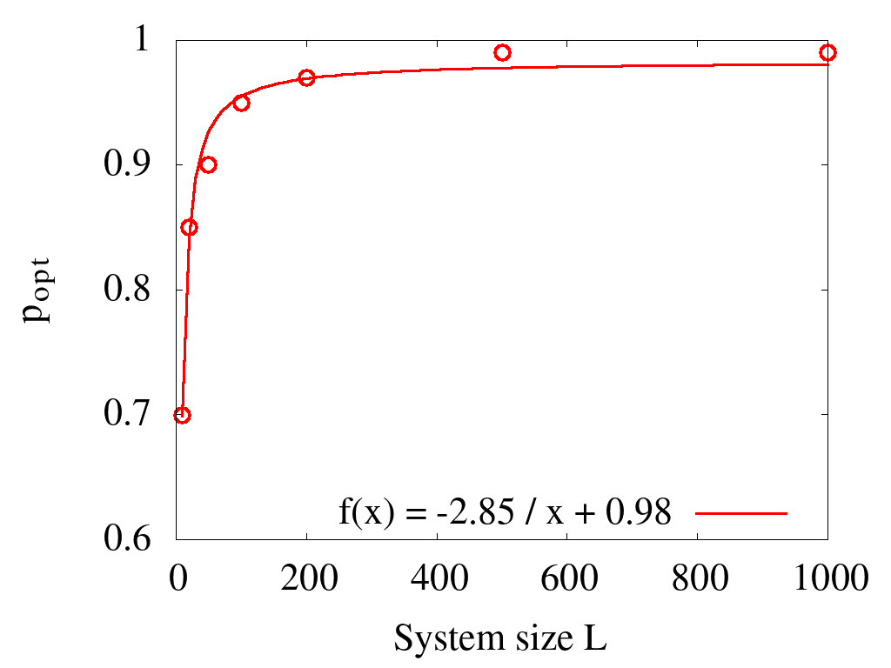
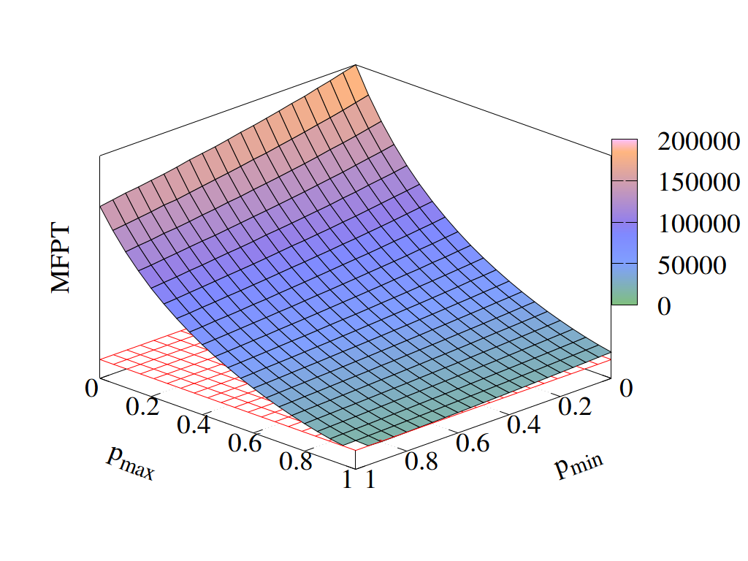
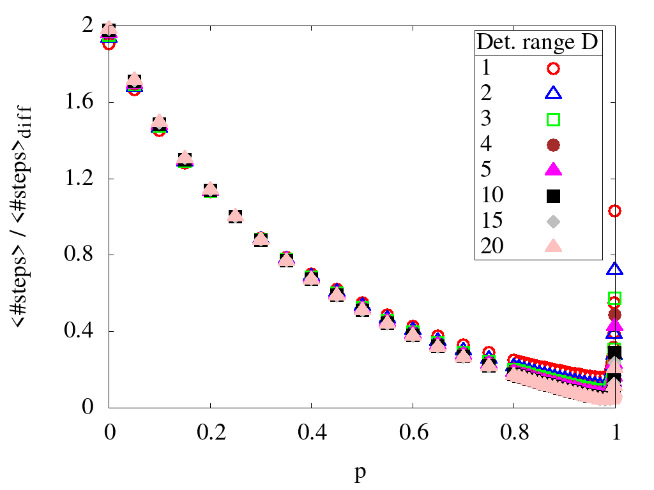
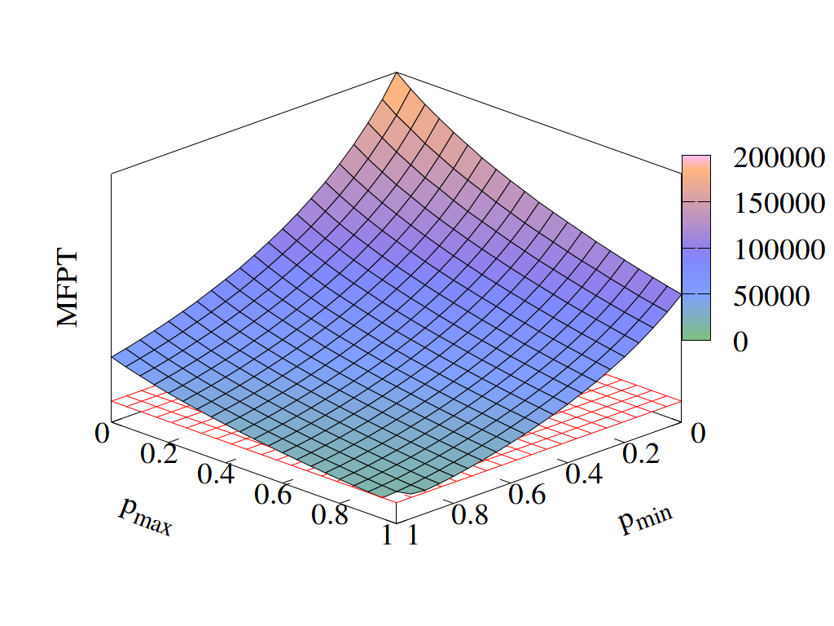
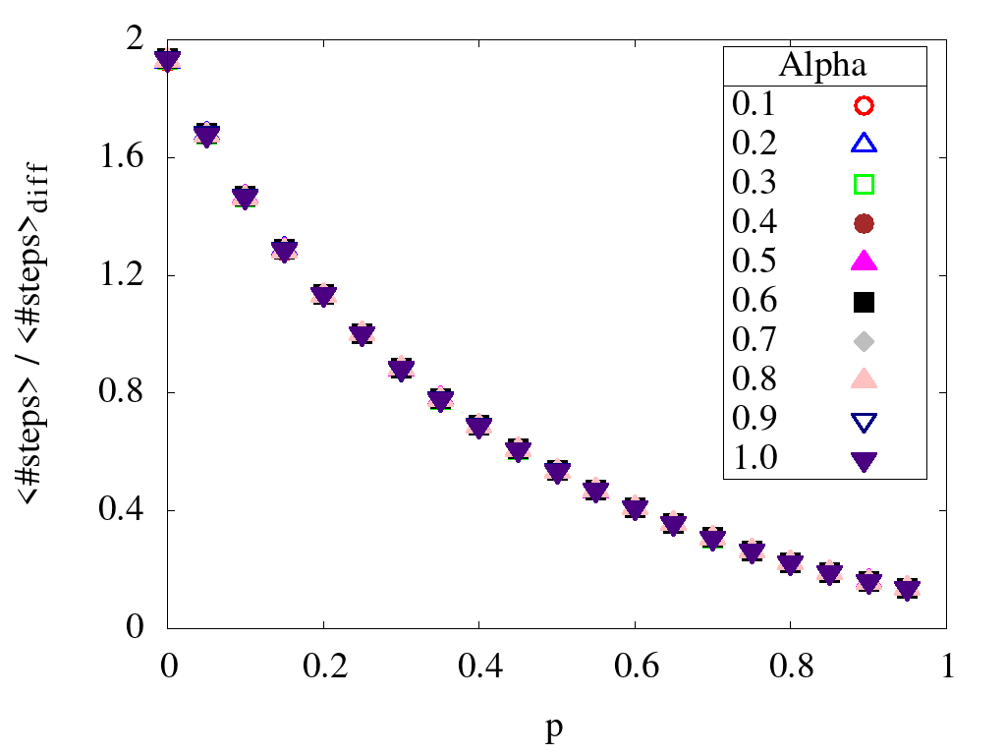
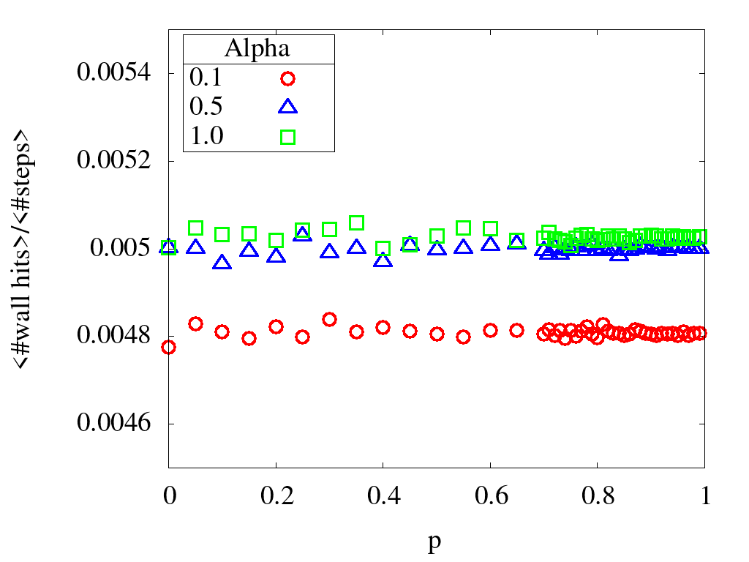
First-Passage Properties of Active Particles with Position-Dependent Persistency
Kevin Klein, Ludger Santen and M. Reza Shaebani
Department of Theoretical Physics, Saarland University, Saarbrücken, Germany
Abstract
We consider an active motion with a single-state of motility in confined geometries. We first investigate the mean first-passage time (MFPT) of a random walk with constant activity on a two-dimensional lattice and verify that the MFPT admits a minimum as a function of the activity. The optimal activity varies with the system size, the detection range of the searcher (or equivalently the target size), and the boundary conditions. We also study the MFPTs of random walks with position-dependent activity. We consider linearly increasing or decreasing activities versus the distance to the target, as well as nonmonotonic functions. It turns out that these search strategies can be even more efficient than the optimal constant activity choice, for some parameter values. Our results help to better understand the chemokinesis of biological organisms and enables us to propose more efficient search strategies by adapting the particle activity to the local available information about the target.
Motivation
Active Motion
Migrating cells perform active motion [1].
Activity can be quantified in terms of the turning-angle distribution of the motion.
Im not sure what to put here exactly or what you expected to see in this paragraph.
Chemotaxis: In order to survive and grow, microorganisms need to find nutrients, food, prey or mating partners. Therefore, they essentially use tactics of a hunting dog by means of chemotaxis. This means, that after sensing a chemical gradient, they are able to change their state of motility by e. g. switching from a nonbiased to a biased movement [2].
Chemokinesis: Not sure where to find adequate information about this. I mean I could just write sth like that instead of sensing a gradient only the absolut value of concentration is sensed in depending on this the state of motility is changed but that is just what I know from you and I have no reference right now.
A useful measure for activity is the persistency of a moving organism. The persistency of a random walker in continuous space can thus be measured by the average of the cosine over the turning angles as follows:
For a random walker in discrete space, e.g. a lattice, the persistency can simply be measured as the probability to keep moving in the same direction.
First-Passage Times of Motions with Constant Activity
Search Efficiency of Position-Dependent Activity
System size
System size
Position-dependent persistency
We varied the size of the system between 10 and 1000 and averaged the MFPT over one million simulations as shown in the figure to the right.
MFPT is scaled by
the MFPT for p = 0.25
which is equivalent to
a pure diffusive motion.
We now introduce random walks with position-dependent activity which is realized by using a position-dependent persistency.
In the figure to the left a monotonic decreasing persistency profile is shown: close to the target the random walk is balistic whereas far away from the target the motion is purely diffusive.
For the MFPT simulations we use a system size of L = 200, a detection range of D = 1, periodic boundary conditions and we average over one million simulations.
According to our results the optimal persistency increases with the system size. The increase can be approximately described by an 1/x law as shown in the figure to the left.
Linear and symmetric parabolic persistency profiles
Detection range
The MFPTs for a linear relation between persistency and distance is shown to the left. The persistency decreases/increases from p_max to p_min over the whole possible distance range.
We find that for parameters close to 1 the MFPT becomes lower than the one of the constant activity (red grid).
For a system size of L = 200 we varied the detection range between 1 and 20 and averaged the MFPT over one million simulations as shown in the figure to the right.
The optimal persistency remains at the same value for all different detection ranges, there is no dependency on the detection range.
MFPT is scaled by
the MFPT for p = 0.25
which is equivalent to
a pure diffusive motion.
The MFPTs for a parabolic relation between persistency and distance is shown to the right. Depending on p_min/p_max the parabola is opening to the top/bottom and is symmetric to half of the max distance.
Again we find that for parameters close to 1 the MFPT becomes lower than the one of the constant activity (red grid).
Absorbing boundaries
As can be seen in the figures to the left and below, absorbing boundaries with release probability alpha do not effect the position of the optimal persistency.
MFPT is scaled by
the MFPT for p = 0.25
which is equivalent to
a pure diffusive motion.
Averaged over 1 billion steps.
References
[1] P. Maiuri et al., Cell 161, 374, 2015.
[2] M. Eisenbach, Chemotaxis, Imperial College Press, 2004.

