Slide 1


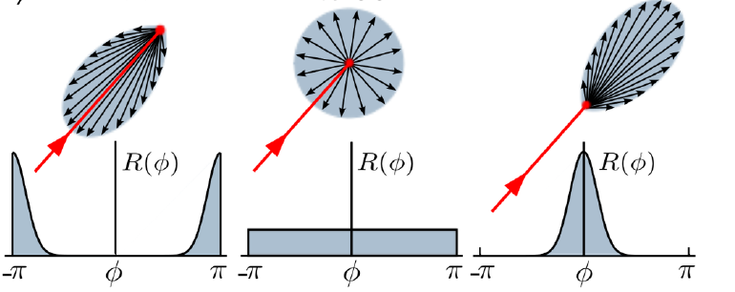

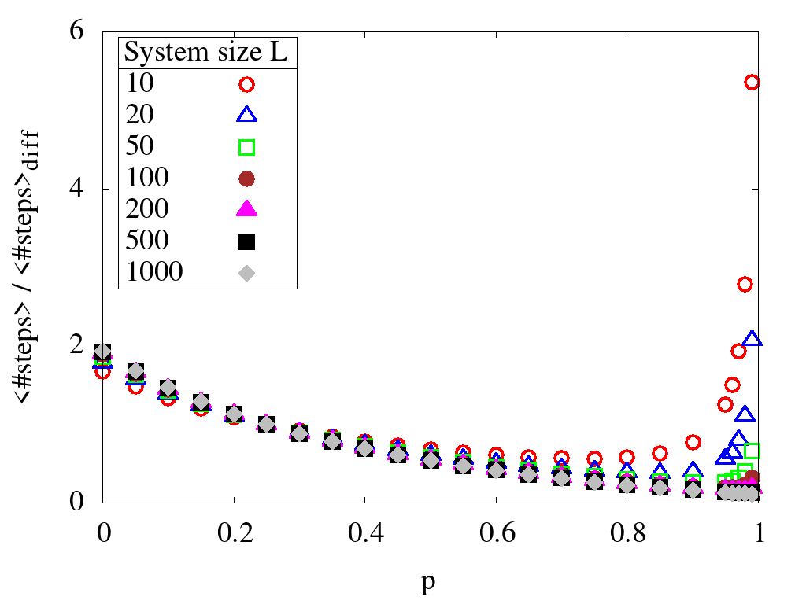
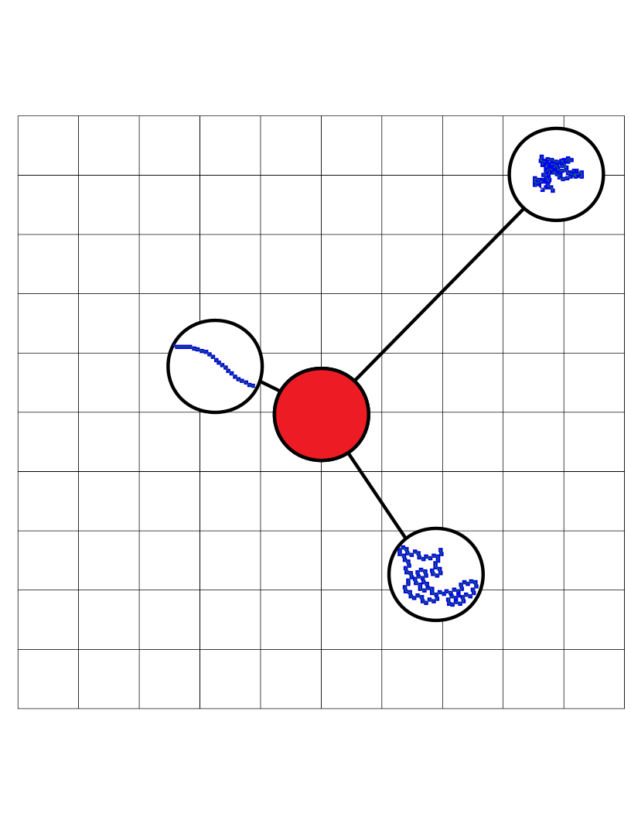
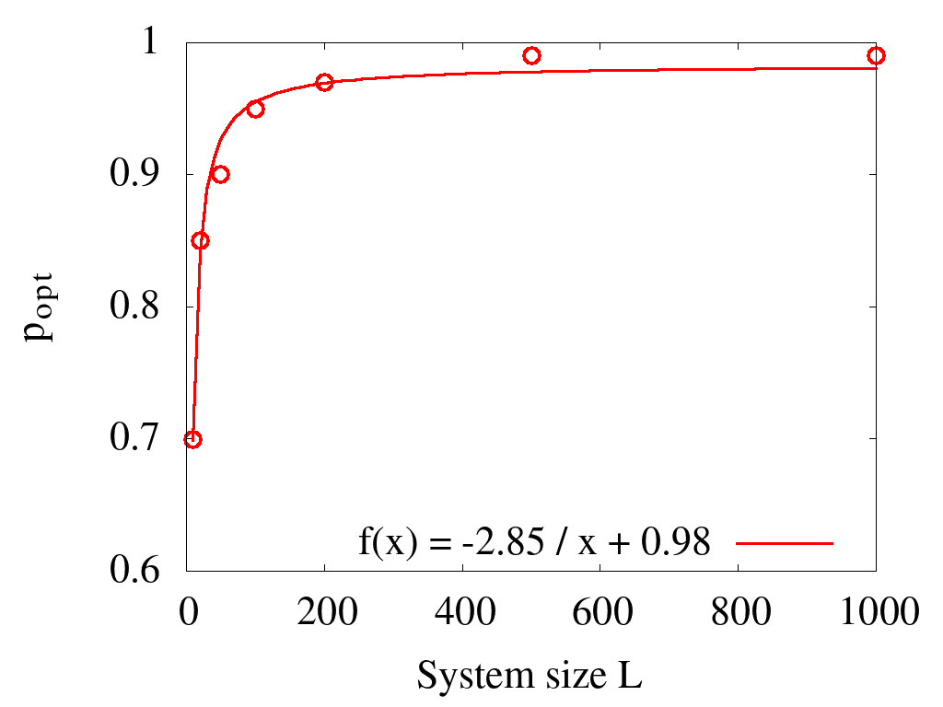
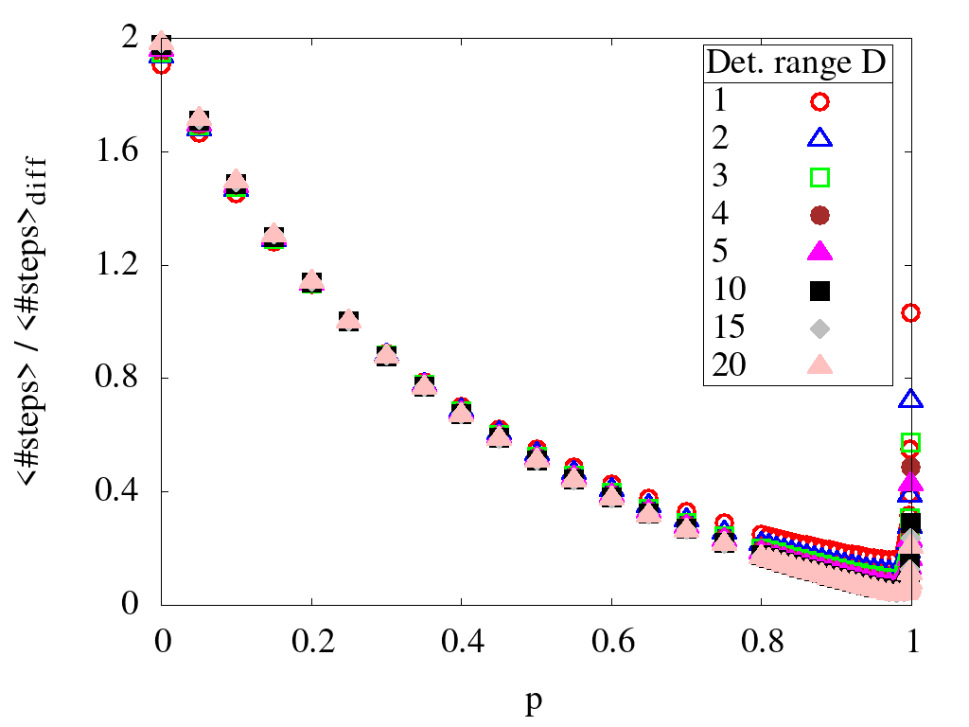
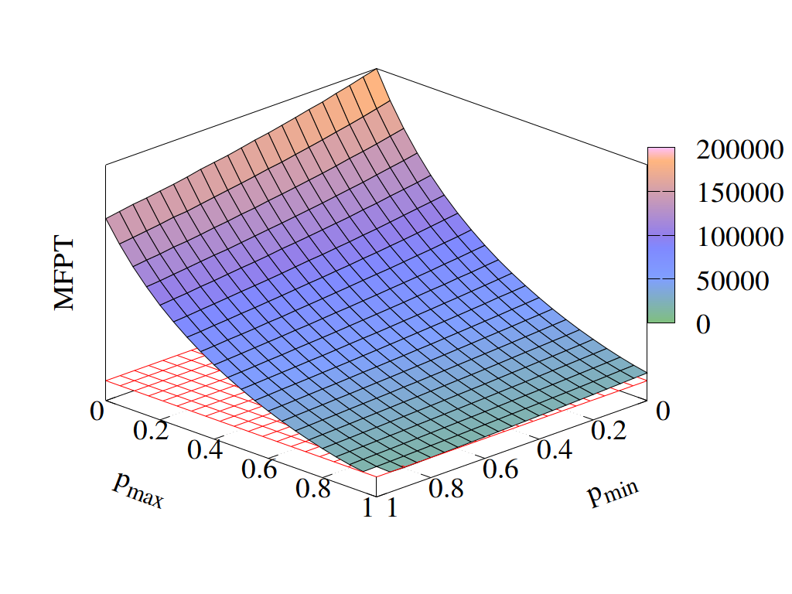
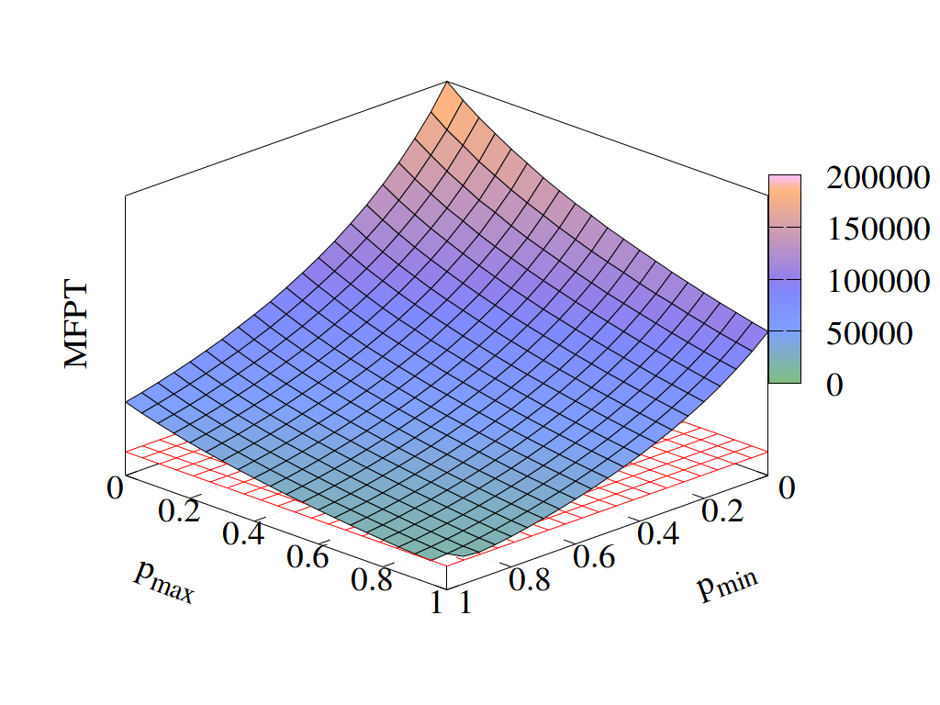
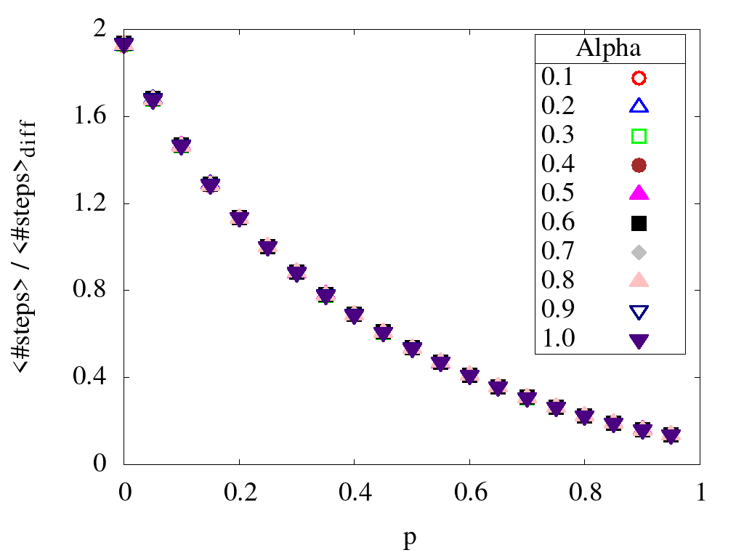
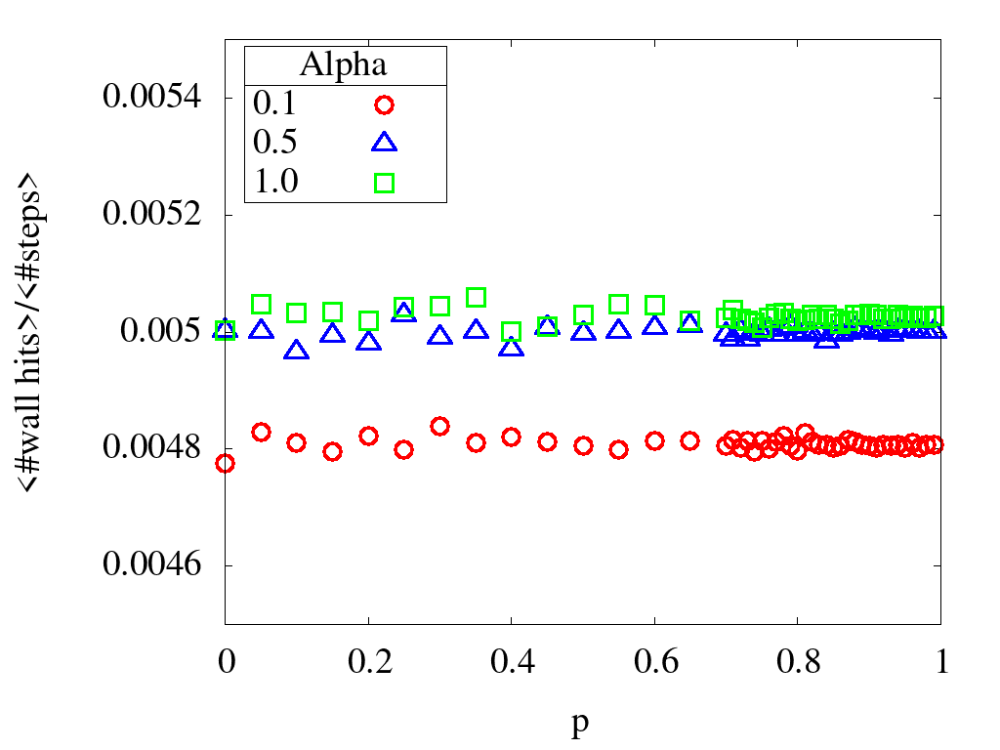
First-Passage Properties of Active Particles with Position-Dependent Persistency
Kevin Klein, Ludger Santen and M. Reza Shaebani
Department of Theoretical Physics, Saarland University, Saarbrücken, Germany
Abstract
We consider an active motion with a single-state of motility in confined geometries. We first investigate the mean first-passage time (MFPT) of a random walk with constant activity on a two-dimensional lattice and verify that the MFPT admits a minimum as a function of the activity. The optimal activity varies with the system size, the detection range of the searcher (or equivalently the target size), and the boundary conditions. We also study the MFPTs of random walks with position-dependent activity. We consider linearly increasing or decreasing activities versus the distance to the target, as well as nonmonotonic functions. It turns out that these search strategies can be even more efficient than the optimal constant activity choice, for some parameter values. Our results help to better understand the chemokinesis of biological organisms and enables us to propose more efficient search strategies by adapting the particle activity to the local available information about the target.
Motivation
Active Motion
Some of the biological organisms exhibit a single-state active dynamics with a variable activity.
For example, migrating cells perform an active motion in which the cell persistency (activity) varies with the cell velocity [1].
The possibility of changing the activity enables the organisms to adapt themselves to the environmental changes and perform an efficient chemotaxis or chemokinesis.
Activity can be quantified in terms of the turning-angle distribution of the motion.
The arrows in the right figure indicate the possible directions of motion in the next step.
Chemotaxis: In order to survive and grow, living organisms need to find nutrients, food, prey or mating partners. One possibility is chemotaxis, i.e. if they can sense and follow the (chemical) gradients [2]. Thus, here the organisms respond to the environment by rather directed movements.
A useful measure for activity is the Fourier transform of the turning-angle distribution, which corresponds to average of cosine for symmetric distributions:
Chemokinesis: In chemokinesis, the organisms can only sense the level of the chemicals in the environments but not the gradients. The response has a random nature in this case, and the searcher may follow different strategies such as changing the speed or persistency.
For a random walker in discrete space, e.g. a lattice, the possibilities for the turning angles reduce to those allowed by the lattice structure. In this case, we define the persistency (i.e. activity) as the probability to keep moving along the previous direction of motion.
First-Passage Times of Motions with Constant Activity
Search Efficiency of Position-Dependent Activity
System size
Position-dependent persistency
System size
We consider several scenarios of single-state active walks with a position-dependent activity.
In the right schematic figure, a monotonically decreasing persistency with the distance from the target is depicted: close to the target the dynamics is nearly ballistic whereas far away from the target the motion is purely diffusive.
To obtain the MFPT, we run simulations where the system size is set to L=200 and the detection range to D=1. Periodic boundary conditions are imposed and we average over an ensemble of one million realizations.
We vary the system size by several orders of magnitude, while the target is always located at the center of the system. By repeating the simulation for an ensemble of different initial positions of the searcher, we calculate the MFPT to reach the target.
MFPT is scaled by
the MFPT for p = 0.25
which is equivalent to
a pure diffusive motion.
According to our results, the optimal activity (persistency) increases with the system size. The increase can be approximately described by an 1/L functionality as shown in the left figure.
Linear and symmetric parabolic persistency profiles
Detection range
The MFPT for a linear relation between the persistency and the distance is shown in the left figure. The persistency decreases/increases within the range [p_min, p_max] over the whole range of possible distances.
For p_min and p_max parameter values close to 1, the linear profile can be even more efficient than the optimal choice in the constant activity strategy (red grid).
For the system size L=200, we vary the detection range within [1, 20] and obtain the MFPT for each detection range over an ensemble of the initial positions of the searcher.
The optimal persistency remains approximately independent of the detection range.
The MFPTs for a parabolic relation between persistency and distance is shown in the right figure. The parabola admits a minimum/maximum and is chosen to be symmetric.
Similarly, we find a range of parameter values close to 1, where the MFPT becomes lower than the one for the optimal constant activity (red grid).
Absorbing boundaries
The following figures verify that the optimal activity is not considerably influenced by the stickiness of the lateral walls.
Averaged over 1 billion steps.
References
[1] P. Maiuri et al., Cell 161, 374, 2015.
[2] M. Eisenbach, Chemotaxis, Imperial College Press, 2004.

