Slide 1
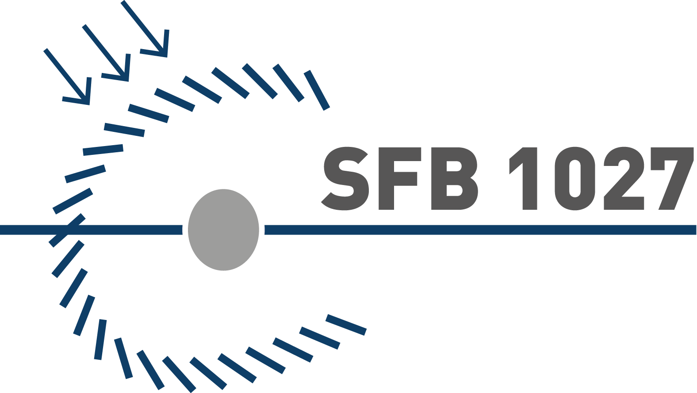

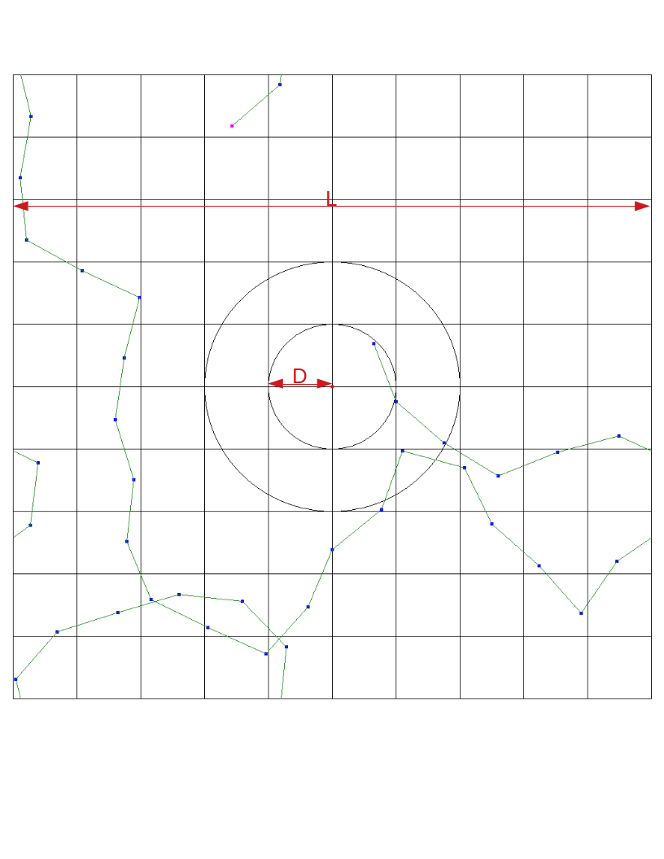


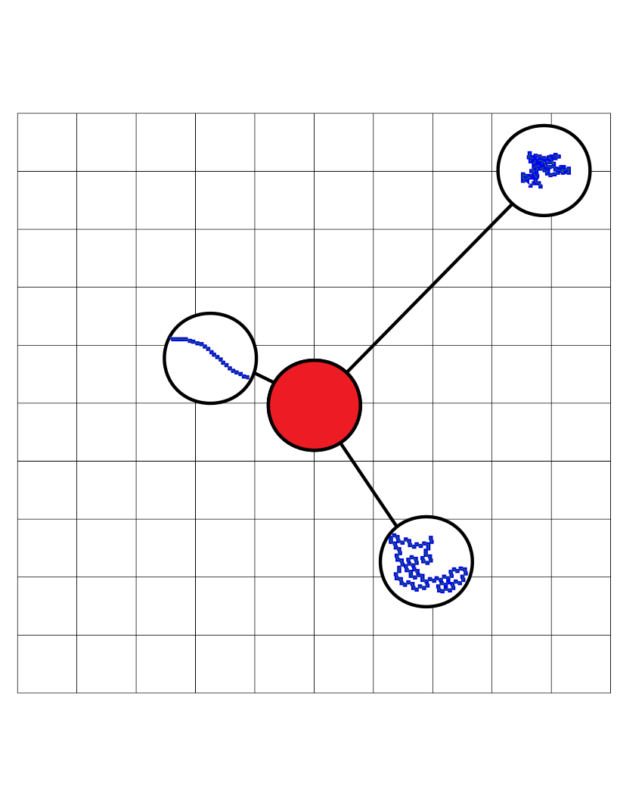
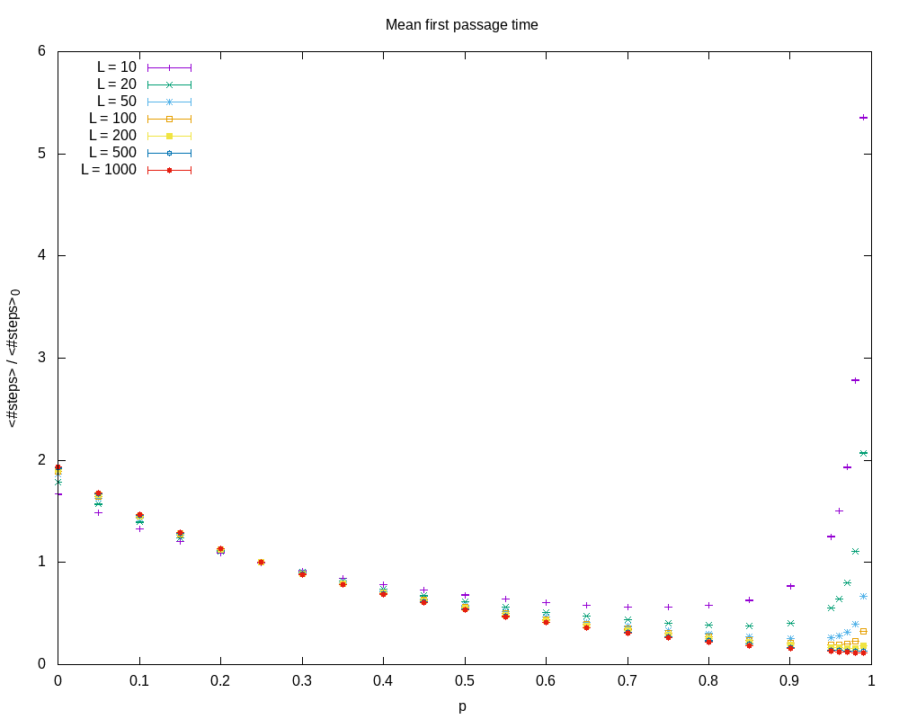
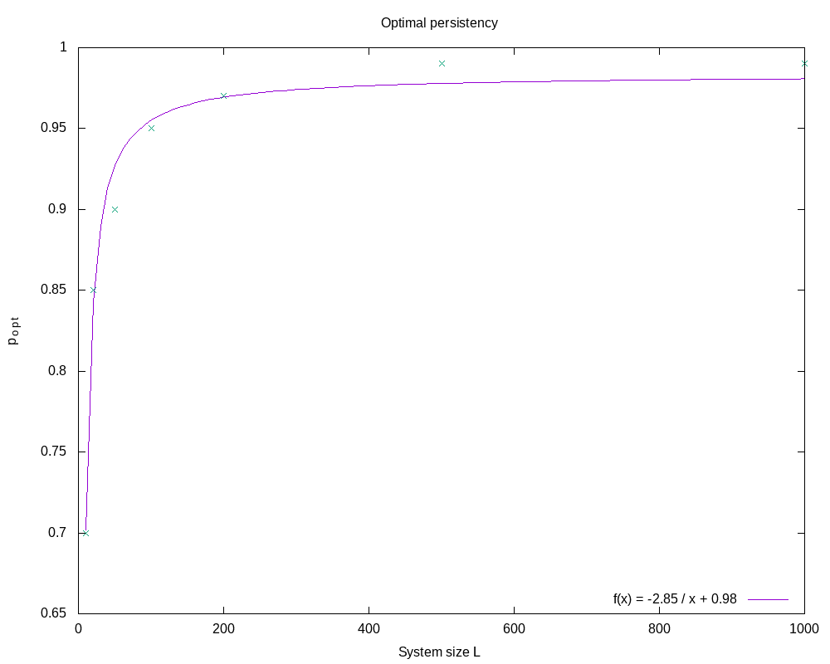
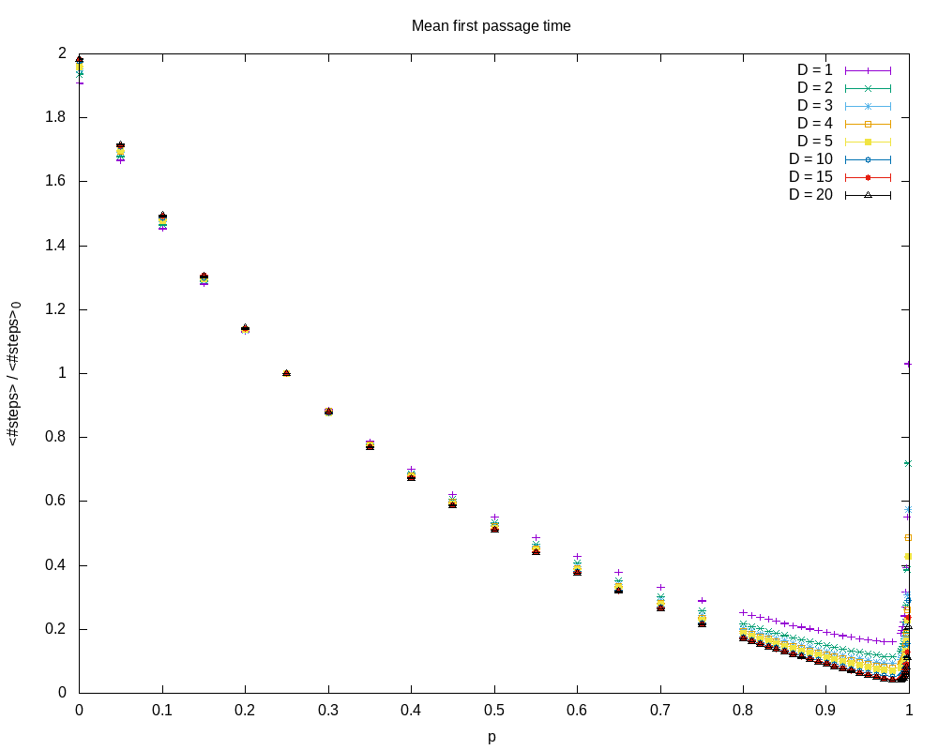
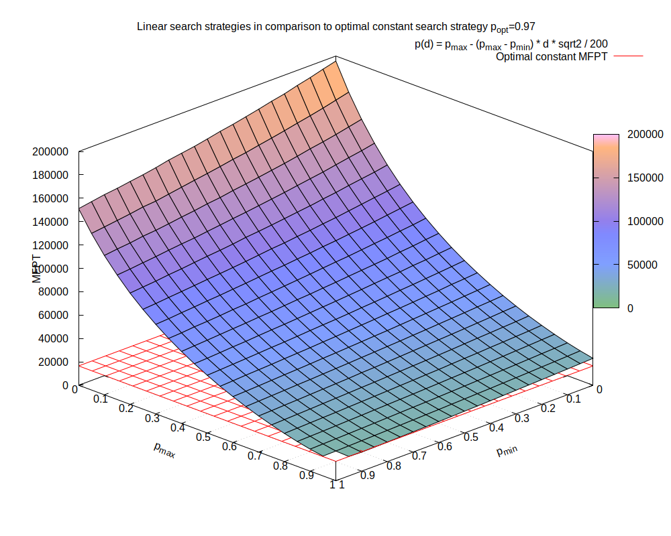
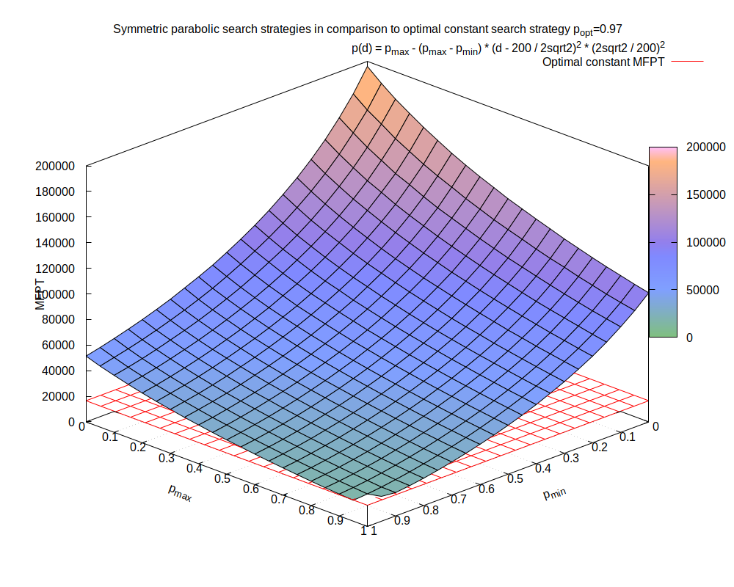
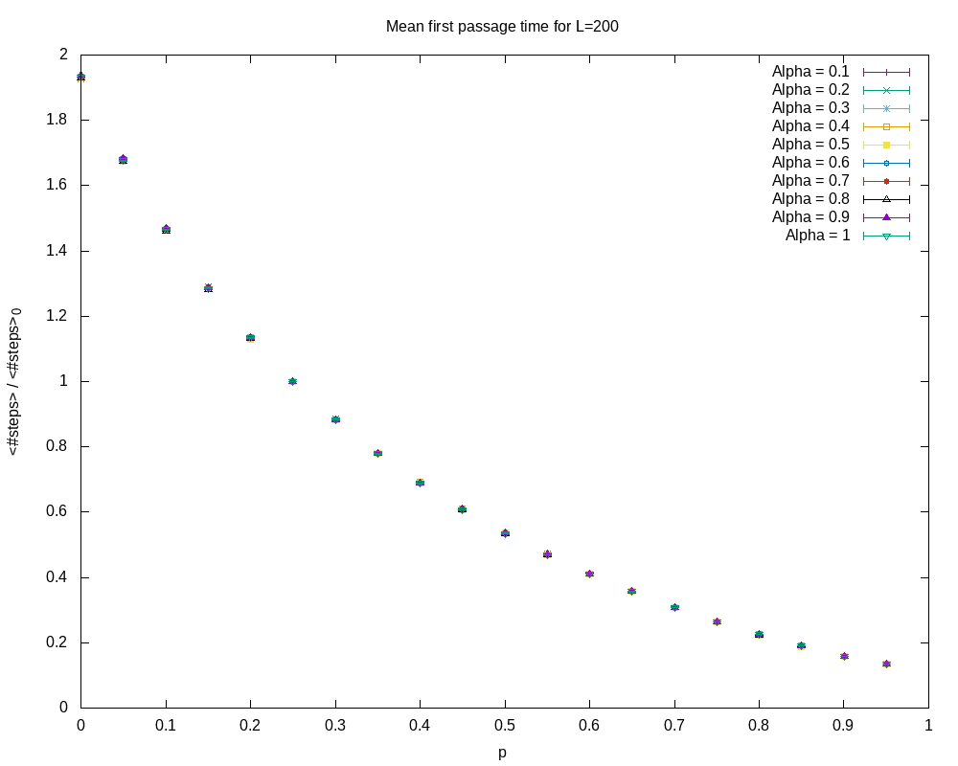
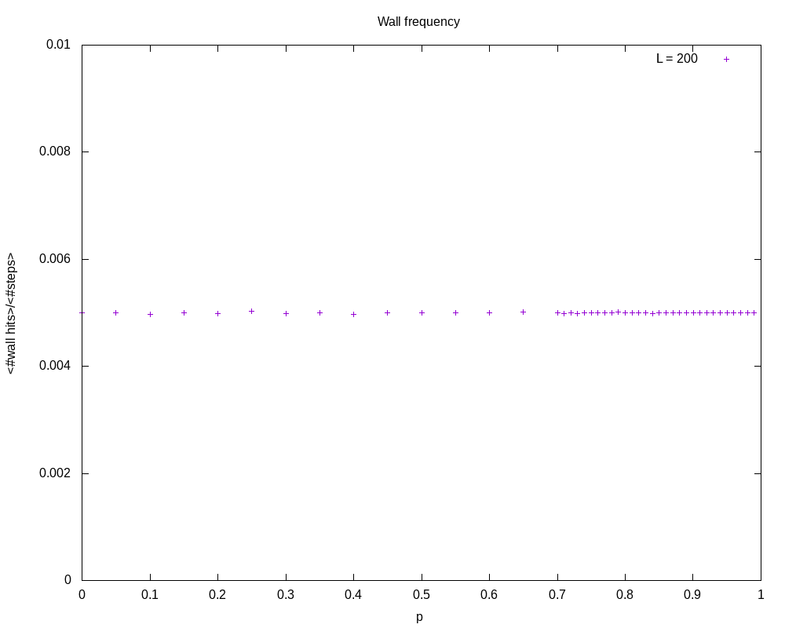
First-Passage Properties of Active Particles with
Position-Dependent Persistency
Kevin Klein, Ludger Santen and M. Reza Shaebani
Department of Theoretical Physics, Saarland University, Saarbrücken, Germany
Abstract
We consider a random walker that is looking for a hidden target in a quadratic system of size L. At first, the searcher is given a constant persistency and the influence on the first-passage time of different parameters such as the system size and the detection radius at which the searcher is able to detect the target is examined. Therefore, the search is carried out in a continuous system and on a lattice. We find the optimal constant persistency that minimizes the search time for the given system and set of parameters.
In the next step, position-dependent persistency profiles are introduced, which are responsible for a change of the persistency of the searcher in dependence on the target-searcher distance. We check the efficiency of these profiles against the optimal constant persistency search strategy and find that rather trivial distance dependent search strategies are hardly as efficient as the constant strategy.
The Model
To the left there is an example trajectory of a search in a continuous system with periodic boundaries of length L=10, detection radius D=1 and with persistency parameter p=0.8. The persistency is realised by taking turning angles from a truncated Gaussian distribution, where sigma is the tuning parameter:
For the lattice version the search only takes place on the grid. Also the persistency is realised in a more trivial way, as there are only 4 possible directions in each step:
Given a persistency parameter p=0.4 is equivalent to continuing in the same direction with probability 0.4 and turning to any other direction with (1-p) / 3 = 0.2.
Results – search with constant persistency on a lattice
Position-dependent Persistency profiles
Influence of the system size
Linear profile scheme
After the optimal constant persistency has been found we introduce the ability of the searcher to change its persistency depending on its distance to the target.
To the left a linear profile that increases persistency from 0 to 1 is schematically shown. Far away the searcher executes a pure diffusion whereas close to the target it moves balistically.
As one can see on the left the mean first-passage times for different system sizes L are low for high persistency parameters p. Also the minimum shifts to higher values of p for bigger systems.
The optimal persistency in dependency on the system size is shown on the right. A 1/x dependency seems to be the best fit.
Results – simple persistency profiles
Influence of the detection radius
Linear profile
Symmetric parabolic profile
The detection radius D does not affect the search times as much as the system size does as can be seen to the right. Especially the position of the minimum remains at the same value of p for different system sizes.
Absorbing boundaries
Depending on the parameters p_min and p_max the linear profile corresponds to linearly increasing or decreasing values of p as the distance to the target increases. As it can be seen in the graph, almost all kinds of profiles perform worse than the constant search strategy, which is depicted by the red grid (~16540 steps). However, for a from p=1 to p=0.9 linearly decreasing profile the lowest MFPT has been found for the tested parameters. This profile is roughly 300 steps better than the constant one.
A similar result can be observed for the symmetric parabolic profile. Here the parameters correspond to parabolas open to positive or negative values. Again most of the parameter sets perform worse than the constant search strategy but for a parabola open to positive values and persistency p=1 at zero and max distance and minimum p=0.95 a MFPT roughly 250 steps lower than the constant one has been found.
Absorbing boundaries do not shift the position of the minimum either. This fact is supported by the relative number of wall hits for different p.

