Slide 1






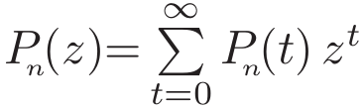
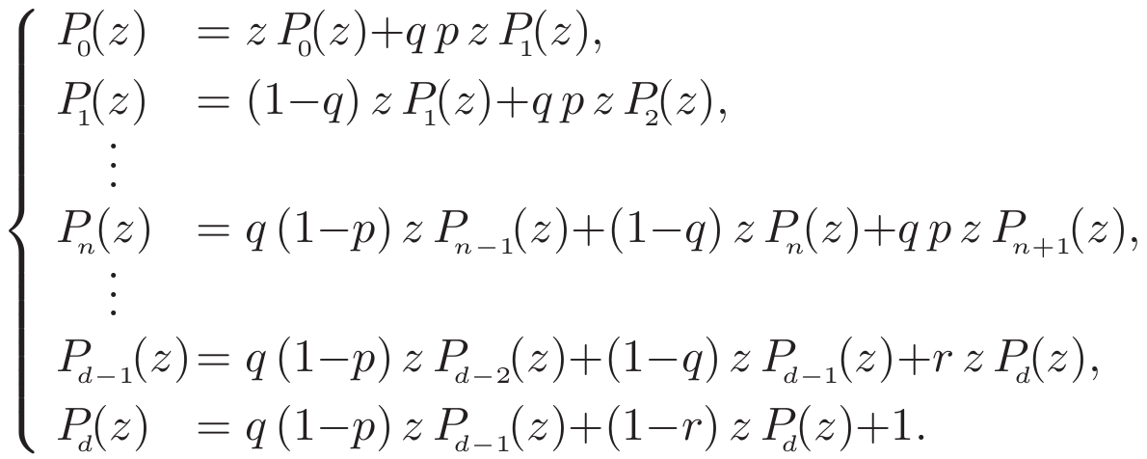

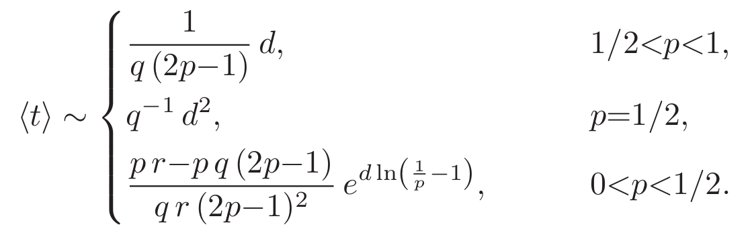
Trapping in and escape from branched structures of neuronal dendrites
Robin Jose, Ludger Santen and M. Reza Shaebani
Department of Theoretical Physics, Saarland University, Saarbrücken, Germany
Abstract
We present a coarse-grained model for stochastic transport of noninteracting chemical signals inside neuronal dendrites and show how first-passage properties depend on the key structural factors affected by neurodegenerative diseases or aging: the extent of the tree, the topological bias induced by segmental decrease of dendrite diameter, and the trapping probabilities in biochemical cages and growth cones. We derive an exact expression for the distribution of first-passage times, which follows a universal exponential decay in the long-time limit. The asymptotic mean first-passage time exhibits a crossover from power-law to exponential scaling upon reducing the topological bias. The analytical predictions are in remarkable agreement with simulations. Our results evidence that structural irregularities caused by aging or neuronal diseases can create local traps and heterogeneous patterns of signal transmission.
: Depth of the dendritic tree
Structure Parameters: : Probability of stepping toward soma
: Probability of being in the motion state
: Probability of returning from growth cones
In view of the morphological differences between the dendrites of healthy and degenerate brain tissues, we concentrate on the major characteristics affected by neurodegenerative diseases: the overall extent of dendritic trees, the thicknesses of channels, and the structure and density of spines.
By adopting a mesoscopic perspective for transmission of ions and molecules inside dendrites, we consider the motion of a noninteracting random walker on the nodes of a tree-like regular network with a finite depth d, parameterizing the extent of branches. After entering the network, the walker randomly jumps to the neighboring nodes until it is absorbed in the soma.
To take into account the stochastic trapping events in spines and growth cones, we assume that the walker either moves in the channel or resides inside biochemical cages.
The Model
Dendritic Structure
Master Equations - Z-Transform
Z-Transform:
Initial conditions:
Results – single particle, regular tree
Many particle interaction
[1]
Distribution Functions
Distribution Functions
When we take particle interaction into account by considering spatial exclusion, the exponential tail can be still observed. However, the tail’s slope strongly depends on the number of particles inside the tree controled by the input rate at the dead ends in the stationary state.
We compare the analytical prediction for the first-passage time F(t), with results of extensive Monte Carlo simulations. As shown in the Figure on the left, the agreement is excellent. Notably, F(t) exhibits an exponential tail. We checked that the exponential decay holds independent of the choice of the trapping factor q, the boundary condition r at the deepest branch level (reflecting versus absorbing), or the chance p of hopping to shallower layers. The slope however varies with q, p, r and d but does not depend on the choice of initial condition.
ip: input rate
symbols: simulations,
lines: theory,
dots: asymptotics
Irregularities in the tree
Mass distribution
[1]
Escape time ratio
Mean values
Our main quantity of interest is the mean-first-passage time of chemical signals to reach the soma.
The figure on the right shows that the mean value may vary by several orders of magnitude when changing the parameters p, q, or r in a given tree of depth d typically induced by aging and many neurodegenerative diseases.
So far, we only considered regular structures, while real dendritic trees are more diverse. To take into account structural irregularities we study the impact of static irregularities induced by pathological changes on signal transmission by varying the parameters q, r or p (shown in the figure above).
The differences of the healthy tree and an affected sub-branch can induce drastic changes in their escape time ratio. As an example we create steady-state population imbalance: In a tree with pronounced hierarchy p=0.9, a uniform sub-branch (p=1/3) imposes a strong local trap and attracts nearly 70% of the total population. Such uneven distribution of signaling molecules can affect neural activities.
Next we clarify how the mean-first-passage time varies with the extent of the tree.
In the course of progression of some diseases, thicker channels undergo stronger pathological changes leading to a more uniform structure.
We find a crossover of the asymptotic mean escape time from a power-law to an exponential scaling. It can be summarized by the respective leading terms.
[1]
R.Jose, L.Santen, M.R. Shaebani; Submitted (2017).
It was supported by the German Research Foundation (DFG) within the Collaborative Research Center SFB 1027, project A7.

