Slide 1
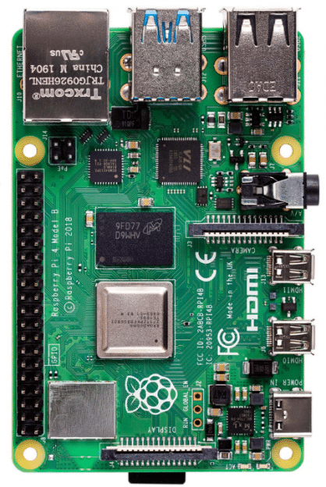
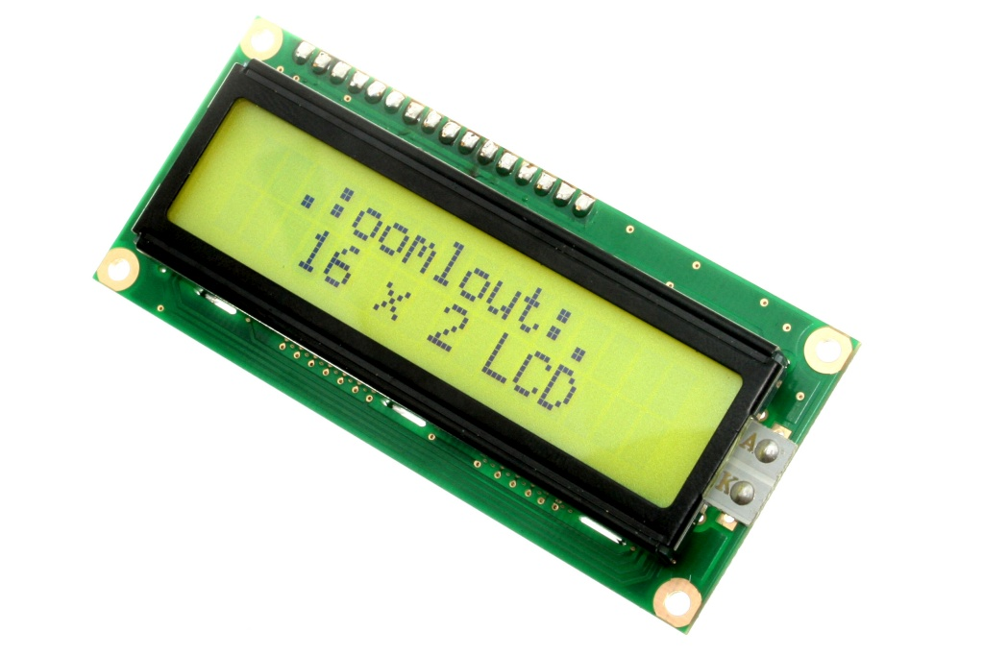
Reflective Surface
IR receiver LED 1 When IR is detected Start timer
ADC
IR LED Driver/Amp circuit
IR emitter LED
RPi for processing signals
Router Spindle Nut
Display spindle RPM
This Photo by Unknown Author is licensed under CC BY-SA

Slide 2
Reflective Surface
ADC
IR LED Driver/Amp circuit
RPi for processing signals
Router Spindle Nut
IR receiver LED 2 When IR is detected end timer and begin rotational velocity calculation in Rpi. Spindle nut has rotated through a know angle ϴ
Display spindle RPM
This Photo by Unknown Author is licensed under CC BY-SA

