Slide 1
Science
CS
Visibility Effect
research project
COMP396
Prepared by：Chicheng Zheng
Supervisor：Clark Verbrugge
1

Slide 2
Content
01
Introduction
02
Background and Related Work
03
Implementation
04
Test Case
05
Conclusion and Impact
CONTENT
2

Slide 3
01
Introduction
3

Slide 4
01
Introduction
Motivation Summary
Implementation
Summary
Test Case
Summary
Role playing Game
Art Gallery Algorithm
Concave
Convex
4

Slide 5
02
Background and Related work
5

Slide 6
02
Background
Visibility Polygon
Art Gallary Algorithm
The visibility polygon or visibility region for a point p in the plane among obstacles is the possibly unbounded polygonal region of all points of the plane visible from p.
Basically, the idea is to find the all the triangles that form the visibility polygon, and we can get those triangles by emitting the ray from the view point
6

Slide 7
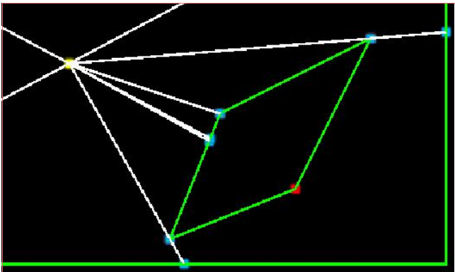
02
Related Work
View Point
Sight Angle
It is the guard position, and
this project is focusing the visibility effect of related to this view point.
Therefore, the sight angle defines
the max range of perspective.
Sight Range
Hit Point
Sight Range is the max value it
could see from the view point.
All the hit points generated by the ray cast from the view point. It is the intersection point of those ray with boundry or obstacles.
7

Slide 8
03
Implementation
8

Slide 9
03
Implementation
Step 4
Generate Mesh
Step 3
Generate Ray Cast
Step 2
Triangulation
Step 1
Generate obstacles and boundry
9

Slide 10
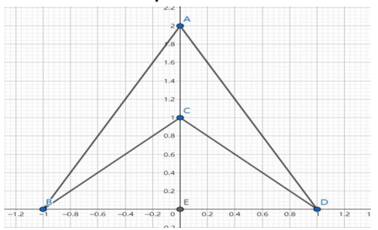
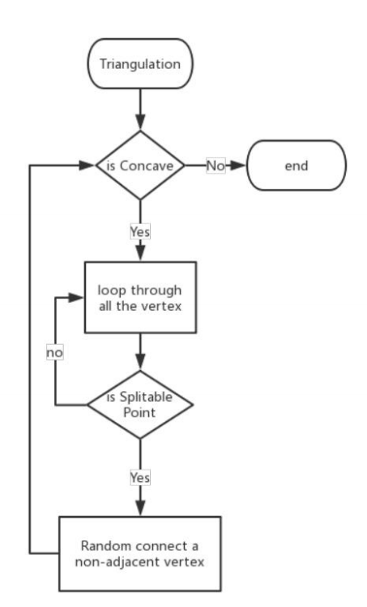
03
Triangulation
10

Slide 11
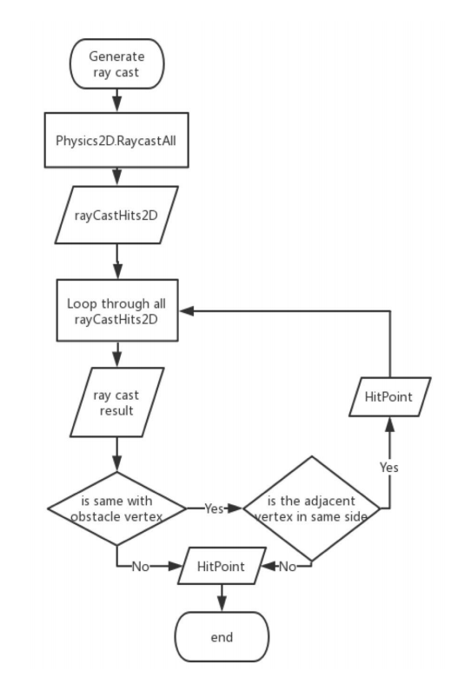
03
Generate Ray Cast
11

Slide 12
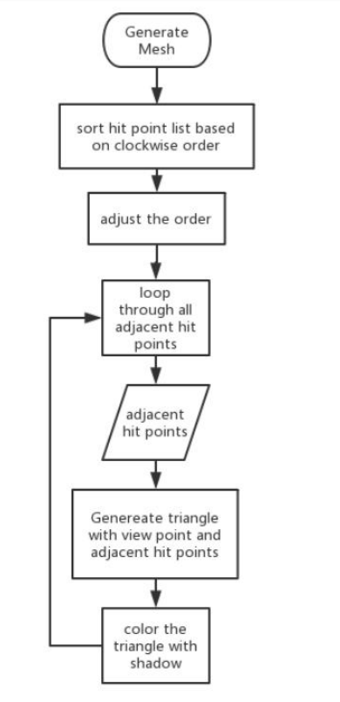
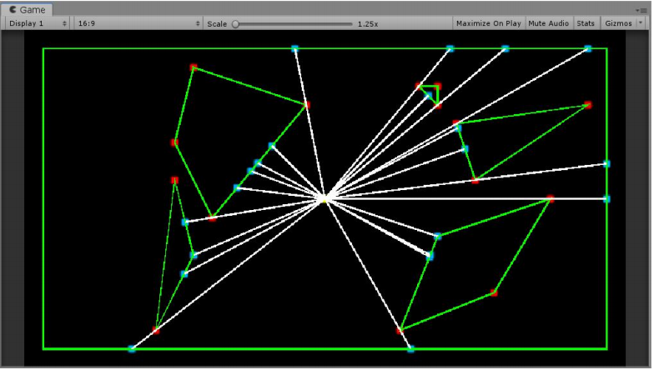
03
Generate Mesh
12

Slide 13
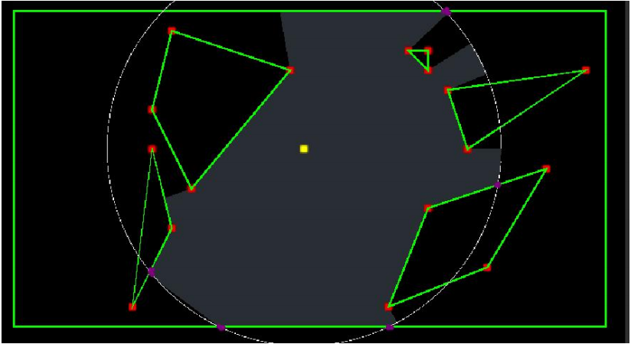
03
Partially & range
Exclude the ray cast
Truncation the ray cast
Compute additional hit points
13

Slide 14
04
Test Case
14

Slide 15
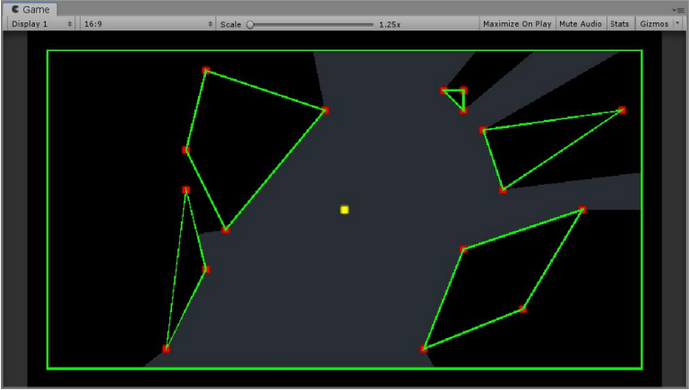
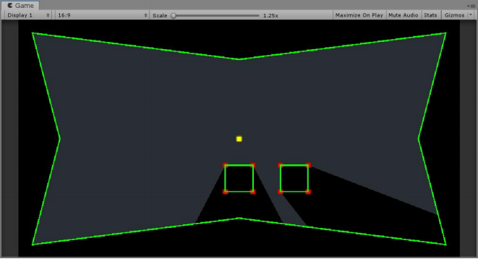
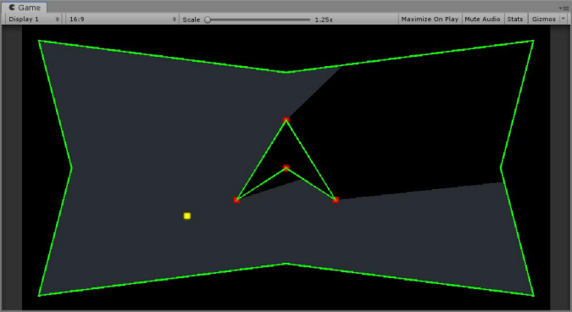
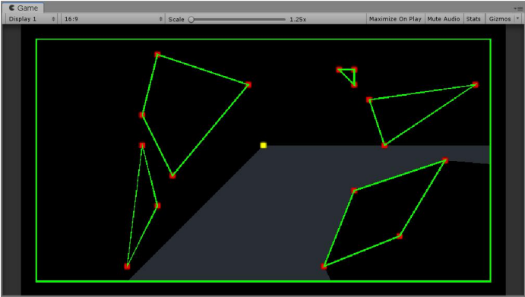
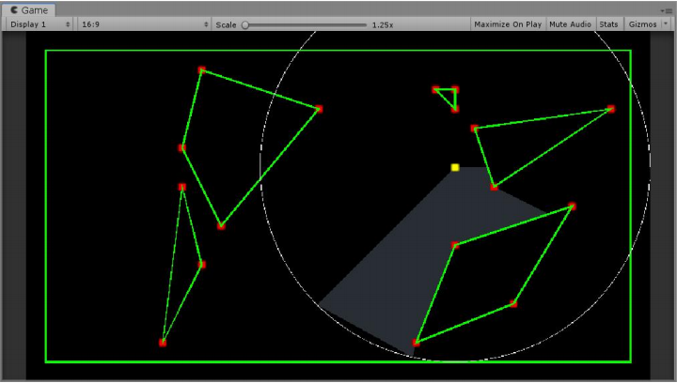
04
Test Case
Convex Boundry & Obstacle
Concave Boundary
Concave Obstacle
Partially View
Visibility with Range Limitation
15

Slide 16
05
Conclusion and Impact
16

Slide 17
Thank You
Science CS
Prepared By：Chicheng Zheng
The End
Supervisor：Clark Verbrugge
17

