Slide 1
TUD Präsentation Template
Format 16:9
Here is a Subtitle, e.g., the Name of the Speaker, Structural Unit,
Venue and Date of the Presentation or other contextual Information
As of 22.04.2026

Slide 2
Font Size 32 pt
Mastertext Content – Fontsize 20 pt
testet in the following settings (reading distance: first to last seat row):
    HSZ Audimax
    HSZ lecture hall 03
    HSZ seminar room E01
The font size can be adjusted as needed to values between 16pt and 24pt.
Normal reading text (see also https://leserlich.info/leserlich-und-lesbar)
should generally not be smaller than 16 pt

Slide 3
TUD Colors
Brillantblau
Hex #00008C
RGB 0 / 0 / 140
CMYK 100 / 80 / 5 / 0
NCS 3060-R80B
Dunkelblau
Hex #001450
RGB 0 / 20 / 80
CMYK 100 / 70 / 10 / 60
NCS 7020-R70B
Schwarz
Hex #00000
RGB 0 / 0 / 0
CMYK 0 / 0 / 0 / 100
NCS 9000-N
Grau 100%
Hex #323F4B
RGB 50 / 63 / 75
CMYK 45 / 20 / 5 / 80
NCS 8005-R80B
Weiß
Hex #FFFFFF
RGB 255 / 255 / 255
CMYK 0 / 0 / 0 / 0
NCS 0300-N
Blau 1
Hex #2F57B2
RGB 47 / 87 / 178
CMYK 90 / 50 / 0 / 0
NCS 3050-R90B
Violett 1
Hex #7369BE
RGB 115 / 105 / 190
CMYK 64 / 62 / 0 / 0
NCS 2050-R60B
Magenta 1
Hex #BC1589
RGB 188 / 21 / 137
CMYK 30 / 96 / 0 / 0
NCS 2060-R40B
Rot 1
Hex #D20F41
RGB 210 / 15 / 65
CMYK 0 / 100 / 60 / 0
NCS 1080-R
Orange 1
Hex #C85000
RGB 200 / 80 / 0
CMYK 0 / 90 / 100 / 20
NCS 2075-Y70R
Gelb 1
Hex #FFC700
RGB 255 / 199 / 0
CMYK 0 / 25 / 100 / 0
NCS 0580-Y10R
Oliv 1
Hex #767A23
RGB 118 / 122 / 35
CMYK 50 / 35 / 100 / 22
NCS 4040-G80Y
Grün 1
Hex #007D4B
RGB 0 / 125 / 75
CMYK 90 / 0 / 80 / 15
NCS 3050-G
Türkis 1
Hex #0A777F
RGB 10 / 119 / 127
CMYK 100 / 10 / 30 / 40
NCS 3060-B10G
Blau 2
Hex #97C6FF
RGB 151 / 198 / 255
CMYK 43 / 15 / 0 / 0
NCS 1040-R90B
Violett 2
Hex #C8C8FF
RGB 200 / 200 / 255
CMYK 20 / 20 / 0 / 0
NCS 0520-R60B
Magenta 2
Hex #FFB9FF
RGB 255 / 185 / 255
CMYK 0 / 30 / 0 / 0
NCS 0520-R40B
Rot 2
Hex #FFAAA5
RGB 255 / 170 / 165
CMYK 0 / 44 / 27 / 0
NCS 1030-R
Orange 2
Hex #FFBE78
RGB 255 / 190 / 120
CMYK 0 / 30 / 55 / 0
NCS 1030-Y30R
Gelb 2
Hex #FFE483
RGB 255 / 228 / 131
CMYK 0 / 5 / 50 / 0
NCS 0530-G90Y
Oliv 2
Hex #D2DC46
RGB 210 / 220 / 70
CMYK 25 / 0 / 81 / 0
NCS 0550-G60Y
Grün 2
Hex #8CE6AA
RGB 140 / 230 / 170
CMYK 45 / 0 / 45 / 0
NCS 2030-G10Y
Türkis 2
Hex #8CE6D7
RGB 140 / 230 / 215
CMYK 45 / 0 / 20 / 0
NCS 1030-B30G

Slide 4
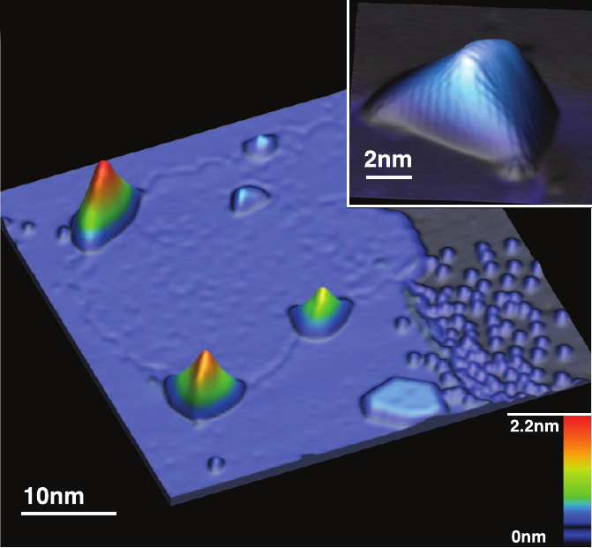
Gigantic Magnetic Field in Graphene Nanobubbles
Graphene Nanobubbles on Pt surface

Slide 5
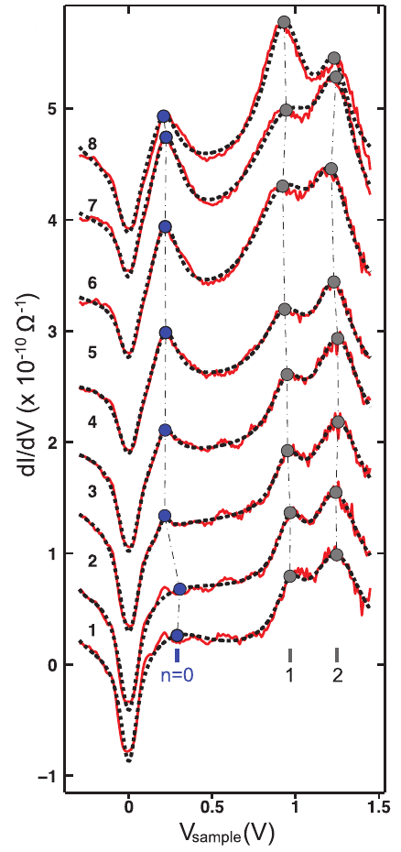
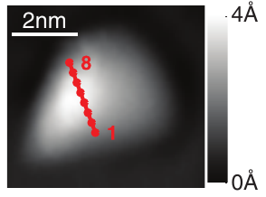
Gigantic Magnetic Field in Graphene Nanobubbles
Graphene Nanobubbles on Pt surface
Scanning Tunnel Spectroscopy probes Local Density of States
  Landau-Level (LL) Structure

Slide 6
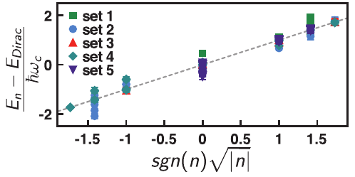
Gigantic Magnetic Field in Graphene Nanobubbles
Graphene Nanobubbles on Pt surface
Scanning Tunnel Spectroscopy probes Local Density of States
  Landau-Level (LL) Structure
Fitting LL-positions against
reveals pseudo-magnetic field strength

Slide 7
Gigantic Magnetic Field in Graphene Nanobubbles
Graphene Nanobubbles on Pt surface
Scanning Tunnel Spectroscopy probes Local Density of States
  Landau-Level (LL) Structure
Fitting LL-positions against
reveals magnetic field strength
Magnetic Field in center of single bubbles estimated as 300...400 T
  Far surpasses any human-made non-destructive magnetic field (~ 100 T, Los Alamos 2012?)

