Slide 1
Tabular Reinforcement Learning
SARSA & Q-learning on the class gridworld, plus comparison of 6 algorithms, Cliff Walking, Optuna tuning and training analysis
Igor Ruiz & Andoni Garrido · Reinforcement Learning · Universidad de Deusto · October 2026

Slide 2
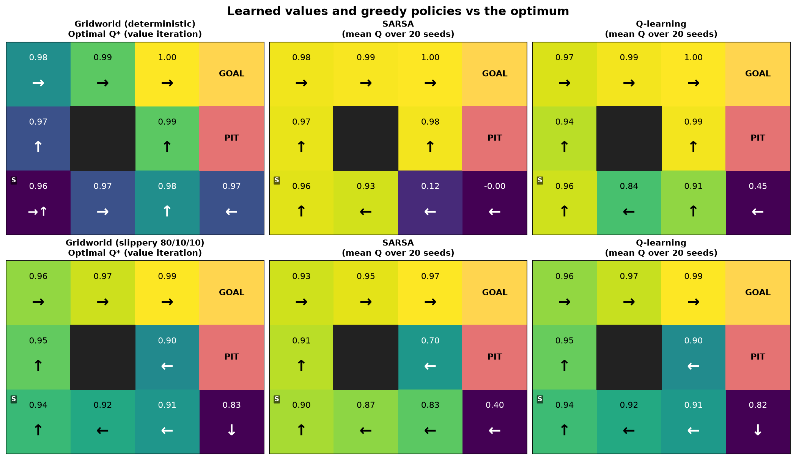
Setup
Same environment as in class (3x4 gridworld), plus a second one (Cliff Walking)
• Gridworld 3x4: +1 goal, −1 pit, wall; deterministic and slippery (80% intended, 10%/10% sideways)
• Cliff Walking 4x12: −1 per step, −100 on the cliff (back to start)
• Agents are model-free: they only call reset()/step()
• Value iteration (uses P) only gives the ground truth Q* for the metrics
• 20 seeds per configuration, ε-greedy with decay, γ = 0.99

Slide 3
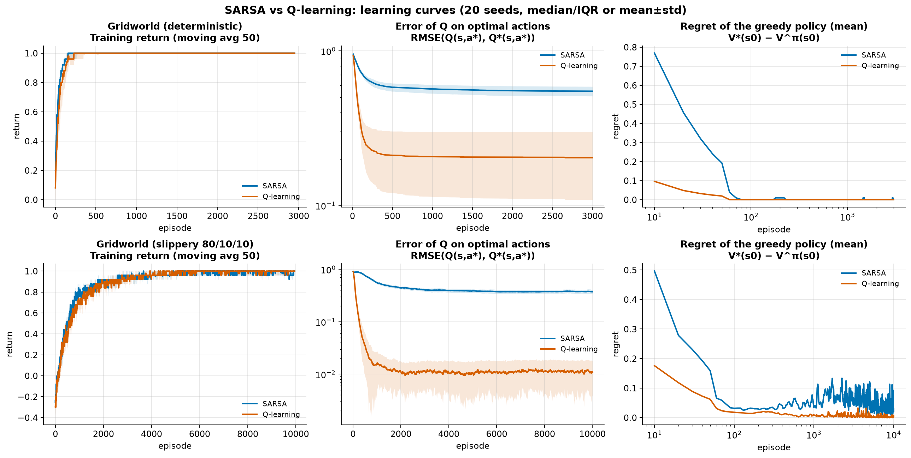
Minimum requirement: SARSA vs Q-learning
Both learn the optimal policy in both gridworlds
• SARSA (on-policy, Bellman eq.): Q ← Q + α[r + γ Q(s',a') − Q]
• Q-learning (off-policy, BOE): Q ← Q + α[r + γ max Q(s',·) − Q]
• Deterministic: π* in all 20 seeds (Q-learning stable after ~10 episodes, SARSA ~200)
• Slippery, default schedule (ε_min = 0.05, constant α): Q-learning 19/20 seeds optimal, SARSA 15/20
• SARSA learns Q of the ε-greedy policy and rarely visits the states next to the pit
• Theory fix: GLIE (ε → 0) + Robbins–Monro α(s,a) = α/(1+k·N) → both 20/20 seeds optimal

Slide 4
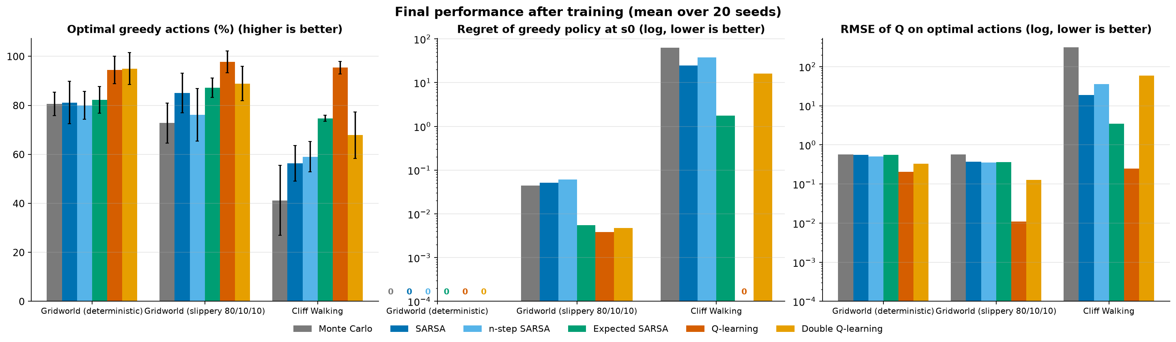
Comparison of all tabular algorithms
Monte Carlo · SARSA · n-step SARSA · Expected SARSA · Q-learning · Double Q-learning
• Q-learning has the most accurate Q* and the lowest regret overall
• Expected SARSA is the best on-policy method (lower variance than SARSA)
• Monte Carlo fails in Cliff Walking: episodes rarely finish, so returns are uninformative (needs terminal episodes)

Slide 5
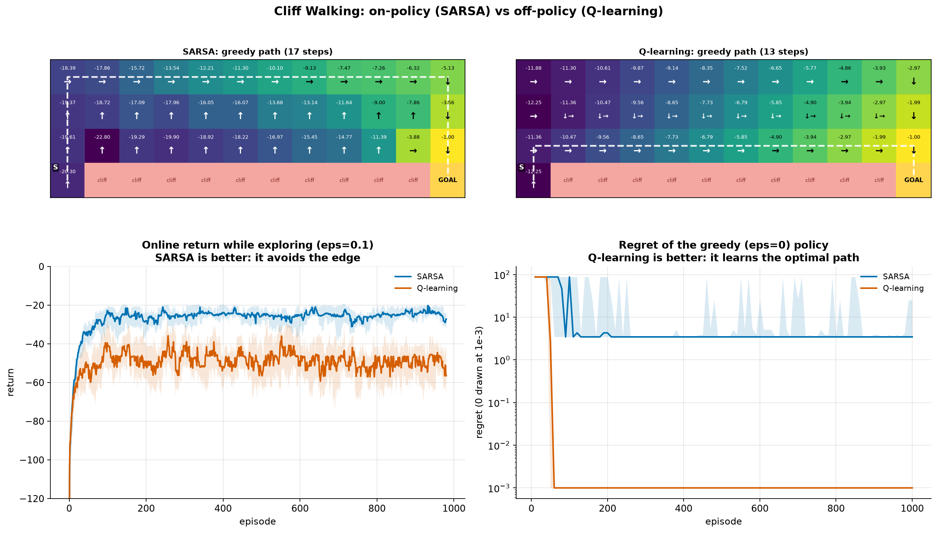
On-policy vs off-policy: Cliff Walking
Classic Sutton & Barto experiment, ε = 0.1, α = 0.5
• Q-learning learns the optimal path on the cliff edge, but falls while exploring
• SARSA learns a safer path because its target includes its own random actions
• Online return: SARSA better · Greedy policy: Q-learning optimal

Slide 6
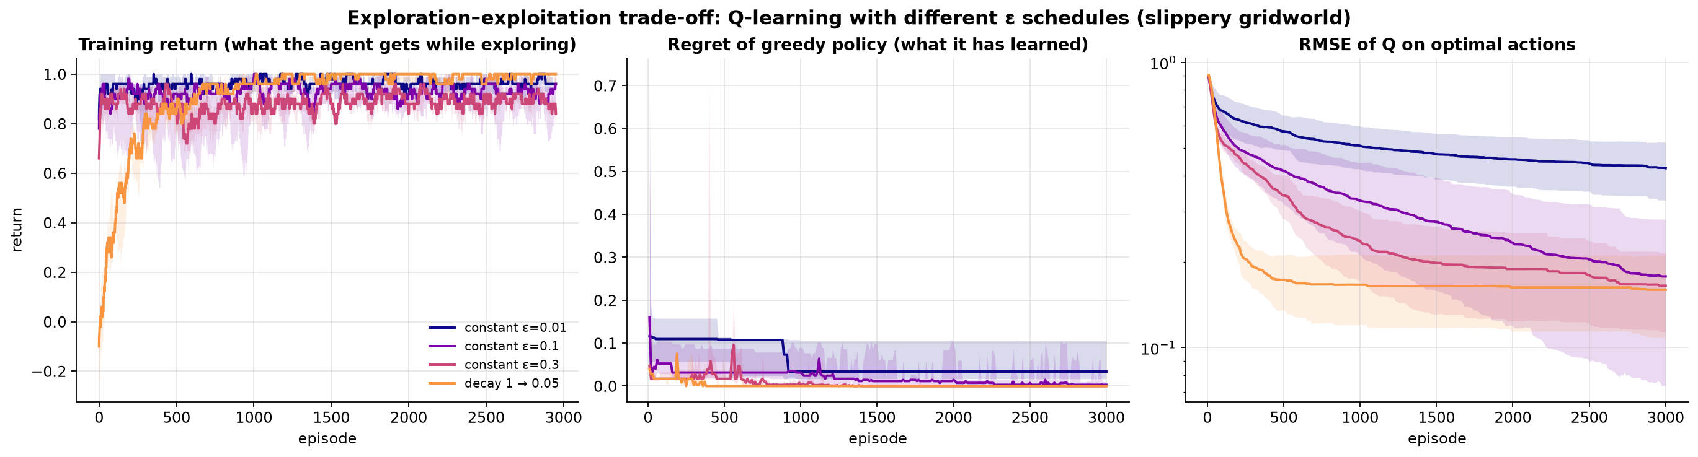
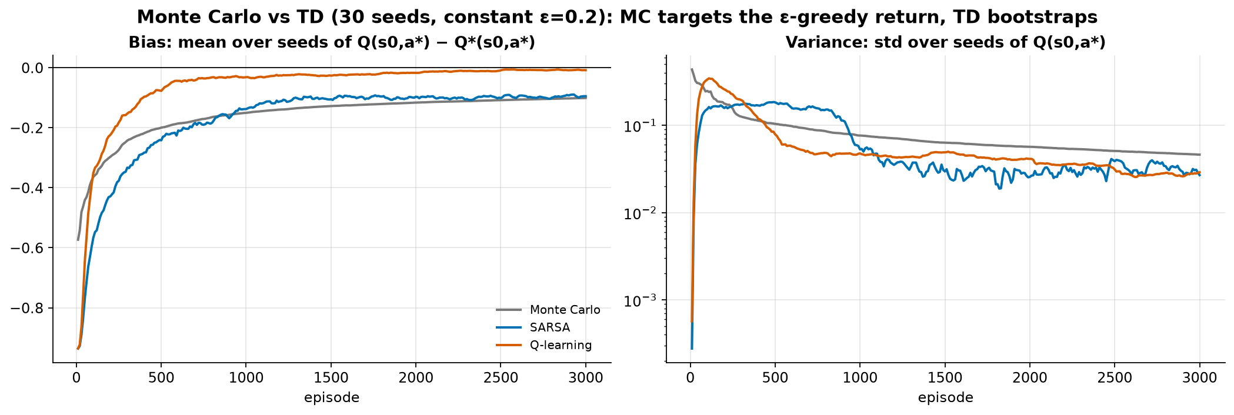
Analysis of the training process
Exploration schedule and Monte Carlo vs TD bias/variance

Slide 7
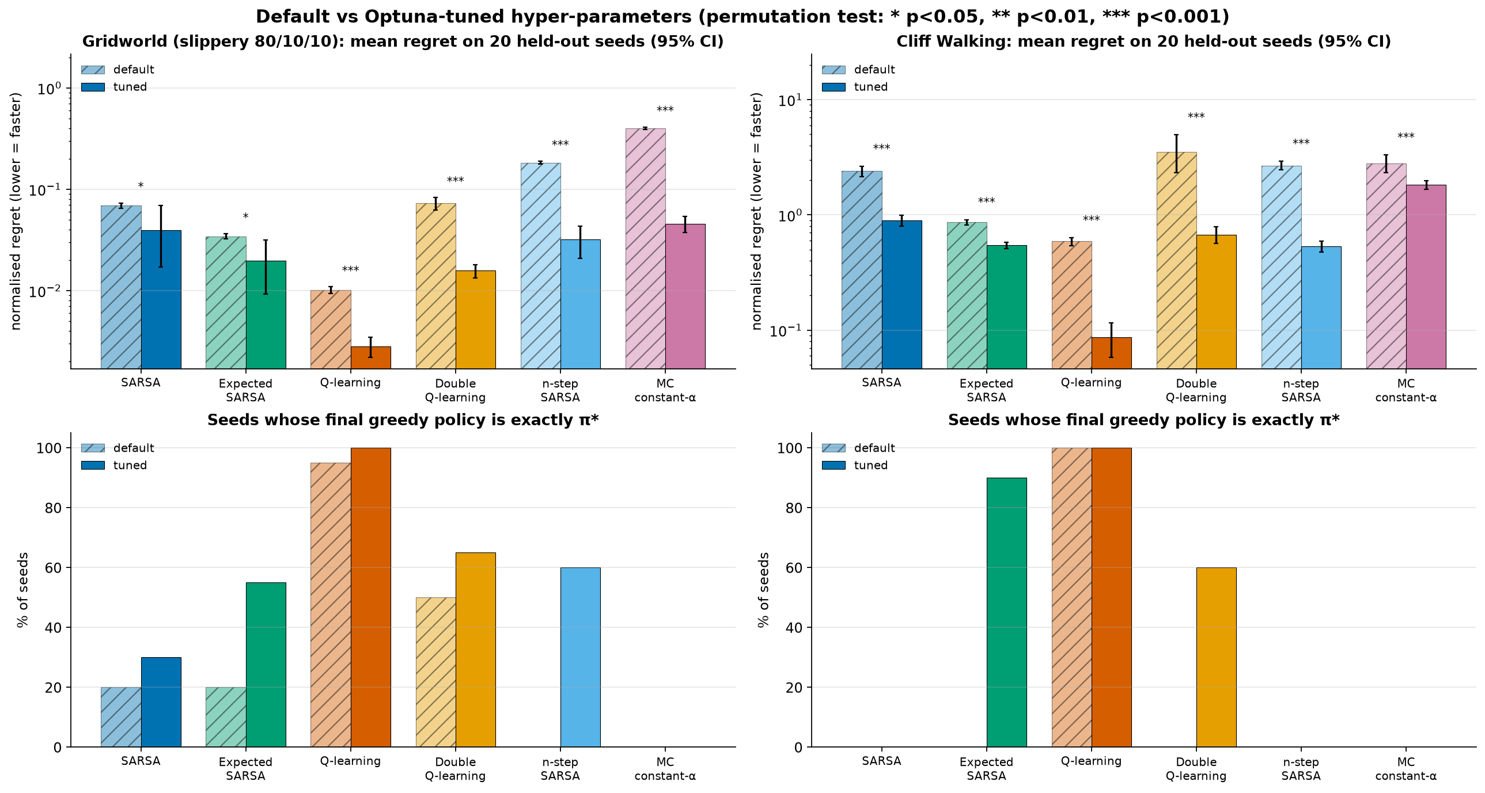
Hyper-parameter tuning with Optuna
Multi-objective TPE (speed vs exactness), 12 studies x 150 trials
• Speed better in all 12 cases (permutation test p<0.05, 10 with p<0.001, 20 held-out seeds)
• Q-learning (slippery): 20/20 seeds optimal in 3000 episodes
• Expected SARSA (Cliff): 0 → 18/20 optimal
• Optuna rediscovered the theory: Robbins–Monro α in 8/10, ε → 0 (GLIE)
• Cliff: Q-learning keeps ε=0.27 (off-policy), Expected SARSA needs ε→0 (on-policy)
• n-step: n=1 with noisy transitions, n=4 in Cliff

Slide 8
Conclusions
• SARSA and Q-learning both solve the deterministic and the stochastic gridworld
• Q-learning (BOE) → Q*; SARSA (BE) → Q of the ε-greedy policy: safer behaviour while exploring
• Stochastic transitions need decaying α and ε → 0 (Robbins–Monro + GLIE) to reach π* in every seed
• TD bootstraps (low variance, biased); MC uses real returns (unbiased, high variance, needs episodes to end)
• Expected SARSA lowers variance; Double Q removes maximisation bias but learns more slowly
• Everything is reproducible: results cached; `uv run python -m experiments.run_all` redraws without training

Slide 9
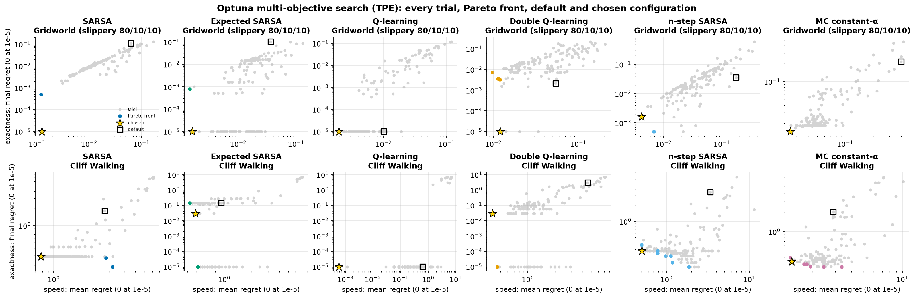
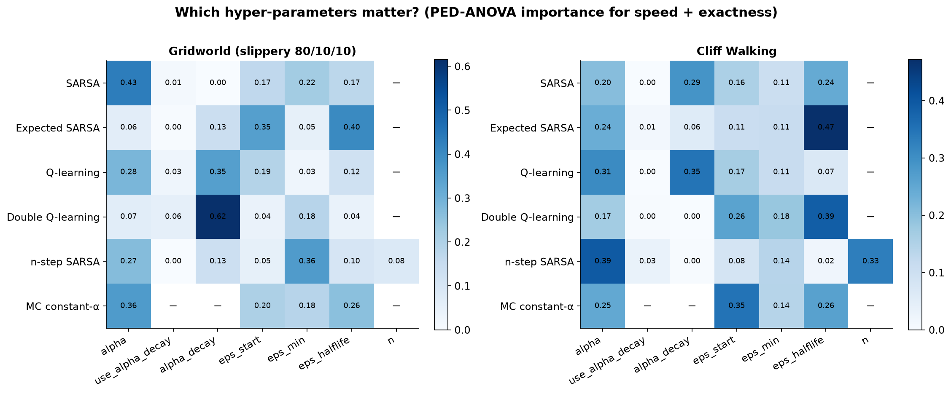
Backup: Optuna Pareto fronts and parameter importance
Speed vs exactness trade-off; which hyper-parameters matter

Slide 10
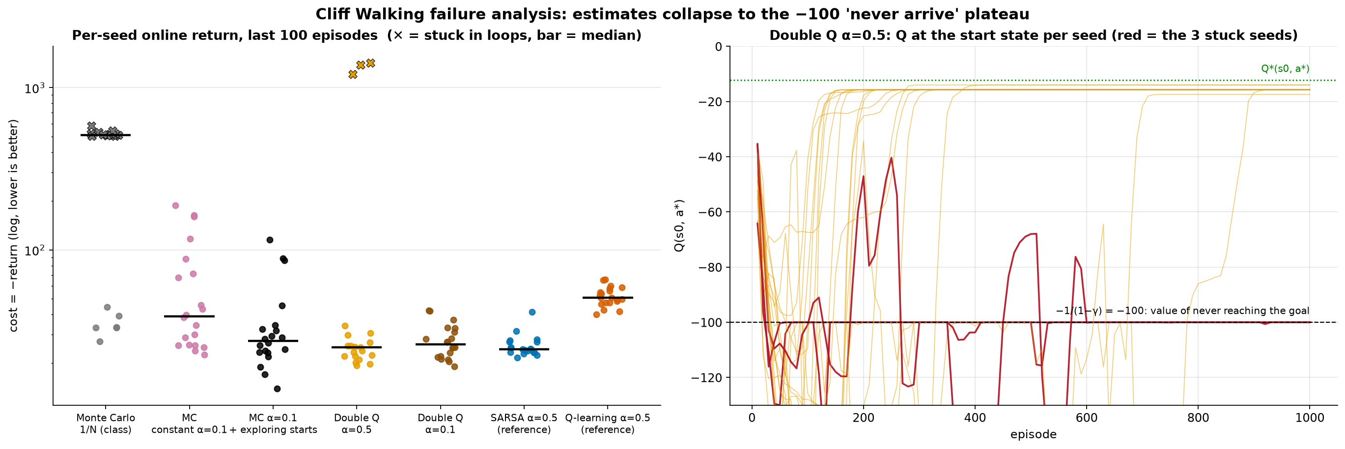
Backup: why MC and Double Q fail in Cliff Walking
Estimates collapse to the −1/(1−γ) = −100 'never arrive' plateau
• MC with 1/N: the −1500 returns of the first episodes stay in the mean forever (non-stationary target)
• Constant-α MC: 14/20 stuck seeds → 0/20; exploring starts helps further
• Double Q, α = 0.5: 3/20 seeds collapse to −100; α = 0.1 → 0/20

Slide 11
Backup: dynamic programming (model-based)
Used only as ground truth; agents never see P
• Value iteration: apply the BOE V(s) ← max_a Σ p(s'|s,a)[r + γV(s')] until Δ < θ
• Policy iteration: evaluate π exactly (Bellman eq. → linear system), then improve greedily
• Both give the same V* (unit test). Number of sweeps:
Deterministic grid: VI 6 · PI 6
Slippery grid: VI 145 · PI 7
Cliff Walking: VI 15 · PI 15
• VI: cheap sweeps, asymptotic convergence · PI: expensive steps, exact in a few iterations

Slide 12
Backup: extras beyond the class slides
Each one is a small change to an algorithm seen in class
• Expected SARSA: target r + γ Σ π(a'|s') Q(s',a') (Bellman eq. (3) inside the TD target, lower variance)
• Double Q-learning: two tables, one picks argmax, the other evaluates it (removes the max over-estimation)
• n-step SARSA: n = 1 → SARSA, n → ∞ → Monte Carlo
• Regret = V*(s0) − V^π(s0), computed exactly with the model
• α(s,a) = α/(1+k·N(s,a)): Robbins–Monro; MC's online mean is the case α = 1/N
• Optuna TPE: proposes hyper-parameters where the good trials concentrate; report on held-out seeds

