Slide 1
Causal Inference and ML:
Minimum Wage Policies
and Teen Employment
Estimating the Effect of Minimum Wage on Teen Employment using DML-DiD
Elaa Hamdi
June 2026
Github Repository:
github.com/Ela200/did-minimum-wage-project
1

Slide 2
Overview
01
Data & EDA
02
Causal Framework
Dataset structure, descriptive statistics, and employment trends
DAG and identification of confounders
03
Data Preparation
04
Methodology
Treatment/control groups, baseline period, sample restrictions
Doubly Robust DML-DiD estimator and ML learners
05
Results
06
Validity & Conclusion
ATT estimates, dynamic effects, and heterogeneity by county
Pre-trend test and key takeaways
2

Slide 3
Data & Research Design
County-year panel data, United States 2001–2007 (N = 18,851 obs.).
Outcome: log county-level teen employment.
Treatment: indicator for county minimum wage above the federal level.
Source: Callaway (2022) / Callaway & Sant'Anna (2021)
Summary Statistics
Variable | Mean | Std Dev
Log Teen Employment (lemp) | 5.85 | 1.61
Log Population (lpop) | 10.28 | 1.44
Log Avg Annual Pay (lavg_pay) | 10.24 | 0.21
3

Slide 4
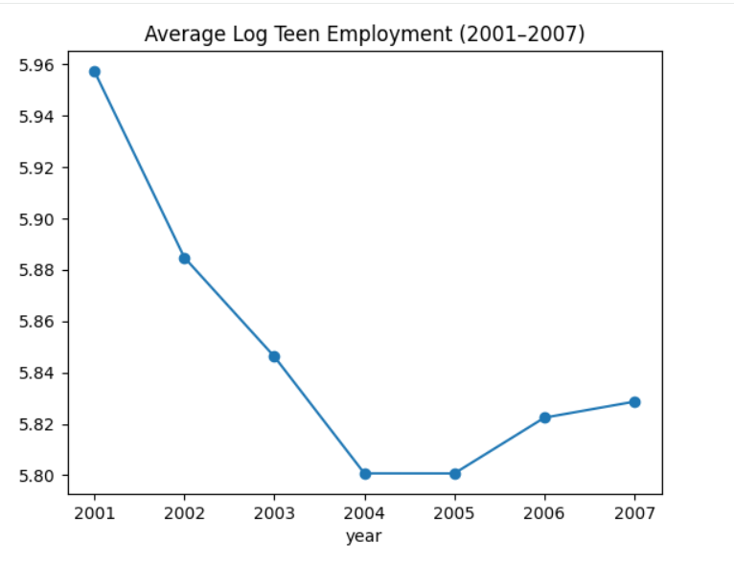
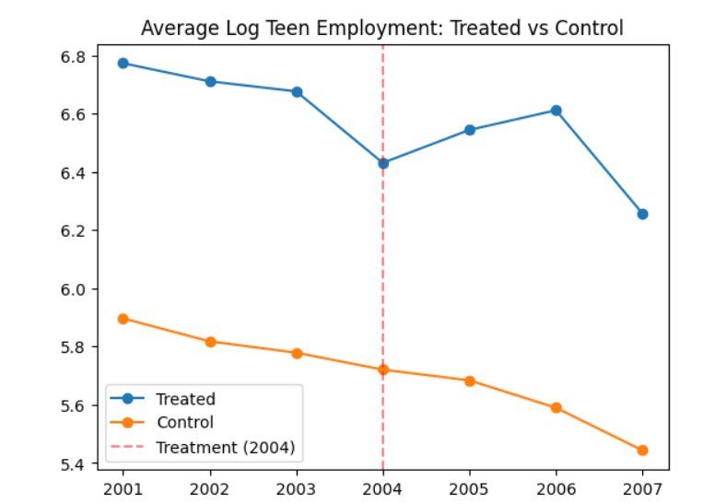
Employment Trends — Treated vs. Control
4

Slide 5
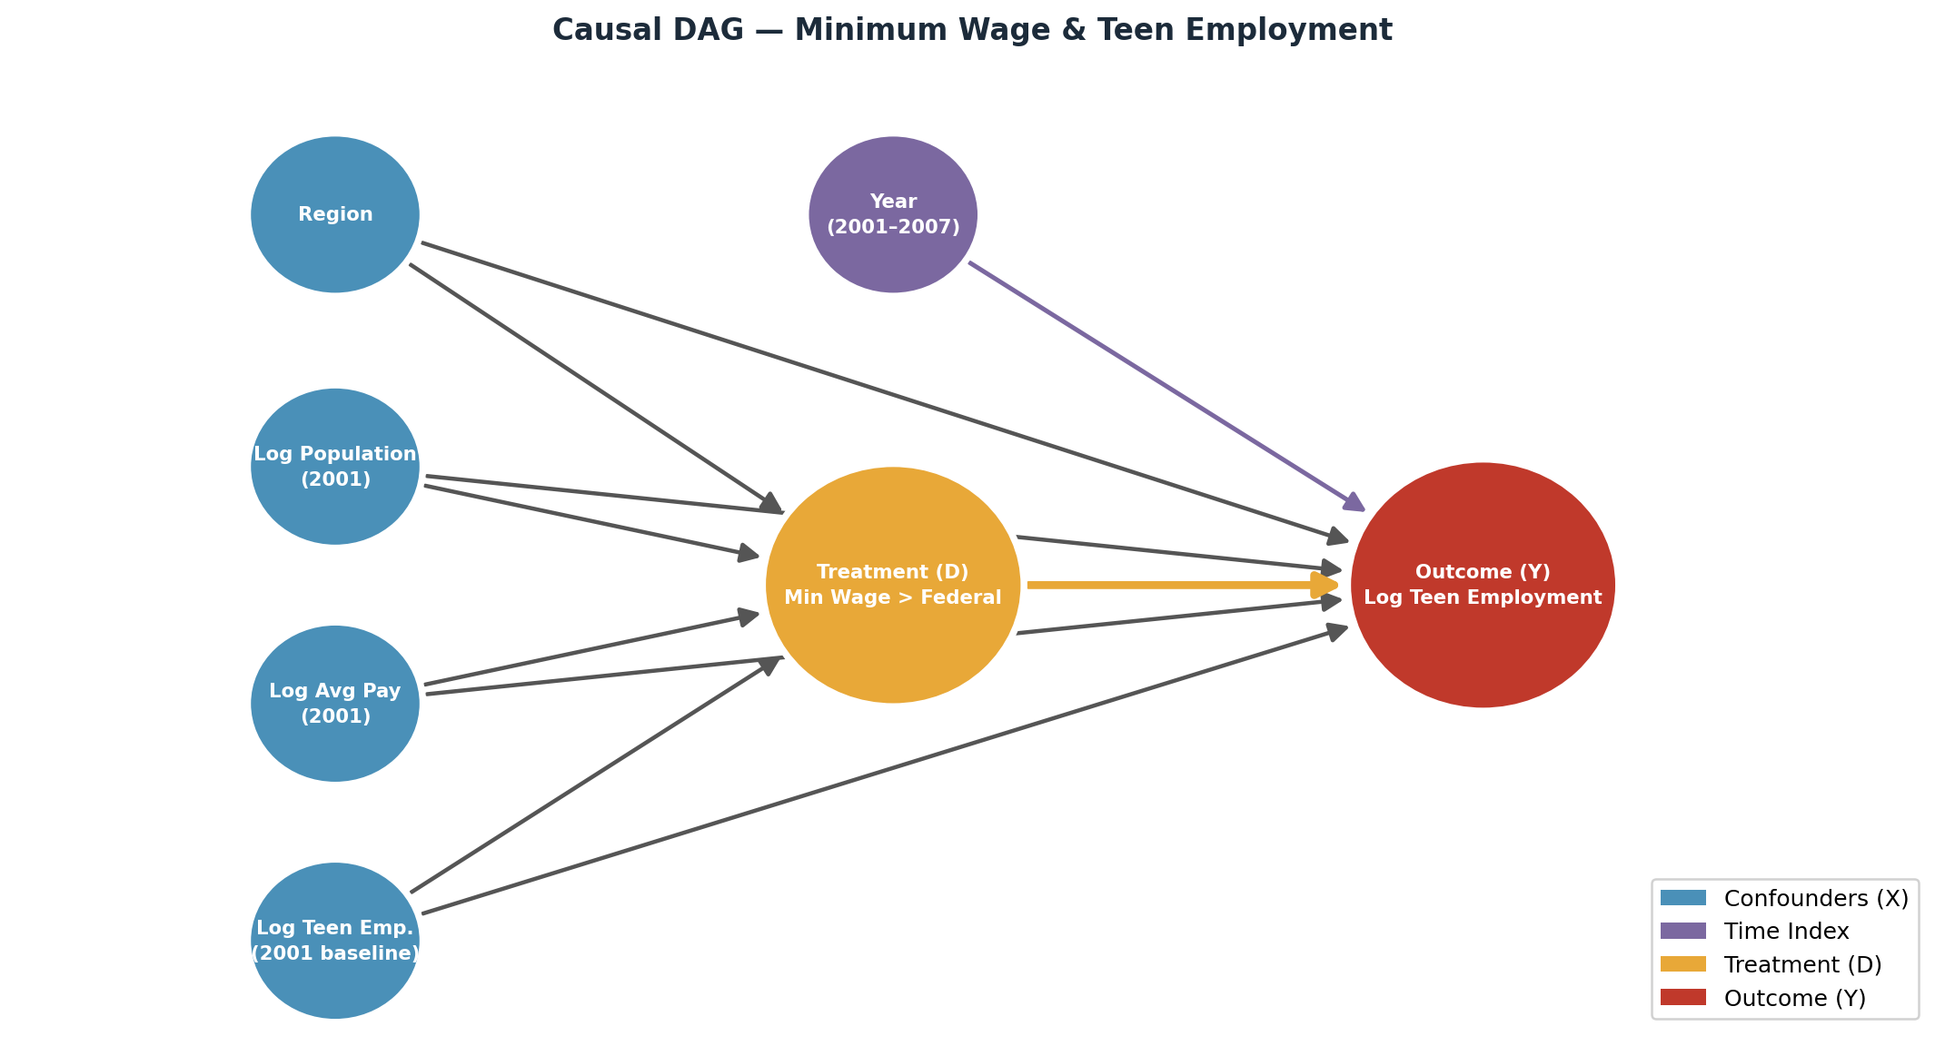
Causal Framework — DAG
5

Slide 6
Data Preparation & Identification
Treatment cohort
Sample restriction
Only counties that first raised their minimum wage above the federal level in 2004 (G = 2004) are included as the treated group.
Counties already treated in 2001 are excluded from the analysis, to keep a clean pre-treatment period.
Pre-treatment baseline
Conditional parallel trends
2003 serves as the reference period — the outcome is defined as ΔY = lemp_t − lemp_2003.
Parallel trends holds after conditioning on 2001 population, avg pay, teen employment, and region (4 categories).
Control group
Counties remaining at the federal minimum wage in each year — a group that shrinks annually as more counties adopt higher wages.
6

Slide 7
Methodology — DML-DiD Estimator
Doubly Robust ATT (DR-DiD)
The estimator combines an outcome model E[ΔY|D=0,X], a propensity score E[D|X], and P(D=1) into a doubly robust score. Consistent if either nuisance model is correctly specified.
5-Fold Cross-Fitting
Nuisance functions are estimated out-of-sample using StratifiedKFold (5 splits) to avoid overfitting bias in the final ATT estimate.
Six ML Learners Compared
No Controls, Linear (Basic), Region interactions (Expansion), Lasso (CV), Ridge (CV), Random Forest — selected by RMSE on held-out folds.
Best & Stack Ensembles
Best combines the individually lowest-RMSE learner for each nuisance. Stack fits a linear combination of all learner predictions before the final stage.
Propensity Trimming
Propensity scores clipped at 0.01 to avoid extreme inverse-probability weights. Estimated via DummyRegressor as the constant P(D=1) within each fold.
7

Slide 8
Results — ATT Estimates (2004–2007)
ATET point estimates across all learners and years. Negative values indicate a decrease in log teen employment following the minimum wage increase.
Learner | 2004 | 2005 | 2006 | 2007
No Controls | −0.040 | −0.076 | −0.117 | −0.131
Basic | −0.021 | −0.048 | −0.053 | −0.067
Expansion | −0.017 | −0.049 | −0.052 | −0.071
Lasso (CV) | −0.039 | −0.036 | −0.043 | −0.062
Ridge (CV) | −0.023 | −0.045 | −0.051 | −0.064
Random Forest | −0.023 | −0.049 | −0.051 | −0.067
Best | −0.019 | −0.049 | −0.049 | −0.077
Stack | −0.021 | −0.049 | −0.050 | −0.065
8

Slide 9
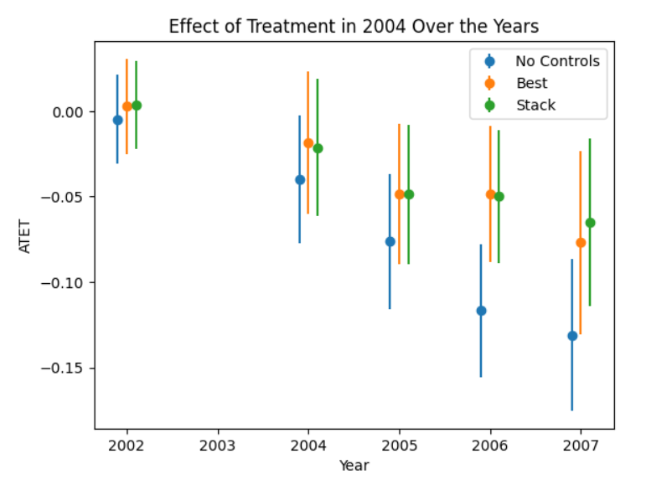
Results — Dynamic Treatment Effect
The effect is small in 2004 and grows over time — consistent with gradual firm adjustment. The 2002 placebo (pre-treatment) shows ATT ≈ 0, validating parallel trends.
9

Slide 10
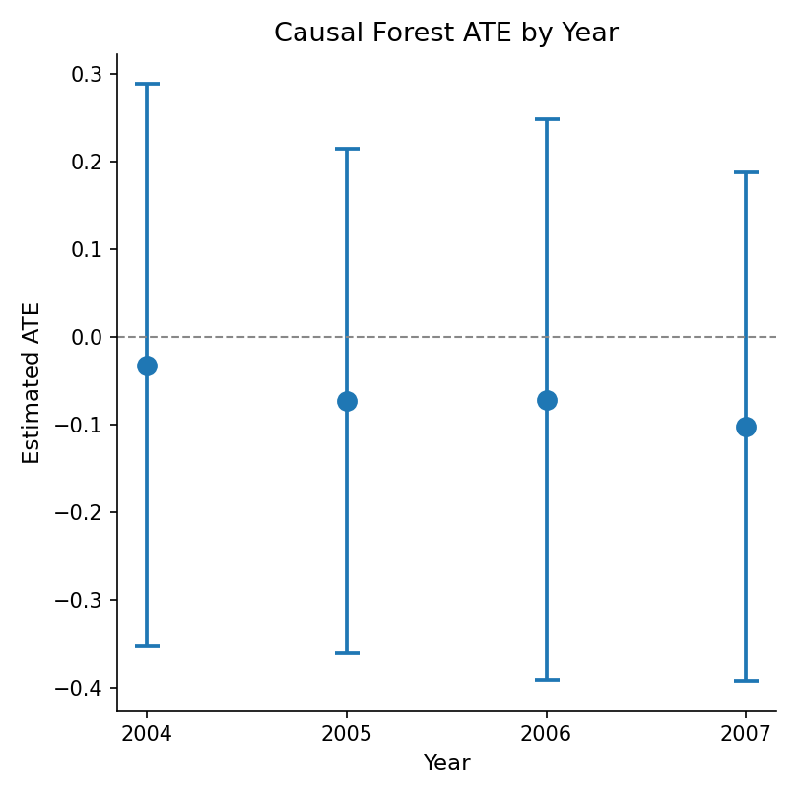
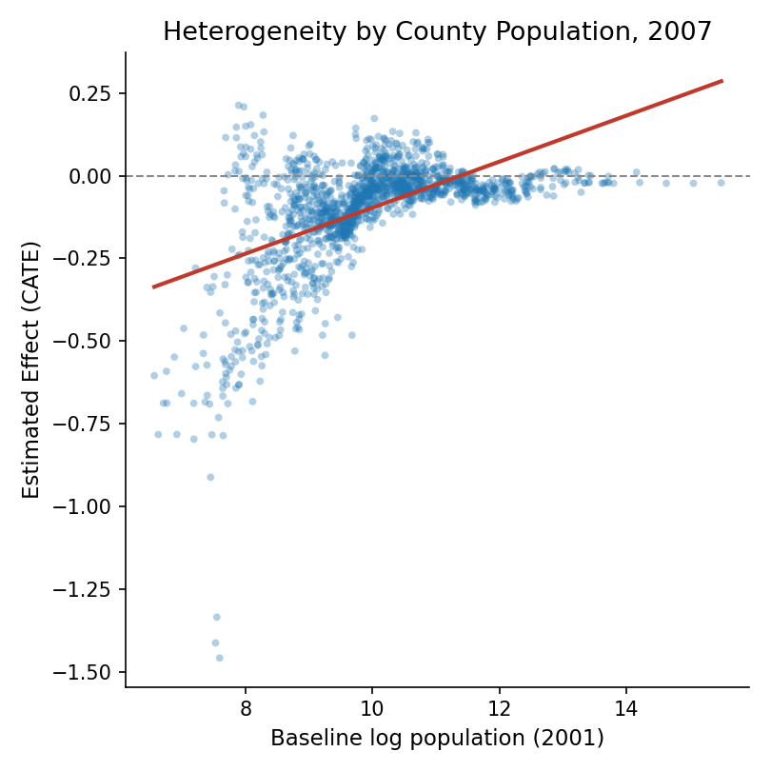
Heterogeneity Analysis — Causal Forest
Beyond a single average effect: does the impact of the minimum wage increase vary by county characteristics?
The average effect deepens from −0.10 by 2007. County-level effects range from −1.46 to 0.21, correlating with baseline population (r = 0.55) — smaller counties see larger declines.
10

Slide 11
Validity — Pre-Trend Test (Placebo 2002)
The full DML-DiD pipeline is re-run treating 2002 as the “treatment” year, before any actual wage change. All learners should return ATT ≈ 0 under valid parallel trends.
ATT Estimates — Year 2002 (Placebo)
Learner | ATT (2002) | Std. Error
No Controls | −0.005 | 0.013
Basic | 0.003 | 0.014
Expansion | 0.004 | 0.014
Lasso (CV) | 0.010 | 0.022
Ridge (CV) | 0.002 | 0.013
Random Forest | 0.002 | 0.013
Best | 0.003 | 0.014
Stack | 0.004 | 0.013
11

Slide 12
Conclusion
−0.13
8/8
≈0
MOST NEGATIVE ATT, 2007 (NO CONTROLS)
learners agree on direction
ATT, 2002 placebo (all learners)
Negative employment effect
Robust across learners
Parallel trends validated
Treated counties show a statistically significant decline in log teen employment, growing from −0.02 in 2004 to −0.07 by 2007. The delay is consistent with gradual labour-market adjustment.
Estimates are consistent across all six ML learners, Best, and Stack. No Controls overstates the effect by roughly 2×, confirming that conditioning on pre-treatment covariates matters for credible inference.
The 2002 placebo yields ATT ≈ 0 across all learners, none significant at 5%, supporting the conditional parallel trends assumption underlying the design.
12

