Slide 1
ROBUSTNESS OF VISION ALGORITHMS
Under Real-World Image Distortions
Classical & deep-learning vision tasks, evaluated on real driving imagery — compression, low-light, and motion-blur distortions, classical restoration, and YOLO fine-tuning.
Digital Image Processing & Computer Vision — Course Project

Slide 2
Project at a Glance
1
Dataset
BDD100K — 150-image subset with real detection ground truth
2
Tasks
Edge/Corner detection, Line detection (both low-level, classical) + Object detection (high-level, DL)
3
Distortions
Compression, Low-light, Motion blur — all directly relevant to dashcam footage
4
Severity
5 calibrated levels per distortion, measured in PSNR (dB)
5
Restoration
Bilateral deblocking, Gamma+CLAHE, Wiener deconvolution (tuned per severity) — matched to each distortion's cause
6
Fine-tuning
YOLOv8n only — the classical tasks have no trainable weights
Vision Robustness Under Distortion • 2

Slide 3
Four-Stage Pipeline
Every image passes through all four stages, evaluated on all 3 tasks
1
2
3
4
→
→
→
CLEAN
DISTORTED
RESTORED
FINE-TUNED
Baseline evaluation on the original image
3 distortions × 5 severity levels applied
Classical restoration applied to distorted image
YOLOv8n fine-tuned on distorted images (detection only)
100 images × (1 clean + 3 distortions × 5 levels × 2 stages) → 1,600 image variants across the pipeline
Vision Robustness Under Distortion • 3

Slide 4
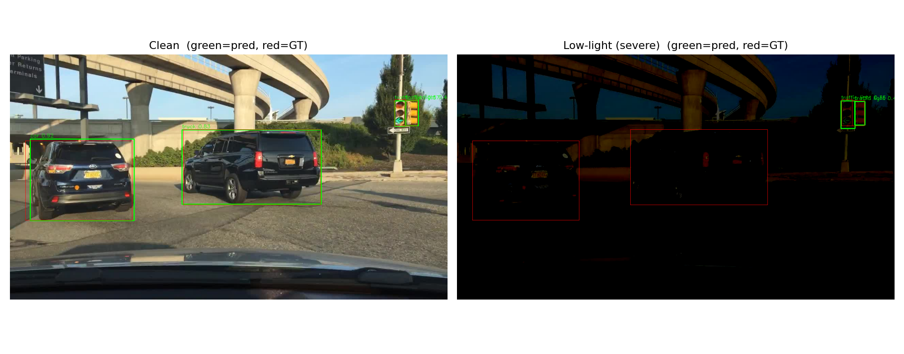
Dataset: BDD100K
Why BDD100K
● Real driving footage with genuine detection ground truth
● Cityscapes and KITTI both required login-gated downloads that couldn't be scripted
● 150-image subset, train split — small but sufficient for this scope
Class distribution (150-image subset)
GT sanity check — predictions (green) vs. ground truth (red), clean vs. severe low-light
car
1543
traffic light
400
Known limitation
truck
83
Zero bicycle/motorcycle/train instances in this sample; heavily skewed toward cars and traffic lights. Per-class metrics for rare classes aren't meaningful at this scale.
bus
43
person
13
Vision Robustness Under Distortion • 4

Slide 5
Three Tasks: Low-Level + High-Level
1
2
3
Edge / Corner Detection
Line Detection
Object Detection
LOW-LEVEL · CLASSICAL
LOW-LEVEL · CLASSICAL
HIGH-LEVEL · DEEP LEARNING
cv2.Canny + goodFeaturesToTrack (Shi-Tomasi) + ORB
cv2.Canny + HoughLinesP
ultralytics YOLOv8n (COCO-pretrained)
No GT exists — measured against the clean image's own output (edge IoU, corner ratio, ORB match ratio)
Replaced an original optical-flow/tracking plan that needed video frames we didn't have
The one task with real ground truth — scored with proper IoU-matched precision/recall/F1
Vision Robustness Under Distortion • 5

Slide 6
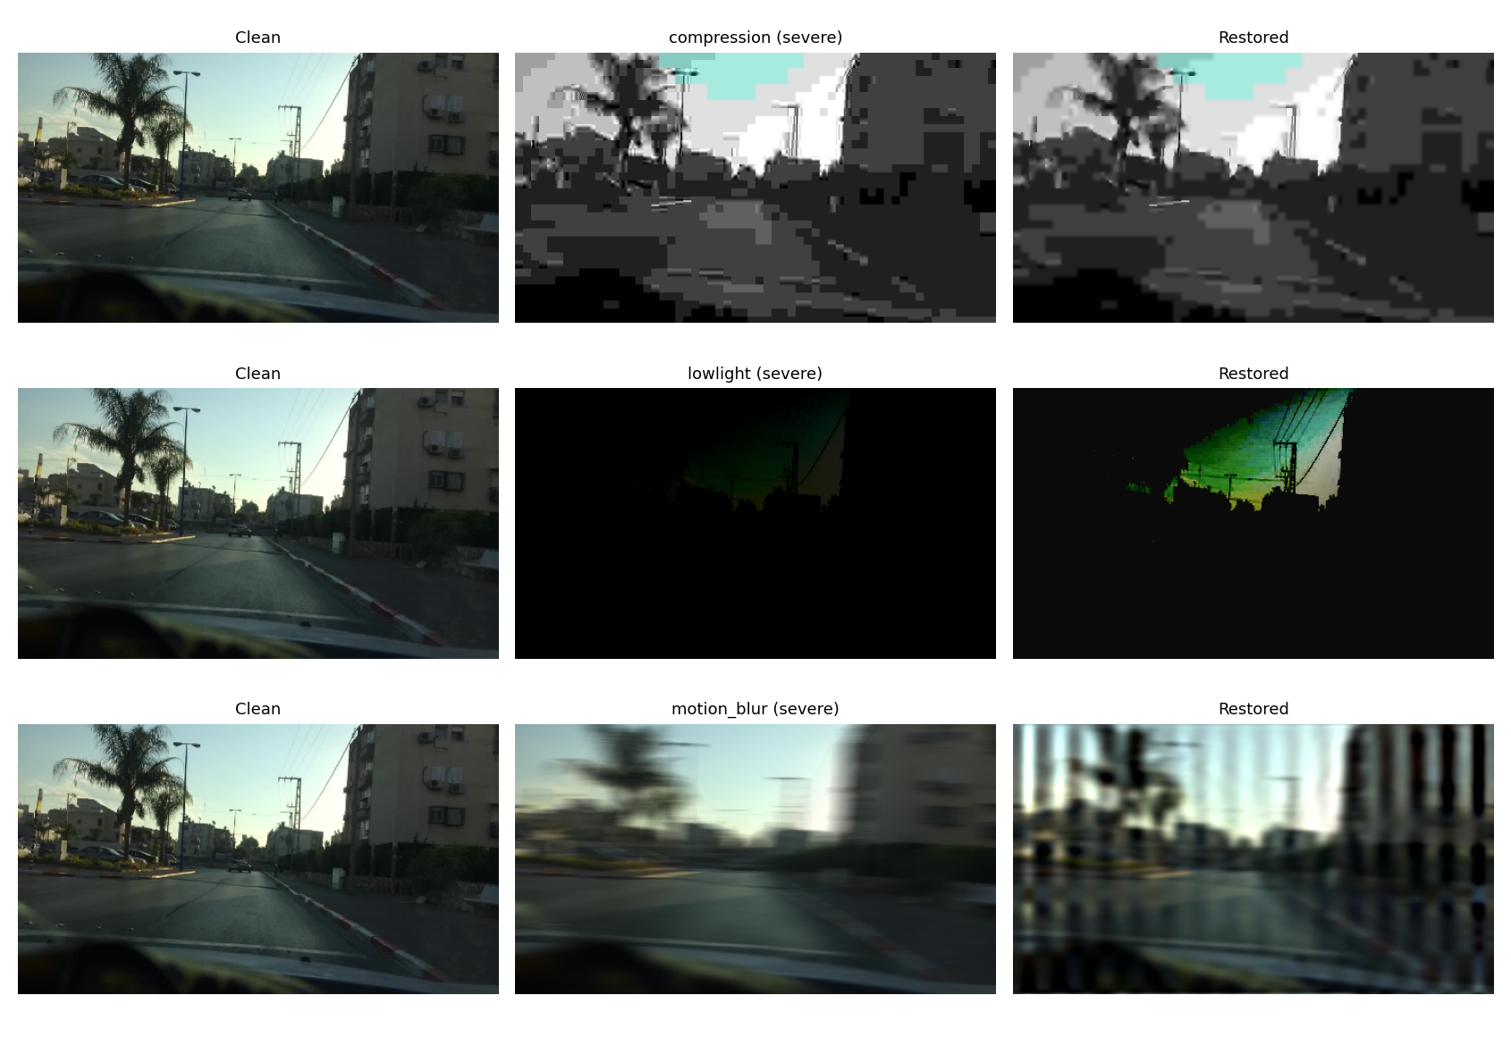
Three Distortions
Chosen for direct relevance to dashcam/driving conditions — 5 calibrated severity levels each, measured in PSNR (dB)
Compression
quality 50→3 → ~39→24 dB
Low-light
brightness -0.2→-0.9 → ~18→7 dB
Motion blur
kernel 5→31px → ~33→25 dB
Motion blur uses a known, controlled linear kernel (not random) — so restoration can be genuine non-blind deconvolution.
Vision Robustness Under Distortion • 6

Slide 7
Restoration Methods (Stage 3)
Compression
Smooths blocking artifacts while preserving color and most edges
C
Bilateral filter on Y (luma) channel only
Low-light
Lifts shadow detail, then boosts local contrast without blowing out highlights
L
Gamma correction (γ=0.35) + CLAHE on L channel
Motion blur
Best detection F1 of 3 methods explicitly compared (0.357 vs. 0.323 for no restoration) — see next slide
M
Wiener deconvolution, regularization tuned per severity level
Vision Robustness Under Distortion • 7

Slide 8
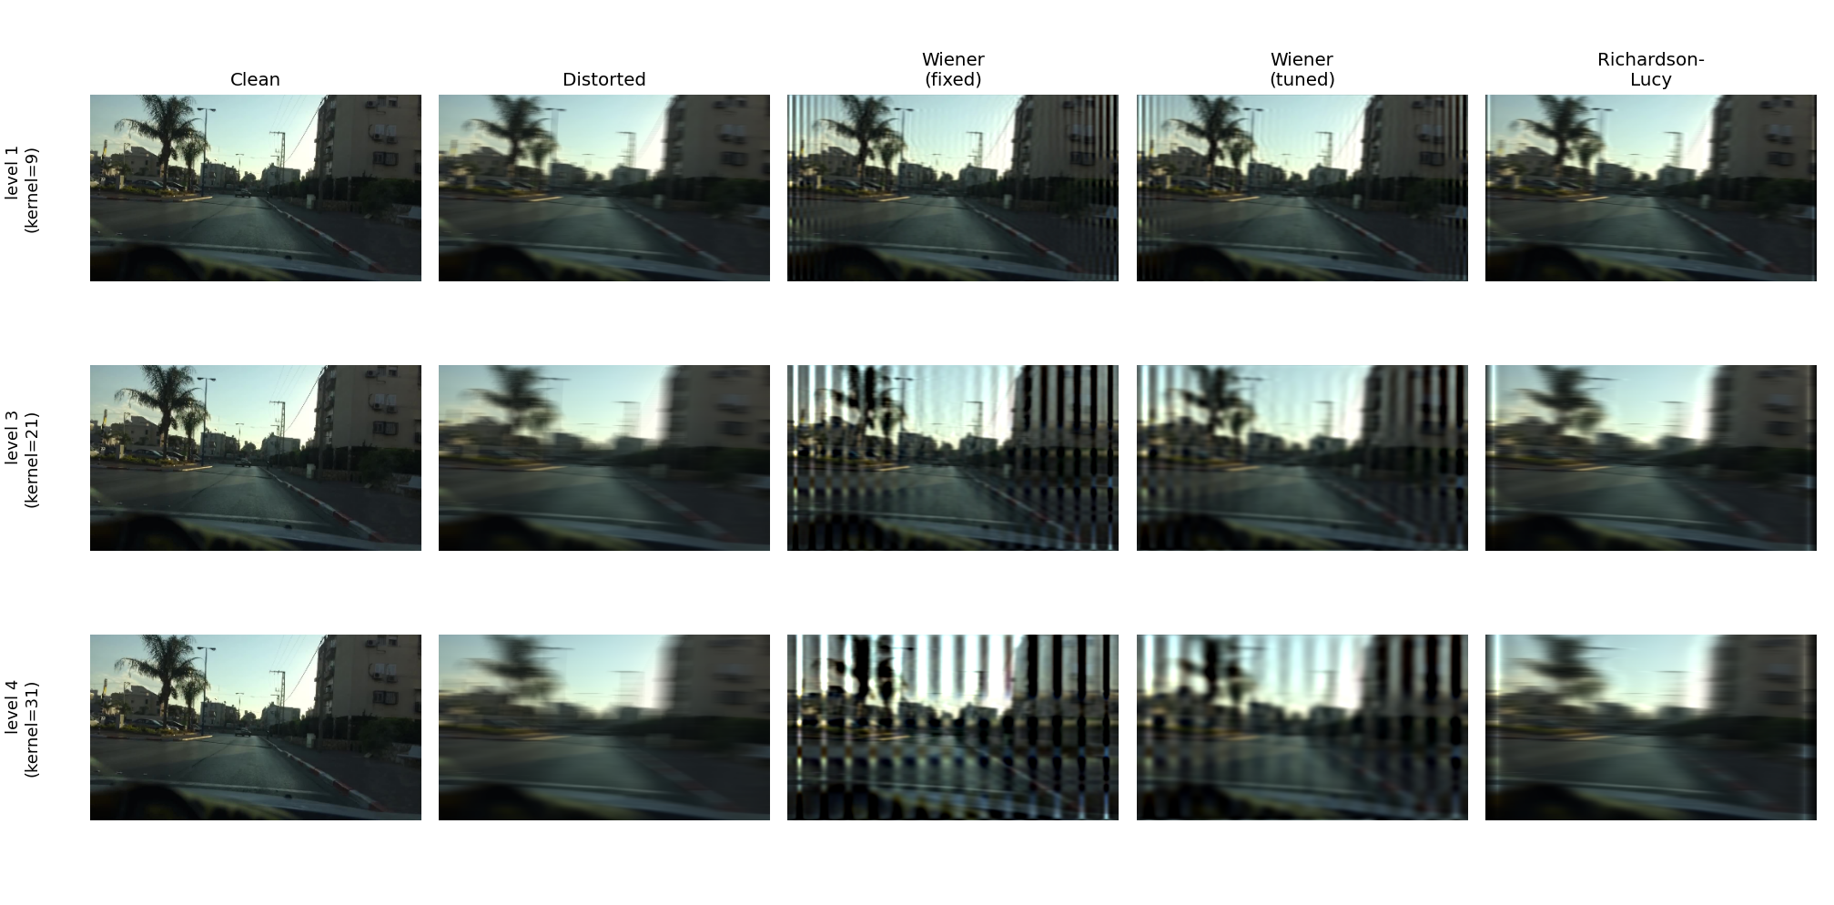
Restoration Method Comparison: Motion Blur
Three methods, kept side by side on purpose — no single metric predicted the best one for the actual task
Method
Det. F1
PSNR
Stripe
Distorted (none)
0.323
27.66
0.54
Wiener (fixed)
0.311
25.70
2.78
collapses at severe level (F1=0.017)
Wiener (tuned)
0.357
28.31
1.49
production choice — best detection F1
Richardson-Lucy
0.291
27.58
2.04
cleanest-looking, worst for detection
Vision Robustness Under Distortion • 8

Slide 9
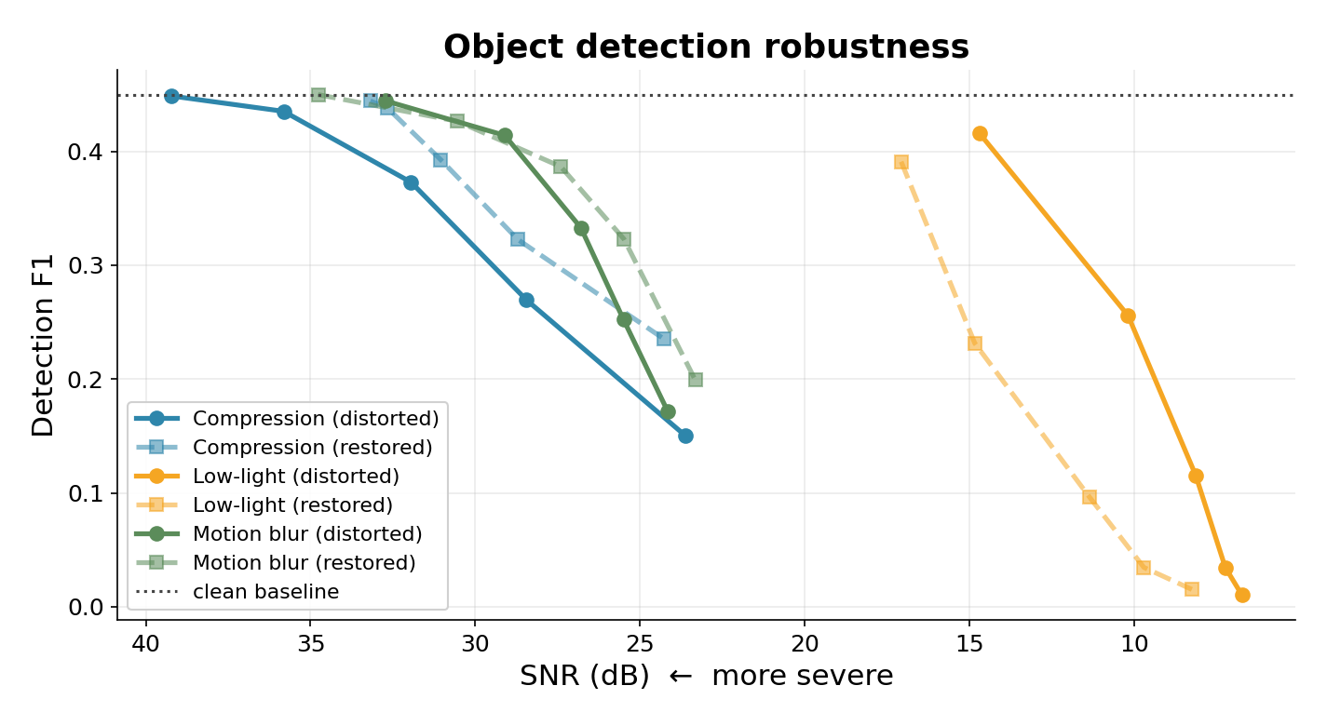
Results: Object Detection Robustness
Detection F1 vs. real BDD100K ground truth — solid = distorted, dashed = after restoration
Vision Robustness Under Distortion • 9

Slide 10
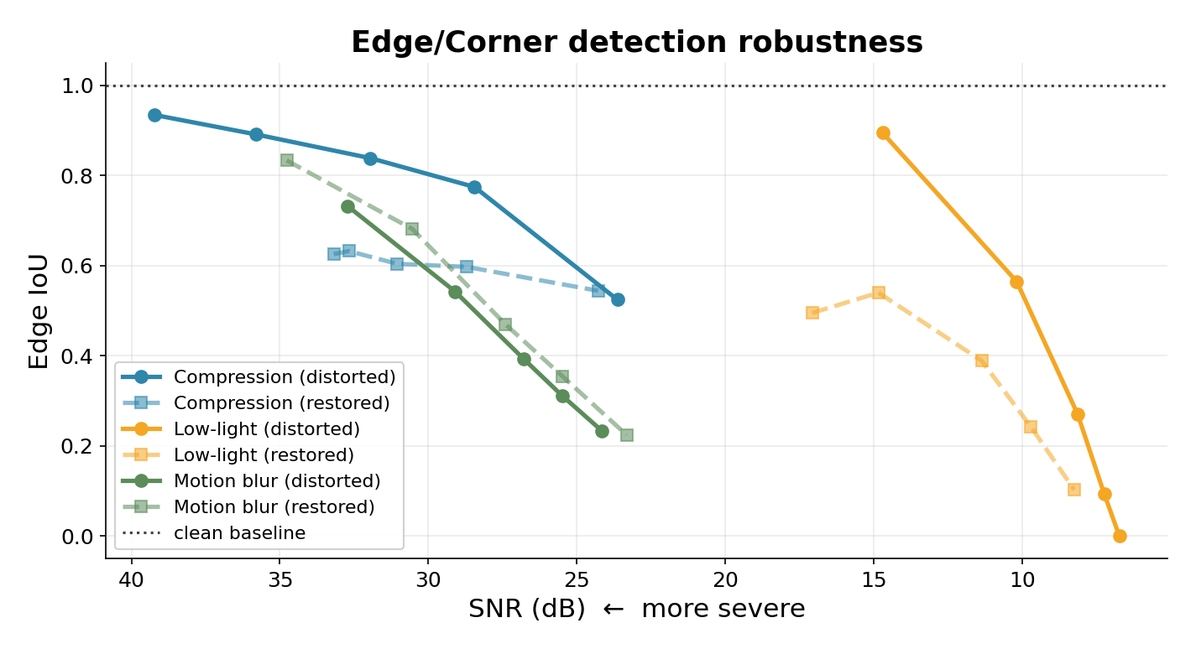
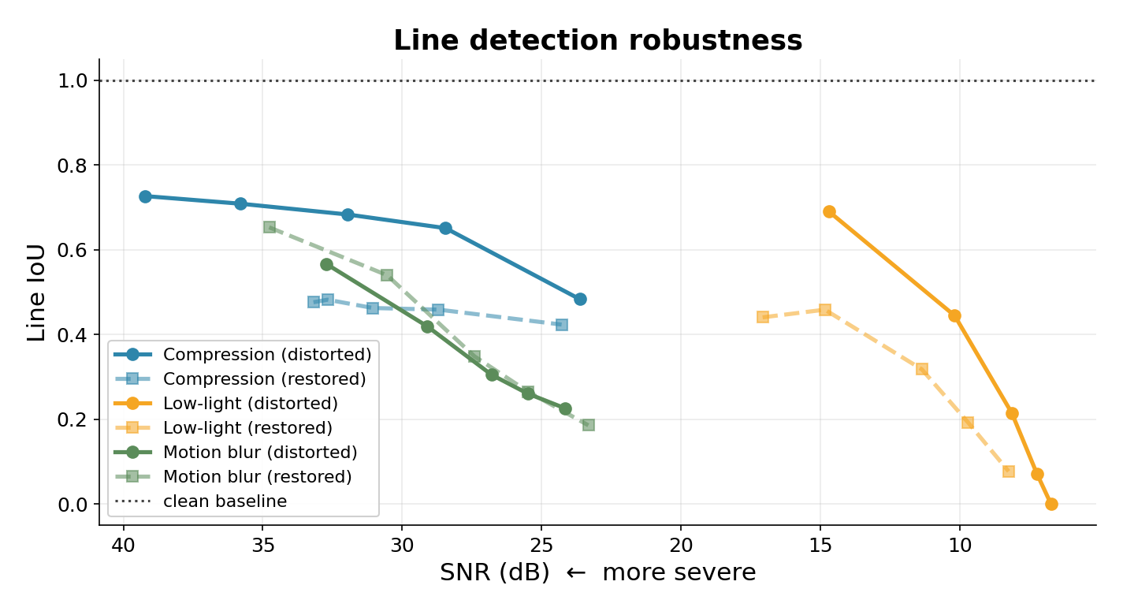
Results: Edge/Corner & Line Detection
Measured against each image's own clean-image output (no external GT available for these low-level tasks)
Notable: with the production restoration method (tuned Wiener), motion blur improves on both fronts at every severity level — edge IoU 0.44→0.51 and detection F1 0.32→0.36 — but that wasn't true for every method tried; see the dedicated comparison slide.
Vision Robustness Under Distortion • 10

Slide 11
Key Findings
1
Clear degradation with severity
Compression detection F1 falls from 0.45 (mild) to 0.15 (severe) as SNR drops.
2
Restoration helps most when things are worst
Deblocking barely changes mild-compression F1, but meaningfully helps at severe levels.
3
Pixel quality ≠ downstream performance
Low-light restoration improves SNR (9.4→12.2 dB) but slightly hurts detection F1.
4
“Cleanest-looking” restoration isn't always best
Richardson-Lucy looks cleanest but has the worst detection F1 of 3 methods (0.291); tuned Wiener wins on the metric that matters (0.357) despite more visible artifact.
5
Baseline domain gap motivates fine-tuning
Even on clean images, stock YOLOv8n only reaches F1=0.45 against BDD100K's real GT.
Vision Robustness Under Distortion • 11

Slide 12
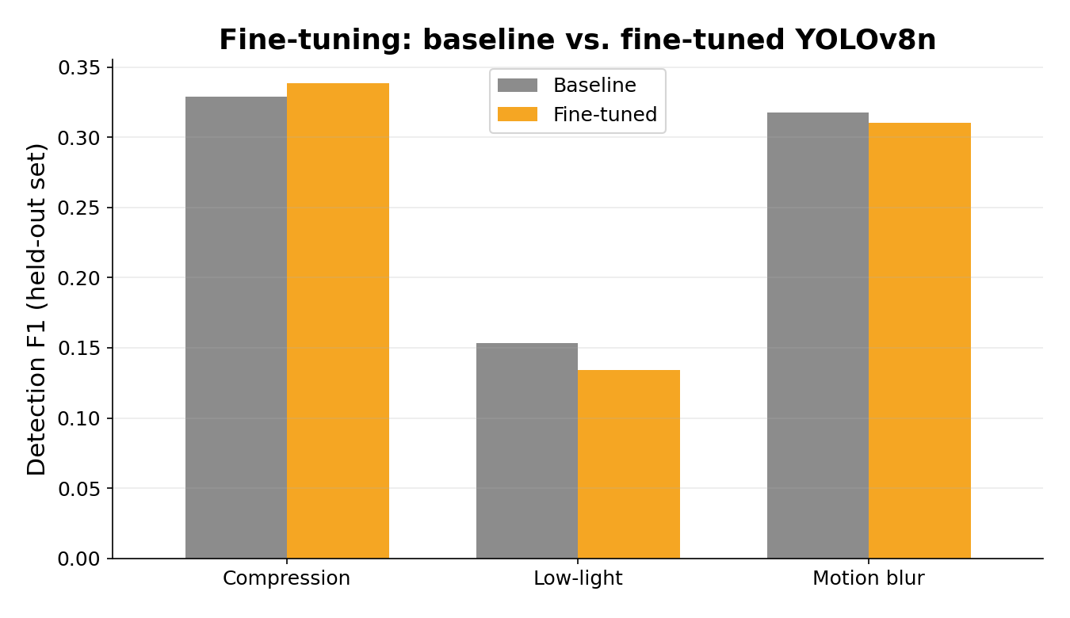
Fine-Tuning (Stage 4)
Overall Detection F1
0.267 → 0.261
baseline → fine-tuned (held-out distorted set)
Honest result: no clear win
F1 is essentially flat overall — small recall gain traded for a precision drop. Results are mixed per distortion (compression improved slightly, low-light got worse). Expected at this scale: 40–50 training images, 5–8 epochs, CPU-only — squarely the regime where catastrophic forgetting can outweigh adaptation.
Vision Robustness Under Distortion • 12

Slide 13
Process Highlights
Real friction points hit while building this — documented, not hidden
Dataset access
Cityscapes and KITTI both required login-gated downloads. Switched to BDD100K, downloaded manually, filtered locally.
!
1GB label file
BDD100K's full label file (~70k entries) was too big to hand off. A local script filtered it down to the 150 images actually used, in under 1MB.
!
The fine-tuning caching bug
First attempt showed byte-identical baseline vs. fine-tuned results — a cached YOLO model got mutated in-place by .train(). Fixed with two independent model instances.
!
A restoration bug, chased across 3 attempts
Fixed-balance Wiener caused striping; tuning it per-level fixed that. Richardson-Lucy then looked even better on one test image — but a full 150-image comparison showed it actually has the worst detection F1 of all 3. Tuned Wiener (the one abandoned in step 2) is the real winner.
!
Vision Robustness Under Distortion • 13

Slide 14
Limitations & Takeaways
● Small scale by design (150 images) — explicitly permitted for this course project; pipeline scales to any N
● Class imbalance: zero bicycle/motorcycle/train instances in this sample
● Edge/corner and line detection use clean-image-as-reference, not external ground truth
● BDD100K → COCO class mapping is approximate (“rider” folds into “person”; “traffic sign” dropped)
● Fine-tuning is a proof of concept, not a production training run
Full code, data, results, and this report:
github.com — see README.md
Thank you

