Slide 1
A Survey on Low Power Network Protocols for the Internet of Things based on a paper by: Rault et al
By: Noam Major, Elad Hillel, Itai Sidnik

Slide 2
Presentation Overview
IoT Energy Challenges
The Importance of Low-Power Network Protocols
Energy Consumption in IoT Networks
Categorization of Low-Power Protocols
MAC Layer Protocols
Network Layer Protocols
Application Layer Protocols
Cross-Layer Approaches
Future Directions
Conclusion

Slide 3
IoT Energy Challenges
Massive Scale: Billions of connected devices
Deployment Locations: Often remote or inaccessible
Cost Sensitivity: Energy efficiency directly impacts economic viability
Battery Constraints:
Limited capacity
Difficult/costly battery replacement
Need for years of operation

Slide 4
Why Network Protocols Matter
Communication dominates energy consumption:
60-80% of total energy budget in typical IoT devices
Far exceeds sensing and processing energy costs
Key Energy Drains:
Transmission power
Idle listening
Protocol overhead
Collisions and retransmissions

Slide 5
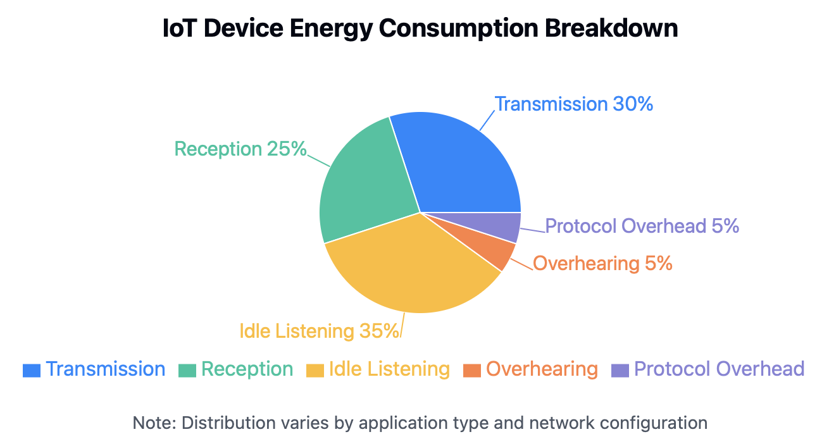
Energy Consumption Breakdown
Transmission: Active sending of data packets
Reception: Receiving and processing incoming data
Idle Listening: Monitoring channel for potential transmissions
Overhearing: Processing packets meant for other nodes
Protocol Overhead: Control packets, beacons, synchronization

Slide 6
Categorization of Low-Power Protocols
By Network Layer:
MAC Layer (Media Access Control)
Network Layer (Routing)
Application Layer
Cross-Layer Approaches
By Design Approach:
Duty Cycling
Data Reduction
Energy-Efficient Routing
Topology Control

Slide 7
MAC Layer Protocols - Overview
Primary Goal: Efficient channel access
Key Energy-Saving Approaches:
Duty cycling
Collision avoidance
Overhearing prevention
Message passing optimization

Slide 8
MAC Layer - Duty Cycling Protocols
Synchronized Protocols:
S-MAC: Sleep/wake scheduling
T-MAC: Adaptive duty cycle
IEEE 802.15.4: Beacon-enabled mode
Asynchronous Protocols:
B-MAC: Low power listening (LPL)
X-MAC: Short preamble sampling
RI-MAC: Receiver-initiated transmission

Slide 9
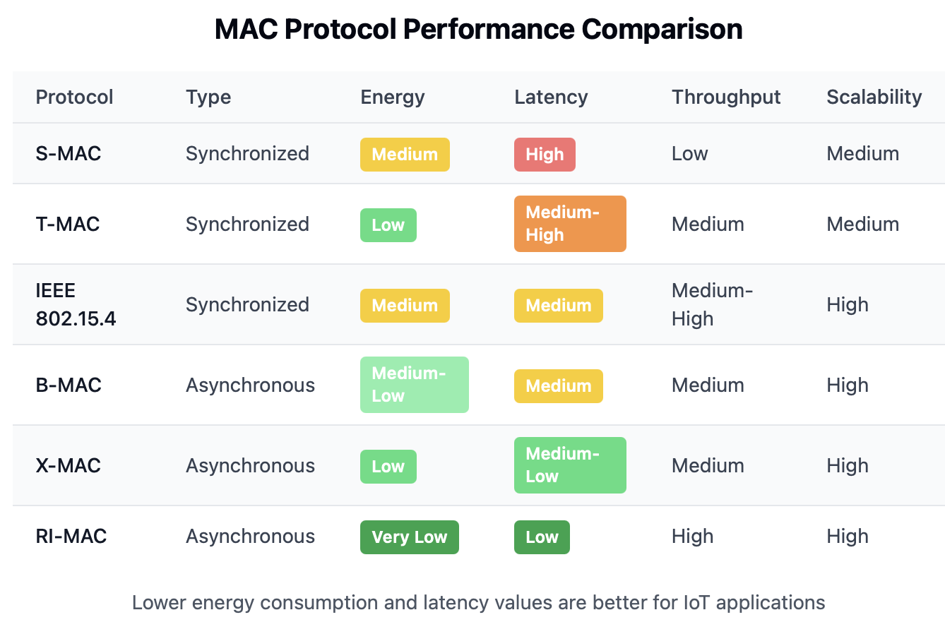
MAC Layer - Performance Comparison
Metrics:
Energy efficiency
Latency
Throughput
Scalability
Trade-offs:
Energy vs. latency
Simplicity vs. performance
Synchronization overhead vs. idle listening

Slide 10
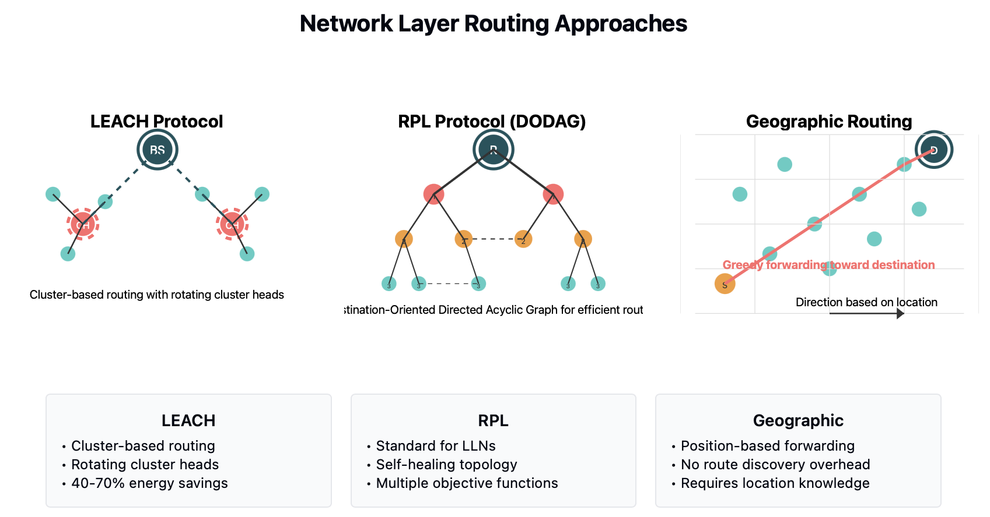
Network Layer Protocols - Overview
Primary Goal: Energy-efficient routing
Key Energy-Saving Approaches:
Clustered architectures
Multipath routing
Geographic routing
Data-centric routing

Slide 11
Network Layer - Routing Protocols
LEACH: Low Energy Adaptive Clustering Hierarchy
Cluster-based approach with rotating cluster heads
RPL: IPv6 Routing Protocol for Low-Power and Lossy Networks
Destination-oriented directed acyclic graph (DODAG)
AODV-EE: Energy-Efficient Ad hoc On-Demand Distance Vector
Energy-aware route selection
Geographic Routing: Position-based forwarding

Slide 12
Network Layer - Energy-Saving Techniques
Clustering: Reducing communication distances
Data Aggregation: Combining multiple data packets
Multipath Routing: Distributing energy load
Sleep Scheduling: Coordinated with routing decisions
Topology Control: Adjusting transmission power

Slide 13
Application Layer Protocols
CoAP: Constrained Application Protocol
Lightweight alternative to HTTP
Built-in resource discovery
Observe option for reduced polling
MQTT: Message Queuing Telemetry Transport
Publish-subscribe pattern
Minimal packet overhead
QoS levels for reliability/efficiency tradeoffs
AMQP: Advanced Message Queuing Protocol
Reliable queuing with different delivery guarantees

Slide 14
Protocol Stack Comparison
Traditional Internet: TCP/IP Stack
HTTP, FTP, SMTP
TCP, UDP
IP
Ethernet, WiFi
IoT Low-Power Stack:
CoAP, MQTT
UDP (typically)
6LoWPAN
IEEE 802.15.4, BLE, LoRaWAN

Slide 15
Cross-Layer Approaches
Definition: Optimization across multiple protocol layers
Benefits:
Coordinated sleep scheduling
Joint routing and MAC optimization
Application-aware protocol adaptation
Examples:
DMAC: Data-gathering MAC
CTP: Collection Tree Protocol
TinyOS Low-Power Listening integration

Slide 16
Real-World Protocol Performance
Case Study 1: Smart Agriculture Deployment
Protocol: IEEE 802.15.4 + RPL
Results: 2-year battery life, 99.8% reliability
Case Study 2: Building Energy Management
Protocol: BLE + MQTT-SN
Results: 45% energy savings over WiFi + HTTP
Key Findings: Proper protocol selection can extend device lifetime by 5-10x

Slide 17
Emerging Low-Power Technologies
LPWAN: Low-Power Wide-Area Networks
LoRaWAN: Long range, very low power
Sigfox: Ultra-narrow band, subscription-based
NB-IoT: Cellular-based IoT network
Wake-Up Radio: Ultra-low power secondary radio
Eliminates idle listening
Activation only when needed

Slide 18
Future Research Directions
Opportunistic Energy Harvesting Integration
Protocols adapting to available energy
Machine Learning for Protocol Optimization
Predictive sleep scheduling
Intelligent routing decisions
Secure Low-Power Communication
Energy-efficient encryption
Lightweight authentication
Standardization Challenges

Slide 19
Conclusion
Network protocols dominate IoT energy consumption
Duty cycling is the most effective energy-saving technique
Protocol selection should consider application requirements
Cross-layer approaches offer the best optimization potential
Emerging technologies promise further efficiency improvements
Proper protocol design can extend IoT device lifetime from months to years

