Slide 1
Energy efficiency in wireless sensor networks: A top-down survey based on a paper by: Tifenn Rault, Abdelmadjid Bouabdallah, Yacine Challal
By: Noam Major, Elad Hillel, Itai Sidnik

Slide 2
Presentation Overview
IoT Energy Challenges
WSN applications and their requirements
Energy Consumption in IoT Networks
Categorization of Low-Power Protocols
MAC Layer Protocols
Network Layer Protocols
Application Layer Protocols
Cross-Layer Approaches
Future Directions
Conclusion

Slide 3
IoT Energy Challenges - Energy Efficiency in WSNs: Research Gap Analysis
The Research Gap
Abundant literature on energy-saving in Wireless Sensor Networks
No universal solution exists for all applications
Example: Safety applications require fast response times
Example: Agricultural applications prioritize other factors
Previous Survey Limitations
Yick et al. [1]: General WSN survey without specific energy focus
Anastasi et al. [2]: Limited to duty cycling and data-reduction
Other surveys [3,4,5]: Focus on single mechanism categories
Energy-efficient routing
Data aggregation
Energy harvesting
Paper's Novel Contribution
Top-down holistic survey integrating recent techniques
Application-specific approach to energy efficiency
First survey examining trade-offs between meeting specifications and sustainability
[1]: https://www.sciencedirect.com/science/article/abs/pii/S1389128614001418#b0005
[2]: https://www.scopus.com/record/display.uri?eid=2-s2.0-56449087483&origin=inward&txGid=b3a8a86b9b912d7af68729ab1f30d3a1

Slide 4
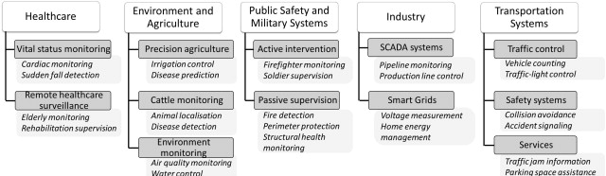
WSN applications and their requirements
Healthcare
Environment and Agriculture
Public Safety and Military Systems
Industry
Transportation Systems

Slide 5
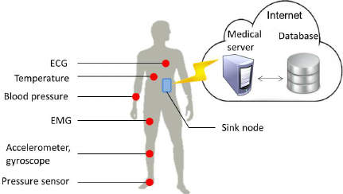
healthCare
Two healthcare oriented systems:
vital status monitoring
Remote health-care surveillance
These two uses of WSN’s require the following:
Hard real-time data delivery delays
confidentiality
access control
mobility
Quality of Service

Slide 6
Public safety and Military systems
Two main catagories of these systems:
Active intervention:
Passive supervision:
refers to systems with nodes attached to agents for temporary deployment and is dedicated to the safety of team-oriented activities. While working, each member carries a sensor so that a remote leader will be able to monitor both the holder’s status and the environmental parameters. This applies to emergency rescue teams, miners and soldiers
Refers to systems using static sensors that are deployed in a large area such as a civil infrastructure or nuclear site for long-term monitoring. Relevant examples of passive supervision applications are surveillance and target tracking, emergency navigation, fire detection in a building, structural health monitoring and natural disaster prevention such as in the case of tsunamis, eruptions or flooding.
These systems require: short delays, service differentiation, data integrity, mobility and insure coverage

Slide 7
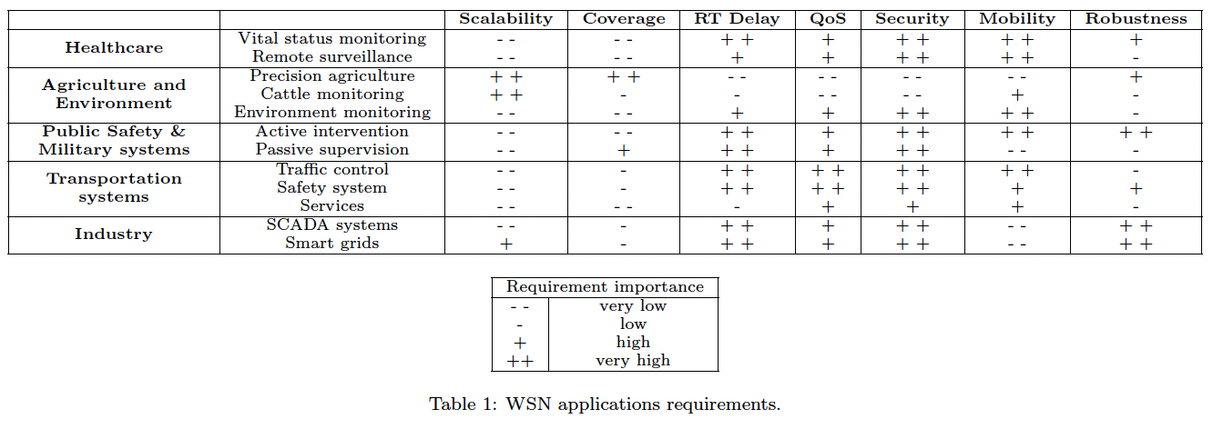
Breakdown of requirements

Slide 8
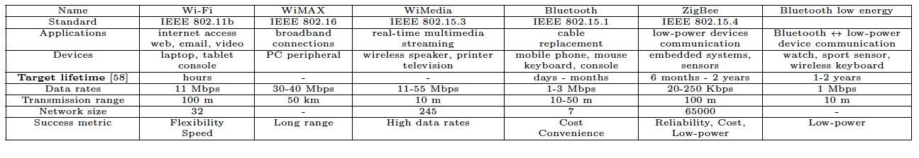
Low-power WSN standards – some examples
ZigBee:
WirelessHART:
Bluetooth Low Energy:
is a wireless technology developed as an
open standard to address the requirements of low-cost, low-power devices. ZigBee defines the upper layer communication protocols based on the IEEE 802.15.4 standard. It supports several network topologies connecting hundreds to thousands of devices.
WirelessHART uses IEEE 802.15.4 technology for monitoring equipment in industrial settings. It offers three key benefits: security, reliability, and power savings. To conserve energy, it uses a time-slot system (TDMA) that lets devices sleep when not active. The network is centrally managed, with a main controller creating and controlling all communication paths based on data it collects about nearby devices.
Bluetooth Low Energy (BLE) is designed for small, inexpensive devices that need to run on tiny batteries for a long time. It connects gadgets like watches, fitness trackers, and keyboards to phones and computers. The key feature is its ultra low-power idle mode, which lets devices work for over a year on a single battery. BLE is commonly used in healthcare monitors, sports equipment, and security devices.

Slide 9
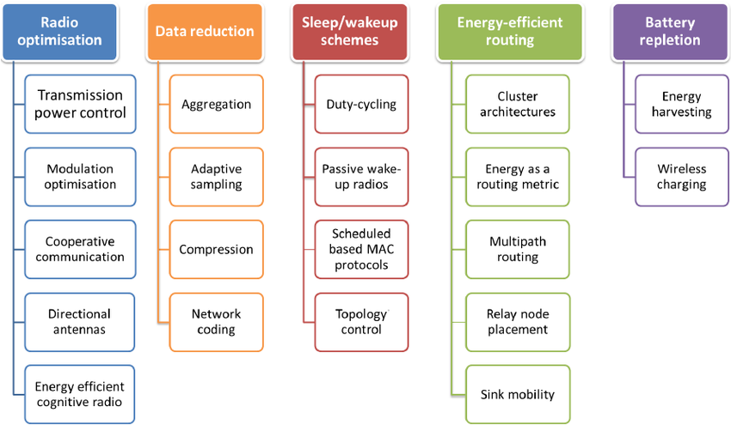
Energy-saving mechanisms

Slide 10
Radio optimization
“The radio module is the main component that causes battery depletion of sensor nodes. To reduce energy dissipation due to wireless communications, researchers have tried to optimize radio parameters such as coding and modulation schemes, power transmission and antenna direction.”

Slide 11
Modulation Optimization
Cooperative communications schemes
Optimizes radio parameters to minimize energy use
Balances circuit power vs. transmission power
Key insight: For short distances, circuit power dominates; for long distances, transmission power dominates
Research shows energy can be minimized by optimizing transmission time and selecting the right modulation scheme for specific distances
Multiple single-antenna devices collaborate to create virtual multiple-antenna systems
Leverages "overheard" data from neighboring nodes due to wireless broadcast nature
Creates spatial diversity to reduce fading and shadowing effects
Benefits:
Extended communication range
Better duty cycle balancing across network
More energy-efficient than SISO systems at certain distances
Reduced end-to-end delays
Directional Antennas
Transmission Power Control (TPC)
Send/receive signals in one direction instead of omnidirectionally
Benefits:
Improved transmission range and throughput
Less power required for same range
Multiple simultaneous nearby communications possible
Reduced overhearing in unwanted directions
Challenges:
Requires localization for proper orientation
Needs specialized MAC protocols
Issues with signal interference, antenna adjustment, and "deafness"
Improves energy efficiency by adjusting radio transmission power
In CTCA: nodes with more battery power increase transmission so others can conserve energy
Trade-offs:
Lower power reduces interference and overhearing
Lower power increases hop count and delay
Affects network connectivity and topology
Enables better spatial bandwidth reuse

Slide 12
Cognitive Radio
Cognitive Radio (CR): An intelligent radio system that dynamically selects communication channels and adjusts its parameters based on network demands.
Software-Defined Radio (SDR): Enables fully reconfigurable wireless transceivers that improve context-awareness.
Energy Challenges: CR's advanced functionalities require more energy than traditional devices, making energy-efficient designs crucial.
Research Focus Areas:
Power control of transmitters
Residual energy-based channel assignment
Network coding integration with CR
Open Research Issues: Cross-layer solutions for MAC, routing, and clustering protocols.

Slide 13
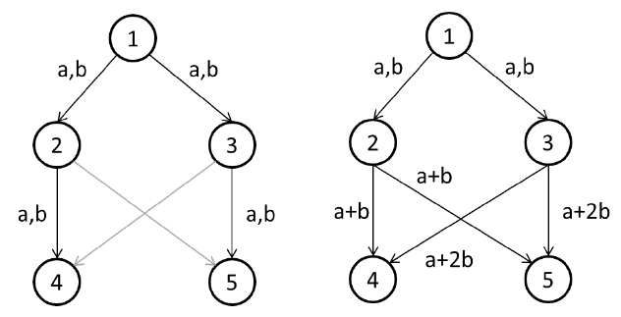
Data reduction “aims to reduce the amount of data to be delivered to the sink.”

Slide 14
Aggregation
Adaptive sampling
Definition:
Nodes along the path to the sink perform data fusion to minimize the data forwarded.
Benefits:
Reduced Traffic: Less data transmitted, optimizing bandwidth.
Lower Latency: Decreased traffic results in faster transmission times.
Drawbacks:
Loss of Accuracy:
Aggregated data may not fully represent original inputs.
Sink may not recover complete information, reducing precision.
Definition:
Dynamically adjusts the sampling rate at each sensor to optimize energy and resource usage while meeting application requirements.
Benefits:
Energy Efficiency: Reduces unnecessary sampling to save power.
Optimized Communication: Lowers bandwidth usage by limiting redundant data.
Techniques:
Spatial Correlation:
Decrease sampling in areas with low data variation.
Network coding
Data compression
Definition:
Technique to reduce traffic by transmitting linear combinations of packets instead of separate copies.
Advantages:
Reduced Traffic: Fewer transmissions save bandwidth.
Energy Efficiency: Less communication, more computation (faster and less power-hungry).
Enhanced Approach - AdapCode [86]:
Sends 1 message per N received, saving up to (N-1)/N bandwidth.
Uses Gaussian elimination for packet recovery.
📈 Reliability boost: Adapts N based on node density and supports negative acknowledgments for packet loss.
Definition:
Data compression reduces the number of bits required to represent information.
Benefits:
Energy Efficiency:
Smaller packet sizes lead to shorter transmission times.
Less energy is consumed during data transmission.
Challenges:
Standard compression algorithms are too resource-intensive for sensor nodes.
Solutions:
Specialized techniques are designed to match the computational and power constraints of wireless motes.

Slide 15
Sleep/wakeup schemes
“Idle states are major sources of energy consumption at the radio component. Sleep/wakeup schemes aim to adapt node activity to save energy by putting the radio in sleep mode.”

Slide 16
Passive wake-up radios
Definition:
Optimizes duty cycling by splitting responsibilities between two radios to minimize unnecessary wake-ups and improve energy efficiency.
Radio Types:
Low-Power Radio:
Always active for listening.
Activates the main radio only when communication is required.
Power-Hungry Radio:
Remains off during idle times.
Manages data transmission when triggered.
Benefits:
Reduced Idle Listening: Minimizes energy wasted on unnecessary wakeups.
Optimized Communication: Efficiently activates the main radio only when needed.
Challenges:
Synchronization Complexity: Requires efficient coordination between the two radios.
Switching Overhead: Transitioning between radios must be seamless to avoid delays.

Slide 17
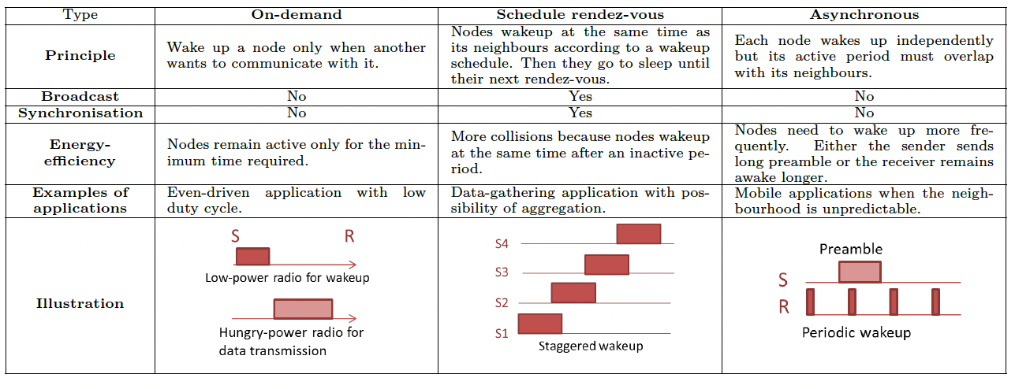
Duty cycling
Definition:
Duty cycling schedules the radio state of nodes to minimize idle listening and promote sleep mode when inactive.
Categories:
On-demand: Activated based on network requests.
Asynchronous: Nodes wake up independently, not synchronized.
Scheduled Rendezvous: Nodes wake up at predefined times.
Benefits:
Energy Efficiency: Drastically reduces power consumption.
Challenges:
Sleep Latency: Nodes may wait for others to wake up.
Broadcast Limitations: Not all neighbors are active simultaneously.
Parameter Tuning: Adjusting listen/sleep periods, preamble length, and slot time affects performance.
Duty cycle properties.

Slide 18
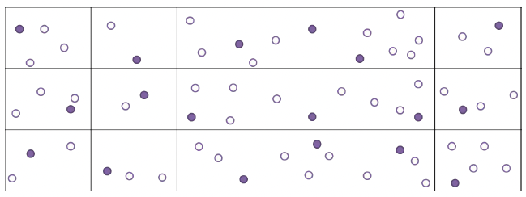
Topology control
Definition:
Dynamically adjusts the network topology by deactivating redundant nodes while maintaining connectivity and coverage.
Objective:
Minimize Active Nodes:
Deactivate unnecessary nodes to extend network lifetime.
Exploit redundancy for energy conservation.
Techniques:
Selective Activation:
Only activate a subset of nodes to maintain coverage and connectivity.
minimizing the overlap area of active nodes.
Correlated Data Gathering:
optimize the selection of connected sensors based on spatial correlation.
Useful for applications like environmental monitoring, where inactive node data can be inferred from active ones.
Benefits:
Energy Efficiency: Extends network lifespan by reducing power usage.
Optimized Coverage: Maintains application-specific coverage with fewer active nodes.
Example of a topology control method applied to a network.
To ensure the field coverage, a sensor must remain activated
in each square area. The other nodes are deactivated.

Slide 19
Energy-efficient routing
“Routing is an additional burden that can seriously
drain energy reserves. In particular, in multi-hop schemes,
nodes closer to the sink are stressed because they have
to route more packets. Therefore, their battery depletes
faster.”

Slide 20
Cluster architectures
Energy as a routing metric
Definition:
Organizes the network into clusters, each managed by a Cluster Head (CH).
The CH coordinates member activities and communicates with other CHs or the base station.
Benefits:
Energy Efficiency:
Reduced Communication Range: Shorter distances within clusters save energy.
Fewer Transmissions: CH performs data fusion, reducing redundant messages.
Minimized Energy-Intensive Tasks: Coordination and aggregation are handled by the CH.
Node Power Management: Non-CH nodes can power off while the CH handles forwarding.
Balanced Consumption: CH rotation prevents overuse of any single node.
Scalability:
Clusters create a hierarchical structure, optimizing management and growth.
Definition:
Uses energy availability as a key factor in path selection during routing.
Prioritizes routes with nodes that have higher residual energy to extend network lifetime.
Techniques:
Exponential and Sine Cost Function-based Route (ESCFR):
Maps small changes in node energy to large changes in cost function value.
Goal: Prefer sensors with higher remaining energy to balance power consumption.
Double Cost Function-based Route (DCFR):
Considers both remaining energy and consumption rate.
Focus: Helps balance load in hotspots with high traffic and energy drain.
Obstacle Adaptability: Enhances performance even in challenging terrains.
Benefits:
Extended Network Lifetime: Avoids overusing low-energy nodes.
Balanced Energy Consumption: Distributes traffic more evenly across the network.

Slide 21
Multipath routing
Relay node placement
Definition:
Single-Path Routing:
Simpler but can drain energy of nodes along the path quickly.
Multipath Routing:
Discovers multiple paths for data transmission.
Balances energy consumption by alternating nodes on different paths.
Techniques:
EEMRP (Energy-Efficient Multipath Routing Protocol):
Finds multiple node-disjoint paths based on energy levels and hop distances.
Dynamically allocates traffic rates to optimize energy usage.
EECA (Energy-Efficient and Collision Aware):
Builds two node-disjoint, collision-free routes between source and sink.
Benefits:
Energy Balancing: Reduces the risk of node exhaustion.
Enhanced Reliability: Multiple routes allow for fast recovery from node failures.
Increased Network Lifespan: Extends operation by distributing load efficiently.
Definition:
Relay node placement optimizes the distribution of nodes to prevent energy holes and maintain network connectivity.
Objective:
Prevent Premature Node Depletion:
Avoids network partitioning by balancing energy consumption.
Reduces sensor hot-spots where energy drain is concentrated.
Ensure Coverage and k-Connectivity:
Guarantees that the network remains operational and connected.
Techniques:
Even Distribution: Spreads nodes uniformly to balance load.
Enhanced Relay Nodes: Adds high-capacity nodes in critical areas.
Optimized Sink Placement:
Strategically position static sinks to reduce the average hop distance to the nearest sink.
Benefits:
Energy Efficiency: Extends network lifespan by preventing isolated energy drain.
Improved Connectivity: Minimizes risks of communication breakdown.
Balanced Load: Distributes traffic evenly to prevent bottlenecks.

Slide 22
Sink Mobility
Definition:
Sink mobility involves moving the base station within the network to balance energy consumption and improve connectivity.
Problem with Static Sinks:
Nodes near the base station deplete energy faster due to heavy traffic load.
Leads to network disconnection and reduced lifespan.
Solution:
Mobile Base Station:
Moves around the network to collect data from nodes.
Distributes workload, preventing isolated energy drain.
Benefits:
Increased Network Lifetime: Balances energy consumption across nodes.
Enhanced Connectivity: Improves reachability in sparse networks.
Reduced Contention & Collisions: Single-hop communication minimizes message loss.
Challenges:
Mobility Optimization:
Path planning is needed to prevent latency and buffer overflow.
Ensuring efficient coverage without excessive movement.

Slide 23
Charging
“Several recent research studies address energy harvesting and wireless charging techniques. Both are promising solutions which aim to recharge sensor batteries without human intervention."

Slide 24
Energy harvesting
Wireless charging
Definition:
Allows sensor nodes to harvest energy from the environment (e.g., solar, wind, kinetic), enabling continuous operation.
How It Works:
Energy Sources:
Solar, wind, kinetic, and other ambient energy forms.
Energy Conversion:
Converts ambient energy into electrical energy.
Consumed directly or stored for later use.
Techniques:
Energy Prediction Schemes:
Estimate future energy availability to adjust sampling rate, transmit power, and duty cycling.
Adaptive Modes:
Intensive operation during high energy periods (e.g., daytime for solar-powered motes).
Conservative mode during low energy availability (e.g., nighttime).
Challenges:
Residual Energy Imbalance:
Nodes may have uneven energy due to differences in harvesting.
Routing protocols should account for these variations.
Battery Degradation:
Protocols need to manage leakage and storage loss over time.
Benefits:
Extended Network Lifetime:
Sensors can operate theoretically indefinitely if energy is continuously available.
Reduced Maintenance:
Less dependency on battery replacement or manual intervention.
Definition:
Wireless charging allows energy to be transmitted to sensor nodes without physical contact, ensuring perpetual operation.
Techniques:
Electromagnetic (EM) Radiation:
Suitable for ultra-low power sensors (e.g., temperature, light, moisture).
Limitation: Efficiency drops quickly over distance; potential safety concerns.
Magnetic Resonant Coupling:
High efficiency within a several-meter range.
Promising for WSNs due to stronger power transfer capabilities.
Applications:
Medical Sensors & Implants – Powering health-monitoring devices wirelessly.
Embedded Concrete Sensors – Recharging sensors inside infrastructure.
UAV-Powered Ground Sensors – Providing energy from drones.
Advanced Concepts:
Mobile Chargers:
Recharge nodes directly during movement across the network.
Energy Cooperation:
Nodes share energy with neighboring sensors, enabling multi-hop energy transfer.
Self-sustaining Networks: Sensors can harvest, store, and transfer energy to maintain network health.
Benefits:
Sustainable Network Operation: Reduced need for manual recharging.
Extended Lifetime: Eliminates energy as a limiting factor.
Network Flexibility: Easier deployment in remote or hard-to-reach areas.

Slide 25
Integration
In previous slides different ways to enhance WSN lifetimes using methods to enhance energy efficency, but it is also clear that there is a strong dependency between application needs and that energy efficency needs. so it is clear that various performance metrics have to be optimized jointly. A few examples of this are:
routing protocols and sleep/wakeup schemes directly effect network latency
radio optimization trades off signal quality for battery conservation
data reduction approaches can affect the accuracy of the collected information
Using these observations we can better understand the dependency and trade offs on energy efficiency and quality of our WSN.
It is necessary to develop solutions that can achieve better integration and trade-offs between different requirements we will try and present a three of those options.

Slide 26
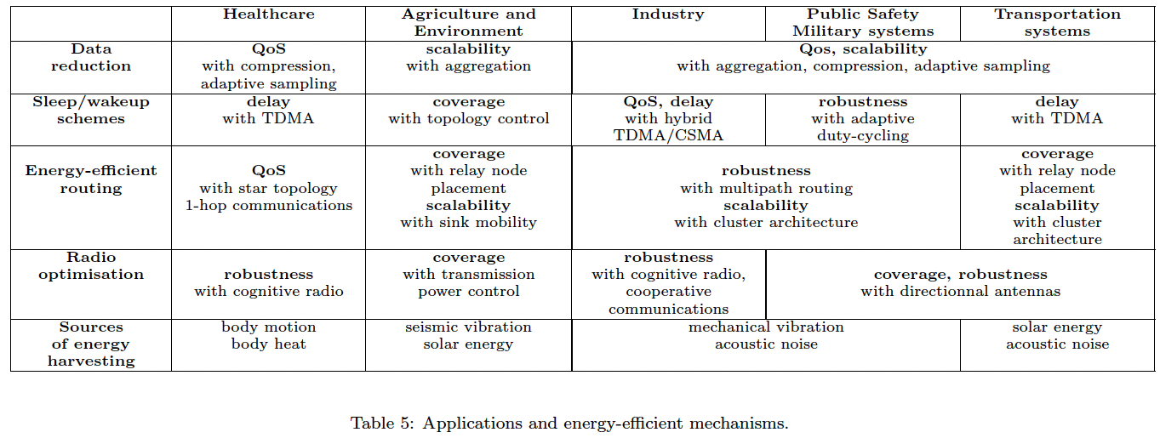
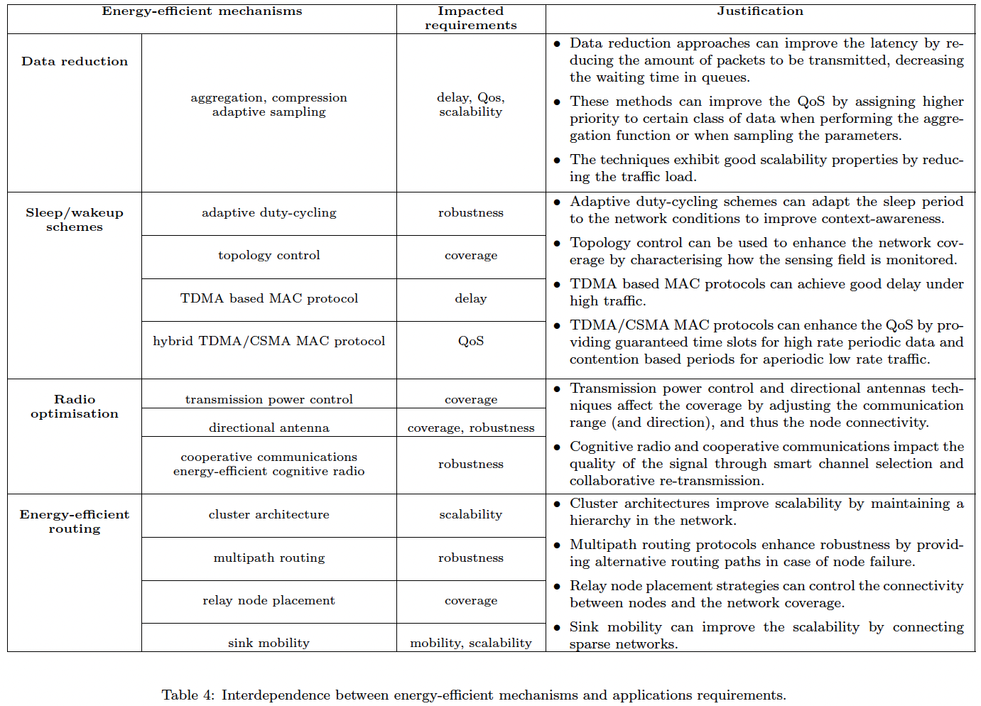

Slide 27
Multimetric protocols Balancing Energy Efficiency with Other Requirements
Key Concepts
Combines energy efficiency with other application needs (QoS, security)
Uses weight functions to balance multiple metrics
Adapts to changing network conditions
Examples
ATSR: Energy + location + trust metrics for secure routing
ERTLD: Combines RSSI, power, and delay for real-time delivery
PEMuR: Energy-efficient video routing with QoS awareness
InRout: Uses Q-learning to balance reliability and energy
Challenges
Weight adjustment often relies on trial-and-error
Extra overhead from maintaining multiple metrics
Metrics like link quality can vary over time
Requires additional control message exchange
Benefits
Improved adaptability to changing network conditions
Better application-specific performance
More flexible decision-making at node level
Enables intelligent trade-offs (e.g., security vs. energy)

Slide 28
Cross Layer approaches
What are Cross-Layer Approaches?
Integrated designs that exploit interactions between different network layers
Significantly improve energy efficiency and adaptability to dynamic environments
Enable tackling interdependence of sensor requirements (QoS, routing, lifetime, security)
Key Benefits
Optimized Performance: Joint consideration of multiple layers leads to better overall network performance
Energy Efficiency: Combined practices across layers (clustering, sleep/active scheduling, power control)
Adaptability: Better handling of topology changes and dynamic environments
Example Applications
Monitoring battery level (physical layer) to assign communication slots (MAC layer)
Considering interference graphs when routing data to optimize transmission delay
Handling topology changes across multiple layers after node addition/removal
Real-World Solutions
Cooperative communication + hierarchical architectures + data aggregation (Gao et al.)
Node placement + topology control + MAC scheduling (Chang et al.)
Transmission power control + sleep/wakeup scheduling (Liu et al.)
Routing + MAC protocols for load balancing and traffic adaptation (Almalkawi et al.)

Slide 29
Multi-Objective Optimization
Key Approaches
Evolutionary Algorithms
Biological evolution principles: survival of fittest, mutation, selection
Example Applications:
MODE algorithm: Energy vs. latency trade-offs
DPAP: Node location & power optimization for coverage & lifetime
EMOCA: Target detection vs. energy & sensor count (WSN placement)
Game Theory
Models rational interactions between network entities
Uses incentives to promote cooperation over selfish behavior
Example Applications:
Cross-authority packet forwarding cooperation
CAR: Correlation-aware routing for energy minimization
Concept
Definition: Optimizing multiple objective functions simultaneously
Challenge: No single solution can optimize all objectives in non-trivial problems
Goal: Find diverse set of Pareto-optimal solutions representing different trade-offs
Implementation Considerations
High computational requirements → better for base station processing
Limited resource suitability for sensor nodes
Centralized approaches require global knowledge
Scalability challenges as network size increases

