Slide 1
Football
Data science
Presented by:
Israel Adgo & Elad Karni

Slide 2
TABLE OF CONTENTS
01
03
05
ML
Cleaning the data
Presenting the prediction question
02
04
06
Crawling
EDA
Conclusions

Slide 3
The prediction question
•What could affect the salary in the first season in the NFL?
•Can we predict a NFL player's first year salary depending on player characteristics?

Slide 4
Data acquisition
Data sources:
https://www.spotrac.com/nfl/contracts/cumulative-cash
Its took to us 10 hours to scrape the data.

Slide 5
Data Crawling
We used python library for the crawling mission:
•Beautiful Soup (for the first season salary data)

Slide 6
Data Scraped
Position
Draft Year
First Name
Experience Years
Age
Last Name
Draft Round
College
Agent
Salary
Player status
Team

Slide 7
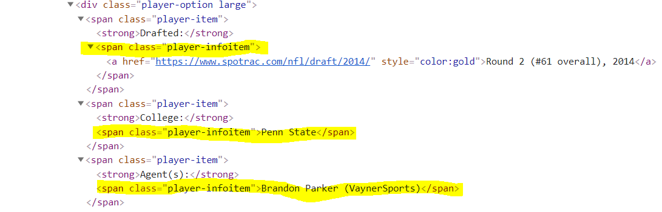
Difficulties
We had difficulty deleting the data marked on the picture
so we had to find a creative way to differentiate between each information.

Slide 8
Data Cleaning
We cleaned all unnecessary data
-Outliers
-Missing data
-Empty cells

Slide 9
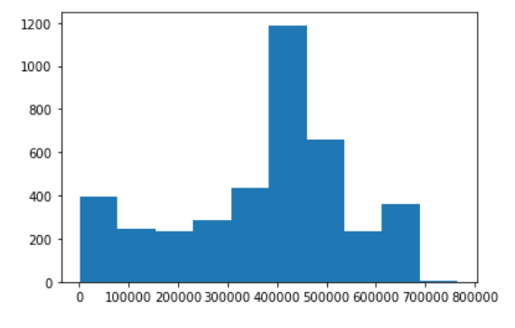
EDA
The graph shows the most common salary. You can see it is between 400k and 450k.

Slide 10
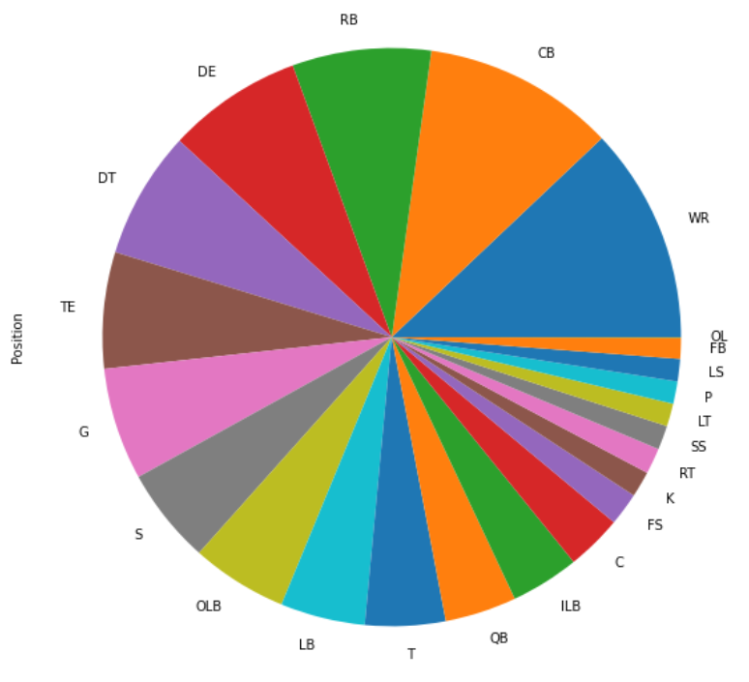
EDA
In the graph you can see the most common position and you can see that it is WR.

Slide 11
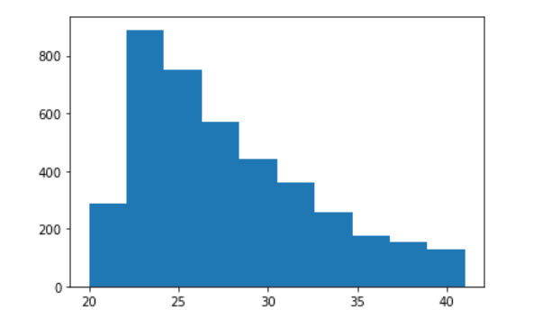
EDA
The graph shows the number of players by age. It can be seen that as the age increases the number of players decreases.

Slide 12
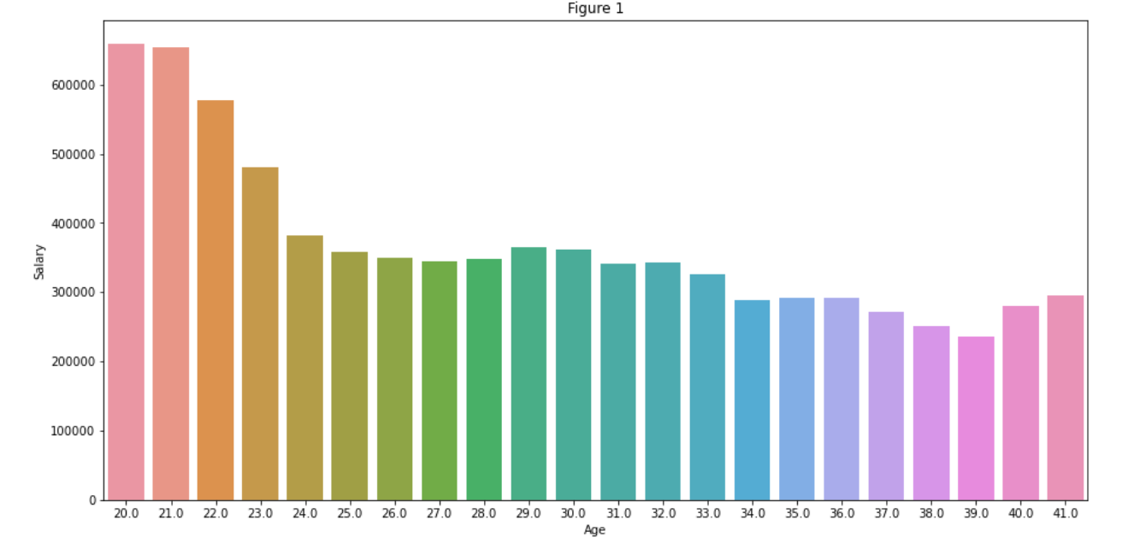
EDA
The graph shows the average salary for each age. You can see that the young players earn more.

Slide 13
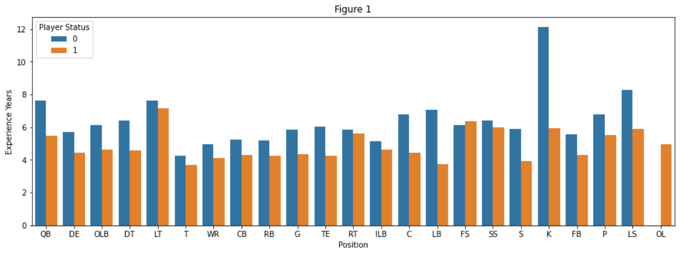
EDA
In the graph you can see the years of experience of each position from the data we scraped with each player's status: active and inactive

Slide 14
Machine Learning
- We built a Linear regression model using ‘sklearn’ python library, in order to predict our target - ‘Salary’ of the Players.

Slide 15
Split Data- Train and Test
Total amount of data is 4077 rows, the data is splitted in the following way:
-70% Train - 2853 rows.
-30% Test - 1224 rows.

Slide 16
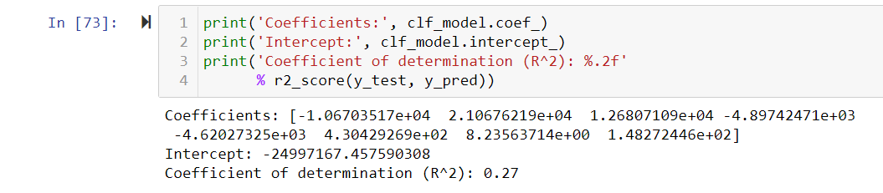
Problem with our ML Model
We could not find a solution to the low result we got in the test R2^2
Without significant reduction in the amount of data

Slide 17
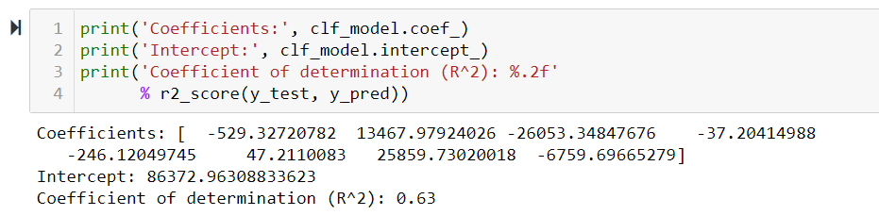
Problem with our ML Model
After significantly deleting our data (2167 lines left)
We were able to reach a R2 ^ 2 result higher than 0.5

Slide 18
Conclusion
We came to the conclusion that when a player is selected in the draft (selection of the player for the NFL League) at a younger age so his salary will be higher.

Slide 19
Thanks!

