Slide 1

CheckMate
An autonomous agent that grades Calculus 1 exams
Elad Nachalieli · Shiri Haboob · Yaron Mozes
Notes:
Open with the name and one sentence: this is an agent that grades handwritten Calculus exams on its own. Keep it to 15 seconds — the why comes next.

Slide 2



Grading Calculus by hand doesn't scale
Every exam round, the same bottleneck.
Slow feedback
Inconsistent credit
Missing feedback
Students wait days to find out where they went wrong — after they've moved on.
Partial credit drifts between graders and across a long stack. Same mistake, different score.
Students sometimes receive only a score, with no explanation of what went wrong or how to improve.
Notes:
Three pains: time, delay, fairness. Land the fairness one hardest — inconsistency is what students actually resent.

Slide 3

We believe feedback should be fast, consistent, and fair — for every student, on every question.
Notes:
This is the 'why'. Say it slowly. The key turn: grading is reasoning, so it deserves an agent, not a workflow. That framing sets up the whole architecture.

Slide 4




What CheckMate does
Give it a scanned exam. It returns a score, partial credit, and written feedback for every question.
Full scanned exam (all pages)
CheckMate reasons + verifies
Score + feedback
It reads every page, splits the exam into questions, and grades each on the student's actual method.
Notes:
One line, one picture: scan in, grade out. Stress that it evaluates the student's own approach, so alternative valid methods still get credit.

Slide 5
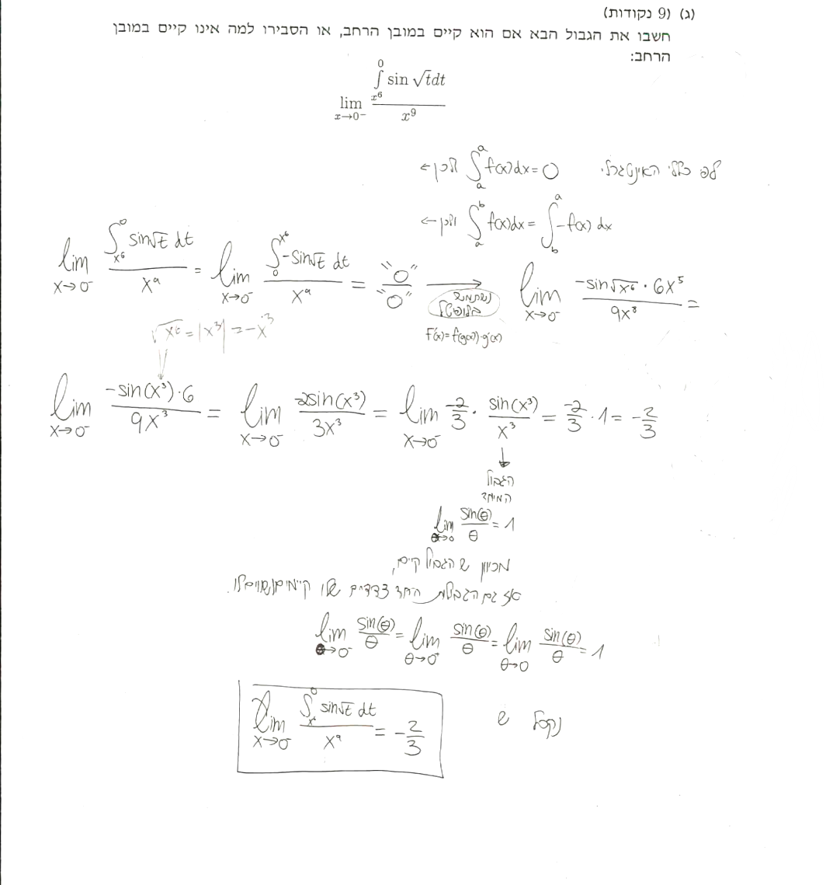
One question from the exam, graded
Question 3(c) · 9 points
CheckMate
5 / 9
+5 Method is correct — bound flip, L'Hôpital via FTC, sin θ/θ → 1.
- 4 Sign lost at √(x⁶) = |x|³ = −x³. Answer −2/3; correct is +2/3.
Real exam scan
…repeated for every question, then totaled into the final exam grade.
Notes:
Concrete proof it works. The Verifier catches the missing x term with symbolic math, and the agent still awards partial credit for correct method. Then say: this runs for every question and totals the exam. This is the moment to win the room.

Slide 6
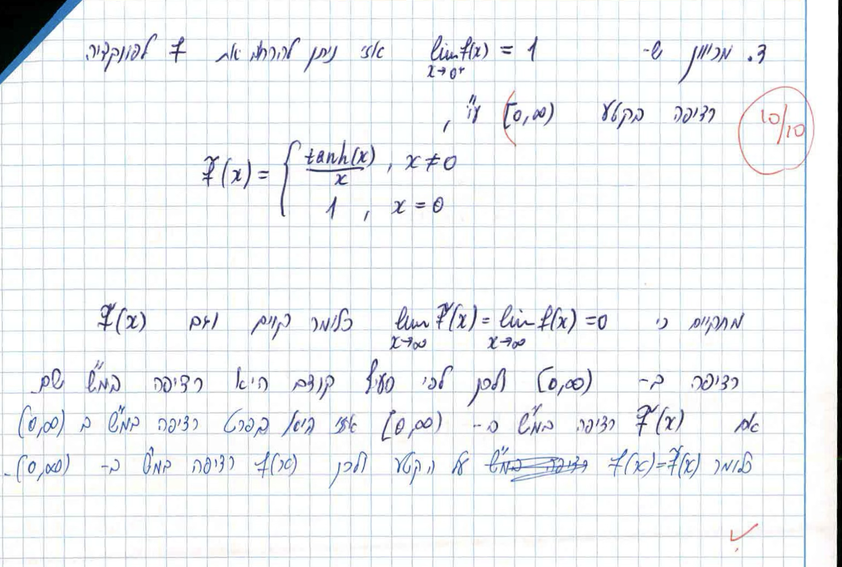
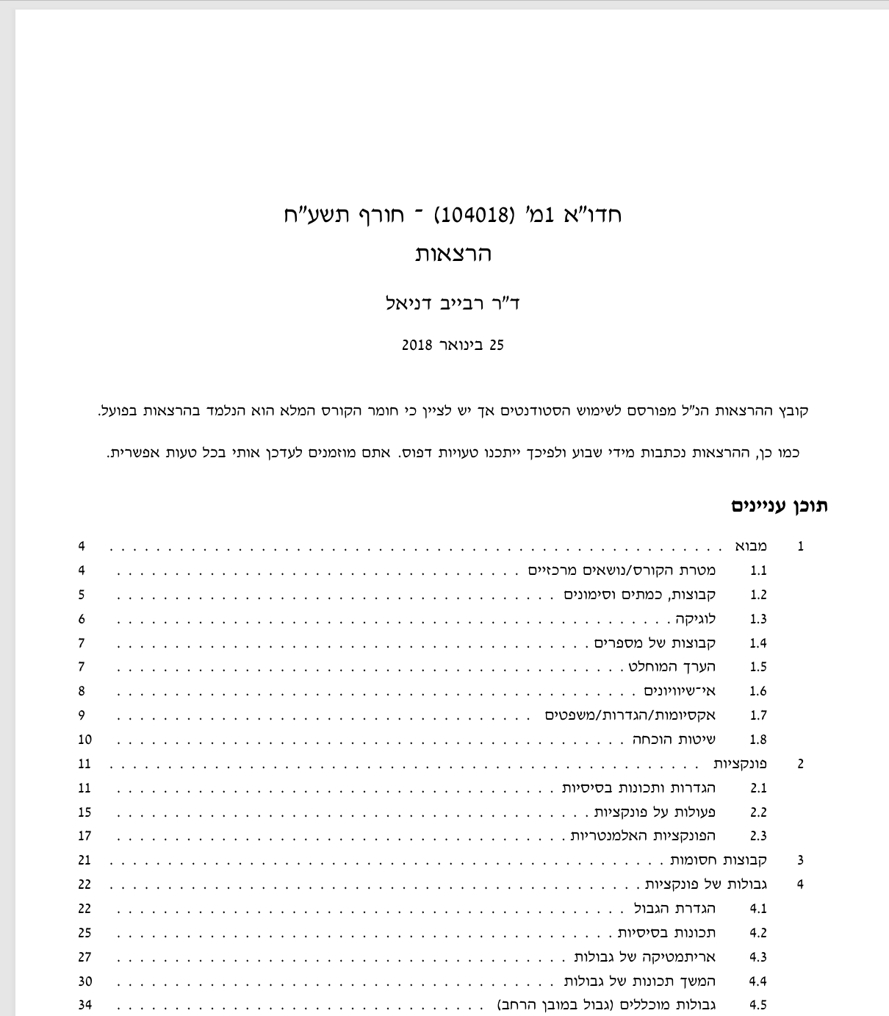
The data behind CheckMate
Two data sources, two jobs — what we collected, and why.
1
Past exams & solutions
2
Course material (Calculus 1)
Test & evaluate — real scans with the TA’s per-question grades and notes: the bar CheckMate must match before production.
Ground & verify (RAG) — the course lecture notes, the single source of truth every grade is grounded in instead of invented.
One set to test against, one to stay grounded in.

Slide 7
CheckMate as a Reflection Agent
The agent grades first, then critiques its own grade against retrieved course evidence.
LLM
LLM
LLM
Parser
student answer
Grader
initial score + feedback
Initial grade
score + feedback
Reflector
self-critique
Final result
grade + feedback + trace
Revise until confident · max N passes
Approve or escalate
if still unsure after N passes
Reflection critique
solution match · partial credit · unclear answer?
RAG evidence
RAG evidence
Knowledge base
course notes · official solutions · TA-graded examples

Slide 8
Inside CheckMate’s system prompt
The prompt-engineering techniques we built into the grading prompt.
SYSTEM PROMPT
Persona pattern
An expert, consistent grader voice.
PERSONA · You are a senior TA grading Calculus 1
exams — rigorous, fair, and consistent.
You receive one question at a time with the
student’s work and official solution.
REASONING · Think step by step:
restate the method, compare to the correct
one, find where credit is lost, then score.
FEW-SHOT · Example —
Student: d/dx[x²·ln x] = 2x·ln x
You: rule started; missing x²·(1/x)=x.
Method sound → 3 / 5.
OUTPUT · feedback · score · justification.
Chain-of-thought
Reason step by step before scoring.
Few-shot example
One worked case sets the standard.
Structured output
Predictable fields the app can parse.

Slide 9



Why CheckMate's grades hold up
Grounded in the source
Checks its own grade
Escalates when unsure
Every grade is grounded in the official solution and course notes — not invented.
Critiques each grade and revises until confident — capped at N passes.
Low-confidence or unclear answers go to the teacher, never guessed.
Notes:
Reliability rests on three things: grounding (retrieval of the official solution + rubric), reflection, and knowing when to refuse. Grounding is the key anti-hallucination point — grades follow the material, not the model's memory. Budget and speed are handled in the caption.

Slide 10

Where CheckMate goes next
ROADMAP
Beyond the course deliverable — same engine, three directions.
Class score distribution
Class trends
Score spread, hardest questions, and topic gaps for the lecturer.
Practice mode
The same grader on homework — feedback before the exam.
Improves every round
Resolved escalations become new graded examples.
illustrative
Notes:
Frame this clearly as beyond the course deliverable (Roadmap badge). Three directions: class trends for the lecturer; practice mode — the same grader on homework before the exam; and a flywheel — every teacher-resolved escalation becomes a new graded example, so the agent sharpens each round. If asked how hard: the per-question traces already exist, aggregation is the easy next step.

Slide 11
CheckMate
Fast, consistent, fair feedback.
Notes:
Bookend to the why. End on the student benefit, then invite questions. Total target: under 10 minutes.

