Slide 1
Data-Driven Customer Segmentation and Product Recommendation System for SMEs
A case study using the UCI Online Retail dataset
Emeka Hilary Nwosu | Student ID: 20023332
Supervisor: Michael Ajao-Olarinoye
Department of Computer Science and Technology, Ulster University

Slide 2
Introduction & Problem Statement
Why SME e-commerce needs a low-cost analytics pipeline
SMEs generate transactional data but lack the tools to turn it into insight
Large retailers use segmentation and recommendation to retain customers — SMEs cannot match the cost or complexity
Without segmentation, marketing stays generic and recommendations are not based on real co-purchase behaviour
Problem: no low-cost, repeatable pipeline exists from raw transactions to actionable segments and recommendations

Slide 3
Research Aim & Objectives
Aim: design and evaluate a data-driven segmentation and recommendation system for SMEs
Clean and preprocess the UCI Online Retail transaction dataset
Engineer customer-level RFM (Recency, Frequency, Monetary) features
Segment customers using RFM scoring, K-Means and Hierarchical clustering
Build product recommendations via association rule mining and item-based collaborative filtering
Evaluate both components and discuss their value for SME decision-making

Slide 4
Research Questions
Five questions guiding the study
RQ1: How can transaction data support customer segmentation in SME e-commerce?
RQ2: Which clustering technique gives the best grouping of customers?
RQ3: How can customer buying trends enhance product recommendations?
RQ4: What is the impact of the recommendation system on personalisation?
RQ5: How can customer analytics help SMEs make better decisions?

Slide 5
Literature Review Highlights
Positioning this study
RFM analysis (Hughes, 1994) remains a simple, interpretable segmentation baseline
K-Means and hierarchical clustering are widely used, but rarely compared head-to-head
Association rule mining and item-based collaborative filtering are established recommendation techniques
Most prior work treats segmentation and recommendation as separate problems
SME-scale analytics remains under-researched relative to large-enterprise platforms

Slide 6
Novelty of this Research
What makes this study different
Integrates segmentation and recommendation into one end-to-end pipeline
Deliberately scoped to SME resource constraints — cost, skills, infrastructure
Benchmarks three clustering methods and three recommendation approaches in the same evaluation framework
Delivers results as a working interactive application, not just a notebook report

Slide 7
Methodology Overview
A repeatable, five-stage pipeline
1. Data acquisition and preprocessing
2. Feature engineering (RFM)
3. Customer segmentation and evaluation
4. Product recommendation and evaluation
5. Delivery via an interactive web application

Slide 8
Dataset & Preprocessing
UCI Online Retail dataset
541,909 transaction line items, Dec 2010 – Dec 2011, UK-based online retailer
Removed cancelled orders, invalid quantities/prices, and rows with missing Customer ID
Cleaned to 392,692 line items across 4,338 customers and 3,665 products
United Kingdom accounts for 82.0% of total revenue

Slide 9
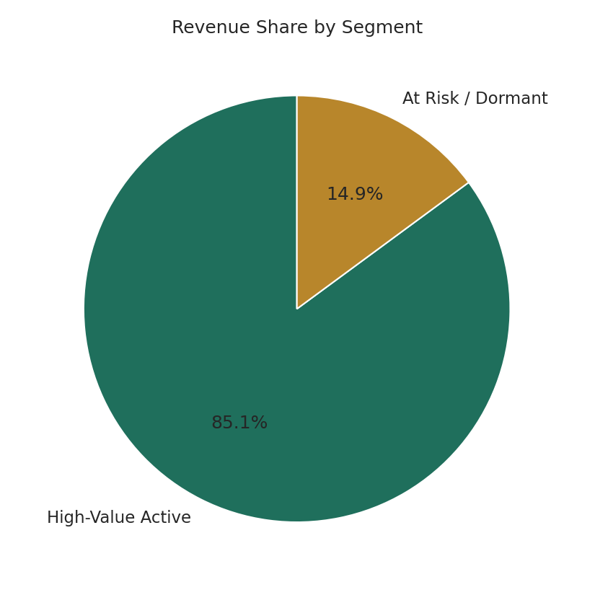
Customer Segmentation Results
K-Means clustering on RFM features
K-Means (k = 2) outperformed Hierarchical and DBSCAN
Silhouette score 0.433, Davies-Bouldin index 0.784
High-Value Active: 38.4% of customers
At Risk / Dormant: 61.6% of customers
High-Value segment generates 85.1% of revenue

Slide 10
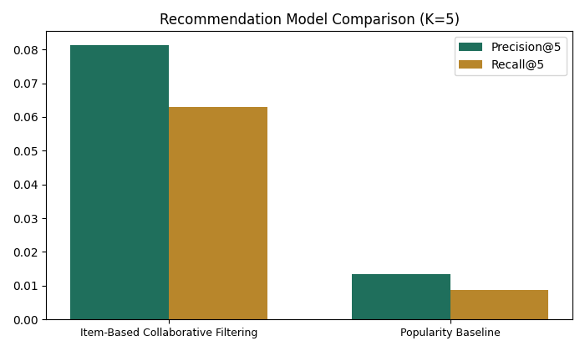
Recommendation Results
Item-based collaborative filtering vs. popularity baseline
86 association rules mined, with lift up to 24.0
Item-based CF: Precision@5 = 0.081, Recall@5 = 0.063
Popularity baseline: Precision@5 = 0.013, Recall@5 = 0.009
Personalisation delivers ~6x precision and ~7x recall improvement

Slide 11
System Architecture
A three-part, modular design
Offline analysis (Jupyter Notebook): cleaning, segmentation, recommendation
API backend (FastAPI): serves trained models via REST endpoints
Frontend (React): interactive dashboard for segments and recommendations
Modular design allows independent testing, replacement and scaling of each part

Slide 12
Key Findings Summary
Revisiting the five research questions
RQ1: RFM features alone produce a valid, interpretable segmentation
RQ2: K-Means gives the best-separated clusters
RQ3: Association rules and collaborative filtering both surface actionable co-purchase patterns
RQ4: Personalised recommendations clearly outperform a non-personalised baseline
RQ5: Segments and recommendations are delivered via a working dashboard, not just a report

Slide 13
Contributions & Significance
Why this work matters
Combines segmentation and recommendation in one evaluated pipeline
Gives SMEs evidence-based guidance on which techniques to adopt
Demonstrates a reproducible, low-cost approach using open-source tools
Extends customer analytics literature to an under-served SME context

Slide 14
Limitations & Future Work
What this study does not yet cover
Single dataset, single retailer — generalisability untested
Only two statistically distinct segments (k = 2); richer segmentation not supported by this data
Recommendation coverage limited to UK transactions and frequently-purchased items
Future work: multi-dataset validation, real-time model updates, richer behavioural features

Slide 15
References
[1] J. Han, M. Kamber, and J. Pei, Data Mining: Concepts and Techniques, 3rd ed. Morgan Kaufmann, 2011.
[2] C. C. Aggarwal, Recommender Systems: The Textbook. Springer, 2016.
[3] P.-N. Tan, M. Steinbach, and V. Kumar, Introduction to Data Mining, 2nd ed. Pearson, 2018.
[4] A. Géron, Hands-On Machine Learning with Scikit-Learn, Keras, and TensorFlow, 3rd ed. O’Reilly, 2022.
[5] D. Chen, “Online Retail,” UCI Machine Learning Repository, 2015.
[6] J. MacQueen, “Some methods for classification and analysis of multivariate observations,” 1967.
[7] J. H. Ward, “Hierarchical grouping to optimize an objective function,” J. Am. Stat. Assoc., 1963.
[8] M. Ester et al., “A density-based algorithm for discovering clusters with noise,” KDD, 1996.
[9] D. L. Davies and D. W. Bouldin, “A cluster separation measure,” IEEE TPAMI, 1979.
[10] P. J. Rousseeuw, “Silhouettes: A graphical aid to cluster validation,” J. Comput. Appl. Math., 1987.
[11] R. Agrawal, T. Imieliński, and A. Swami, “Mining association rules in large databases,” ACM SIGMOD, 1993.
[12] J. Han, J. Pei, and Y. Yin, “Mining frequent patterns without candidate generation,” ACM SIGMOD Record, 2000.
[13] B. Sarwar et al., “Item-based collaborative filtering recommendation algorithms,” WWW, 2001.
[14] A. M. Hughes, Strategic Database Marketing. Probus Publishing, 1994.
[15] R. T. Fielding, “Architectural styles and the design of network-based software architectures,” Ph.D. dissertation, UC Irvine, 2000.

