Slide 1
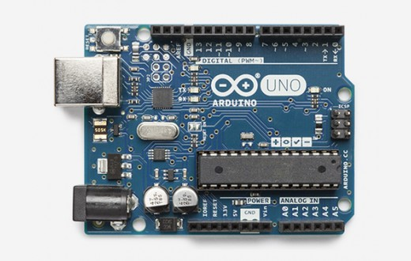
Arduino Intro

Slide 2
What is Arduino
Arduino is an open-source electronics platform based on easy-to-use hardware and software. Arduino boards are able to read inputs - light on a sensor, a finger on a button, or a Twitter message - and turn it into an output - activating a motor, turning on an LED, publishing something online. You can tell your board what to do by sending a set of instructions to the microcontroller on the board. To do so you use the Arduino programming language and the Arduino Software (IDE).

Slide 3
What is Arduino
Over the years Arduino has been the brain of thousands of projects, from everyday objects to complex scientific instruments. A worldwide community of makers - students, hobbyists, artists, programmers, and professionals - has gathered around this open-source platform, their contributions have added up to an incredible amount of accessible knowledge that can be of great help to novices and experts alike.

Slide 4
What is Arduino
Arduino was born at the Ivrea Interaction Design Institute as an easy tool for fast prototyping, aimed at students without a background in electronics and programming. As soon as it reached a wider community, the Arduino board started changing to adapt to new needs and challenges, differentiating its offer from simple 8-bit boards to products for IoT applications, wearable, 3D printing, and embedded environments. All Arduino boards are completely open-source, empowering users to build them independently and eventually adapt them to their particular needs. The software, too, is open-source, and it is growing through the contributions of users worldwide.

Slide 5
Why Arduino
Thanks to its simple and accessible user experience, Arduino has been used in thousands of different projects and applications. The Arduino software is easy-to-use for beginners, yet flexible enough for advanced users. It runs on Mac, Windows, and Linux. Teachers and students use it to build low cost scientific instruments, to prove chemistry and physics principles, or to get started with programming and robotics. Designers and architects build interactive prototypes, musicians and artists use it for installations and to experiment with new musical instruments..

Slide 6
Why Arduino
Arduino simplifies the process of working with microcontrollers, it offers some advantage for teachers, students, and interested amateurs over other systems:
Inexpensive - Arduino boards are relatively inexpensive compared to other microcontroller platforms.
Cross-platform - The Arduino Software (IDE) runs on Windows, Macintosh OSX, and Linux operating systems. Most microcontroller systems are limited to Windows.

Slide 7
Why Arduino
Simple, clear programming environment - The Arduino Software (IDE) is easy-to-use for beginners, yet flexible enough for advanced users to take advantage of as well.
Open source and extensible software - The Arduino software is published as open source tools, available for extension by experienced programmers. The language can be expanded through C++ libraries, and people wanting to understand the technical details can make the leap from Arduino to the AVR C programming language on which it's based.
Open source and extensible hardware - The plans of the Arduino boards are published under a Creative Commons license, so experienced circuit designers can make their own version of the module, extending it and improving it.

Slide 8
Overview
The Arduino microcontroller is an easy to use yet powerful single board computer that has gained considerable traction in the hobby and professional market. The Arduino is open-source, which means hardware is reasonably priced and development software is free.

Slide 9
Overview
The UNO is the best board to get started with electronics and coding. If this is your first experience tinkering with Arduino platform, the UNO is the most robust board you can start playing with. The UNO is the most used and documented board of the whole Arduino family.

Slide 10
Overview

Slide 11
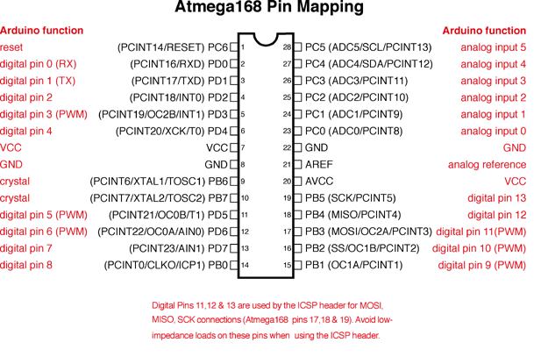
Overview

Slide 12
Overview
The Uno board features an Atmel ATmega328 microcontroller operating at 5 V with 2 Kb of RAM, 32 Kb of flash memory for storing programs and 1 Kb of EEPROM for storing parameters. The clock speed is 16 MHz, which translates to about executing about 300,000 lines of C source code per second. The board has 14 digital I/O pins and 6 analog input pins.

Slide 13
Overview
Microcontroller | ATmega328P
Operating Voltage | 5V
Input Voltage (recommended) | 7-12V
Input Voltage (limit) | 6-20V
Digital I/O Pins | 14 (of which 6 provide PWM output)
PWM Digital I/O Pins | 6
Analog Input Pins | 6
DC Current per I/O Pin | 20 mA
DC Current for 3.3V Pin | 50 mA
Flash Memory | 32 KB (ATmega328P) of which 0.5 KB used by bootloader
SRAM | 2 KB (ATmega328P)
EEPROM | 1 KB (ATmega328P)
Clock Speed | 16 MHz
LED_BUILTIN | 13
The Uno board features an Atmel ATmega328 microcontroller operating at 5 V with 2 Kb of RAM, 32 Kb of flash memory for storing programs and 1 Kb of EEPROM for storing parameters. The clock speed is 16 MHz, which translates to about executing about 300,000 lines of C source code per second. The board has 14 digital I/O pins and 6 analog input pins.

Slide 14
Overview
There is a USB connector for talking to the host computer and a DC power jack for connecting an external 6-20 V power source, for example a 9 V battery, when running a program while not connected to the host computer. Headers are provided for interfacing to the I/O pins using 22 g solid wire or header connectors.

Slide 15
Overview
The Arduino programming language is a simplified version of C/C++. If you know C, programming the Arduino will be familiar. If you do not know C, no need to worry as only a few commands are needed to perform useful functions.

Slide 16
Overview
An important feature of the Arduino is that you can create a control program on the host PC, download it to the Arduino and it will run automatically. Remove the USB cable connection to the PC, and the program will still run from the top each time you push the reset button. Remove the battery and put the Arduino board in a closet for six months. When you reconnect the battery, the last program you stored will run.

Slide 17
What You Need for a Working System
Arduino Uno board
USB programming cable
3. 9V battery or external power supply (for stand-alone operation)
4. Solderless breadboard for external circuits, and solid wire for connections
5. Host PC running the Arduino development environment. Versions exist for Windows, Mac and Linux

Slide 18
Installing the Software
Follow the instructions on the Getting Started section of the Arduino web site, http://arduino.cc/en/Guide/HomePage. Go all the way through the steps to where you see the pin 13 LED blinking. This is the indication that you have all software and drivers successfully installed and can start exploring with your own programs.

Slide 19
Connecting a Battery
For stand-alone operation, the board is powered by a battery rather than through the USB connection to the computer. While the external power can be anywhere in the range of 6 to 24 V (for example, you could use a car battery), a standard 9 V battery is convenient. While you could jam the leads of a battery snap into the Vin and Gnd connections on the board, it is better to solder the battery snap leads to a DC power plug and connect to the power jack on the board.

Slide 20
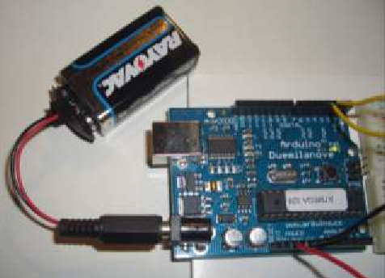
Connecting a Battery

Slide 21
Connecting a Battery
Disconnect your Arduino from the computer. Connect a 9 V battery to the Arduino power jack using the battery snap adapter. Confirm that the blinking program runs. This shows that you can power the Arduino from a battery and that the program you download runs without needing a connection to the host PC.

Slide 22
Moving On
Connect your Arduino to the computer with the USB cable. You do not need the battery for now. The green PWR LED will light. If there was already a program burned into the Arduino, it will run.

Slide 23
Moving On
Start the Arduino development environment. In Arduino-speak, programs are called “sketches” .
In the editing window that comes up, enter the following program, paying attention to where semi-colons appear at the end of command lines.

Slide 24
Moving On
void setup() {
Serial.begin(9600);
Serial.println("Hello World");
}
void loop() {
}

Slide 25
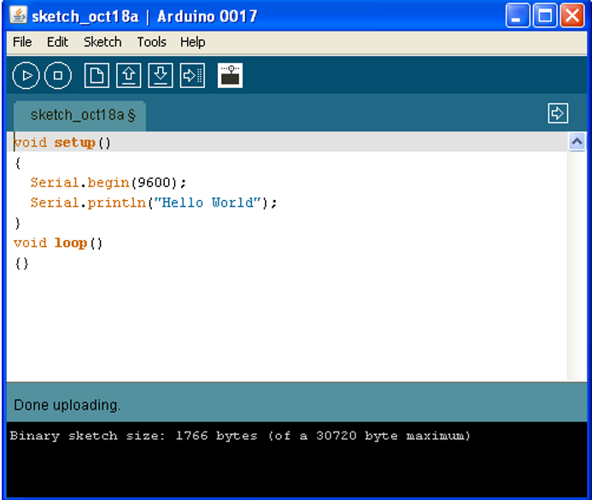
Moving On
void setup() {
Serial.begin(9600);
Serial.println("Hello World");
}
void loop() {
}

Slide 26
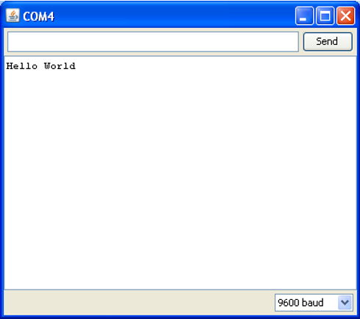
Moving On
Click the Upload button or Ctrl-U to compile the program and load on the Arduino board. Click the Serial Monitor button.

Slide 27
Solderless Breadboards
A solderless breadboard is an essential tool for rapidly prototyping electronic circuits. Components and wire push into breadboard holes. Rows and columns of holes are internally connected to make connections easy. Wires run from the breadboard to the I/O pins on the Arduino board. Make connections using short lengths of solid wire stripped of insulation about 0.25” at each end.

Slide 28
Solderless Breadboards
Here is a photo of a breadboard showing which runs are connected internally. The pairs of horizontal runs at the top and bottom are useful for running power and ground. Convention is to make the red colored run +5 V and the blue colored run Gnd. The power runs are sometimes called “power busses”.

Slide 29
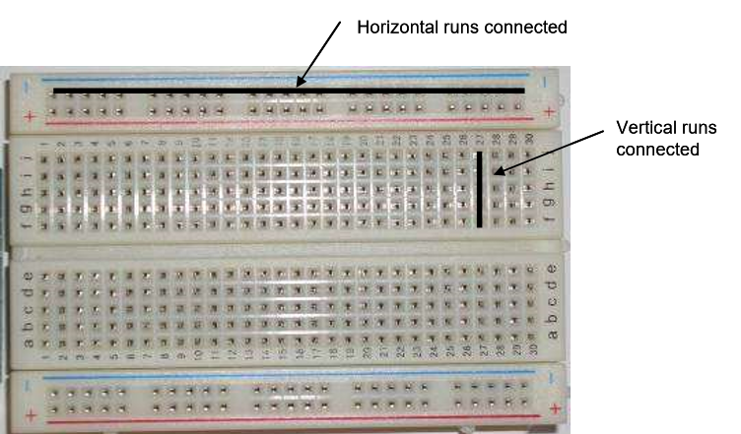
Solderless Breadboards
Here is a photo of a breadboard showing which runs are connected internally. The pairs of horizontal runs at the top and bottom are useful for running power and ground. Convention is to make the red colored run +5 V and the blue colored run Gnd. The power runs are sometimes called “power busses”.

Slide 30
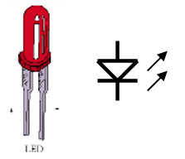
Flashing an LED
Light emitting diodes (LED's) are handy for checking out what the Arduino can do.. For this task, you need an LED, a 330 ohm resistor, and some short pieces of 22 or 24 g wire. The figure to the right is a sketch of an LED and its symbol used in electronic schematics

Slide 31
Flashing an LED
Connect the 5V power pin on the Arduino to the bottom red power bus on the breadboard and the Gnd pin on the Arduino to the bottom blue power buss on the breadboard.
Connect the notched or flat side of the LED to the Gnd bus and the other side to a free hole in main area of the breadboard Place the resistor so that one end is in the same column as the LED and the other end is in a free column. From that column, connect a wire to digital pin 2 on the Arduino board.

Slide 32
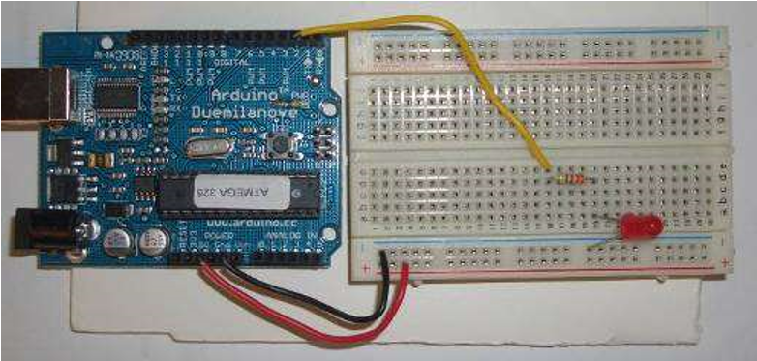
Flashing an LED
Connect the 5V power pin on the Arduino to the bottom red power bus on the breadboard and the Gnd pin on the Arduino to the bottom blue power buss on the breadboard.
Connect the notched or flat side of the LED to the Gnd bus and the other side to a free hole in main area of the breadboard Place the resistor so that one end is in the same column as the LED and the other end is in a free column. From that column, connect a wire to digital pin 2 on the Arduino board.

Slide 33
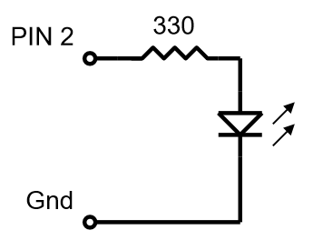
Flashing an LED
To test whether the LED works, temporarily disconnect the wire from pin 2 on the Arduino board and touch to the 5V power bus. The LED should light up. If not, try changing the orientation of the LED. Place the wire back in pin 2.

Slide 34
Flashing an LED
void setup() {
pinMode(2,OUTPUT);
digitalWrite(2,HIGH);
delay(1000);
digitalWrite(2,LOW); }
void loop() {
}

Slide 35
Flashing an LED
/* Blinking LED, 1.0 Hz on pin 2 */
void setup() // one-time actions { pinMode(2,OUTPUT); // pin 2 as an output
}
void loop() // loop forever { digitalWrite(2,HIGH); // pin 2 high (LED on)
delay(500); // wait 500 ms
digitalWrite(2,LOW); // pin 2 low (LED off)
delay(500); // wait 500 ms
}

Slide 36
Reading a switch
The LED exercise shows how the Arduino can control the outside world. Many applications require reading the state of sensors, including switches.
For this exercise, the Arduino will read the state of a normally-open push button switch and display the results on the PC using the serial.println() command. You will need a switch, a 10 kohm resistor and some pieces of hookup wire. If you don't have a switch, substitute two wires and manually connect their free ends to simulate a switch closure.

Slide 37
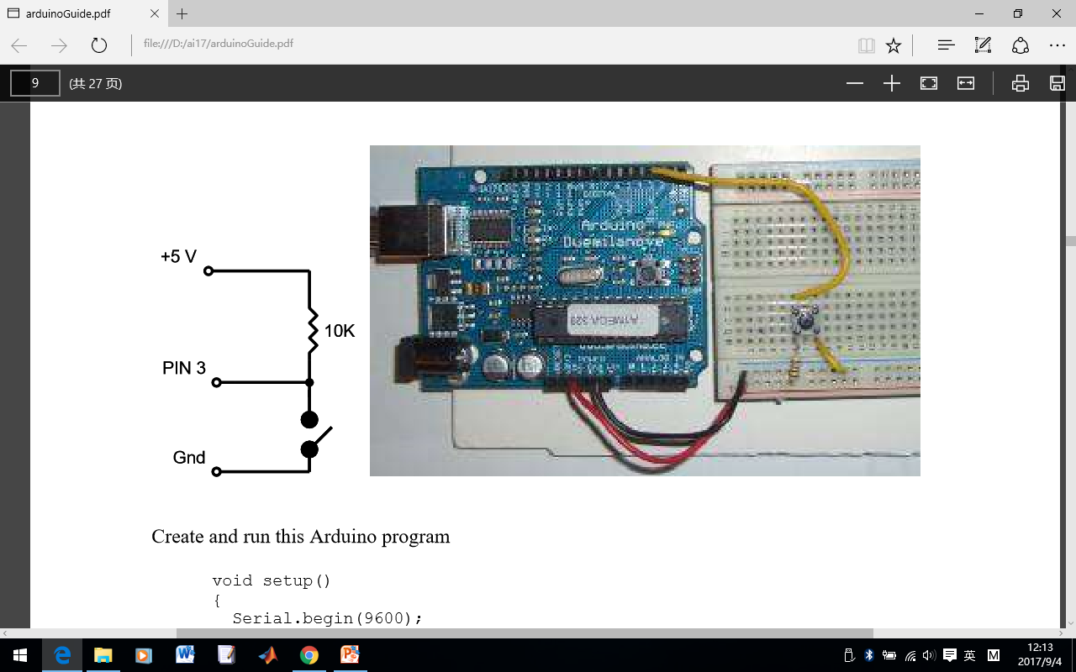
Reading a switch
The LED exercise shows how the Arduino can control the outside world. Many applications require reading the state of sensors, including switches.
For this exercise, the Arduino will read the state of a normally-open push button switch and display the results on the PC using the serial.println() command. You will need a switch, a 10 kohm resistor and some pieces of hookup wire. If you don't have a switch, substitute two wires and manually connect their free ends to simulate a switch closure.

Slide 38
Reading a switch
void setup()
{
Serial.begin(9600);
}
void loop() { Serial.println(digitalRead(3));
delay(250);
}

Slide 39
Reading a switch
void setup()
{ Serial.begin(9600);
}
void loop()
{ while (digitalRead(3) == HIGH) ;
Serial.println("Somebody closed the switch!");
while (digitalRead(3) == LOW) ;
Serial.println("The switch is now open!");
}

Slide 40
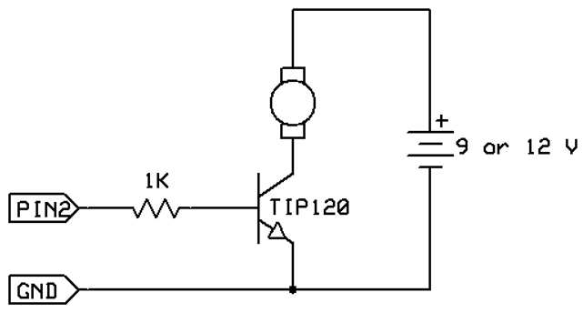
Controlling a Small DC Motor
The Arduino can control a small DC motor through a transistor switch. You will need a TIP120 transistor, a 1K resistor a 9V battery with battery snap and a motor.

Slide 41
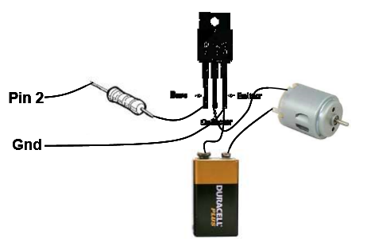
Controlling a Small DC Motor
Pin 2 can be any digital I/O pin on your Arduino. Connect the minus of the battery to the emitter of the transistor (E pin) and also connect the emitter of the transistor to Gnd on the Arduino board.

Slide 42
Controlling a Small DC Motor
To check if things are working, take a jumper wire and short the collector to the emitter pins of the transistor. The motor should turn on. Next, disconnect the 1K resistor from pin 2 and jumper it to +5V. The motor should turn on. Put the resistor back into pin 2 and run the following test program:

Slide 43
Controlling a Small DC Motor
void setup()
{ pinMode(2,OUTPUT);
digitalWrite(2,HIGH);
delay(1000);
digitalWrite(2,LOW);
}
void loop()
{}
The motor should turn on for 1 second.

Slide 44
Arduino Hardware
The power of the Arduino is not its ability to crunch code, but rather its ability to interact with the outside world through its input-output (I/O) pins. The Arduino has 14 digital I/O pins labeled 0 to 13 that can be used to turn motors and lights on and off and read the state of switches.

Slide 45
Arduino Hardware
Each digital pin can sink or source about 40 mA of current. This is more than adequate for interfacing to most devices, but does mean that interface circuits are needed to control devices other than simple LED's. In other words, you cannot run a motor directly using the current available from an Arduino pin, but rather must have the pin drive an interface circuit that in turn drives the motor. A later section of this document shows how to interface to a small motor.

Slide 46
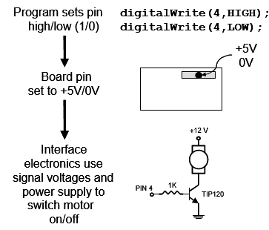
Arduino Hardware
To interact with the outside world, the program sets digital pins to a high or low value, which corresponds to +5 V or 0 V at the pin. The pin is connected to external interface electronics and then to the device being switched on and off.

Slide 47
Arduino Hardware
To determine the state of switches and other sensors, the Arduino is able to read the voltage value applied to its pins as a binary number. The interface circuitry translates the sensor signal into a 0 or +5 V signal applied to the digital I/O pin. Through a program command, the Ardiomp interrogates the state of the pin. If the pin is at 0 V, the program will read it as a 0 or LOW. If it is at +5 V, the program will read it as a 1 or HIGH. If more than +5 V is applied, you may blow out your board, so be careful.

Slide 48
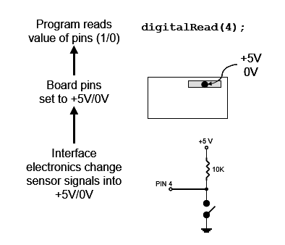
Arduino Hardware

Slide 49
Arduino Hardware
Interacting with the world has two sides. First, the designer must create electronic interface circuits that allow motors and other devices to be controlled by a low (1-10 mA) current signal that switches between 0 and 5 V, and other circuits that convert sensor readings into a switched 0 or 5 V signal. Second, the designer must write a program using the set of Arduino commands that set and read the I/O pins.

Slide 50
The Simple Commands
pinMode
This command, which goes in the setup() function, is used to set the direction of a digital I/O pin. Set the pin to OUTPUT if the pin is driving and LED, motor or other device. Set the pin to INPUT if the pin is reading a switch or other sensor. On power up or reset, all pins default to inputs. This example sets pin 2 to an output and pin 3 to an input.
void setup() {
pinMode(2,OUTPUT);
pinMode(3,INPUT);
}
void loop() {}

Slide 51
The Simple Commands
Serial.print
The Serial.print command lets you see what's going on inside the Arduino from your computer. For example, you can see the result of a math operation to determine if you are getting the right number. Or, you can see the state of a digital input pin to see if the Arduino is a sensor or switch properly. When your interface circuits or program does not seem to be working, use the Serial.print command to shed a little light on the situation. For this command to show anything, you need to have the Arduino connected to the host computer with the USB cable.

Slide 52
The Simple Commands
Serial.print
void setup()
{ Serial.begin(9600);
}
void loop() { Serial.println(digitalRead(2));
delay(100);
}

Slide 53
The Simple Commands
digitalWrite
This command sets an I/O pin high (+5V) or low (0V) and is the workhorse for commanding the outside world of lights, motors, and anything else interfaced to your board. Use the pinMode() command in the setup() function to set the pin to an output.
digitalWrite(2,HIGH); // sets pin 2 to +5 volts digitalWrite(2,LOW); // sets pin 2 to zero volts

Slide 54
The Simple Commands
delay
Delay pauses the program for a specified number of milliseconds. Since most interactions with the world involve timing, this is an essential instruction. The delay can be for 0 to 4,294,967,295 msec. This code snippet turn on pin 2 for 1 second.
digitalWrite(2,HIGH); // pin 2 high (LED on) delay(1000); // wait 1000 ms digitalWrite(2,LOW); // pin 2 low (LED off)

Slide 55
functions
Functions are a powerful programming feature that are used when you want to set up an action that can be called from several places in the program. For example, let's say you wanted an LED connected to pin 2 to flash 3 times as an alert, but that you needed to execute the alert at three different places in the program. One solution would be to type in the flashing code at the three separate program locations. This uses up precious code space and also means that if you change the flash function, for example changing from 3 flashes to 4, you have to change the code in three places. A better solution is to write the flash function as a subroutine and to call it from the main body of the code.

Slide 56
int i;
void setup()
{ pinMode(2,OUTPUT);
Serial.begin(9600);
Serial.println("Welcome to my program");
delay(1000);
flasher(); // call flasher function
Serial.println("I hope you like flashing");
delay(1000);
flasher(); // call flasher again
}
void loop() {}
void flasher()
{ for(i=0;i<3;i++) {
digitalWrite(2,HIGH);
delay(250);
digitalWrite(2,LOW);
delay(250);
} }

Slide 57
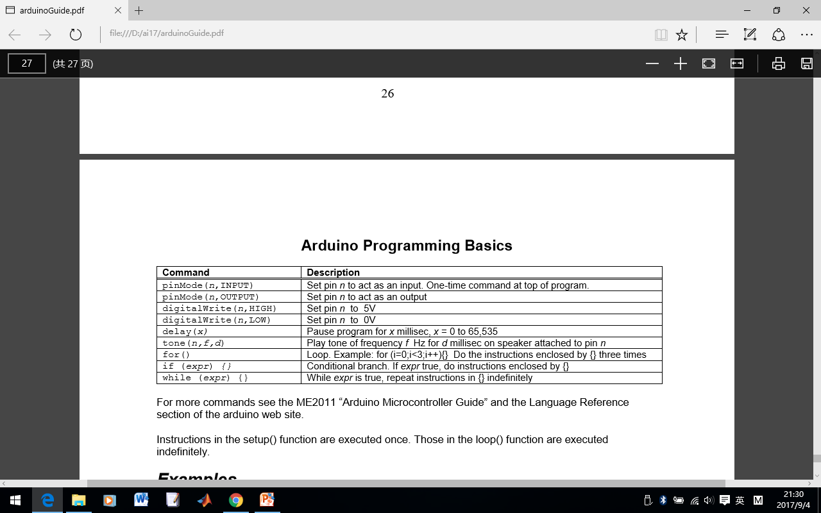
Arduino Programming Basics

Slide 58
Examples - 1
Turn on LED connected to Pin 2 for 1 s.
void setup()
{ pinMode(2,OUTPUT);
digitalWrite(2,HIGH);
delay(1000);
digitalWrite(2,LOW);
}
void loop() {}

Slide 59
Examples - 2
Flash LED connected to Pin 2 at 1 Hz forever.
void setup()
{ pinMode(2,OUTPUT);
}
void loop()
{ digitalWrite(2,HIGH);
delay(500);
digitalWrite(2,LOW);
delay(500);
}

Slide 60
Examples - 3
Turn on motor connected to Pin 4 for 1 s.
void setup()
{ pinMode(4,OUTPUT);
digitalWrite(4,HIGH);
delay(1000);
digitalWrite(4,LOW);
}
void loop()
{}

Slide 61
Examples - 4
Play 440 hz tone for one second on speaker connected to pin 5. Delay is needed because the program does not wait for the tone() command to finish but rather immediately goes to the command following tone().
void setup()
{ pinMode(5,OUTPUT);
tone(5,440,1000);
delay(1100);
}
void loop()
{}

Slide 62
Examples - 5
LED is on Pin 2 and switch is on Pin 6. Turns on the LED for one sec when switch is pressed
void setup()
{ pinMode(2,OUTPUT);
pinMode(6,INPUT);
while (digitalRead(6) == HIGH)
;
digitalWrite(2,HIGH);
delay(1000);
digitalWrite(2,LOW);
}
void loop()
{}

