Slide 1
Hands-On Machine Learning with Scikit-Learn and TensorFlow
Concepts, Tools, and Techniques to Build Intelligent Systems

Slide 2
CHAPTER 2
End-to-End Machine Learning Project
In this chapter, you will go through an example project end to end, pretending to be a recently hired data scientist in a real estate company.

Slide 3
CHAPTER 2
End-to-End Machine Learning Project
1. Look at the big picture.
2. Get the data.
3. Discover and visualize the data to gain insights.
4. Prepare the data for Machine Learning algorithms.
5. Select a model and train it.
6. Fine-tune your model.
7. Present your solution.
8. Launch, monitor, and maintain your system.

Slide 4
Dataset
we chose the California Housing Prices dataset from the StatLib repository. This dataset was based on data from the 1990 California census. It is not exactly recent, but it has many qualities for learning, so we will pretend it is recent data.
We also added a categorical attribute and removed a few features for teaching purposes.

Slide 5
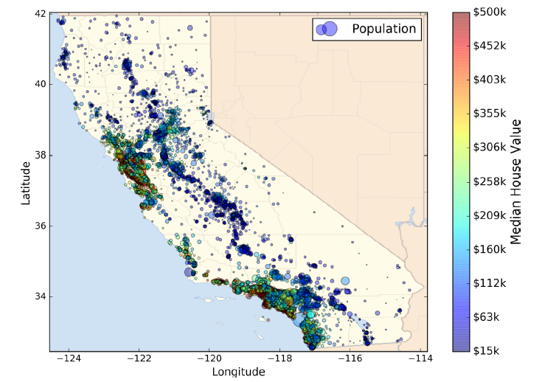
Dataset
we chose the California Housing Prices dataset from the StatLib repository. This dataset was based on data from the 1990 California census. It is not exactly recent, but it has many qualities for learning, so we will pretend it is recent data.
We also added a categorical attribute and removed a few features for teaching purposes.

Slide 6
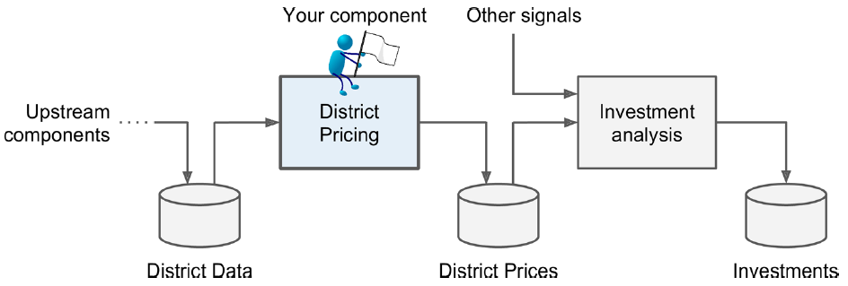
Frame the Problem

Slide 7
Frame the Problem
It is clearly a typical supervised learning task since you are given labeled training examples.
Moreover, it is also a typical regression task, since you are asked to predict a value. More specifically, this is a multivariate regression problem since the system will use multiple features to make a prediction.
Finally, there is no continuous flow of data coming in the system, there is no particular need to adjust to changing data rapidly, and the data is small enough to fit in memory, so plain batch learning should do just fine.

Slide 8
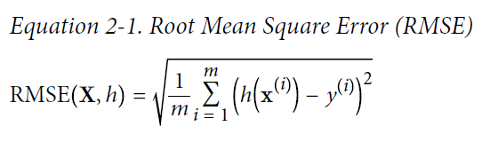
Select a Performance Measure
A typical performance measure for regression problems is the Root Mean Square Error (RMSE). It measures the standard deviation4 of the errors the system makes in its predictions.

Slide 9
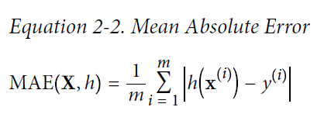
Select a Performance Measure
In some contexts you may prefer to use another function. For example, suppose that there are many outlier districts. In that case, you may consider using the Mean Absolute Error.

Slide 10

Select a Performance Measure
Computing the root of a sum of squares (RMSE) corresponds to the Euclidian norm: it is the notion of distance you are familiar with. It is also called the ℓ2 norm, noted || ・||₂ (or just ||・||).
Computing the sum of absolutes (MAE) corresponds to the ℓ1 norm, noted ||・||₁. It is sometimes called the Manhattan norm because it measures the distance between two points in a city if you can only travel along orthogonal city blocks.
More generally, the ℓk norm of a vector v containing n elements is defined as
ℓ0 just gives the cardinality of the vector (i.e., the number of elements), and ℓ∞ gives the maximum absolute value in the vector.
The higher the norm index, the more it focuses on large values and neglects small ones. This is why the RMSE is more sensitive to outliers than the MAE. But when outliers are exponentially rare (like in a bell-shaped curve), the RMSE performs very well and is generally preferred.

Slide 11
Get data
import os
import tarfile
from six.moves import urllib
DOWNLOAD_ROOT = "https://raw.githubusercontent.com/ageron/handson-ml/master/"
HOUSING_PATH = "datasets/housing"
HOUSING_URL = DOWNLOAD_ROOT + HOUSING_PATH + "/housing.tgz“
def fetch_housing_data(housing_url=HOUSING_URL, housing_path=HOUSING_PATH):
if not os.path.isdir(housing_path):
os.makedirs(housing_path)
tgz_path = os.path.join(housing_path, "housing.tgz")
urllib.request.urlretrieve(housing_url, tgz_path)
housing_tgz = tarfile.open(tgz_path)
housing_tgz.extractall(path=housing_path)
housing_tgz.close()

Slide 12
Load data
import pandas as pd
def load_housing_data(housing_path=HOUSING_PATH):
csv_path = os.path.join(housing_path, "housing.csv")
return pd.read_csv(csv_path)

Slide 13
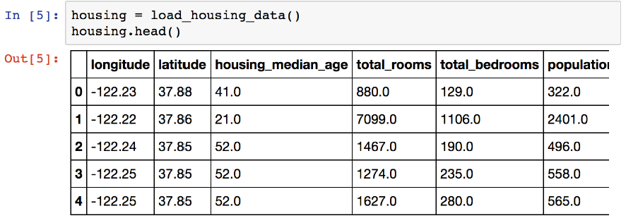
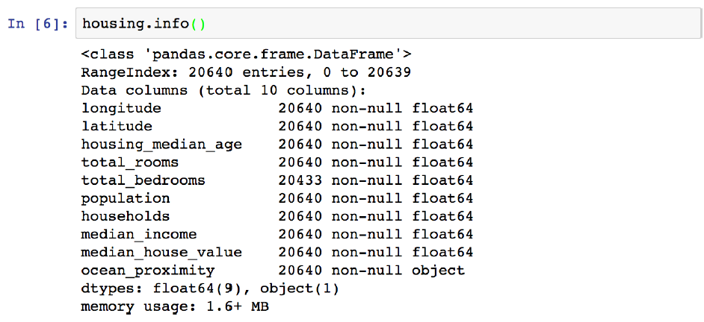

Slide 14
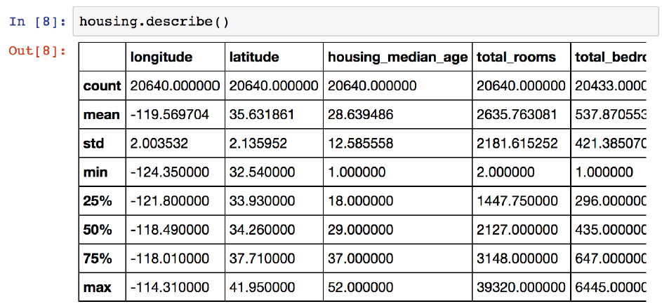

Slide 15
Show data
%matplotlib inline # only in a Jupyter notebook
import matplotlib.pyplot as plt
housing.hist(bins=50, figsize=(20,15))
plt.show()

Slide 16
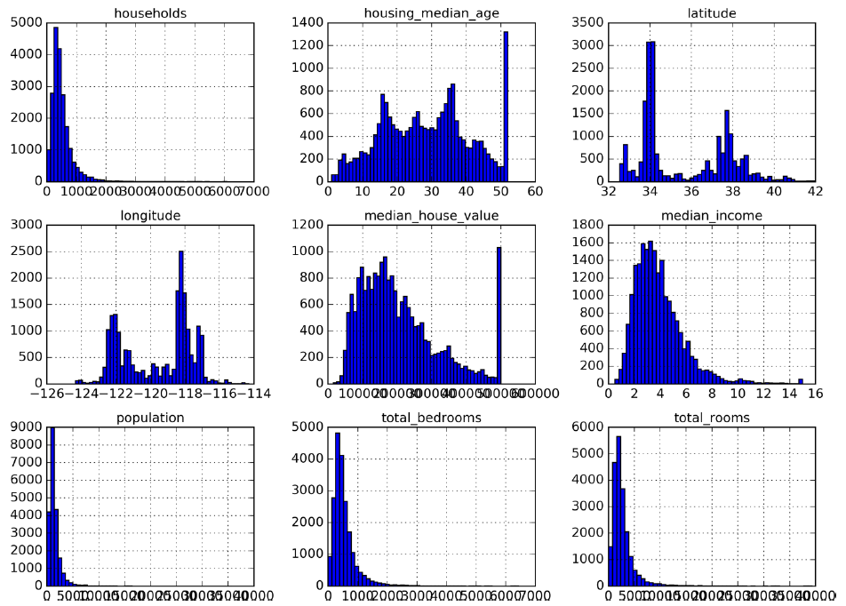
Show data
%matplotlib inline # only in a Jupyter notebook
import matplotlib.pyplot as plt
housing.hist(bins=50, figsize=(20,15))
plt.show()

Slide 17
Create a Test Set
import numpy as np
def split_train_test(data, test_ratio):
shuffled_indices = np.random.permutation(len(data))
test_set_size = int(len(data) * test_ratio)
test_indices = shuffled_indices[:test_set_size]
train_indices = shuffled_indices[test_set_size:]
return data.iloc[train_indices], data.iloc[test_indices]

Slide 18
Create a Test Set
import hashlib
def test_set_check(identifier, test_ratio, hash):
return hash(np.int64(identifier)).digest()[-1] < 256 * test_ratio
def split_train_test_by_id(data, test_ratio, id_column, hash=hashlib.md5):
ids = data[id_column]
in_test_set = ids.apply(lambda id_: test_set_check(id_, test_ratio, hash))
return data.loc[~in_test_set], data.loc[in_test_set]

Slide 19
Create a Test Set
So far we have considered purely random sampling methods. This is generally fine if your dataset is large enough (especially relative to the number of attributes), but if it is not, you run the risk of introducing a significant sampling bias. When a survey company decides to call 1,000 people to ask them a few questions, they don’t just pick 1,000 people randomly in a phone booth. They try to ensure that these 1,000 people are representative of the whole population.

Slide 20
Create a Test Set
For example, the US population is composed of 51.3% female and 48.7% male, so a well-conducted survey in the US would try to maintain this ratio in the sample: 513 female and 487 male. This is called stratified sampling: the population is divided into homogeneous subgroups called strata, and the right number of instances is sampled from each stratum to guarantee that the test set is representative of the overall population.

Slide 21
Create a Test Set
Suppose you chatted with experts who told you that the median income is a very important attribute to predict median housing prices. You may want to ensure that the test set is representative of the various categories of incomes in the whole dataset. Since the median income is a continuous numerical attribute, you first need to create an income category attribute. Let’s look at the median income histogram more closely.

Slide 22
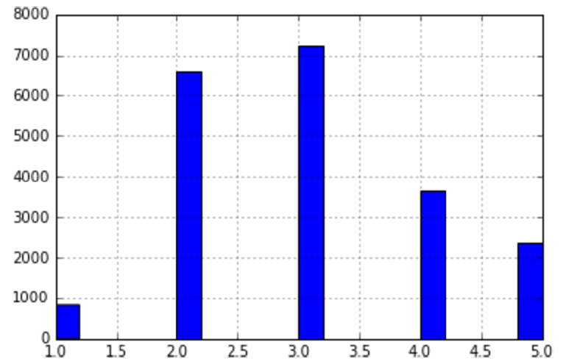
Create a Test Set
Suppose you chatted with experts who told you that the median income is a very important attribute to predict median housing prices. You may want to ensure that the test set is representative of the various categories of incomes in the whole dataset. Since the median income is a continuous numerical attribute, you first need to create an income category attribute. Let’s look at the median income histogram more closely.

Slide 23
Create a Test Set
The following code creates an income category attribute by dividing the median income by 1.5 (to limit the number of income categories), and rounding up using ceil (to have discrete categories), and then merging all the categories greater than 5 into category 5:
housing["income_cat"] = np.ceil(housing["median_income"] / 1.5)
housing["income_cat"].where(housing["income_cat"] > 5, 5.0, inplace=True)

Slide 24
Create a Test Set
Now you are ready to do stratified sampling based on the income category. For this you can use Scikit-Learn’s StratifiedShuffleSplit class:
from sklearn.model_selection import StratifiedShuffleSplit
split = StratifiedShuffleSplit(n_splits=1, test_size=0.2, random_state=42)
for train_index, test_index in split.split(housing, housing["income_cat"]):
strat_train_set = housing.loc[train_index]
strat_test_set = housing.loc[test_index]

Slide 25
Create a Test Set
>>> housing["income_cat"].value_counts() / len(housing)
3.0 0.350581
2.0 0.318847
4.0 0.176308
5.0 0.114438
1.0 0.039826
Name: income_cat, dtype: float64

Slide 26
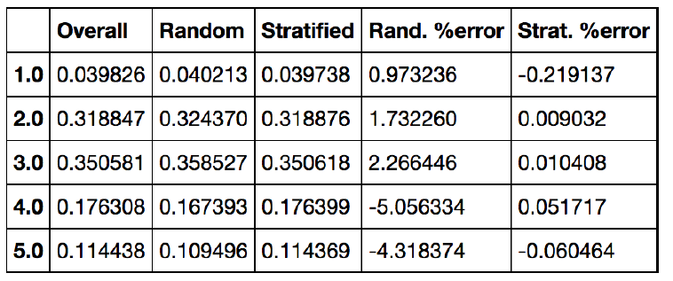
Create a Test Set
>>> housing["income_cat"].value_counts() / len(housing)
3.0 0.350581
2.0 0.318847
4.0 0.176308
5.0 0.114438
1.0 0.039826
Name: income_cat, dtype: float64

Slide 27
Discover and Visualize the data
First, make sure you have put the test set aside and you are only exploring the training set. Also, if the training set is very large, you may want to sample an exploration set, to make manipulations easy and fast. In our case, the set is quite small so you can just work directly on the full set. Let’s create a copy so you can play with it without harming the training set:
housing = strat_train_set.copy()

Slide 28
Visualizing Geographical Data
Since there is geographical information (latitude and longitude), it is a good idea to create a scatterplot of all districts to visualize the data.
housing.plot(kind="scatter", x="longitude", y="latitude")

Slide 29
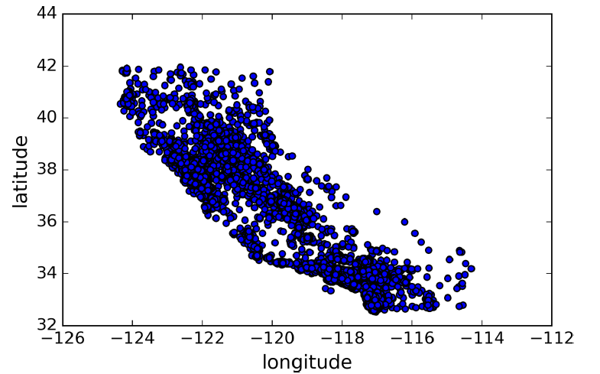
Visualizing Geographical Data
Since there is geographical information (latitude and longitude), it is a good idea to create a scatterplot of all districts to visualize the data.
housing.plot(kind="scatter", x="longitude", y="latitude")

Slide 30
Visualizing Geographical Data
Setting the alpha option to 0.1 makes it much easier to visualize the places where there is a high density of data points.
housing.plot(kind="scatter", x="longitude", y="latitude", alpha=0.1)

Slide 31
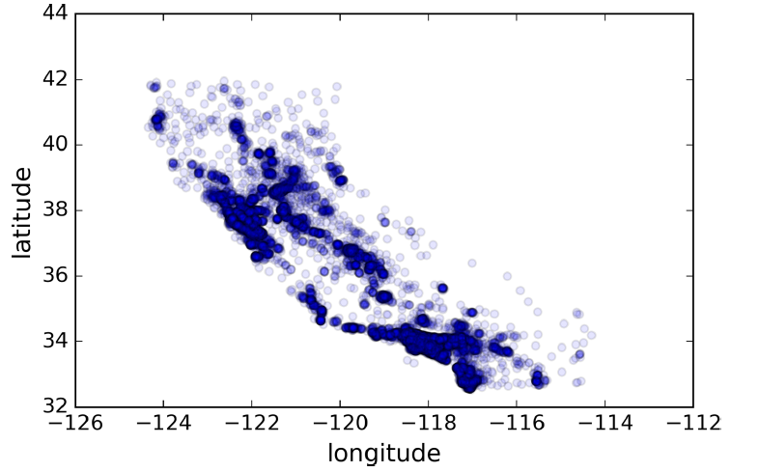
Visualizing Geographical Data
Setting the alpha option to 0.1 makes it much easier to visualize the places where there is a high density of data points.
housing.plot(kind="scatter", x="longitude", y="latitude", alpha=0.1)

Slide 32
Visualizing Geographical Data
Now let’s look at the housing prices. The radius of each circle represents the district’s population (option s), and the color represents the price (option c). We will use a predefined color map (option cmap) called jet, which ranges from blue (low values) to red (high prices):
housing.plot(kind="scatter", x="longitude", y="latitude", alpha=0.4,
s=housing["population"]/100, label="population",
c="median_house_value", cmap=plt.get_cmap("jet"), colorbar=True,
)
plt.legend()

Slide 33
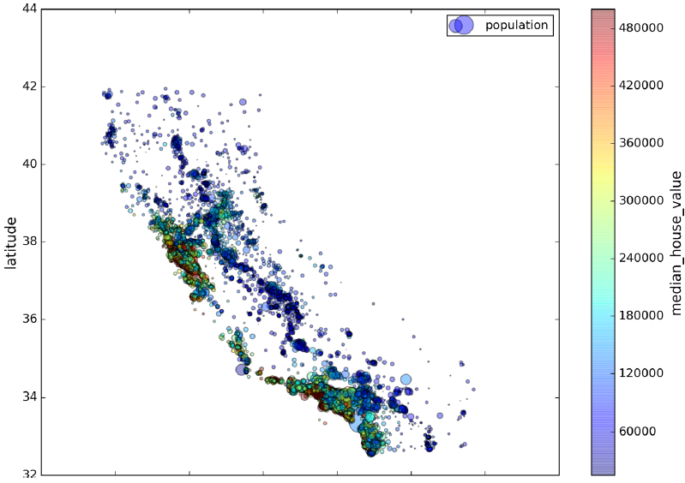
Visualizing Geographical Data
Now let’s look at the housing prices. The radius of each circle represents the district’s population (option s), and the color represents the price (option c). We will use a predefined color map (option cmap) called jet, which ranges from blue (low values) to red (high prices):
housing.plot(kind="scatter", x="longitude", y="latitude", alpha=0.4,
s=housing["population"]/100, label="population",
c="median_house_value", cmap=plt.get_cmap("jet"), colorbar=True,
)
plt.legend()

Slide 34
Looking for Correlations
Since the dataset is not too large, you can easily compute the standard correlation coefficient (also called Pearson’s r) between every pair of attributes using the corr() method:
corr_matrix = housing.corr()

Slide 35
Looking for Correlations
>>> corr_matrix["median_house_value"].sort_values(ascending=False)
median_house_value 1.000000
median_income 0.687170
total_rooms 0.135231
housing_median_age 0.114220
households 0.064702
total_bedrooms 0.047865
population -0.026699
longitude -0.047279
latitude -0.142826
Name: median_house_value, dtype: float64

Slide 36
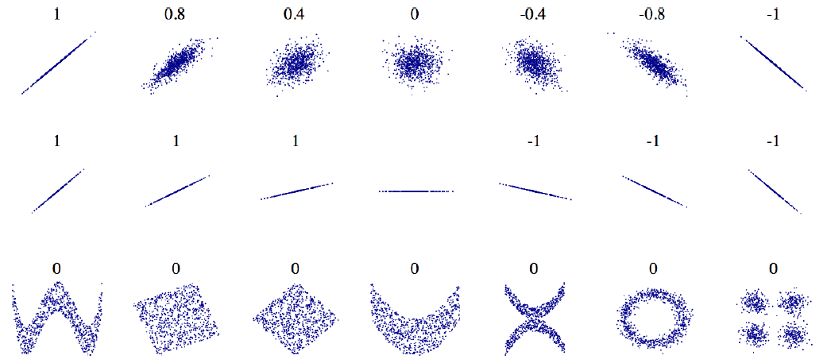
Looking for Correlations
Standard correlation coefficient of various datasets

Slide 37
Looking for Correlations
Another way to check for correlation between attributes is to use Pandas’ scatter_matrix function, which plots every numerical attribute against every other numerical attribute.
from pandas.tools.plotting import scatter_matrix
attributes = ["median_house_value", "median_income", "total_rooms",
"housing_median_age"]
scatter_matrix(housing[attributes], figsize=(12, 8))

Slide 38
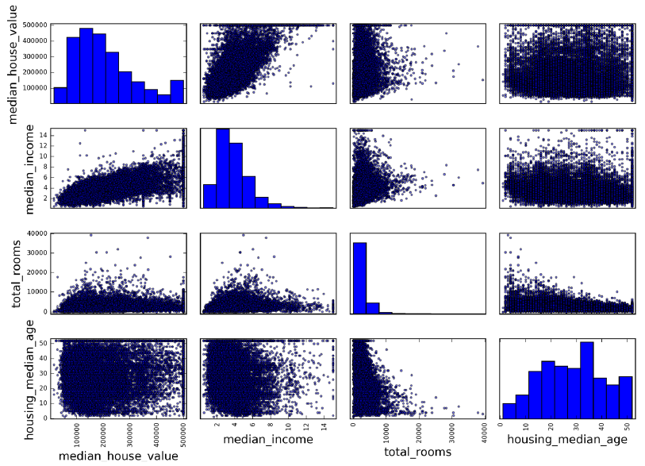
Looking for Correlations
Another way to check for correlation between attributes is to use Pandas’ scatter_matrix function, which plots every numerical attribute against every other numerical attribute.
from pandas.tools.plotting import scatter_matrix
attributes = ["median_house_value", "median_income", "total_rooms",
"housing_median_age"]
scatter_matrix(housing[attributes], figsize=(12, 8))

Slide 39
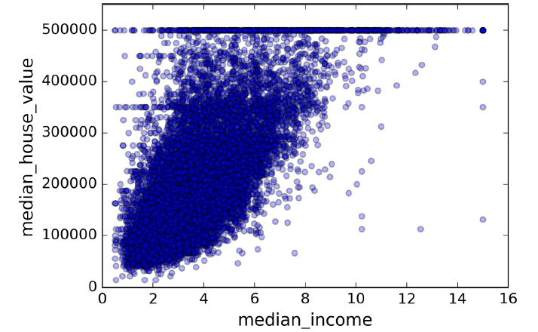
housing.plot(kind="scatter", x="median_income", y="median_house_value",
alpha=0.1)

Slide 40
Experimenting with Attribute Combinations
One last thing is to try out various attribute combinations. For example, the total number of rooms in a district is not very useful if you don’t know how many households there are. What you really want is the number of rooms per household. Similarly, the total number of bedrooms by itself is not very useful: you probably want to compare it to the number of rooms. And the population per household also seems like an interesting attribute combination to look at. Let’s create these new attributes:

Slide 41
housing["rooms_per_household"] = housing["total_rooms"]/housing["households"]
housing["bedrooms_per_room"] = housing["total_bedrooms"]/housing["total_rooms"]
housing["population_per_household"]=housing["population"]/housing["households"]
>>> corr_matrix = housing.corr()
>>> corr_matrix["median_house_value"].sort_values(ascending=False)
median_house_value 1.000000
median_income 0.687170
rooms_per_household 0.199343
total_rooms 0.135231
housing_median_age 0.114220
households 0.064702
total_bedrooms 0.047865
population_per_household -0.021984
population -0.026699
longitude -0.047279
latitude -0.142826
bedrooms_per_room -0.260070
Name: median_house_value, dtype: float64

Slide 42
Prepare the Data for Machine Learning Algorithms
housing = strat_train_set.drop("median_house_value", axis=1)
housing_labels = strat_train_set["median_house_value"].copy()
housing.dropna(subset=["total_bedrooms"]) # option 1
housing.drop("total_bedrooms", axis=1) # option 2
median = housing["total_bedrooms"].median()
housing["total_bedrooms"].fillna(median) # option 3
from sklearn.preprocessing import Imputer
imputer = Imputer(strategy="median")
housing_num = housing.drop("ocean_proximity", axis=1)
imputer.fit(housing_num)

Slide 43
Prepare the Data for Machine Learning Algorithms
>>> imputer.statistics_
array([ -118.51 , 34.26 , 29. , 2119. , 433. , 1164. , 408. , 3.5414])
>>> housing_num.median().values
array([ -118.51 , 34.26 , 29. , 2119. , 433. , 1164. , 408. , 3.5414])
X = imputer.transform(housing_num)
housing_tr = pd.DataFrame(X, columns=housing_num.columns)

Slide 44
Handling Text and Categorical Attributes
Earlier we left out the categorical attribute ocean_proximity because it is a text attribute so we cannot compute its median. Most Machine Learning algorithms prefer to work with numbers anyway, so let’s convert these text labels to numbers.
>>> from sklearn.preprocessing import LabelEncoder
>>> encoder = LabelEncoder()
>>> housing_cat = housing["ocean_proximity"]
>>> housing_cat_encoded = encoder.fit_transform(housing_cat)
>>> housing_cat_encoded
array([1, 1, 4, ..., 1, 0, 3])

Slide 45
Handling Text and Categorical Attributes
>>> print(encoder.classes_)
['<1H OCEAN' 'INLAND' 'ISLAND' 'NEAR BAY' 'NEAR OCEAN']
One issue with this representation is that ML algorithms will assume that two nearby values are more similar than two distant values. To fix this issue, a common solution is to create one binary attribute per category: one attribute equal to 1 when the category is “<1H OCEAN” (and 0 otherwise), another attribute equal to 1 when the category is “INLAND” (and 0 otherwise), and so on. This is called one-hot encoding.

Slide 46
Handling Text and Categorical Attributes
Scikit-Learn provides a OneHotEncoder encoder to convert integer categorical values into one-hot vectors. Let’s encode the categories as one-hot vectors. Note that fit_transform() expects a 2D array, but housing_cat_encoded is a 1D array, so we need to reshape it:
>>> from sklearn.preprocessing import OneHotEncoder
>>> encoder = OneHotEncoder()
>>> housing_cat_1hot = encoder.fit_transform(housing_cat_encoded.reshape(-1,1))
>>> housing_cat_1hot
<16513x5 sparse matrix of type '<class 'numpy.float64'>'
with 16513 stored elements in Compressed Sparse Row format>

Slide 47
Handling Text and Categorical Attributes
After onehot encoding we get a matrix with thousands of columns, and the matrix is full of zeros except for one 1 per row. Using up tons of memory mostly to store zeros would be very wasteful, so instead a sparse matrix only stores the location of the nonzero elements. You can use it mostly like a normal 2D array, but if you really want to convert it to a (dense) NumPy array, just call the toarray() method:
>>> housing_cat_1hot.toarray()
array([[ 0., 1., 0., 0., 0.],
[ 0., 1., 0., 0., 0.],
[ 0., 0., 0., 0., 1.],
...,
[ 0., 1., 0., 0., 0.], …

Slide 48
Handling Text and Categorical Attributes
We can apply both transformations (from text categories to integer categories, then from integer categories to one-hot vectors) in one shot using the LabelBinarizer class:
>>> from sklearn.preprocessing import LabelBinarizer
>>> encoder = LabelBinarizer()
>>> housing_cat_1hot = encoder.fit_transform(housing_cat)
>>> housing_cat_1hot
array([[0, 1, 0, 0, 0],
[0, 1, 0, 0, 0],
[0, 0, 0, 0, 1],
...,

Slide 49
Custom Transformers
from sklearn.base import BaseEstimator, TransformerMixin
rooms_ix, bedrooms_ix, population_ix, household_ix = 3, 4, 5, 6
class CombinedAttributesAdder(BaseEstimator, TransformerMixin):
def __init__(self, add_bedrooms_per_room = True): # no *args or **kargs
self.add_bedrooms_per_room = add_bedrooms_per_room
def fit(self, X, y=None):
return self # nothing else to do
def transform(self, X, y=None):
rooms_per_household = X[:, rooms_ix] / X[:, household_ix]
population_per_household = X[:, population_ix] / X[:, household_ix]
if self.add_bedrooms_per_room:
bedrooms_per_room = X[:, bedrooms_ix] / X[:, rooms_ix]
return np.c_[X, rooms_per_household, population_per_household, bedrooms_per_room]
else:
return np.c_[X, rooms_per_household, population_per_household]
attr_adder = CombinedAttributesAdder(add_bedrooms_per_room=False)
housing_extra_attribs = attr_adder.transform(housing.values)

Slide 50
Feature Scaling
One of the most important transformations you need to apply to your data is feature scaling. With few exceptions, Machine Learning algorithms don’t perform well when the input numerical attributes have very different scales. This is the case for the housing data: the total number of rooms ranges from about 6 to 39,320, while the median incomes only range from 0 to 15. Note that scaling the target values is generally not required.
There are two common ways to get all attributes to have the same scale: min-max scaling (normalization) and standardization.

Slide 51
Transformation Pipelines
As you can see, there are many data transformation steps that need to be executed in the right order. Fortunately, Scikit-Learn provides the Pipeline class to help with such sequences of transformations. Here is a small pipeline for the numerical attributes:
from sklearn.pipeline import Pipeline
from sklearn.preprocessing import StandardScaler
num_pipeline = Pipeline([
('imputer', Imputer(strategy="median")),
('attribs_adder', CombinedAttributesAdder()),
('std_scaler', StandardScaler()),])
housing_num_tr = num_pipeline.fit_transform(housing_num)

Slide 52
Transformation Pipelines
from sklearn.pipeline import FeatureUnion
num_attribs = list(housing_num)
cat_attribs = ["ocean_proximity"]
num_pipeline = Pipeline([
('selector', DataFrameSelector(num_attribs)),
('imputer', Imputer(strategy="median")),
('attribs_adder', CombinedAttributesAdder()),
('std_scaler', StandardScaler()), ])
cat_pipeline = Pipeline([
('selector', DataFrameSelector(cat_attribs)),
('label_binarizer', LabelBinarizer()), ])
full_pipeline = FeatureUnion(transformer_list=[
("num_pipeline", num_pipeline),
("cat_pipeline", cat_pipeline), ])

Slide 53
Transformation Pipelines
>>> housing_prepared = full_pipeline.fit_transform(housing)
>>> housing_prepared
array([[ 0.73225807, -0.67331551, 0.58426443, ..., 0. ,
0. , 0. ],
[-0.99102923, 1.63234656, -0.92655887, ..., 0. ,
0. , 0. ],
[...]
>>> housing_prepared.shape
(16513, 17)

Slide 54
Transformation Pipelines
Each subpipeline starts with a selector transformer: it simply transforms the data by selecting the desired attributes (numerical or categorical), dropping the rest, and converting the resulting DataFrame to a NumPy array. There is nothing in Scikit-Learn to handle Pandas DataFrames, so we need to write a simple custom transformer for this task:
from sklearn.base import BaseEstimator, TransformerMixin
class DataFrameSelector(BaseEstimator, TransformerMixin):
def __init__(self, attribute_names):
self.attribute_names = attribute_names
def fit(self, X, y=None):
return self
def transform(self, X):
return X[self.attribute_names].values

Slide 55
Select and Train a Model
Let’s first train a Linear Regression model:
from sklearn.linear_model import LinearRegression
lin_reg = LinearRegression()
lin_reg.fit(housing_prepared, housing_labels)
Let’s try it out on a few instances from the training set:
>>> some_data = housing.iloc[:5]
>>> some_labels = housing_labels.iloc[:5]
>>> some_data_prepared = full_pipeline.transform(some_data)
>>> print("Predictions:\t", lin_reg.predict(some_data_prepared))
Predictions: [ 303104. 44800. 308928. 294208. 368704.]
>>> print("Labels:\t\t", list(some_labels))
Labels: [359400.0, 69700.0, 302100.0, 301300.0, 351900.0]

Slide 56
Select and Train a Model
Let’s measure this regression model’s RMSE on the whole training set using Scikit-Learn’s mean_squared_error function:
>>> from sklearn.metrics import mean_squared_error
>>> housing_predictions = lin_reg.predict(housing_prepared)
>>> lin_mse = mean_squared_error(housing_labels, housing_predictions)
>>> lin_rmse = np.sqrt(lin_mse)
>>> lin_rmse
68628.413493824875

Slide 57
Select and Train a Model
Let’s train a DecisionTreeRegressor. This is a powerful model, capable of finding complex nonlinear relationships in the data. The code should look familiar by now:
from sklearn.tree import DecisionTreeRegressor
tree_reg = DecisionTreeRegressor()
tree_reg.fit(housing_prepared, housing_labels)
Now that the model is trained, let’s evaluate it on the training set:
>>> housing_predictions = tree_reg.predict(housing_prepared)
>>> tree_mse = mean_squared_error(housing_labels, housing_predictions)
>>> tree_rmse = np.sqrt(tree_mse)
>>> tree_rmse
0.0

Slide 58
Better Evaluation Using Cross-Validation
One way to evaluate the Decision Tree model would be to use the train_test_split function to split the training set into a smaller training set and a validation set, then train your models against the smaller training set and evaluate them against the validation set. It’s a bit of work, but nothing too difficult and it would work fairly well.
A great alternative is to use Scikit-Learn’s cross-validation feature. The following code performs K-fold cross-validation: it randomly splits the training set into 10 distinct subsets called folds, then it trains and evaluates the Decision Tree model 10 times, picking a different fold for evaluation every time and training on the other 9 folds. The result is an array containing the 10 evaluation scores:

Slide 59
Better Evaluation Using Cross-Validation
from sklearn.model_selection import cross_val_score
scores = cross_val_score(tree_reg, housing_prepared, housing_labels,
scoring="neg_mean_squared_error", cv=10)
rmse_scores = np.sqrt(-scores)
Let’s look at the results:
>>> def display_scores(scores):
... print("Scores:", scores)
... print("Mean:", scores.mean())
... print("Standard deviation:", scores.std())
>>> display_scores(tree_rmse_scores)
Scores: [ 74678.4916885 64766.2398337 69632.86942005 …
Mean: 71199.4280043
Standard deviation: 3202.70522793

Slide 60
Better Evaluation Using Cross-Validation
Let’s compute the same scores for the Linear Regression model just to be sure:
>>> lin_scores = cross_val_score(lin_reg, housing_prepared, housing_labels,
... scoring="neg_mean_squared_error", cv=10)
...
>>> lin_rmse_scores = np.sqrt(-lin_scores)
>>> display_scores(lin_rmse_scores)
Scores: [ 70423.5893262 65804.84913139 66620.84314068 …
Mean: 68972.377566
Standard deviation: 2493.98819069
That’s right: the Decision Tree model is overfitting so badly that it performs worse than the Linear Regression model.

Slide 61
Better Evaluation Using Cross-Validation
Let’s try one last model now: the RandomForestRegressor. Random Forests work by training many Decision Trees on random subsets of the features, then averaging out their predictions. Building a model on top of many other models is called Ensemble Learning, and it is often a great way to push ML algorithms even further.
>>> from sklearn.ensemble import RandomForestRegressor
>>> forest_reg = RandomForestRegressor()
>>> forest_reg.fit(housing_prepared, housing_labels)
>>> [...]
>>> forest_rmse
22542.396440343684
>>> display_scores(forest_rmse_scores)
Scores: [ 53789.2879722 50256.19806622 52521.55342602 …
Mean: 52634.1919593
Standard deviation: 1576.20472269

Slide 62
Better Evaluation Using Cross-Validation
The score on the training set is still much lower than on the validation sets, meaning that the model is still overfitting the training set.
Possible solutions for overfitting are to simplify the model, constrain it (i.e., regularize it), or get a lot more training data. However, before you dive much deeper in Random Forests, you should try out many other models from various categories of Machine Learning algorithms (several Support Vector Machines with different kernels, possibly a neural network, etc.), without spending too much time tweaking the hyperparameters. The goal is to shortlist a few (two to five) promising models.

Slide 63
Fine-Tune Your Model - Grid Search
One way to do that would be to fiddle with the hyperparameters manually, until you find a great combination of hyperparameter values. This would be very tedious work, and you may not have time to explore many combinations.
Instead you should get Scikit-Learn’s GridSearchCV to search for you. All you need to do is tell it which hyperparameters you want it to experiment with, and what values to try out, and it will evaluate all the possible combinations of hyperparameter values, using cross-validation. For example, the following code searches for the best combination of hyperparameter values for the RandomForestRegressor:

Slide 64
Fine-Tune Your Model - Grid Search
from sklearn.model_selection import GridSearchCV
param_grid = [
{'n_estimators': [3, 10, 30], 'max_features': [2, 4, 6, 8]},
{'bootstrap': [False], 'n_estimators': [3, 10], 'max_features': [2, 3, 4]},
]
forest_reg = RandomForestRegressor()
grid_search = GridSearchCV(forest_reg, param_grid, cv=5,
scoring='neg_mean_squared_error')
grid_search.fit(housing_prepared, housing_labels)

Slide 65
Fine-Tune Your Model - Grid Search
This param_grid tells Scikit-Learn to first evaluate all 3 × 4 = 12 combinations of n_estimators and max_features hyperparameter values specified in the first dict, then try all 2 × 3 = 6 combinations of hyperparameter values in the second dict, but this time with the bootstrap hyperparameter set to False instead of True (which is the default value for this hyperparameter).
All in all, the grid search will explore 12 + 6 = 18 combinations of RandomForestRe gressor hyperparameter values, and it will train each model five times (since we are using five-fold cross validation). In other words, all in all, there will be 18 × 5 = 90 rounds of training! It may take quite a long time, but when it is done you can get the best combination of parameters like this:

Slide 66
Fine-Tune Your Model - Grid Search
>>> grid_search.best_params_
{'max_features': 6, 'n_estimators': 30}
>>> grid_search.best_estimator_
RandomForestRegressor(bootstrap=True, criterion='mse', max_depth=None,
max_features=6, max_leaf_nodes=None, min_samples_leaf=1,
min_samples_split=2, min_weight_fraction_leaf=0.0,
n_estimators=30, n_jobs=1, oob_score=False, random_state=None,
verbose=0, warm_start=False)

Slide 67
Fine-Tune Your Model - Grid Search
>>> cvres = grid_search.cv_results_
... for mean_score, params in zip(cvres["mean_test_score"], cvres["params"]):
... print(np.sqrt(-mean_score), params)
...
64912.0351358 {'max_features': 2, 'n_estimators': 3}
55535.2786524 {'max_features': 2, 'n_estimators': 10}
52940.2696165 {'max_features': 2, 'n_estimators': 30}
60384.0908354 {'max_features': 4, 'n_estimators': 3}
52709.9199934 {'max_features': 4, 'n_estimators': 10}
50503.5985321 {'max_features': 4, 'n_estimators': 30}
…
62371.1221202 {'bootstrap': False, 'max_features': 2, 'n_estimators': 3}
54572.2557534 {'bootstrap': False, 'max_features': 2, 'n_estimators': 10}
59634.0533132 {'bootstrap': False, 'max_features': 3, 'n_estimators': 3}
52456.0883904 {'bootstrap': False, 'max_features': 3, 'n_estimators': 10}
58825.665239 {'bootstrap': False, 'max_features': 4, 'n_estimators': 3}
52012.9945396 {'bootstrap': False, 'max_features': 4, 'n_estimators': 10}

Slide 68
Fine-Tune Your Model - Randomized Search
The grid search approach is fine when you are exploring relatively few combinations, like in the previous example, but when the hyperparameter search space is large, it is often preferable to use RandomizedSearchCV instead. This class can be used in much the same way as the GridSearchCV class, but instead of trying out all possible combinations, it evaluates a given number of random combinations by selecting a random value for each hyperparameter at every iteration. This approach has two main benefits:
If you let the randomized search run for, say, 1,000 iterations, this approach will explore 1,000 different values for each hyperparameter (instead of just a few values per hyperparameter with the grid search approach).
You have more control over the computing budget you want to allocate to hyperparameter search, simply by setting the number of iterations.

Slide 69
Fine-Tune Your Model - Ensemble Methods
Another way to fine-tune your system is to try to combine the models that perform best. The group (or “ensemble”) will often perform better than the best individual model (just like Random Forests perform better than the individual Decision Trees they rely on), especially if the individual models make very different types of errors.

Slide 70
Analyze the Best Models and Their Errors
You will often gain good insights on the problem by inspecting the best models. For example, the RandomForestRegressor can indicate the relative importance of each attribute for making accurate predictions:
>>> feature_importances = grid_search.best_estimator_.feature_importances_
>>> feature_importances
array([ 7.14156423e-02, 6.76139189e-02, 4.44260894e-02,
1.66308583e-02, 1.66076861e-02, 1.82402545e-02,
…
1.53344918e-01, 8.41308969e-05, 2.68483884e-03,
3.46681181e-03])

Slide 71
Analyze the Best Models and Their Errors
Let’s display these importance scores next to their corresponding attribute names:
>>> extra_attribs = ["rooms_per_hhold", "pop_per_hhold", "bedrooms_per_room"]
>>> cat_one_hot_attribs = list(encoder.classes_)
>>> attributes = num_attribs + extra_attribs + cat_one_hot_attribs
>>> sorted(zip(feature_importances, attributes), reverse=True)
[(0.32649798665134971, 'median_income'),
(0.15334491760305854, 'INLAND'),
(0.11305529021187399, 'pop_per_hhold'),
…
(8.4130896890070617e-05, 'ISLAND')]

Slide 72
Evaluate Your System on the Test Set
After tweaking your models for a while, you eventually have a system that performs sufficiently well. Now is the time to evaluate the final model on the test set. There is nothing special about this process; just get the predictors and the labels from your test set, run your full_pipeline to transform the data (call transform(), not fit_transform()!), and evaluate the final model on the test set:

Slide 73
Evaluate Your System on the Test Set
final_model = grid_search.best_estimator_
X_test = strat_test_set.drop("median_house_value", axis=1)
y_test = strat_test_set["median_house_value"].copy()
X_test_prepared = full_pipeline.transform(X_test)
final_predictions = final_model.predict(X_test_prepared)
final_mse = mean_squared_error(y_test, final_predictions)
final_rmse = np.sqrt(final_mse) # => evaluates to 48,209.6

Slide 74
Evaluate Your System on the Test Set
The performance will usually be slightly worse than what you measured using crossvalidation if you did a lot of hyperparameter tuning (because your system ends up fine-tuned to perform well on the validation data, and will likely not perform as well on unknown datasets). It is not the case in this example, but when this happens you must resist the temptation to tweak the hyperparameters to make the numbers look good on the test set; the improvements would be unlikely to generalize to new data.

Slide 75
Launch, Monitor, and Maintain Your System
Perfect, you got approval to launch! You need to get your solution ready for production, in particular by plugging the production input data sources into your system and writing tests.
You also need to write monitoring code to check your system’s live performance at regular intervals and trigger alerts when it drops. This is important to catch not only sudden breakage, but also performance degradation. This is quite common because models tend to “rot” as data evolves over time, unless the models are regularly trained on fresh data.

Slide 76
Launch, Monitor, and Maintain Your System
you will generally want to train your models on a regular basis using fresh data. You should automate this process as much as possible. If you don’t, you are very likely to refresh your model only every six months (at best), and your system’s performance may fluctuate severely over time.
If your system is an online learning system, you should make sure you save snapshots of its state at regular intervals so you can easily roll back to a previously working state.

