Slide 1
Hands-On Machine Learning with Scikit-Learn and TensorFlow
Concepts, Tools, and Techniques to Build Intelligent Systems

Slide 2
CHAPTER 4
Training Models
Understanding what’s under the hood will also help you debug issues and perform error analysis more efficiently. In this chapter, we will start by looking at the Linear Regression model, one of the simplest models there is. We will discuss two very different ways to train it:
Using a direct “closed-form” equation that directly computes the model parameters that best fit the model to the training set.
Using an iterative optimization approach, called Gradient Descent (GD), that gradually tweaks the model parameters to minimize the cost function over the training set, eventually converging to the same set of parameters as the first method. We will look at Batch GD, Mini-batch GD, and Stochastic GD.

Slide 3
CHAPTER 4
Training Models
Next we will look at Polynomial Regression, a more complex model that can fit nonlinear datasets. Since this model has more parameters than Linear Regression, it is more prone to overfitting the training data, so we will look at how to detect whether or not this is the case, using learning curves, and then we will look at several regularization techniques that can reduce the risk of overfitting the training set.
Finally, we will look at two more models that are commonly used for classification tasks: Logistic Regression and Softmax Regression.

Slide 4
Linear Regression
a linear model makes a prediction by simply computing a weighted sum of the input features, plus a constant called the bias term (also called the intercept term), as shown in Equation 4-1.
Equation 4-1. Linear Regression model prediction
ŷ = θ0 + θ1x1 + θ2x2 + ⋯ + θnxn
ŷ is the predicted value.
n is the number of features.
xi is the ith feature value.
θj is the jth model parameter (including the bias term θ0 and the feature weights θ1, θ2, ⋯, θn).

Slide 5
Linear Regression
This can be written much more concisely using a vectorized form, as shown in Equation 4-2.
Equation 4-2. Linear Regression model (vectorized form)
ŷ = h_{θ}(x) = θ^{T} ・ x
• θ is the model’s parameter vector, containing the bias term θ0 and the feature weights θ1 to θn.
• θ^{T} is the transpose of θ (a row vector instead of a column vector).
• x is the instance’s feature vector, containing x0 to xn, with x0 always equal to 1.
• θ^{T} ・ x is the dot product of θ^{T} and x.
• h_{θ} is the hypothesis function, using the model parameters θ.

Slide 6

Linear Regression
The MSE of a Linear Regression hypothesis hθ on a training set X is calculated using Equation 4-3.
Equation 4-3. MSE cost function for a Linear Regression model

Slide 7

The Normal Equation
To find the value of θ that minimizes the cost function, there is a closed-form solution —in other words, a mathematical equation that gives the result directly. This is called the Normal Equation .
Equation 4-4. Normal Equation

Slide 8
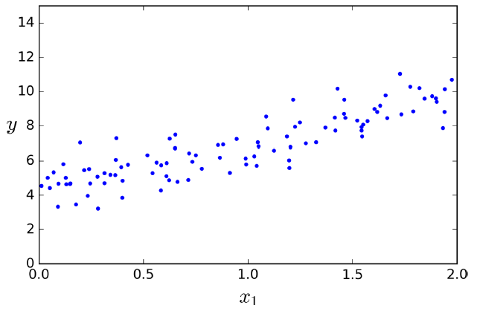
The Normal Equation
import numpy as np
X = 2 * np.random.rand(100, 1)
y = 4 + 3 * X + np.random.randn(100, 1)

Slide 9
The Normal Equation
Now let’s compute θ using the Normal Equation. We will use the inv() function from NumPy’s Linear Algebra module (np.linalg) to compute the inverse of a matrix, and the dot() method for matrix multiplication:
X_b = np.c_[np.ones((100, 1)), X] # add x0 = 1 to each instance
theta_best = np.linalg.inv(X_b.T.dot(X_b)).dot(X_b.T).dot(y)
The actual function that we used to generate the data is y = 4 + 3x0 + Gaussian noise. Let’s see what the equation found:
>>> theta_best
array([[ 4.21509616],
[ 2.77011339]])

Slide 10
The Normal Equation
Now you can make predictions using θ:
>>> X_new = np.array([[0], [2]])
>>> X_new_b = np.c_[np.ones((2, 1)), X_new] # add x0 = 1 to each instance
>>> y_predict = X_new_b.dot(theta_best)
>>> y_predict
array([[ 4.21509616],
[ 9.75532293]])
Let’s plot this model’s predictions (Figure 4-2):
plt.plot(X_new, y_predict, "r-")
plt.plot(X, y, "b.")
plt.axis([0, 2, 0, 15])
plt.show()

Slide 11
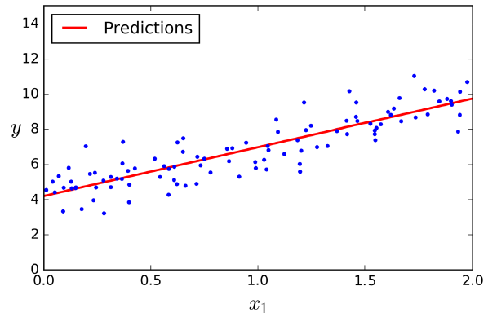
The Normal Equation
Now you can make predictions using θ:
>>> X_new = np.array([[0], [2]])
>>> X_new_b = np.c_[np.ones((2, 1)), X_new] # add x0 = 1 to each instance
>>> y_predict = X_new_b.dot(theta_best)
>>> y_predict
array([[ 4.21509616],
[ 9.75532293]])
Let’s plot this model’s predictions (Figure 4-2):
plt.plot(X_new, y_predict, "r-")
plt.plot(X, y, "b.")
plt.axis([0, 2, 0, 15])
plt.show()

Slide 12
The Normal Equation
The equivalent code using Scikit-Learn looks like this:
>>> from sklearn.linear_model import LinearRegression
>>> lin_reg = LinearRegression()
>>> lin_reg.fit(X, y)
>>> lin_reg.intercept_, lin_reg.coef_
(array([ 4.21509616]), array([[ 2.77011339]]))
>>> lin_reg.predict(X_new)
array([[ 4.21509616],
[ 9.75532293]])

Slide 13
Computational Complexity
The Normal Equation computes the inverse of XT ・ X, which is an n × n matrix (where n is the number of features). The computational complexity of inverting such a matrix is typically about O(n2.4) to O(n3) (depending on the implementation). In other words, if you double the number of features, you multiply the computation time by roughly 22.4 = 5.3 to 23 = 8.
On the positive side, this equation is linear with regards to the number of instances in the training set (it is O(m)), so it handles large training sets efficiently, provided they can fit in memory.

Slide 14
Computational Complexity
Also, once you have trained your Linear Regression model (using the Normal Equation or any other algorithm), predictions are very fast: the computational complexity is linear with regards to both the number of instances you want to make predictions on and the number of features. In other words, making predictions on twice as many instances (or twice as many features) will just take roughly twice as much time.
Now we will look at very different ways to train a Linear Regression model, better suited for cases where there are a large number of features, or too many training instances to fit in memory.

Slide 15
Gradient Descent
Gradient Descent is a very generic optimization algorithm capable of finding optimal solutions to a wide range of problems. The general idea of Gradient Descent is to tweak parameters iteratively in order to minimize a cost function.
Suppose you are lost in the mountains in a dense fog; you can only feel the slope of the ground. A good strategy to get to the bottom of the valley quickly is to go downhill in the direction of the steepest slope. This is exactly what Gradient Descent does: it measures the local gradient of the error function with regards to the parameter vector θ, and it goes in the direction of descending gradient. Once the gradient is zero, you have reached a minimum!

Slide 16
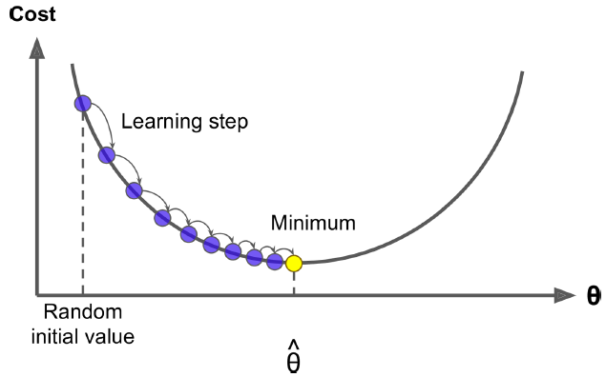
Gradient Descent
Concretely, you start by filling θ with random values (this is called random initialization), and then you improve it gradually, taking one baby step at a time, attempting to decrease the cost function (e.g., MSE), until the algorithm converges.

Slide 17
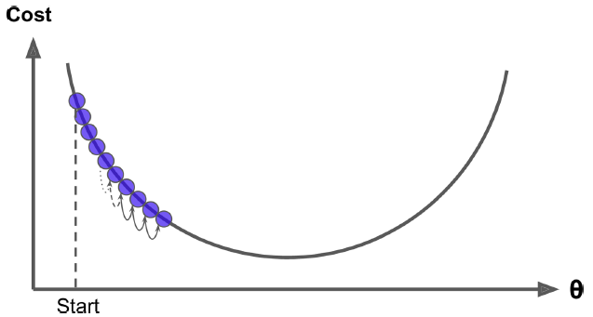
Gradient Descent
An important parameter in Gradient Descent is the size of the steps, determined by the learning rate hyperparameter. If the learning rate is too small, then the algorithm will have to go through many iterations to converge, which will take a long time.

Slide 18
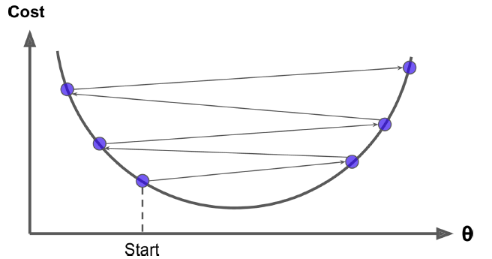
Gradient Descent
On the other hand, if the learning rate is too high, you might jump across the valley and end up on the other side, possibly even higher up than you were before. This might make the algorithm diverge, with larger and larger values, failing to find a good solution.

Slide 19
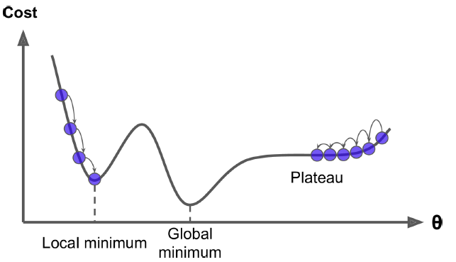
Gradient Descent
Finally, there may be holes, ridges, making convergence to the minimum very difficult. If it starts on the left, then it will converge to a local minimum. If it starts on the right, then it will take a very long time to cross the plateau, and if you stop too early you will never reach the global minimum.

Slide 20
Gradient Descent
Fortunately, the MSE cost function for a Linear Regression model happens to be a convex function, which means that if you pick any two points on the curve, the line segment joining them never crosses the curve. This implies that there are no local minima, just one global minimum. It is also a continuous function with a slope that never changes abruptly.4 These two facts have a great consequence: Gradient Descent is guaranteed to approach arbitrarily close the global minimum (if you wait long enough and if the learning rate is not too high).

Slide 21
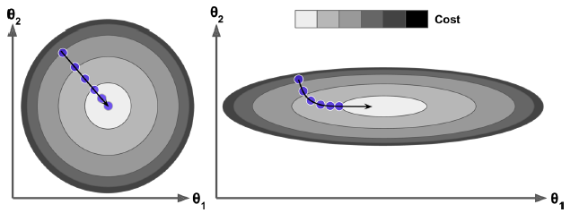
Gradient Descent
In fact, the cost function has the shape of a bowl, but it can be an elongated bowl if the features have very different scales. Figure 4-7 shows Gradient Descent on a training set where features 1 and 2 have the same scale (on the left), and on a training set where feature 1 has much smaller values than feature 2 (on the right).

Slide 22
Gradient Descent
Training a model means searching for a combination of model parameters that minimizes a cost function (over the training set). It is a search in the model’s parameter space: the more parameters a model has, the more dimensions this space has, and the harder the search is: searching for a needle in a 300-dimensional haystack is much trickier than in three dimensions. Fortunately, since the cost function is convex in the case of Linear Regression, the needle is simply at the bottom of the bowl.

Slide 23
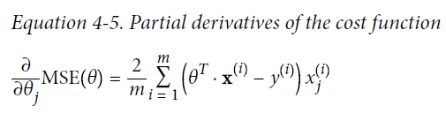
Batch Gradient Descent
To implement Gradient Descent, you need to compute the gradient of the cost function with regards to each model parameter θj. In other words, you need to calculate how much the cost function will change if you change θj just a little bit. This is called a partial derivative. It is like asking “what is the slope of the mountain under my feet if I face east?” and then asking the same question facing north (and so on for all other dimensions, if you can imagine a universe with more than three dimensions).

Slide 24
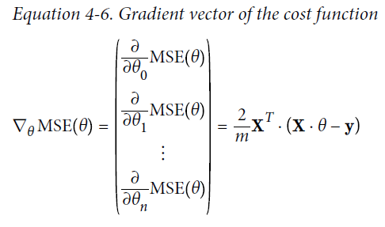
Batch Gradient Descent
Instead of computing these gradients individually, you can use Equation 4-6 to compute them all in one go. The gradient vector, noted ∇_{θ}MSE(θ), contains all the partial
derivatives of the cost function (one for each model parameter).

Slide 25
Batch Gradient Descent
Notice that this formula involves calculations over the full training set X, at each Gradient Descent step! This is why the algorithm is called Batch Gradient Descent: it uses the whole batch of training data at every step. As a result it is terribly slow on very large training sets. However, Gradient Descent scales well with the number of features; training a Linear Regression model when there are hundreds of thousands of features is much faster using Gradient Descent than using the Normal Equation.

Slide 26
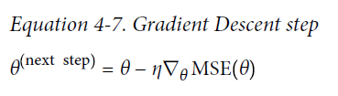
Batch Gradient Descent
Once you have the gradient vector, which points uphill, just go in the opposite direction to go downhill. This means subtracting ∇_{θ}MSE(θ) from θ. This is where the learning rate η comes into play:6 multiply the gradient vector by η to determine the size of the downhill step (Equation 4-7).

Slide 27
Batch Gradient Descent
eta = 0.1 # learning rate
n_iterations = 1000
m = 100
theta = np.random.randn(2,1) # random initialization
for iteration in range(n_iterations):
gradients = 2/m * X_b.T.dot(X_b.dot(theta) - y)
theta = theta - eta * gradients
>>> theta
array([[ 4.21509616],
[ 2.77011339]])

Slide 28
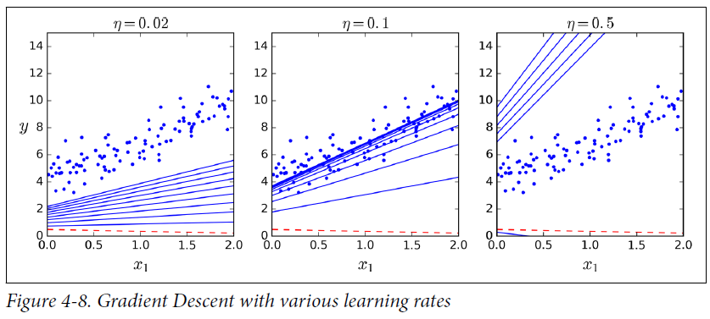
Batch Gradient Descent
what if you had used a different learning rate eta? Figure 4-8 shows the first 10 steps of Gradient Descent using three different learning rates (the dashed red line represents the starting point).

Slide 29
Convergence Rate
When the cost function is convex and its slope does not change abruptly (as is the case for the MSE cost function), it can be shown that Batch Gradient Descent with a fixed learning rate has a convergence rate of O (1/#iterations) . In other words, if you divide the tolerance ϵ by 10 (to have a more precise solution), then the algorithm will have to run about 10 times more iterations.

Slide 30
Stochastic Gradient Descent
The main problem with Batch Gradient Descent is the fact that it uses the whole training set to compute the gradients at every step, which makes it very slow when the training set is large. At the opposite extreme, Stochastic Gradient Descent just picks a random instance in the training set at every step and computes the gradients based only on that single instance.

Slide 31
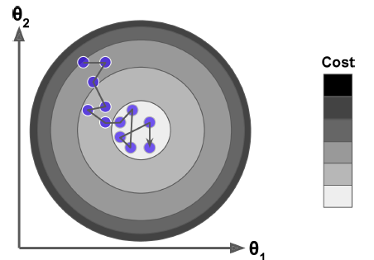
Stochastic Gradient Descent
On the other hand, due to its stochastic (i.e., random) nature, this algorithm is much less regular than Batch Gradient Descent: instead of gently decreasing until it reaches the minimum, the cost function will bounce up and down, decreasing only on average. Over time it will end up very close to the minimum, but once it gets there it will continue to bounce around, never settling down.

Slide 32
Stochastic Gradient Descent
Therefore randomness is good to escape from local optima, but bad because it means that the algorithm can never settle at the minimum. One solution to this dilemma is to gradually reduce the learning rate. The steps start out large (which helps make quick progress and escape local minima), then get smaller and smaller, allowing the algorithm to settle at the global minimum. This process is called simulated annealing, because it resembles the process of annealing in metallurgy where molten metal is slowly cooled down. The function that determines the learning rate at each iteration is called the learning schedule.

Slide 33
n_epochs = 50
t0, t1 = 5, 50 # learning schedule hyperparameters
def learning_schedule(t):
return t0 / (t + t1)
theta = np.random.randn(2,1) # random initialization
for epoch in range(n_epochs):
for i in range(m):
random_index = np.random.randint(m)
xi = X_b[random_index:random_index+1]
yi = y[random_index:random_index+1]
gradients = 2 * xi.T.dot(xi.dot(theta) - yi)
eta = learning_schedule(epoch * m + i)
theta = theta - eta * gradients
>>> theta
array([[ 4.21076011],
[ 2.74856079]])

Slide 34
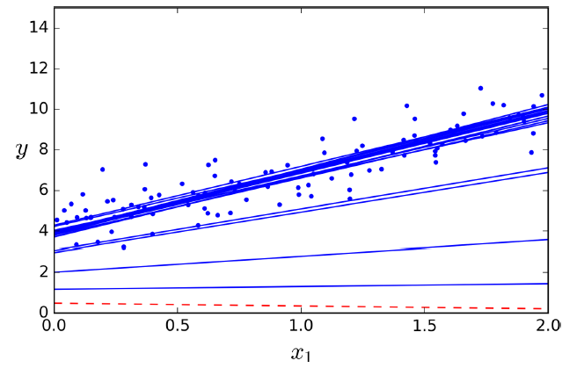

Slide 35
Stochastic Gradient Descent
To perform Linear Regression using SGD with Scikit-Learn, you can use the SGDRegressor class, which defaults to optimizing the squared error cost function.
from sklearn.linear_model import SGDRegressor
sgd_reg = SGDRegressor(n_iter=50, penalty=None, eta0=0.1)
sgd_reg.fit(X, y.ravel())
Once again, you find a solution very close to the one returned by the Normal Equation:
>>> sgd_reg.intercept_, sgd_reg.coef_
(array([ 4.18380366]), array([ 2.74205299]))

Slide 36
Mini-batch Gradient Descent
The last Gradient Descent algorithm we will look at is called Mini-batch Gradient Descent. It is quite simple to understand once you know Batch and Stochastic Gradient Descent: at each step, instead of computing the gradients based on the full training set (as in Batch GD) or based on just one instance (as in Stochastic GD), Mini-batch GD computes the gradients on small random sets of instances called mini-batches. The main advantage of Mini-batch GD over Stochastic GD is that you can get a performance boost from hardware optimization of matrix operations, especially when using GPUs.

Slide 37
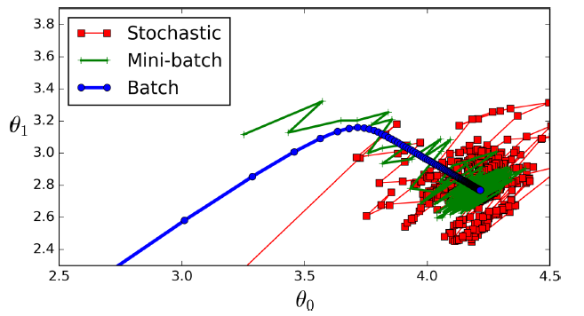
Mini-batch Gradient Descent
The algorithm’s progress in parameter space is less erratic than with SGD, especially with fairly large mini-batches. As a result, Mini-batch GD will end up walking around a bit closer to the minimum than SGD. But, on the other hand, it may be harder for it to escape from local minima.

Slide 38
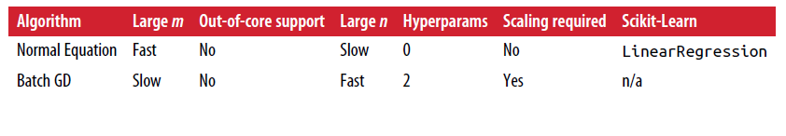
Mini-batch Gradient Descent
Table 4-1. Comparison of algorithms for Linear Regression

Slide 39
Polynomial Regression
What if your data is actually more complex than a simple straight line? Surprisingly, you can actually use a linear model to fit nonlinear data. A simple way to do this is to add powers of each feature as new features, then train a linear model on this extended set of features. This technique is called Polynomial Regression.

Slide 40
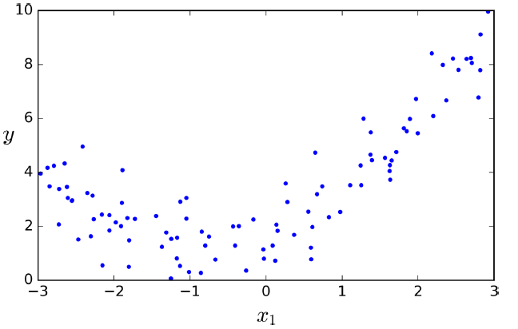
Polynomial Regression
m = 100
X = 6 * np.random.rand(m, 1) - 3
y = 0.5 * X**2 + X + 2 + np.random.randn(m, 1)

Slide 41
Polynomial Regression
So let’s use Scikit-Learn’s Poly nomialFeatures class to transform our training data, adding the square (2nd-degree polynomial) of each feature in the training set as new features (in this case there is just one feature):
>>> from sklearn.preprocessing import PolynomialFeatures
>>> poly_features = PolynomialFeatures(degree=2, include_bias=False)
>>> X_poly = poly_features.fit_transform(X)
>>> X[0]
array([-0.75275929])
>>> X_poly[0]
array([-0.75275929, 0.56664654])

Slide 42
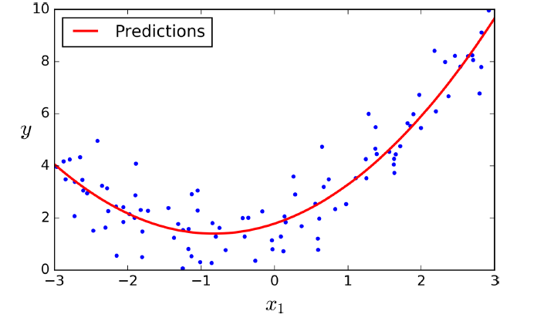
Polynomial Regression
>>> lin_reg = LinearRegression()
>>> lin_reg.fit(X_poly, y)
>>> lin_reg.intercept_, lin_reg.coef_
(array([ 1.78134581]), array([[ 0.93366893, 0.56456263]]))

Slide 43
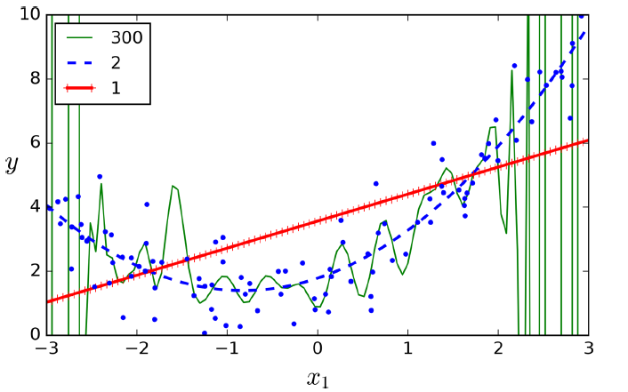
Learning Curves
>>> lin_reg = LinearRegression()
>>> lin_reg.fit(X_poly, y)
>>> lin_reg.intercept_, lin_reg.coef_
(array([ 1.78134581]), array([[ 0.93366893, 0.56456263]]))

Slide 44
Learning Curves
If a model performs well on the training data but generalizes poorly according to the cross-validation metrics, then your model is overfitting. If it performs poorly on both, then it is underfitting. This is one way to tell when a model is too simple or too complex.
Another way is to look at the learning curves: these are plots of the model’s performance on the training set and the validation set as a function of the training set size. To generate the plots, simply train the model several times on different sized subsets of the training set. The following code defines a function that plots the learning curves of a model given some training data:

Slide 45
Learning Curves
from sklearn.metrics import mean_squared_error
from sklearn.model_selection import train_test_split
def plot_learning_curves(model, X, y):
X_train, X_val, y_train, y_val = train_test_split(X, y, test_size=0.2)
train_errors, val_errors = [], []
for m in range(1, len(X_train)):
model.fit(X_train[:m], y_train[:m])
y_train_predict = model.predict(X_train[:m])
y_val_predict = model.predict(X_val)
train_errors.append(mean_squared_error(y_train_predict, y_train[:m]))
val_errors.append(mean_squared_error(y_val_predict, y_val))
plt.plot(np.sqrt(train_errors), "r-+", linewidth=2, label="train")
plt.plot(np.sqrt(val_errors), "b-", linewidth=3, label="val")

Slide 46
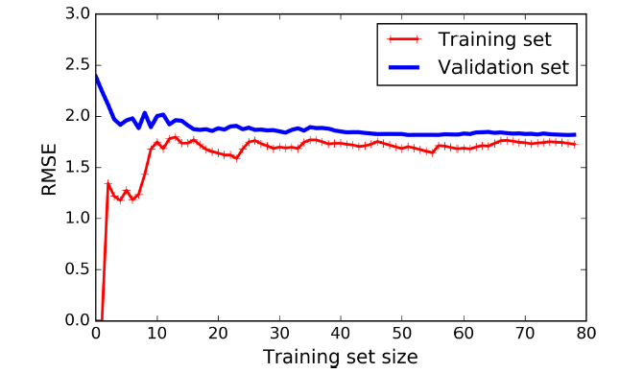
Learning Curves
lin_reg = LinearRegression()
plot_learning_curves(lin_reg, X, y)

Slide 47
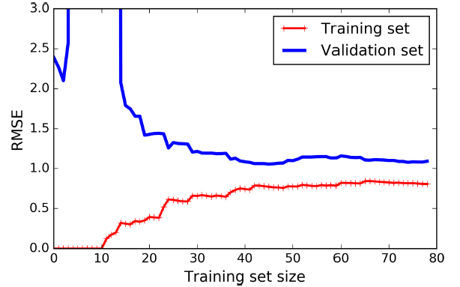
Learning Curves
from sklearn.pipeline import Pipeline
polynomial_regression = Pipeline((
("poly_features", PolynomialFeatures(degree=10, include_bias=False)),
("sgd_reg", LinearRegression()), ))
plot_learning_curves(polynomial_regression, X, y)

Slide 48
The Bias/Variance Tradeoff
An important theoretical result of statistics and Machine Learning is the fact that a model’s generalization error can be expressed as the sum of three very different errors:
Bias: This part of the generalization error is due to wrong assumptions, such as assuming that the data is linear when it is actually quadratic. A high-bias model is most likely to underfit the training data.
Variance: This part is due to the model’s excessive sensitivity to small variations in the training data. A model with many degrees of freedom (such as a high-degree polynomial model) is likely to have high variance, and thus to overfit the training data.
Irreducible error: This part is due to the noisiness of the data itself. The only way to reduce this part of the error is to clean up the data (e.g., fix the data sources, such as broken sensors, or detect and remove outliers).

Slide 49
Regularized Linear Models
a good way to reduce overfitting is to regularize the model (i.e., to constrain it): the fewer degrees of freedom it has, the harder it will be for it to overfit the data. For example, a simple way to regularize a polynomial model is to reduce the number of polynomial degrees.
For a linear model, regularization is typically achieved by constraining the weights of the model. We will now look at Ridge Regression, Lasso Regression, and Elastic Net, which implement three different ways to constrain the weights.

Slide 50

Ridge Regression
Ridge Regression (also called Tikhonov regularization) is a regularized version of Linear Regression: a regularization term equal to is added to the cost function. This forces the learning algorithm to not only fit the data but also keep the model weights as small as possible. Note that the regularization term should only be added to the cost function during training. Once the model is trained, you want to evaluate the model’s performance using the unregularized performance measure.

Slide 51
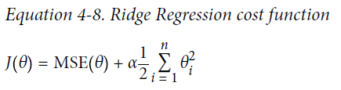
Ridge Regression
The hyperparameter α controls how much you want to regularize the model. If α = 0 then Ridge Regression is just Linear Regression. If α is very large, then all weights end up very close to zero and the result is a flat line going through the data’s mean. Equation 4-8 presents the Ridge Regression cost function.

Slide 52
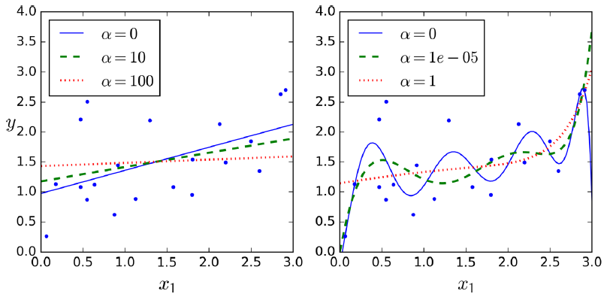
Ridge Regression
It is important to scale the data (e.g., using a StandardScaler) before performing Ridge Regression, as it is sensitive to the scale of the input features.

Slide 53
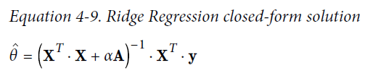
Ridge Regression
As with Linear Regression, we can perform Ridge Regression either by computing a closed-form equation or by performing Gradient Descent. The pros and cons are the same. Equation 4-9 shows the closed-form solution (where A is the n × n identity matrix13 except with a 0 in the top-left cell, corresponding to the bias term).

Slide 54
Ridge Regression
Here is how to perform Ridge Regression with Scikit-Learn using a closed-form solution (a variant of Equation 4-9 using a matrix factorization technique by Andre-Louis Cholesky):
>>> from sklearn.linear_model import Ridge
>>> ridge_reg = Ridge(alpha=1, solver="cholesky")
>>> ridge_reg.fit(X, y)
>>> ridge_reg.predict([[1.5]])
array([[ 1.55071465]])

Slide 55
Ridge Regression
And using Stochastic Gradient Descent:
>>> sgd_reg = SGDRegressor(penalty="l2")
>>> sgd_reg.fit(X, y.ravel())
>>> sgd_reg.predict([[1.5]])
array([[ 1.13500145]])
The penalty hyperparameter sets the type of regularization term to use. Specifying "l2" indicates that you want SGD to add a regularization term to the cost function equal to half the square of the ℓ2 norm of the weight vector: this is simply Ridge Regression.

Slide 56
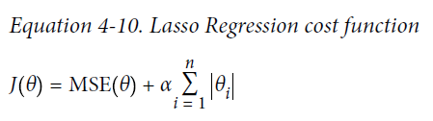
Lasso Regression
Least Absolute Shrinkage and Selection Operator Regression (simply called Lasso Regression) is another regularized version of Linear Regression: just like Ridge Regression, it adds a regularization term to the cost function, but it uses the ℓ1 norm of the weight vector instead of half the square of the ℓ2 norm (see Equation 4-10).

Slide 57
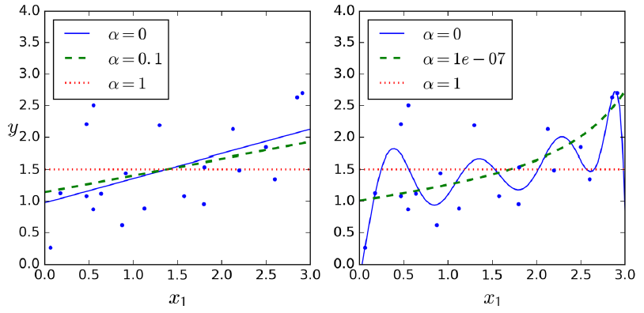
Lasso Regression
Least Absolute Shrinkage and Selection Operator Regression (simply called Lasso Regression) is another regularized version of Linear Regression: just like Ridge Regression, it adds a regularization term to the cost function, but it uses the ℓ1 norm of the weight vector instead of half the square of the ℓ2 norm (see Equation 4-10).

Slide 58
Lasso Regression
An important characteristic of Lasso Regression is that it tends to completely eliminate the weights of the least important features (i.e., set them to zero). For example, the dashed line in the right plot on Figure 4-18 (with α = 10-7) looks quadratic, almost linear: all the weights for the high-degree polynomial features are equal to zero. In other words, Lasso Regression automatically performs feature selection and outputs a sparse model (i.e., with few nonzero feature weights).

Slide 59
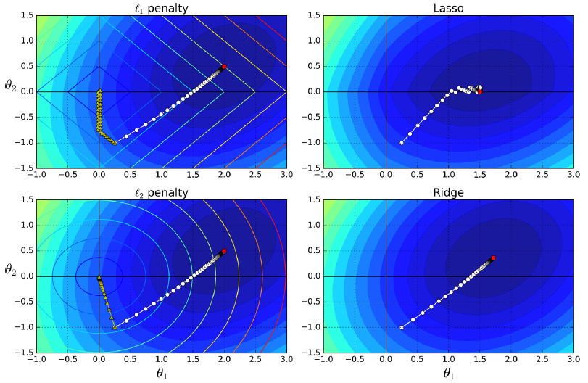
Lasso Regression
An important characteristic of Lasso Regression is that it tends to completely eliminate the weights of the least important features (i.e., set them to zero). For example, the dashed line in the right plot on Figure 4-18 (with α = 10-7) looks quadratic, almost linear: all the weights for the high-degree polynomial features are equal to zero. In other words, Lasso Regression automatically performs feature selection and outputs a sparse model (i.e., with few nonzero feature weights).

Slide 60
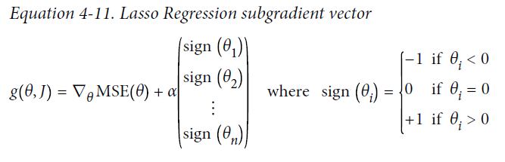
Lasso Regression
The Lasso cost function is not differentiable at θ_{i} = 0 (for i = 1, 2, ⋯, n), but Gradient Descent still works fine if you use a subgradient vector g instead when any θ_{i} = 0. Equation 4-11 shows a subgradient vector equation you can use for Gradient Descent with the Lasso cost function.

Slide 61
Lasso Regression
Here is a small Scikit-Learn example using the Lasso class. Note that you could instead use an SGDRegressor(penalty="l1").
>>> from sklearn.linear_model import Lasso
>>> lasso_reg = Lasso(alpha=0.1)
>>> lasso_reg.fit(X, y)
>>> lasso_reg.predict([[1.5]])
array([ 1.53788174])

Slide 62
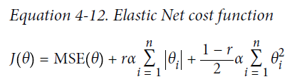
Elastic Net
Elastic Net is a middle ground between Ridge Regression and Lasso Regression. The regularization term is a simple mix of both Ridge and Lasso’s regularization terms, and you can control the mix ratio r. When r = 0, Elastic Net is equivalent to Ridge Regression, and when r = 1, it is equivalent to Lasso Regression (see Equation 4-12).

Slide 63
Elastic Net
So when should you use Linear Regression, Ridge, Lasso, or Elastic Net? It is almost always preferable to have at least a little bit of regularization, so generally you should avoid plain Linear Regression. Ridge is a good default, but if you suspect that only a few features are actually useful, you should prefer Lasso or Elastic Net since they tend to reduce the useless features’ weights down to zero as we have discussed. In general, Elastic Net is preferred over Lasso since Lasso may behave erratically when the number of features is greater than the number of training instances or when several features are strongly correlated.

Slide 64
Elastic Net
Here is a short example using Scikit-Learn’s ElasticNet (l1_ratio corresponds to the mix ratio r):
>>> from sklearn.linear_model import ElasticNet
>>> elastic_net = ElasticNet(alpha=0.1, l1_ratio=0.5)
>>> elastic_net.fit(X, y)
>>> elastic_net.predict([[1.5]])
array([ 1.54333232])

Slide 65
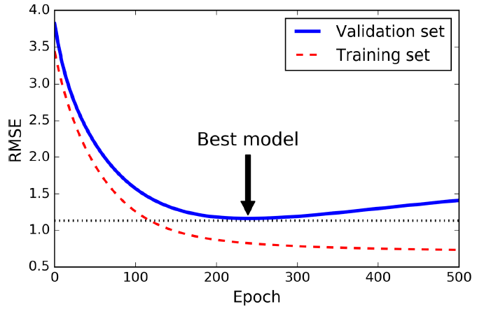
Early Stopping
A very different way to regularize iterative learning algorithms such as Gradient Descent is to stop training as soon as the validation error reaches a minimum. This is called early stopping.

Slide 66
Early Stopping
from sklearn.base import clone
sgd_reg = SGDRegressor(n_iter=1, warm_start=True, penalty=None,
learning_rate="constant", eta0=0.0005)
minimum_val_error = float("inf")
best_epoch = None
best_model = None
for epoch in range(1000):
sgd_reg.fit(X_train_poly_scaled, y_train) # continues where it left off
y_val_predict = sgd_reg.predict(X_val_poly_scaled)
val_error = mean_squared_error(y_val_predict, y_val)
if val_error < minimum_val_error:
minimum_val_error = val_error
best_epoch = epoch
best_model = clone(sgd_reg)

Slide 67
Logistic Regression
As we discussed in Chapter 1, some regression algorithms can be used for classification as well (and vice versa). Logistic Regression (also called Logit Regression) is commonly used to estimate the probability that an instance belongs to a particular class (e.g., what is the probability that this email is spam?). If the estimated probability is greater than 50%, then the model predicts that the instance belongs to that class (called the positive class, labeled “1”), or else it predicts that it does not (i.e., it belongs to the negative class, labeled “0”). This makes it a binary classifier.

Slide 68
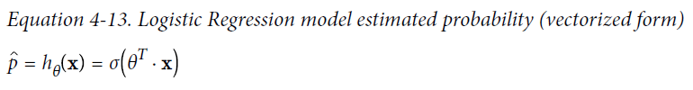
Estimating Probabilities
So how does it work? Just like a Linear Regression model, a Logistic Regression model computes a weighted sum of the input features (plus a bias term), but instead of outputting the result directly like the Linear Regression model does, it outputs the logistic of this result (see Equation 4-13).
The logistic—also called the logit, noted σ(・)—is a sigmoid function (i.e., S-shaped) that outputs a number between 0 and 1.

Slide 69
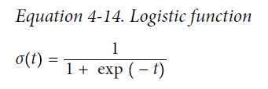
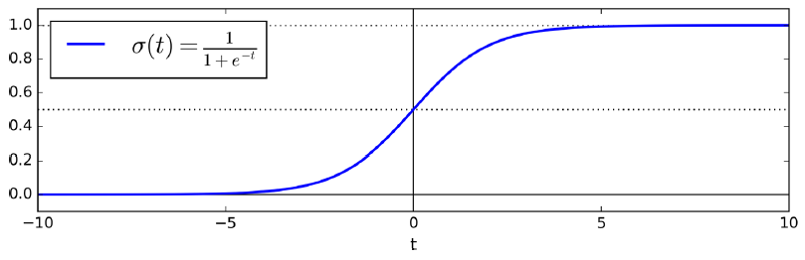
Estimating Probabilities

Slide 70
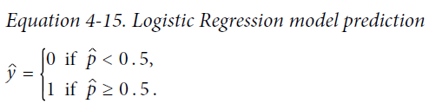
Estimating Probabilities
Once the Logistic Regression model has estimated the probability p = h_{θ}(x) that an instance x belongs to the positive class, it can make its prediction ŷ easily (see Equation 4-15).
Notice that σ(t) < 0.5 when t < 0, and σ(t) ≥ 0.5 when t ≥ 0, so a Logistic Regression model predicts 1 if θ^{T}・x is positive, and 0 if it is negative.

Slide 71
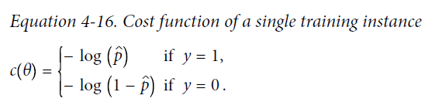
Training and Cost Function
Good, now you know how a Logistic Regression model estimates probabilities and makes predictions. But how is it trained? The objective of training is to set the parameter vector θ so that the model estimates high probabilities for positive instances (y = 1) and low probabilities for negative instances (y = 0). This idea is captured by the cost function shown in Equation 4-16 for a single training instance x.

Slide 72
Training and Cost Function
This cost function makes sense because – log(t) grows very large when t approaches 0, so the cost will be large if the model estimates a probability close to 0 for a positive instance, and it will also be very large if the model estimates a probability close to 1 for a negative instance. On the other hand, – log(t) is close to 0 when t is close to 1, so the cost will be close to 0 if the estimated probability is close to 0 for a negative instance or close to 1 for a positive instance, which is precisely what we want.

Slide 73
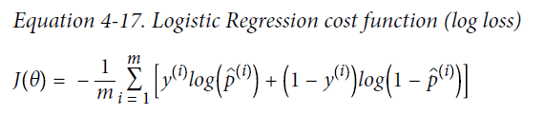
Training and Cost Function
The cost function over the whole training set is simply the average cost over all training instances. It can be written in a single expression (as you can verify easily), called the log loss, shown in Equation 4-17.

Slide 74
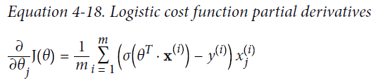
Training and Cost Function
The bad news is that there is no known closed-form equation to compute the value of θ that minimizes this cost function (there is no equivalent of the Normal Equation). But the good news is that this cost function is convex, so Gradient Descent (or any other optimization algorithm) is guaranteed to find the global minimum (if the learning rate is not too large and you wait long enough). The partial derivatives of the cost function with regards to the jth model parameter θj is given by Equation 4-18.

Slide 75
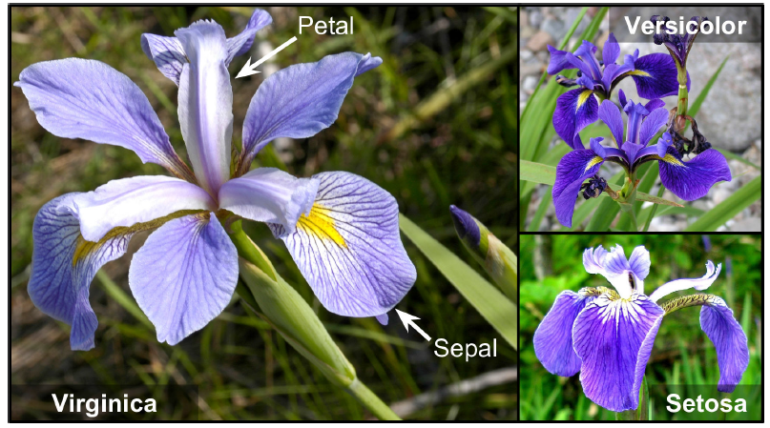
Decision Boundaries
Let’s use the iris dataset to illustrate Logistic Regression. This is a famous dataset that contains the sepal and petal length and width of 150 iris flowers of three different species: Iris-Setosa, Iris-Versicolor, and Iris-Virginica.

Slide 76
Decision Boundaries
Let’s try to build a classifier to detect the Iris-Virginica type based only on the petal width feature. First let’s load the data:
>>> from sklearn import datasets
>>> iris = datasets.load_iris()
>>> list(iris.keys())
['data', 'target_names', 'feature_names', 'target', 'DESCR']
>>> X = iris["data"][:, 3:] # petal width
>>> y = (iris["target"] == 2).astype(np.int) # 1 if Iris-Virginica, else 0

Slide 77
Decision Boundaries
Now let’s train a Logistic Regression model:
from sklearn.linear_model import LogisticRegression
log_reg = LogisticRegression()
log_reg.fit(X, y)
Let’s look at the model’s estimated probabilities for flowers with petal widths varying from 0 to 3 cm:
X_new = np.linspace(0, 3, 1000).reshape(-1, 1)
y_proba = log_reg.predict_proba(X_new)
plt.plot(X_new, y_proba[:, 1], "g-", label="Iris-Virginica")
plt.plot(X_new, y_proba[:, 0], "b--", label="Not Iris-Virginica")
# + more Matplotlib code to make the image look pretty

Slide 78
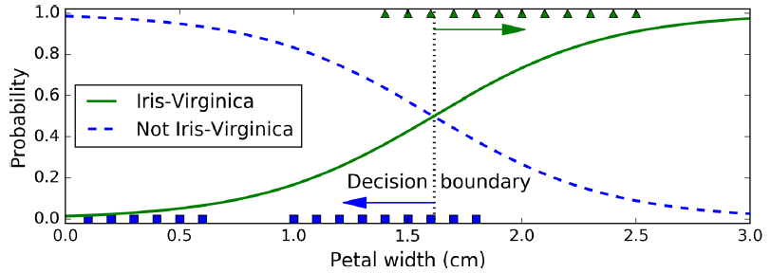
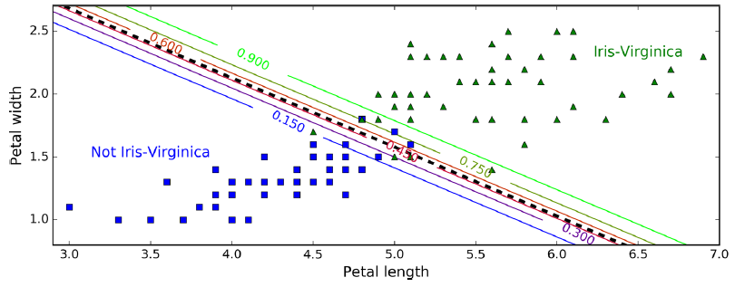
Decision Boundaries

Slide 79
Softmax Regression
The Logistic Regression model can be generalized to support multiple classes directly, without having to train and combine multiple binary classifiers (as discussed in Chapter 3). This is called Softmax Regression, or Multinomial Logistic Regression.

Slide 80
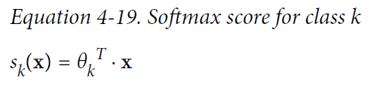
Softmax Regression
The idea is quite simple: when given an instance x, the Softmax Regression model first computes a score s_{k}(x) for each class k, then estimates the probability of each class by applying the softmax function (also called the normalized exponential) to the scores. The equation to compute s_{k}(x) should look familiar, as it is just like the equation for Linear Regression prediction (see Equation 4-19).

Slide 81
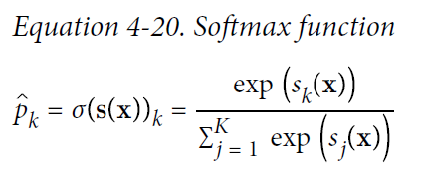
Softmax Regression
Once you have computed the score of every class for the instance x, you can estimate the probability p_{k} that the instance belongs to class k by running the scores through the softmax function (Equation 4-20): it computes the exponential of every score, then normalizes them (dividing by the sum of all the exponentials).

Slide 82
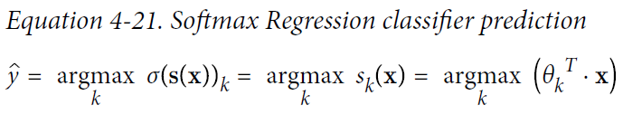
Softmax Regression
Just like the Logistic Regression classifier, the Softmax Regression classifier predicts the class with the highest estimated probability (which is simply the class with the highest score), as shown in Equation 4-21.

Slide 83
Softmax Regression
Now that you know how the model estimates probabilities and makes predictions, let’s take a look at training. The objective is to have a model that estimates a high probability for the target class (and consequently a low probability for the other classes). Minimizing the cost function shown in Equation 4-22, called the cross entropy, should lead to this objective because it penalizes the model when it estimates a low probability for a target class. Cross entropy is frequently used to measure how well a set of estimated class probabilities match the target classes.

Slide 84
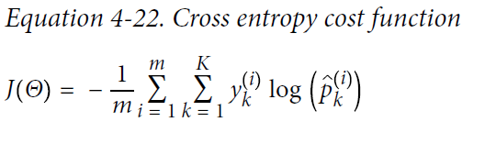
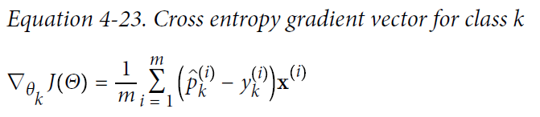
Softmax Regression
The gradient vector of this cost function with regards to θ_{k} is given by Equation 4-23:

Slide 85
Softmax Regression
X = iris["data"][:, (2, 3)] # petal length, petal width
y = iris["target"]
softmax_reg = LogisticRegression(multi_class="multinomial",solver="lbfgs", C=10)
softmax_reg.fit(X, y)
>>> softmax_reg.predict([[5, 2]])
array([2])
>>> softmax_reg.predict_proba([[5, 2]])
array([[ 6.33134078e-07, 5.75276067e-02, 9.42471760e-01]])

Slide 86
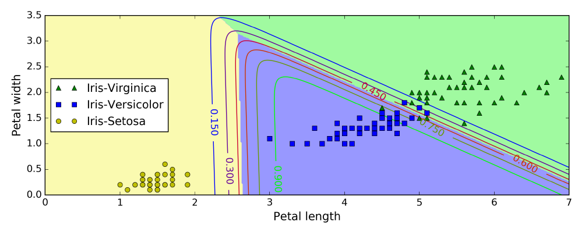
Softmax Regression
X = iris["data"][:, (2, 3)] # petal length, petal width
y = iris["target"]
softmax_reg = LogisticRegression(multi_class="multinomial",solver="lbfgs", C=10)
softmax_reg.fit(X, y)
>>> softmax_reg.predict([[5, 2]])
array([2])
>>> softmax_reg.predict_proba([[5, 2]])
array([[ 6.33134078e-07, 5.75276067e-02, 9.42471760e-01]])

