Slide 1
Inputs
Features
Multiple labels
Truth Discovery
Estimated
labels
Proposed algorithm
Initial weight
Adaboost
Outputs
Predict model

Slide 2
Inputs
Features
Multiple labels
Estimated
labels
Truth Inference
Medaboost
Outputs
Predict model

Slide 3
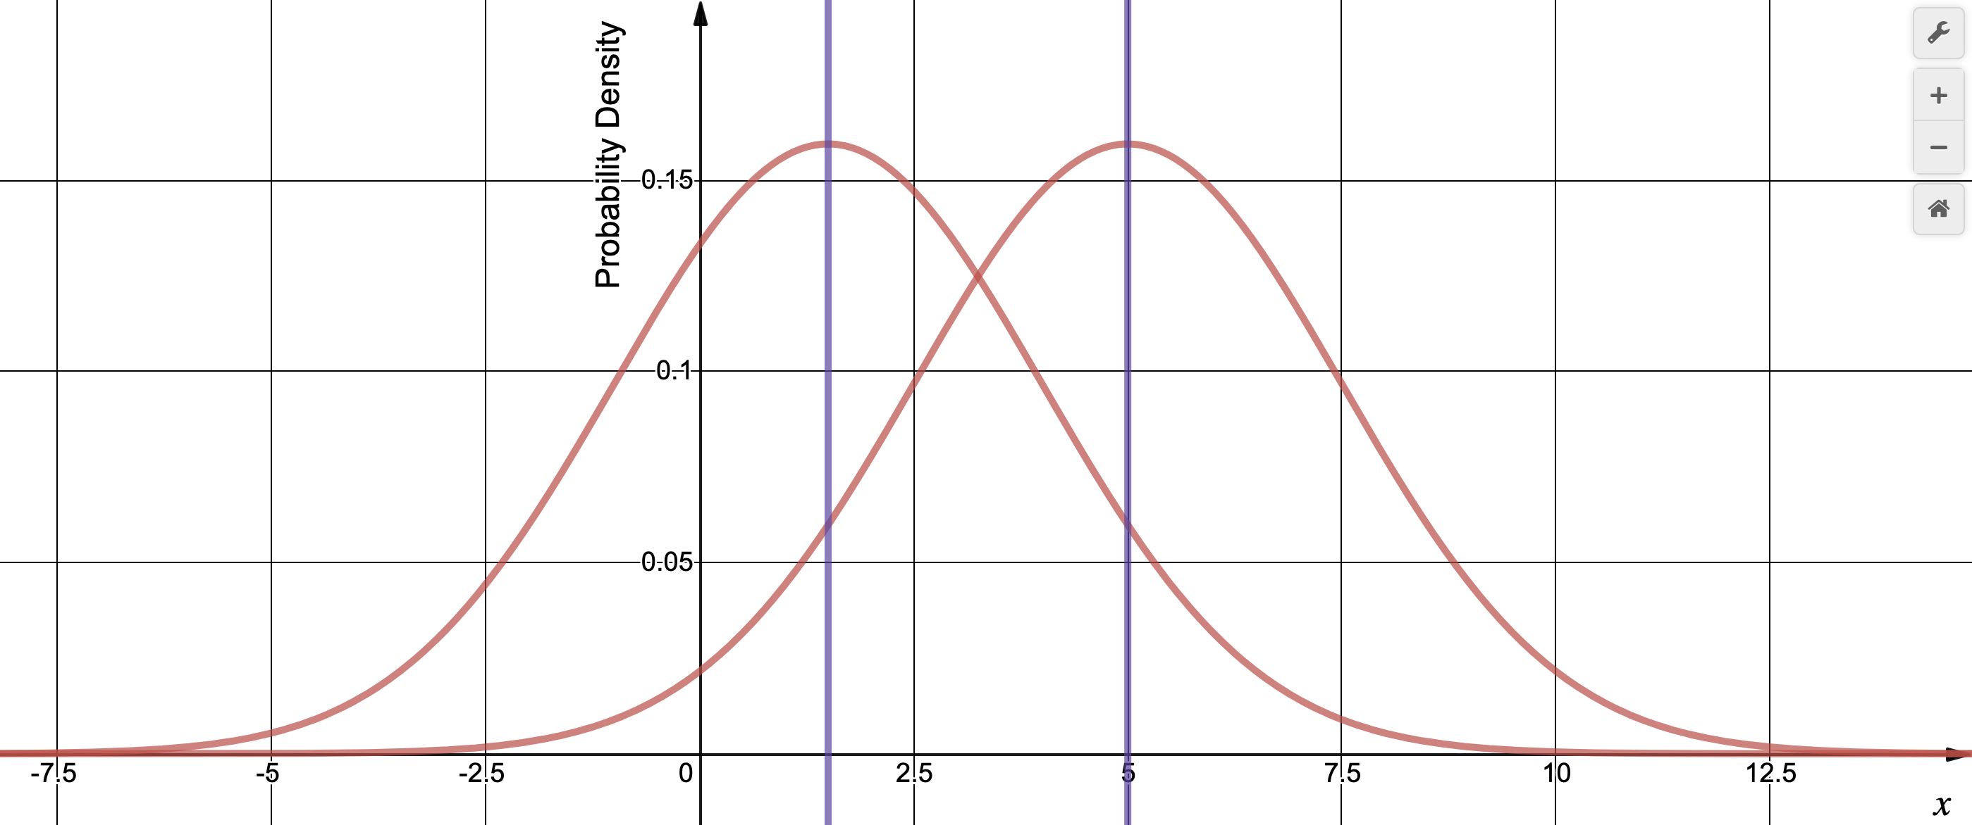
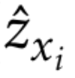
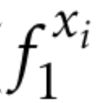
z_{i} = -1
z_{i} = 1
f₁ = 1.5
f₁ = 5

Slide 4
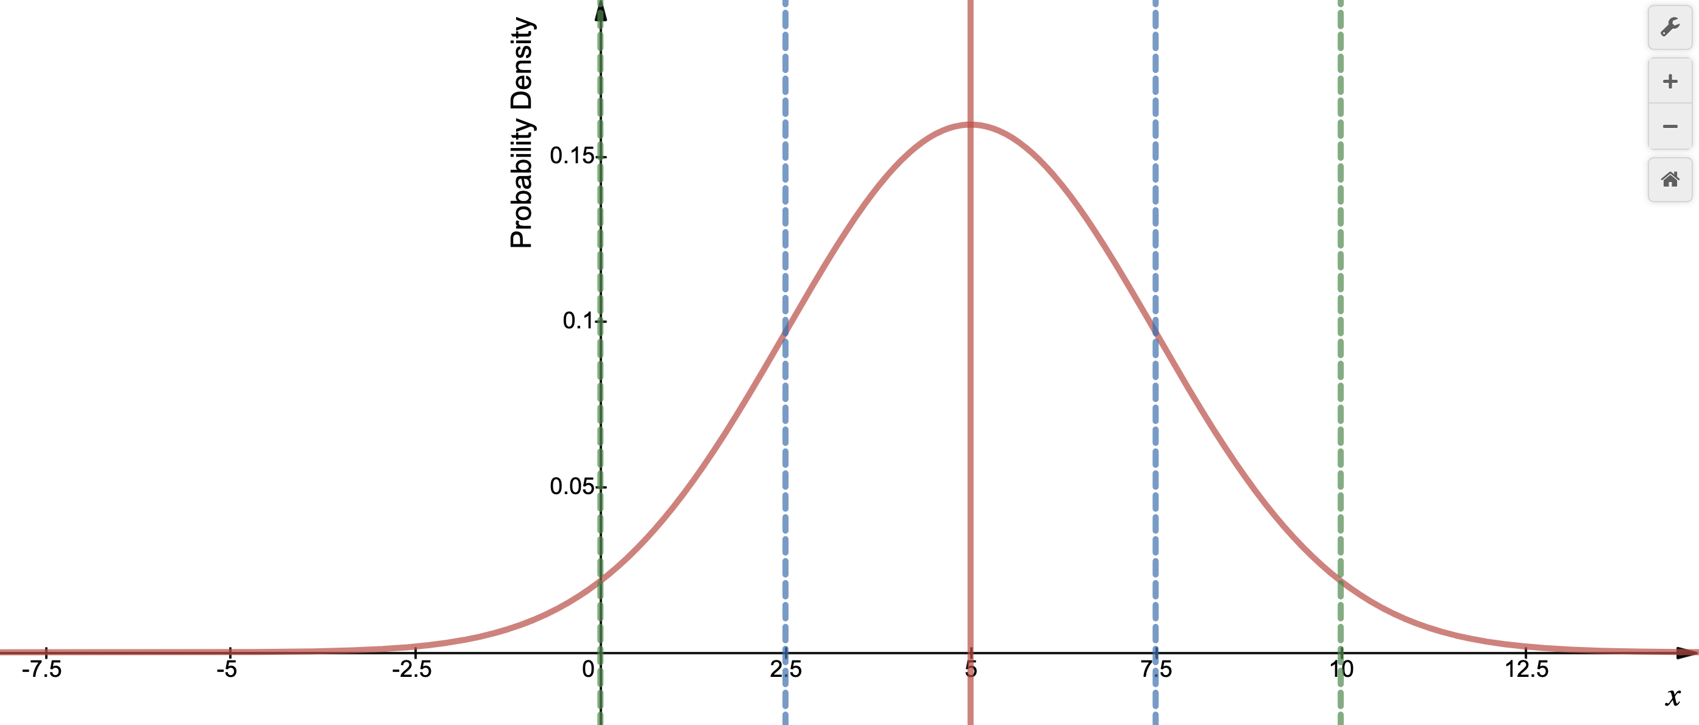
34.1%
34.1%
13.6%
13.6%
2.1%
2.1%
μ - 2σ = 0
μ - σ = 2.5
μ = 5
μ + σ = 7.5
μ + 2σ = 10

