Slide 1
Safe Borrowing of External Controls
via Covariate-Shift-Adjusted Longitudinal Residual-Rank Screening
A conformal screen for hybrid controlled trials
Keep the compatible external controls · drop the incompatible ones · borrow safely

Slide 2
PART I
The Problem & Background
Why borrow external controls, and when is it dangerous?

Slide 3
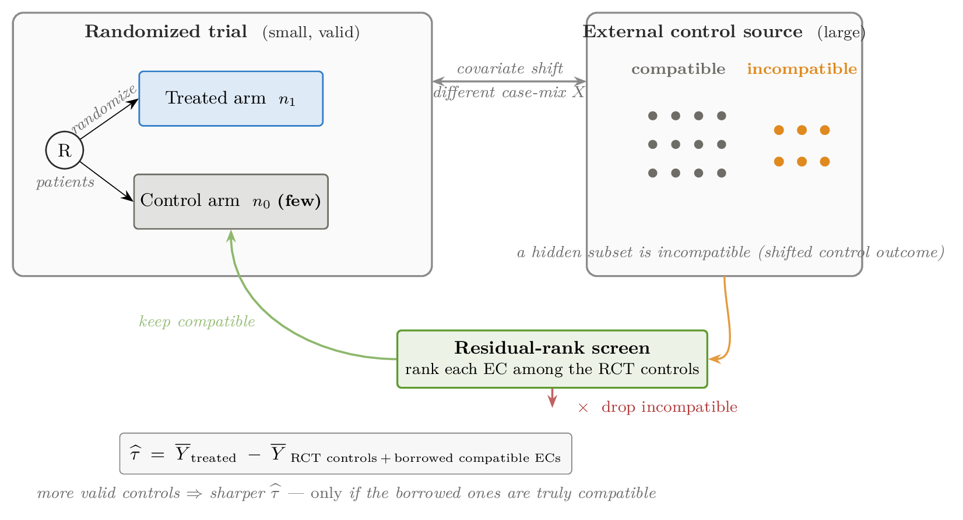
SCIENTIFIC MOTIVATION
Hybrid trials: borrowing external controls
The setting
▪ A randomized trial (RCT) gives unbiased treatment-effect estimates — but its control arm is often small, so precision and power are limited.
▪ Registries, historical trial arms, and electronic health records offer many external controls (ECs) that could sharpen the control comparison.
The danger
▪ Borrowing ALL of them is risky: if a hidden subset is incompatible (their control-outcome law really differs), the borrowed control mean is biased and confidence-interval coverage collapses.
▪ RCT-only is always valid but discards the external information — precision left on the table.
Goal: screen the external controls for outcome compatibility — keep the compatible ones, drop the rest — then borrow. “Screen, then borrow.”
1

Slide 4
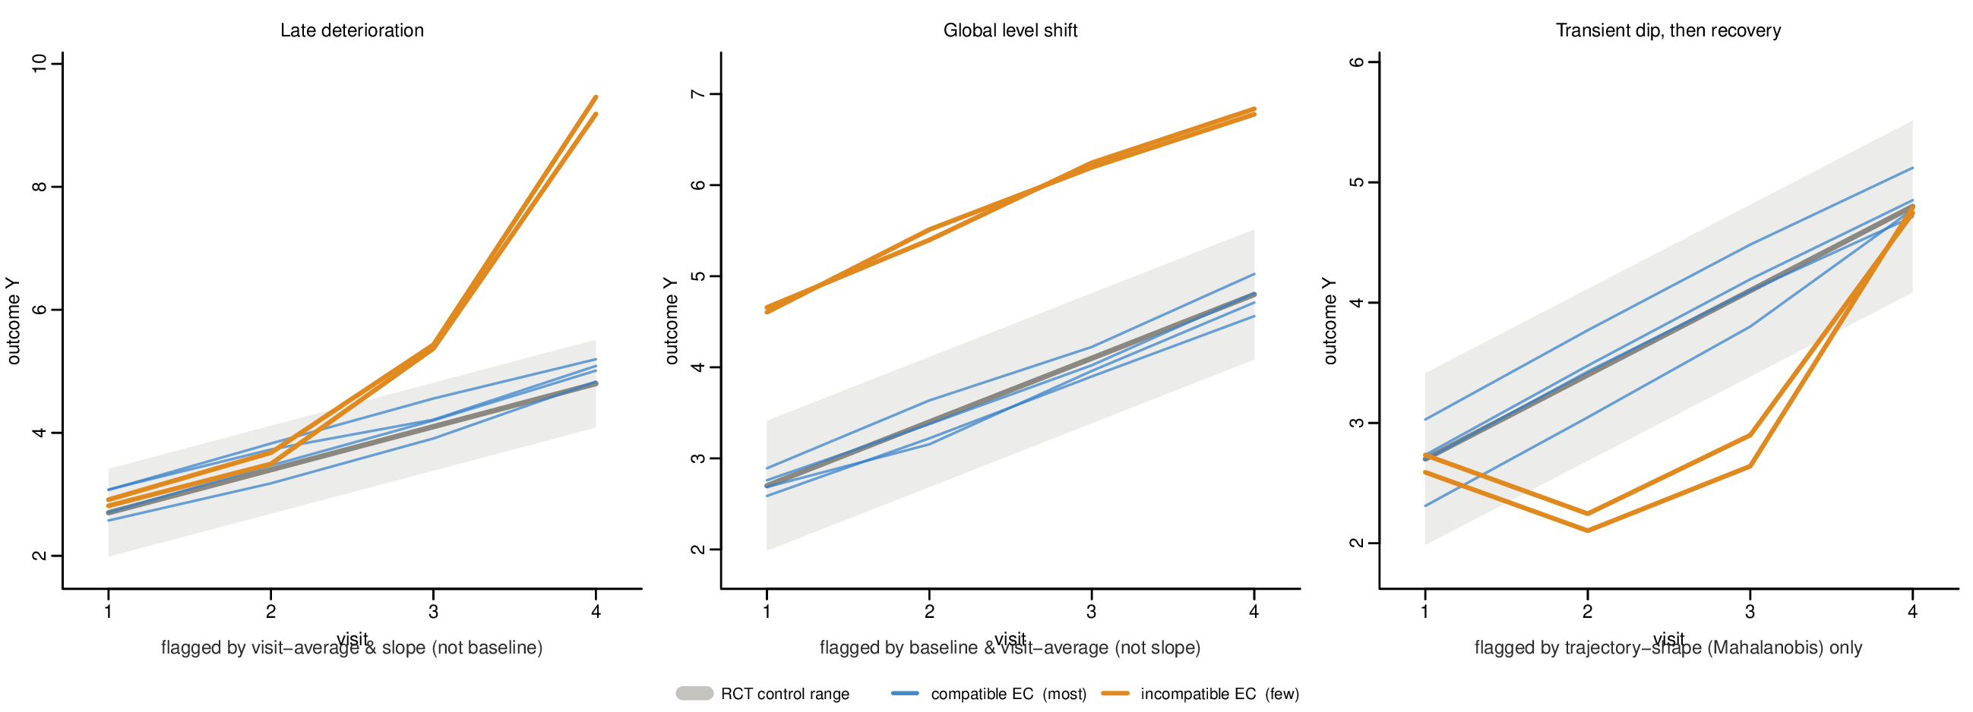
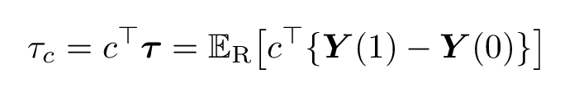
SCIENTIFIC MOTIVATION
Why longitudinal outcomes matter
▪ Outcomes are trajectories over visits, not a single number. The estimand is a prespecified linear contrast of the trajectory (formula at right):
– examples of the contrast c: final visit · final-minus-baseline · visit average · slope · area-under-the-curve.
▪ Longitudinal data reveal the temporal PATTERN of response: two sources can agree at the last visit yet differ in early decline, slope, curvature, or recovery.
▪ Such discrepancies can matter clinically — and can expose incompatibility that a single scalar endpoint cannot see.
▪ It is also harder to model: within-subject correlation, irregular visit timing, missingness, dropout.
Key takeaway: a single endpoint can hide incompatibility that the full trajectory reveals — so the screen compares whole trajectories, not one number.
2

Slide 5
SCIENTIFIC MOTIVATION
Real-world external controls differ in many ways
Ways compatible-looking ECs can actually differ
▪ Baseline disease severity and prognostic factors;
▪ Visit schedules and observation frequency;
▪ Endpoint collection, measurement error, and adjudication;
▪ Missingness and dropout mechanisms;
▪ Calendar time, standard of care, concomitant treatment;
▪ Conditional outcome means, variances, correlations, or tails.
The consequence
Full borrowing improves precision ONLY if the ECs are compatible; otherwise it injects bias.
So the scientific question is not WHETHER to use external data, but WHICH external subjects carry credible information for the trial population.
Our answer: screen at the OUTCOME level (residual trajectories) — complementary to design-stage covariate balancing.
3

Slide 6
IDENTIFICATION ASSUMPTIONS & DIAGNOSTIC TARGETS
Identification: notation and the target
Notation
▪ S = 1 the randomized trial, S = 0 the external source; within the trial A = 1 treated, A = 0 control.
▪ Screening compares randomized controls (S=1, A=0) with external controls (S=0), both observed under control.
▪ X = baseline covariates measured comparably in both sources.
The causal target
▪ A prespecified contrast of the trajectory, in the randomized-trial population:
Central discipline of this work:
– separate the causal IDENTIFICATION assumptions (below) from the weaker object a chosen score actually SCREENS.
– The two are not the same — conflating them is a common error.
4

Slide 7
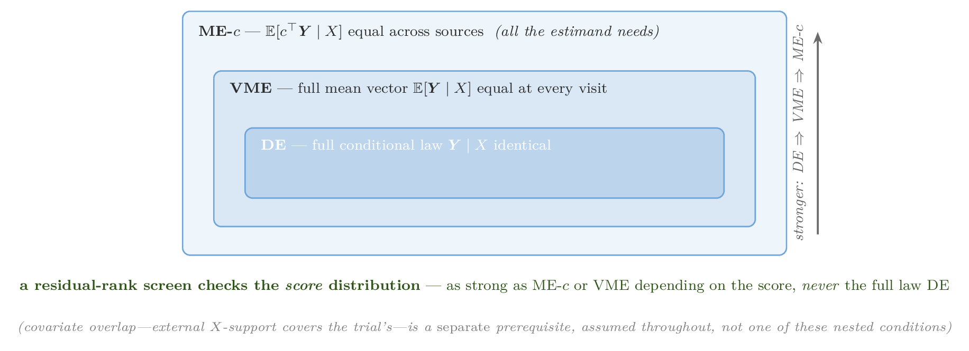
IDENTIFICATION ASSUMPTIONS & DIAGNOSTIC TARGETS
Assumptions
Assumption 0 — covariate overlap (support)
The trial's covariate support must be covered by the external source. The covariate DISTRIBUTIONS may still differ — that is covariate shift, which is allowed and corrected by weighting (Part II).
Compatibility of the control outcome law (nested, weakest → strongest)
– ME-c: the mean of ONE contrast is equal — and c is the contrast the ESTIMATOR uses. All that IDENTIFICATION needs.
– VME: the full mean vector is equal at every visit.
– DE: the full conditional distribution is equal (what ordinary conformal validity nominally asks).
5

Slide 8
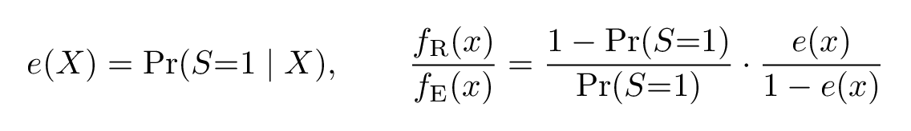
EXISTING DESIGN-STAGE SCREEN
Existing tool: design-stage propensity-score trimming
What it does
▪ The source propensity score e(X) = Pr(S=1 | X); matching / weighting / trimming balance measured baseline covariates.
▪ Extreme e(X) flags regions where one source has little density relative to the other:
What it does NOT do
▪ Propensity trimming targets covariate OVERLAP / positivity only (Assumption 0).
▪ It does not assess whether the control OUTCOME law Y(0) | X is actually compatible across sources.
Complementary, not competing:
– propensity trimming → X-overlap; residual-rank screening → outcome-compatibility through the score V.
– Units outside the X-support should not be rescued by an outcome screen; units WITH good X-support may still have incompatible trajectories — that is what our screen catches next.
6

Slide 9
IDENTIFICATION ASSUMPTIONS & DIAGNOSTIC TARGETS
What a residual-rank screen actually checks
The object actually screened
▪ A residual-rank screen tests the distribution of the nonconformity SCORE V — an object as strong as ME-c or VME depending on the score, but NEVER the full law DE.
▪ So it controls borrowing bias for the estimand without asserting the (essentially unfalsifiable) full-law equality: it sits between what identification NEEDS (ME-c) and the too-strong DE.
The score decides what you can see
▪ WHICH score you rank on determines which departures the screen detects: a score aligned to the drift is powerful, a score blind to it has no power (we define and choose the score in Part II).
Design target: choose the score so that “looks compatible on the score” implies “compatible for the functional your ESTIMATOR uses” — i.e. ME-c indexed by the estimator's a.
7

Slide 10
PART II
The Method, Step by Step
From a broad-audience idea to the full formulation

Slide 11
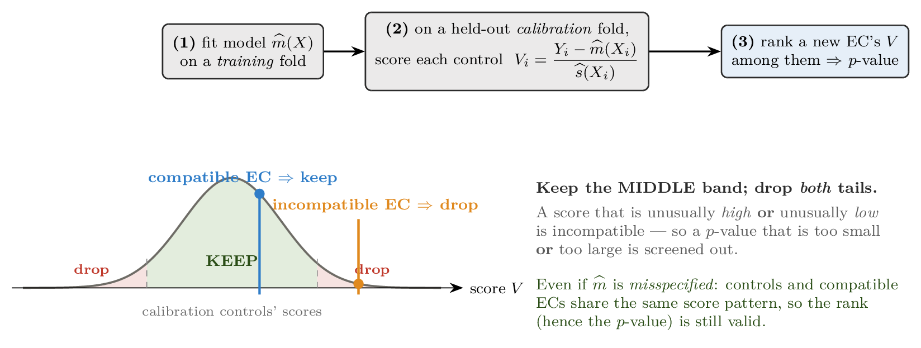
BASIC IDEA FOR A BROAD AUDIENCE
Building blocks: nonconformity scores & split conformal
A nonconformity score
A scalar V = s(Y, X; model): how UNUSUAL a point is given the fitted model (e.g. a standardized residual; large |V| = far from expected).
Split conformal
Fit on a TRAINING fold; score a held-out CALIBRATION fold; rank a new point's score among those calibration scores.
Why it is valid — and robust to a wrong model
Under compatibility the new point is EXCHANGEABLE with the calibration controls → uniform rank → valid p-value, for ANY score.
Even if the model is MISSPECIFIED, controls and compatible ECs share the SAME score pattern → ranks unchanged → still valid. Misspecification costs POWER, not validity.
8

Slide 12
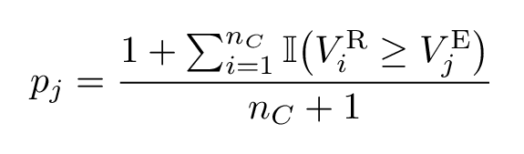
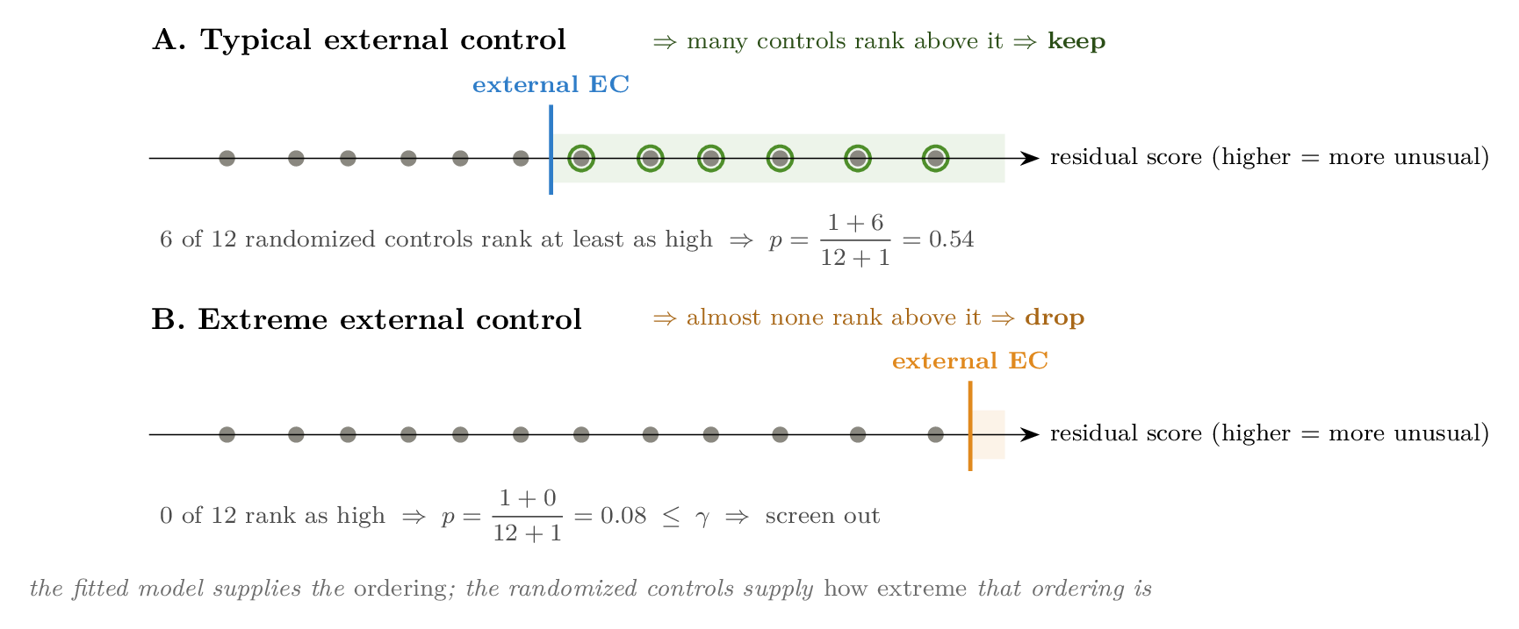
BASIC IDEA FOR A BROAD AUDIENCE
The core idea, applied to the external controls
▪ For each external control, compute the same score and RANK it among the randomized-control scores — a conformal p-value:
Keep the middle, drop BOTH tails
A score that is extreme in EITHER direction — unusually high OR unusually low — signals incompatibility. So drop an EC whose p-value is too small OR too large, and keep the central band:
The fitted model supplies the ORDERING; the randomized controls supply how extreme that ordering is.
9

Slide 13
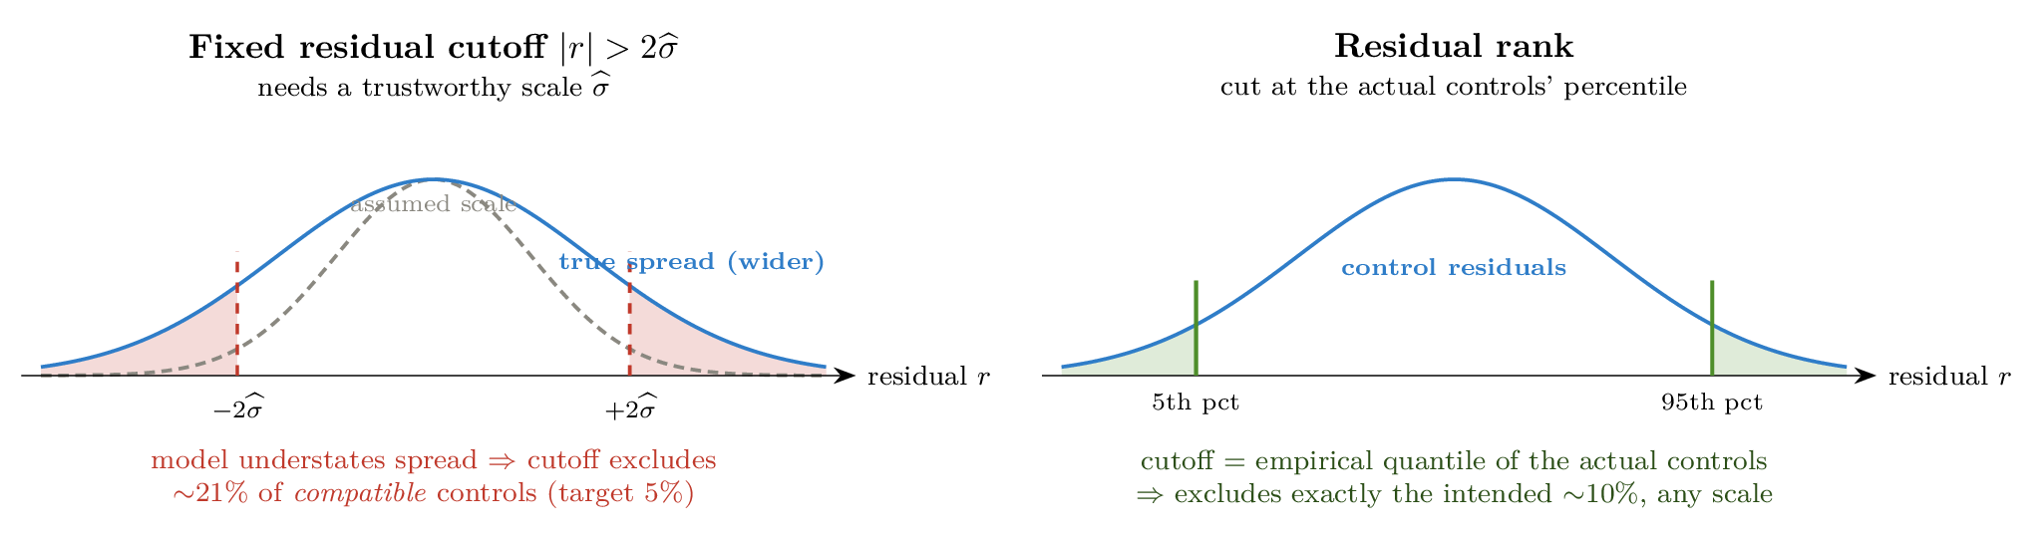
WHY RANK CALIBRATION IS PREFERABLE
Why rank, not a raw residual — (1) distribution-free
▪ After cross-fitting, regard the working model as fixed. Under compatibility the control and EC scores are EXCHANGEABLE, so their conditional CDFs match:
This holds for ANY fixed score — even one from a misspecified model.
⇒ the rank is uniform, the p-value super-uniform (valid): no normality, no chi-square reference, no numeric threshold to trust.
Contrast with a fixed residual cutoff
▪ A cutoff |r| > 2σ̂ must trust the model's SCALE σ̂. If the model understates the spread, the cutoff excludes many COMPATIBLE controls (right).
10

Slide 14
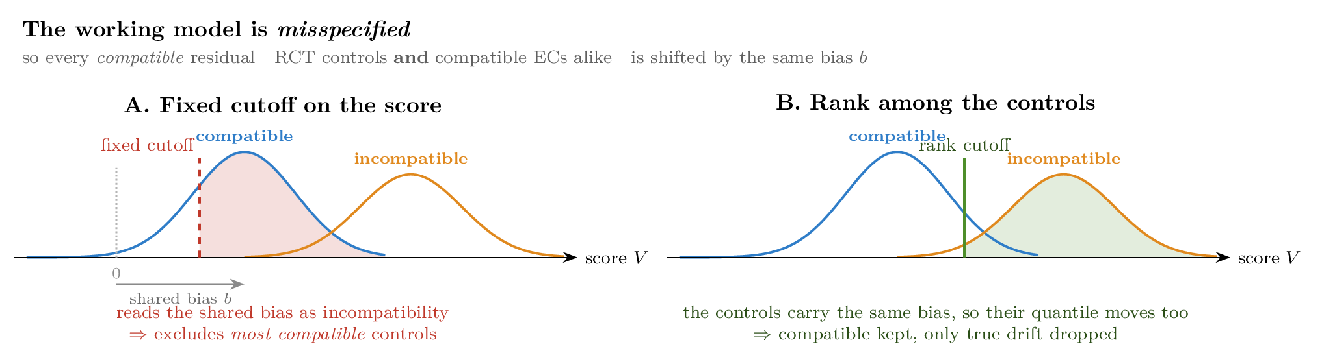
THE CORE REASON TO RANK, NOT THRESHOLD
Why rank — (2) robust to model misspecification
The deeper reason to rank rather than threshold the residual value
▪ A wrong working mean model shifts EVERY compatible residual — randomized controls AND compatible ECs alike — by the SAME bias b (they share the true conditional law, so the same misspecified score map applies to both).
A fixed cutoff reads that shared bias as incompatibility → excludes most compatible controls.
Ranking against the controls: their quantile carries the same bias, so it MOVES with them → the shared error cancels → only genuinely different ECs are flagged.
This is the conformal exchangeability guarantee — valid p-values under ANY working model, correct or not. Scale-robustness (previous slide) is a special case.
11

Slide 15
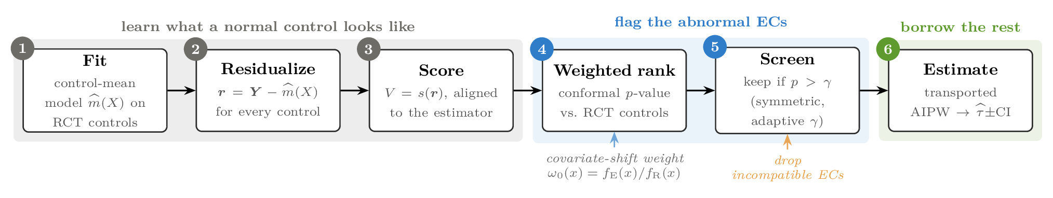
PROPOSED FULL METHOD
The full method: six steps
LEARN what a normal control looks like: (1) fit a control-mean model on RCT controls, (2) residualize, (3) reduce to an estimator-aligned score.
FLAG the abnormal ECs: (4) rank each EC against the RCT controls with covariate-shift weighting, (5) screen with a symmetric, adaptive threshold.
BORROW the rest: (6) refit a transported AIPW on RCT controls + retained ECs → τ̂ with a confidence interval.
12

Slide 16
PROPOSED FULL METHOD
Steps 1–2: estimand and working models
Step 1 — prespecify the estimand & harmonize the data
▪ Choose the primary contrast c and target τ_c; two contrasts are used later so a given drift projects onto them differently:
– Align eligibility, endpoint definitions, visit windows, baseline covariates, data-quality rules; check X-overlap.
Step 2 — fit working longitudinal models on the randomized controls
▪ Fit the control mean (and scale / covariance) models by K-fold CROSS-FITTING, so in-sample residuals are not over-optimistic.
The model need only supply a useful ordering — rank calibration handles the rest, even under misspecification.
13

Slide 17
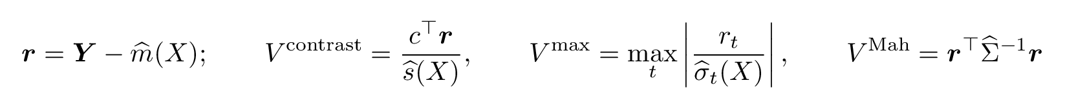
PROPOSED FULL METHOD
Step 3: the longitudinal nonconformity score
▪ Residualize the trajectory, r = Y − m̂(X), then reduce it to a single scalar score. Three options:
Contrast score (c = the contrast through which the trajectory enters the estimator): most powerful when the drift is along c — global shifts, level changes.
Max standardized residual: sensitive to a spike at any single visit.
Common-reference Mahalanobis: aggregates the whole trajectory shape — best for ramps / curvature / transient dips.
Design principle
Match the score to (1) the functional the ESTIMATOR actually uses, and then (2) the ANTICIPATED drift shape. A contrast blind to the drift will not detect it.
Point (1) is not the same as “match the estimand” — that is the next two slides.
14

Slide 18
PROPOSED FULL METHOD
Choosing c: the estimand does not fix the score
Two things determine c — not one
(1) What the ESTIMAND of interest is. (2) How much LONGITUDINAL INFORMATION we wish to borrow in estimating it. The second is routinely left implicit — and it is the one that actually decides c.
A last-visit ATE does NOT automatically give c = (−1,0,0,1)
– If NO longitudinal structure is imposed and the last-visit outcomes are fully observed: the most direct estimator uses only the final outcomes. The earlier visits do not participate in estimating the last-visit mean → the score may target the final visit alone.
– If longitudinal structure IS imposed — to improve the efficiency of the last-visit ATE — then the earlier visits directly affect the final estimate → the score must reflect whole-trajectory information.
Three ways the earlier visits get in
– Repeated-measures GLS: if some covariate effects are assumed constant across visits, all visits are used jointly to estimate those shared parameters — which in turn determine the last-visit mean.
– MMRM under missingness: the earlier repeated measurements help learn the longitudinal association, then used to predict or recover missing final outcomes.
– Assumed shared trajectory (e.g. the mean is linear in t): all visits jointly estimate the trajectory parameters, and the last-visit mean is a function of them.
15

Slide 19
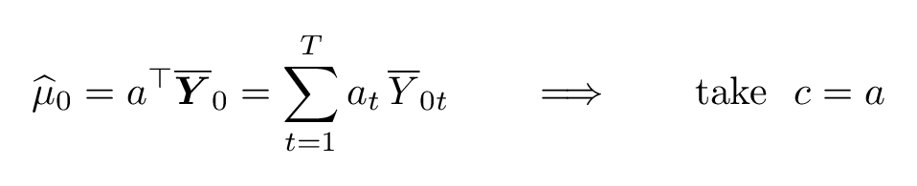
PROPOSED FULL METHOD
The operative question — and the rule it implies
Agreement at the final visit is not sufficient
Even if the randomized and external controls have EXACTLY the same mean at the last visit, differences at intermediate visits can still corrupt the longitudinal structure used to estimate the last-visit ATE — and thereby the estimator. Checking the first-to-last contrast alone would never see it.
So the real question is not “are the last visits the same?”
It is: DO THE INTERMEDIATE VISITS ENTER AND INFLUENCE THE ESTIMATION OF THE LAST-VISIT ATE? If we choose to exploit them for efficiency, they are part of the estimator — and must therefore be part of the compatibility assessment. Only if we do not use them at all is whole-trajectory compatibility unnecessary.
The rule: when the estimator touches the control trajectories through a′Ȳ₀ —
– final-outcomes-only: a = (0,0,0,1) → c collapses onto the last visit
– assumed linear trajectory: the fitted last-visit mean is α̂ + β̂ × (last visit time), and α̂, β̂ are linear in ALL visit means → a spans them
– GLS / MMRM: a is induced by the working covariance and the shared-parameter constraints → generically nonzero at every visit
Consequence: compatibility is a property of the (estimand, ESTIMATOR) pair — not of the estimand alone.
16

Slide 20
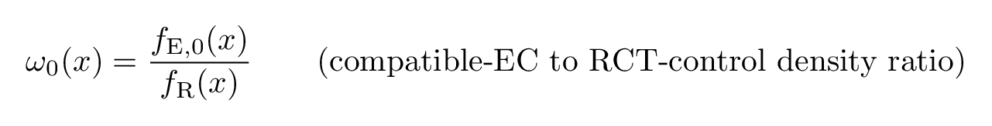
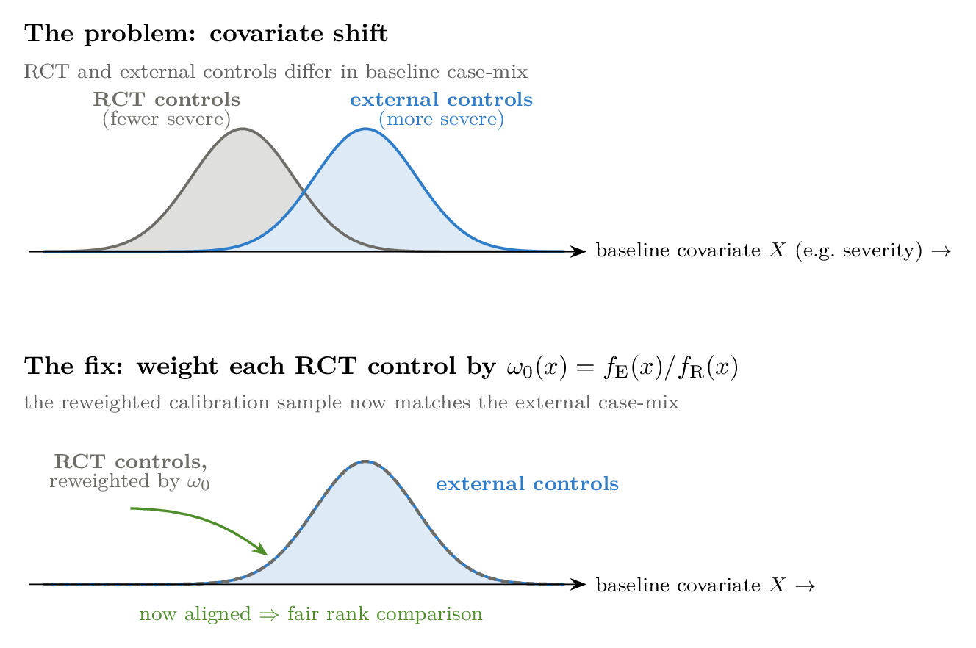
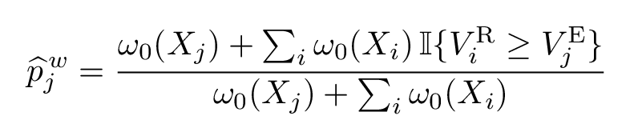
PROPOSED FULL METHOD
Steps 4–5: covariate-shift weighting
▪ Randomized and external covariate mixes differ, so we reweight the calibration ranks by the density ratio:
Transport identity — weighted RCT scores represent the compatible-EC score law:
Without weighting, high-severity compatible ECs look “extreme” only because they are over-represented externally → false exclusions. Weighting removes exactly this (right).
17

Slide 21
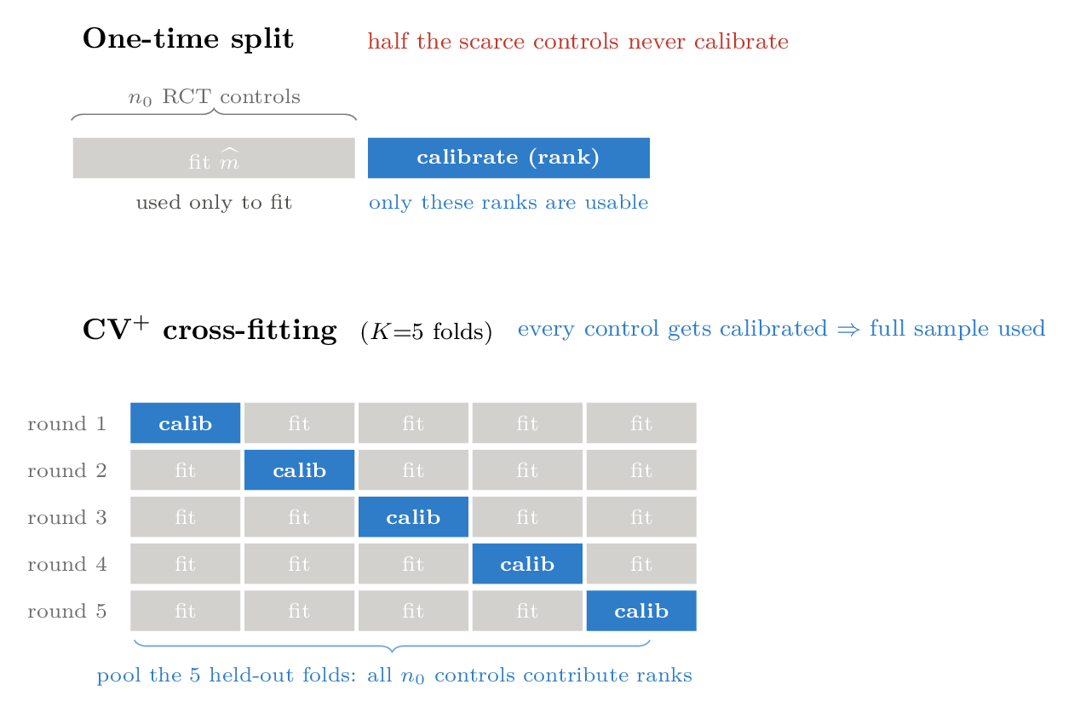
PROPOSED FULL METHOD
Steps 6–7: from a one-time split to cross-fit (CV+)
▪ A single train/calibrate split wastes half of the already-scarce randomized controls.
▪ CV+ scores each fold from a model fit on the other folds:
Every randomized control eventually contributes a calibration rank → the WHOLE control sample is used.
This is the main efficiency lever of the method — we quantify the gain in the simulation (≈ +0.06 power at controlled type-I).
18

Slide 22
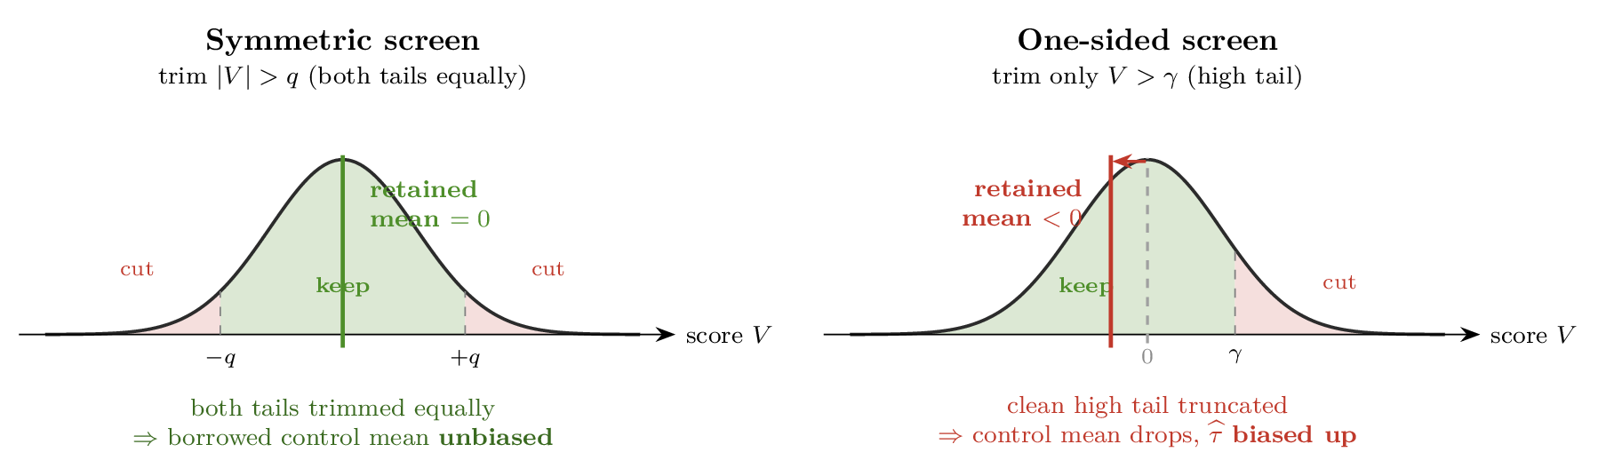
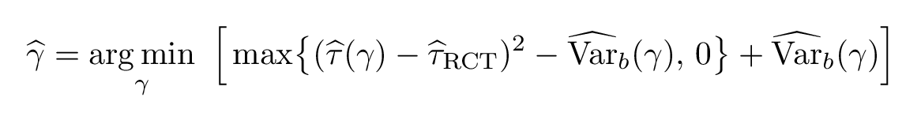
PROPOSED FULL METHOD
Step 8: conservative screening — symmetric + adaptive γ
Symmetric trimming (keeps the borrowed mean unbiased)
▪ Screen on |V| with a SINGLE threshold, trimming both tails equally:
Trimming both tails equally leaves the retained control mean unmoved → the borrowed mean stays UNBIASED (right).
Adaptive threshold (no labels needed)
▪ Choose γ per dataset to minimize an estimated MSE of the borrowing estimate (a de-biased CSB objective):
Small γ borrows more but risks leaking contamination; large γ is safer with less gain. Adaptive γ balances the two automatically.
19

Slide 23
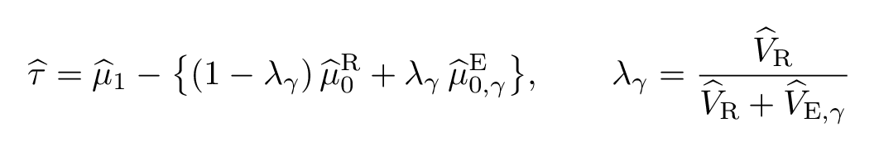
PROPOSED FULL METHOD
Step 9: refit the borrowing estimator (transported AIPW)
▪ On the RETAINED external controls, refit the source density, the outcome model, and the inverse-variance borrowing weight; form the transported AIPW control mean and combine it with the randomized-control mean:
λ = efficient inverse-variance weight: borrow LESS from noisier external controls → lower RMSE.
Doubly robust: consistent if either the outcome model or the source/weight model is correct.
Output: τ̂ with a full-pipeline bootstrap confidence interval that re-runs the entire screen on each resample (so selection uncertainty is propagated).
20

Slide 24
PART III
Simulation
A transparent longitudinal data-generating process, and the results

Slide 25
SIMULATION SETUP
Simulation: the data-generating process
Samples and mild covariate shift (S=1 trial; S=0 external; centered binary terms use B tilde):
Baseline construction, then one shared covariate coefficient vector and a small linear time slope:
Thirty percent of external controls are incompatible; the discrepancy has a covariate-dependent level plus a small time drift:
Analysis: nlme::gls(Y ~ Y0 + X1 + X2 + B1 + ... + B4 + time, corCompSymm(~1|id), REML). All 12 visits estimate the shared coefficients used in visit-12 AIPW. Estimand: trial-population ATE at visit 12; true tau = 0.70. Residual variance = 4 and CS correlation = 0.30.
21

Slide 26
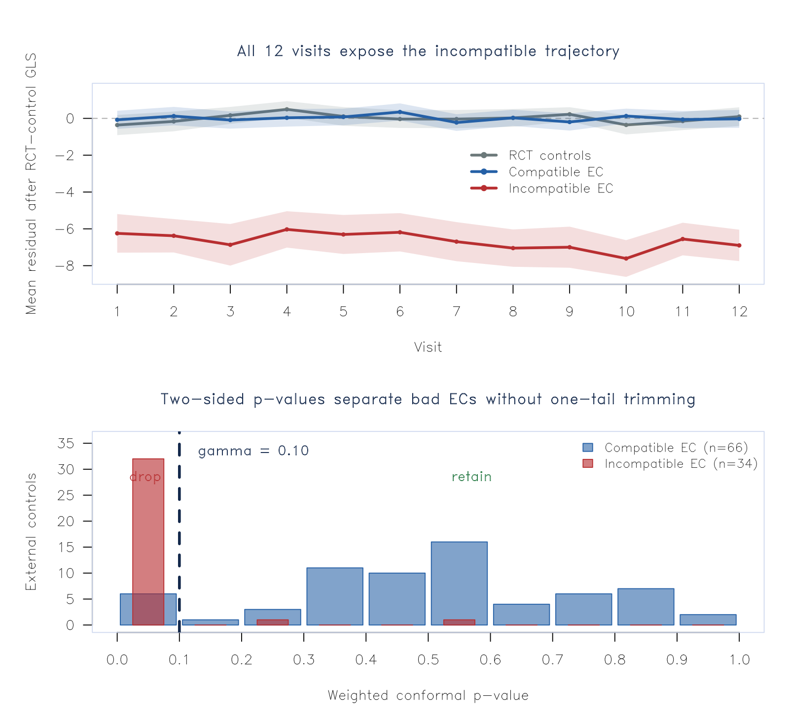
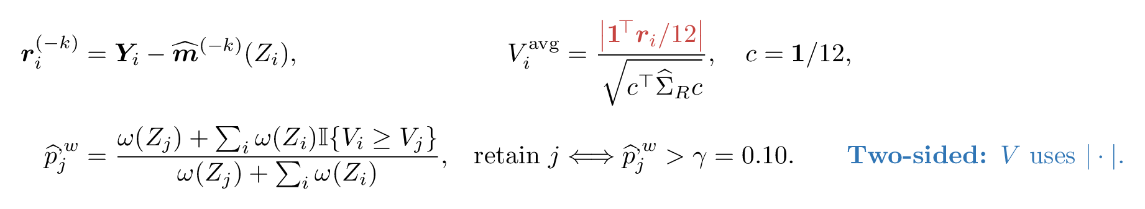
SIMULATION SETUP
The screen in action (one draw at the reference cell)
Reference draw. Seed 2 gives 34 contaminated ECs; the primary screen detects 94.1% and wrongly excludes 9.1% of clean ECs.
Top. After the RCT-control 12-visit GLS, compatible EC residuals track zero, while incompatible trajectories sit roughly 6–8 units lower across visits.
Bottom. Bad-EC p-values concentrate below gamma=0.10; clean-EC p-values remain spread over [0,1].
Cross-fitting. Five folds refit both the shared-coefficient GLS and the logistic source model; weighted RCT-control ranks are compared with each EC.
Two-sided by construction. The nonconformity score uses an absolute residual contrast, so positive and negative incompatibility are treated symmetrically.
22

Slide 27
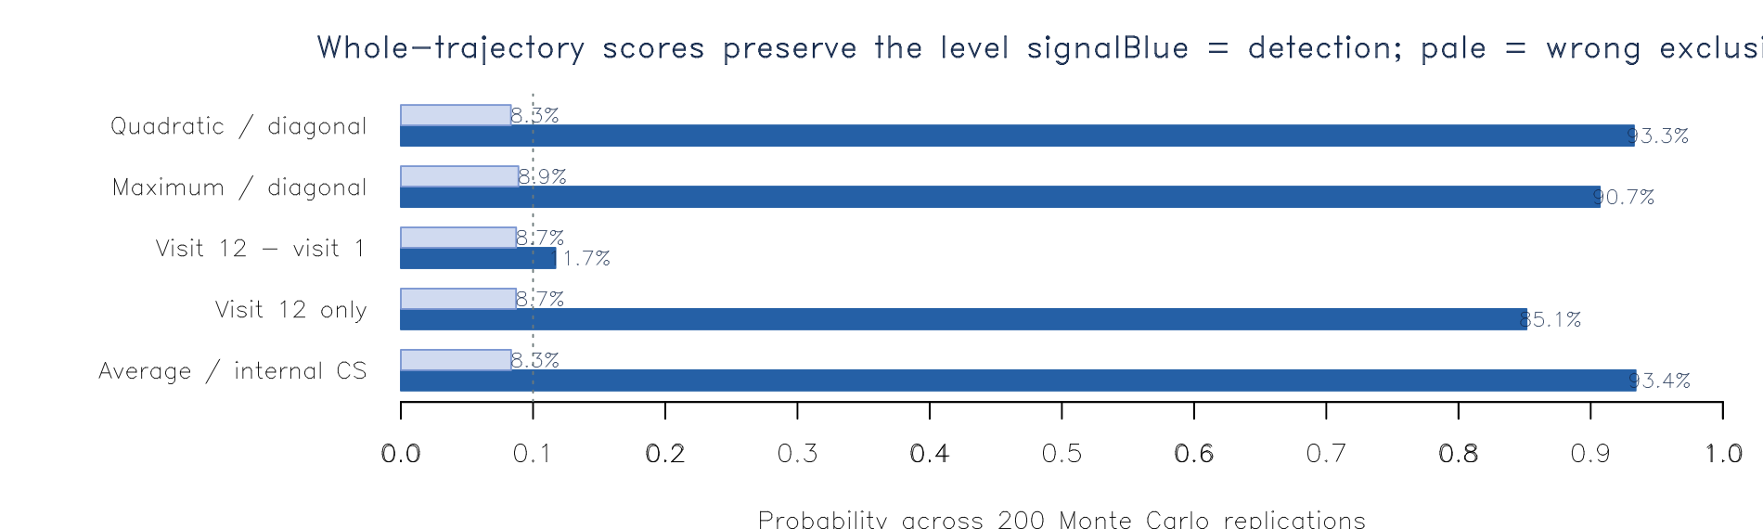
SIMULATION SETUP
When can the screen detect contamination?
Why average works. The incompatible DGP is mainly a common level discrepancy plus 0.10 × time. Averaging all visits keeps that level signal; the visit-12-minus-visit-1 contrast cancels it and leaves only 1.1 units.
Signal-to-noise. Standardized SNR is 5.37 for the visit average, 3.49 for visit 12 alone, and only 0.465 for the first-to-last contrast.
Observed screen. At the two-sided gamma=0.10 cutoff, average/internal-CS detects 93.4% with 8.3% wrong exclusion; final-only detects 85.2%, but c1 detects just 11.7%.
Covariance choice. Estimate score covariance from internal RCT controls. Estimating it from contaminated ECs inflates the scale and masks the signal.
23

Slide 28
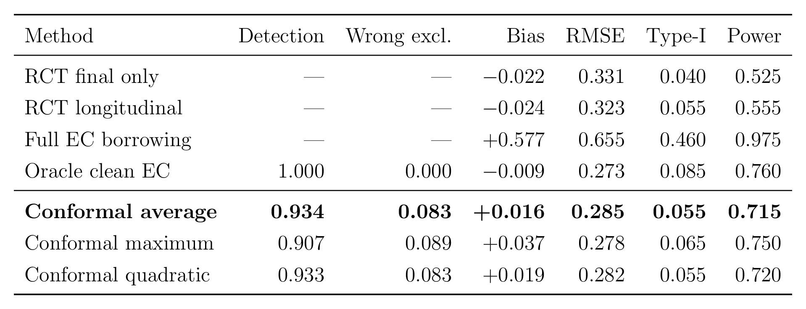
SIMULATION RESULTS
Result: beats RCT-only on all four criteria at once
Primary conformal average. Bias = 0.016; RMSE = 0.285, an 11.9% reduction from RCT-longitudinal (0.323); type-I = 0.055; power rises from 0.555 to 0.715.
Screen quality. Detection = 0.934 and wrong exclusion = 0.083; on average 64.1 clean and 2.0 bad ECs remain, with borrowing coefficient 0.507.
Monte Carlo inference. 200 replications and 500 full-pipeline subject bootstraps. Type-I and power use two-sided 95% percentile intervals; the conformal p-value is also two-sided through |V|.
24

Slide 29
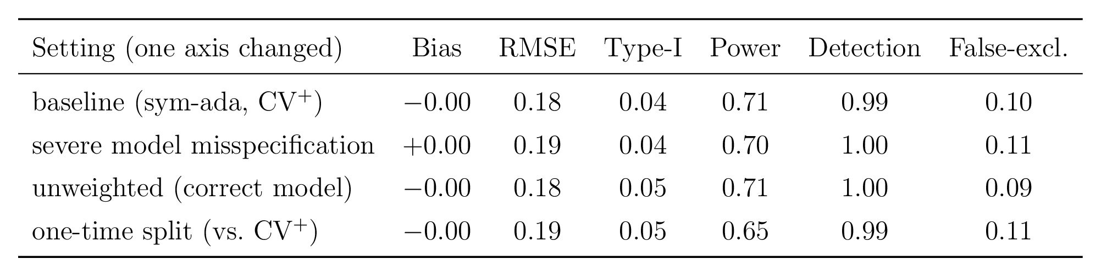
SIMULATION RESULTS
Result: robust — and CV+ is the efficiency lever
Robust to model misspecification: even dropping the covariate from the working mean model barely moves bias or power — the shared model error is absorbed by the RCT-control calibration.
Weighting is a low-cost safeguard: a near no-op under the correct model; it earns its keep under misspecification and at low signal-to-noise.
CV+ vs one-time split: +0.06 power (0.71 vs 0.65) at controlled type-I — simply by not wasting the scarce randomized controls.
25

Slide 30
PART IV
Discussion
Scope, limits, and open problems

Slide 31
DISCUSSION
Scope, limits, and positioning
Insurance, not a free lunch: residual-rank screening turns naive full-borrow's catastrophic bias into VALID, ROBUST inference, with a modest but real efficiency gain when the randomized arm is underpowered.
The upside is bounded
▪ An oracle-ceiling limits the gain to ≈ 15–25% RMSE: the treated arm is not borrowable, so the borrowable share of variance is n(R,1) / (n(R,0)+n(R,1)).
▪ Borrowing helps most when randomized controls are scarce — but the screen also needs enough controls to calibrate; CV+ widens this window.
Two things you must choose well
▪ The score must match the anticipated drift shape (a mismatched contrast is blind to the drift).
▪ Detection is signal-to-noise-limited; residual undetected low-SNR drift is the main risk.
26

Slide 32
DISCUSSION
Two design questions the theory raises
1) Which nonconformity score?
▪ FIRST the estimator, then the drift. c is fixed by the functional the estimator uses — not by the estimand label. A last-visit ATE gives c=(−1,0,0,1) only if the estimator ignores the earlier visits; impose longitudinal structure for efficiency (GLS / MMRM / shared trajectory) and c must span the visits.
▪ Then align to the anticipated drift: contrast score for global / level shifts; Mahalanobis (trajectory-shape) for ramps, curvature, transient dips; max for a single-visit spike. A score blind to the drift has no power — pick by the expected departure, and pre-specify it.
▪ Detection is not identification: a richer (VME-level) score catches more kinds of drift but can over-exclude compatible ECs; the estimand needs only ME-c — indexed by the estimator's a, not by the estimand's contrast.
2) The assumption hierarchy — what is actually sufficient
▪ Identifying the effect needs only ME-c (the one-contrast conditional mean); VME and DE are strictly stronger and are NOT required.
▪ Ordinary conformal validity nominally needs the full law DE; our screen relaxes this — it checks only the SCORE distribution (between ME-c and VME), a SUFFICIENT screen without assuming DE.
The crux is the gap between what identification NEEDS (ME-c), what the screen CHECKS (the score law), and what the chosen score is SENSITIVE to — pick the score so “score-compatible” implies “ME-c-compatible.”
27

Slide 33
DISCUSSION & PROBLEMS
Open problems
▪ Soft / continuous borrowing: down-weight rather than hard keep/drop, to remove the selection bias scalably (the current screen trades a little bias for robustness).
▪ Nested bootstrap for the adaptive-γ confidence interval: the current re-use of the point-selected γ inside the bootstrap is mildly anti-conservative.
▪ Type-I is reported RELATIVE to RCT-only — both share a percentile-bootstrap floor set by the number of resamples B; larger B pulls the absolute value to nominal.
▪ Multiplicity / FDR across many external controls (family-wise exclusion of at least one compatible EC is common).
▪ Validation on a covariate-driven (plasmode) design, beyond the analytic binary toy, to show the conclusions are not an artifact of the toy.
28

Slide 34
TAKEAWAYS
Summary
Problem
▪ Borrow external controls to sharpen a hybrid trial — without importing bias from incompatible ones.
Idea
▪ Rank each EC's longitudinal residual score among the randomized controls — weighted to absorb covariate shift — and borrow only the conforming ones through a transported AIPW.
Three design choices that make it work
– Symmetric trimming → the borrowed control mean stays unbiased.
– CV+ rank calibration → does not waste the scarce randomized controls (the efficiency lever).
– Estimator-matched score (c = the estimator's a) → detects the drift that actually matters.
Why rank, not a raw residual
Rank calibration is distribution-free and robust to model misspecification — the core reason. Result: safe, valid, robust borrowing that beats RCT-only and approaches the oracle.
29

