Slide 1























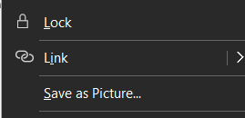
Note: Select icons, right click save as picture

