Slide 1
GaragePro
Fast auto service booking
Elijah Lake
Aug, 29th 2025

Slide 2
GaragePro — Java Full‑Stack Project
Project: GaragePro (service booking & advisor dashboard)
Author: Elijah Lake
Date: Aug 29, 2025

Slide 3
Project Concept- GaragePro (Auto Service Booking)
Overview: GaragePro is a lightweight web app that lets customers book vehicle maintenance easily. Pick a service, choose a mechanic, select Morning/Afternoon, and get a quoted price.
GitHub README
https://github.com/Elake22/GaragePro
Problem Statement: Makes booking vehicle service quick and easy
Target Users: Vehicle owners scheduling routine maintenance or repairs and Service advisors/managers who review, confirm, and manage appointments.
Goals: Making it easy, like booking a haircut. Learn and practice creating a app from start to finish
Notes:
GaragePro is a lightweight way to book vehicle service in minutes. The flow is simple pick services, choose a mechanic, select morning or afternoon, and get an instant quote. On the shop side, a Service Advisor view lists incoming requests so they can confirm times and keep the day organized. The goal was to remove friction, simple booking, and show a clear end-to-end path from the customer’s form to a saved records the advisor can act on.”

Slide 4
Tech Stack
Frontend: React, HTML CSS, JavaScript
Backend: Java (Spring Boot), JPA, Jakarta, Lombok
Database: MySQL
APIs and Tools: Bootstrap, Postman
Notes:
The Tech stach frontend, I used React with Vite for fast development and hot module reloading. Styling is handled with Bootstrap , and routing is managed using React Router. On the backend, I used Spring Boot with Java . Spring handles the RESTful API endpoints, and Spring Data JPA connects to a MySQL database. For validation, I used Jakarta Validation (like @Email, @NotBlank), and Lombok helps reduce repetitive code like getters and setters. This stack allows clean separation of concerns and ensures proper validation and communication between the client and server.

Slide 5
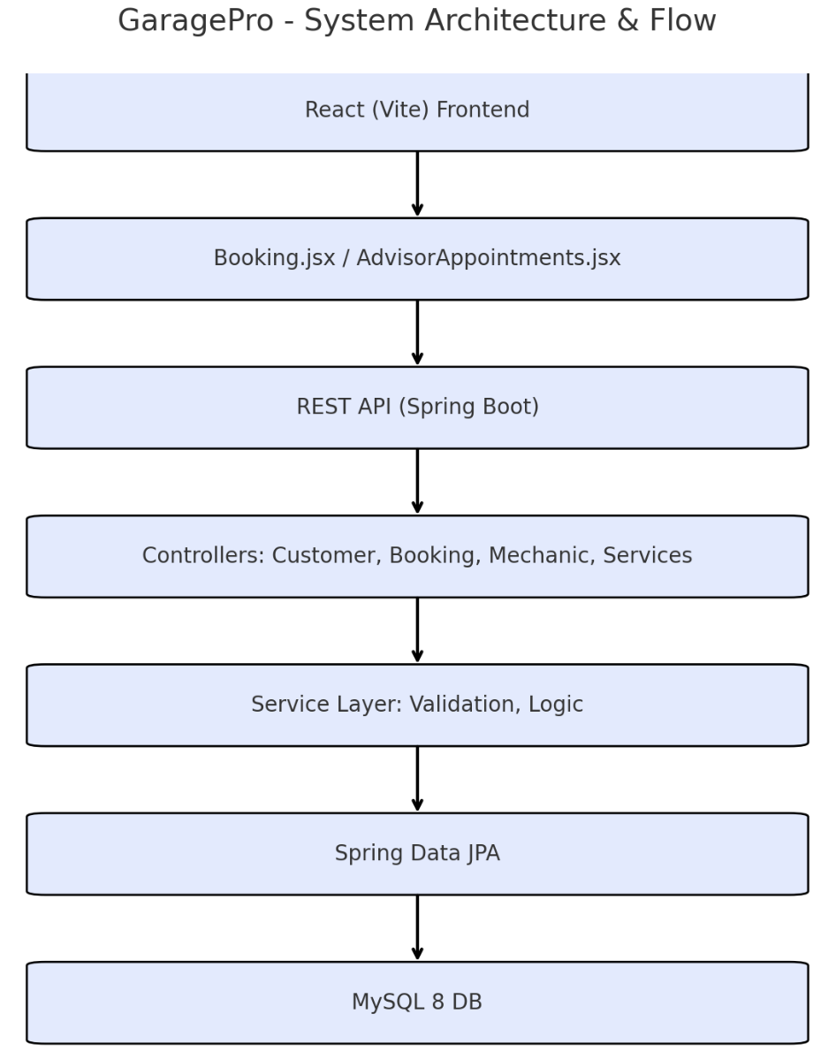
System Design & Architecture
Overall Architecture Diagram
Domain Layer – Entities/Models
Data Layer – Repos & Database
Service Layer – Business / Validation
Controller – REST APIs (GET/POST/PUT/DELETE)
Component Breakdown
Frontend Components – Pages, Routes, UI Pieces
Backend Controllers/Services – Booking, Customer, Mechanic, Services
Notes:
We keep the app in clear layers so each part has one job.
Domain Layer data shapes—Customer, Mechanic, Service, Booking. these map to tables.
Data Layer is Spring Data JPA. Repositories read/write those entities to MySQL with simple CRUD methods.
Service Layer contains the rules and business logic: prevent past-date bookings, normalize statuses, upsert customers by email, and return fully-initialized results for the advisor view.
Controller exposes clean REST endpoints under /api/**
On the component side, the frontend (React/Vite) is a set of pages and reusable UI pieces Home, Booking, Confirm, and the Advisor dashboard calling a tiny api.js.
The backend is organized by feature (Booking, Customer, Mechanic, Services) with a controller and a service per feature.
This layering keeps the UI simple, puts business logic in one place, and makes data access reliable so adding things like ‘change booking status’ stays easy and safe.”

Slide 6
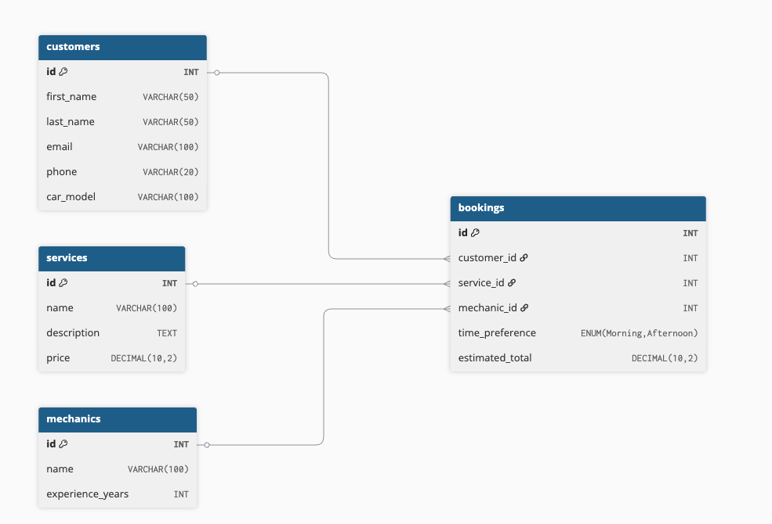
Database Design
Tables: customers, mechanics, services, bookings.
Notes:
The core data into Customers, Mechanics, Services, and Bookings. Bookings holds the foreign keys and represents the actual appointment. A unique index on customer email prevents duplicates, and store quoted prices and notes right on the booking for transparency. With added sensible indexes like status and appointment time so the advisor view can filter today’s schedule quickly as data grows.

Slide 7
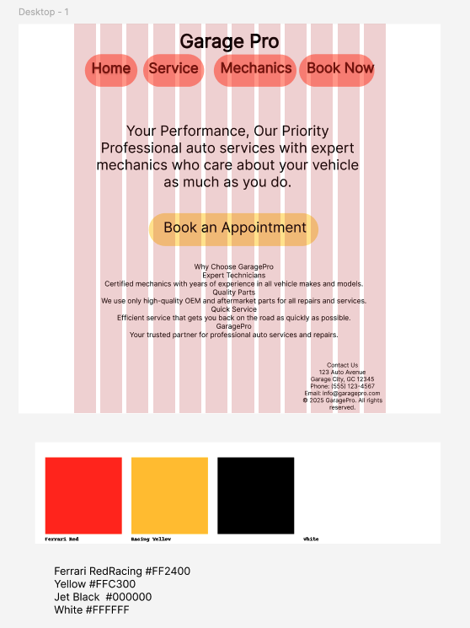
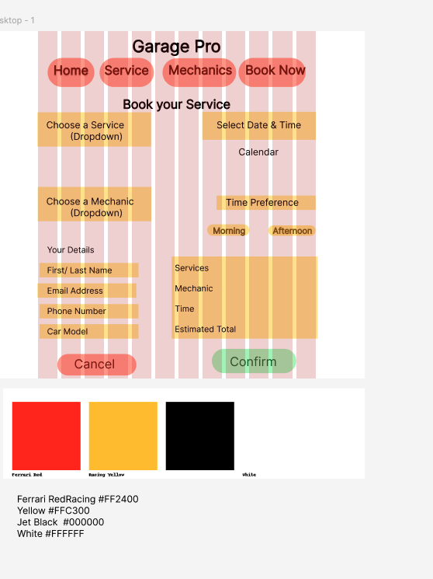
UI/UX Mockups
Purpose: Fast, trustworthy path to booking
Mocks: Home + Booking screens
Home: Bold hero, value badges, clear Book CTA
Booking flow: Services → Mechanic → Date (AM/PM) → Details → Confirm
Visuals: Ferrari Red + Racing Yellow, rounded cards, clear buttons
Access & mobile: High contrast, focus states, responsive layout
Home
Booking
Notes:
Two mocks to lock the brand colors and a homepage that builds trust and a streamlined booking screen that minimizes decisions. The home page uses a bold hero, three value badges, and one primary “Book an Appointment” call-to-action so users always know the next step. Below that, popular services and a mechanic preview.
On the booking screen, the flow is intentionally linear: select services, choose a mechanic, pick a date with a simple Morning/Afternoon choice , add contact/vehicle details, then review the quote and confirm.
Later added an Service Advisor page - http://localhost:5173/advisor/appointments

Slide 8
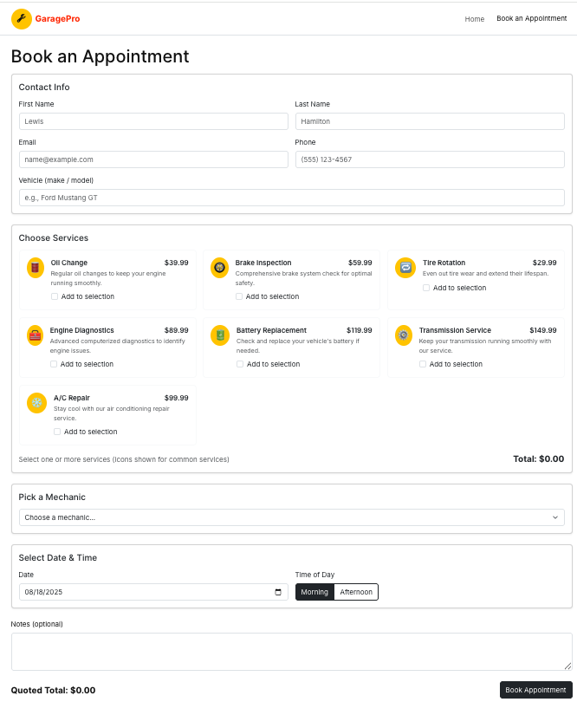
Idea to Creation
Mock design- Home → Choose services → Pick mechanic → Select date (AM/PM) → Contact & vehicle → Review quote → Submit → Confirmation
Current design - Home → Contact & vehicle → Choose services → Pick mechanic → Select date (AM/PM) → Review quote → Submit → Confirmation
Notes:
The primary user journey focuses on fast, low-friction booking. A customer lands on Home, selects one or more services, chooses a mechanic, and picks a date using a simple Morning/Afternoon choice to reduce time-picker errors. They add contact and vehicle details, review the auto-calculated quote, and submit. On success, we route to a confirmation page with a human-readable “When” label and a clear next step.
Validation is split between client and server. The UI blocks obvious mistakes (invalid email/phone, past dates or already-elapsed slots), while the API enforces business rules (no past appointments, required foreign keys) and returns friendly error messages that render as a banner. This keeps the flow responsive while ensuring data integrity.

Slide 9
Core Features
CRUD Operations: Customers, Mechanics, Services done; Bookings create/list now
User Dashboard: Appointments list with search + status filter
Data Visualization / Reporting: Price & service and confirm page
Notifications / Feedback: Client validation + and readable input / API errors.
Mobile Responsiveness: Bootstrap + custom CSS
Notes:
Core features include creating or updating the customer by email, creating a booking with a quoted total, and a confirmation page that summarizes the appointment. The advisor appointments page lists requests with search and status filters, so staff can see what’s coming and prioritize. We added client-side checks and server-side guards to keep data clean and turn vague 500s into understandable, friendly messages
CRUD Operations: Full CRUD for Customers, Mechanics, and Services. For Bookings, it support create and list now; update/delete + status transitions (Confirm/In-Progress/Complete/Cancel) are next.
User Dashboard: The advisor view shows all appointments with instant search (name, email, phone, vehicle) and status filtering, plus a quick refresh.
Data Visualization / Reporting: Not implemented yet. First step will be a daily schedule export and simple “service mix / revenue by service” summary; lightweight charts can follow.
Notifications / Feedback: The UI validates email/phone/date and surfaces friendly server errors via our global exception handler. Next, we’ll add email/SMS confirmations and reminders.
Mobile Responsiveness: Built with Bootstrap 5 and small custom CSS—buttons and inputs are touch-friendly, and focus states are accessible across breakpoints.

Slide 10
Live Demo
Garage Pro
Click Here
Notes:
http://localhost:5173/ Garage Pro
http://localhost:5173/advisor/appointments - Service Advisor Portal

Slide 11
Challenges
Duplicate email → 500s: Normalized emails (trim/lowercase) and switched to “find-or-create + update” with @ControllerAdvice returning a clear 400 instead of a DB uniqueness error.
Past-date bookings rejected: Blocked past dates/times in the UI and re-validated in BookingService.addBooking, returning a friendly 400 if violated.
Validation Coordination: Coordinating form validation on both the client and server side was a key challenge. I used React’s validation tools along with Jakarta Validator in Spring Boot.
Notes:
I hit a few issues. Duplicate emails initially triggered database errors; I fixed that by normalizing emails and doing an ‘update-or-create’ in the service layer, returning a clear 400 to the UI. Past dates caused validation failures; it now block past morning/afternoon slots in the UI and re-check on the server
Coordinating form validation on both the client and server side was a key challenge. I used React’s validation tools along with Jakarta Validator in Spring Boot. Managing multi-step form state was another challenge, solved using React. Finally, Making sure both frontend and backend agreed on data formats and validation rules, and managing the state between steps in the booking form.

Slide 12
Future Enhancements
Payments & pricing: deposits/checkout, bundles, promo codes.
Service Advisor dashboard: approve/deny, reschedule, edit, complete.
Availability & conflict checks: mechanic hours, prevent double-booking.
Notifications: email/SMS reminders and status updates.
Auth & roles: Advisor/Admin + audit log of changes.
Reporting & export: daily workload, revenue, CSV.
Notes:
Next step ideas: Develop the advisor dashboard from read-only to full scheduling approve/deny requests, reschedule, edit details, and mark jobs complete. To improve reliability, I add availability rules and conflict detection: store mechanic working hours and block times, and check overlaps to prevent double-booking. Customers and advisors will get timely email/SMS notifications for confirmations, changes, and reminders. We’ll introduce authentication with role-based access (Advisor/Admin) and log all changes for traceability. On the business side, we’ll support pricing bundles and optional payments For visibility, add simple reports daily workload, revenue, and CSV export and maybe some logging

Slide 13
Conclusion
What I learned
Built an end-to-end booking flow: React UI → Spring Boot API → MySQL (CRUD, validation, errors).
Normalized data and added guards for past dates, missing fields, and bad inputs (front + back end).
Implemented advisor view that returns fully populated booking details (customer, service, mechanic).
Ensured reliable round-trip: form input → persisted records → accurate UI display.
How a real shop would use it
Customers book online in minutes
Advisors see requests instantly, confirm times, assign mechanics, and update status
Quotes and notes follow the job for transparency and fewer callbacks.
Builds customer history (vehicle, past services, quotes) for faster check-ins and smarter upsells.
Simple reporting supports staffing/pricing; mobile-friendly and easy for small shops to adopt.
Notes:
What we learned I designed a straightforward booking app that simple to use: customers pick services and a mechanic, choose a time, and get a quote. I added checks in the browser and on the server so bad inputs don’t slip through things like past dates, wrong emails, or missing fields. When something is wrong, the system explains it in plain language instead of crazy error messages.. We also made sure the “advisor view” loads complete appointment details reliably, so staff can trust what they see without clicking around.
Real-world use Shops can accept bookings online instead of calling around like crazy. Customers see available options, pick morning or afternoon, and the shop confirms or reschedules if needed. This reduces no-shows, smooths the daily workload by assigning the right mechanic, and captures notes and prices for future visits. Over time, those records help with quick estimates and reminders, which improves customer experience and keeps bays full.

Slide 14

Final remarks and Q & A.

