Slide 1
ELAKIYA I Deep Learning Project

Slide 2
PROJECT TITLE
TRAFFIC SIGN RECOGNIZER USING CONVOLUTIONAL NEURAL NETWORKS
This project aims to develop a robust traffic sign recognition system using Convolutional Neural Networks (CNNs). By leveraging the power of deep learning, the system can automatically detect and classify various traffic signs captured by cameras or sensors in real-time. Through the utilization of CNN architecture, which is well-suited for image classification tasks, the system achieves high accuracy and efficiency in recognizing traffic signs, contributing to enhanced road safety and intelligent transportation systems.

Slide 3
AGENDA * Problem Statement * Project Overview * End users * Solution and its Value Proposition * The Wow in a Solution * Modelling * Results

Slide 4
PROBLEM STATEMENT There are several different types of traffic signs like speed limits, no entry, traffic signals, turn left or right, children crossing, no passing of heavy vehicles, etc. Traffic signs classification is the process of identifying which class a traffic sign belongs to. we will build a deep neural network model that can classify traffic signs present in the image into different categories. With this model, we are able to read and understand traffic signs which are a very important task for all autonomous vehicles.

Slide 5
PROJECT OVERVIEW Developing a traffic sign recognition system using Convolutional Neural Networks (CNNs) to enhance road safety and aid in driver assistance. The project involves gathering a dataset of traffic sign images, designing and training a CNN model, and evaluating its performance. The system aims to accurately detect and classify various traffic signs in real-time, overcoming challenges such as varying lighting conditions and sign variations. By leveraging deep learning techniques, the goal is to create an efficient and reliable solution for intelligent transportation systems.

Slide 6
WHO ARE THE END USERS? Drivers: Regular drivers who benefit from real-time assistance in recognizing and interpreting traffic signs, aiding in safe driving practices. Fleet Operators: Companies operating vehicle fleets, such as delivery services or transportation companies, could use the system to improve driver safety and efficiency. Autonomous Vehicle Systems: Manufacturers and developers of autonomous vehicles can integrate traffic sign recognition systems to enhance their vehicles' perception capabilities and adherence to traffic regulations. Urban Planners and Traffic Engineers: Professionals involved in urban planning and traffic management may utilize data collected from these systems to optimize traffic flow and improve road infrastructure. Government Agencies: Departments of transportation and other governmental bodies responsible for road safety and traffic regulations can benefit from insights provided by these systems to make informed policy decisions and improve road safety initiatives.

Slide 7
SOLUTION AND ITS VALUE PROPOSITION SOLUTION: The traffic sign recognition system utilizes Convolutional Neural Networks (CNNs) to accurately detect and classify various traffic signs in real-time. It involves data collection, preprocessing, model training, and deployment to provide a robust and efficient solution for traffic sign recognition tasks. VALUE PROPOSITION: Enhanced Road Safety: Prompt recognition of traffic signs reduces accident risks and promotes safe driving practices. Efficiency and Convenience: Automated recognition streamlines transportation systems and aids drivers, especially in challenging conditions. Cost Savings: Reduced operational expenses for fleet operators and autonomous vehicle manufacturers. Data-Driven Insights: Valuable data for urban planners, traffic engineers, and government agencies to optimize traffic flow and infrastructure. Scalability and Adaptability: Deployable across diverse transportation settings, providing long-term value and versatility.

Slide 8
THE WOW FACTOR IN THE SOLUTION Real-Time Safety Enhancement: The system provides instantaneous recognition of traffic signs, actively contributing to safer roads and potentially preventing accidents. Efficiency Augmentation: By automating the recognition process, the system optimizes transportation efficiency, saving time for drivers and operators while ensuring smoother traffic flow. Cost-Efficiency: The implementation of the system leads to significant cost savings for fleet operators and autonomous vehicle manufacturers, making it an attractive investment with tangible returns. Data-Driven Decision Making: The system generates valuable insights that go beyond immediate safety concerns, empowering urban planners and government agencies to make informed decisions about traffic management and infrastructure development. Adaptability and Future-Proofing: Its scalability and adaptability ensure that the solution remains relevant and effective in evolving transportation landscapes, promising long-term value for users.

Slide 9
MODELLING Data Preparation: Gather a dataset of labeled traffic sign images. Consider using publicly available datasets like GTSRB. Preprocess the images by resizing them to a uniform size, normalizing pixel values, and potentially augmenting the dataset with techniques like rotation, translation, and flipping to increase model robustness. Model Architecture Design: Design a CNN architecture suitable for image classification tasks. Start with a simple architecture like LeNet or VGGNet and customize it based on your dataset and requirements. Include convolutional layers, pooling layers, and fully connected layers. Use activation functions like ReLU to introduce non-linearity. Training: Split the dataset into training, validation, and test sets. Compile the model with an appropriate loss function (e.g., categorical cross-entropy) and optimizer (e.g., Adam). Train the model on the training set, adjusting weights using backpropagation to minimize the loss function. Validate the model's performance on the validation set, adjusting hyperparameters if needed to prevent overfitting.

Slide 10
Evaluation: Evaluate the trained model on the test set to assess its performance on unseen data. Calculate metrics such as accuracy, precision, recall, and F1-score to quantify the model's performance. Visualize the model's predictions and explore misclassifications to identify areas for improvement. Fine-Tuning and Optimization: Fine-tune the model based on evaluation results, adjusting hyperparameters, modifying the architecture, or incorporating regularization techniques like dropout. Experiment with techniques like transfer learning, where pre-trained models trained on large-scale datasets are adapted to the traffic sign recognition task, potentially improving performance and convergence speed. Deployment: Deploy the trained model in real-world applications, such as onboard systems in vehicles or traffic surveillance cameras, where it can recognize and interpret traffic signs in real-time.

Slide 11
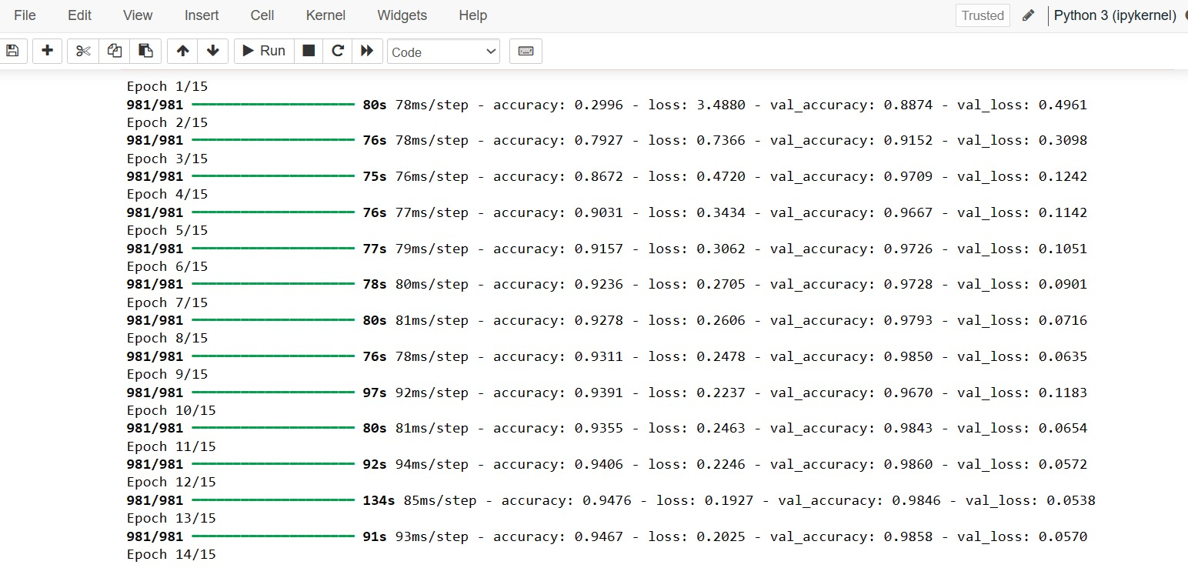
RESULTS:

Slide 12
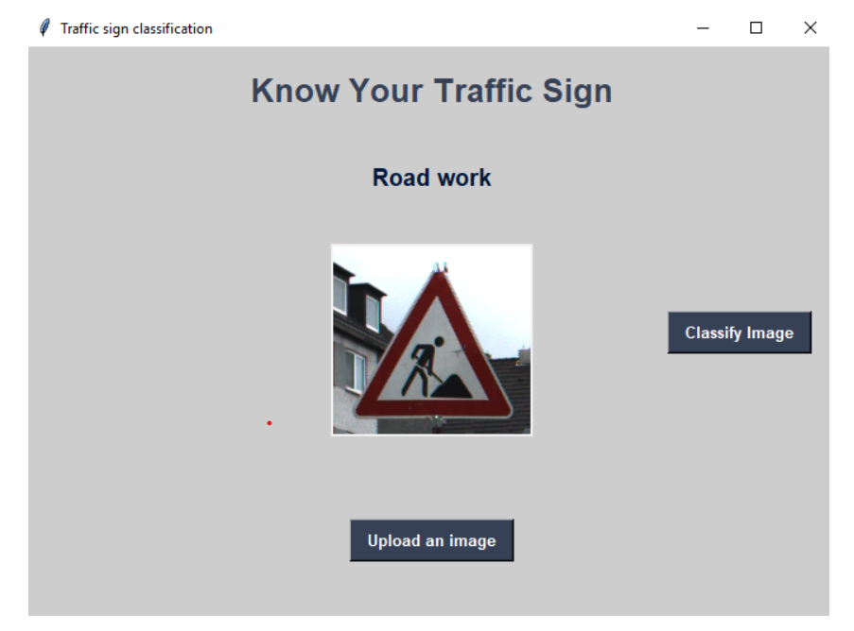
DemoLink

