Slide 1
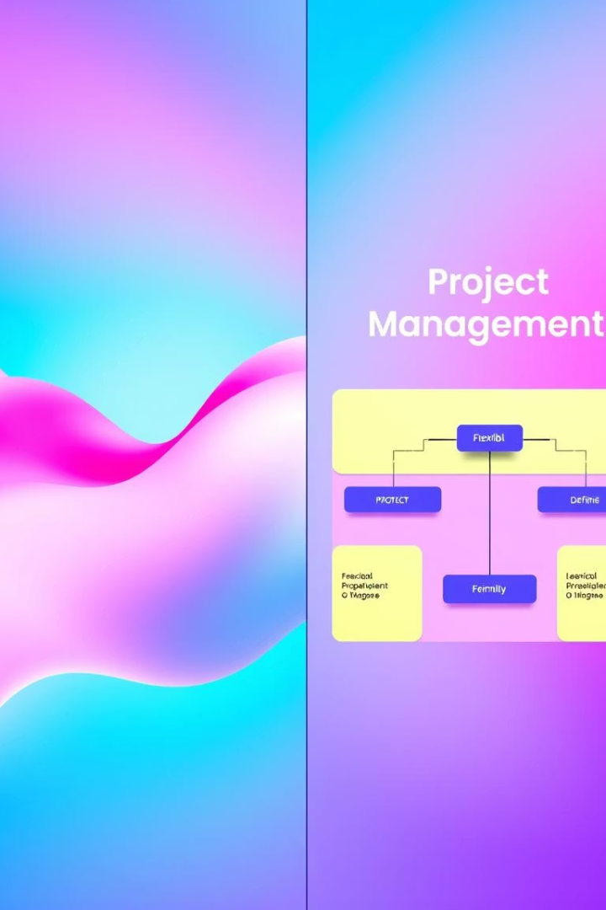
Agile vs. Scrum: A Side-by-Side Comparison
Definition
Philosophy and set of guiding principles
Specific framework for implementing Agile
Scope
Broad approach to project management
Focused on iterative project delivery
Prescriptiveness
Less prescriptive, more flexible
More prescriptive, with defined roles and events
Implementation
Can be implemented in various ways
Specific set of practices to follow
Focus
Customer satisfaction through collaboration
Delivering working software in short sprints
Agile is a broad philosophy, while Scrum is a specific framework within it. Agile is flexible, focusing on customer satisfaction and collaboration. Scrum is more prescriptive, emphasizing iterative delivery through defined practices like sprints.

Slide 2





Agile Values: The Agile Manifesto
Individuals and interactions
Prioritize people and their communication over rigid processes and tools.
Working software
Deliver functional software consistently, rather than extensive documentation.
Customer collaboration
Engage actively with customers throughout the project lifecycle.
Responding to change
Embrace adaptability to evolving requirements, instead of sticking to a fixed plan.
The Agile Manifesto emphasizes human interaction and functional software. It champions collaboration with customers and adapting to change. These values guide iterative progress and continuous improvement.

Slide 3

Scrum Values: The Scrum Framework
Commitment
Courage
Focus
Team members are dedicated to achieving their Sprint goals.
The team has the bravery to address challenges and do what is right.
Everyone concentrates on the tasks within the current Sprint.
Openness
Respect
Transparency is key; team and stakeholders share progress and challenges.
Team members value each other's skills and contributions.
Scrum values drive effective teamwork and project delivery. Commitment, courage, and focus ensure progress during Sprints. Openness and respect foster a healthy, productive environment.

Slide 4




Real-World Example: Agile in Marketing
Customer Feedback
Real-time Analytics
Kanban Boards
Prioritize continuous feedback
Adapt strategies based on data
Visualize workflow effectively
An Agile marketing team remains flexible and responsive. They use Kanban boards to manage campaigns visually. Strategies evolve quickly based on real-time customer feedback and analytics. This iterative approach ensures maximum impact.

Slide 5








Real-World Example: Scrum in Software Development
Two-Week Sprints
Product Backlog
Focused development cycles
Prioritized by Product Owner
Working Increments
Daily Stand-ups
Delivered each Sprint
Brief team syncs
A Scrum software team builds mobile apps using short, focused sprints. Daily stand-up meetings ensure alignment and quick problem-solving. The product owner manages a prioritized backlog. This leads to regular delivery of functional software increments.

Slide 6
In Summary: Agile and Scrum
Agile: The Philosophy
Scrum: The Framework
Agile is a mindset and a set of principles. It prioritizes flexibility and customer collaboration. It guides how teams approach work, emphasizing adaptability.
Scrum is a specific way to implement Agile. It provides defined roles, events, and artifacts. It's a structured method for iterative project delivery.
Agile is the "what" and Scrum is the "how." Scrum offers a structured path to embody Agile principles. The choice depends on project needs and team dynamics.

