Slide 1


EchoPay
ECHOPAY

Slide 2




ECHOPAY
TEAM MEMBERS
J. Elakkiya
C. Kanimozhi
P. Manjari
P. Matheeshini

Slide 3
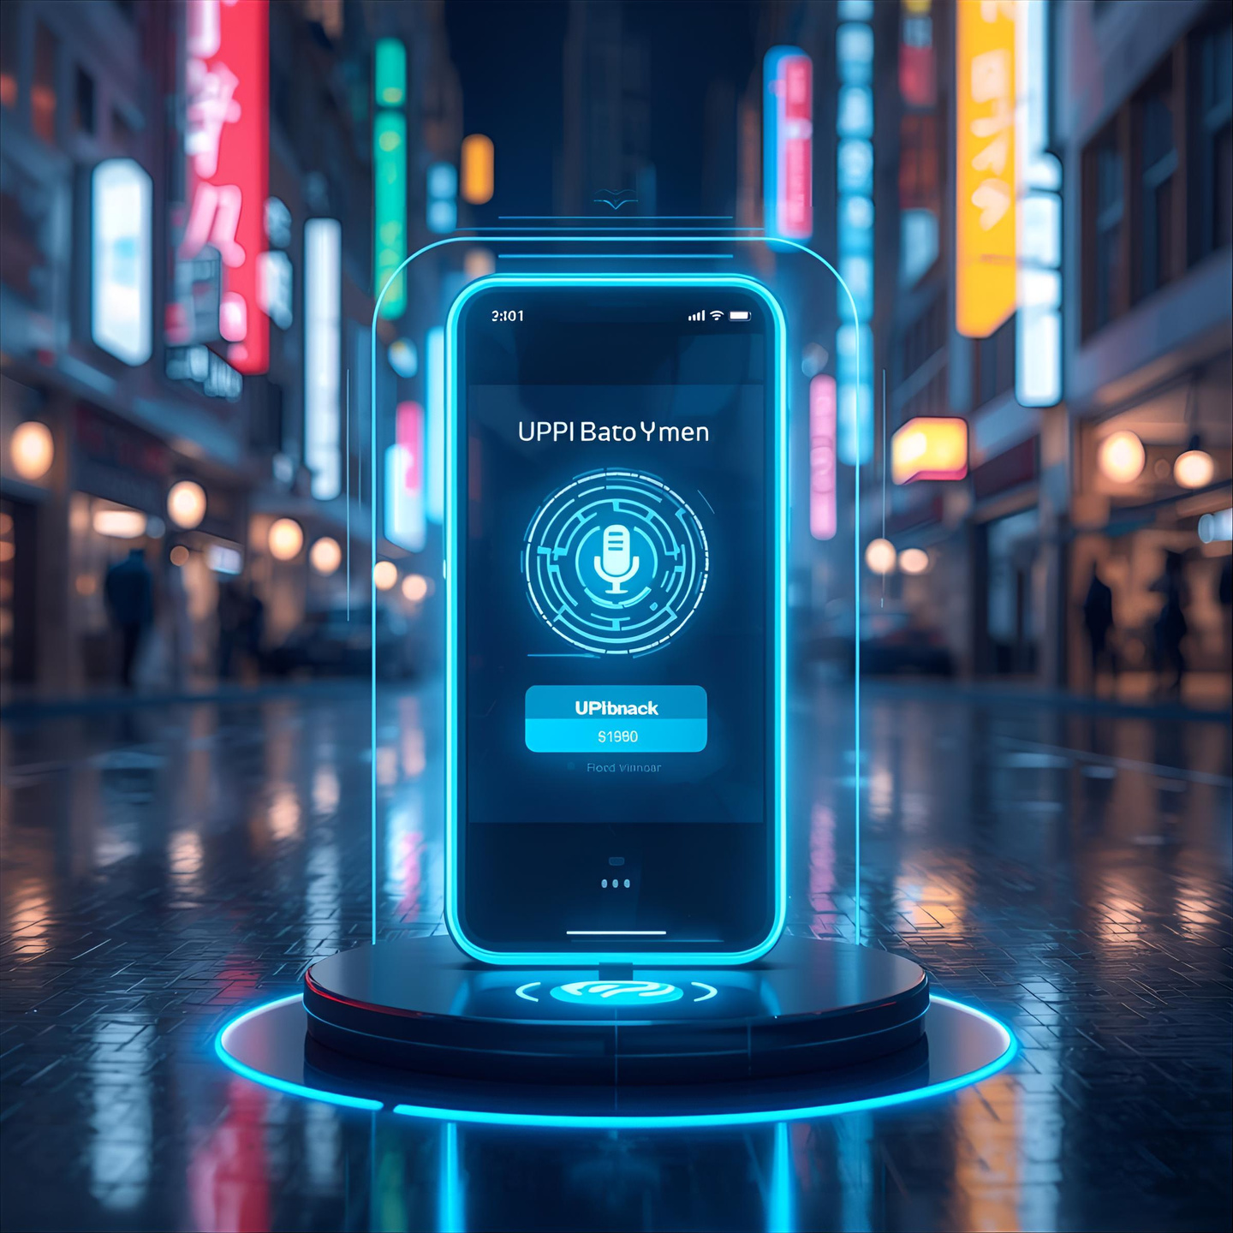

EchoPay
ABOUT THE PROJECT
Digital payments are becoming essential in India, but many elderly users and illiterates struggle to use UPI apps due to complex interfaces and small text.
EchoPay is a simplified, voice-based UPI payment app that helps seniors make secure transactions easily using voice commands in their preferred language

Slide 4
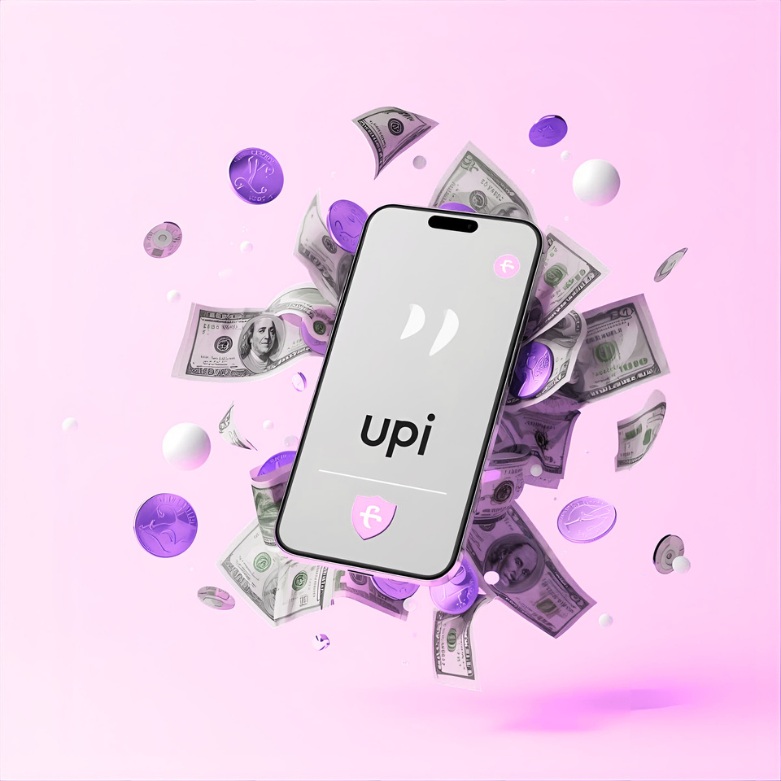
Echopay
PROBLEM & SOLUTION
PROBLEM
Elderly people find it hard to use digital payment apps because of:
Small fonts and confusing layouts
Fear of making payment mistakes
Difficulty in remembering PINs
Lack of local language support
Limited accessibility for vision or mobility issues
SOLUTION
A voice-enabled UPI payment app that allows seniors to:
Get audio confirmation before sending money
Use Local Indian language voice options
Experience large icons, minimal screens, and clear instructions
Build trust through visual + voice feedback after transactions
Reduce number of steps required to make payments

Slide 5
Echopay
Target
Audience
Primary Users
Location Focus:
Secondary Users
Elderly users aged 55+ struggling with digital payments
Urban and semi-urban India
All over India
Family members who help seniors manage payments.
To collect detailed insights about the emotions, fears, and comfort levels of elderly users while using UPI payment apps.

Slide 6





Echopay
Design Thinking
Empathize
Ideate
Test
Define
Design

Slide 7
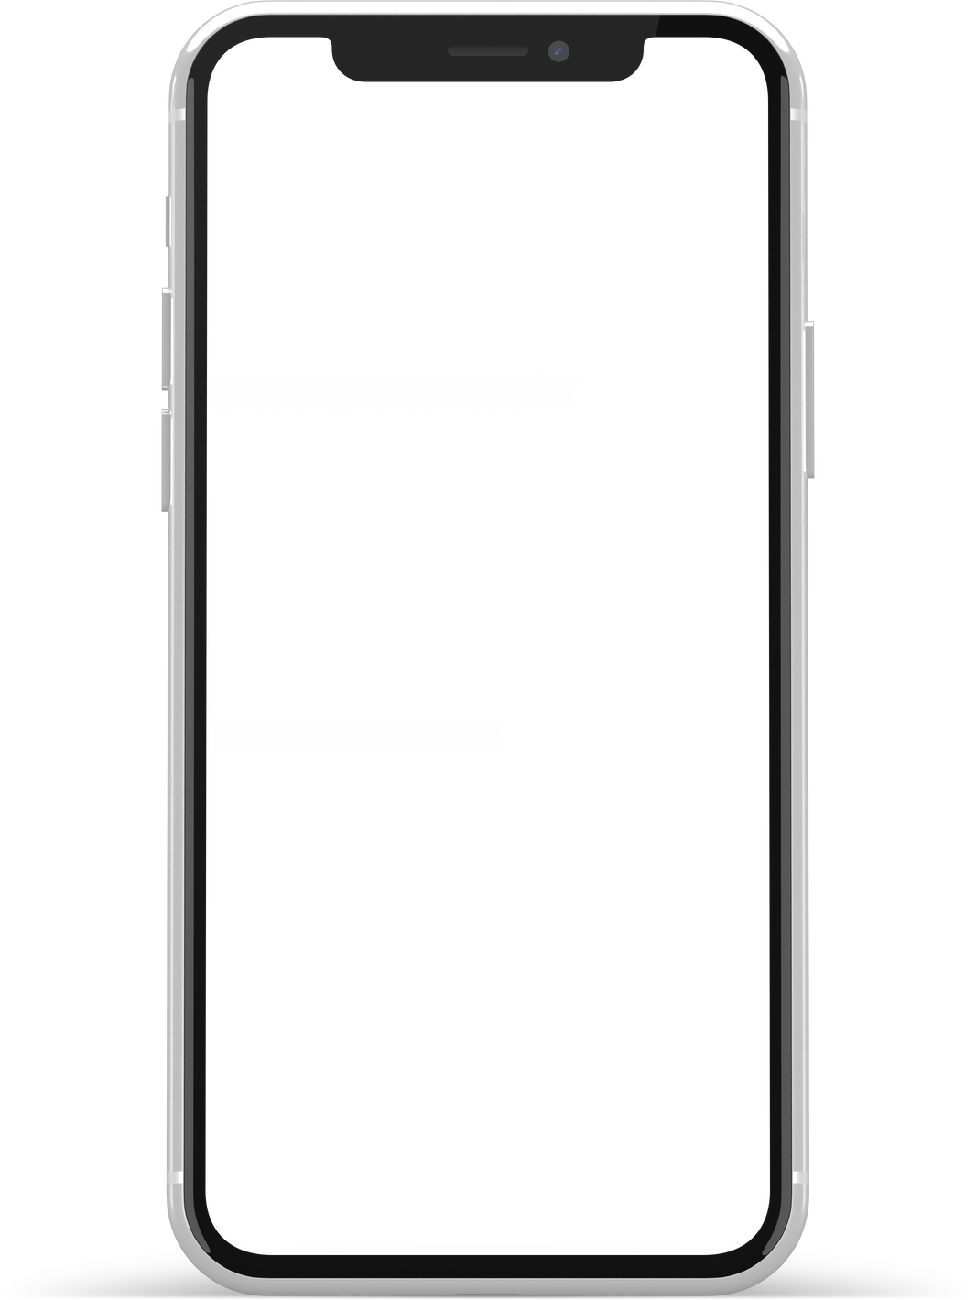

EchoPay
User Research
How often do you use digital payments (UPI)?
What problems do you face while using UPI apps?
Which language do you prefer for digital payments?
Have you ever made a payment mistake online?
Would you prefer voice-based help while making payments?
Do you seek help from family members to complete payments?
Would you like an app that confirms transactions by voice?
How confident do you feel while making payments alone?
🧩 Insights:
Users want control + simplicity.
Familiarity with voice assistants (Google Assistant) makes this concept feasible.

Slide 8
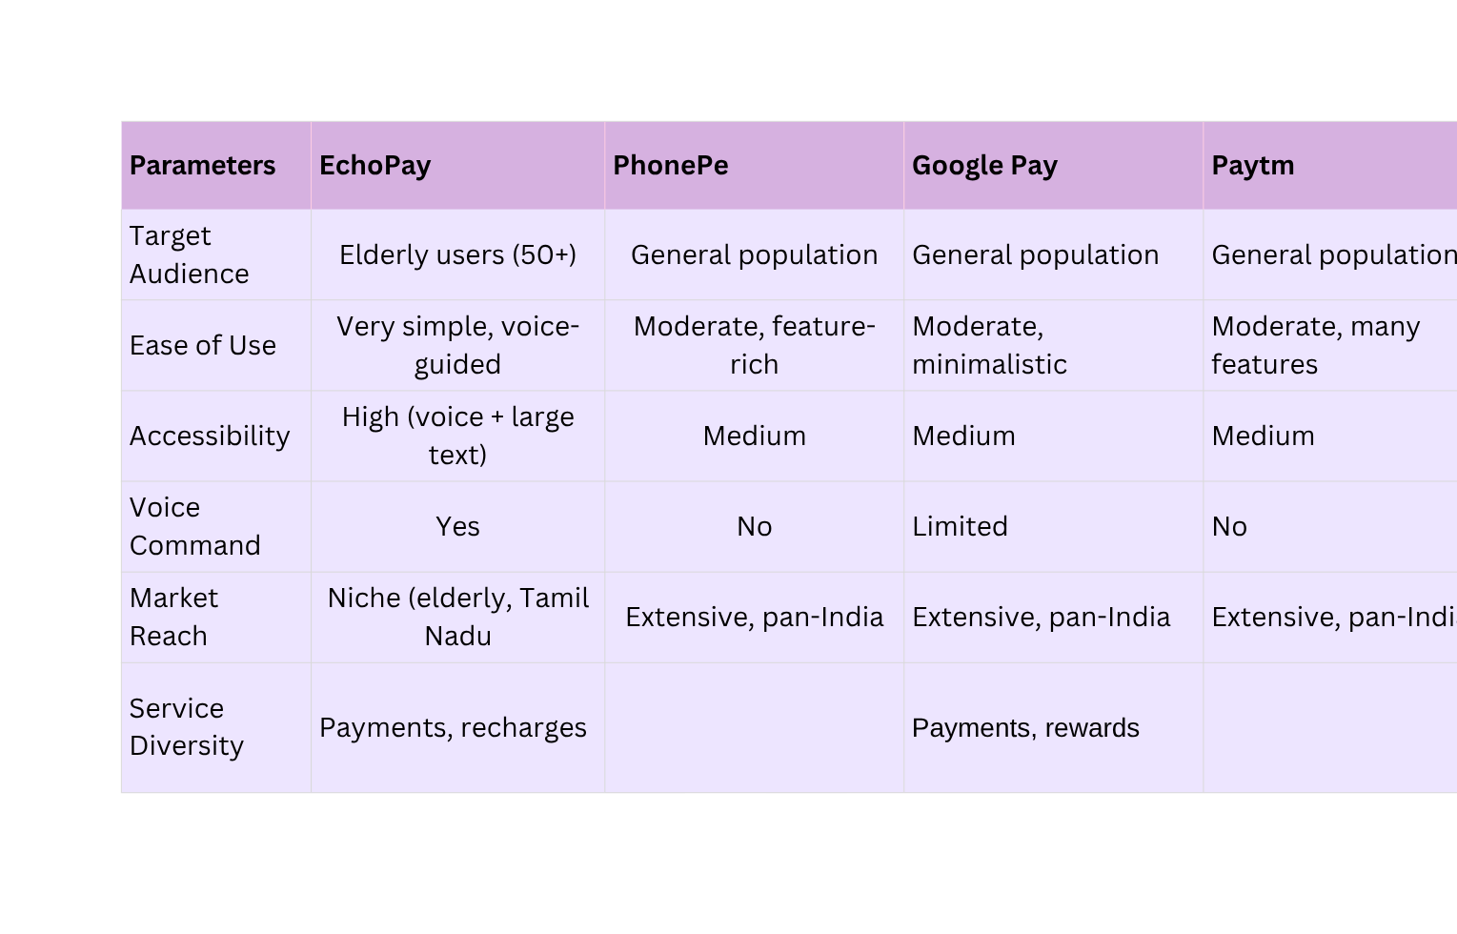
EchoPay
Competitor Analysis
Payments, recharges, insurance, gold
Payments, recharges, financial services

Slide 9
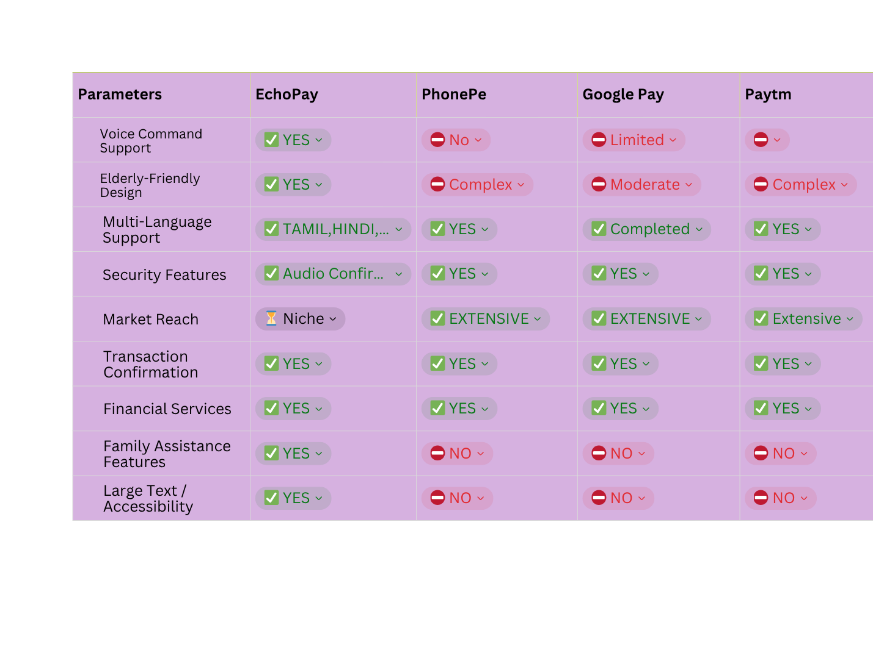
EchoPay
Feature Analysis

Slide 10




EchoPay
SWOT Analysis
STRENGTHS
WEAKNESSES
Complexity for Elderly Users: Feature-rich interface may overwhelm older users.
Security Concerns: Incidents of fraud and phishing attacks have been reported.
•Dominant player with a significant market share in UPI transactions.
•User-Friendly Interface: Intuitive design catering to a broad audience.
PhonePe
THREATS
OPPORTUNITIES
Regulatory Challenges: Government policies may impact operations.
Intense Competition: Rival apps may erode market share.
Expansion into Rural Areas: Potential to reach underserved populations.
Partnerships with Financial Institutions: Collaborations can enhance service offerings

Slide 11

User Persona
Name: Rajendran Pillai
Age: 70
Occupation: Retired Government Officer
Location: Madurai, Tamil Nadu
Tech Comfort: Moderate (uses phone for WhatsApp and YouTube)
Goals :Make payments independently and confidently.
Trust digital transactions.
Frustrations: Confusing layouts, small text, and fear of errors.
Struggles to remember PINs and read English screens
Needs:
Tamil voice guidance.
Simple and secure experience.
Clear voice and visual feedback.
🧩 Quote:
“I just want to say the amount and name — and make sure it’s correct before paying.”

Slide 12
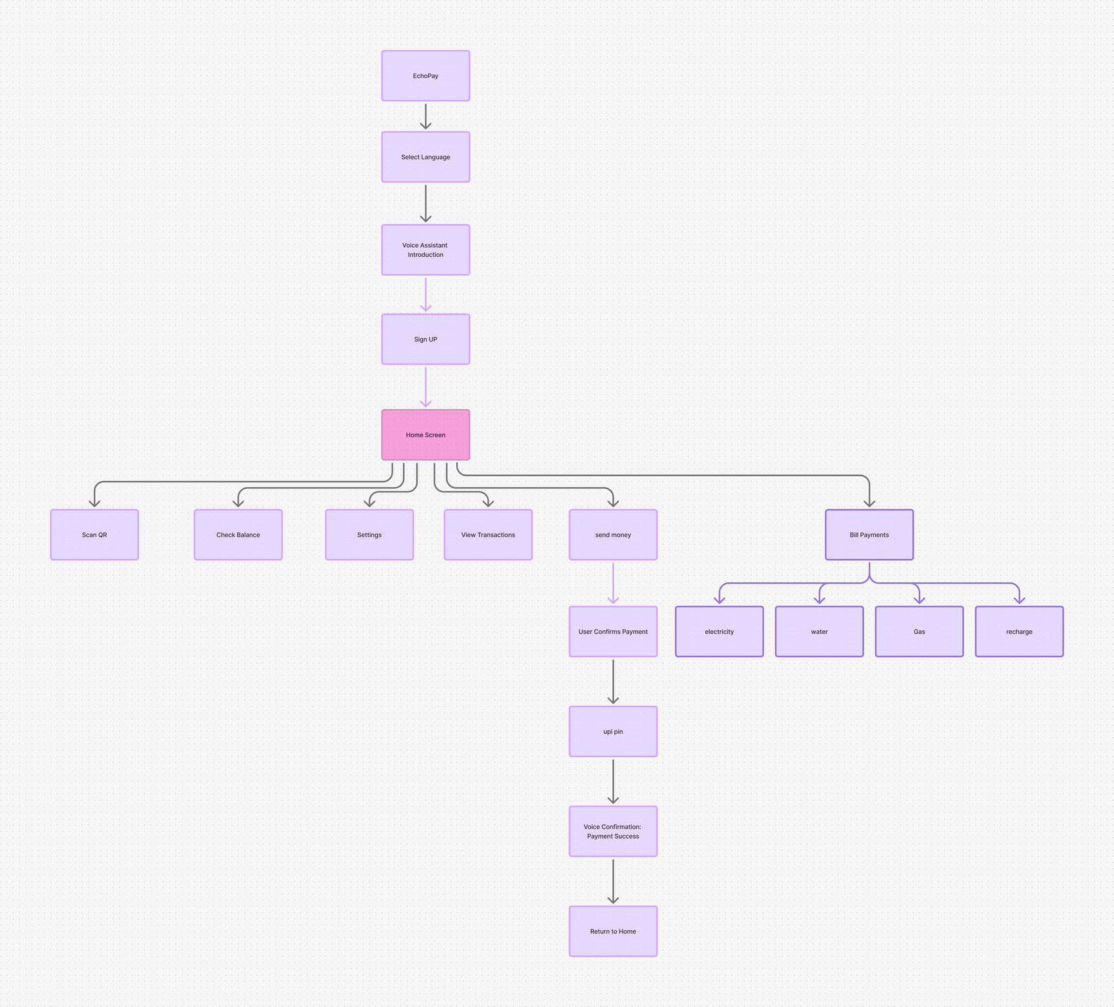
EchoPay
User Flow

Slide 13
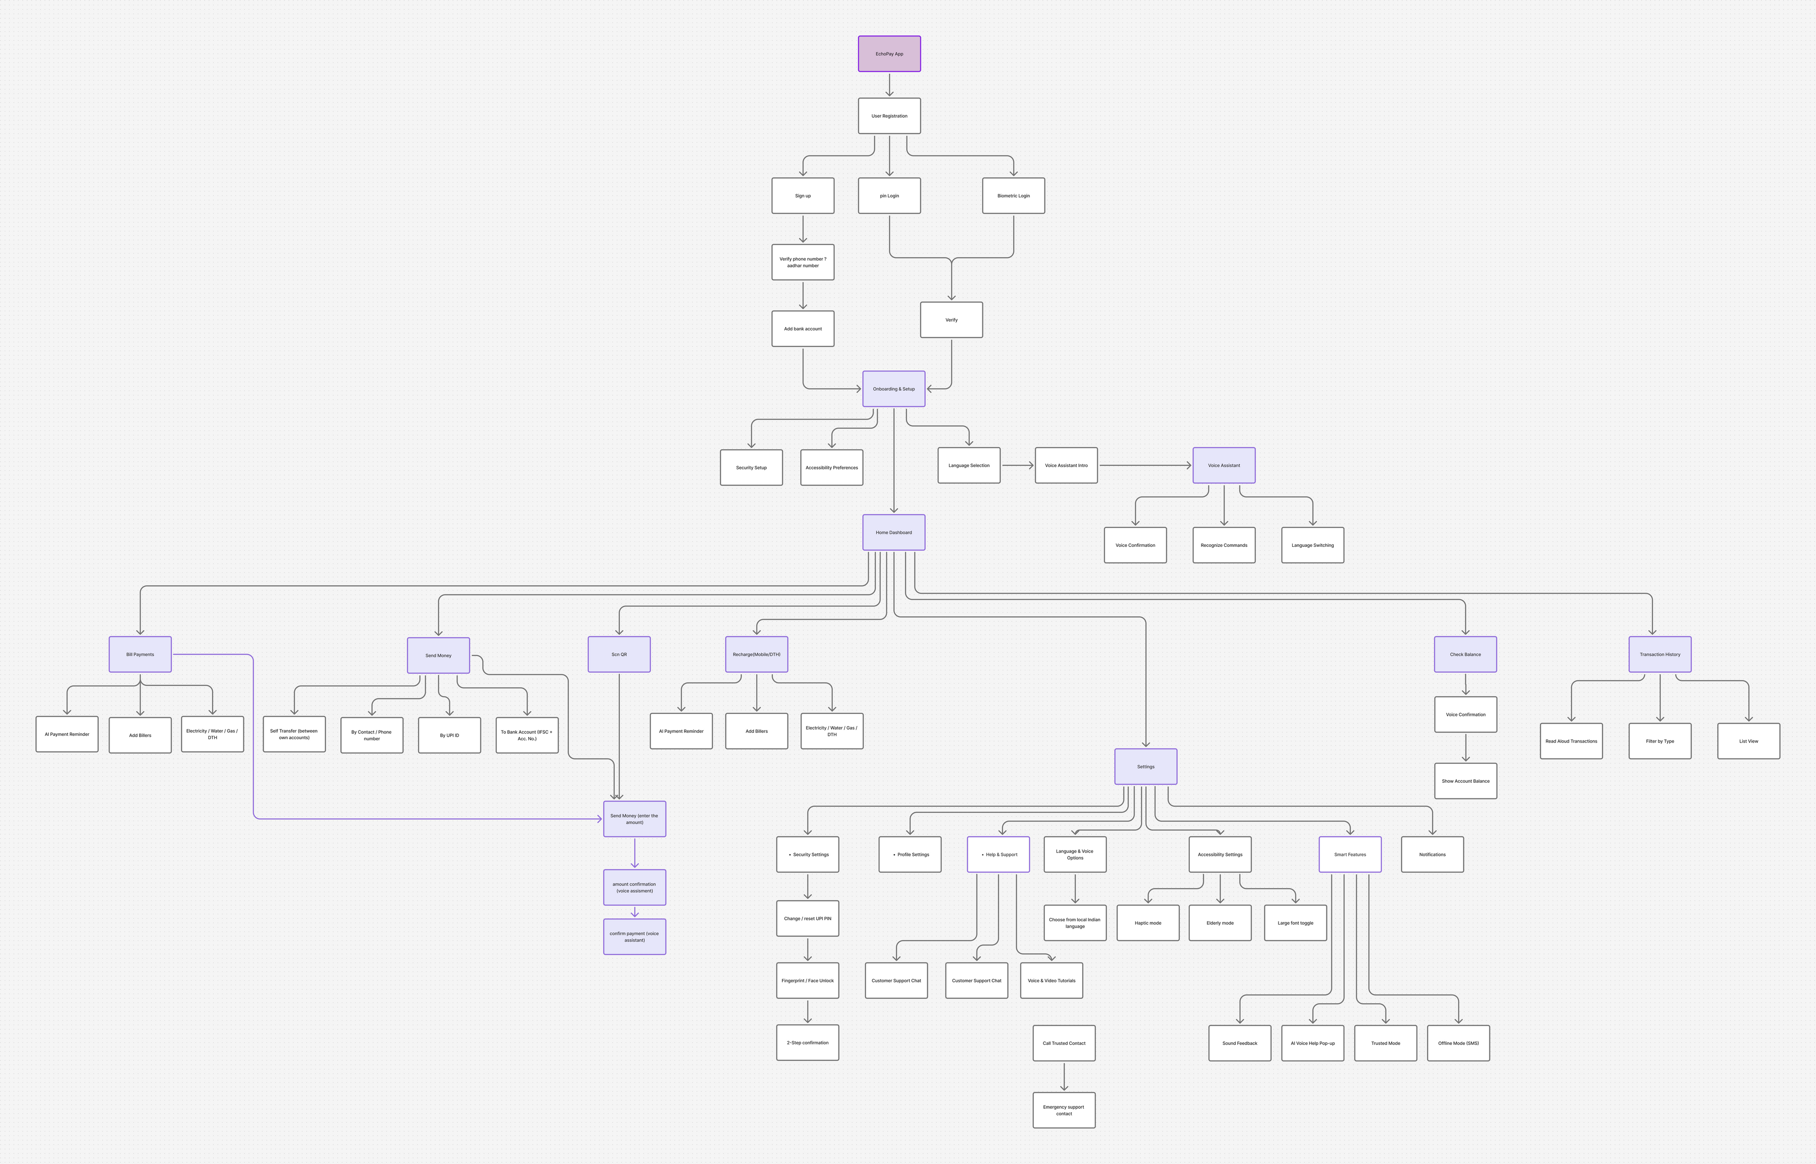
Information architect

Slide 14
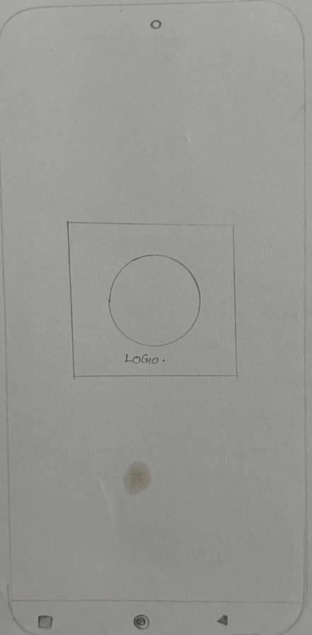
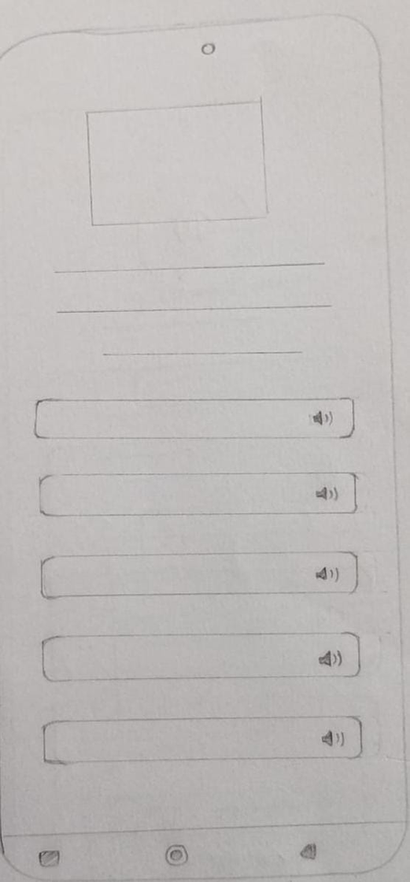
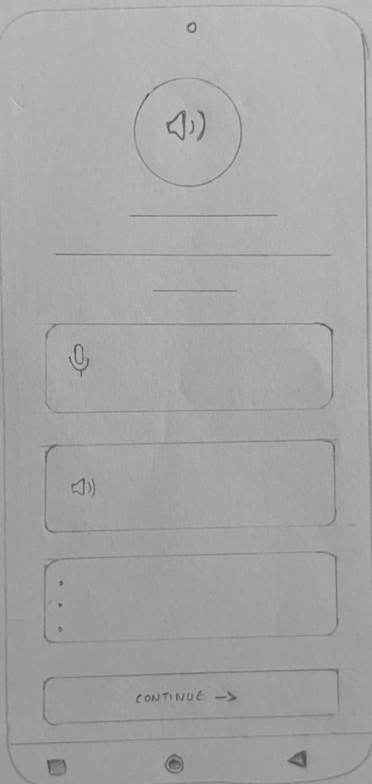
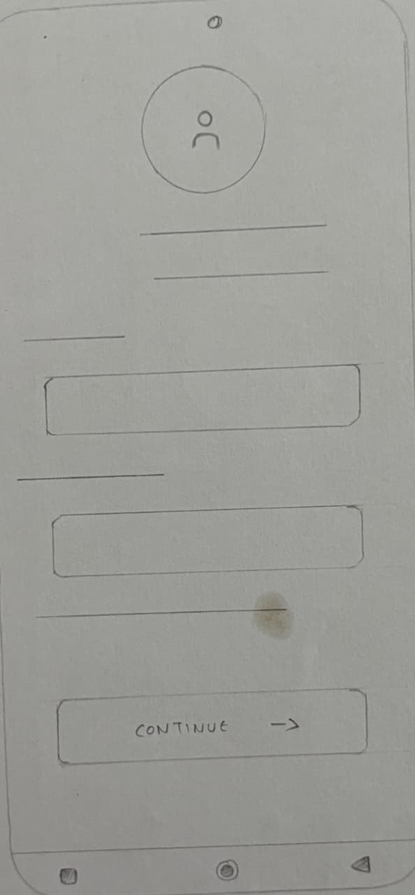
Low Fidelity
Logo
Language Selection
Voice Assistant Intro
Login Page

Slide 15
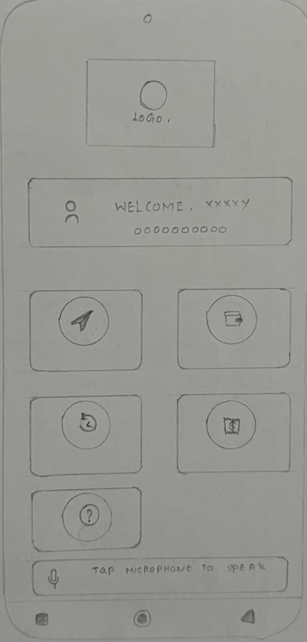
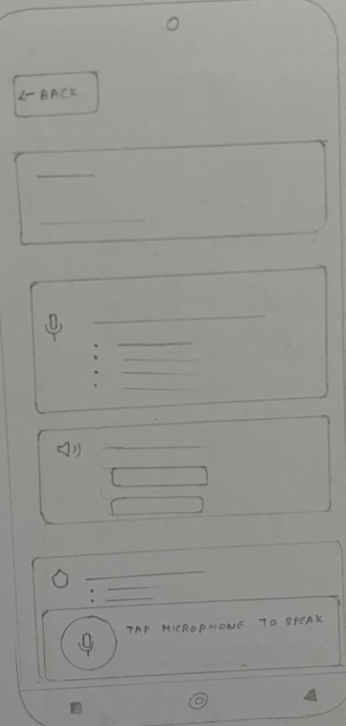
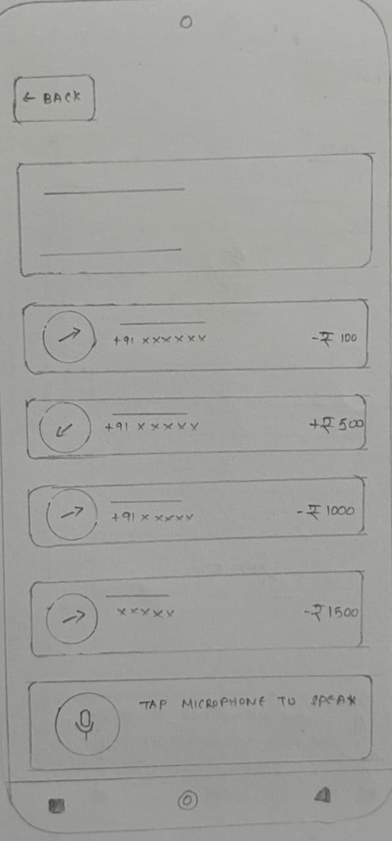
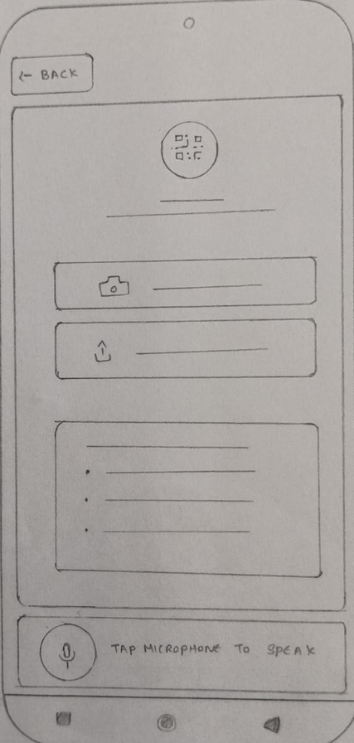
Low Fidelity
Home Screen
Account Balance
Transaction History
QR Scanner

Slide 16
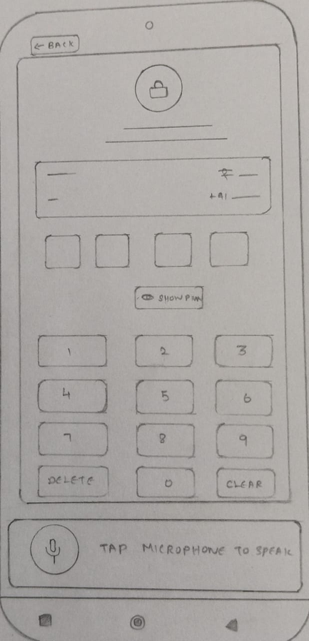
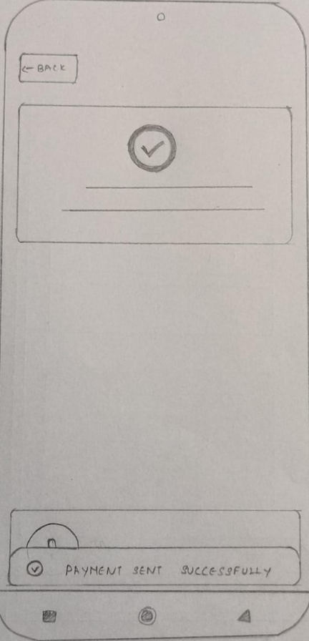
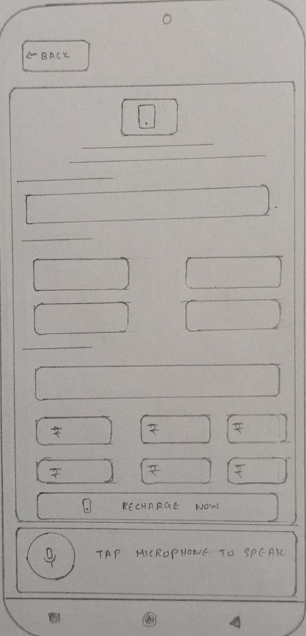
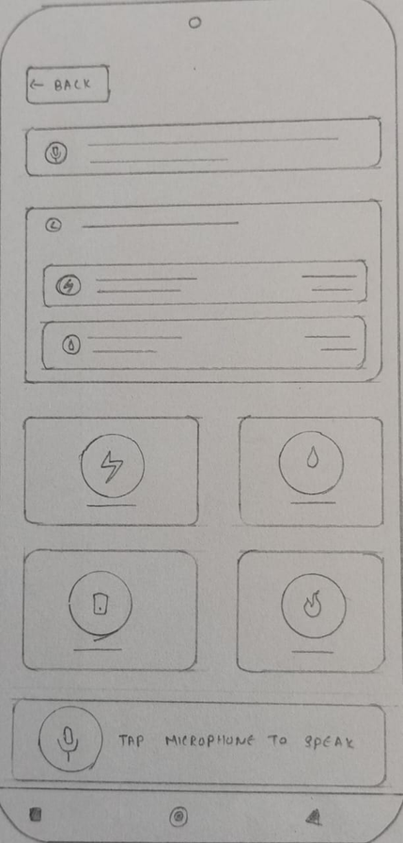
Low Fidelity
UPI Pin
Payment Successful
Mobile Recharge
Bill payments

Slide 17

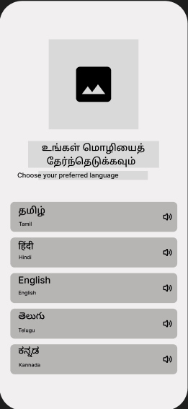
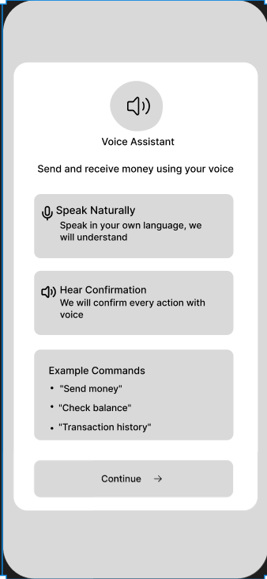
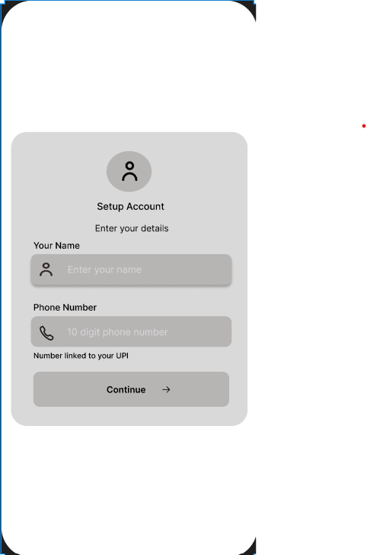
Mid-Fi Screens

Slide 18
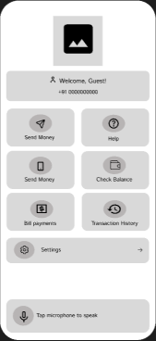
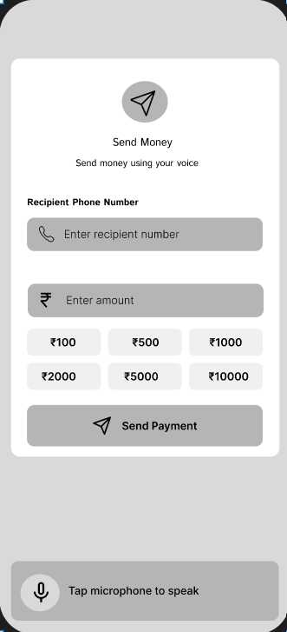
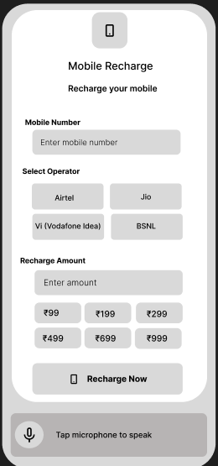
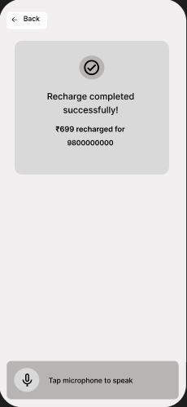
Mid-Fi Screens

Slide 19
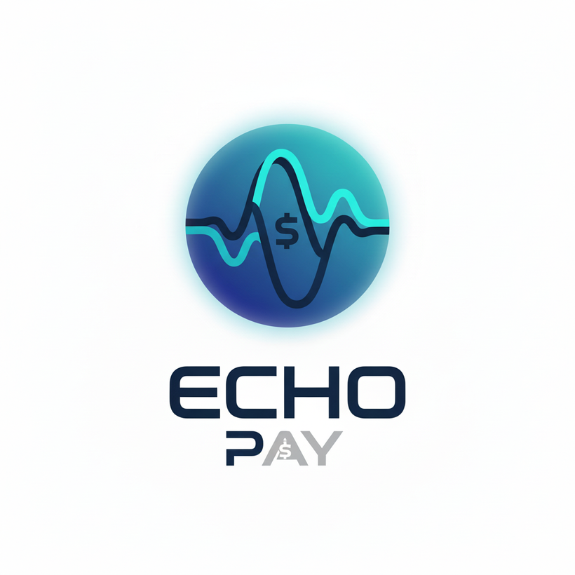
UI Design Kit:Logo
🌀 EchoPay Logo Description
The EchoPay logo visually represents the app’s purpose — simplifying UPI payments through voice assistance for elderly users. The circular icon features a soundwave integrated with a dollar symbol ($), symbolizing voice-driven financial transactions. The wave design reflects clarity, communication, and trust, while the cool blue and teal tones convey security, reliability, and modern technology. The bold typography of “ECHO” paired with the sleek “PAY” highlights the fusion of voice (echo) and payment innovation (pay) — making it both friendly and futuristic.

Slide 20
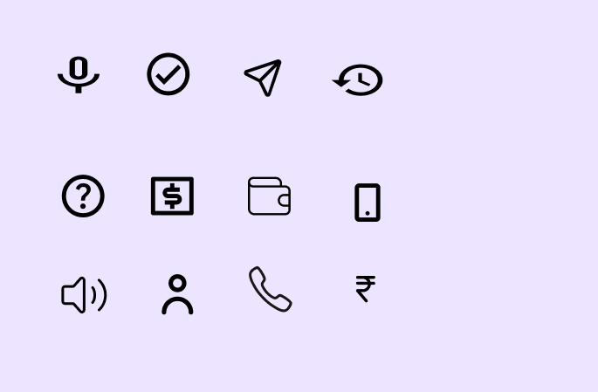
UI Design Kit: Icons
Icons

Slide 21

UI Design Kit: Grid
Grid:
Column : 4
Margin : 16
Gutter : 20

Slide 22

UI Design Kit: Color
Buttons,
highlights
Action icons
#A7F4B3
#3727AC

Slide 23


UI Design Kit: color
Microphone area
background
Card
backgrounds
#8091FB
#FFFFFF
Background
Background
bottom
#000000
#E0F4FF

Slide 24



UI Design Kit: color
Tertitary colors
#00A861
#8257FF
#009EEF
#FF4920

Slide 25
UI Design Kit: TYPOGRAPHY
 | FONT SIZE | FONT WEIGHT | FONT FAMILY | COLOR SCHEME
HEADING 1 | 20 | SEMI BOLD | INTER | PRIMARY
HEADING 2 | 16 | SEMI BOLD | INTER | PRIMARY
HEADING 3 | 14 | MEDIUM | ISTOK WEB | PRIMARY
BODY | 16 | REGULAR | INTER | PRIMARY
CAPTION | 12 | REGULAR | INTER | MUTED
BUTTON | 16 | SEMI BOLD | INTER | SECONDARY

Slide 26
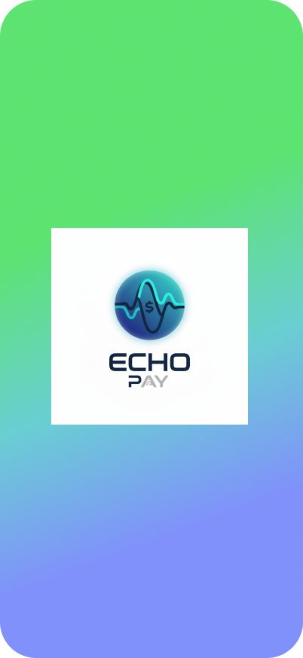
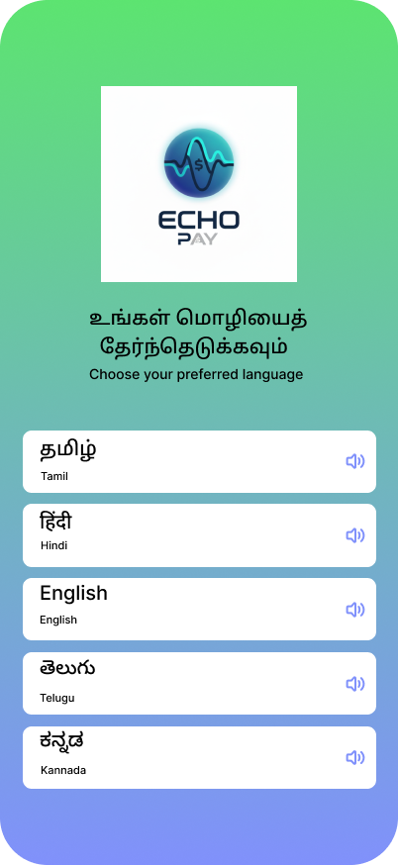
High-Fi Screens
Logo
Language Selection

Slide 27
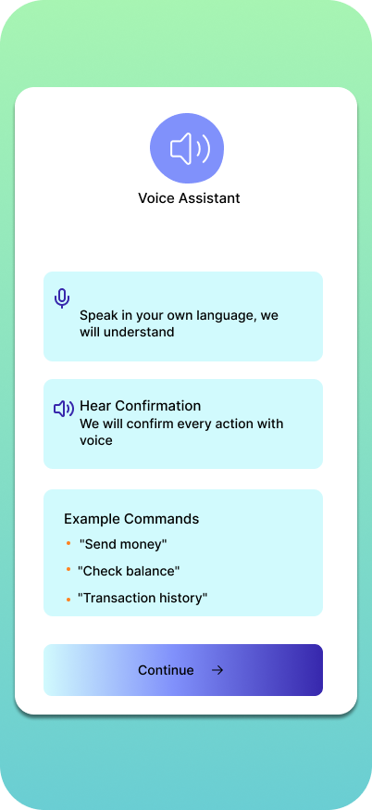
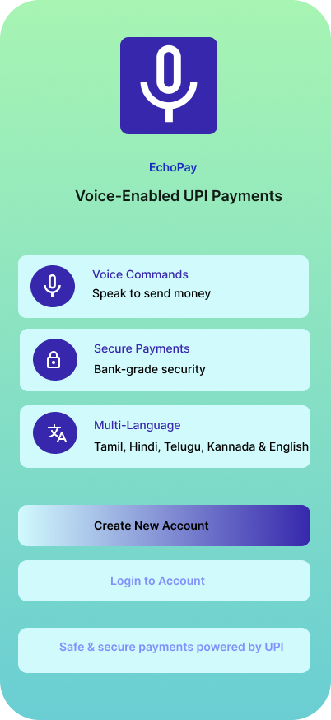
High-Fi Screens

Slide 28
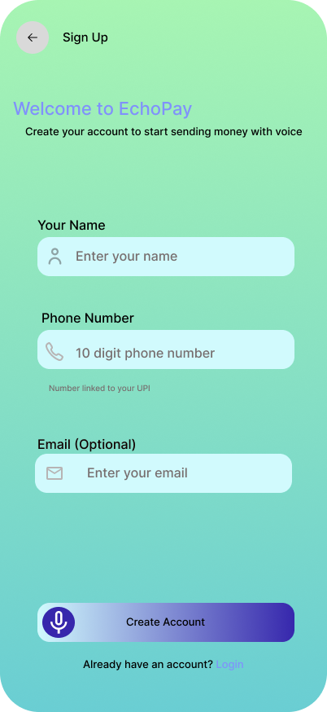
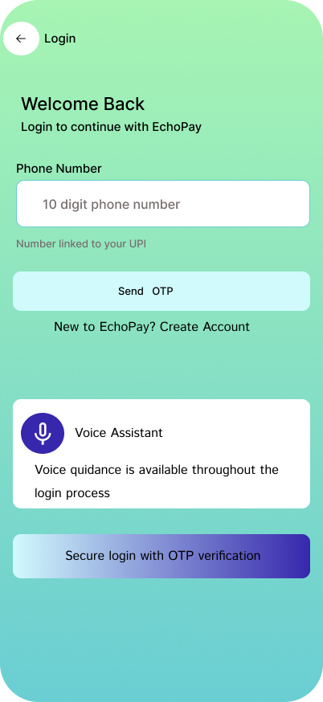
High-Fi Screens
Sign Up Page
Login Page

Slide 29
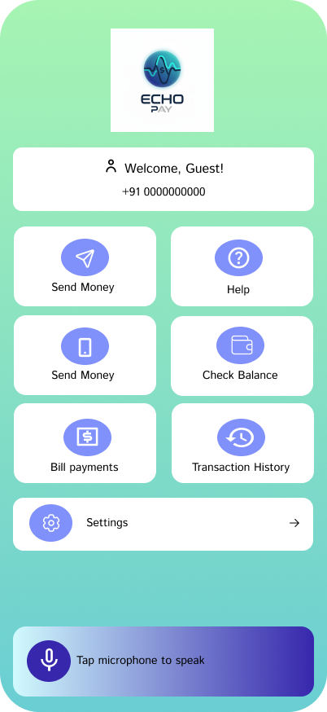
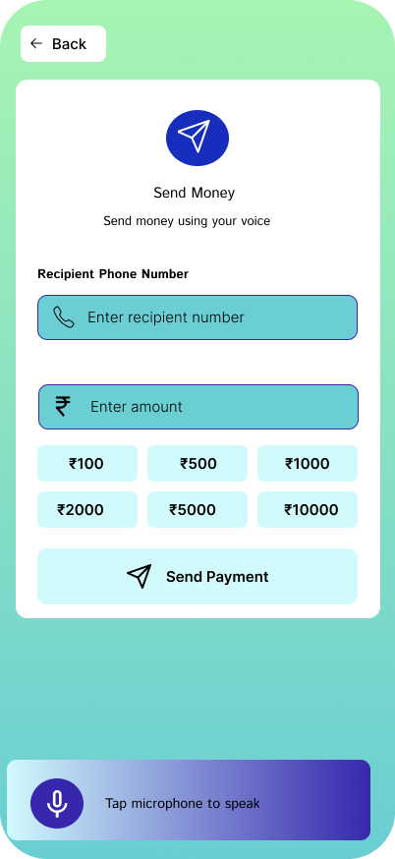
High-Fi Screens
Home Screen
Send money

Slide 30
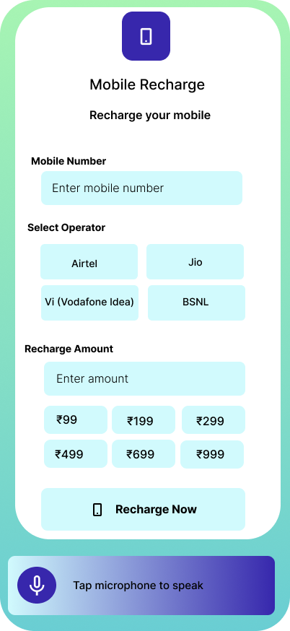
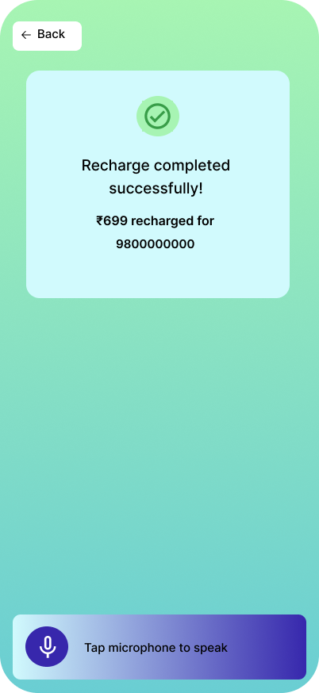
High-Fi Screens
Mobile Recharge
Payment Successful

Slide 31
UI Design Kit: Home Page
Logo
Profile
Sending money via phn number/contacts
QR code scanning option
Mobile Recharge
Account Balance
Gas /electricity/water Bill payments
past transactions info
Settings
Voice Assisstent

Slide 32
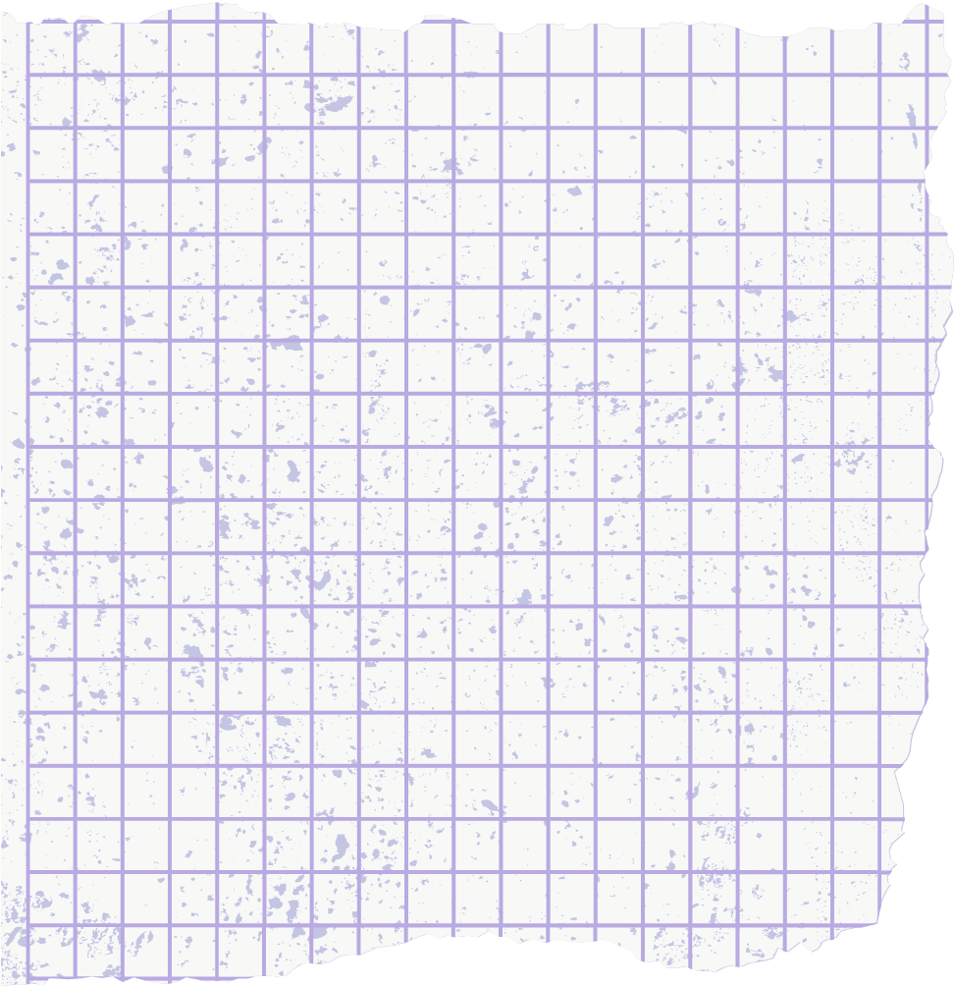



THANK YOU

