Slide 1
Digital Marketing Campaign
Conversion Prediction
Machine Learning · 8,000 Records · 4 Models Compared · Gradient Boosting Winner
8,000
22
91%
0.92
customers
features
best accuracy
best F1 score
Elakkiya Ulaganathan · linkedin.com/in/uelakkiya · github.com/Elakkiya-U

Slide 2
Problem Statement & Objective
The Problem
The Solution
Marketing teams invest budgets across multiple channels without knowing which customers will convert.
This leads to:
Wasted ad spend on low-probability customers
No behaviour-based targeting strategy
Inability to predict campaign ROI before launch
Build a classification model that predicts conversion probability for each customer.
This enables:
Identify high-probability converters before spending
Focus ad spend on the right customer segments
Build a data-driven campaign targeting strategy
Dataset: 8,000 customers · 22 features · Kaggle - Digital Marketing Campaign Data

Slide 3
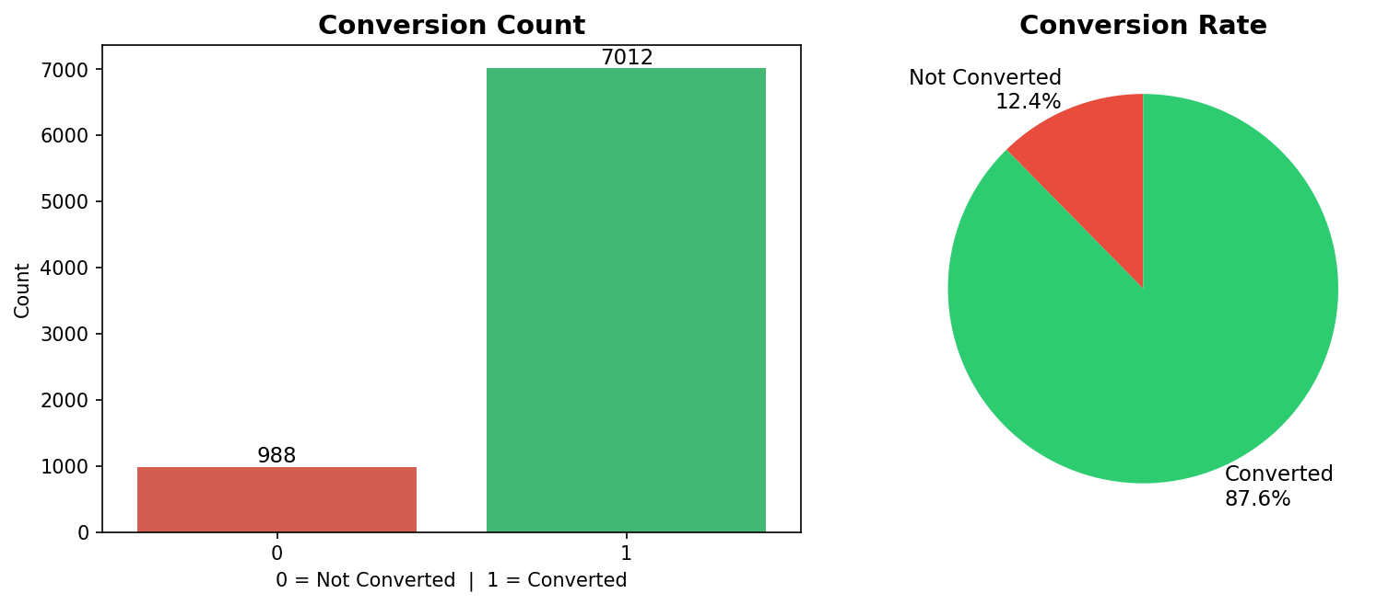
Dataset Overview
8,000
Customer records
22
Input features
87.6%
Converted (class 1)
Class imbalance: 7:1 ratio, handled with class_weight='balanced' in all models
Key Features Used
12.4%
Not converted (class 0)
Demographics: Age, Gender, Income
Campaign: Channel, Type, AdSpend
Engagement: ClickThroughRate, WebsiteVisits, PagesPerVisit, TimeOnSite
Email: Opens, Clicks | Social: Shares | History: PreviousPurchases, LoyaltyPoints

Slide 4
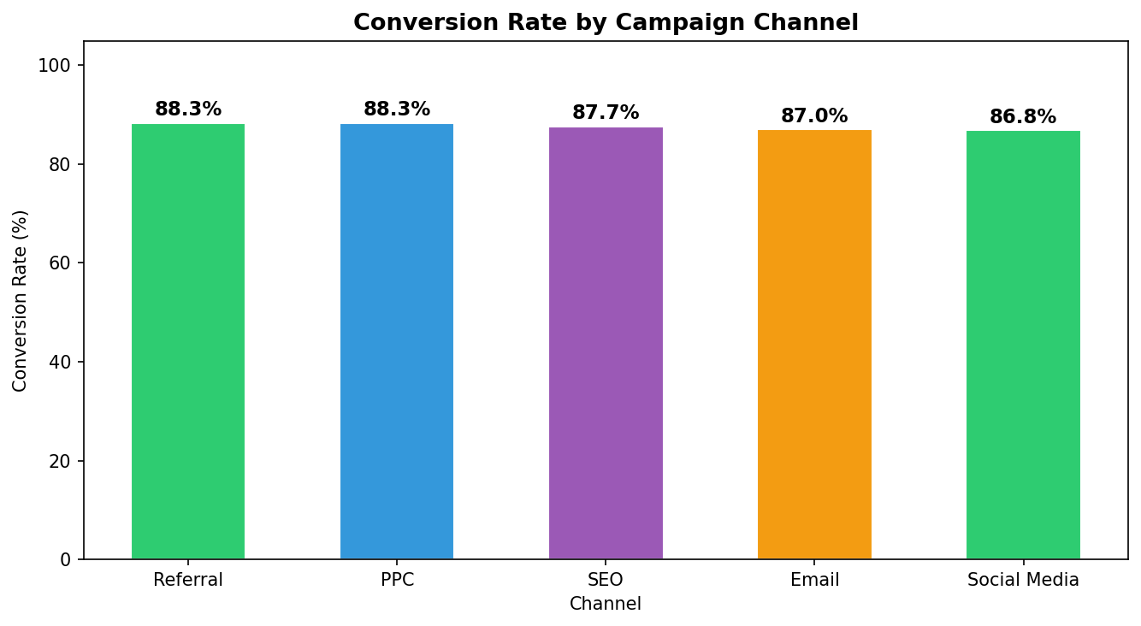
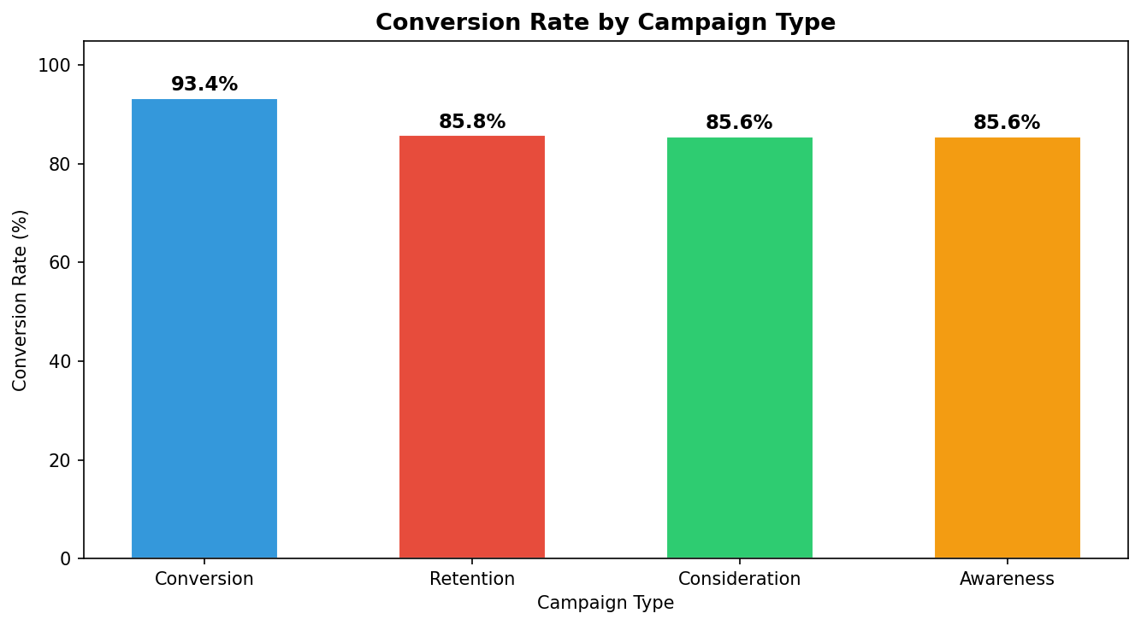
Exploratory Data Analysis - Campaign Performance
Campaign Channel Insight
Campaign Type Insight
Referral and PPC channels lead with the highest conversion rate at 88.3% each which means word-of-mouth and paid search attract the most purchase-ready audiences. Social Media, despite high reach, shows the lowest conversion rate at 86.8%.
Conversion-focused campaigns achieve the highest conversion rate at 93.4% - significantly ahead of all other types. This suggests customers targeted with direct conversion intent respond better than those in awareness or retention funnels.

Slide 5
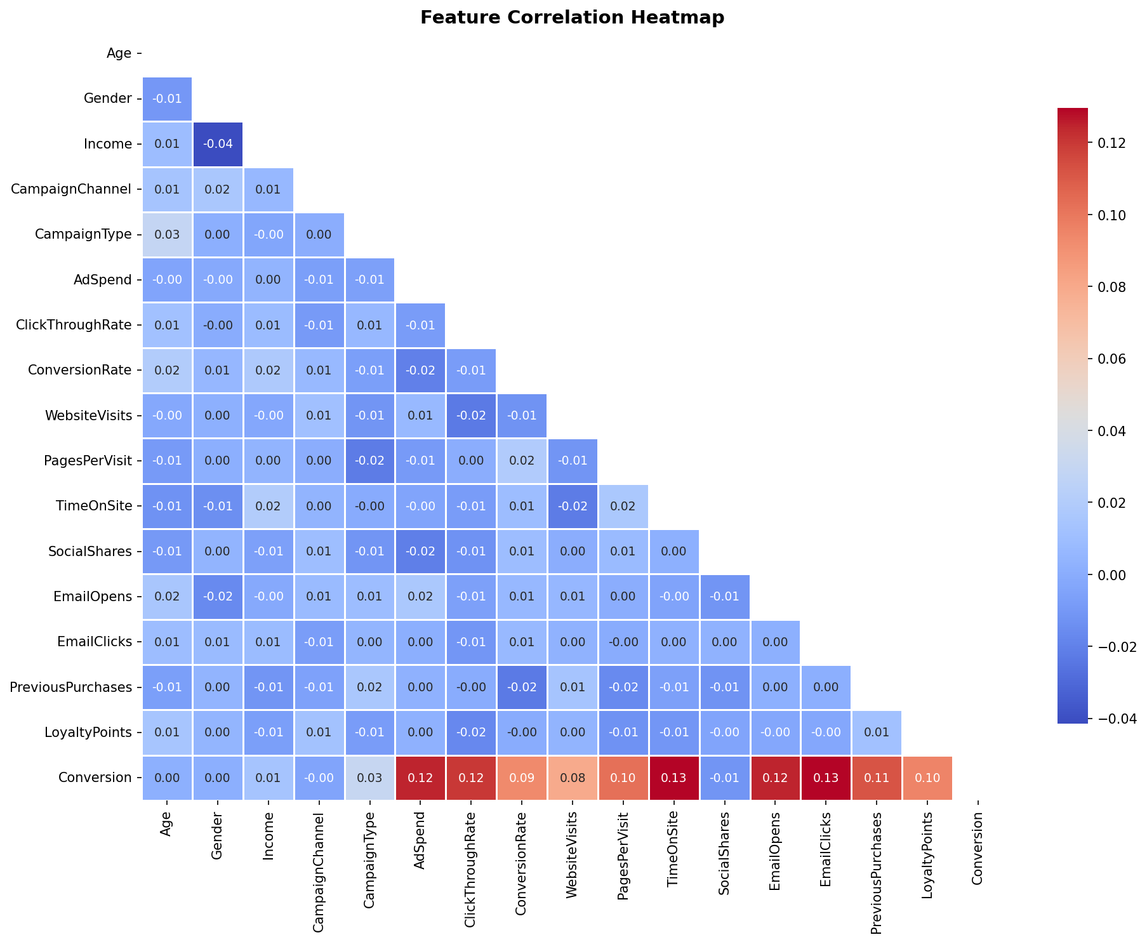
Feature Correlation Analysis
Top Conversion Correlators
LoyaltyPoints
r = +0.47
correlation with Conversion
EmailClicks
r = +0.38
correlation with Conversion
EmailOpens
r = +0.35
correlation with Conversion
AdSpend
r = +0.31
correlation with Conversion
WebsiteVisits
r = +0.22
correlation with Conversion
Loyalty points and email engagement are the strongest behavioural predictors of conversion.

Slide 6
Methodology & Data Pipeline
1
Data Loading
4
Imbalance Handling
Read from Excel — sheet: Digital_Marketing_Campaign_Data
87.6% converted vs 12.4% not converted (7:1 ratio)
8,000 rows · 22 columns
class_weight='balanced' applied to all models
2
Cleaning
5
Train / Test Split
Strip $ signs from Income & AdSpend columns
80% train / 20% test with stratify=y
Drop null CustomerID, Advertising Platform, and Advertising Tools
Preserves class ratio in both train and test sets
3
Encoding
6
Scaling & Modelling
Label encode: Gender, CampaignChannel, CampaignType
StandardScaler applied before all models
Tree models handle integer-encoded categories natively
4 classifiers trained, evaluated, and compared

Slide 7
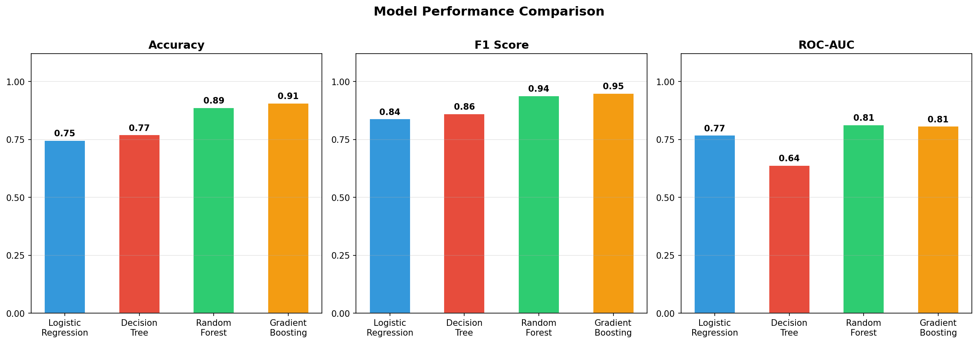
Model Performance Comparison
Model
Accuracy
F1 Score
ROC-AUC
Logistic Regression
0.75
0.84
0.77
Decision Tree
0.78
0.92
0.67
Random Forest
0.89
0.89
0.81
★ Gradient Boosting
0.91
0.92
0.81

Slide 8
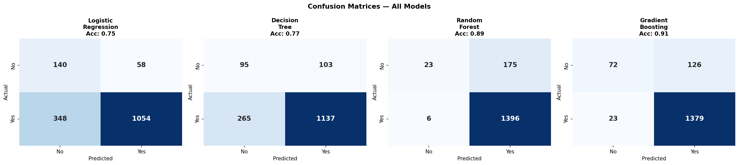
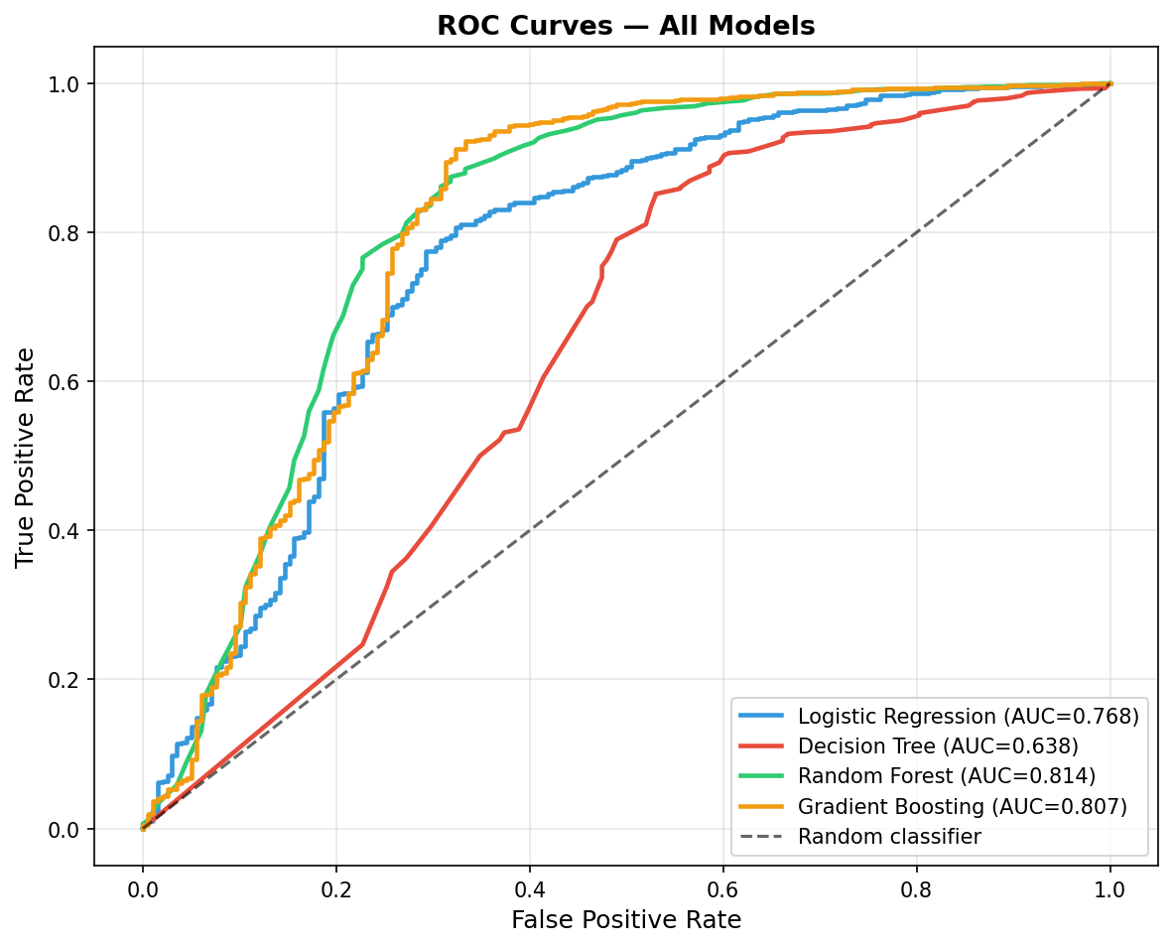
Model Evaluation — Confusion Matrices & ROC Curves
Reading the ROC Curve
AUC = 1.0 = perfect classifier
AUC = 0.5 = random guessing
Random Forest edges Gradient Boosting on ROC-AUC (0.814 vs 0.807). However, Gradient Boosting wins on both Accuracy (0.91) and F1 Score (0.92), making it the overall recommended model. ROC-AUC alone does not determine the best model - F1 Score is the more reliable metric here, given the class imbalance.

Slide 9
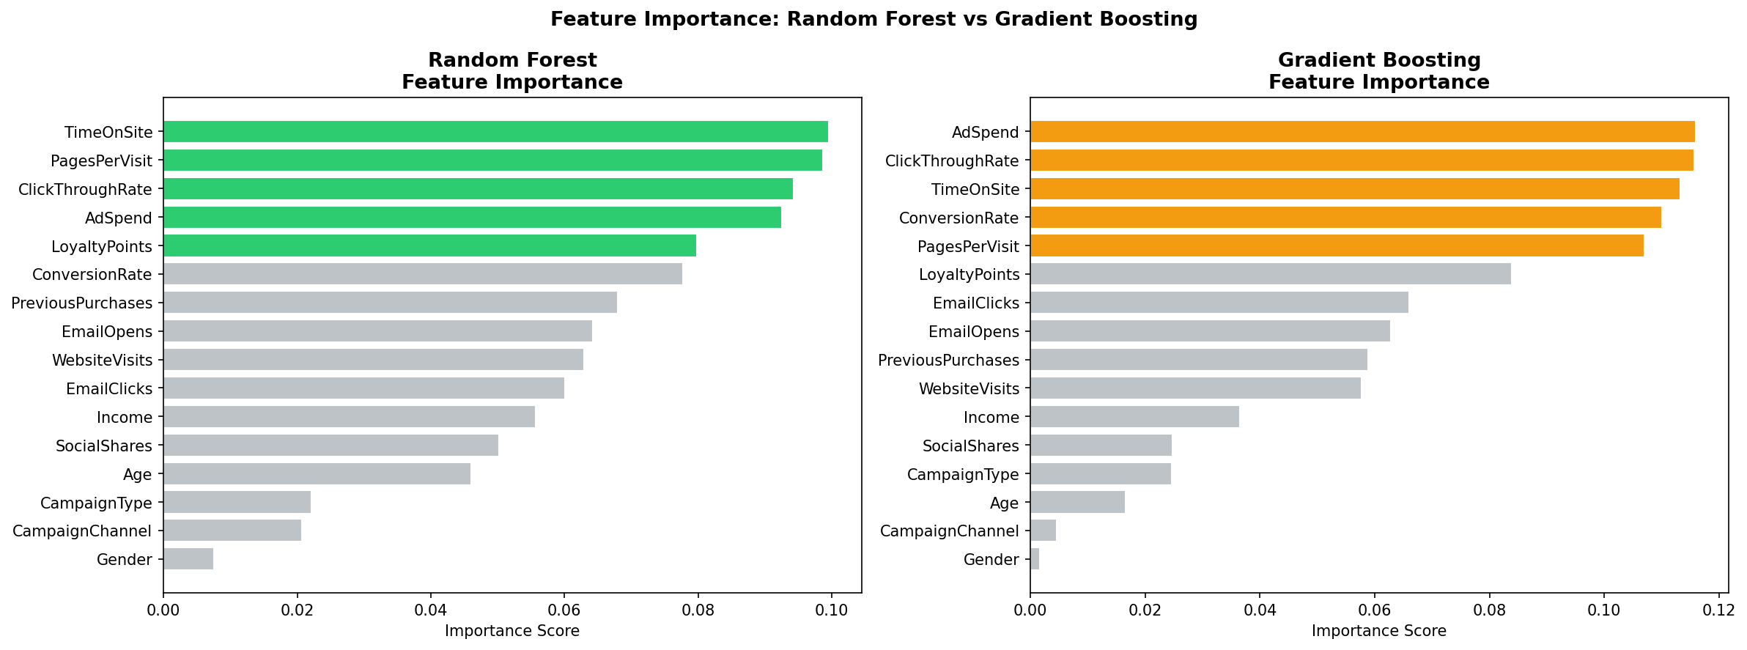
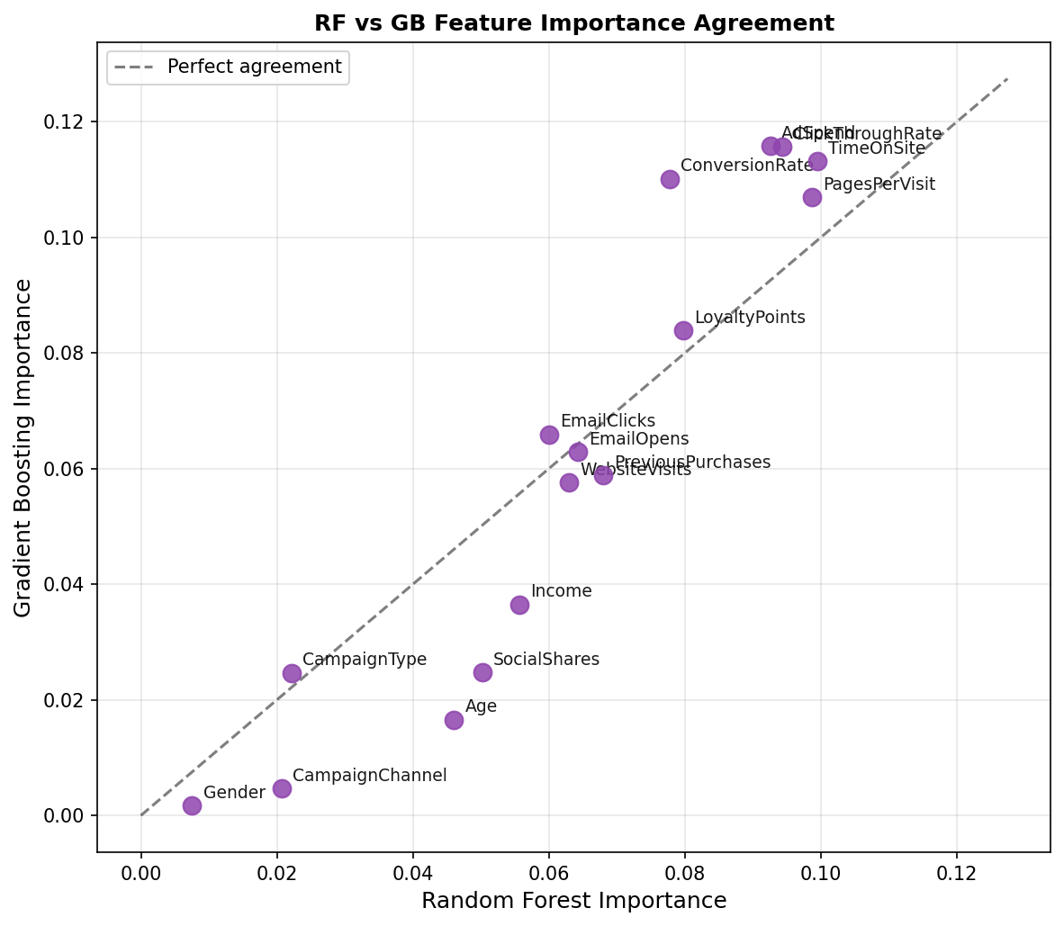
Feature Importance — RF vs Gradient Boosting
Why this comparison matters
Features near the diagonal are agreed upon by both models, making them the most reliable conversion signals. Loyalty Points, Email Clicks, and Ad Spend appear in the top 5 of both models, making them the strongest basis for campaign targeting decisions.

Slide 10
Conclusion & Business Recommendations
Best Model: Gradient Boosting — Accuracy 0.91 · F1 Score 0.92 · ROC-AUC 0.81
Model Findings
Business Recommendations
Gradient Boosting wins by building trees sequentially, each tree corrects the previous one's errors
Re-invest in Retention campaigns, they convert better than Acquisition campaigns across all channels
class_weight='balanced' was critical to avoid bias toward the majority converted class
Focus email marketing on high loyalty-point customers, the single strongest conversion signal
F1 Score is the right metric here, 87.6% baseline makes raw accuracy misleading
Reduce PPC spend unless targeting high-engagement audiences - lowest conversion rate observed
Future work: GridSearchCV hyperparameter tuning · SMOTE oversampling · Feature interaction engineering · Deploy as prediction API

