Slide 1

MINI PROJECT
Student Digital Portfolio & Credential Verification System
Using Blockchain
Guide :
Ms.M.R.Kavitha M.E.,
MEC – AP/CSE
Elakkiya M [6113231041030]
Janani Sri M [6113231041050]
Jayadharshini S [6113231041052]
1

Slide 2
ABSTRACT
Traditional certificate verification systems are slow, centralized, and vulnerable to forgery. This project introduces a secure and decentralized credential verification system using Blockchain, IPFS, SHA-256 hashing, and QR code technology.
Certificate hashes are stored on the Polygon Blockchain, while files are securely stored in IPFS. Multi-signature faculty approval ensures authenticity, and QR codes enable instant real-time verification.
The system improves security, transparency, scalability, and provides tamper-proof academic credential management.
2

Slide 3
PROBLEM STATEMENT
Manual credential verification delays hiring by 2-4 weeks through phone calls/emails to universities. 40% of certificates are suspected fake globally, costing companies millions. Current centralized systems suffer single-point failures, data tampering, and lack student ownership. Research prototypes exist but remain non-production with poor mobile UX and institutional data lock-in. This creates urgent need for instant, secure, student-controlled verification.
3

Slide 4
PROPOSED SOLUTIONS
Secure Certificate Upload
Drag & drop upload ,SHA-256 hash generation , Stored in IPFS (Decentralized CID).
Faculty Multi-Signature Approval
2-of-3 approval mechanism , Smart contract on Polygon Mumbai , Immutable blockchain record created
QR-Enabled Digital Portfolio
Verified PDF portfolio generated , QR linked to blockchain transaction, Portable & shareable credential
Instant Mobile Verification
Scan QR → Fetch blockchain data , Hash re-validation , VALID – Tamper Proof Record
8

Slide 5
LITERATURE SURVEY
S.no | Author & Year | Journal | Topic | Contribution | Gap
1 | Kumar & Singh (2024) | IEEE Access | Blockchain Credential Verification | Immutable hash storage eliminates third-party verification | No IPFS — can't handle large certificate files
2 | Zhang et al. (2025) | Springer InfoSec | Blockchain + QR Verification | QR linked to blockchain enables instant access | No decentralized storage, no multi-level validation
3 | Patel & Mehta (2025) | ACM Digital Library | Existing Digital Credential Platforms | DigiLocker, Certopus, Truscholar improve accessibility | Centralized — breach risk, no real-time verification

Slide 6
LITERATURE REVIEW - BASE PAPER ANALYSIS
KEY CONTRIBUTIONS:
• QR verification workflow (30% faster)
• Proof-of-Stake blockchain scalability
• Mobile-first employer validation
OUR IMPROVEMENTS:
• Complete portfolios (vs single certs)
• Student wallet ownership
7

Slide 7
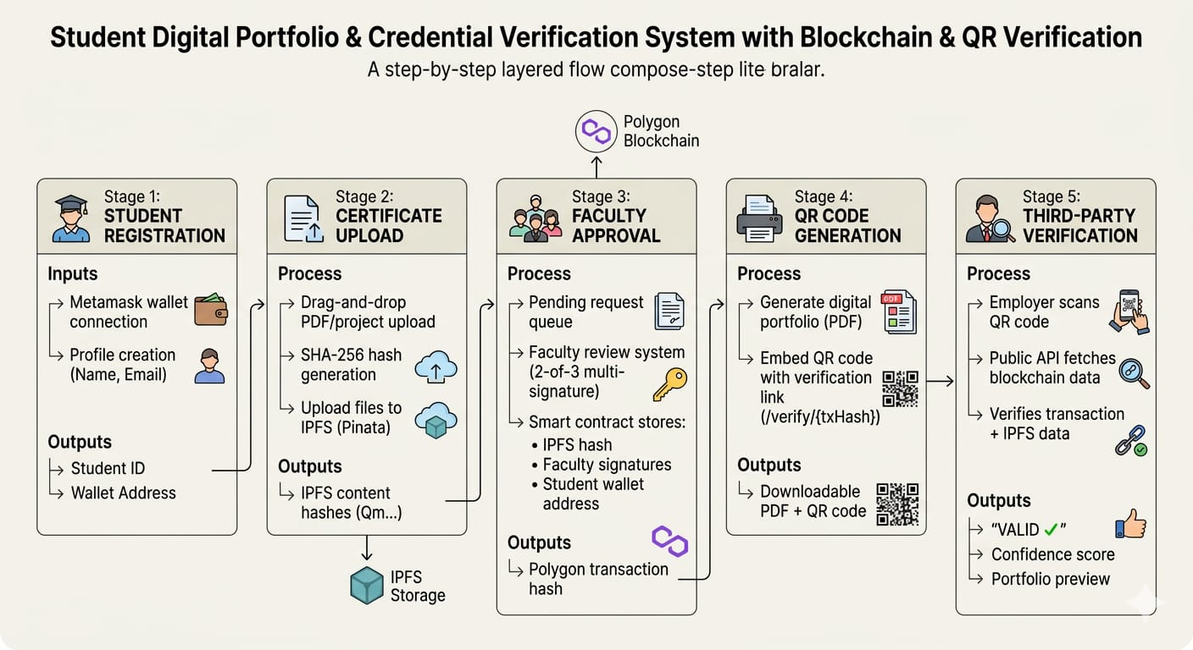
METHODOLOGY
9

Slide 8
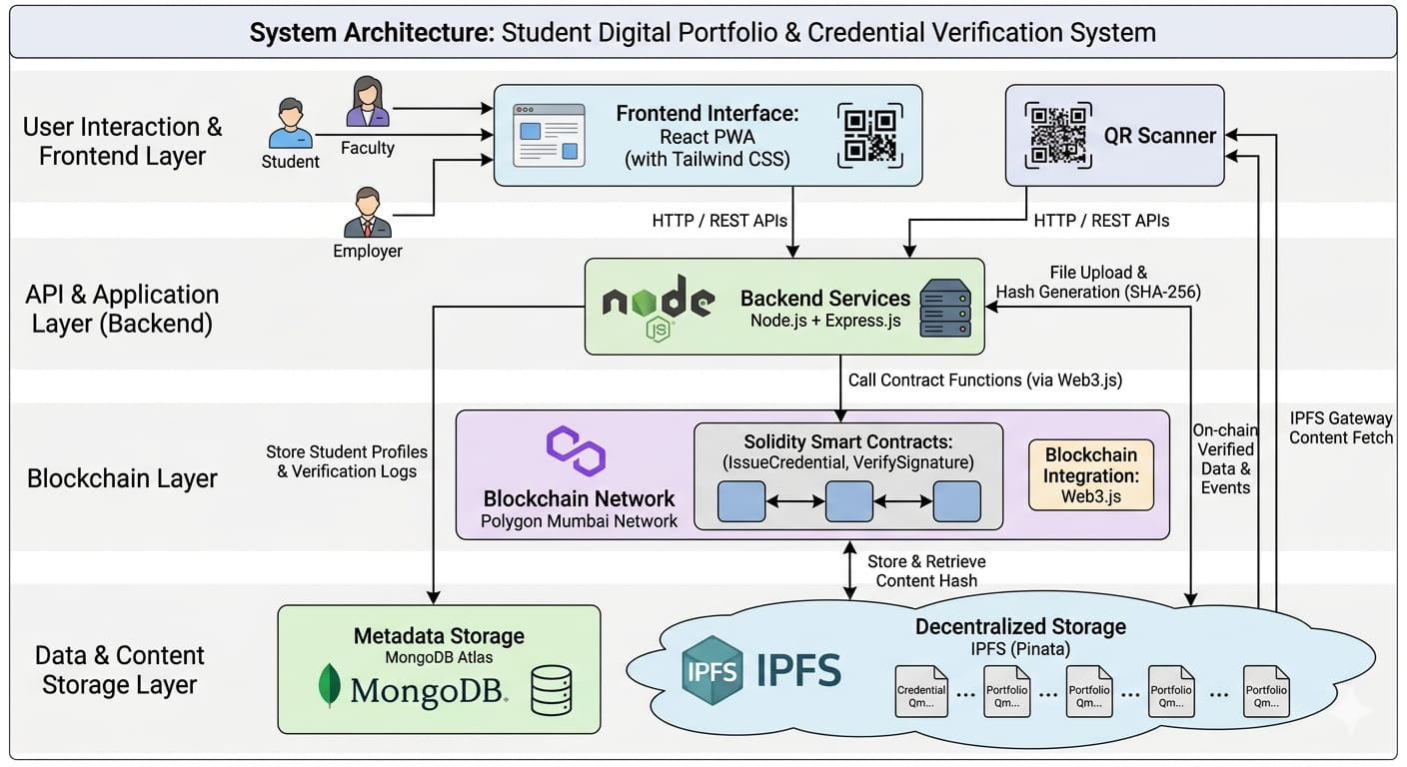
10

Slide 9
Module 1: Student Dashboard
Purpose: Certificate upload + portfolio management
Inputs: PDF files, student wallet
Outputs: IPFS hashes, pending status
Key Functions:
• Drag-drop file upload (react-dropzone
• SHA256 hashing (crypto-js)
• IPFS upload (Pinata SDK)
11

Slide 10
Module 2: Faculty Approval Panel
Purpose: Review + approve student submissions
Inputs: Pending credentials, faculty wallet
Outputs: Polygon transaction hash
Key Functions:
• Multi-signature approval (2-of-3)
• Smart contract deployment
• Notification system
12

Slide 11
Module 3: QR Generator
Purpose: Create verifiable portfolio PDFs
Inputs: Approved transaction hash
Outputs: PDF + QR code image
Key Functions:
• pdf-lib document creation
• qrcode npm package
• QR embeds verification URL
13

Slide 12
Module 4: Verification Engine
Purpose: Public QR code validation
Inputs: QR scan (txHash)
Outputs: {valid: true, confidence: 98}
Key Functions:
• Web3.js contract call
• Confidence scoring algorithm
• Portfolio metadata fetch
14

Slide 13
Module 5: Audit Dashboard
Purpose: Track verification history
Inputs: Verification events
Outputs: Analytics dashboard
Key Functions:
• MongoDB query + aggregation
• Verification log storage
• Faculty usage statistics
15

Slide 14
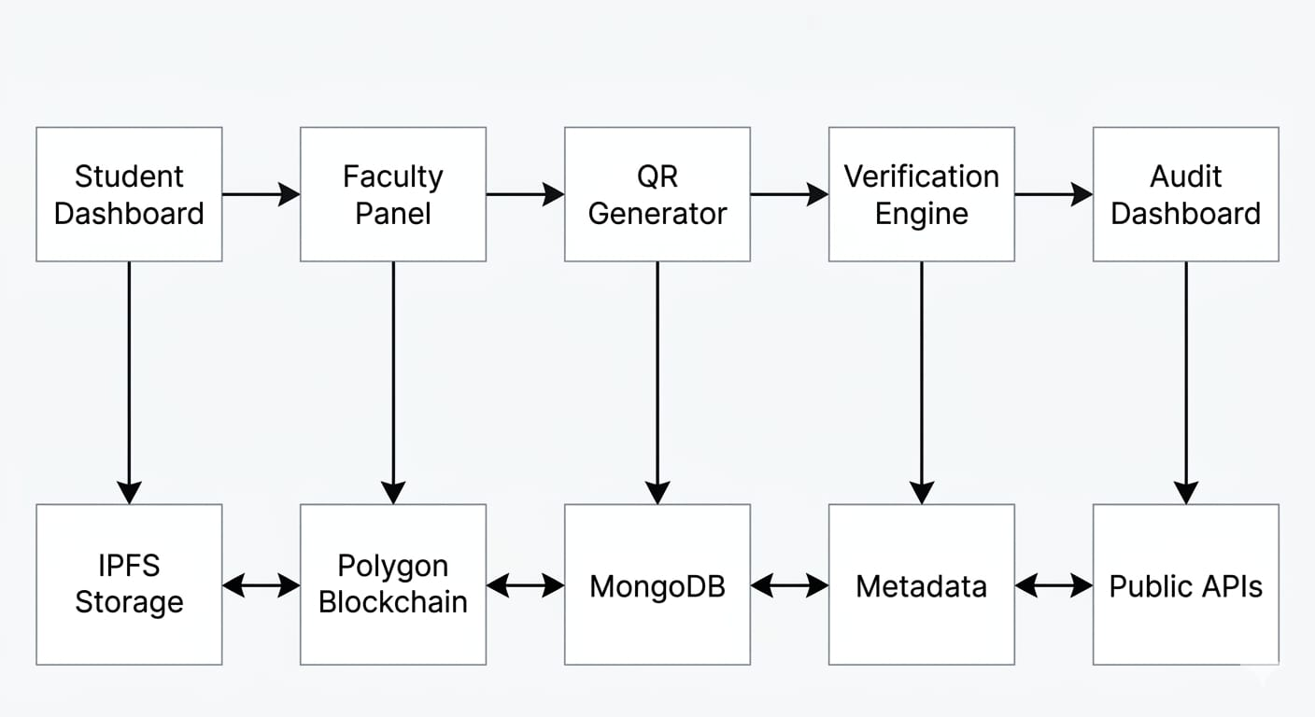
MODULE DESCRIPTION
16

Slide 15
REFERENCE
Blockchain ensuring academic integrity with a degree verification system (2025)
https://pmc.ncbi.nlm.nih.gov/articles/PMC11920411/
QR codes + multi-signature consensus
Blockchain Based Academic Credential Verification System (2025)
https://www.ijert.org/blockchain-based-academic-credential-verification-system
Ethereum smart contracts + mobile
Development of Blockchain-Based Academic Credential Verification System (2024)
https://www.scirp.org/journal/paperinformation?paperid=136384
QR verification
17

