Slide 1

VisionInspect AI
Manufacturing Defect Detection & Quality Inspection System
AI-powered computer vision platform · Internship project · Milestones 1–4
Notes:
Introduce the project: an end-to-end platform that inspects product images, finds and classifies defects, scores severity and decides pass/review/rework/reject. Covers all four milestones.

Slide 2



The problem & our objective
Manual visual inspection is slow, inconsistent and hard to trace
Manual inspection
Defects escape
No visibility
Operators tire, judge differently, and records are paper-based.
Late detection means rework, scrap and customer returns.
Quality data rarely feeds back into process improvement.
Objective Build a web platform that automatically detects product defects from images, classifies them, scores their severity, makes a pass/fail decision and reports production analytics — reducing manual inspection effort and improving quality.
Notes:
Frame the business problem, then state the objective from the project brief.

Slide 3





How an inspection works
Six automated steps, about 136 ms per image on one CPU core
1
2
3
4
5
6
Validate
Quality check
Preprocess
Detect
Classify & score
Decide
format, size, decodable
sharpness, exposure, noise
denoise + contrast (CLAHE)
anomaly map + localise
type + severity 0–100
pass / review / rework / reject
Every result is stored with the original, preprocessed, heatmap and annotated images for traceability.
Notes:
Walk through the six steps. Steps 4 and 5 are the AI core: anomaly detection and classification/severity scoring.

Slide 4
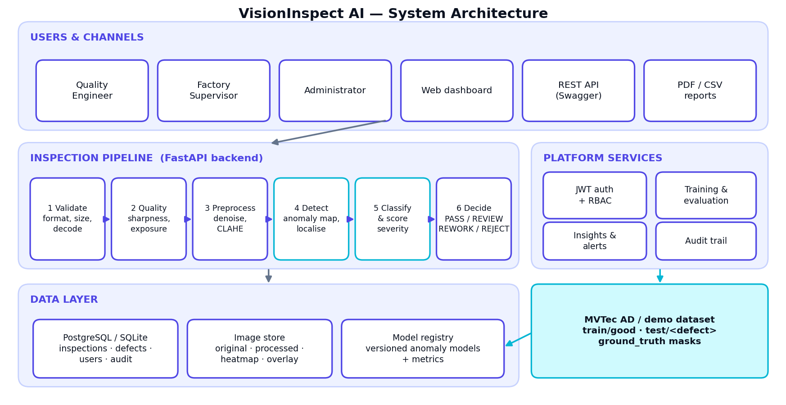
System architecture
Notes:
React frontend behind nginx, FastAPI backend with the inspection pipeline, PostgreSQL/SQLite, image store and a versioned model registry. The dataset feeds model training.

Slide 5



Technology stack
Python computer-vision backend, React single-page frontend, containerised
Frontend
Backend
React 18 · Vite · Tailwind CSS · Recharts
Python · FastAPI · SQLAlchemy · JWT
Computer vision
Data
OpenCV · NumPy · scikit-learn
PostgreSQL / SQLite · image store · model registry
Quality
DevOps
pytest (engine + 15 API tests) · GitHub Actions CI
Docker · Compose · nginx · AWS / Azure guides
Notes:
Matches the stack in the project brief; the brief lists YOLO/TensorFlow/PyTorch as options — we use a lightweight OpenCV + scikit-learn model and keep a clean interface for swapping in deep models.

Slide 6
What was delivered, milestone by milestone
M1
M2
M3
M4
Setup & core
Processing & detection
Classification & analytics
Test, deploy, document
JWT login, 3 roles (RBAC)
Upload, batch, camera simulation
Image validation
Inspection dashboard
MVTec AD dataset loader
Denoise + CLAHE pipeline
Image quality report
Trainable anomaly model
Heatmaps + localisation
Versioned model registry
Defect type classification
Severity scoring (30/25/25/20)
Pass/review/rework/reject
Supervisor review workflow
Dashboards, alerts, PDF/CSV
Validation + benchmark report
API tests + CI
Performance + security hardening
Docker + AWS/Azure guide
Docs, user guide, demo
Notes:
Summarise each milestone. Everything listed is implemented in the code base.

Slide 7

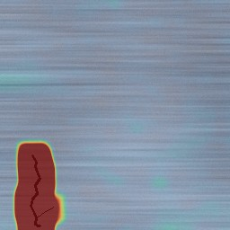
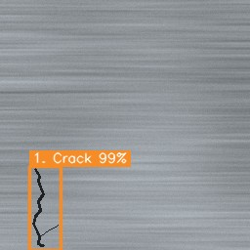
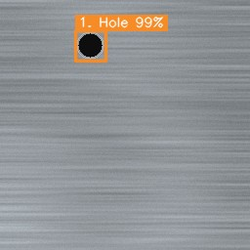
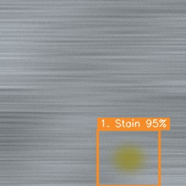
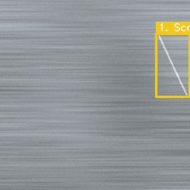
Detection: learn "normal", flag the abnormal
Unsupervised anomaly model trained only on defect-free images
1
Extract two-scale patch features (colour, contrast, gradients)
2
Model normal patches with a k-cluster Gaussian mixture
3
Score each patch by Mahalanobis distance; threshold calibrated on held-out good parts
Input
Anomaly heatmap
Detected + classified
4
Refine blobs to masks → boxes, heatmap, shape features
Notes:
Example outputs on a synthetic brushed-metal plate: a crack (top row) and hole, stain, scratch (bottom row). The model never saw defects during training.

Slide 8
Severity scoring framework
Explainable score from 0–100 for every defect
Critical
80–100
REJECT
High
60–79
REWORK
Medium
40–59
REVIEW
Low
0–39
PASS*
* Low severity becomes REVIEW when any detection has < 70% confidence.
Brief example 85/90/95/92 computes to 90.2 (brief prints 88) — still Critical.
Notes:
Severity = 30% size + 25% location + 25% type + 20% confidence. Mention the arithmetic discrepancy in the brief: with the given weights the example is 90.2, not 88.

Slide 9
Results: defect detection
Held-out synthetic test set — 270 images, 3 product categories
90.6%
defective parts detected
0 / 90
good parts wrongly flagged
136 ms
mean time per image (1 CPU core)
Notes:
AUROC is at least 0.999 in every category. Fabric recall is lower because low-contrast dents (12 of 12) fall below the calibrated threshold. Synthetic data only; real MVTec AD results are the next step.

Slide 10
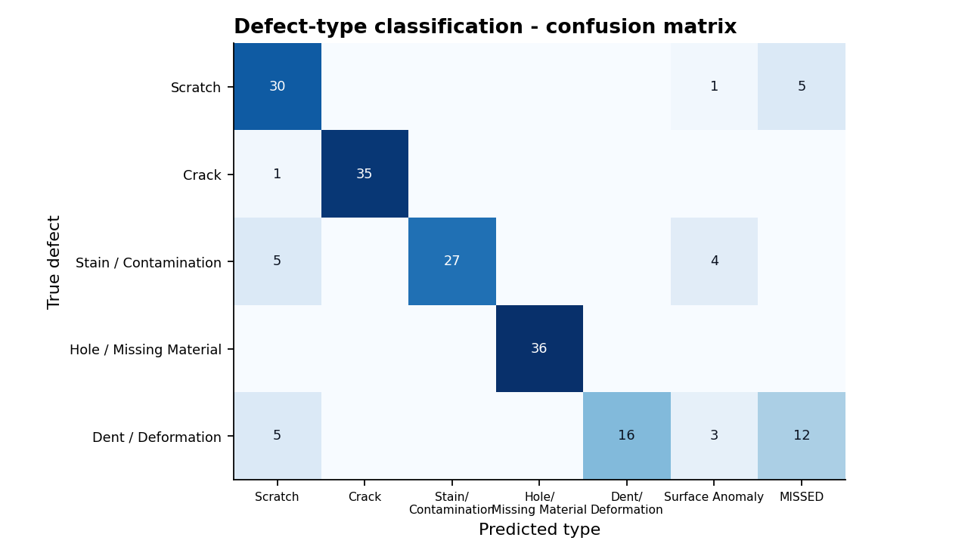
Results: defect-type classification
Rule-based classifier on texture-independent features
72% → 88%
type accuracy among detected defects, before vs after Milestone-4 feature work (held-out data)
Hole: 100%
Crack: 97%
Scratch: 83%
Stain: 75%
Dent: 44%
Weakest: dents (low contrast). Next step: supervised classifier on real labelled defects.
Notes:
Confusion matrix on 180 defective parts. The classifier was tuned on a different random seed than the test set. Holes and cracks are classified best; dents are weakest.

Slide 11
Testing & performance optimisation
Testing
Optimisation & hardening
Engine tests: severity formula, validation, decisions, classifier, train → evaluate
15 end-to-end API tests: auth, RBAC, rate limit, upload, batch, camera, review, PDF, CSV, analytics, training jobs
Validation script reproduces every figure in the report
GitHub Actions CI: pytest + frontend build + Docker build
Eager loading removes N+1 queries in lists and analytics
GZip, asset caching, route-level code splitting
Thread-pooled batch inference (gain needs multi-core hardware; none measured on 1 core)
Login throttling, security headers, PBKDF2 hashing, audit trail
Notes:
Be honest: the thread pool gave no measurable speed-up on the single-core test machine (7.0 to 7.3 images/s); benefit on multi-core is expected but not measured.

Slide 12


Roles, security & audit
Role-based access control enforced on every API route
Administrator
Quality Engineer
Factory Supervisor
Users & roles, audit trail, models, review, delete
Inspect, dataset & model training, analytics
Inspect, review & approve decisions, analytics
JWT authentication · PBKDF2 password hashing (210k iterations)
Login throttling · upload allow-list & size limits · authenticated image access
Audit trail: logins, inspections, reviews, model changes, user changes
Notes:
Three roles. Supervisors can approve/reject/rework flagged parts; every action is audited.

Slide 13
Deployment
One command locally, same containers in the cloud
Browser
nginx
FastAPI
PostgreSQL
→
→
→
React app
static files + /api proxy
inspection pipeline
data + volumes
Docker Compose
AWS / Azure
docker compose up --build
Health checks, restart policy, named volumes
EC2 or Azure VM + Docker Compose (documented)
Scale path: RDS / S3, ECS or Container Apps
Step-by-step in DEPLOYMENT_GUIDE.md
Notes:
Say clearly whether you deployed to a cloud account. The guide documents AWS EC2 and Azure options; if you did not run a live cloud deployment, present it as documented and containerised rather than live.

Slide 14
Limitations & future work
What we know, and what comes next
Known limitations
Future work
Validated on synthetic data, not real MVTec AD yet
Low-contrast defects (dents) are the weakest case
Classifier is rule-based; thresholds tuned on synthetic data
Location score assumes a centre "functional zone"
Jobs run in-process (single instance)
Benchmark on real MVTec AD categories
Deep model (PatchCore / U-Net / YOLO) behind the same interface
Supervised defect classifier on labelled data
Task queue (Celery/Redis) + object storage
Per-product critical-zone masks, MES/PLC integration, e-mail/SMS alerts
Notes:
Being upfront about limitations strengthens the presentation.

Slide 15
Thank you
VisionInspect AI — catching defects before they leave the line.
90.6% detected · 0/90 false alarms · 136 ms / image
Questions?

