Slide 1
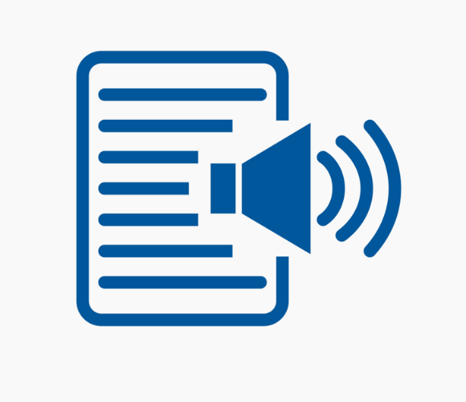
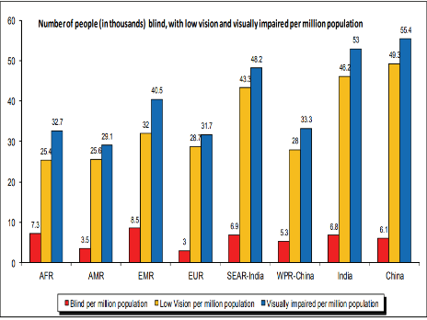

Today’s Agenda:
Click!
An application for blind people to get information online the smart way.
The Problem?
Too much information can also be a bane. Especially if you can’t see it.
Blind people have to listen to around 300 – 400 lines of information in order to get the 3 lines of information they were looking for.
Even though a lot of text to speech converters exist in the internet, there are no converters which tailor to the specifics the user wants to know about.
The solution
The solution we suggest though simple, can work quiet well.
Take Wikipedia, And for the search done by the user, the user gets to choose from the sub-headings of the page on the topic he wants to know about. Thus saving time and effort.
As a further addition, he can go recursively into various new searches until the user is clarified of his doubt.
Risks
A whole ton of sites is not "standards compliant", as in W3C, HTML compliant. This can make the process of extraction of relevant data a bit tedious.
Even if a site is fully compliant, it can be too complicated to actually split it into relevant sub-sections. E.g. Facebook.
A lack of sub-divisions to the topic of interest leads to a long strenuous listen to the entire document.
Description
The product will be a small stand-alone device with just 2 buttons.
A small slider as the power button, and a large push-button, like those in carkeys for the speech to text conversion.
The user holds the button while he asks the device for relevant Wikipedia information.
The user can then interact with the assistant to narrow down his/her search.
For a MVP, we will be presenting the basic application working on jupyter notebook.
Revenue Models:
The appropriate revenue model that can be implemented is Freemium.
All users can enjoy the text to speech features implemented in Wikipedia where they have the option to either listen to the summary or to the entire article.
Premium users can further listen to all sub topics individually and also can listen from other websites in the near future.

Slide 2


The Problem?
Too much information can also be a bane. Especially if you can’t see it.
Visually challenged people have to listen to around 300 – 400 lines of information in order to get the 3 lines of information they were looking for.
Even though a lot of text to speech converters exist in the internet, there are no converters which tailor to the specifics the user wants to know about.

Slide 3
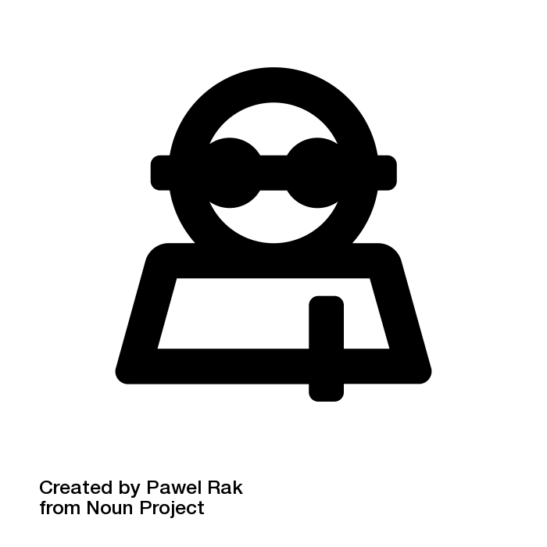
Click!
A smart application for visually impaired people to surf the web.

Slide 4
Click! The solution
The solution we suggest though simple, can work well.
Take Wikipedia, And for the search done by the user, the user gets to choose from the sub-headings of the page on the topic he wants to know about. Thus saving time and effort.
As a further addition, he can go recursively into various new searches until the user is clarified of his doubt.

Slide 5
Click! Description
The product will be a small stand-alone device with just 1 button and a 3.5mm headphone jack.
The user can then interact with the assistant to narrow down his/her search.
For a MVP, we will be presenting the basic application working on jupyter notebook.

Slide 6
Click! Revenue Models:
The appropriate revenue model that can initially be implemented in a ‘Retail Commerce’ style initially.
The device can be sold at 15$ AUD per piece.
The product can move to a Freemium style after an year.
All users can enjoy the text to speech features implemented in Wikipedia where they have the option to either listen to the summary or to the entire article.
Premium users can further listen to all sub topics individually and also can listen from other websites in the near future.

Slide 7
Click! Risks
A whole ton of sites are not "standards compliant", as in W3C, HTML compliant.
Even if a site is fully compliant, it can be too complicated to actually split it into relevant sub-sections. E.g. Facebook.
A lack of sub-divisions to the topic of interest leads to a long strenuous listen to the entire document.
Long-term Mitigation
Device specific Repository.
To implement data extraction, data scrapping in an efficient way.
Web developers can use accessibility guidelines for blind users when designing their websites.

Slide 8

“We need to do in the digital world the same thing we’ve done in the physical world.”

