Slide 1
Keylogger
CAPSTONE PROJECT
Presented By:
Elamathi.R
Jeppiaar Institute of Technology
Artificial Intelligence and Data Science

Slide 2
OUTLINE
Problem Statement Proposed System/Solution
System Development Approach
Algorithm & Deployment
Result (Output Image)
Conclusion
Future Scope
References

Slide 3
Problem Statement
Developing a robust keylogging application using Python and Tkinter, this project aims to provide cybersecurity professionals with a reliable tool for monitoring user interactions. With features to capture key presses, holds, and releases, the application ensures comprehensive insights into keyboard activities. Through a user-friendly interface, users can effortlessly control the logging process, facilitated by Start and Stop buttons. Error handling mechanisms guarantee stability, while logging in text and JSON formats enables seamless analysis. By adhering to coding best practices, the project seeks to empower security professionals in detecting and preventing potential threats, contributing to the ongoing efforts in cybersecurity

Slide 4
PROPOSED SOLUTION
The proposed solution aims to address the challenge of developing a robust keylogging application for security monitoring and analysis. The solution will encompass the following components:
Data Collection:
Gather keyboard activity data, including presses, holds, and releases.
Explore additional data sources for comprehensive insights.
Data Preprocessing:
Clean and preprocess data to handle inconsistencies.
Extract features for analysis.
Machine Learning (Optional):
Implement anomaly detection algorithms.
Train models on labeled data for behavior analysis.
Application Development:
Develop Tkinter interface for user interaction.
Provide real-time visualization and analysis features.
Deployment:
Ensure platform compatibility and accessibility.
Implement security measures for data protection.
Evaluation:
Assess performance metrics like accuracy and user satisfaction.
Incorporate feedback for optimization and improvement.

Slide 5
System Approach
SYSTEM REQUIREMENTS
HARDWARE
Processor: Minimum Intel Core i5 or equivalent
RAM: 8 GB
Storage: 256 GB SSD or higher
SOFTWARE
Operating System: Windows 10, macOS 10.15, Ubuntu 20.04 LTS
Programming Language: Python 3.8 or higher
Library required to build the model
Tkinter: Required for developing the GUI of the keylogger application.
pynput: Essential library for capturing keyboard events and interactions.
json: Utilized for storing logged keyboard data in JSON format.
datetime: Facilitates timestamping of keyboard events for chronological analysis.

Slide 6
Algorithm & Deployment
Algorithm Selection:
Chosen approach: Simple event detection for keylogging.
Justification: Given the straightforward nature of keylogging, complex machine learning algorithms are unnecessary.
Data Input:
Input features: Keyboard events (key press, hold, release) captured by pynput library.
Additional information: Timestamps for chronological tracking.
Training Process:
No traditional training process involved.
Initialization and configuration performed before application start.
Prediction Process:
Real-time logging of keyboard events.
Instant processing without the need for prediction.

Slide 7
Result
The developed keylogger application successfully captures keyboard events, including key press, hold, and release actions, in real-time. The interface built with Tkinter provides users with intuitive controls for starting and stopping the keylogging process. Data logging is implemented efficiently, with options for storing logs in both text and JSON formats. The application demonstrates stability and reliability, with error handling mechanisms ensuring smooth operation even in the presence of unexpected events.

Slide 8
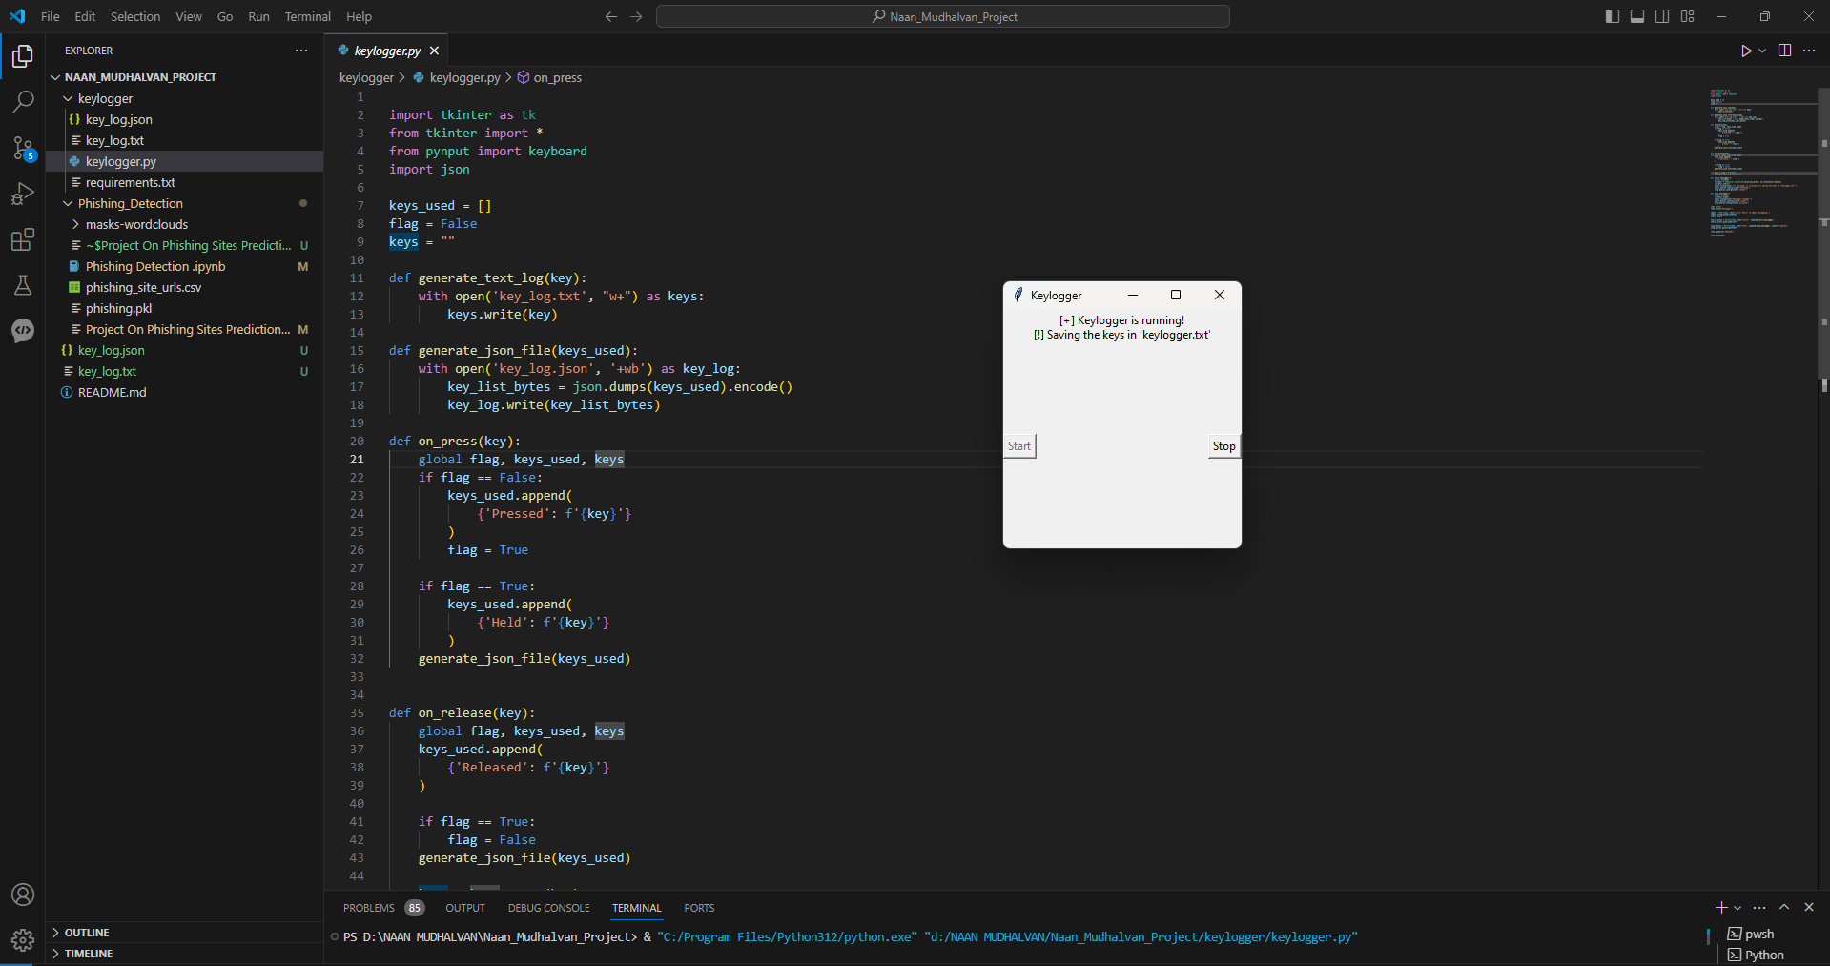

Slide 9
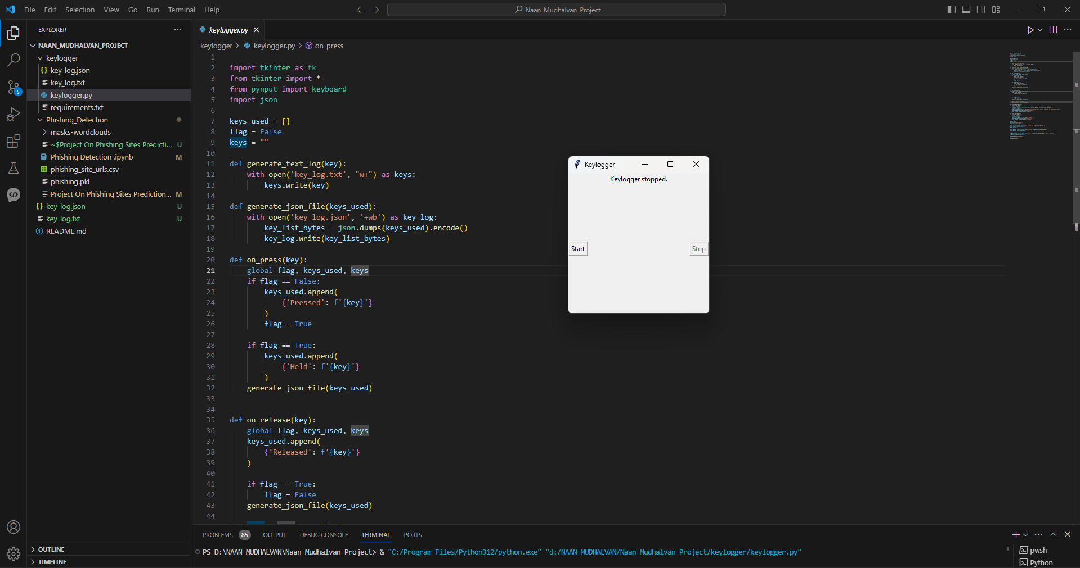

Slide 10
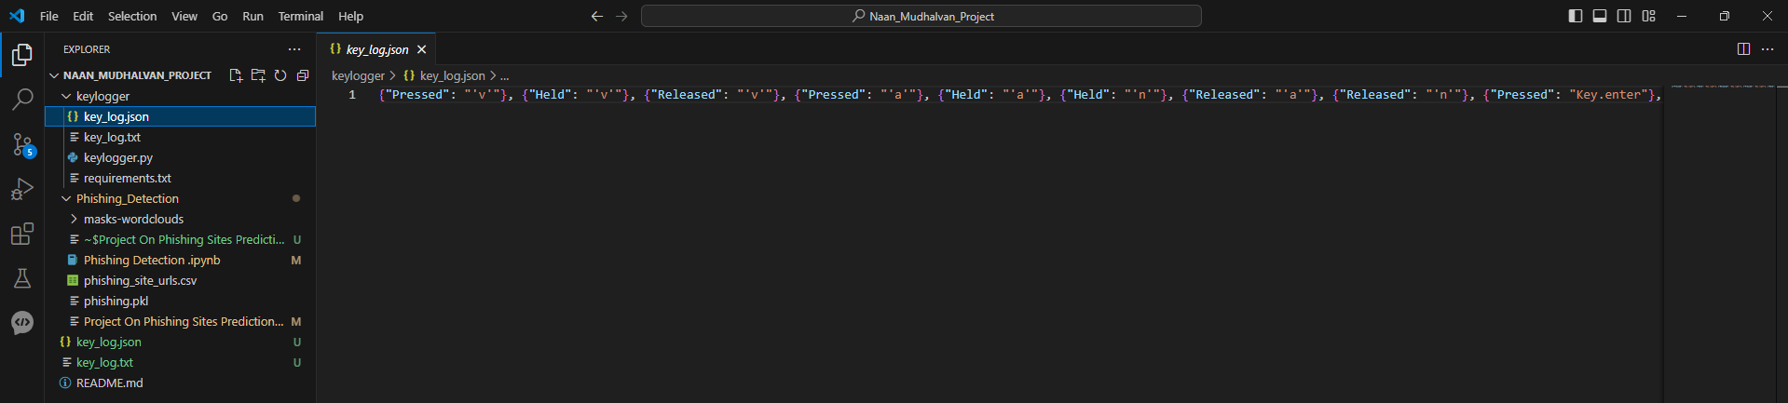

Slide 11
Conclusion
The keylogger application offers a valuable tool for security monitoring and analysis. Its simple yet effective design enables cybersecurity professionals to track user interactions with keyboards, facilitating threat detection and behavior analysis. The project highlights the importance of implementing robust data collection and preprocessing techniques, coupled with user-friendly interfaces for seamless interaction. By adhering to best coding practices and prioritizing user feedback, the keylogger application demonstrates its utility in enhancing security measures and empowering professionals in their cybersecurity efforts.

Slide 12
Future scope
Moving forward, several avenues for further enhancement and expansion of the keylogger application can be explored. This includes:
Incorporating machine learning techniques for anomaly detection and behavior analysis, enhancing the application's ability to identify suspicious activities.
Implementing advanced logging features, such as capturing application-specific keyboard events or monitoring system-wide activities.
Integrating remote monitoring capabilities, allowing users to access keylogging data from multiple devices or locations.
Enhancing security measures to protect sensitive data collected by the keylogger, including encryption and access controls.
Collaborating with cybersecurity experts and organizations to gather insights and feedback for continuous improvement and optimization of the application.

Slide 13
References
Python Software Foundation. (n.d.). Tkinter documentation. Retrieved from https://docs.python.org/3/library/tkinter.html
Pynput Documentation. (n.d.). Retrieved from https://pypi.org/project/pynput/
JSON. (n.d.). Retrieved from https://www.json.org/json-en.html
https://github.com/techtrainer20/TNSDC.git .

Slide 14
THANK YOU

