Slide 1
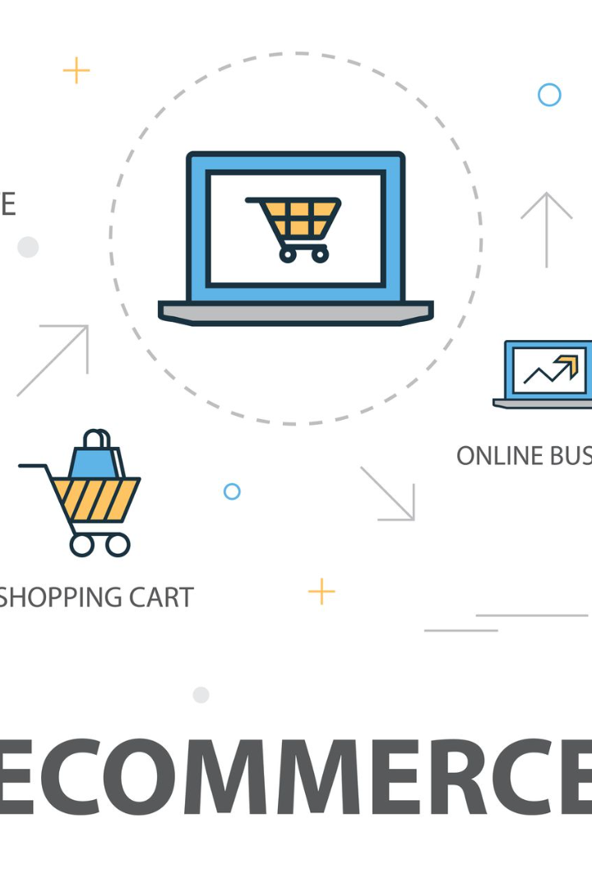

Creating an E-commerce Platform with User Authentication and Shopping Cart Functionality
Welcome to our presentation on building an e-commerce platform with user authentication, a shopping cart, and a seamless checkout process. Get ready to dive into the world of online shopping!
er
by elamathi ravi

Slide 2

Introduction
Gain an overview of the e-commerce platform and understand why incorporating user authentication, a shopping cart, and an efficient checkout process is crucial for a successful online business.

Slide 3
User Registration and Authentication
Learn how to implement user registration and authentication features using a backend server, such as Node.js or Python. Safeguard user data and ensure a secure user experience.

Slide 4
Shopping Cart Functionality
Discover how to implement a shopping cart feature, allowing users to add products to their cart, view the total cost, and manage their selections. Make their shopping experience seamless.

Slide 5

Smooth Checkout Process
Ensure a hassle-free checkout process by handling payment and shipping information efficiently. Guide users through the final steps of their purchase and provide a confirmation message for a satisfying shopping experience.

Slide 6

Why User Authentication Matters
1
Security and Trust
Protect user data and provide a secure environment, fostering trust and confidence in your e-commerce platform.
2
Personalized Experience
Authenticate users to offer personalized recommendations, tailored promotions, and enhanced customer interactions.
3
Order History and Saved Preferences
Enable users to track their past orders and save their preferences for future convenience and customization.

Slide 7
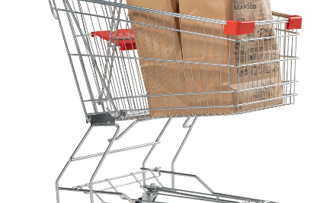
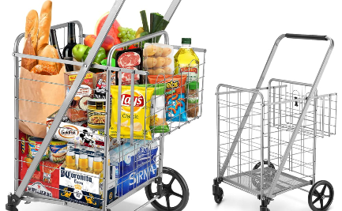
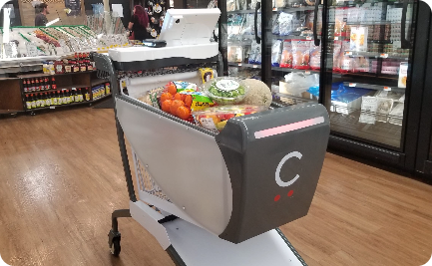
The Power of a Shopping Cart
Easy Product Selection
Transparent Pricing
Convenient Order Management
Allow users to browse and select multiple products, eliminating the need for multiple transactions.
Calculate the total cost, including taxes and shipping fees, to provide users with a clear understanding of their expenses.
Offer functionality for users to modify their cart, remove items, and validate their choices before proceeding to checkout.

Slide 8

A Seamless Checkout Experience
1
Payment and Shipping Information
Securely collect and process payment and shipping details to facilitate a smooth and streamlined checkout process.
2
Order Review
Allow users to review their order details, including product quantities, prices, and delivery options before finalizing their purchase.
3
Confirmation and Thank You
Provide users with a confirmation message, expressing gratitude for their purchase and informing them about the next steps.

