Slide 1
Digital Portfolio
STUDENT NAME : ELAMATHI.R
REGISTER NO AND NMID : 222410237/E5BEBD1012E8232886046C18AC97EB7B
DEPARTMENT : B.SC.COMPUTER SCIENCE
COLLEGE : LAKSHMI BANGARU ARTS & SCIENCE COLLEGE/ MADRAS UNIVERSITY.

Slide 2
PROJECT TITLE
DIGITAL PORTFOLIO

Slide 3


AGENDA
Problem Statement
Project Overview
End Users
Tools and Technologies
Portfolio design and Layout
Features and Functionality
Results and Screenshots
Conclusion
Github Link
3/21/2024 Annual Review

Slide 4

PROBLEM STATEMENT
Traditional paper portfolios are limited, static, and not interactive.
Recruiters and clients prefer accessible, visually appealing, and responsive digital portfolios.
Need for an interactive, user-friendly portfolio to showcase projects, skills, and achievements.

Slide 5

PROJECT OVERVIEW
A personalized digital portfolio website developed using front-end technologies.
Provides sections like: About, Skills, Projects, Resume, Contact.
Responsive design for mobile, tablet, and desktop.
Includes animations and interactive features for better user experience.

Slide 6

WHO ARE THE END USERS?
Students – showcase academic projects and skills.
Job Seekers – highlight achievements and resumes.
Freelancers – display creative works and client projects.
Professionals – build personal branding.

Slide 7
TOOLS AND TECHNIQUES
HTML5 → Content & structure
CSS3 / Tailwind CSS / Bootstrap → Styling & layout
JavaScript (ES6) → Interactivity
React.js (optional) → Dynamic components
GitHub → Version control & hosting (GitHub Pages)

Slide 8
POTFOLIO DESIGN AND LAYOUT
Home Page: Introduction + welcome animation
About Page: Personal details, education, experience
Projects Section: Grid/gallery with images, links, and descriptions
Skills Section: Visual skill bars/charts
Contact Page: Form + social media links
8

Slide 9
FEATURES AND FUNCTIONALITY
Responsive design (works on all devices)
Smooth navigation bar & scrolling
Project cards with hover effects
Interactive animations (using CSS/JS)
Contact form with validation
GitHub integration for project links

Slide 10
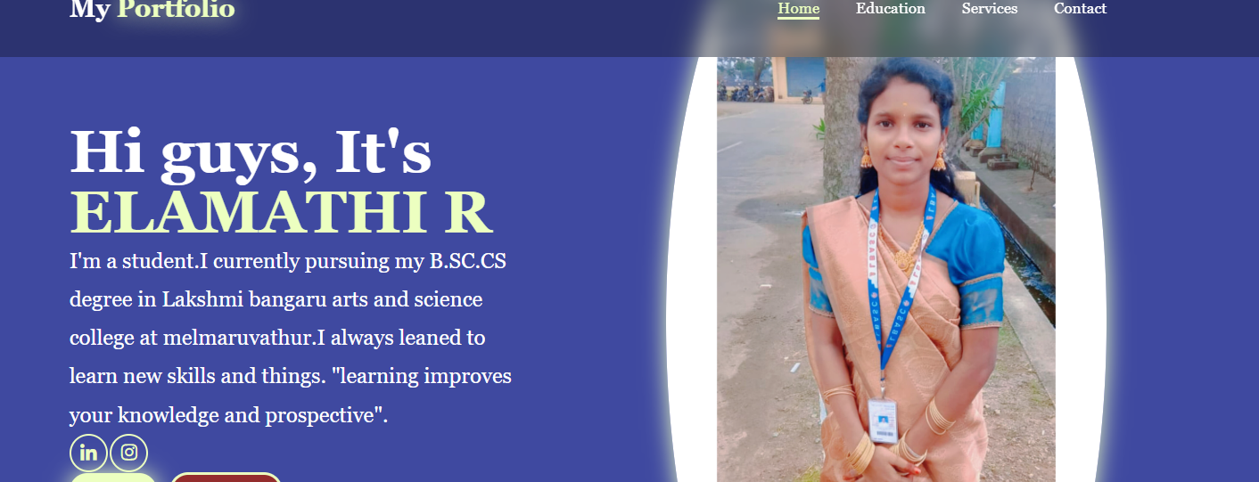

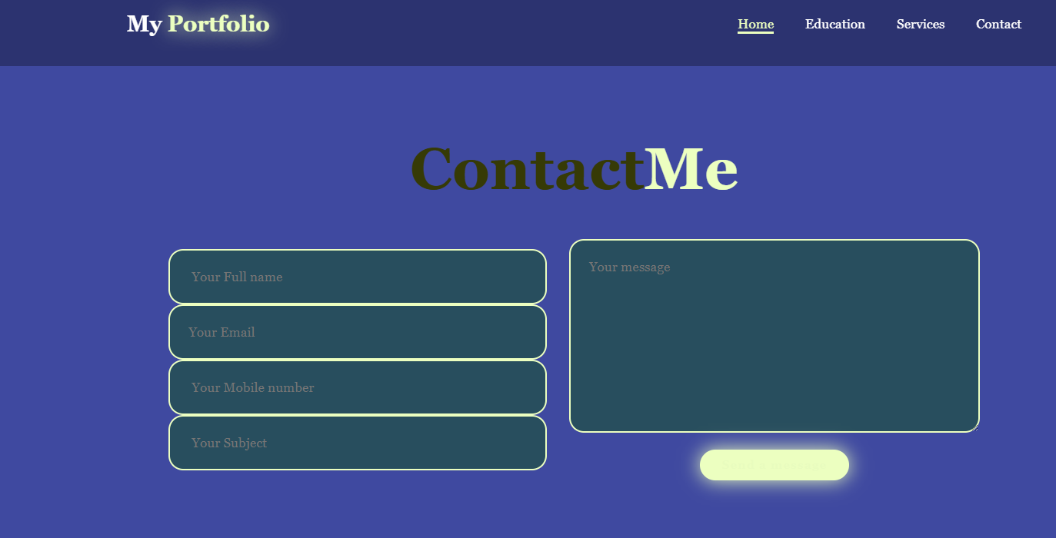
RESULTS AND SCREENSHOTS
3/21/2024 Annual Review
10

Slide 11
CONCLUSION
Interactive portfolio provides a modern way of self-presentation.
Demonstrates technical skills + creativity.
Easy to update, professional, and accessible worldwide.
Helps in career growth, freelancing, and networking.
11

