Slide 1
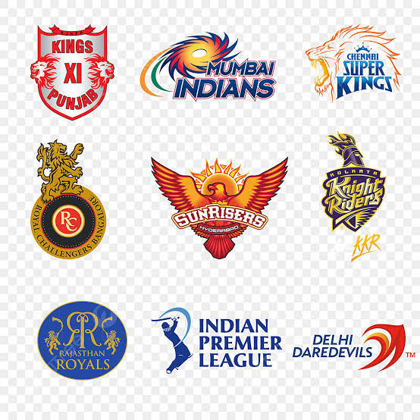
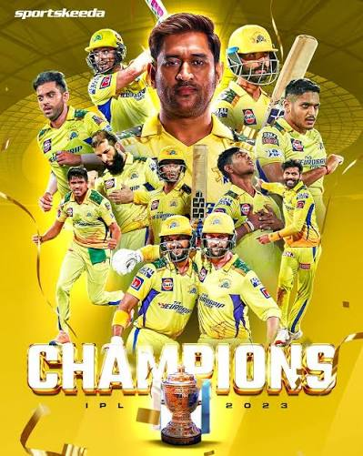
IPL MATCH(2008-2026) ANALYSIS DASHBOARD
Presented by | J. Monisha

Slide 2
Introduction
The Indian Premier League (IPL) is one of the most popular cricket tournaments in the world, generating a large amount of match-related data every season. Analysing this data helps in understanding team performance, winning trends, and overall tournament statistics.
The objective of this project is to transform raw IPL match data into meaningful business insights using Microsoft Excel. By utilizing Excel features such as Pivot Tables, Pivot Charts, Slicers, and Key performance indicators.

Slide 3
Problem Statement
Which team has won the most matches across IPL seasons?
Which venues have the highest average team scores?
Which team has the highest winning percentage?
How have scoring patterns changed across IPL seasons?
Is batting first or batting second more successful?
Does winning the toss influence the match result?
2

Slide 4
Tools & Technology
Microsoft Excel
Pivot Tables
Pivot Charts & Slicers
Used to review, clean, organize and analyze the IPL match dataset.
Used to summarize match records and compare teams, venues and seasons.
Used to visualise results and filter the dashboard by season/year.
3

Slide 5
Data Preprocessing
01 Dataset review
02 Venue cleaning
Checked the available columns and match records.
Standardized venue names to keep the same venue consistent.
03 Team name cleaning
04 Match result check
Standardized team names and winning-team values.
Reviewed the runs and wickets result fields.
05 Calculated category
Created a batting-first / batting-second category using runs and wickets.
4

Slide 6
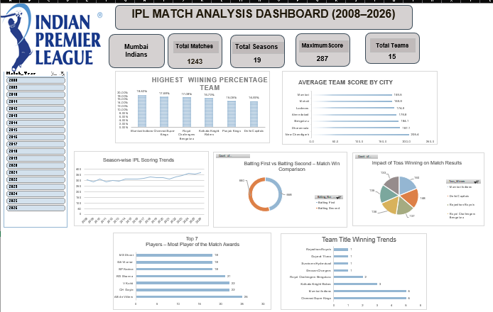
IPL Analysis Dashboard
INSERT YOUR EXCEL DASHBOARD SCREENSHOT HERE
Place the complete dashboard screenshot here, including KPI summaries, charts and the year slicer.
5

Slide 7
Who Can Use This Dashboard?
Cricket Fans
Sports Analysts
Coaches
To explore team wins, player awards, venues and season-wise match trends.
To compare team performance and study patterns in historical match results.
To review past results and venue-related performance before planning strategies.
6

Slide 8
INSHIGTS
1.Mumbai Indians most successful team.
2.New Chandigarh highest average scoring city.
3.Batting Second slightly more successful.
4.Recent seasons la scoring trend is increased.
5.AB de Villiers highest Player of the Match awards.
6.Mumbai Indians & Chennai Super King Won the Highest trophy.

