Slide 1
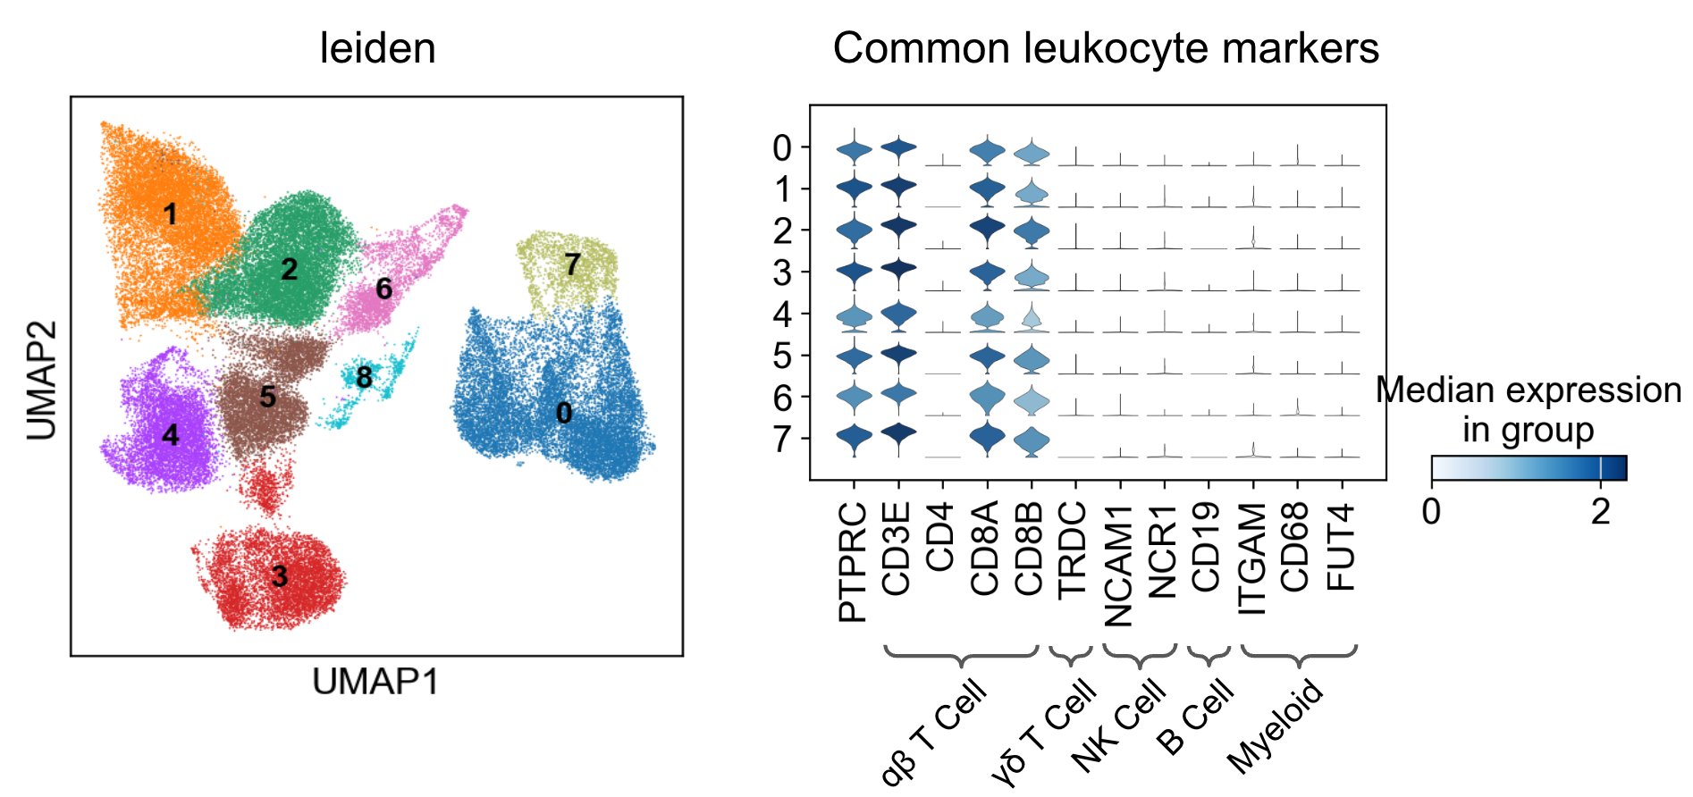
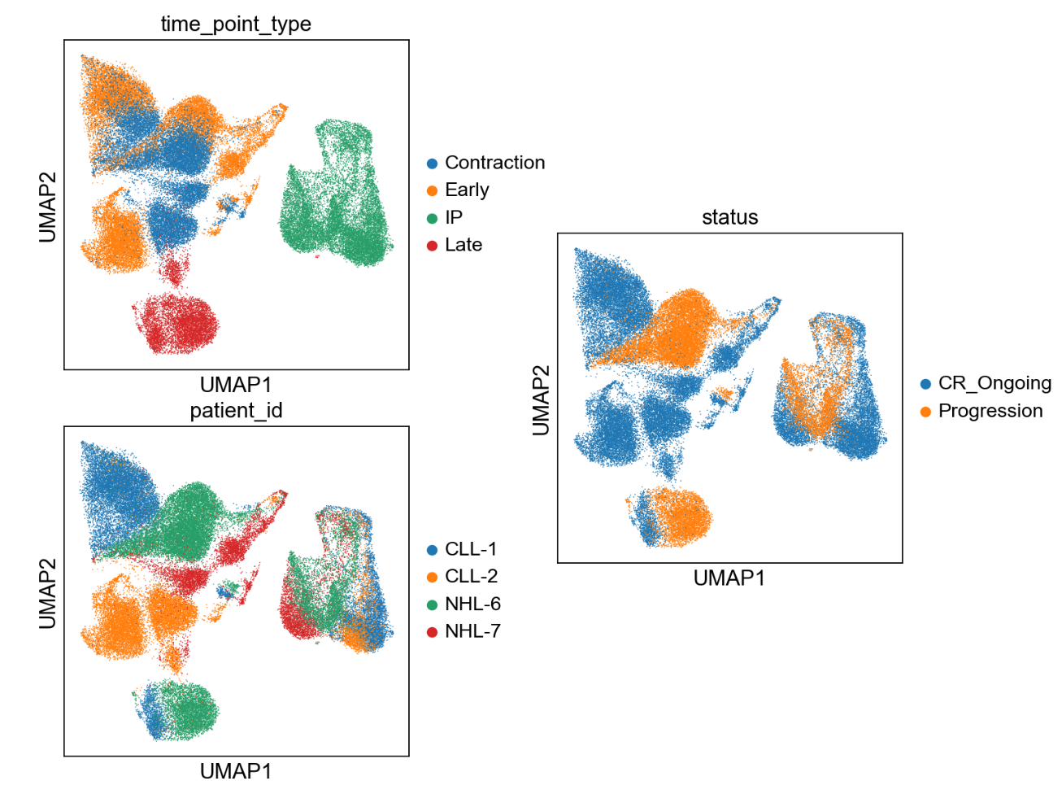
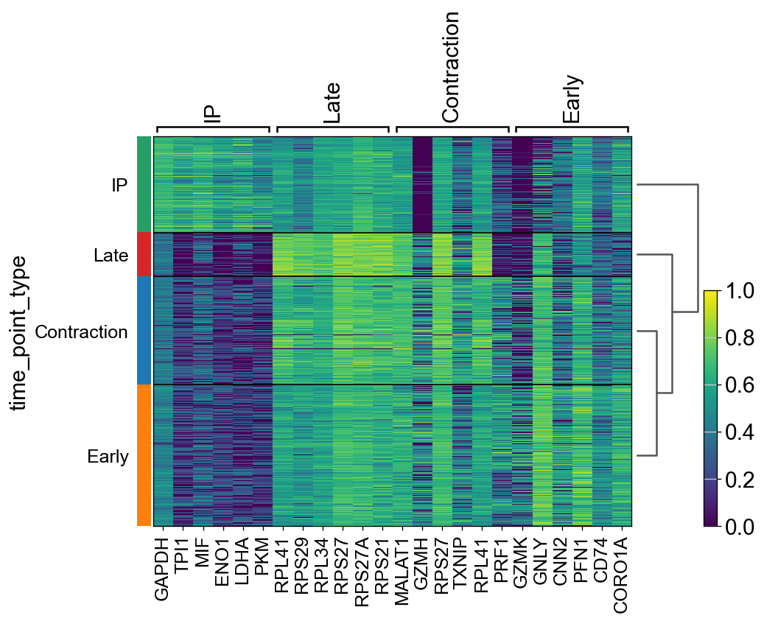
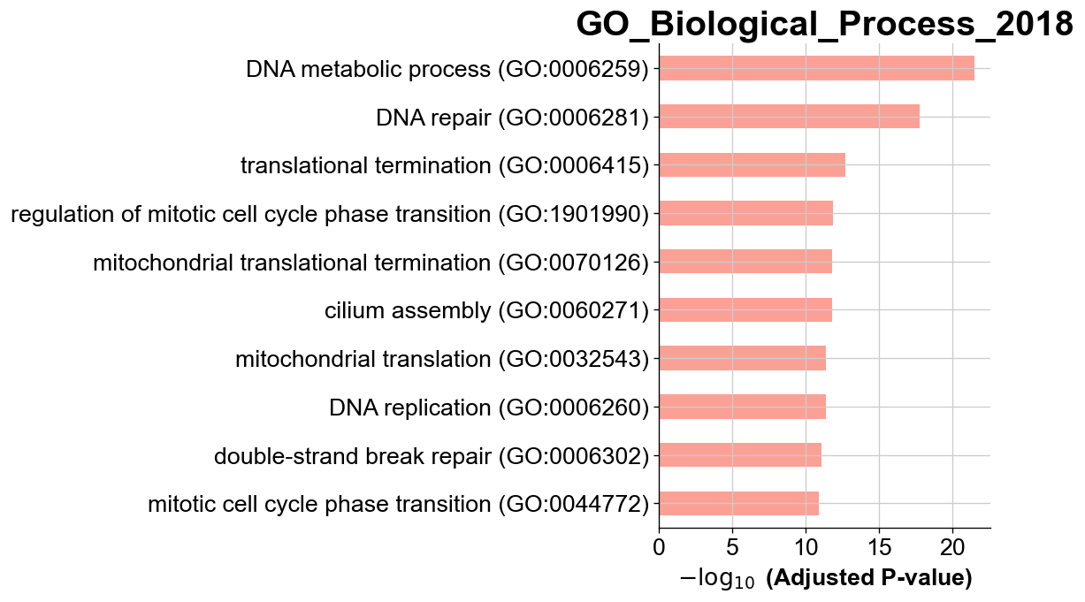
A)
B)
C)
Patient | Age | Sex | Outcome | PFS Status
CLL-1 | 61 | M | CR | CR Ongoing
CLL-2 | 53 | F | CR | CR Ongoing
NHL-6 | 64 | M | CR | CR Ongoing
NHL-7 | 51 | F | CR | Progression
D)
E)
F)
Notes:
Figure 1: Differential Gene Expression Across Timepoints. a) Clinical metadata defined for each patient. b) Initial UMAP patterning for all samples, later characterized by c) timepoint, patient, and progression-free survival (PFS) status. d) characterization of UMAP clusters by hematopoietic lineage-specific markers.

Slide 2
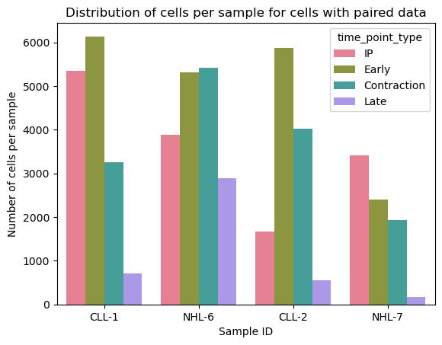
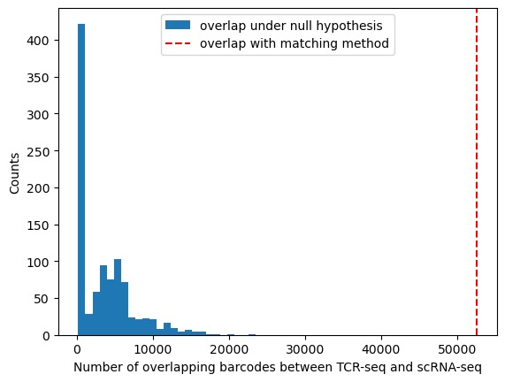
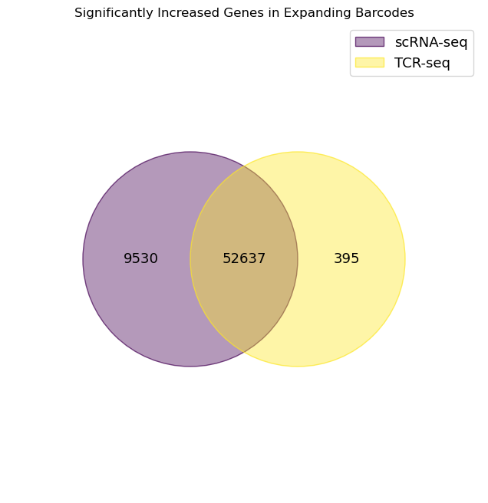
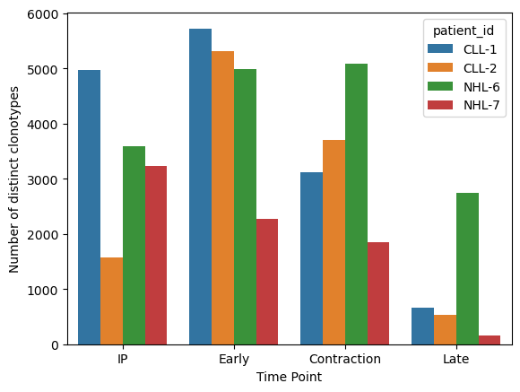
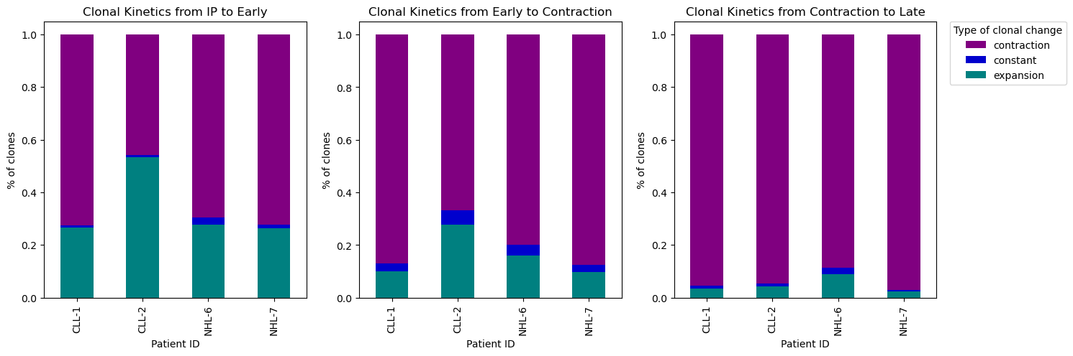
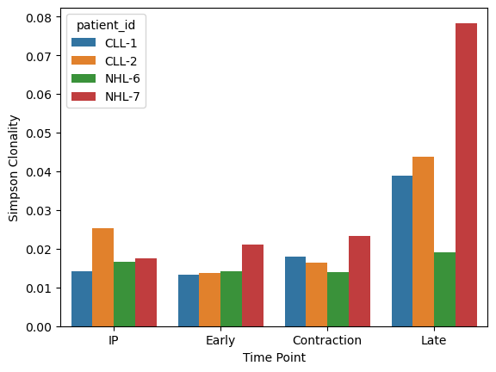
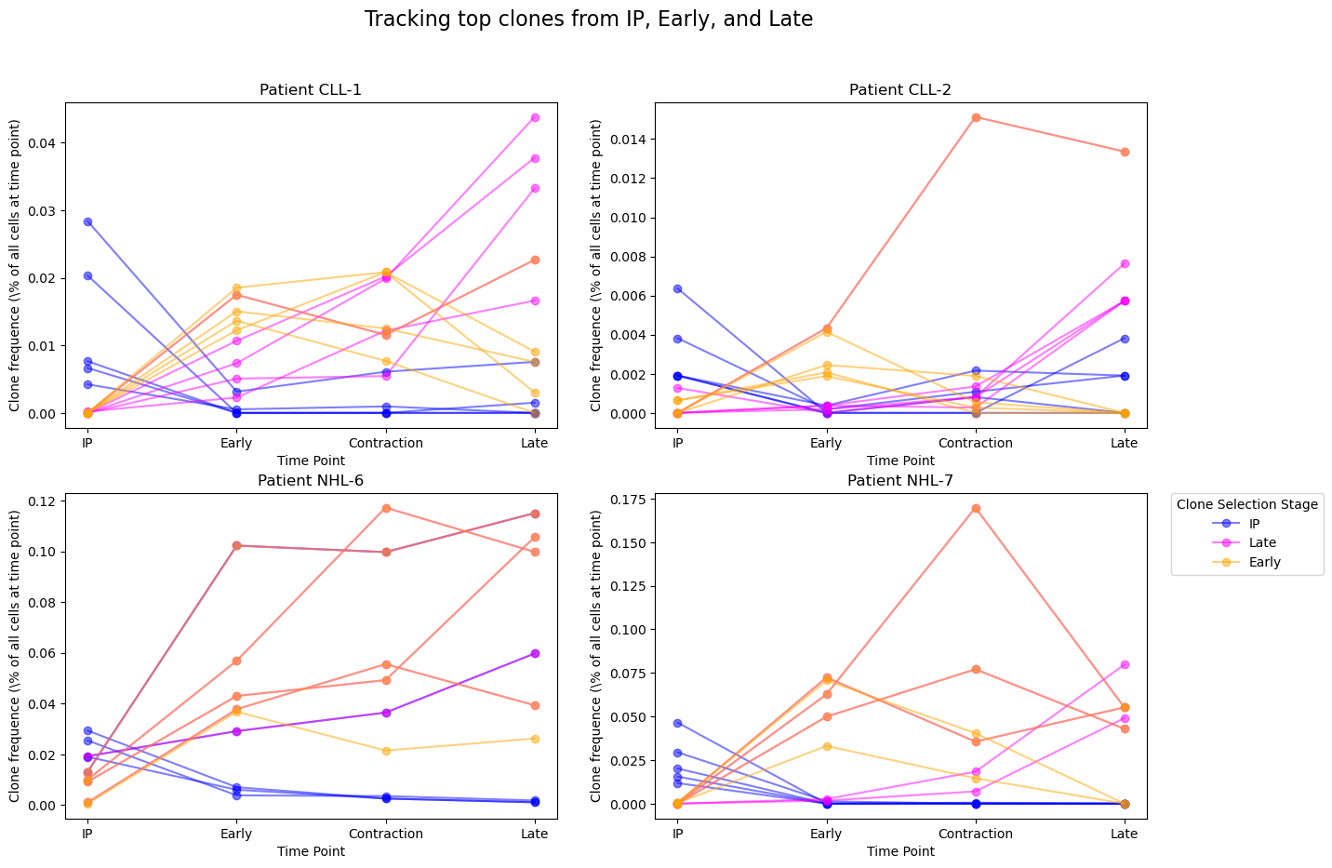
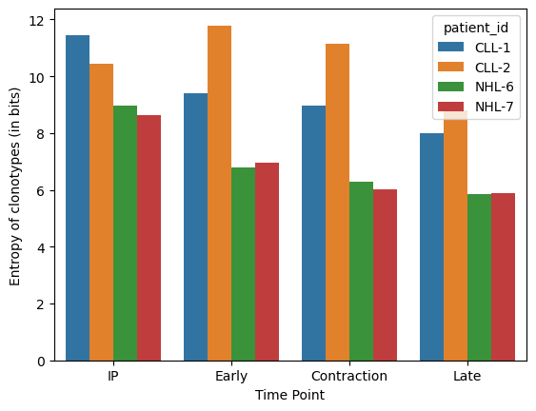
A)
B)
C)
D)
E)
IP to Early
Early to Contraction
Contraction to Late
Distinct
Clonotypes
Simpson
Clonality
F)
CLL-1
CLL-2
NHL-6
NHL-7
Clonotype
Entropy
IP
Early
Late
Contraction
IP
Early
Contr.
Late
IP
Early
Contr.
Late
IP
Early
Contr.
Late
IP
Early
Contr.
Late
Time Points
Time Points
Time Points
Time Points
Time Points
Notes:
Figure 2: CAR-T Clonal Kinetics. a) quality control to assure scTCR and RNA-seq data were properly paired and not due to random pairing. b) unique cells with overlapping sequencing barcodes between the TCR-seq and scRNA-seq datasets. c) The distribution of cells with paired TCR and RNA-seq datasets. d) The number of distinct clonotypes, simpsons clonality, and entropy over time separated by patient ID. e) Breakdown of expanding and contracting kinetics across all clones between timepoints. f) Clonal kinetics of 15 clones represented by the top 5 clones from IP, early, and contraction time points by patient.

Slide 3
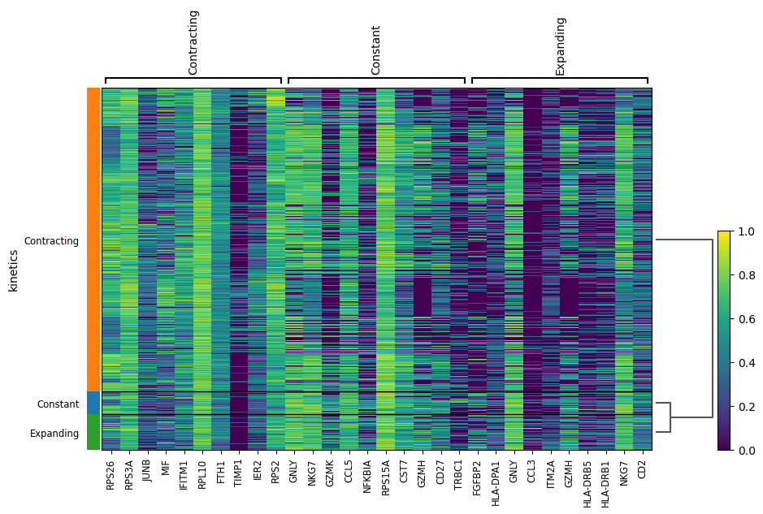
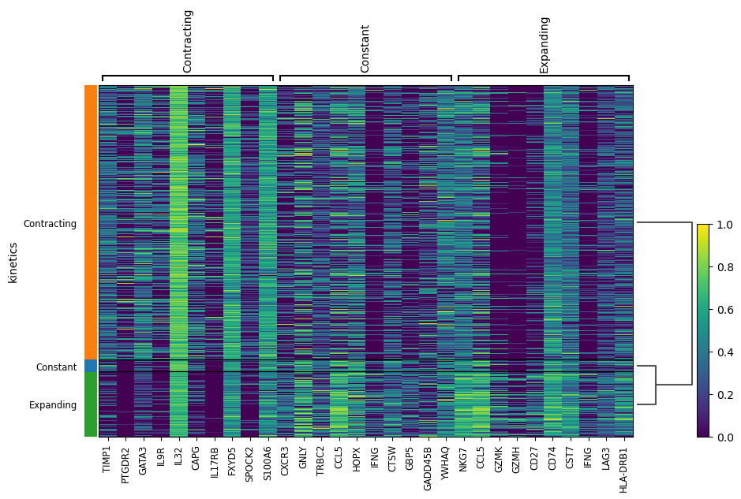
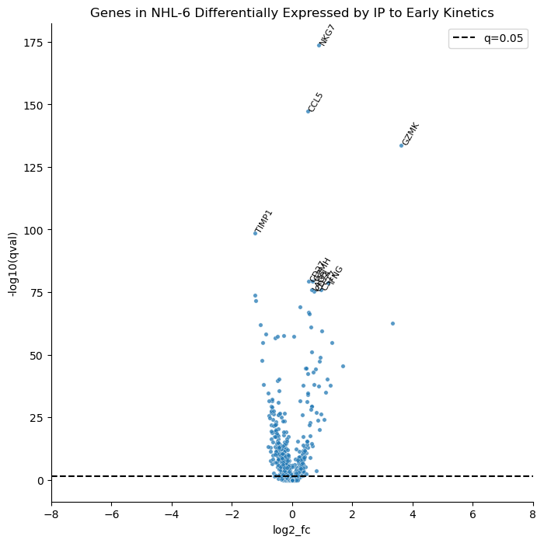
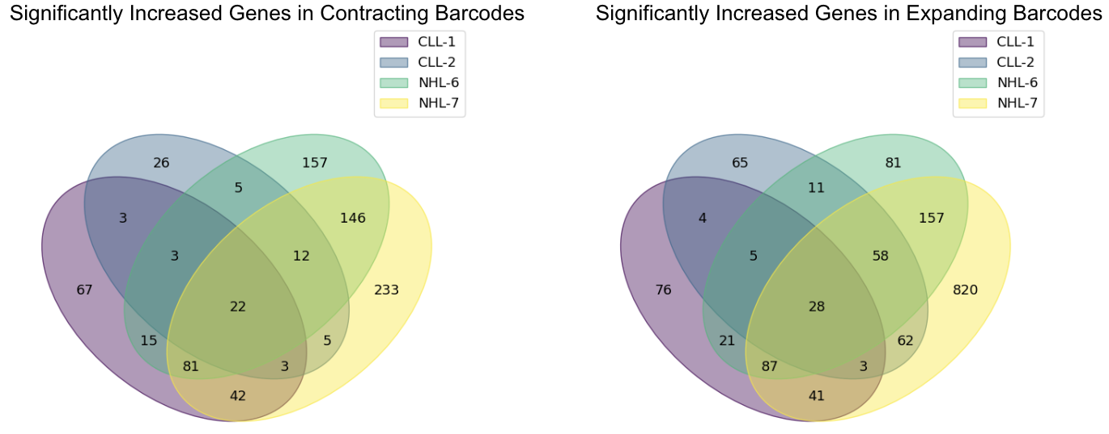
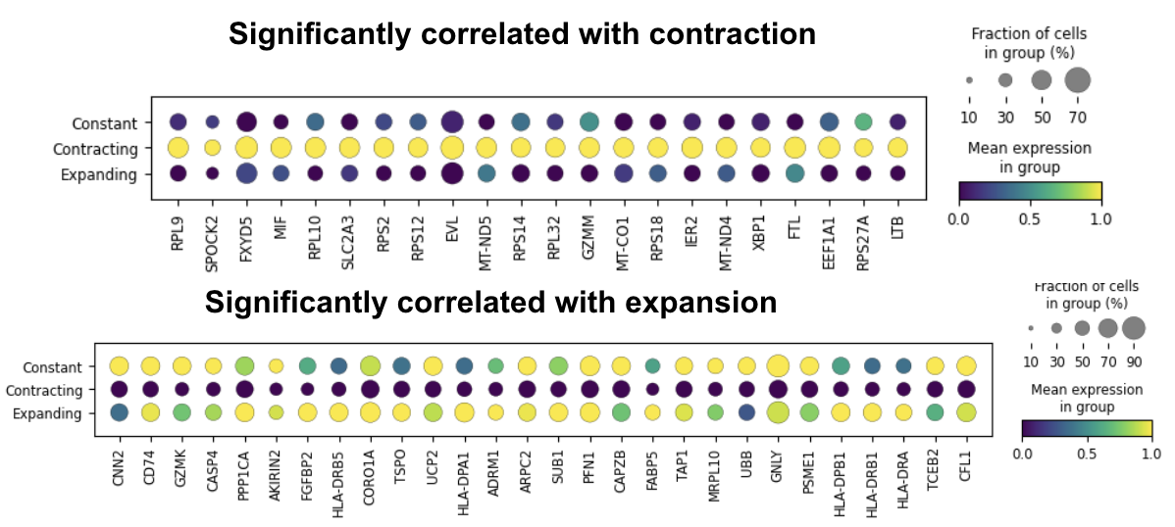
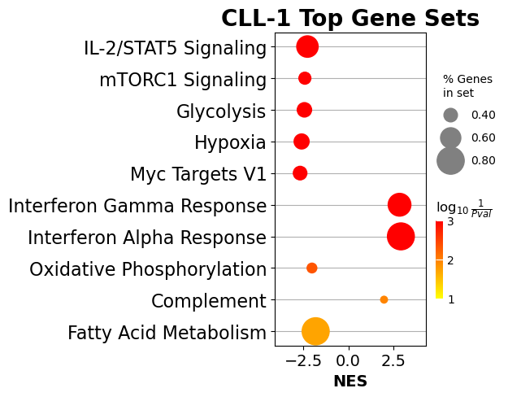
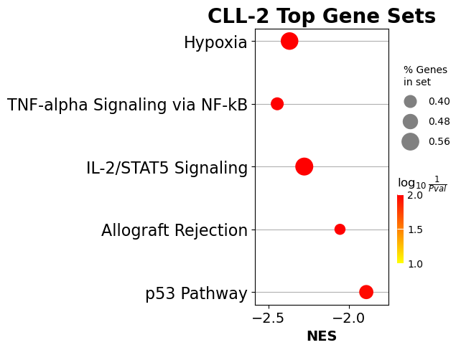
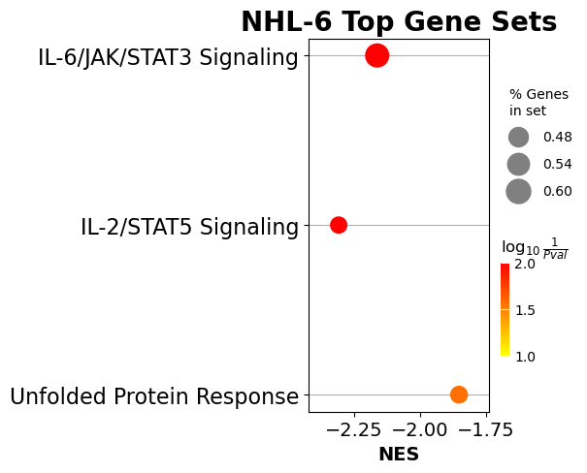
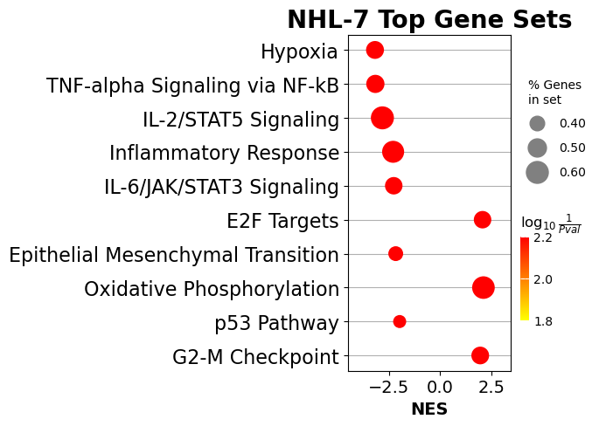
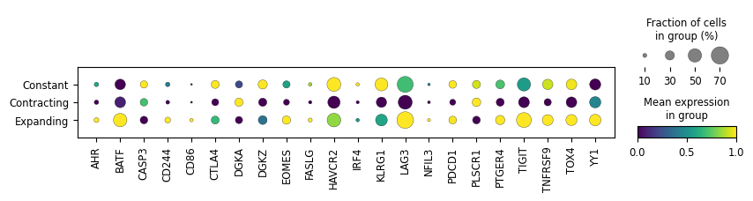
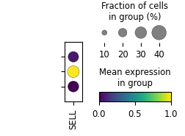
A)
B)
C)
D)
DGE in Contracting Clones
F)
I)
G)
DGE in Expanding Clones
E)
H)
T Cell Exhaustion Gene Set
Notes:
Figure 3: Differential gene expression between kinetic behaviors. a) A heatmap of DEGs between contracting, expanding, and stagnant (constant) kinetic behaviors for all patients. b) A heatmap of DEGs between contracting, expanding, and stagnant (constant) kinetic behaviors for NHL-6. c) a Volcano plot for DEGs from IP to Early in NHL-6. The line represents a q value of 0.05. d-e) The number of DEGs between patients from the IP to Early timepoints, organized by contracting (d) and expanding (e) clonotypes. f-h) DEGs associated with contraction (f) and expansion (g) across clonotypes, as well as relative expression and frequency of T cell exhaustion genes (h). i) Gene set enrichment analysis for contracting clones between IP and Early.

