Slide 1

REALTIME OBJECT DETECTION
Rugilandavyi B. Mubondo
MEng. Geodesy & Geoinformatics
Computer Science Project
2820004
Hochschule Neubrandenburd

Slide 2
GOAL
Build a Web-Implimented Object Detection & Recognition Application

Slide 3
PROBLEM
Most Object Detection Software achieve real-time object detection with powerful Graphics Processing Unit (GPU), but many devices such as cellphones or laptops don’t have adequate GPU power and memory.
OBJECTIVES
Developing a Computer Vision template with React
Running COCO SSD model and dataset
Making real-time detections

Slide 4
OBJECTIVES
Develop a Computer Vision template with React
Run SSD model on COCO dataset
Making real-time detections

Slide 5



Project Tools
Visual Studio
Tensorflow
React

Slide 6
Visual Studio
The Integrated Development Environment(IDE), the project is written in JavaScript
Tensorflow
Software library for machine learning and artificial intelligence.
Tensorflow.js library allows to develop ML (ObjDet) models in JavaScript, and use ML directly in the browser or in Node.js.
React
JavaScript library for building user interfaces based on UI components

Slide 7
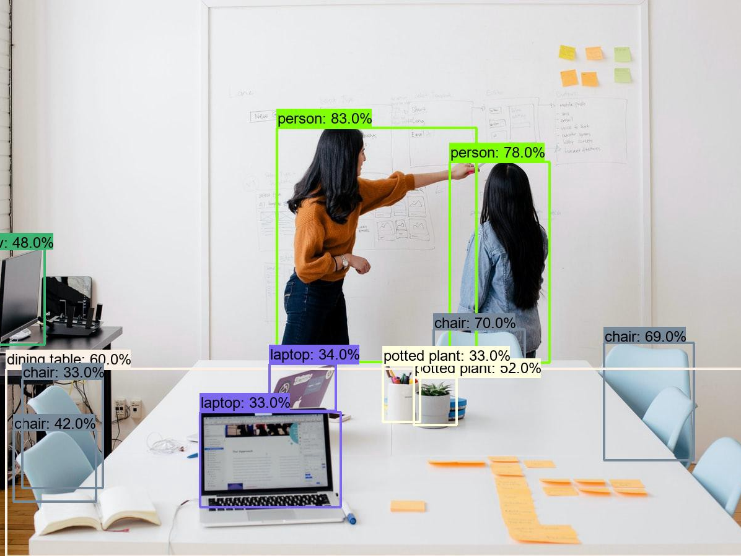
WHAT IS OBJECT DETECTION ?
A computer vision and image processing technology that involves detecting and identifying objects.

Slide 8
Real-Time Object Detection
Performs object detection in real-time with fast inference while maintaining a base level of accuracy.
Relies on a live stream from camera or image source

Slide 9

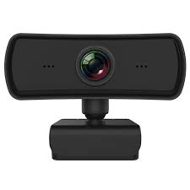


How The Software Works
React.JS for a standalone front-end App
Capture images from webcam stream for object detection
Make detections using tf.js pre-trained model
Render detections on screen

Slide 10
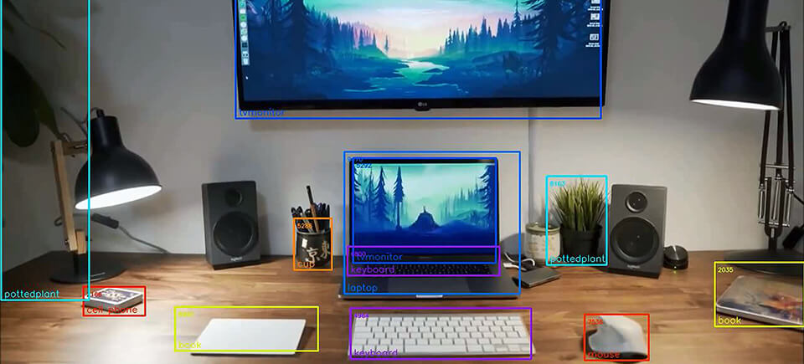


Object Recognition
Object Detection
Is there an object ?
Where is the object ? (object coordinates in image)
Object Identification
What is the object ? (object class)
Localization:
Bounding box frames object location
Classification:
Name of object is determined

Slide 11
OBJECT DETECTION ML MODELS
Machine learning models trained to detect and or recognise objects in images
One-stage models have high inference speeds e.g
SSD
YOLO
Two-stage models have high localization and recognition accuracy e.g
R-CNN
FPM
SPP-Net

Slide 12
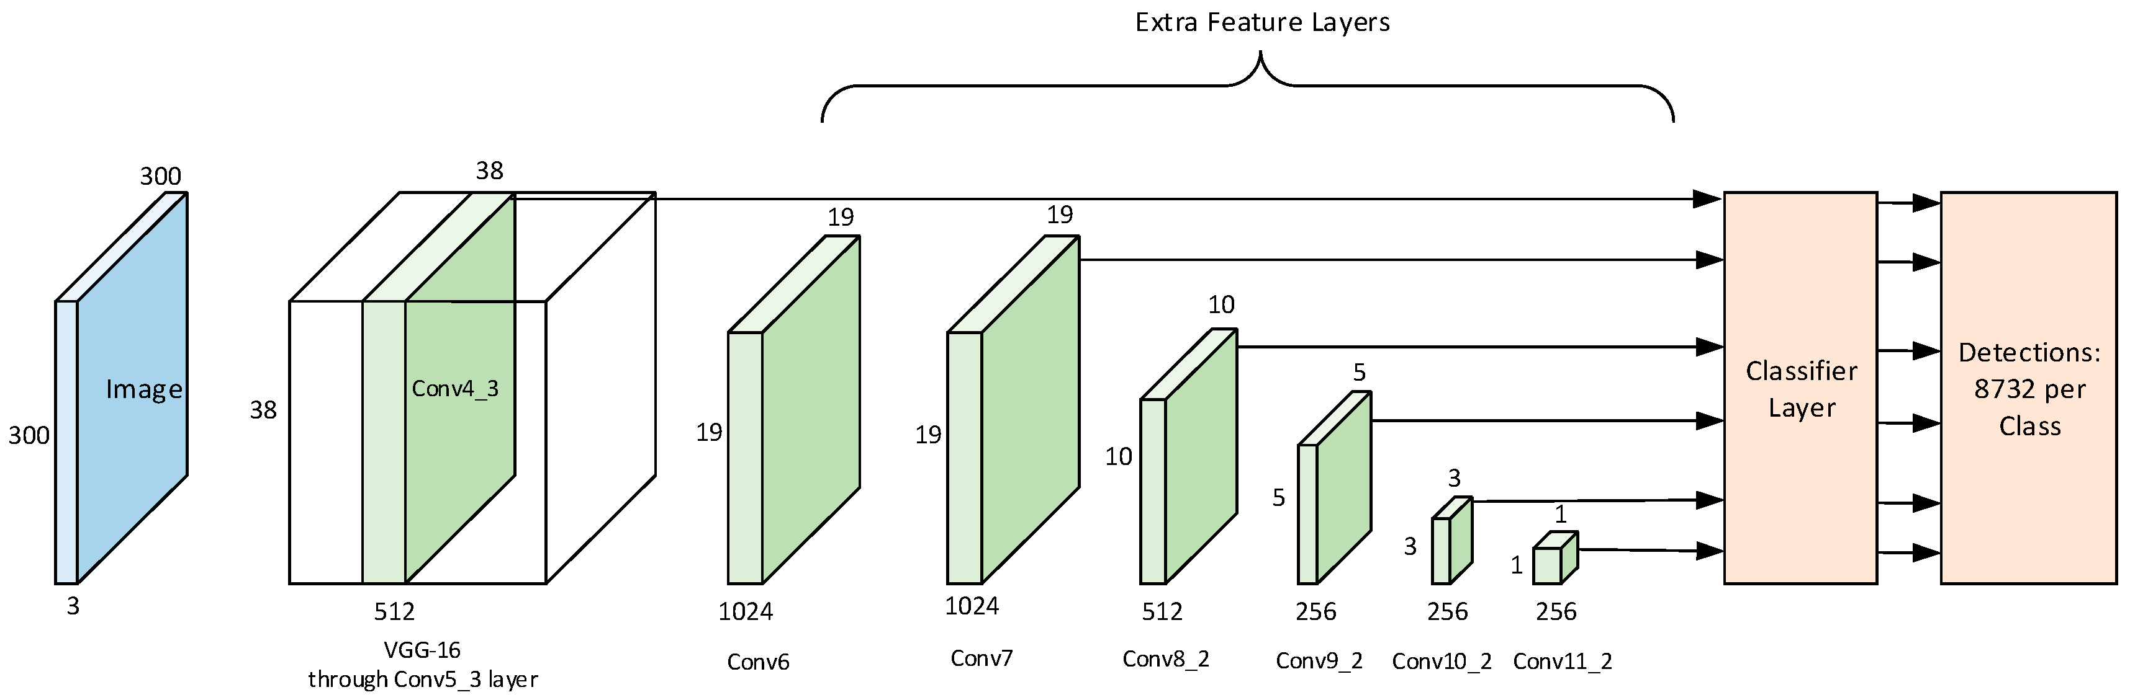
SSD (Single-Shot Detector)
Predicts the boundary boxes and the classes directly from feature maps in one single pass.
It has no delegated region proposal network

Slide 13
Advantages of SSD
Fast therefore most suitable Real-time Object Detection
Simple network structure
Disadvantages
Has relatively low localization and recognition precision
Performance decreases with object size

Slide 16
Source-code and datasets repos
https://github.com/rugilandavyi/RealTimeObjectDetection.git
https://cocodataset.org/#download

