Slide 1

Capstone Project - MyShuttle

Slide 2



PERSONAL BACKGROUND
Project Title : MyShuttle- Smart Shuttle Booking App
Members:
Elangovan R
Gayathri Thalapathi
Teja Boreddy
Trainer :
Suresh Nanjan
www.collaberadigital.com

Slide 3


Problem Statement of the MyShuttle Project
The MyShuttle application is a ride-booking and fare management platform that needed to ensure high reliability, faster delivery cycles, and seamless user experience. Traditional manual testing was slow, error-prone, and lacked the scalability required to validate frequent updates across multiple modules like login, dashboard, and fare history.
To address these challenges, there was a need for an automated Quality Engineering framework that could provide end-to-end functional coverage, validate APIs, test system performance under heavy load, manage test data effectively through databases, and enable global access through cloud deployment.

Slide 4

Requirement and Test Plan
Test Analysis (SRS Documentation)
Conducted Software Requirement Specification (SRS) documentation.
Captured functional and non-functional requirements of MyShuttle
Defined modules to be tested: Login, Dashboard, Fare History, API, Load.
Test Plan (Test Plan Documentation)
Prepared Test Plan document as per IEEE standards
Defined scope, objectives, and testing strategy
Listed test deliverables, resources, and tools (NUnit, Postman, JMeter, MySQL, AWS)
Documented entry/exit criteria, timelines, and responsibilities

Slide 5
Test Environment – MyShuttle Application
To execute and validate the MyShuttle project, a dedicated test environment was configured with the following dependencies:
JDK – Required to compile and run the Java-based MyShuttle application.
Maven – Used as a build and package manager for dependencies and project structure.
MariaDB & MySQL – Database setup for handling user data, test data, and load simulation.
Apache Tomcat – Application server to deploy and run MyShuttle on local host.
The environment was designed to closely simulate real-world conditions, ensuring reliable test execution and accurate results.

Slide 6
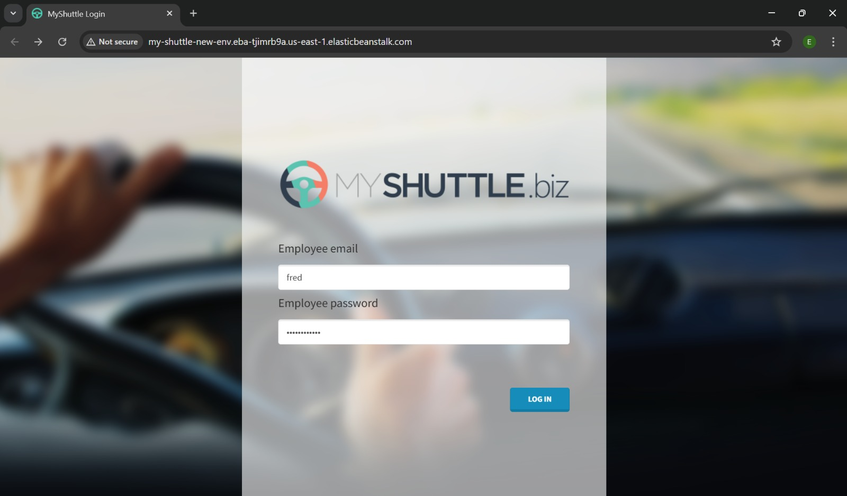
Login Page – MyShuttle Application
This MyShuttle Login Page offers a simple, user-friendly interface for secure account access. Users enter their email and password, with the system validating credentials and showing error messages for incorrect inputs.The page ensuressecure authentication and acts as the entry point to the application’s features.

Slide 7
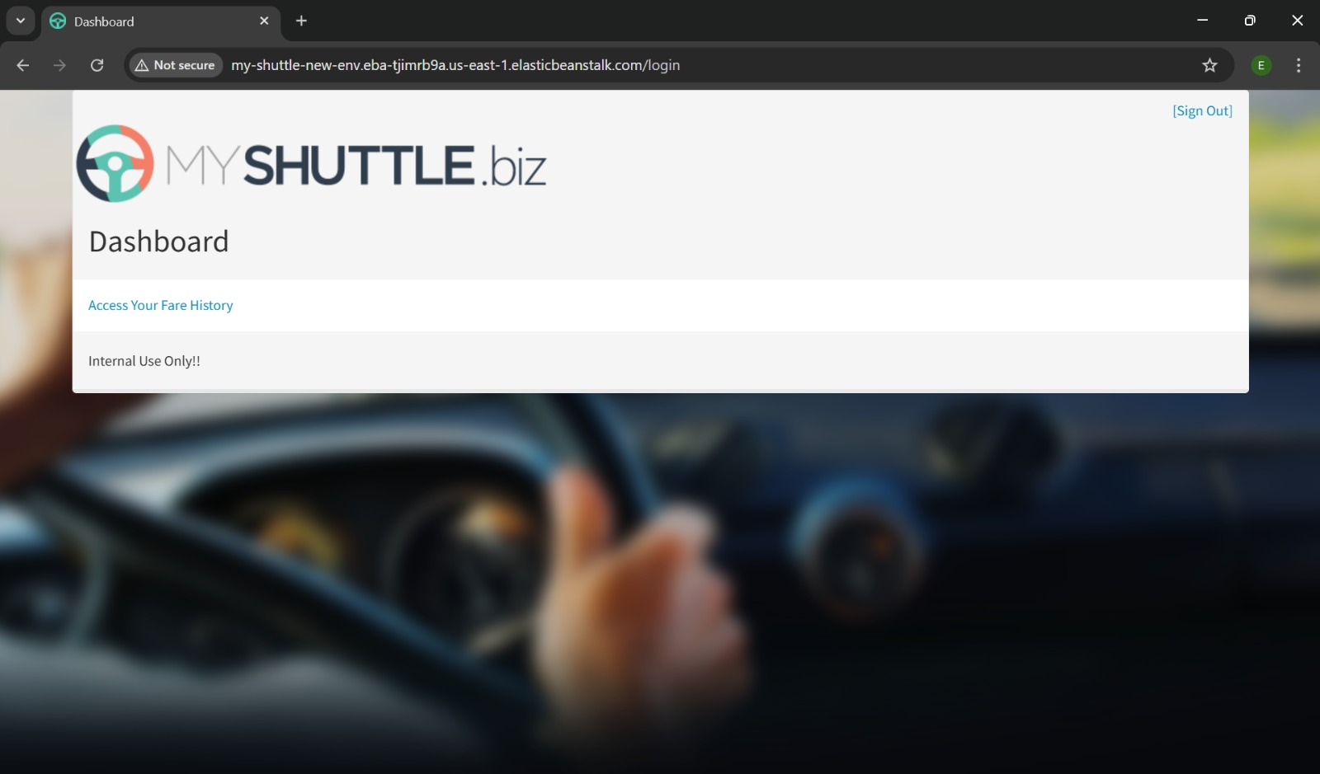
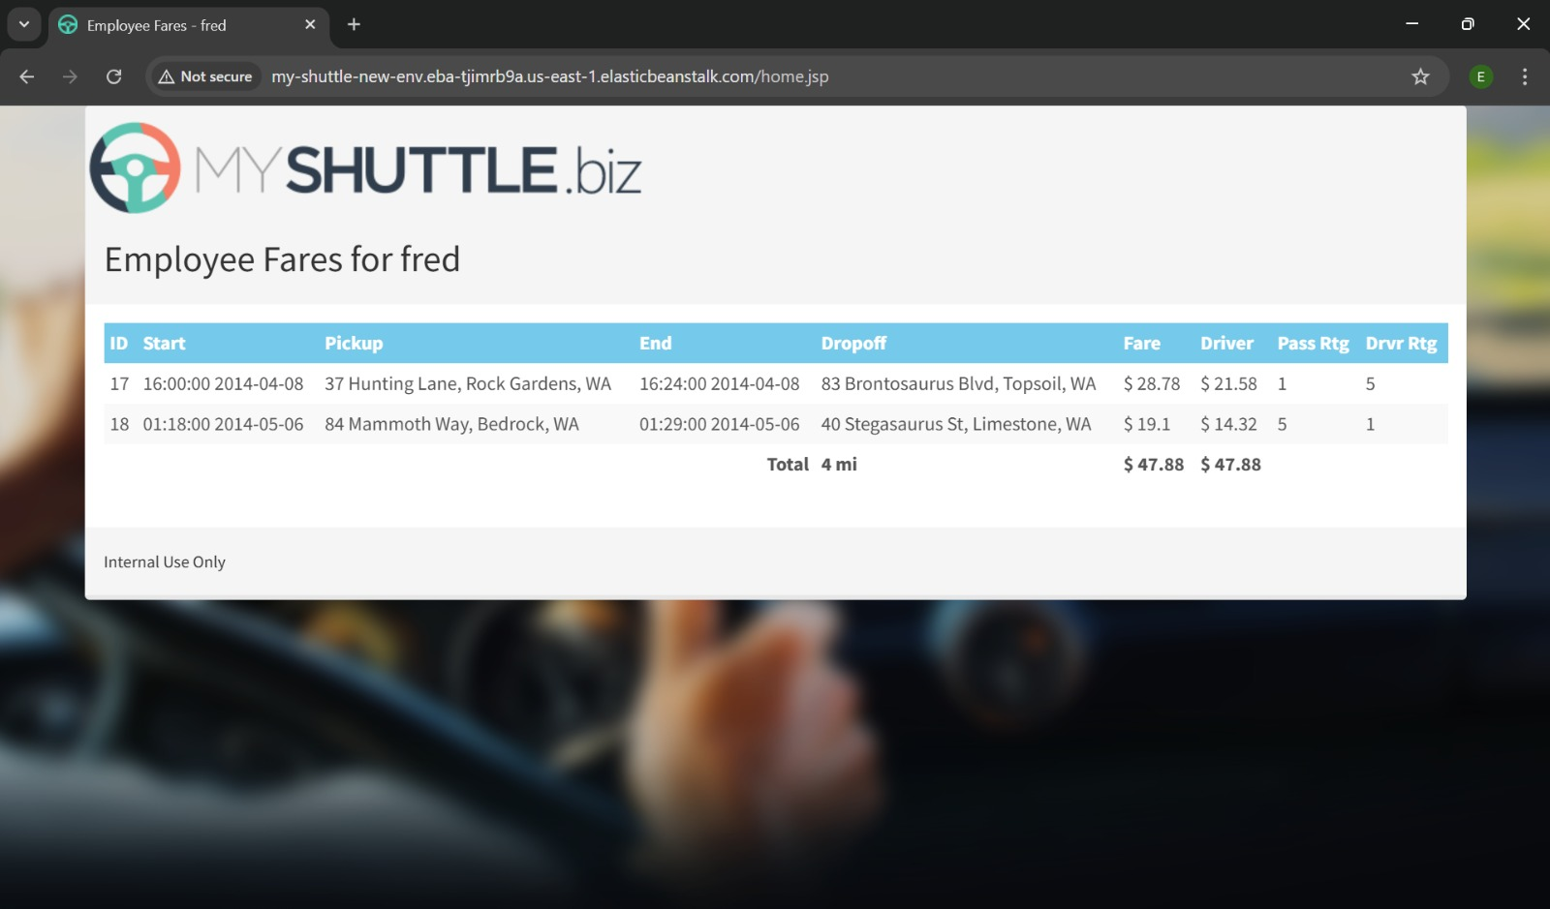
MyShuttle Dashboard and Fare History
The Dashboard provides a quick overview of the user’s activities, including ride history, fare details, and account information. It acts as the central hub for navigating different features of the application.
The Fare History page displays a detailed list of past rides with information such as date, fare amount, and payment status. It helps users track their expenses and maintain ride records easily.

Slide 8
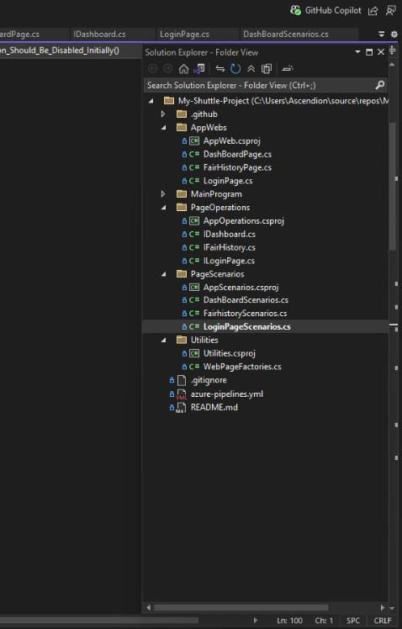
Problem Statement of the MyShuttle Project
Automation testing for the MyShuttle application was implemented to verify the functionality, performance, and reliability of features such as ride booking, fare history, and user authentication. The main goal was to ensure a seam less user experience and reduce manual effort.
Steps followed for Automation Testing of MyShuttle:
Deployment & Setup – Configured MyShuttle in localhost environment
Tool Selection – C# + NUnit with Page Object Model (POM)
Test Case Creation – Designed reusable and modular test scripts
Test Automation – Automated Login, Dashboard, and Fare History modules
Execution & Reporting – Validated with assertions and generated test reports
Continuous Improvement – Optimized scripts for better coverage and Maintainability.
For more information, refer to the provided Git Repository
Link:https://github.com/Elango-17/My-Shuttle-Project

Slide 9
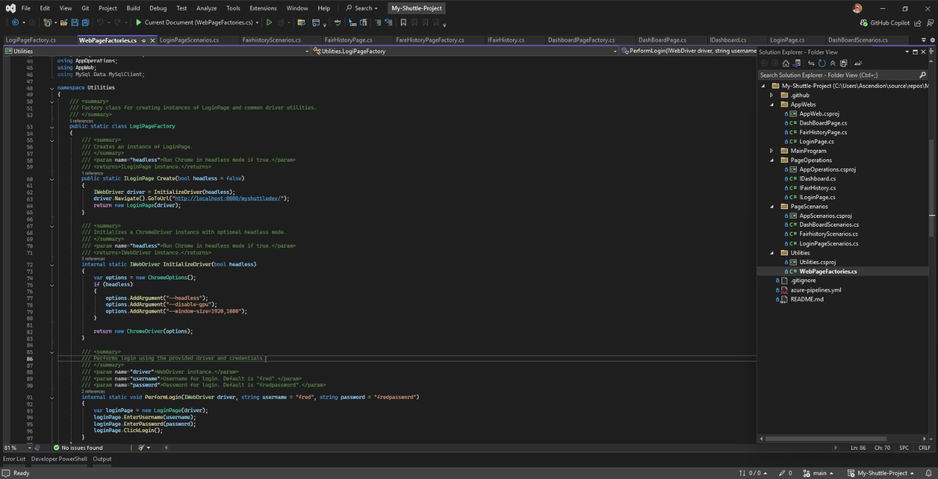
Automation Testing Execution

Slide 10
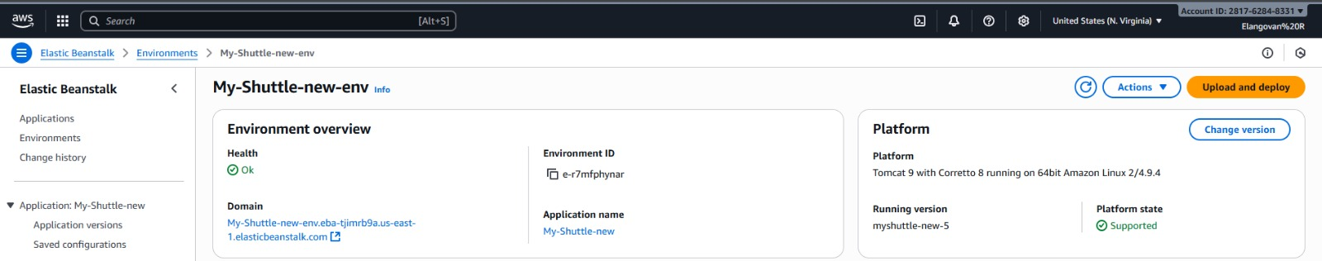
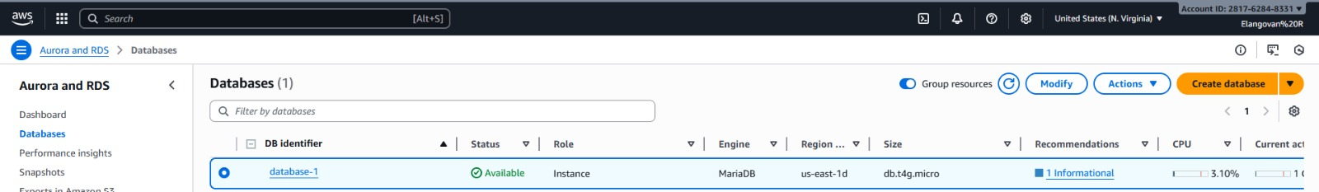
Deploying MyShuttle Application using AWS

Slide 11
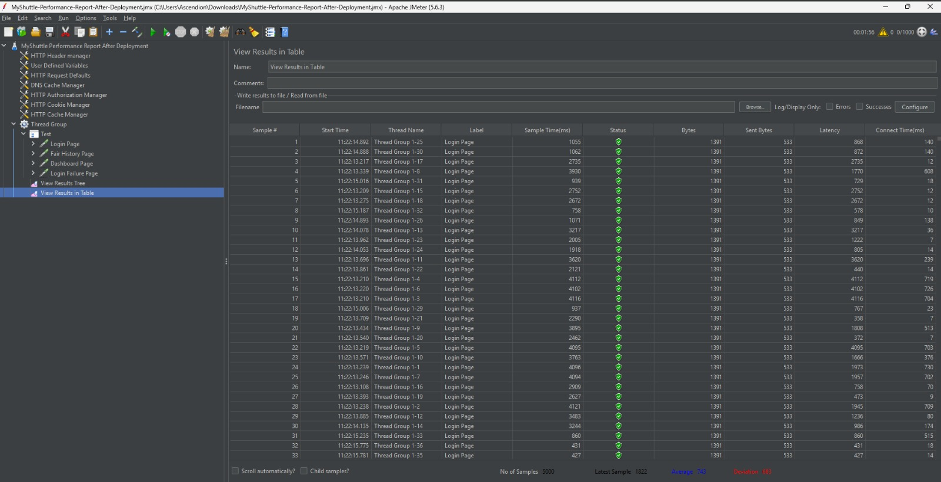
MyShuttle Load Testing - JMeter
Load testing was performed using Apache JMeter to simulate multiple concurrent users on the MyShuttle application. This helped analyze the system’s performance, response time, and scalability under heavy user load.

Slide 12
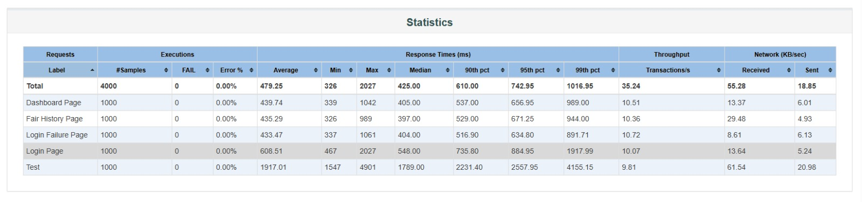
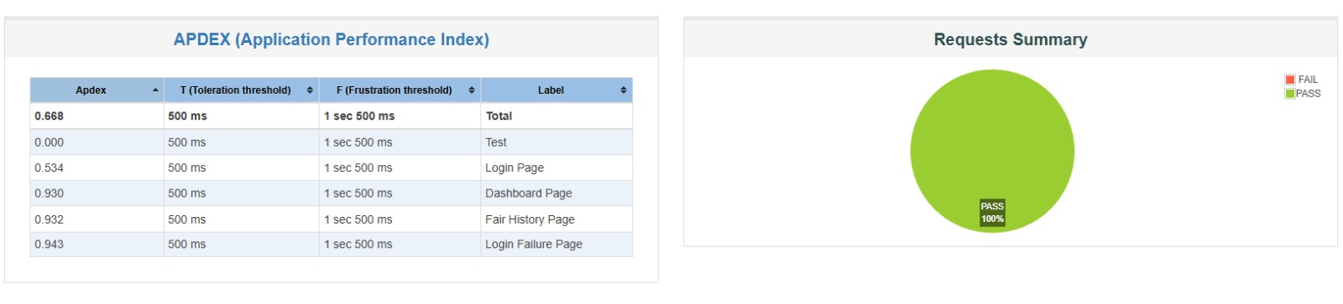
MyShuttle Load Testing - JMeter

Slide 13
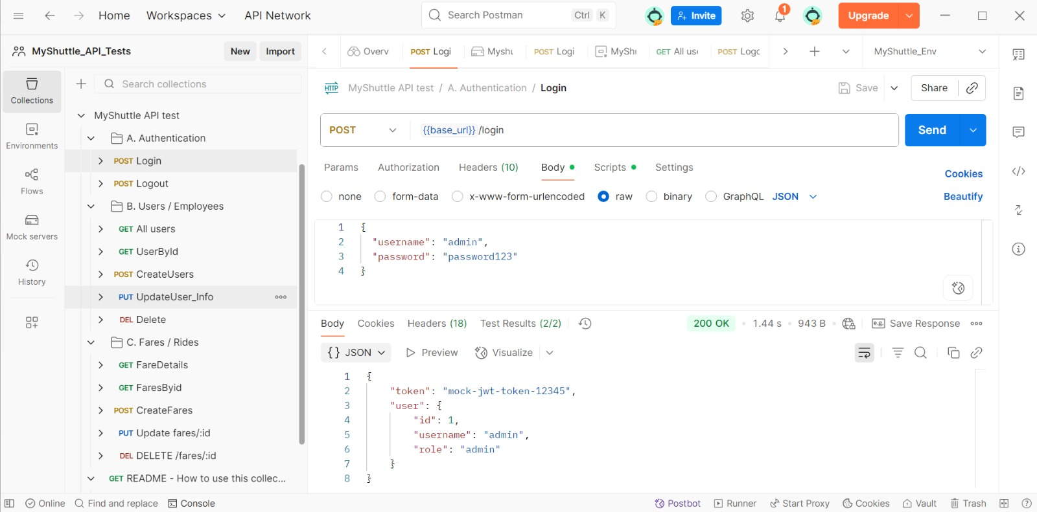
API Testing with Postman – MyShuttle
This picture shows the API testing results of Myshuttle using POSTMAN
API testing in Postman was performed to validate MyShuttle’s endpoints, ensuring accurate responses and reliable backend functionality.

Slide 14
Key Takeaways/Learnings from the Program (HTD)
Hands-on experience with Automation Testing using C# and NUnit.
Practical knowledge of API Testing (Postman) and Load Testing (JMeter).
Exposure to Agile methodology and sprint tracking in Azure DevOps.
Learned database integration and test data setup using MySQL
Experience in cloud deployment and making applications globally accessible (AWS).
Improved skills in problem-solving, collaboration, and reporting
Developed understanding of end-to-end Quality Engineering lifecycle.

Slide 15
Conclusion
The journey through the Quality Engineering training and the MyShuttle capstone project has been a highly enriching experience. Over the course , we gained hands-on exposure to key skills such as Selenium automation, manual testing, performance testing, API testing, and cloud platforms.
The MyShuttle project provided an opportunity to apply these learnings in practice by implementing features like Login, Dashboard, and Fare History. This enhanced our understanding of real-world application development and testing methodologies.
Through structured daily scrum meetings and teamwork, we also developed essential professional skills such as collaboration, communication, and timely delivery, closely simulating an industry environment.

Slide 16
Thank You

