Slide 1


Automated Medical Report Summarizer & Explainer
Team Members
Yassin Saad Michael Adel Michael Wagdy Ziad Maher Sara Aboalyazeed
Supervised by
Dr. Ensaf & Eng zeyad

Slide 2
Agenda
Problem & Solution
Dataset Used
Models Used
Fine-Tuning Techniques
General System Architecture
Results & Discussion
Conclusion & Future Work
1

Slide 3
Problem & Our Solution
The Problem
Our Solution
Clinicians spend significant time manually writing SOAP notes.
Automated LLM system for SOAP notes.
Patient-friendly summaries of medical reports.
Patients struggle to understand complex medical reports.
Improves clinician workflow and patient comprehension.
2

Slide 4
Dataset Used
Dataset Name: Synthetic Medical Dialogues and SOAP Summaries
10,000 samples
9250 train / 500 validation / 250 test
Each sample:
Doctor-patient dialogue
Corresponding SOAP report
Dataset Link: omi-health/medical-dialogue-to-soap-summary · Datasets at Hugging Face
3

Slide 5
Models Used
1
Small T5
2
Facebook BART Large
3
LLaMA 3 2.3B
Lightweight version of T5 for text-to-text NLP.
Seq2seq model for generation and denoising tasks.
Efficient, scalable model from Meta.
4
Tiny LLaMA
5
Microsoft Phi-2
Edge-optimized compact LLM.
Small, high-performing general-purpose model.
4

Slide 6
Fine-Tuning Techniques
1
Full-Parameter Tuning
2
Transfer Learning
3
Prefix Tuning
4
Adapter Learning
5
LoRA (Low-Rank Adaptation)
5

Slide 7
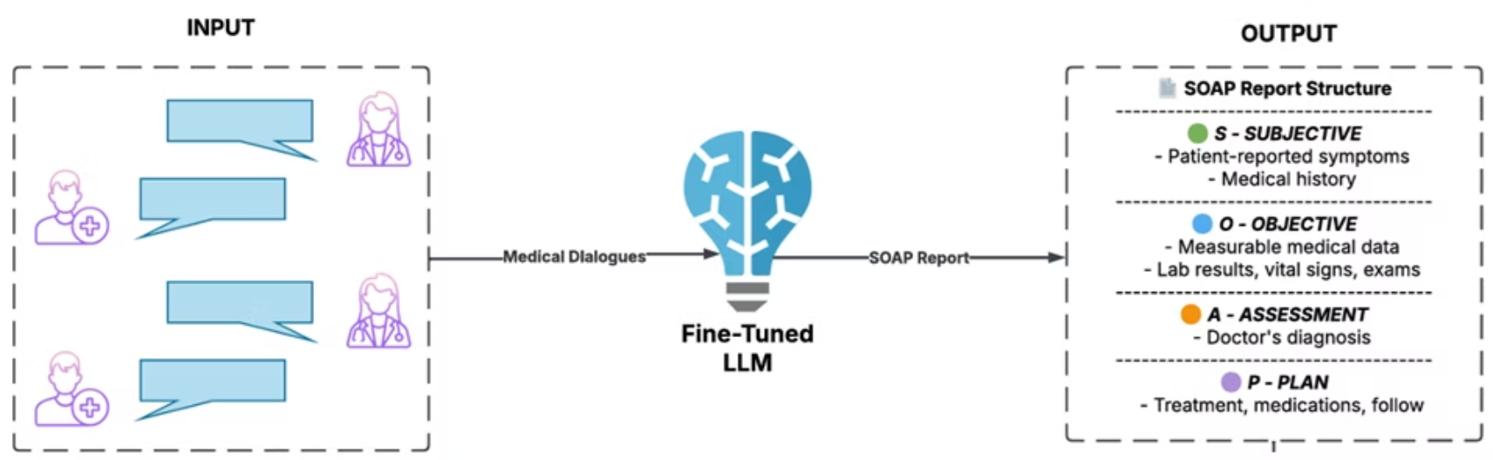

Genral System Architecture
6

Slide 8
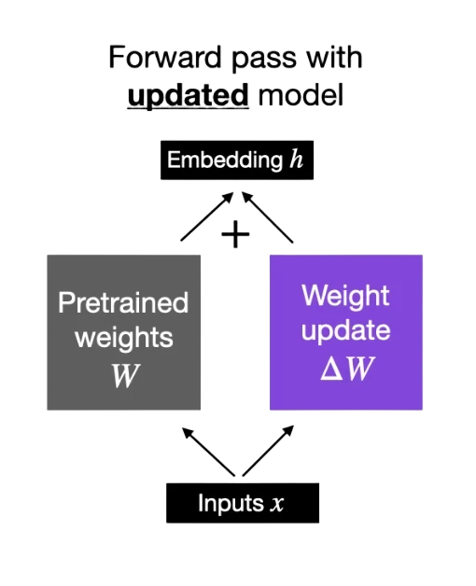
Results & Discussion: Small T5
Technique : All parameters updated
Performance:
ROUGE 1: 0.4724
ROUGE 2: 0.2698
ROUGE-L sum: 0.4003
BERTScore-f1: 0.8709
7

Slide 9
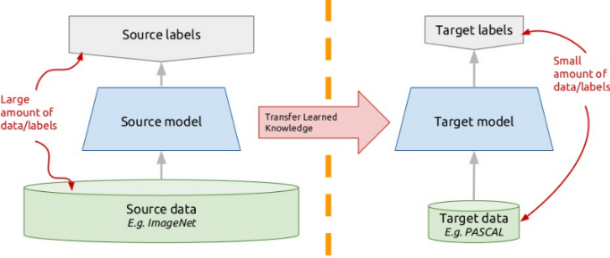
Results & Discussion: BART Large
Technique: Transfer learning from pretrained checkpoint
Performance:
ROUGE 1: 0.5394
ROUGE 2: 0.3064
ROUGE-L sum: 0.4569
BERTScore-f1: 0.8940
8

Slide 10
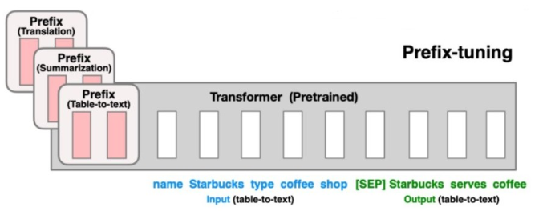
Results & Discussion: Llama 3.2-3B
Technique: Trainable prefix tokens prepended to input
Performance:
ROUGE 1: 0.4804
ROUGE 2: 0.2451
ROUGE-L sum: 0.4304
BERTScore-f1: 0.868
9

Slide 11
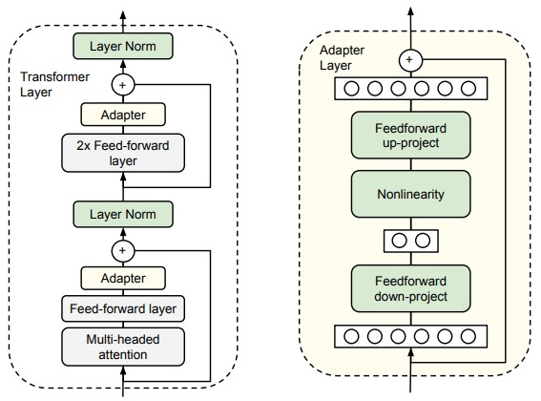
Results & Discussion: Tiny LLaMA
Technique: Adapter modules injected into layers
Performance:
ROUGE 1: 0.349
ROUGE 2: 0.107
ROUGE-L: 0.432
BERTScore-f1: 0.5147
10

Slide 12
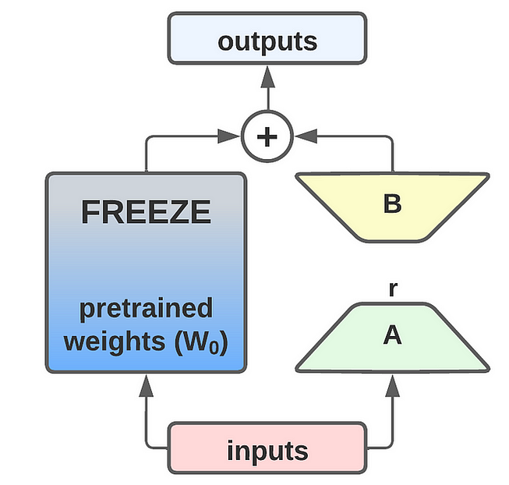
Results & Discussion: Microsoft Phi-2
Technique: Parameter-efficient fine-tuning using LoRA (Low-Rank Adaptation)
Performance:
ROUGE 1:0.328
ROUGE 2:0.102
ROUGE-L SUM:0.398
BERTScore-f1: 0.5037
11

Slide 13
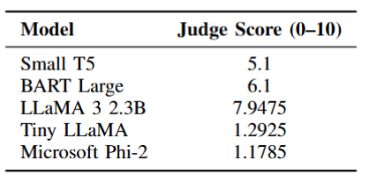
Results & Discussion:
Judge Model Evaluation Overview
Model: Grok’s LLaMA 3 70B
Models were judged based on prompt-response quality via API scoring
Performance:
Evaluation focused on Judge Scores, reflecting accuracy, relevance, or quality.
evaluates the quality of generated SOAP notes based on completeness (0.25 weight),
correctness (0.35 weight),organization (0.20 weight), and clinical relevance (0.20weight)
Results
12

Slide 14


Conclusion & Future Work
Conclusion
Future Work
LLMs automate medical summarization.
Integrate real-time data from wearables.
Fine-tuning improves accuracy.
Develop multi-modal systems.
Enhances clinician efficiency.
Personalize patient education with LLMs.
Boosts patient engagement.
13

Slide 15
Questions?

Slide 16
Thank You

