Slide 1
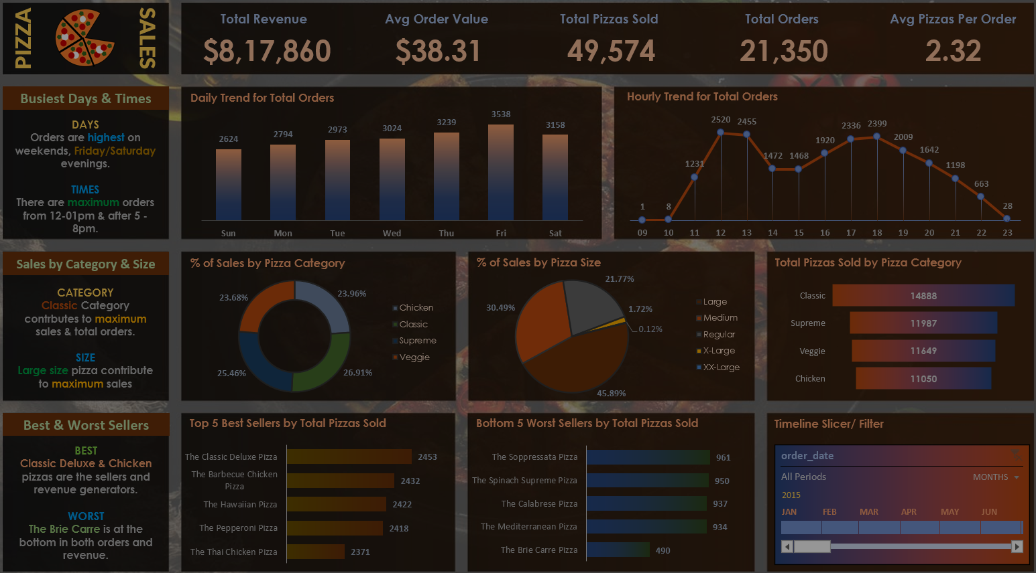



DATA ANALYST PORTFOLIO PROJECT
This Graduation project is a part of DEPI Initiatives
DOTPY Company
Members:
Mohamed Nabil
Shimaa Husien
Bassel
Mahmoud Salah

Slide 2
DATA ANALYST PORTFOLIO PROJECT
PART 1
PYTHON

Slide 3
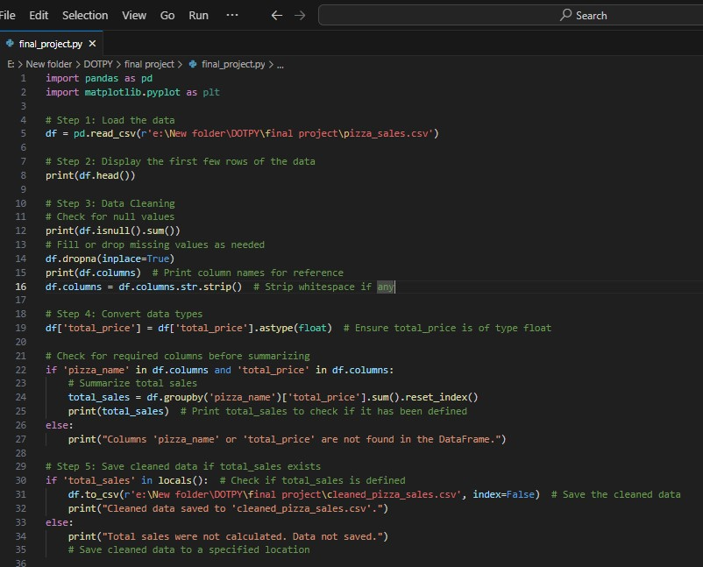

PYTHON
DATA
CLEANING

Slide 4

DATA ANALYST PORTFOLIO PROJECT
PART 2
My SQL SERVER

Slide 5
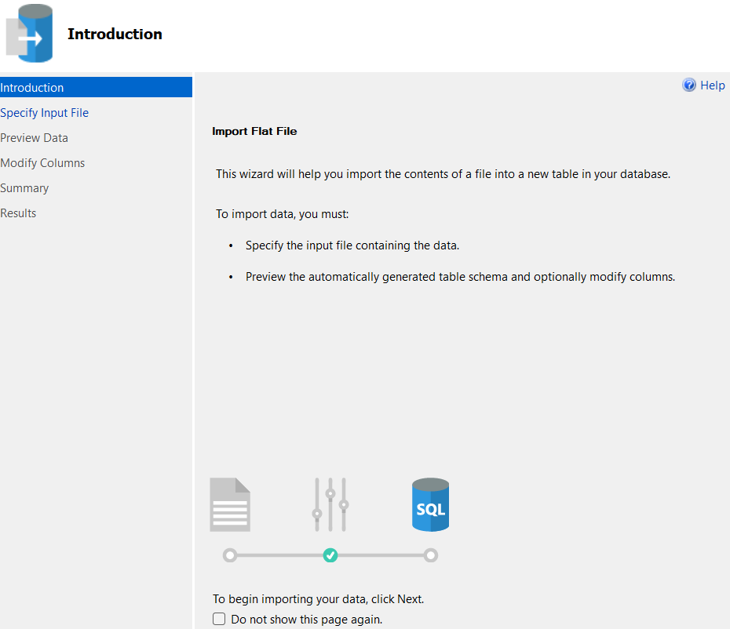

MS SQL SERVER
IMPORT
CLEANED DATA

Slide 6

MS SQL SERVER
CREATING
DB

Slide 7
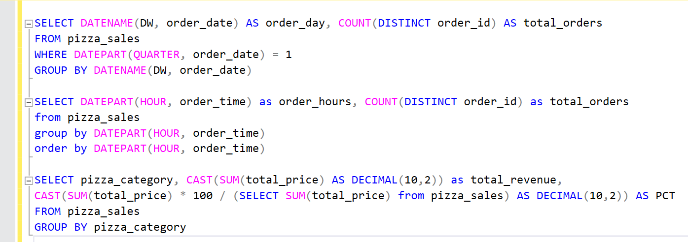
MS SQL SERVER
WRITING
QUERIES

Slide 8
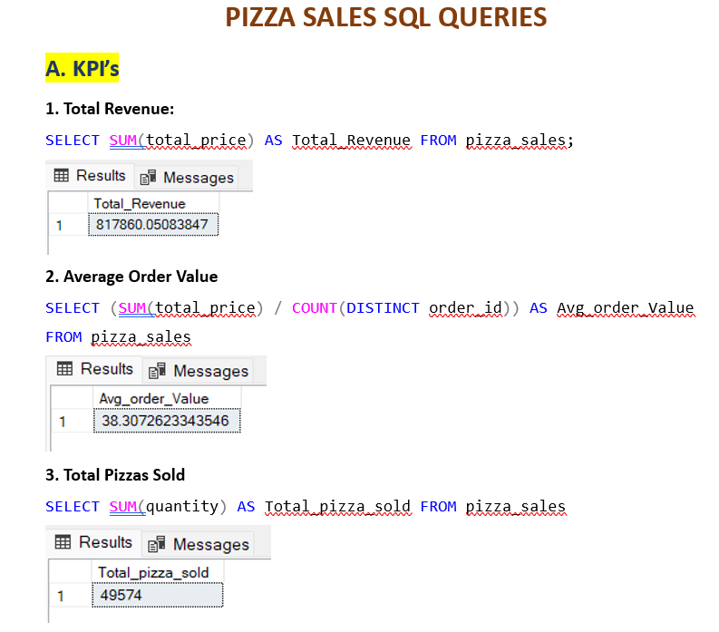

MS SQL SERVER
CREATING
REPORT

Slide 9
DATA ANALYST PORTFOLIO PROJECT
PART 3
TABLEAU

Slide 10

TABLEAU
CONNECTING TO
MS SQL SERVER

Slide 11
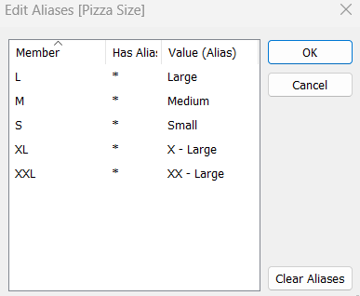

TABLEAU
DATA
PROCESSING

Slide 12
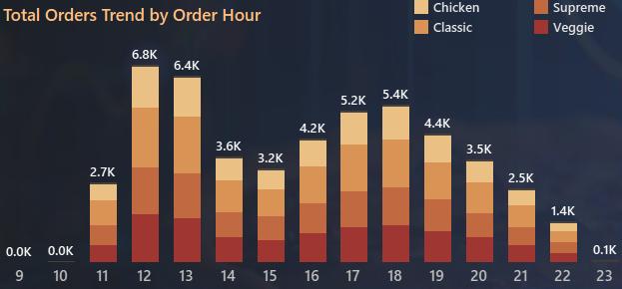

TABLEAU
DATA
VISUALIZATION

Slide 13
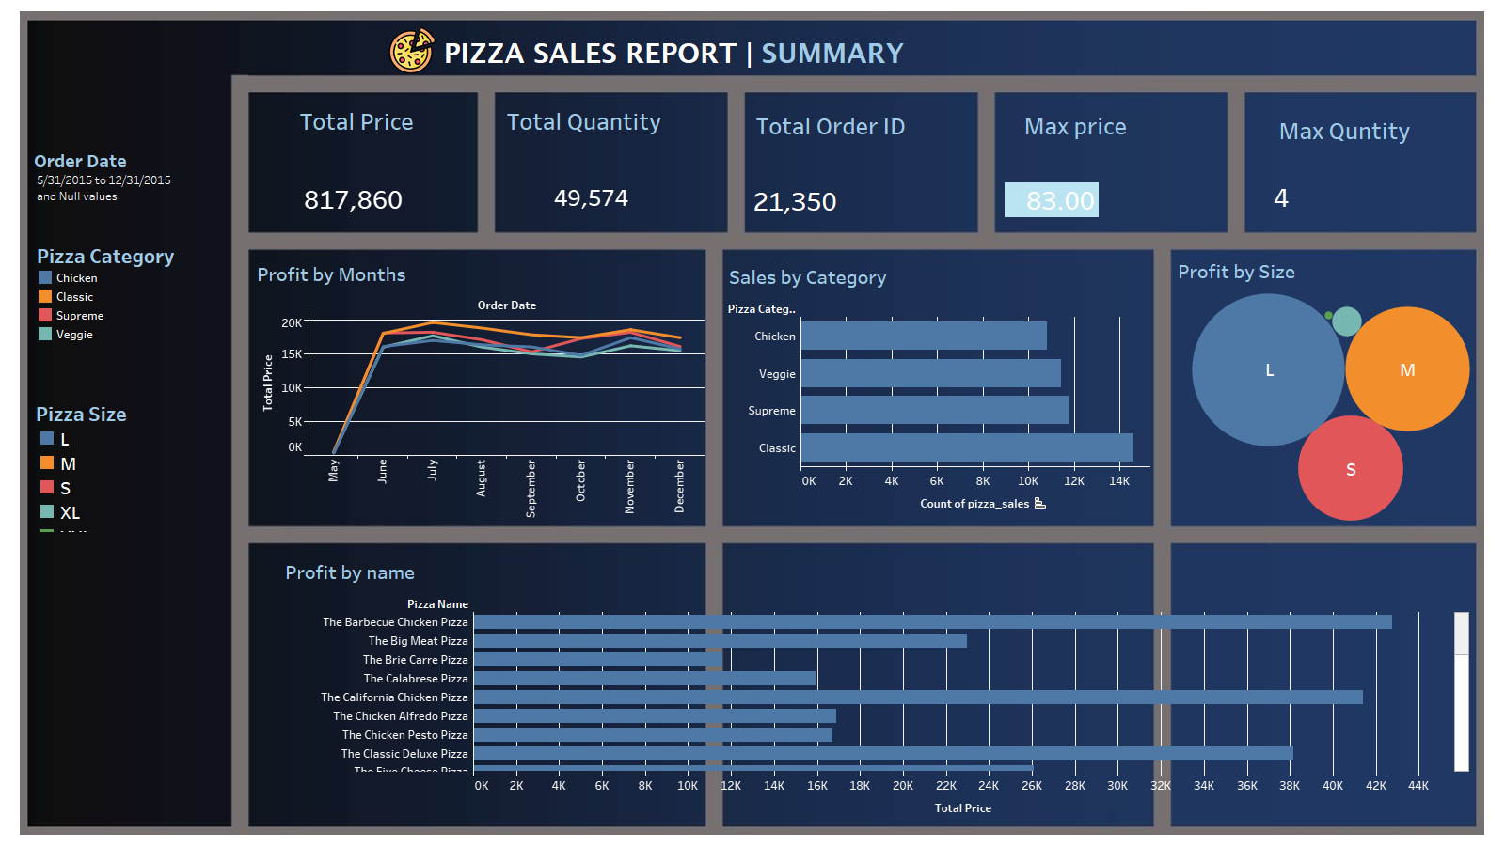

Slide 14
PROBLEM STATEMENT
KPI’s REQUIREMENT
We need to analyze key indicators for our pizza sales data to gain insights into our business performance. Specifically, we want to calculate the following metrics:
Total Revenue: The sum of the total price of all pizza orders.
Average Order Value: The average amount spent per order, calculated by dividing the total revenue by the total number of orders.
Total Pizzas Sold: The sum of the quantities of all pizzas sold.
Total Orders: The total number of orders placed.
Average Pizzas Per Order: The average number of pizzas sold per order, calculated by dividing the total number of pizzas sold by the total number of orders.
Hourly Trend for Total Pizzas Sold:
Create a stacked bar chart that displays the hourly trend of total orders over a specific time period. This chart will help us identify any patterns or fluctuations in order volumes on a hourly basis.

Slide 15
PROBLEM STATEMENT
7.Percentage of Sales by Pizza Category:
Create a pie chart that shows the distribution of sales across different pizza categories. This chart will provide insights into the popularity of various pizza categories and their contribution to overall sales.
8.Percentage of Sales by Pizza Size:
Generate a pie chart that represents the percentage of sales attributed to different pizza sizes. This chart will help us understand customer preferences for pizza sizes and their impact on sales.
9. Top 5 Best Sellers by Revenue, Total Quantity and Total Orders
Create a bar chart highlighting the top 5 best-selling pizzas based on the Revenue, Total Quantity, Total Orders. This chart will help us identify the most popular pizza options.
10. Bottom 5 Best Sellers by Revenue, Total Quantity and Total Orders
Create a bar chart showcasing the bottom 5 worst-selling pizzas based on the Revenue, Total Quantity, Total Orders. This chart will enable us to identify underperforming or less popular pizza options.

Slide 16
SOFTWARE USED
PYTHON : Colab version
My SQL WORKBENCH: 8.0
TABLEAU: 2021.2.801

Slide 17
Project plan and timeline
The project will take one month.
Weekly follow up meeting.

Slide 18
Pricing and Payments conditions
The project price will cost around 300 $,
Payments half at contract, and half after finishing the project.

