Slide 1
Amazon Sales Performance Dashboard
Elavarasi Nisha Rani S E

Slide 2
Project Overview
This project focuses on analyzing Amazon sales data using a dataset sourced from Kaggle (6500 rows). The goal is to extract meaningful insights by performing data cleaning, transformation, and visualization.
The dashboard helps in understanding key metrics such as sales trends, customer behavior, product performance, and regional analysis.

Slide 3
Problem Statement
E-commerce platforms like Amazon generate large volumes of data. Without proper analysis, it becomes difficult to:
Track sales performance across categories
Understand customer purchasing behavior
Analyze the impact of discounts on sales
Identify high-performing products and regions
Make data-driven business decisions
This project solves these challenges by building an interactive Power BI dashboard.

Slide 4
Importance of the Project
Enables data-driven decision making
Helps identify top-performing products and regions
Analyzes customer preferences and behavior
Evaluates discount effectiveness
Supports business growth and strategy planning

Slide 5
Dataset Information
Source: Kaggle
Total Records: 6000+ rows
Domain: E-commerce / Retail
Sample Features: Order ID, Product Category, Quantity Sold, Total Revenue, Discount Percentage, Customer Region, Payment Method, Rating, Order Date.

Slide 6
Tools & Technologies Used
Advanced Excel Data Cleaning Handling Missing Values Removing Duplicates Data Formatting
Microsoft Power BI Power Query Editor (PQE) for ETL Data Transformation Data Modeling DAX Measures Interactive Dashboard Creation

Slide 7
Data Processing Workflow
Data Collection: Imported dataset from Kaggle
Data Cleaning (Excel): Removed null values Eliminated duplicates Standardized formats Fixed inconsistencies
Data Transformation (Power BI - PQE): Data type corrections Column transformations Created calculated columns Applied business logic
Dashboard Development: KPIs (Total Orders, Revenue, Avg Rating, AOV) Visualizations (Bar, Line, Map, Donut, Pie) Filters & Slicers

Slide 8
Dashboard Preview
📊 Bar Chart → Product Category Performance
📈 Line Chart → Avg Rating by product_category
🗺️ Map → Regional Sales Distribution
🍩 Donut Chart → Total revenue by product category
🥧 Pie Chart → Total Orders by customer_region

Slide 9
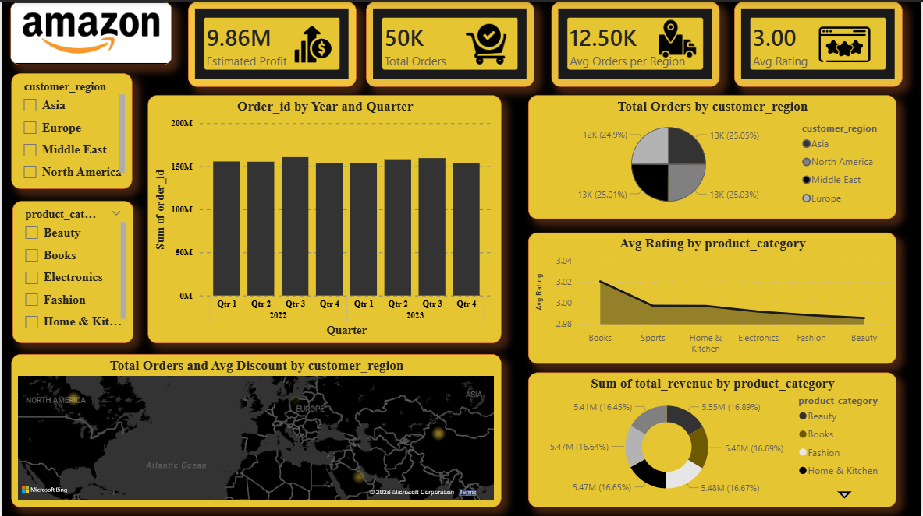

Slide 10
Future Enhancements
SQL data
Customer segmentation
Predictive analytics using Machine Learning
Advanced KPI tracking

Slide 11
Conclusion
This project demonstrates how raw data can be transformed into actionable insights using Excel and Power BI, enabling better business decisions and performance optimization.

Slide 12
THANKYOU

