Slide 1

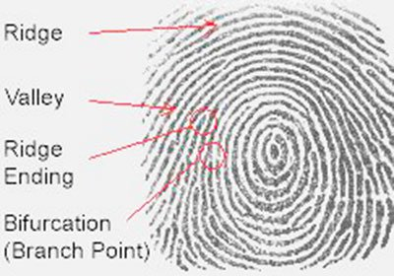
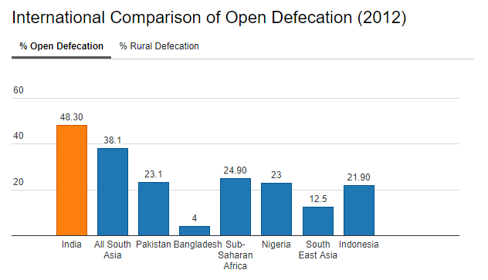
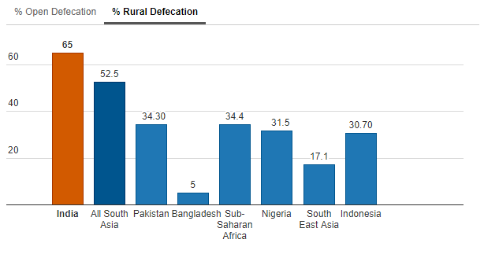
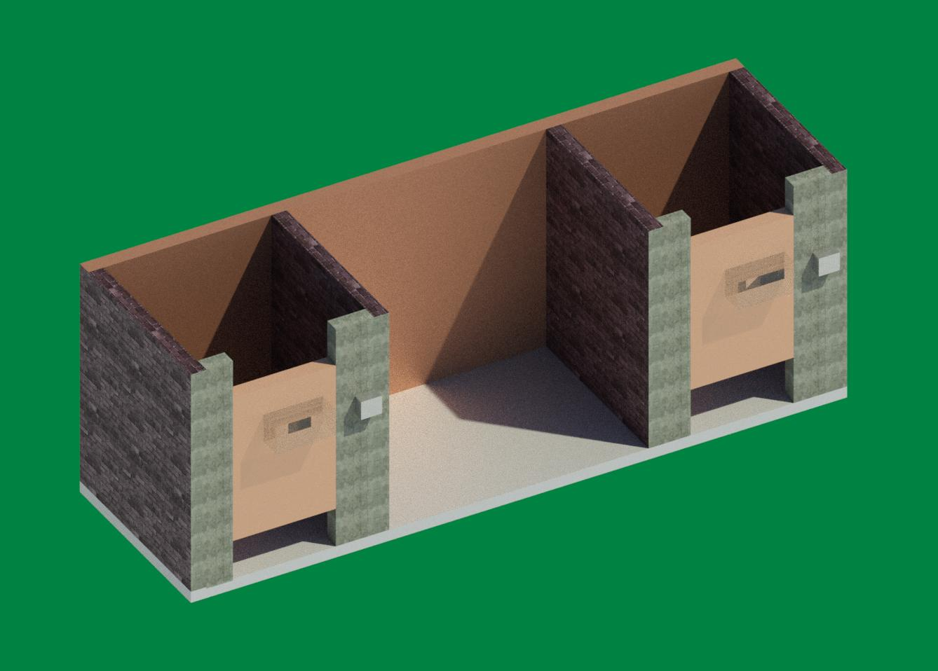
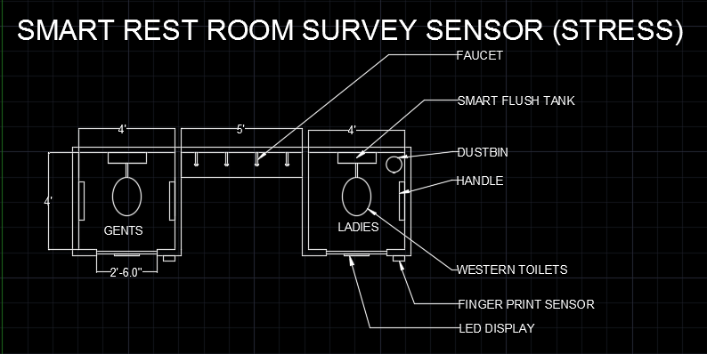
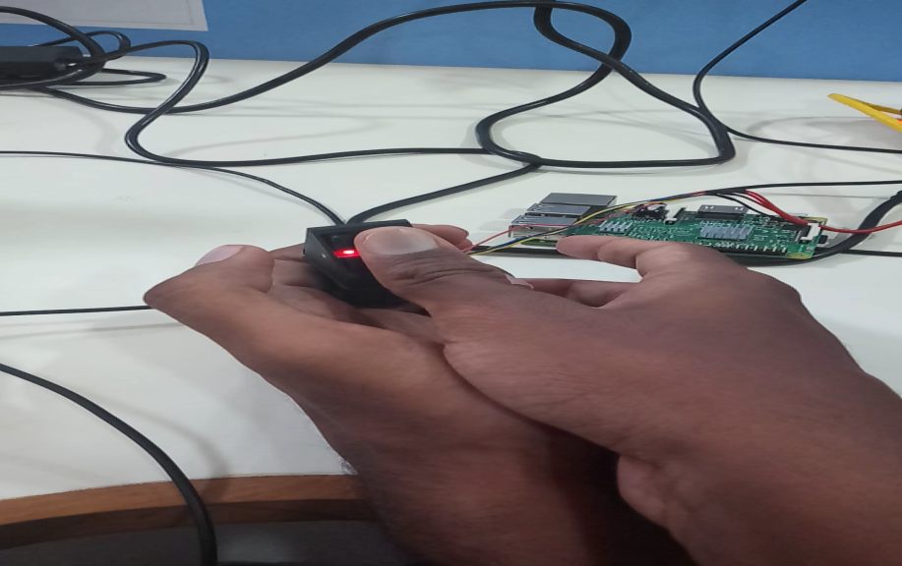
K.S.RANGASAMY COLLEGE OF TECHNOLOGY SMART RESTROOM SURVEY SENSOR-(STRESS)
INTRODUCTION
PROJECT DESCRIPTION
BENEFICIARY OF THE INNOVATION
SCIENCE BEHIND THE PROJECT
One of the major problems in India which needs to be rectified is Open Defecation, since India stands at top in open defecation among the global countries.
There arises a vital and needy solution for this problem. The main reason behind the under usage of public toilets is its cleanliness.
Our proposal offers an automatic flush tank which will clean the toilet at regular intervals, thus rectifying the serious problem.
The clean toilets at free of cost and added advantage will attract the people to use public toilets, thereby reducing the percentage of open defecation.
Our system consists of a fingerprint sensor, Raspberry Pi and LCD display.
When the people record their fingerprint, the raspberry pi will match the fingerprint details of the Aadhar card through a Cloud server
When the two finger print matches, the respective points will be added to their Ration card.
Thus using this project will be helpful in reducing Open Defecation.
By this Project government can easily take survey to find that how many people use Government toilets.
The Aadhar details is linked with project so government can also find ratio of peoples in the area who use government toilet.
Then government can easily focus the particular area of people.
Also government can encourage the people to use public toilet through advertisements and encourage the people to use public toilets by providing some points which will help them to buy ration things for discounts. This will help to promote clean India project.
Then a vital beneficiary are the passengers who travel by bus and train.
The people who don’t have own toilets in their home will be benefitted.
Since the Smart Restrooms are safe, women will be one of our beneficiary.
In biometric identification systems, human traits such as fingerprints, iris or face that are unique to each individual are used to authenticate the person’s identity. The concept of biometrics first started with fingerprints.
The surface of a fingerprint has unique patterns such as ridges and valleys that serve as the distinguishing features for individuals. These patterns are so unique in nature that even twins have different sets of fingerprints.
In biometric authentication, cloud users are initially enrolled into the biometric system. Users are required to register multiple biometric fingerprints during the enrollment process which are then stored as templates at the cloud provider’s section.
Every time when the user wants to access cloud based services, he is prompted to provide his fingerprint image and that is compared with the stored template. On a positive match between the stored template and the user’s current fingerprint scan, the user is authenticated and granted access.
Both the fingerprint templates and the images that the user provides each time for getting access are encrypted for enhanced security.
On completion of successful authentication, the user will then be redirected to the genuine cloud service platform for which he has been provided with the authority to access.
PREVIOUS HISTORY
PROBLEMS & SOLUTION
PROBLEMS
About 892 million people or 12 percent of global population, practice open defecation.
Seventy-six percent of the 892 million people, practice open defecation in the world who live in just seven countries.
India is the country with the highest number of people practicing open defecation, around 525 million people.
SOLUTION
The construction of household owned and community-owned toilets.
Establishing an accountable mechanism of monitoring toilet use.
Encourage the people to use community owned toilets.
3D - MODELLING
2D - MODELLING
NEED FOR SOCIETY
TECHNOLOGY ASPECTS
Sensing
Data Analytics
HUMAN ASPECTS
Capital Lifestyle
Fall Of Diseases
CONCLUSION
After Swachh Bharat (Clean India) plan the percentage of open defecation is 48.3%, then this project will help the government to reduce the percentage of open defecation.
Since the Smart Restrooms have self cleaning techniques, the probability of spread of diseases will be minimum.

