Slide 1
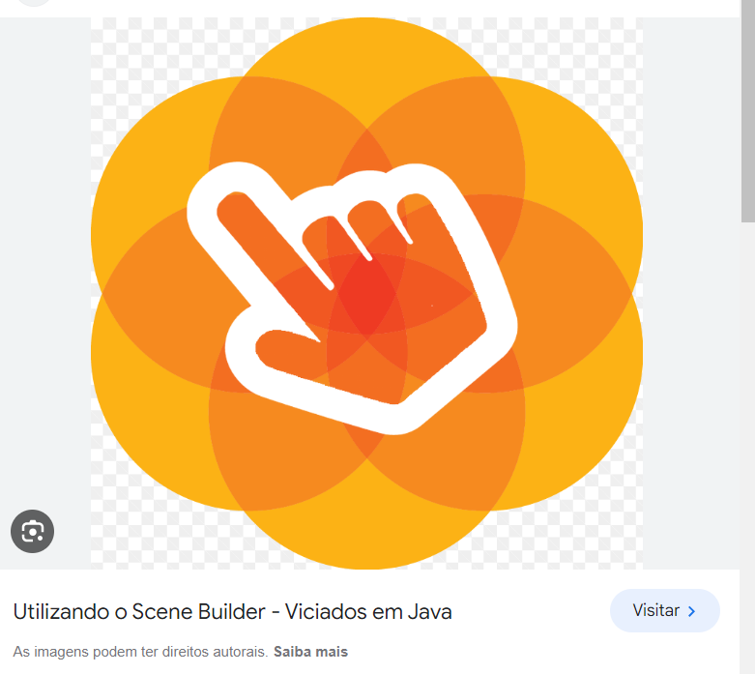

https://www.youtube.com/watch?v=A_fF7fl2lAs

Slide 2
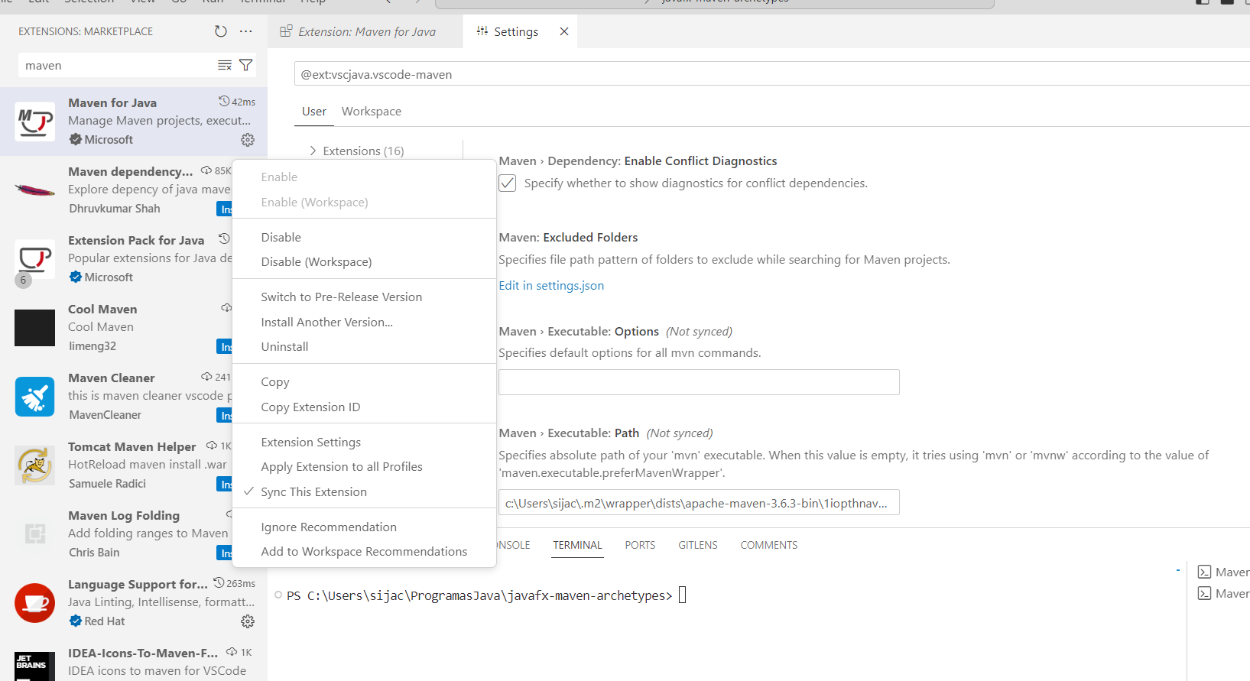
Configurando path JAVA_HOME
Botão direito do mouse

Slide 3
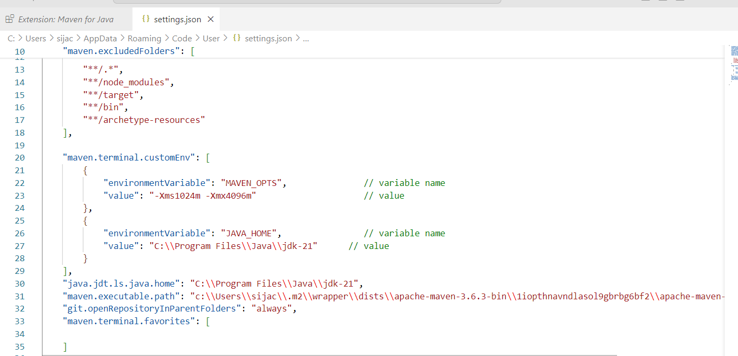

Slide 4
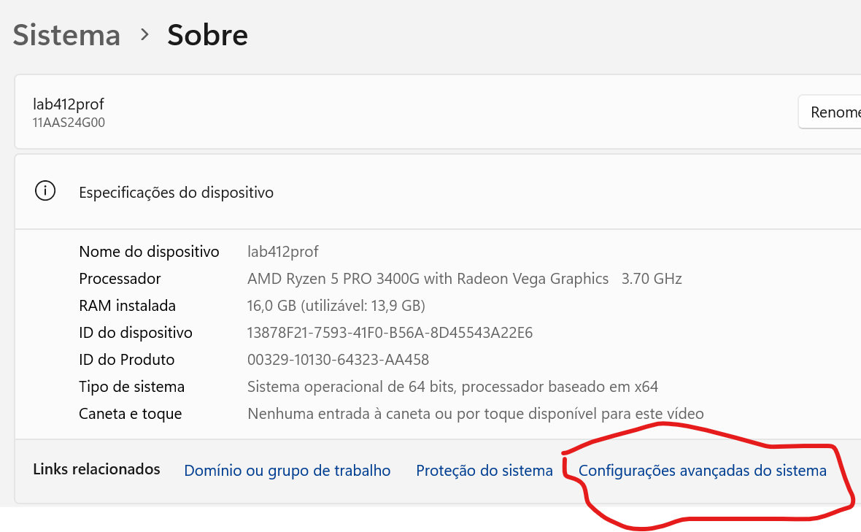
Este computador -> propriedades

Slide 5
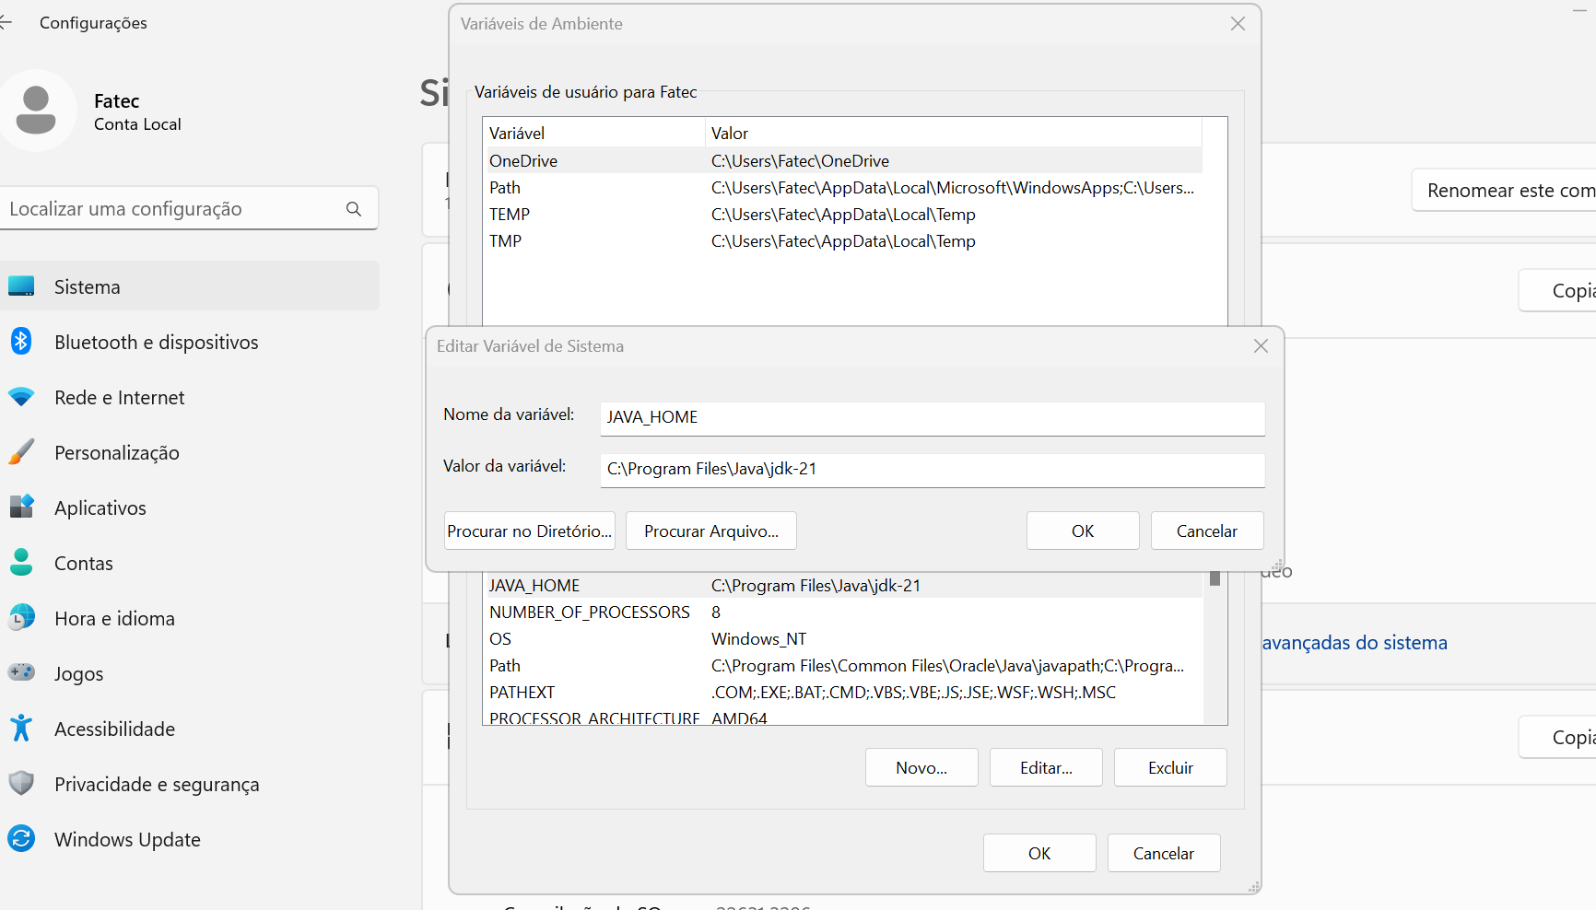

Slide 6
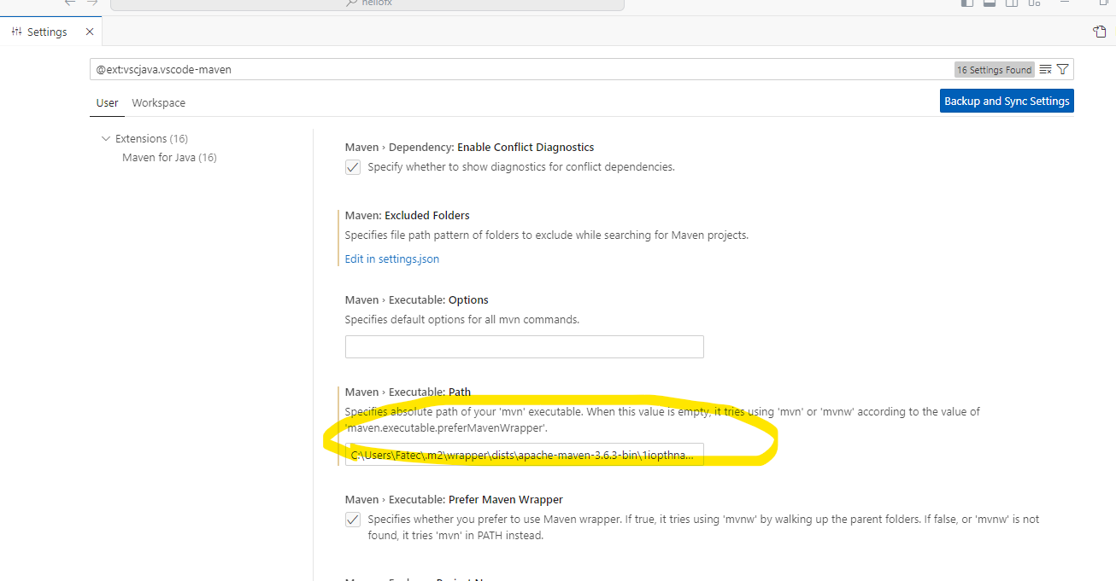
Path do Maven
C:\Users\Fatec\.m2\wrapper\dists\apache-maven-3.6.3-bin\1iopthnavndlasol9gbrbg6bf2\apache-maven-3.6.3\bin\mvn

Slide 7
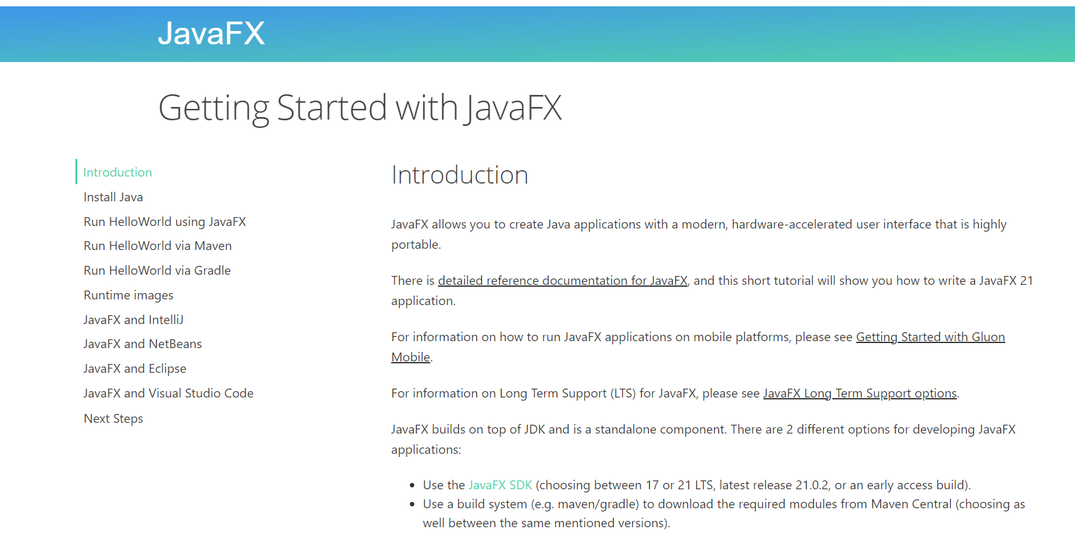
https://openjfx.io/openjfx-docs/#maven

Slide 8
Módulos do Java - explicação
https://www.oracle.com/br/corporate/features/understanding-java-9-modules.html

Slide 9
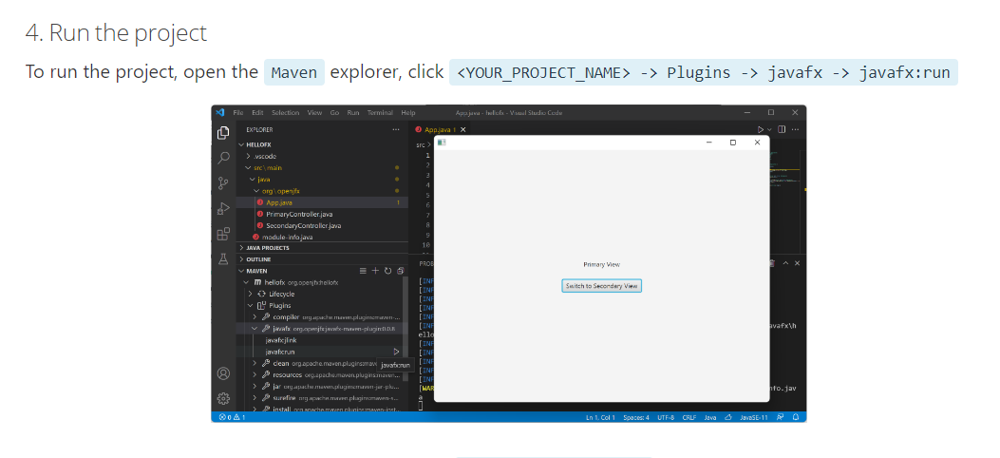

Slide 10
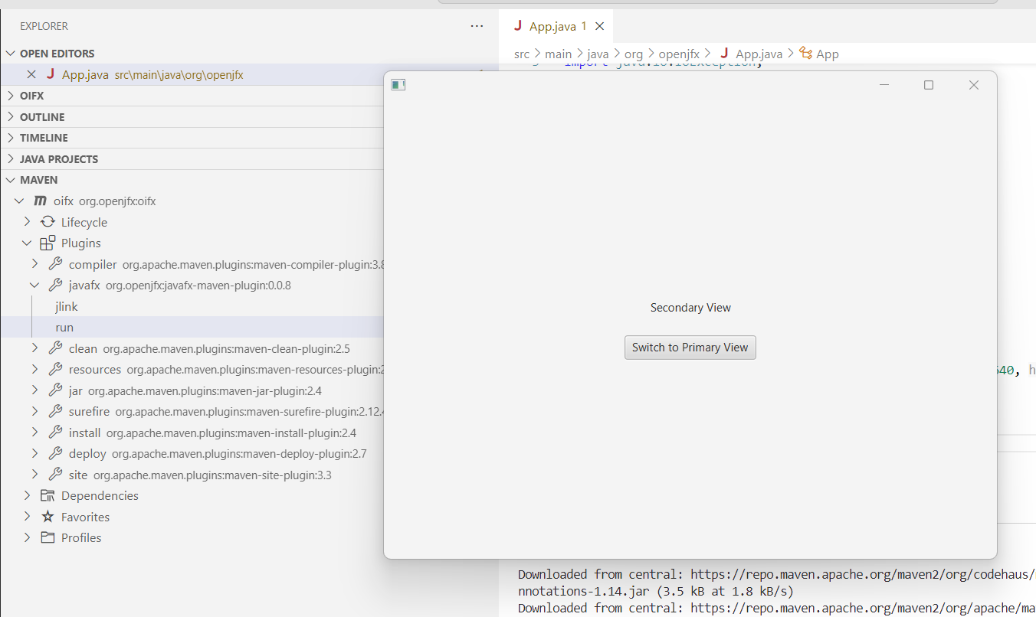
Maven, JavaFX e Vscode – gerando o jar
Alternatively, you can also open a terminal and run mvn clean javafx:run to run the project.

Slide 11
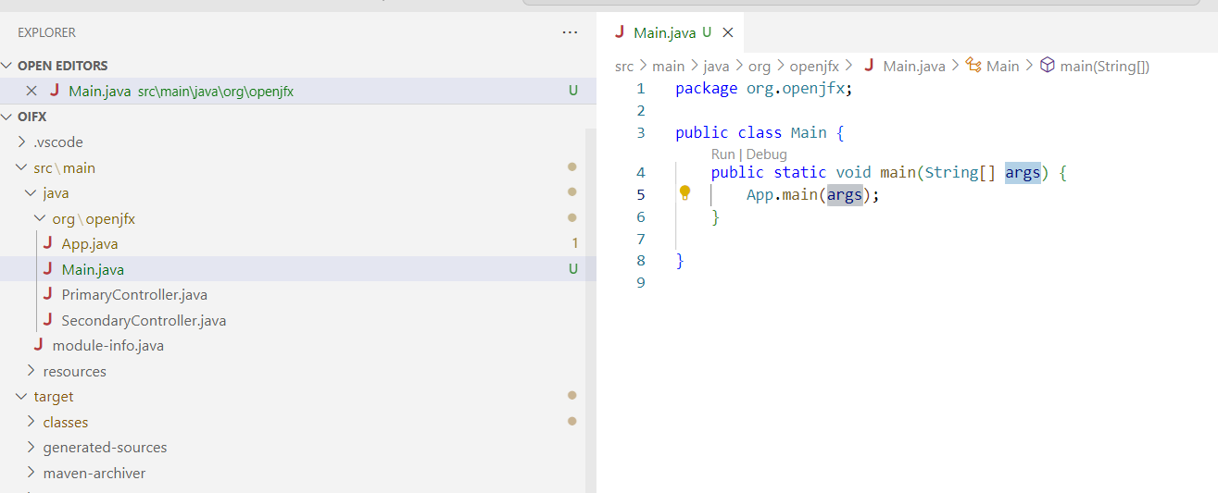
https://www.youtube.com/watch?v=EyYb0GmtEX4
Importante

Slide 12
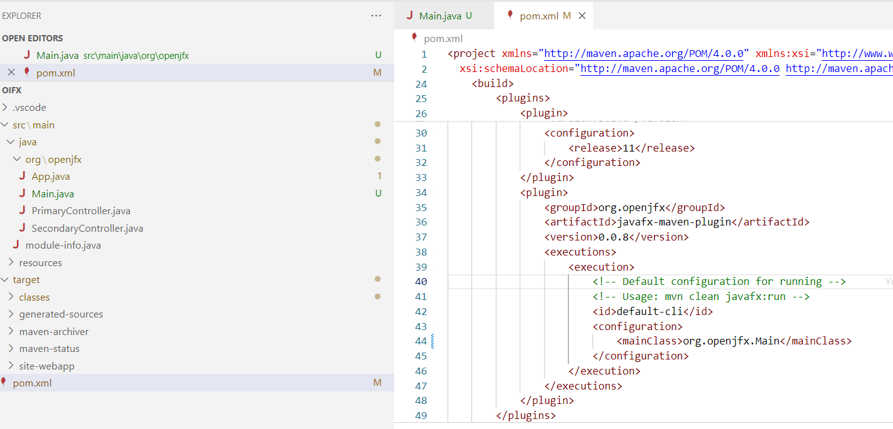

Slide 13
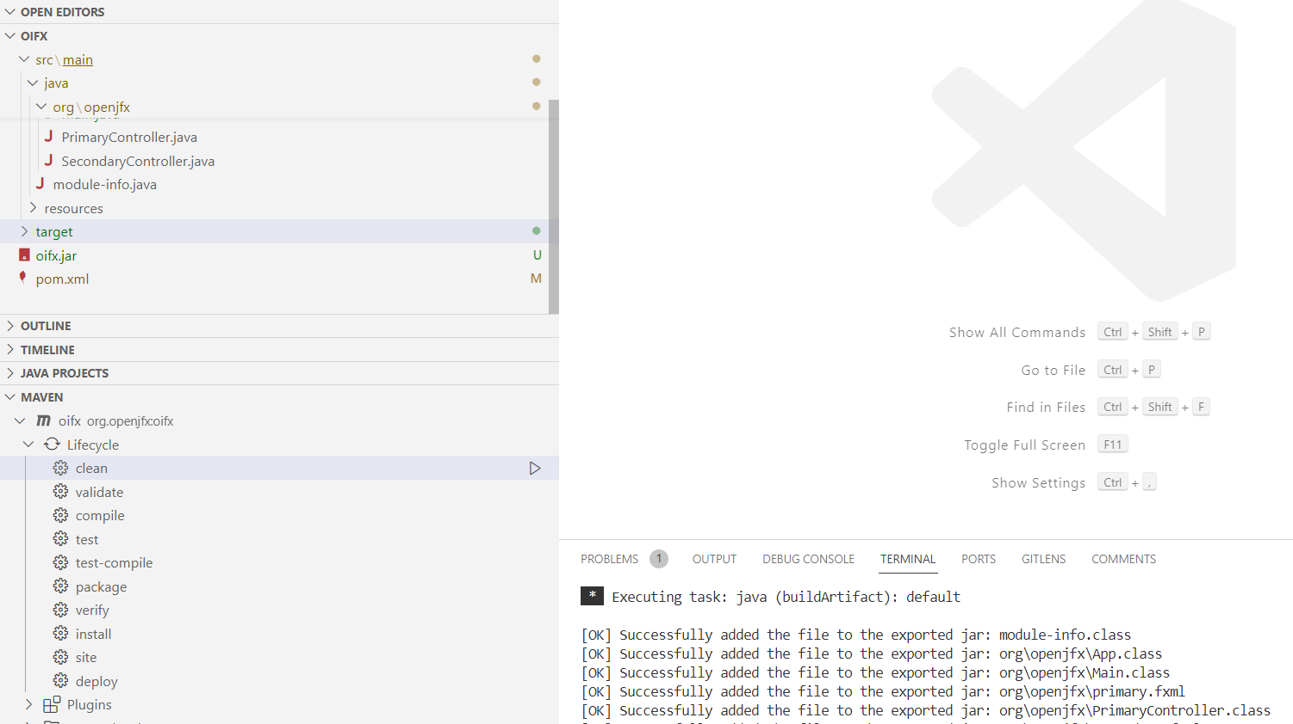
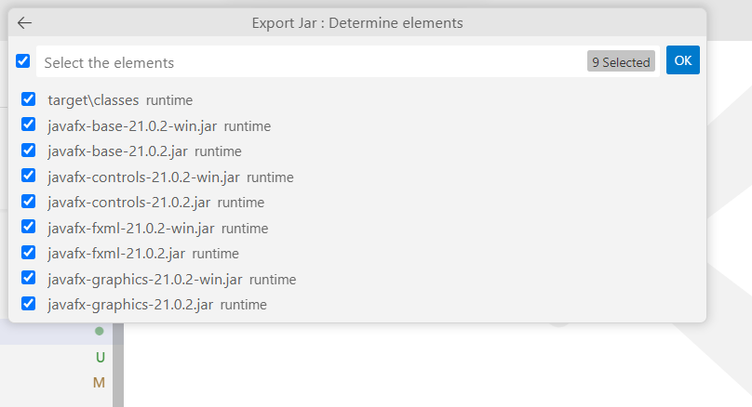
4 - atenção para a versão do javafx ser a mesma citada no arquivo pom.xml
5 – rodar o fora do target
1
3 - Ctrl+shift+p -> java export jar -> Main
2

Slide 14
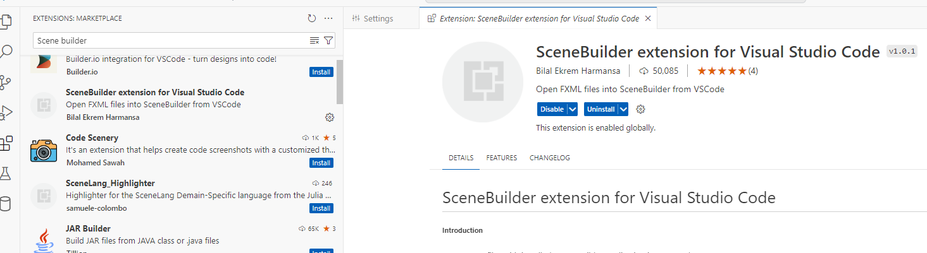
https://www.youtube.com/watch?v=lDCAkowJb90

Slide 15
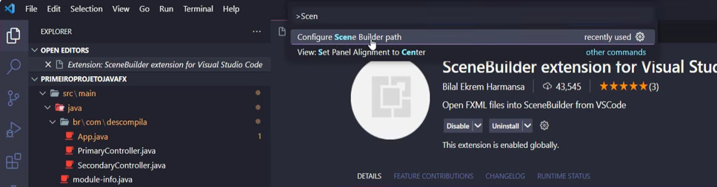
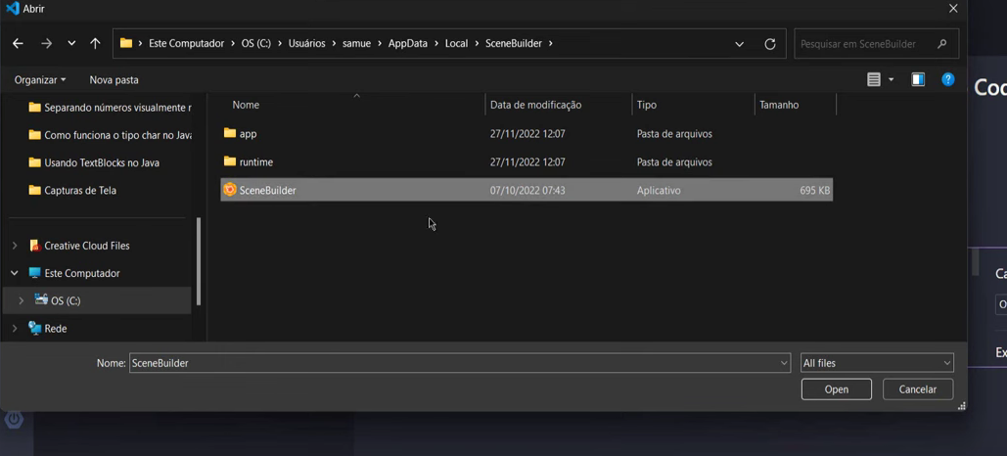

Slide 16
Git Actions

Slide 17
Github Actions
https://docs.github.com/en/actions/automating-builds-and-tests/building-and-testing-java-with-maven

Slide 18
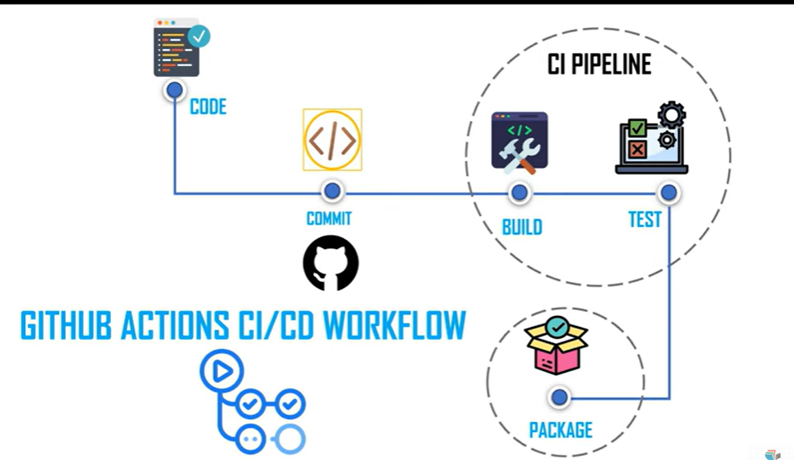
https://www.youtube.com/watch?v=BqCe-nSXSGI

Slide 19
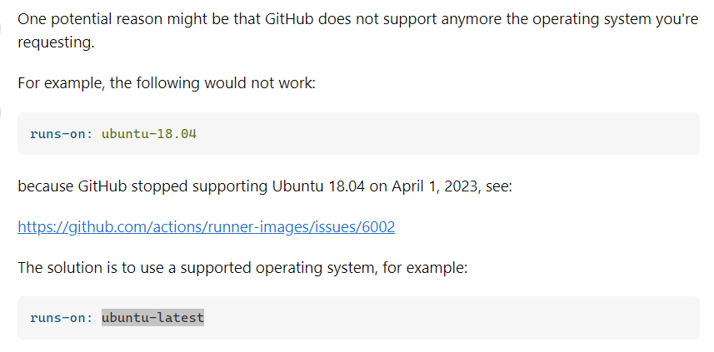
https://stackoverflow.com/questions/70959954/error-waiting-for-a-runner-to-pick-up-this-job-using-github-actions

Slide 20
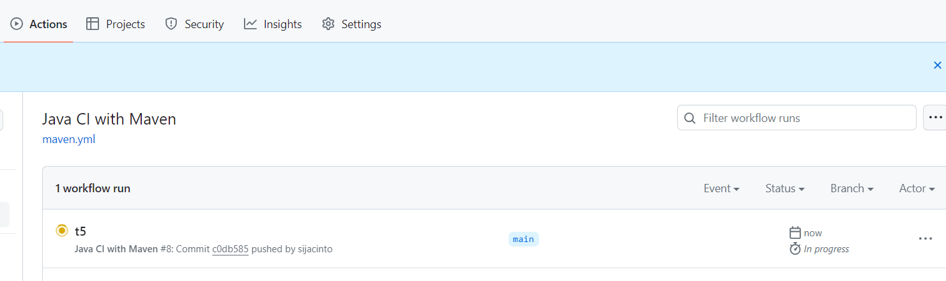
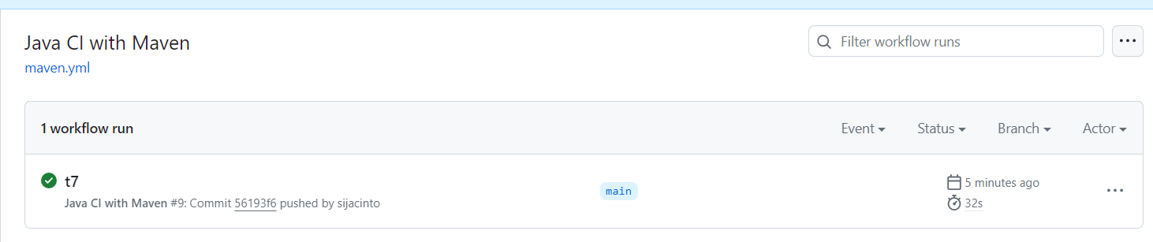

Slide 21
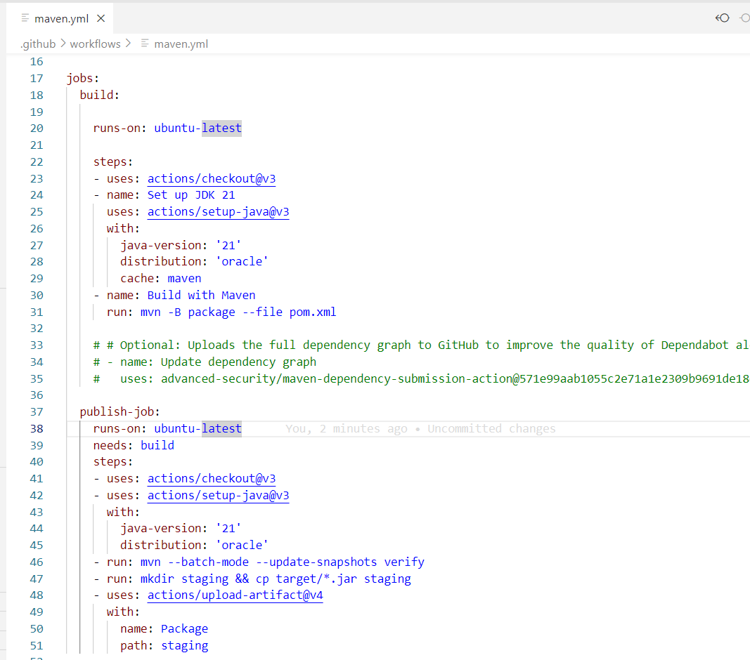
Maven.yml

Slide 22
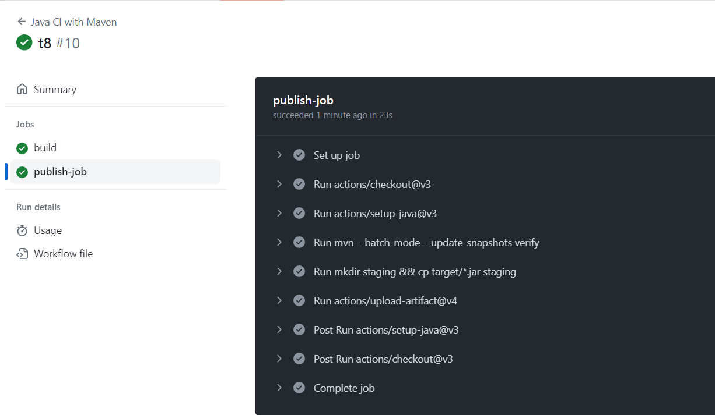
Github Actions

Slide 23
