Slide 1

Maryland Labor Market Inequality: What Shapes Wage Gaps?
Elberth Ndounou-Yindas
Data 205
Montgomery college

Slide 2
Research Question & Why It Matters
Main Question: What drives wage inequality in Maryland?
Maryland is wealthy and highly educated
But large wage gaps still exist
Goal: separate structural vs within‑job inequality

Slide 3
Data & Methods
ACS PUMS 2024 (145k workers → 2.9M weighted)
BLS OEWS 2024 (occupation wages & employment)
Python: pandas, numpy, statsmodels, plotly
Weighted means, regressions, Oaxaca decomposition

Slide 4
Maryland’s Workforce: High‑Skill + Low‑Wage Mix Tree map of occupations

Slide 5
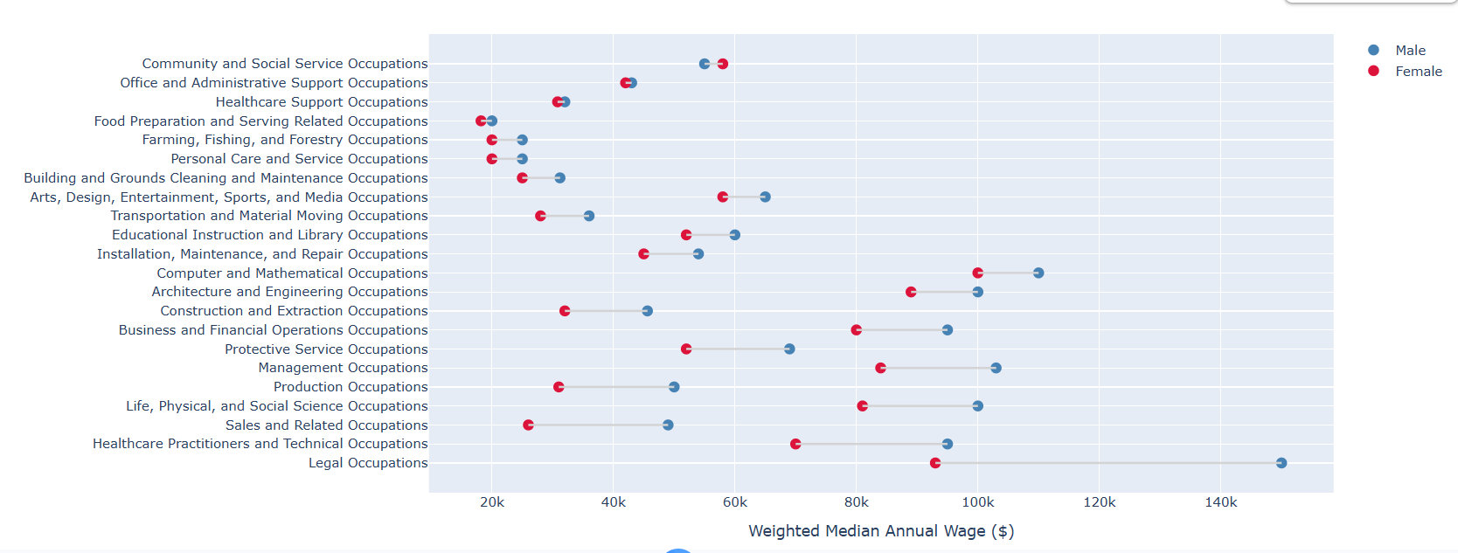
Gender Wage Gap: Structural + Residual Dumbbell chart

Slide 6
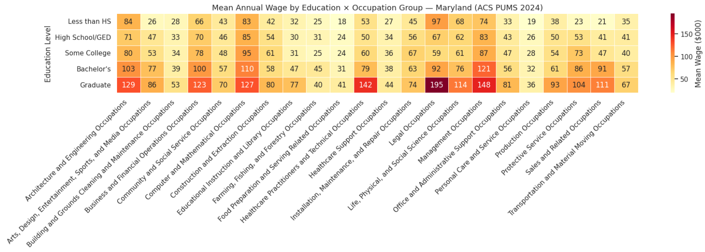
Education Raises Wages — But Field of Study Matters
Figure: Heatmap + Top 20 majors

Slide 7
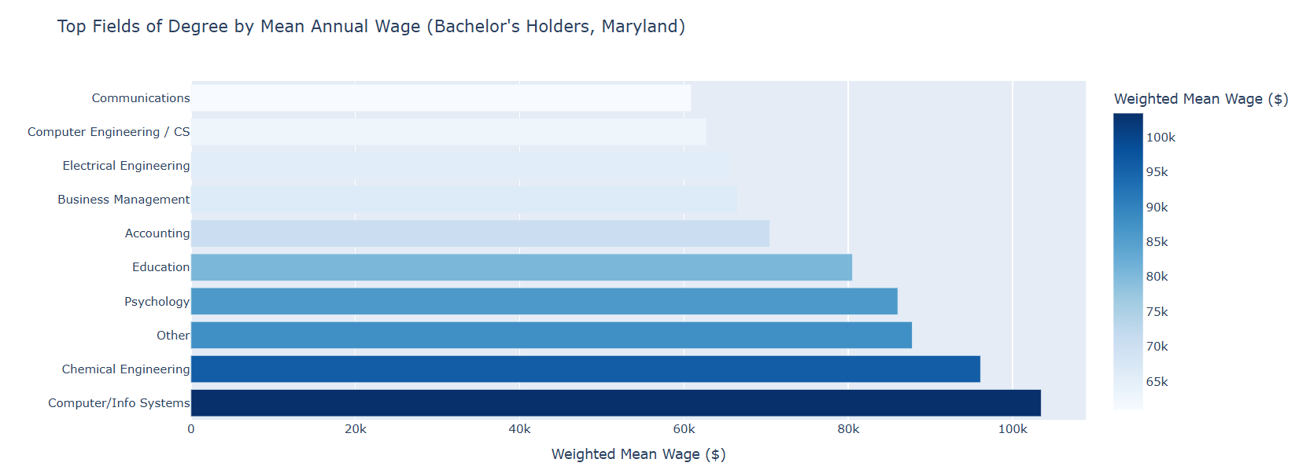

Slide 8
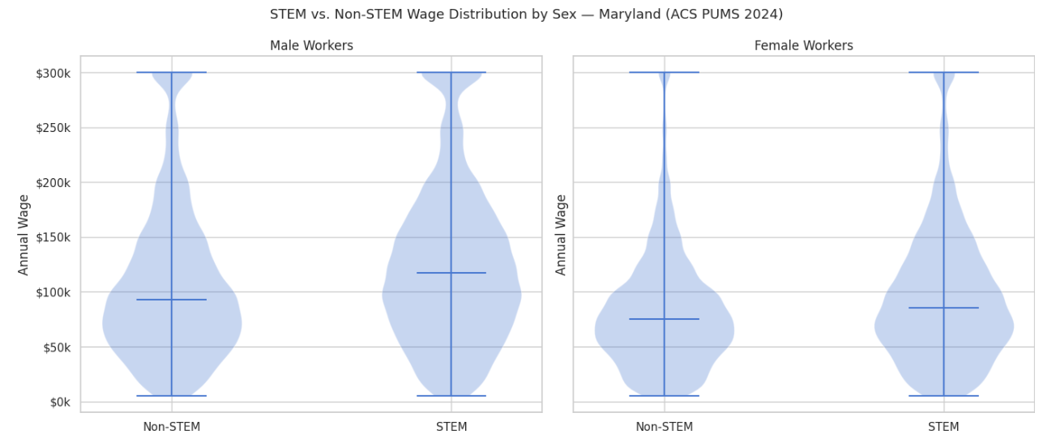
STEM Degrees Give a Big Boost — Unequally
Figure: Violin plots + Race × STEM bars

Slide 9
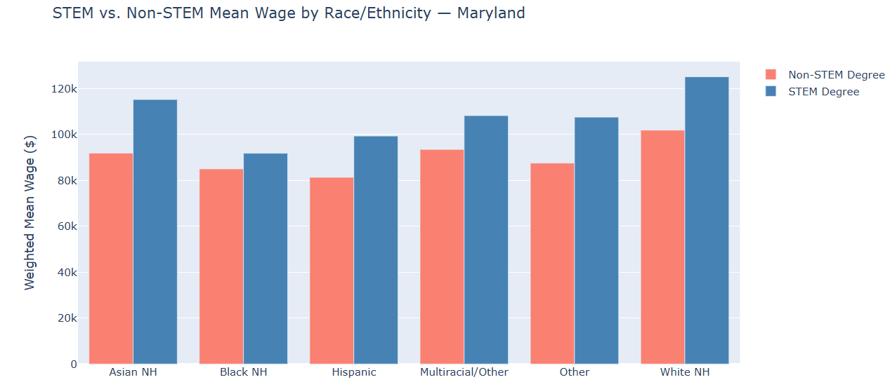

Slide 10
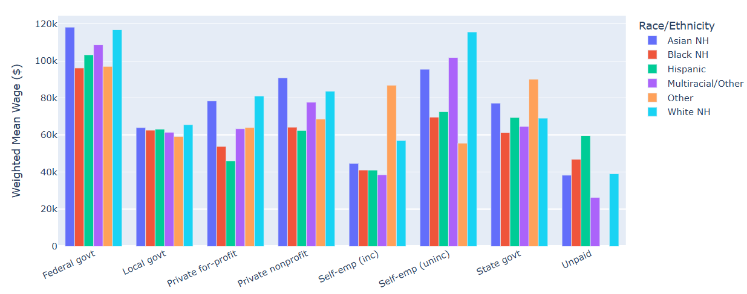
Federal Jobs Are the Most Equitable
Figure: Wages by sector × race

Slide 11
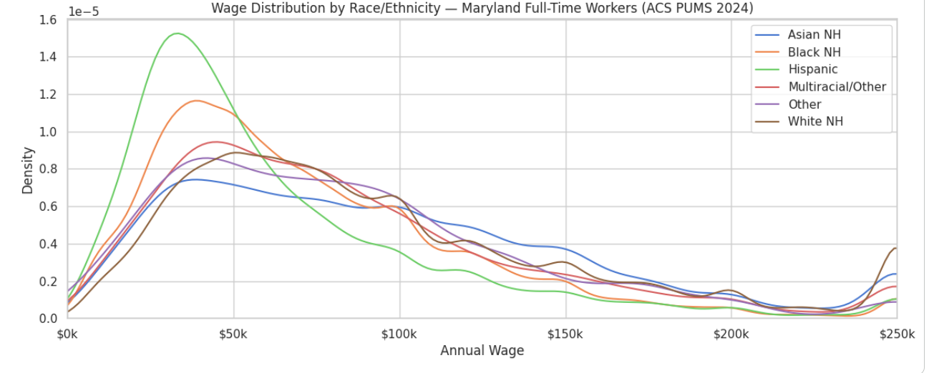
Racial Wage Gap: 60% Explained, 40% Unexplained
Figure: KDE + Oaxaca bar chart

Slide 12
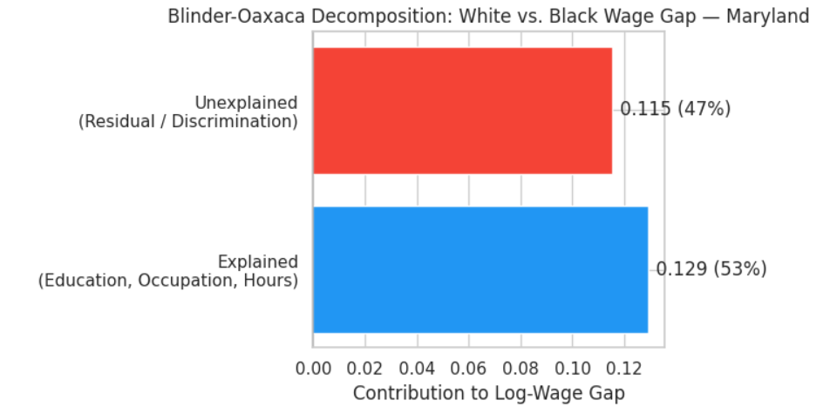

Slide 13
Other Inequality Factors
Foreign‑born workers: 5–8% wage penalty
01
Disability: 19% lower employment rate
02
Low‑wage workers rely more on public transit
03
Part‑time work higher for Black & Hispanic workers
04

Slide 14
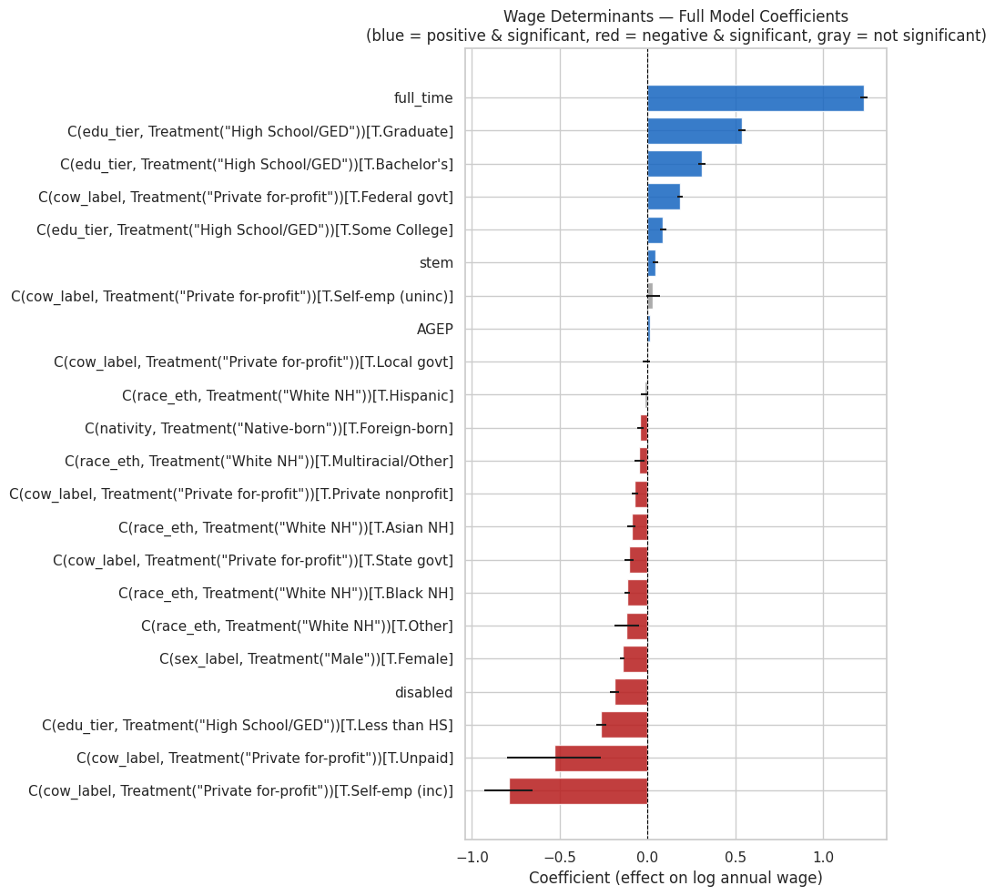
What Predicts Wages? Full Model Results
Figure: Forest plot

Slide 15
Conclusion: Inequality Is Structural and Persistent
Education and occupation explain a lot
But big gaps remain inside the same jobs
Federal jobs show more equity
Private sector shows larger unexplained gaps

Slide 16
references
U.S. Census Bureau.
U.S. Bureau of Labor Statistics.

Slide 17
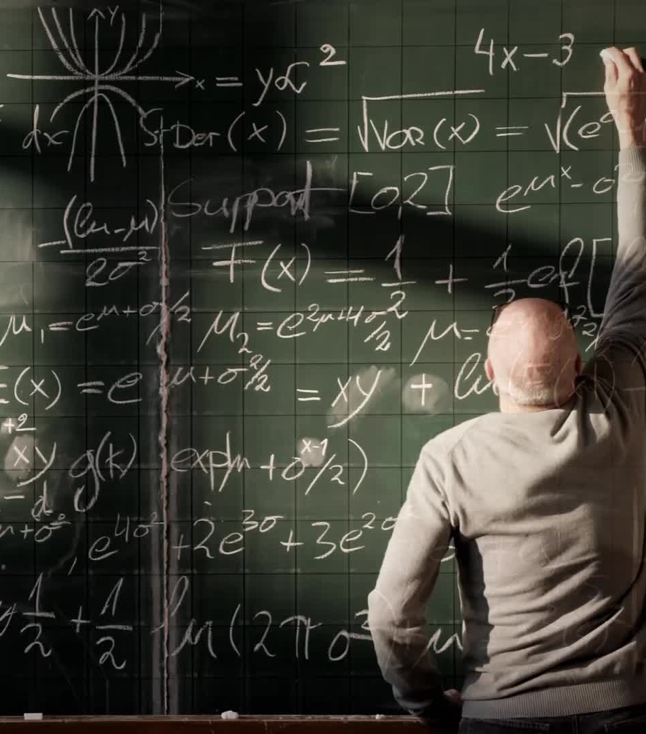
Acknowledgements
A special thanks to :
Professor Lori Perine
Professor Mais Alraee
Professor Muhammed Rebin
Professor Mohamed Abdirisak
All of my Data science classmates

