Slide 1

Team 3.14
It’s a card game

Slide 2
Team Members
Team Leader -Josh Hart
Project Manager - Jack Hammond
Graphic Designer - Cayden Lords
Quality Assurance - Alex Myers
Configuration Manager & Documentation - Oscar Ramos

Slide 3
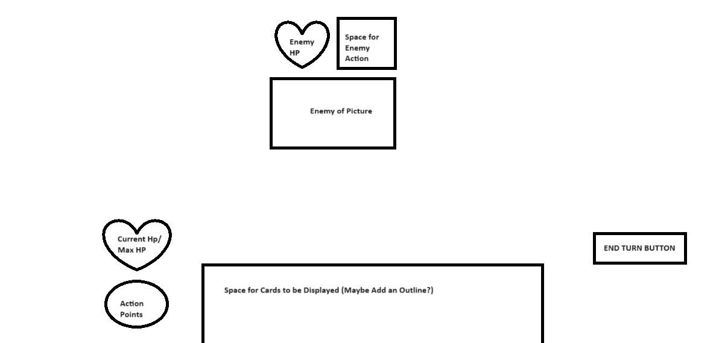
Basic Layout

Slide 4
Current Status
It's alive. It's alive... It's alive, it's moving, it's alive, it's alive, it's alive, it's alive, IT'S ALIVE….. Mostly.
It displays!
It delays!
It betrays!
It doesn’t quite play!

Slide 5
<THIS IS THE SECTION WHERE THE PROGRAM IS DISPLAYED. APPLAUD OUR BRILLIANCE. A PARADE WILL BE EXPECTED>

Slide 6
What Did We Learn From Last Sprint?
As it turns out, everyone can make very efficient, even perfect versions of the sections of code they’re working on……
And it won’t matter if they aren’t built specifically to work with each other.

Slide 7
Sprint Goals for This Sprint that We Are Sprinting
One fully-functional fight!
A starting card deck that’s more than 3 cards!
End conditions and displays!
Cards actually doing stuff!
(Stretch) Animation!
(Stretch) Actually Good Enemy AI!

Slide 8
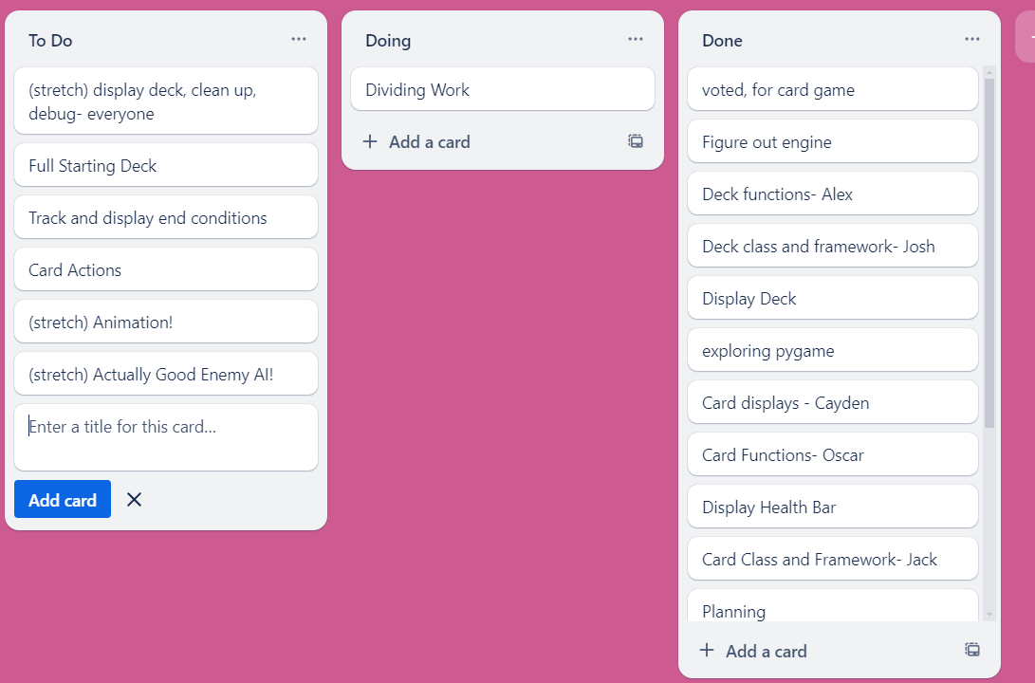
Trello

