Slide 1
A
Ajaia Docs
A lightweight collaborative document editor
Create · format · import · share
Full Stack Product Engineer assessment · Next.js · Tiptap · Prisma/Postgres · Supabase + Vercel
Notes:
Hi, I'm walking through Ajaia Docs, a lightweight collaborative document editor I built for this assessment. It's a Google-Docs-inspired rich-text editor focused on a clean editing experience and a working sharing model. Stack is Next.js full-stack, Tiptap for editing, Prisma on Postgres, deployed on Vercel and Supabase.

Slide 2
THE APPROACH
Scope: depth over breadth
The brief rewards deliberate cuts. I treated the editing experience and the sharing / access-control model as the two areas worth real depth, and kept everything else intentionally minimal.
WENT DEEP
Coherent rich-text editor with autosave
Owner / Editor / Viewer sharing, enforced server-side
Pure, unit-tested authorization logic
4
core areas, built end-to-end
Editing · Import · Sharing · Persistence — all working and verified, not stubbed.
DELIBERATELY CUT
Real-time multiplayer → autosave, last-write-wins
Passwords / OAuth → lightweight email session
Comments, version history, blob storage
Notes:
My guiding principle was depth over breadth. I went deep on the editor and on sharing with real, server-enforced access control. I deliberately cut real-time multiplayer, passwords, comments, and version history — and I'm explicit about those cuts in the architecture note.

Slide 3
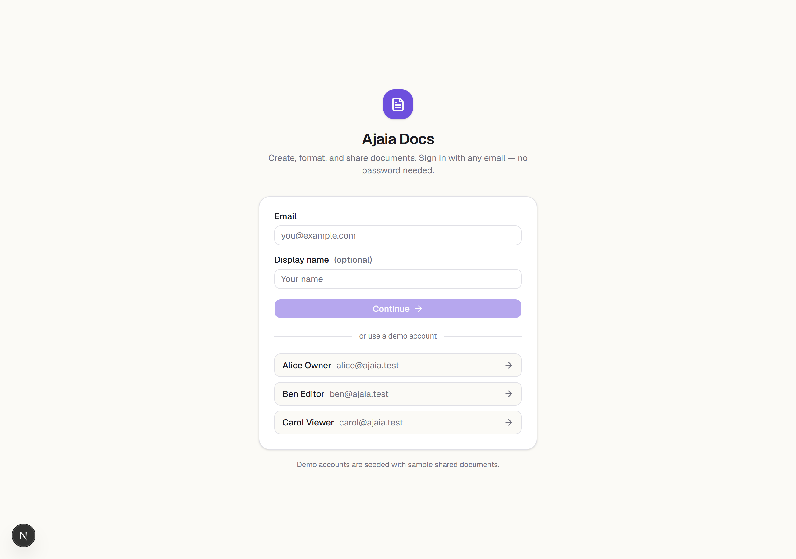
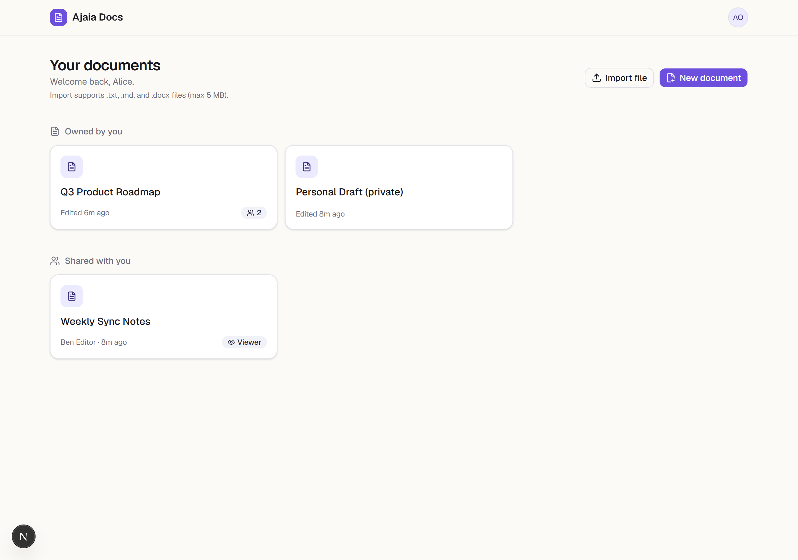
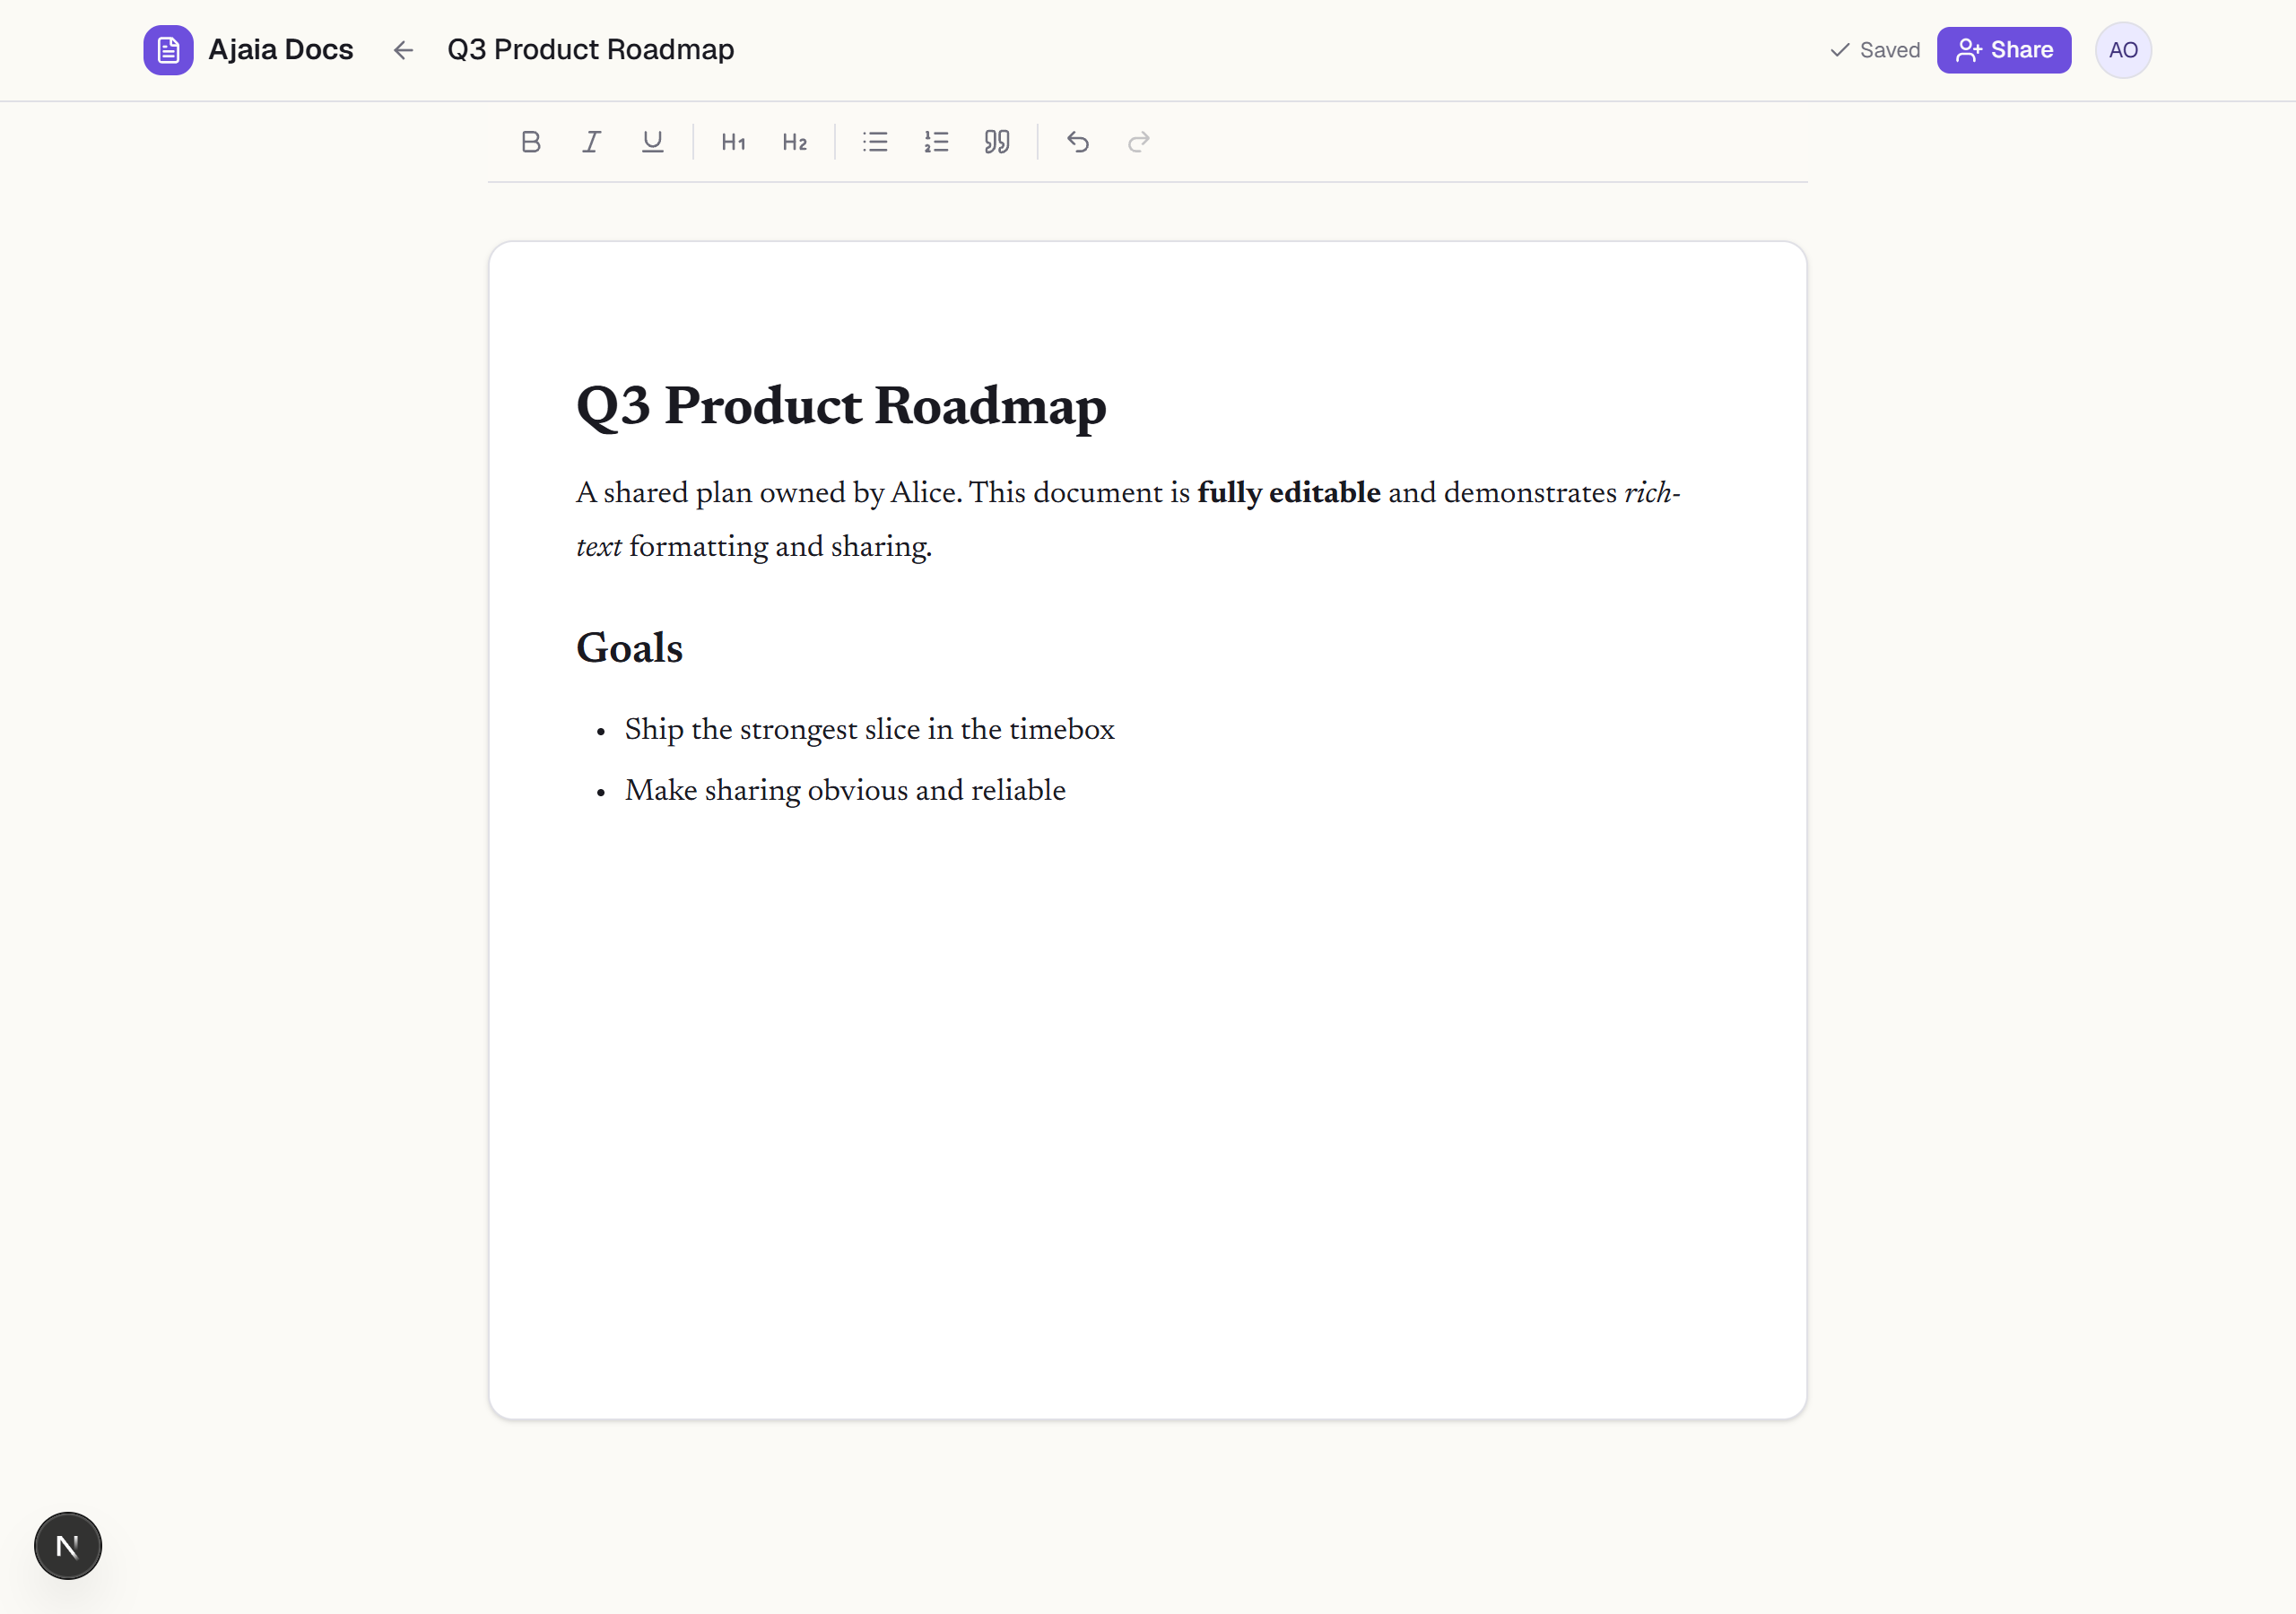
LIVE PRODUCT
The main user flow
1
2
3
Sign in by email — no password
Owned vs. Shared, with role badges
Rich-text editor with autosave
Live demo + 3 seeded accounts (alice / ben / carol @ajaia.test) make the sharing flow testable in seconds.
Notes:
Here's the main flow. You sign in with just an email — no password — which keeps the demo frictionless and makes share-by-email natural. The dashboard cleanly separates documents you own from documents shared with you, with Viewer/Editor badges. Opening a doc gives you the editor: bold, italic, underline, headings, lists, and it autosaves as you type.

Slide 4
CAPABILITIES
What it does
1
Rich-text editing
2
File import
Tiptap/ProseMirror: bold, italic, underline, H1/H2, bullet & numbered lists, quotes, undo/redo — stored as structured JSON.
Upload .txt, .md, or .docx (≤5 MB) → a new editable document with headings, lists and formatting preserved.
3
Sharing & roles
4
Persistence & autosave
Share by email with Viewer (read-only) or Editor rights. Change or revoke access anytime from the share dialog.
Debounced autosave with a live status indicator. Documents and shares persist in Postgres across refresh.
Notes:
Four capabilities, all working. Rich-text editing on Tiptap, stored as structured JSON. File import that turns txt, markdown, or docx into an editable document. Sharing by email with Viewer or Editor roles. And persistence with debounced autosave backed by Postgres.

Slide 5
UNDER THE HOOD
Architecture
Browser
(React + Tiptap)
→
Next.js
Route Handlers
→
access.ts
(authorization)
→
Prisma ORM
→
Postgres
(Supabase)
Every request re-checks access — the editor's read-only mode is a convenience, not the security boundary.
STACK
DATA MODEL
Next.js 16 (App Router) + TypeScript
Tiptap 3 editor · shadcn/ui + framer-motion
Prisma 6 · iron-session (encrypted cookie)
Zod validation · Vitest tests
User id · email · name
Document title · content(JSON) · owner
Share document · user · role(VIEWER|EDITOR)
unique(document, user) — one role per collaborator
Notes:
Architecture is a single Next.js full-stack app. Requests hit route handlers, which delegate the access decision to a pure module called access-dot-ts, then Prisma talks to Postgres on Supabase. The key point: access is re-checked on every request — the read-only UI is convenience, not the security boundary. Three tables: User, Document with content as JSON, and Share with a role and a unique constraint.

Slide 6
THE DEPTH AREA
Access control, done properly
 | Owner | Editor | Viewer | Other
View document | ✓ | ✓ | ✓ | ✗
Edit title / content | ✓ | ✓ | ✗ | ✗
Share / rename / delete | ✓ | ✗ | ✗ | ✗
Why it's solid
Pure functions, zero DB deps
Same logic on every endpoint — no drift
18 Vitest cases cover the full matrix
Verified live against the API:
403
403
401
never
Viewer edits
Stranger reads
Anonymous
Non-owner sees collaborators
Notes:
This is where I went deepest. Authorization lives in pure functions with no database dependency, so every endpoint shares one policy and I can unit-test the whole matrix — owner, editor, viewer, stranger, anonymous. I also verified it live against the API: a viewer's edit returns 403, a stranger gets 403, anonymous gets 401, and non-owners never even receive the collaborator list.

Slide 7
JUDGEMENT UNDER CONSTRAINTS
What I cut — and what's next
CUT ON PURPOSE
NEXT 2–4 HOURS
Real-time multiplayer — autosave + last-write-wins instead
Passwords / OAuth — lightweight email session (allowed by brief)
Blob storage — imports become documents, no bucket needed
Comments, version history, granular roles
Real-time presence + cursors (Tiptap + Yjs)
API-level integration tests vs. a throwaway Postgres
Export to Markdown / PDF + dashboard search
Optimistic UI + soft-delete (trash / restore)
Notes:
I'm explicit about tradeoffs. On purpose I cut real-time collaboration, passwords, blob storage, and comments. With another two to four hours I'd add real-time presence with Yjs, API-level integration tests, export to Markdown and PDF, and soft-delete. The point is these were deliberate, reasoned cuts — not things I ran out of time on by accident.

Slide 8
AI-NATIVE
How I used AI — with judgement
1
2
3
Where it sped me up
What I overrode
How I verified
Scaffolding, REST handlers with consistent validation, and a pure tested access layer — and it drove a real browser to verify each role's behavior.
Pinned Prisma 6 (7 needed driver-adapter config) and switched shadcn to the Radix base when the default generated an incompatible component API.
18 Vitest tests, clean build, and live API checks of 403/401 — plus a real bug AI caught: load fired a spurious autosave, fixed with emitUpdate:false.
Notes:
This was an AI-native build. AI sped me up most on scaffolding and on enforcing a good structural decision — the pure, tested access layer — and it drove a browser to verify each role. But the judgment calls were mine: I overrode the tooling to pin Prisma 6 and to use the Radix component base. And I verified everything — tests, a clean build, live 403/401 checks — including a real bug the verification caught where opening a document fired a spurious save.

Slide 9
Thank you
A focused, working product slice — built, tested, deployed, and honest about its edges.
Repo github.com/Elciiid/AJAIA
Live ajaia-three.vercel.app
Demo alice@ajaia.test · ben@ajaia.test · carol@ajaia.test (no password)
Notes:
To wrap up: this is a focused, working slice — built, tested, deployed, and honest about what I cut and why. The repo and a live demo are linked, with three seeded accounts so you can test the sharing flow immediately. Thanks for reviewing.

