Slide 1
Machine Learning
Course
K-nearest neighbors (KNN)

Slide 2
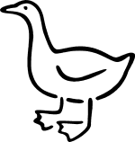
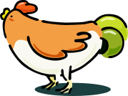


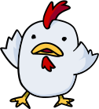

Nearest Neighbor Classifiers
Basic idea:
  If it walks like a duck, quacks like a duck, then it’s probably a duck
Compute Distance
Test Record
Training Records
Choose k of the “nearest” records

Slide 3

Nearest neighbor method
Majority vote within the k nearest neighbors
new
K= 1: brown
K= 3: green

Slide 4
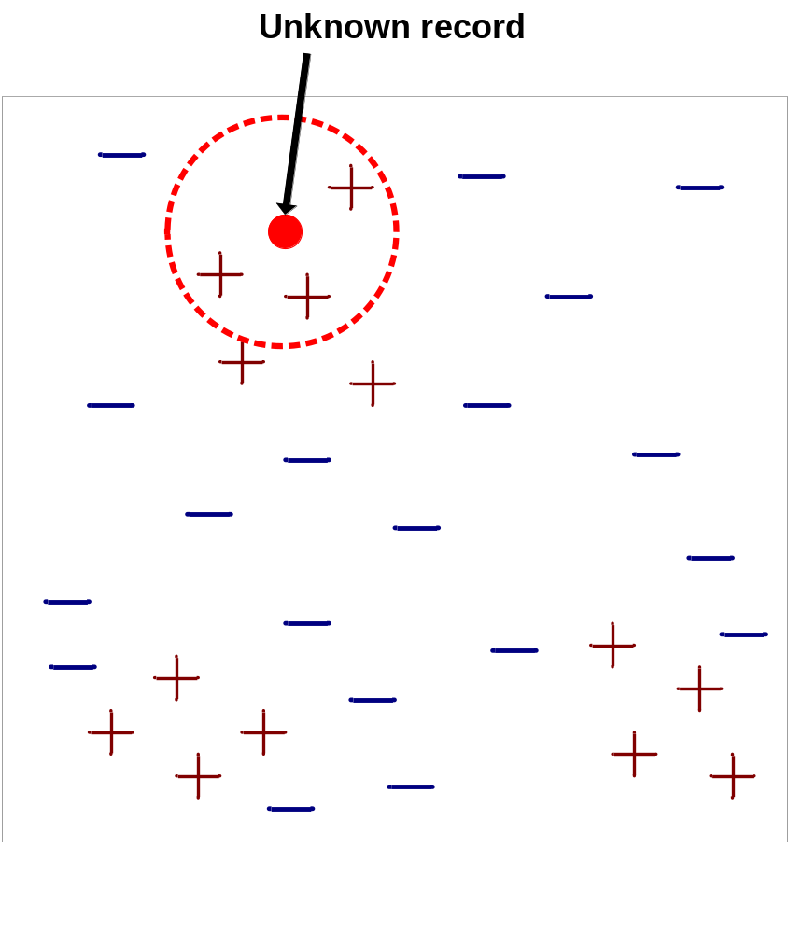
Nearest-Neighbor Classifiers
Requires three things
  The set of stored records
  Distance Metric to compute distance between records
  The value of k, the number of nearest neighbors to retrieve
To classify an unknown record:
  Compute distance to other training records
  Identify k nearest neighbors
  Use class labels of nearest neighbors to determine the class label of unknown record (e.g., by taking majority vote)

Slide 5

Definition of Nearest Neighbor
K-nearest neighbors of a record x are data points that have the k smallest distance to x

Slide 6
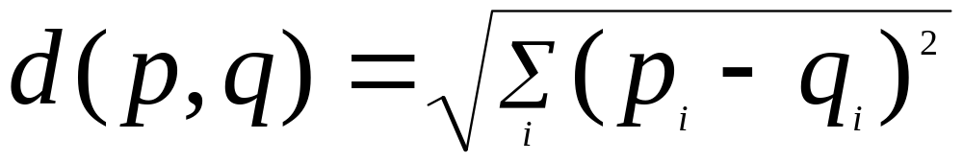
Nearest Neighbor Classification
Compute distance between two points:
  Euclidean distance
Determine the class from nearest neighbor list
  take the majority vote of class labels among the k-nearest neighbors
  Weigh the vote according to distance
    weight factor, w = 1/d²

Slide 7
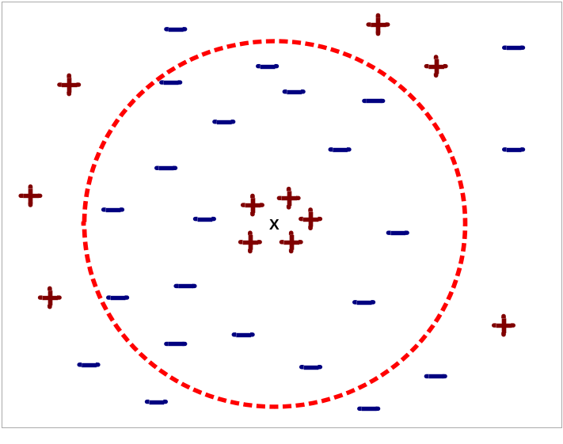
Nearest Neighbor Classification
Choosing the value of k:
  If k is too small, sensitive to noise points
  If k is too large, neighborhood may include points from other classes

