Slide 1
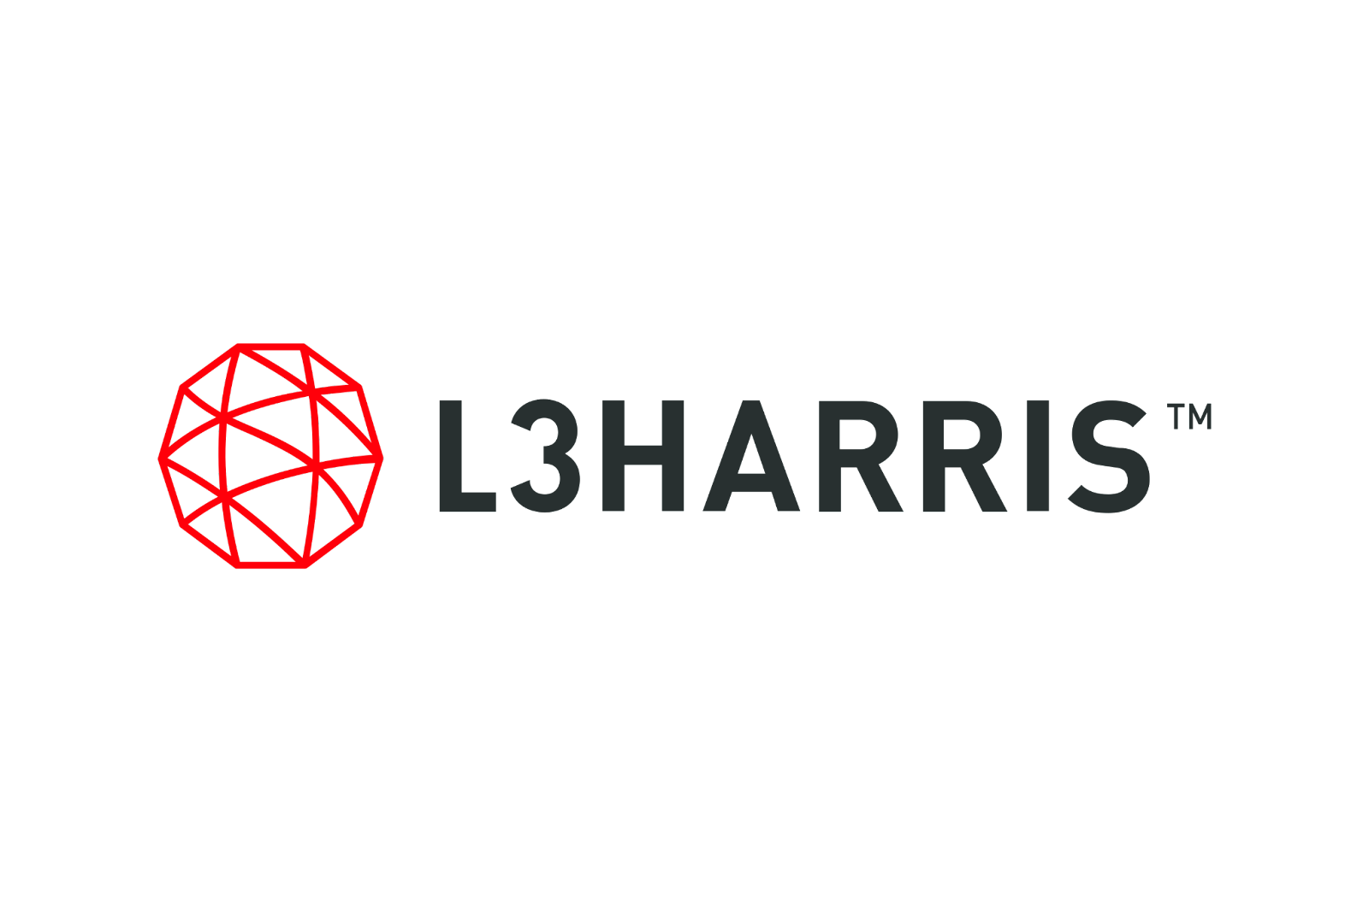


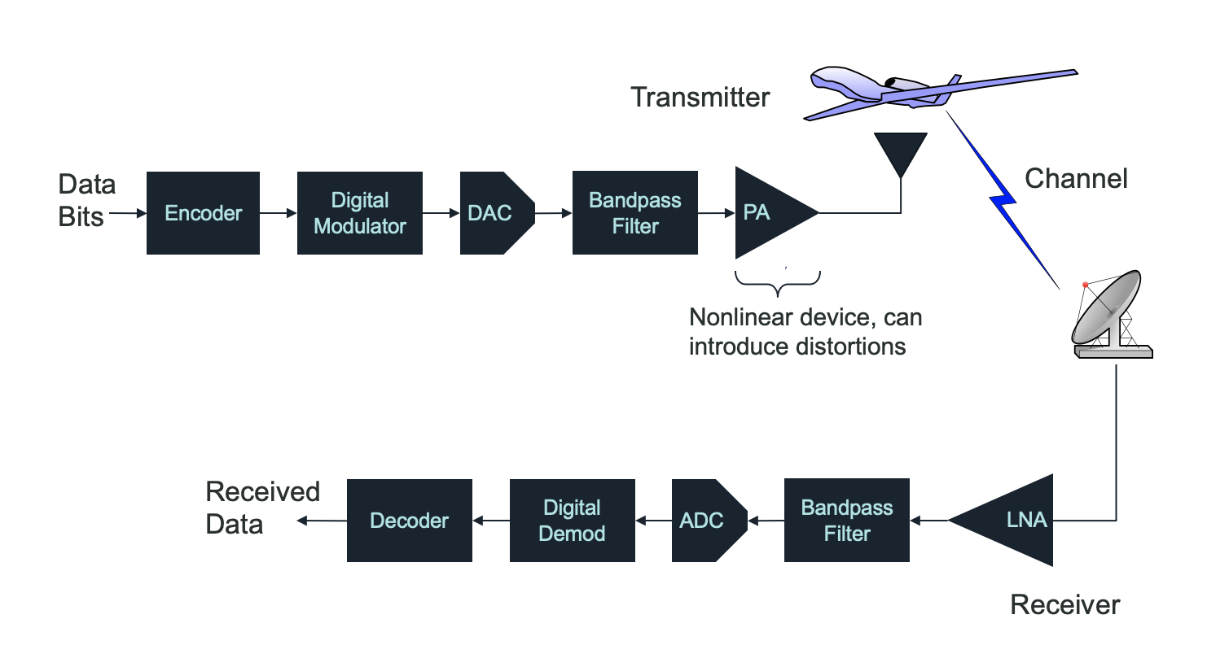
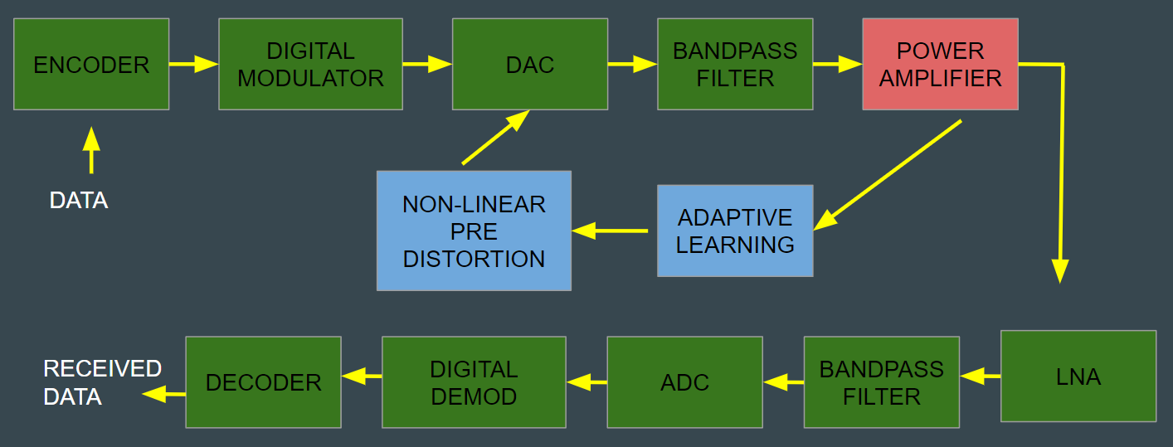
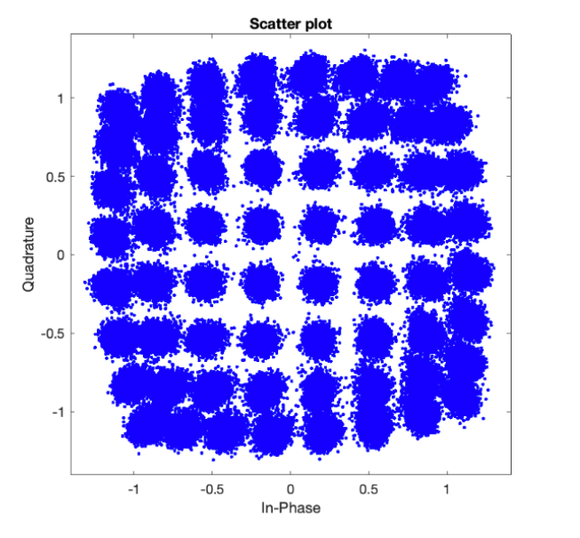
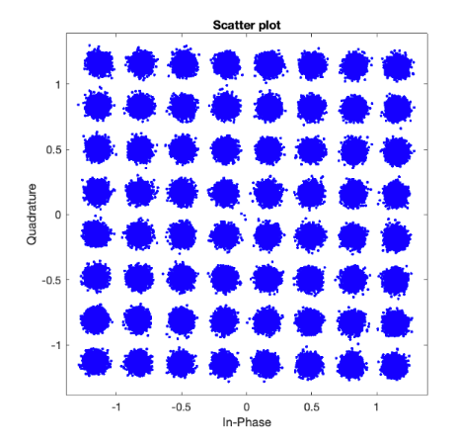
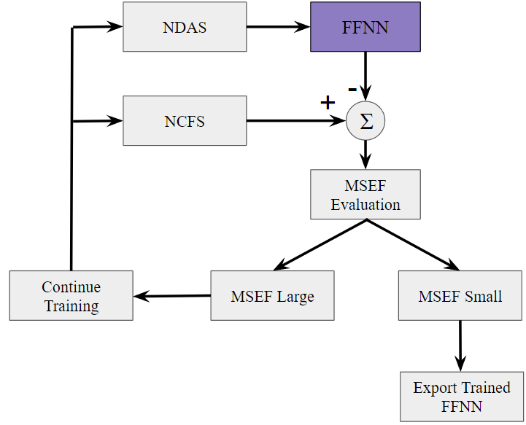
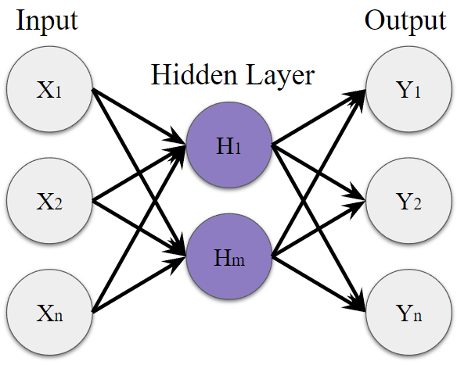
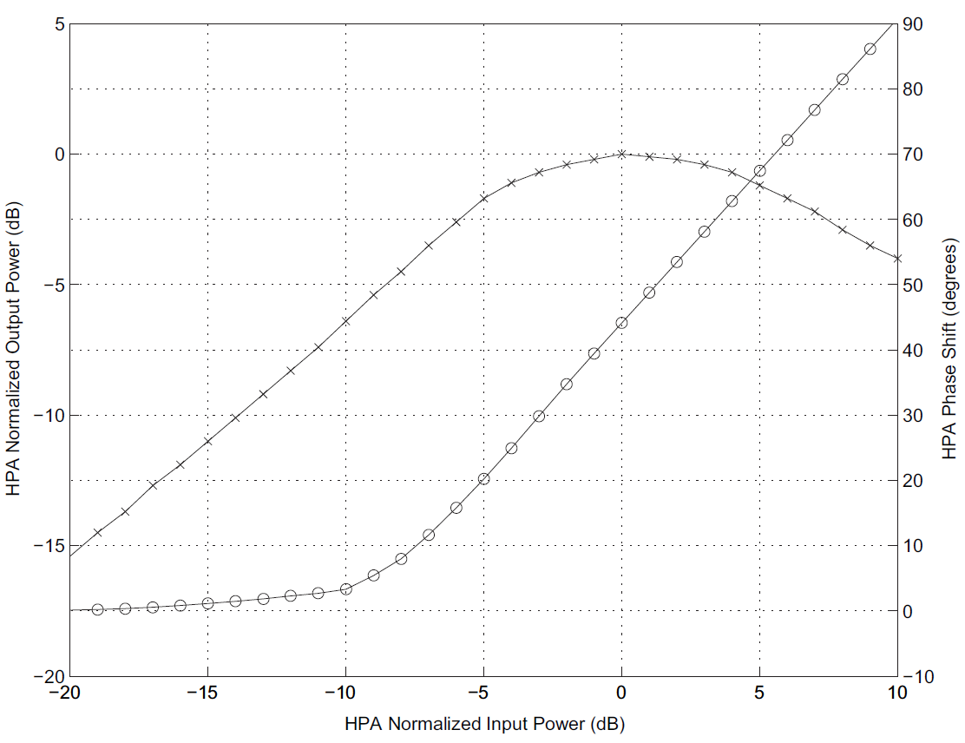
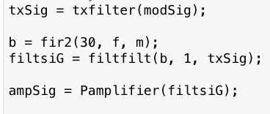
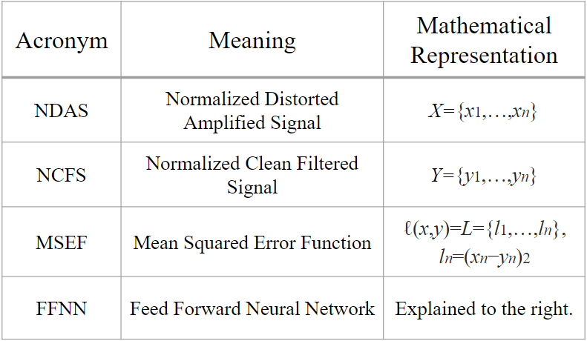
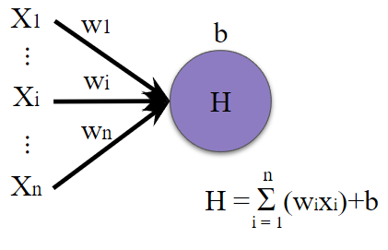
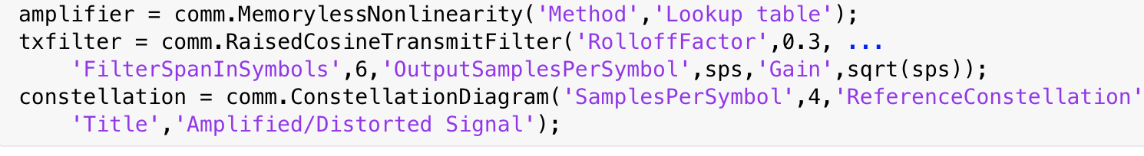
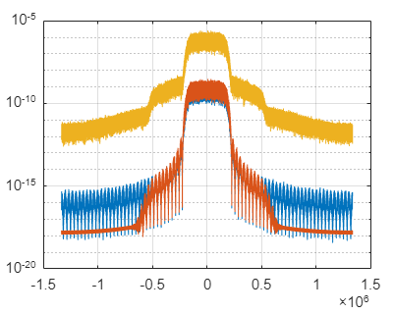
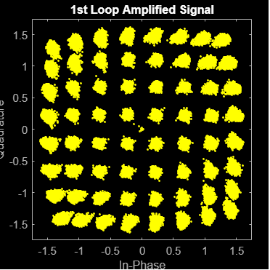
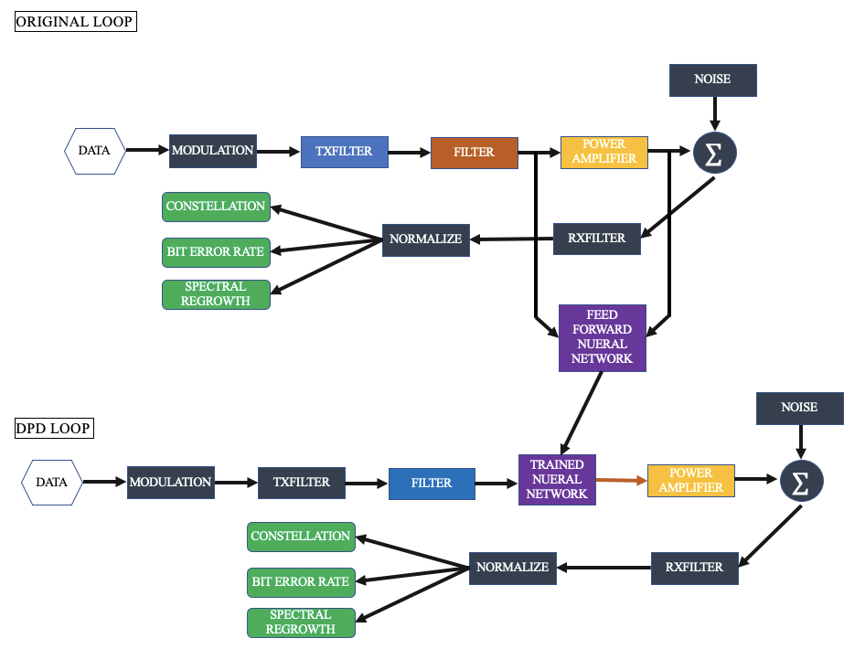
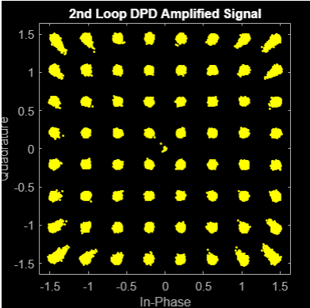
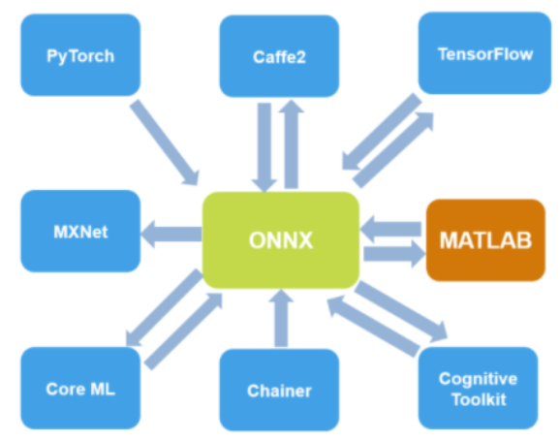
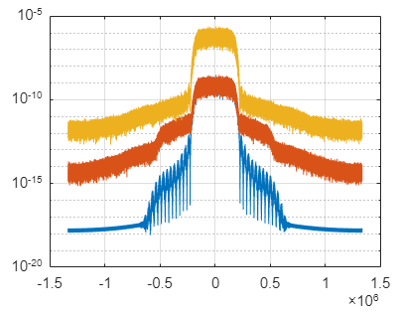
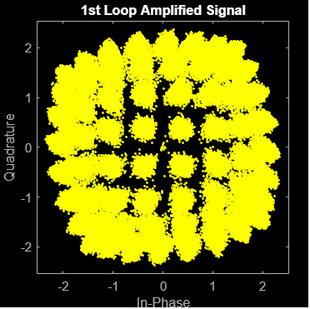
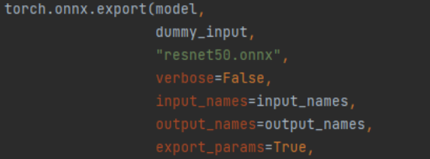
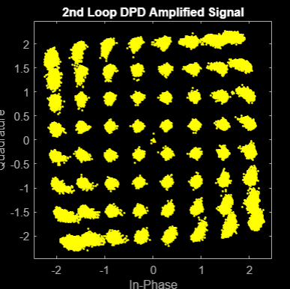

NONLINEAR PRE-DISTORTION USING MACHINE LEARNING
ELDAR MUHIC, JACK THOMAS SORENSON, RILEY RICHARDS
Communication System
Motivation and Objective
Motivation
Objective
Communication systems involve amplifying a signal to send information across large distances. This is used in systems such as:
Cell phone communication
Speech processing
Missile guidance
Power amplifiers distort a signal when used near or at the saturation level – inherent in the design of all power amplifier systems
We want to counteract that distortion by using a neural network to pre-distort the signal, correcting errors introduced by the power amplifier "clipping" effects
Phase 1
Phase 2
Phase 3
Design the power amplifier model in MATLAB
Begin researching NN in Pytorch
Preliminary look at communication between coding languages and other possible solutions
Finish design of power amplifier, complete the 2-box memory model using the Weiner method
Create a working NN in Pytorch
Communicate between the two languages using ONNX files
Test and verify results, adapt as necessary
Compare other to other pre-distortion methods:
MATLAB NN
Memory Polynomial Method
Altering the Pytorch NN structure
[1]
Power Amplifier
The Neural Network
Model
Weiner Model - Linear filter followed by memoryless nonlinearity
Linear Filter
Memoryless Nonlinearity
H
H(W)
LTI
NL(.)
Block Diagram
1-Layer Feed Forward Neural Network
Training & Testing Process
The pre-trained FFNN takes NDAS as input and compares it to desired NCFS generating a MSEF value that represents the differences between the normalized signals.
The training loop repeats this process until the MSEF is small enough to indicate that the FFNN has learned how to match the NDAS to the NCFS.
The post-trained FFNN is implemented into the DPD loop to create DPD by using the NCFS as input.
x(n)
y(n)
z(n)
Start Here
[1]
Same process from Hidden to Output
ONNX Files
(Open Neural Network Exchange)
How They Work
ORIGINAL LOOP
Designed to allow for transfer of trained Neural Networks between coding languages
Example of Export from Pytorch:
Example of Import to MATLAB:
DPD LOOP
ORIGINAL LOOP
DPD LOOP

