Slide 1
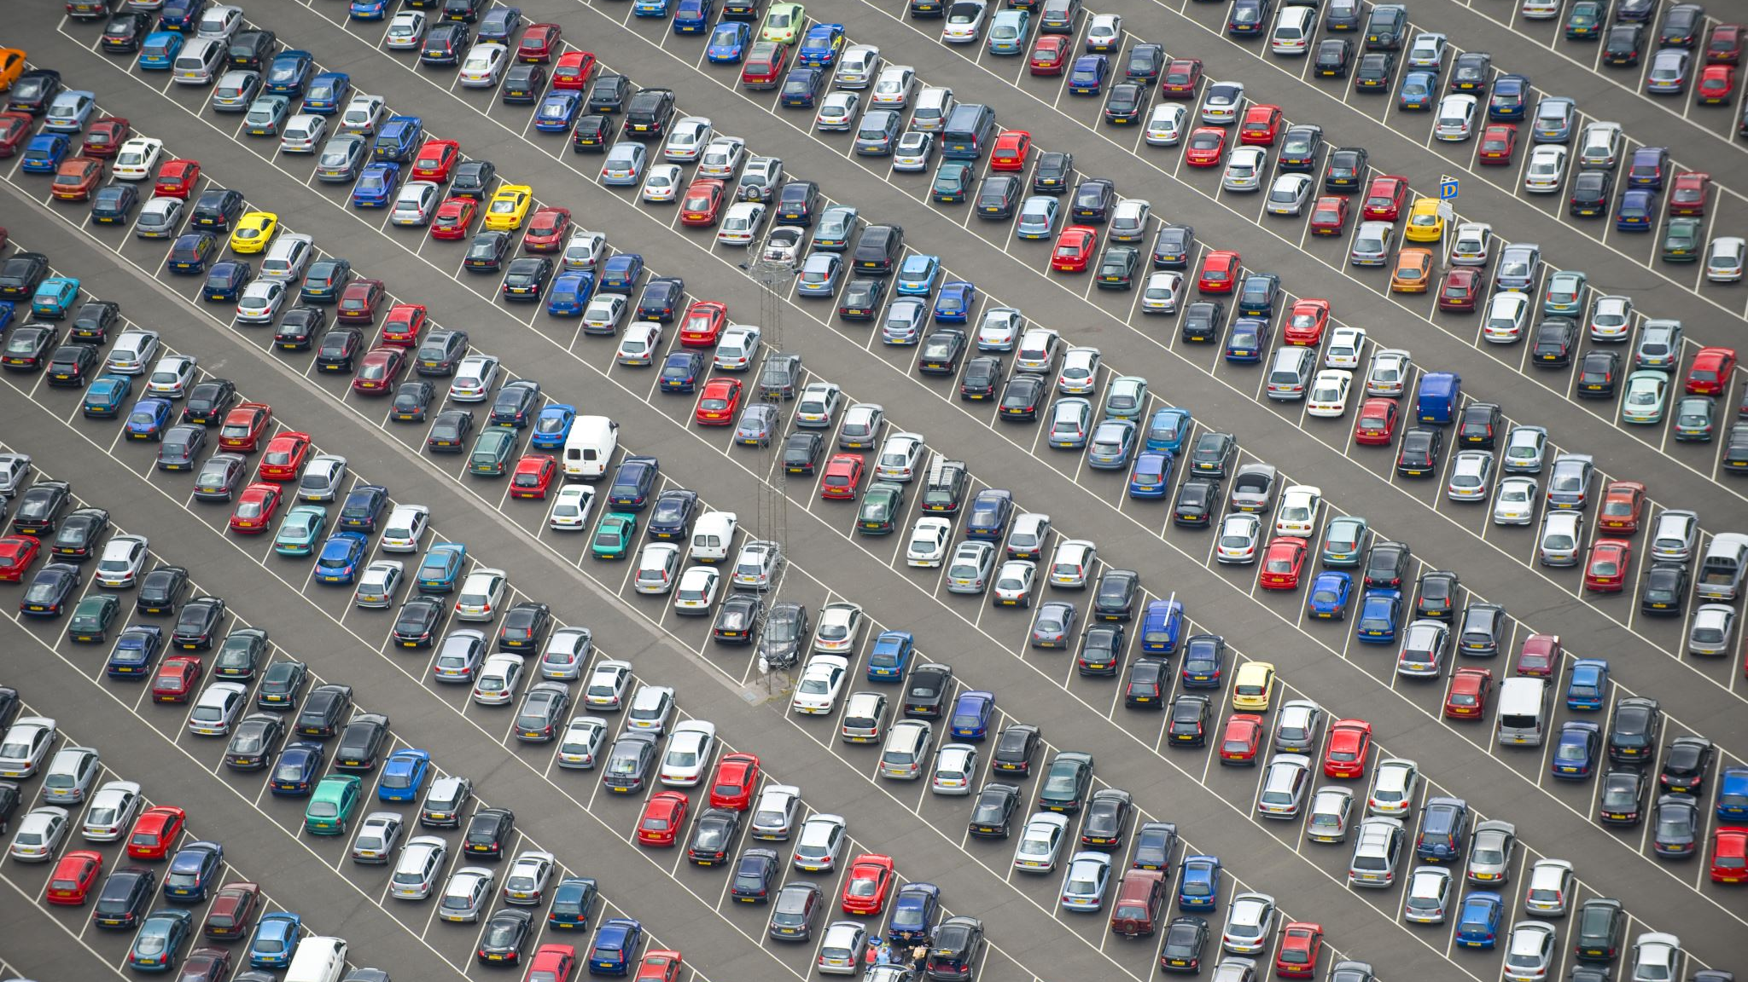
Group 7: Car Parking Jam
Joshua lang, Lucas Newell, Eldar Numanovic

Slide 2
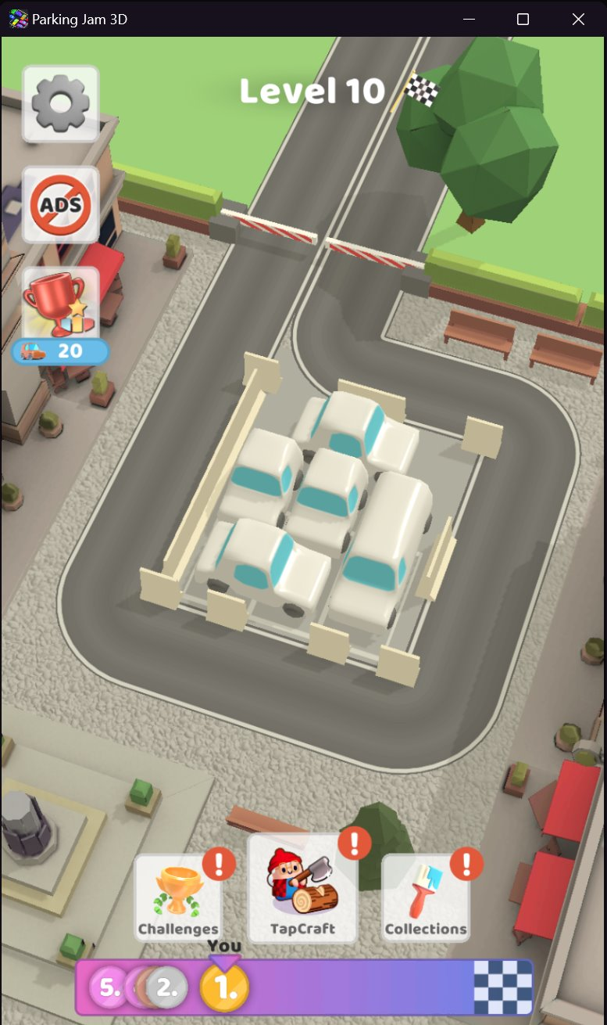

Summary
There exists a board of parking spaces. On this board of parking spaces there are cars and barriers. Cars can move backwards or forwards but not through another car or a blocked off tile of the parking lot. Once a car moves off the edge of the board it is eliminated. The end goal is to remove all the cars from the lot by moving them off the board.

Slide 3
Propositions
C(i, j, o): This proposition is true if there is a car in the grid at position (i, j) facing orientation o at the current state. The orientation o could be:
N/S
E/W
B(i, j): True if the cell at position (i, j) contains a barrier or wall that the car cannot pass through.
E(i, j): True if the cell at position (i, j) in the grid is empty.

Slide 4
Constraints
Empty: A tile is empty if it does not contain a car or a barrier.
¬C(i,j,o)∧¬B(i,j) for all orientations o.
Escape Forwards: A car can escape forwards if all locations directly ahead are empty:
C(i,j,N/S)→E(i−k,j)
(for all range k=1to d where d is the maximum distance to edge of grid)
C(i,j,E/W)→E(i,j+k)
(for all range k=1to d where d is the maximum distance to edge of grid)
Escape Backwards: A car can escape backwards if all locations directly behind are empty:
C(i,j,N/S)→E(i+k,j)
(for all range k=1to d where d is the maximum distance to edge of grid)
C(i,j,E/W)→E(i,j−k)
(for all range k=1 to d where d is the maximum distance to edge of grid)

Slide 5
Constraints (cont.)
Any Car Blocked: A car is blocked when there is a barrier or car both ahead and behind it.
C(i,j,o)→((Bahead (i,j,o)∨Cahead (i,j,o))∧(Bbehind (i,j,o)∨Cbehind (i,j,o))).
All Cars Escape: All cars must escape the grid if no car is blocked.
Any Car Blocked is false.

Slide 6
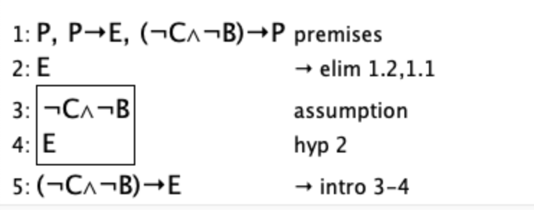
Jape Proof 1
If a tile is passable, and does not contain a car or a barrier then it must be empty
P,P→E,(¬C∧¬B)→P⊢(¬C∧¬B)→E
P represents that a tile is passable
E represents that a tile is empty
C and B represent a car or a barrier respectively
Therefore, a tile is passable only when it does not contain a car or a barrier in which case that tile is empty

Slide 7
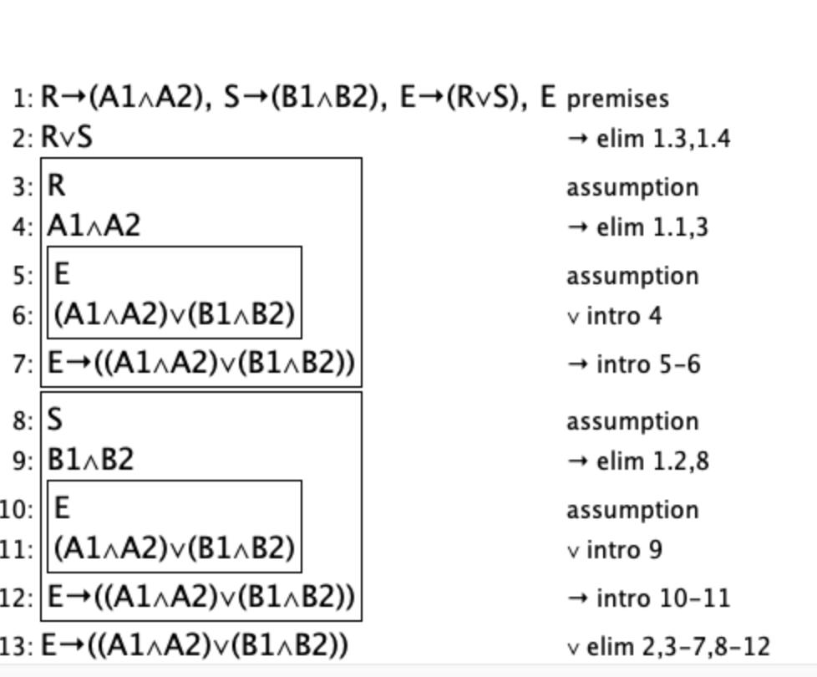
Jape Proof 2
If a car is facing orientation N/S and it is able to exit, then one of the directions N or S must be free
R→(A1∧A2),S→(B1∧B2),E→(R∨S), E⊢E→((A1∧A2)∨(B1∧B2))
A represents the tiles in the direction north and is true if the tile is not blocked.
B represents the tiles in the direction south and is true if the tile is not blocked.
R represents the travel north and is true if the car can travel north, S represents south and is true if the car can travel south.
E represents exit and is true if the car can exit

Slide 8
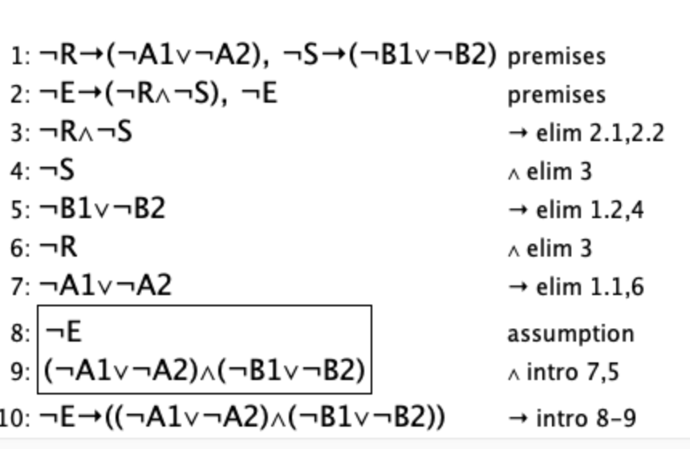
Jape Proof 3
If a car cannot exit then both of the directions of travel must be blocked.
¬R→(¬A1∨¬A2),¬S→(¬B1∨¬B2),¬E→(¬R∧¬S), ¬E⊢¬E→((¬A1∨¬A2)∧(¬B1∨¬B2))
A represents the tiles in the direction north and is true if the tile is not blocked.
B represents the tiles in the direction south and is true if the tile is not blocked.
R represents the travel north and is true if the car can travel north, S represents south and is true if the car can travel south.
E represents exit and is true if the car can exit

Slide 9
Model Exploration
Board Size & Game Setup
Beginning with the original setup of our game, we created a somewhat simplified version of a classic puzzle game that has been adapted into multiple game formats. To do this we restricted our board size to 4x4 with a set number of 5 cars and 5 barriers randomly placed. Through exploring our model we found that this limitation did not need to be in place, our final model can use any size board with any number of cars and barriers.
Car Exit Condition
In our original model we explored a few options for how to remove cars from the board. The first idea we tried was to have an outside ring of tiles on the board considered "exit" tiles, should a car reach that tile it will have "exited". This model we deemed was too different from the original game and was also unccessessary. After a few other iterations of an exit strategy we arrived on what we have now; a car is only moved if it can be moved entirely off the board in which case it is removed.

Slide 10
Model Exploration (cont.)
Car Movement
Car movement was something that was modified a few times over the course of the design process. Iterations of the game included a turn based system for moving cars one space at a time, a turn based system where only cars that can exit will move, and what we have now, a modified system that removes cars when they can move off the board in a systematic way.
Barrier Placement
In the original game there is a set number of barriers per level. We began our model with a set number of barriers and cars however much like our exit condition we attempted to have an outside ring of "exits" that were either blocked off by barriers or not. Ultimately we deemed that given our exit to barrier ratio, this would result in the game being impossible much of the time and instead decided that the barriers should just be objects that occupy any given tile much like a car.

Slide 11
Model Exploration (cont.)
Propositions & Constraints
Due to the other factors of our game that were so frequently changed, our propositions and constraints changed just as frequently. (See Propositions & Constraints original vs final earlier in the presentation).

Slide 12
First Order Extension
Extended Predicates
Car(p, i, j, o): Car p is at position (i,j) facing orientation o.
p identifies cars.
o∈{N/S, E/W}
Barrier(i, j): True if position (i,j) contains a barrier.
Empty(i, j): True if position (i,j) is empty.
PathClear(p, d): True if car p has a clear path in direction d.

Slide 13
First Order Extension (cont.)
Example Extended Constraints
Empty tiles: ∀i,j,p,o, ¬Car(p,i,j,o)∧¬Barrier(i,j)→Empty(i,j)
Escape conditions (forwards and backwards): ∀p,i,j,o,k
Blocked cars: ∀p,i,j,o, Car(p,i,j,o)→((∃k,¬Empty(i−k,j))∧(∃k,¬Empty(i+k,j)))
All Cars Escape: ∀p, ¬Blocked(p)→∃i,j,¬Car(p,i,j,o)
The model now uses predicates with variables and quantifiers to generalize over specific positions, cars, and orientations, replacing the fixed propositions.
By encorperating quantifiers and predicates this first-order extension can now extend beyond simple propositional logic, allowing reasoning about specific objects (cars, grid tiles) and their properties.
This enables more detailed constraints and dynamic relationships, such as modeling individual car movements, paths, and interactions, making the logic more expressive and adaptable.

Slide 14
The End
Thanks for listening

