Slide 1
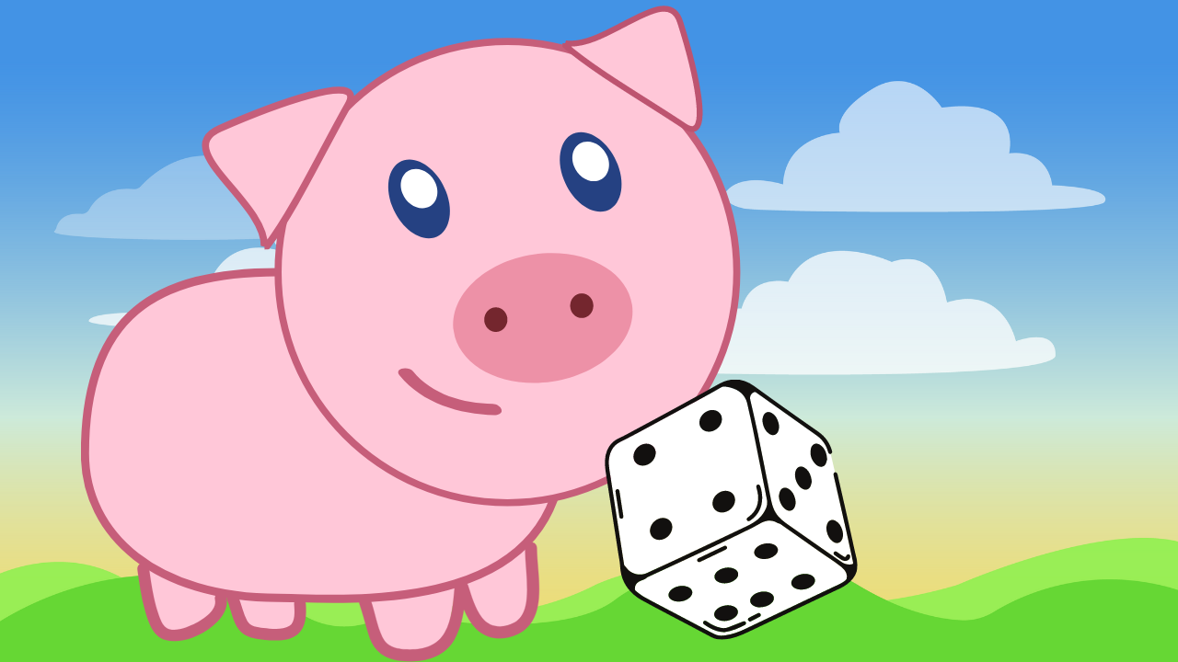
Pig: a Dice Game of Strategic chance
By Elder Veliz
12-03-2024

Slide 2
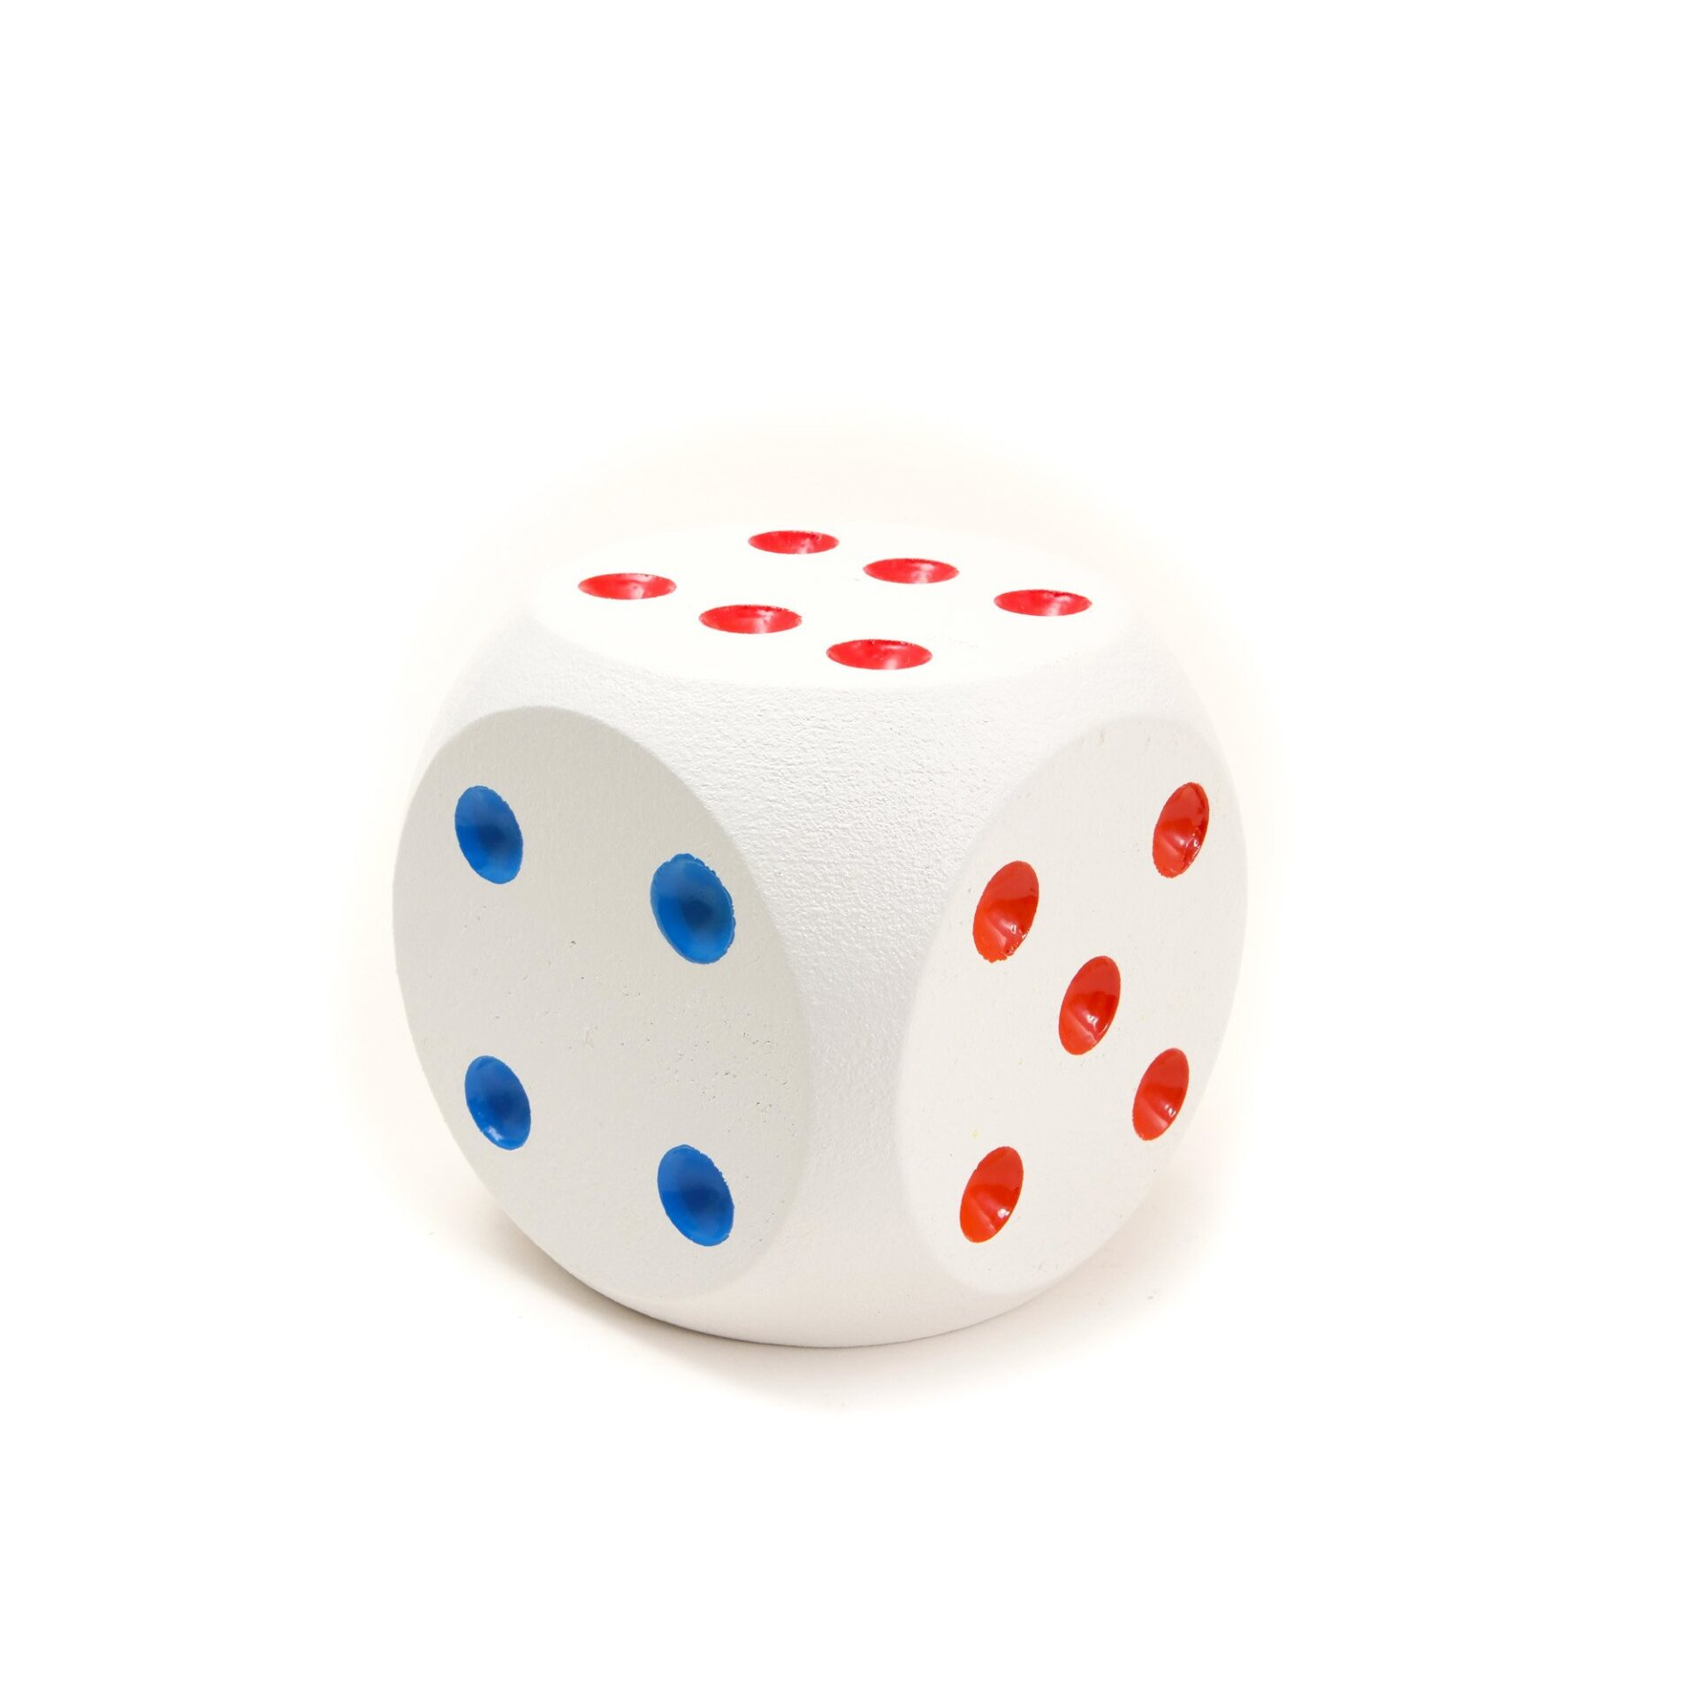
How to Play
Set-up: 1 fair, six-sided die and 1+ (non-)human players
Player(s) alternate turns:
If a player rolls a 1, they lose all points accumulated in that turn and their turn ends.
If a player rolls a 2-6, they can choose to:
"hold" and bank the points accumulated in that turn,
or roll again.
The first player to reach or exceed the target score of 100 wins the game.
Roll
2-6
Roll
1
Hold

Slide 3
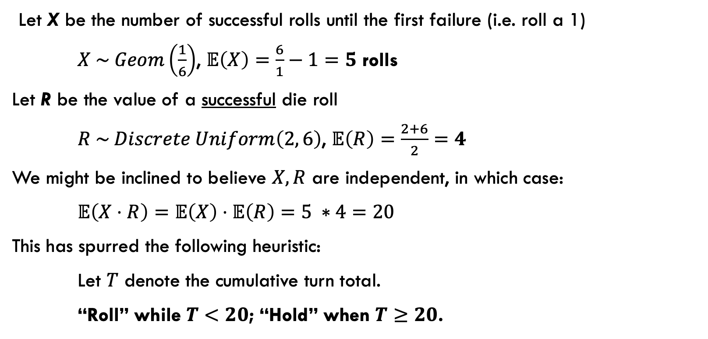
Heuristic Strategy
Let X be the number of successful rolls until the first failure (i.e. roll a 1)
$X \sim Geom\left(\frac{1}{6}\right)$, $𝔼\left(X\right)=\frac{6}{1}−1=5$ rolls
Let R be the value of a successful die roll
$R \sim Discrete Uniform\left(2, 6\right)$, $𝔼\left(R\right)=\frac{2+6}{2}=4$
We might be inclined to believe $X, R$ are independent, in which case:
$𝔼\left(X⋅R\right)=𝔼\left(X\right)⋅𝔼\left(R\right)=5 ∗4=20$
This has spurred the following heuristic:
Let $T$ denote the cumulative turn total.
“Roll” while $T<20$; “Hold” when $T≥20$.

Slide 4
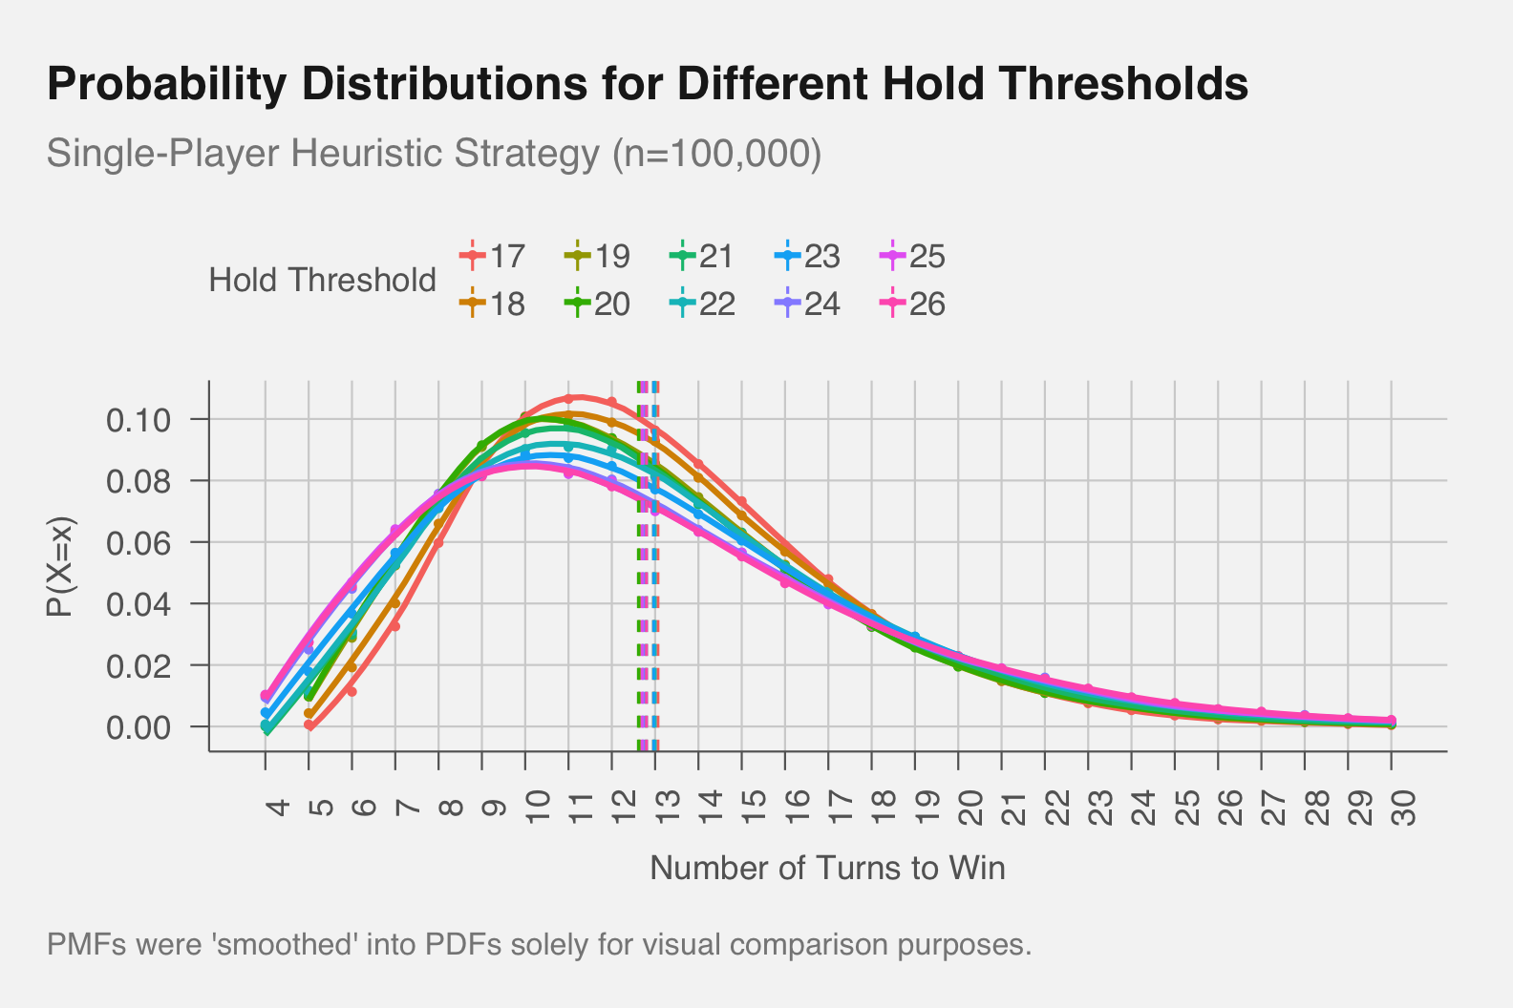
Results of different “Hold” Thresholds

Slide 5
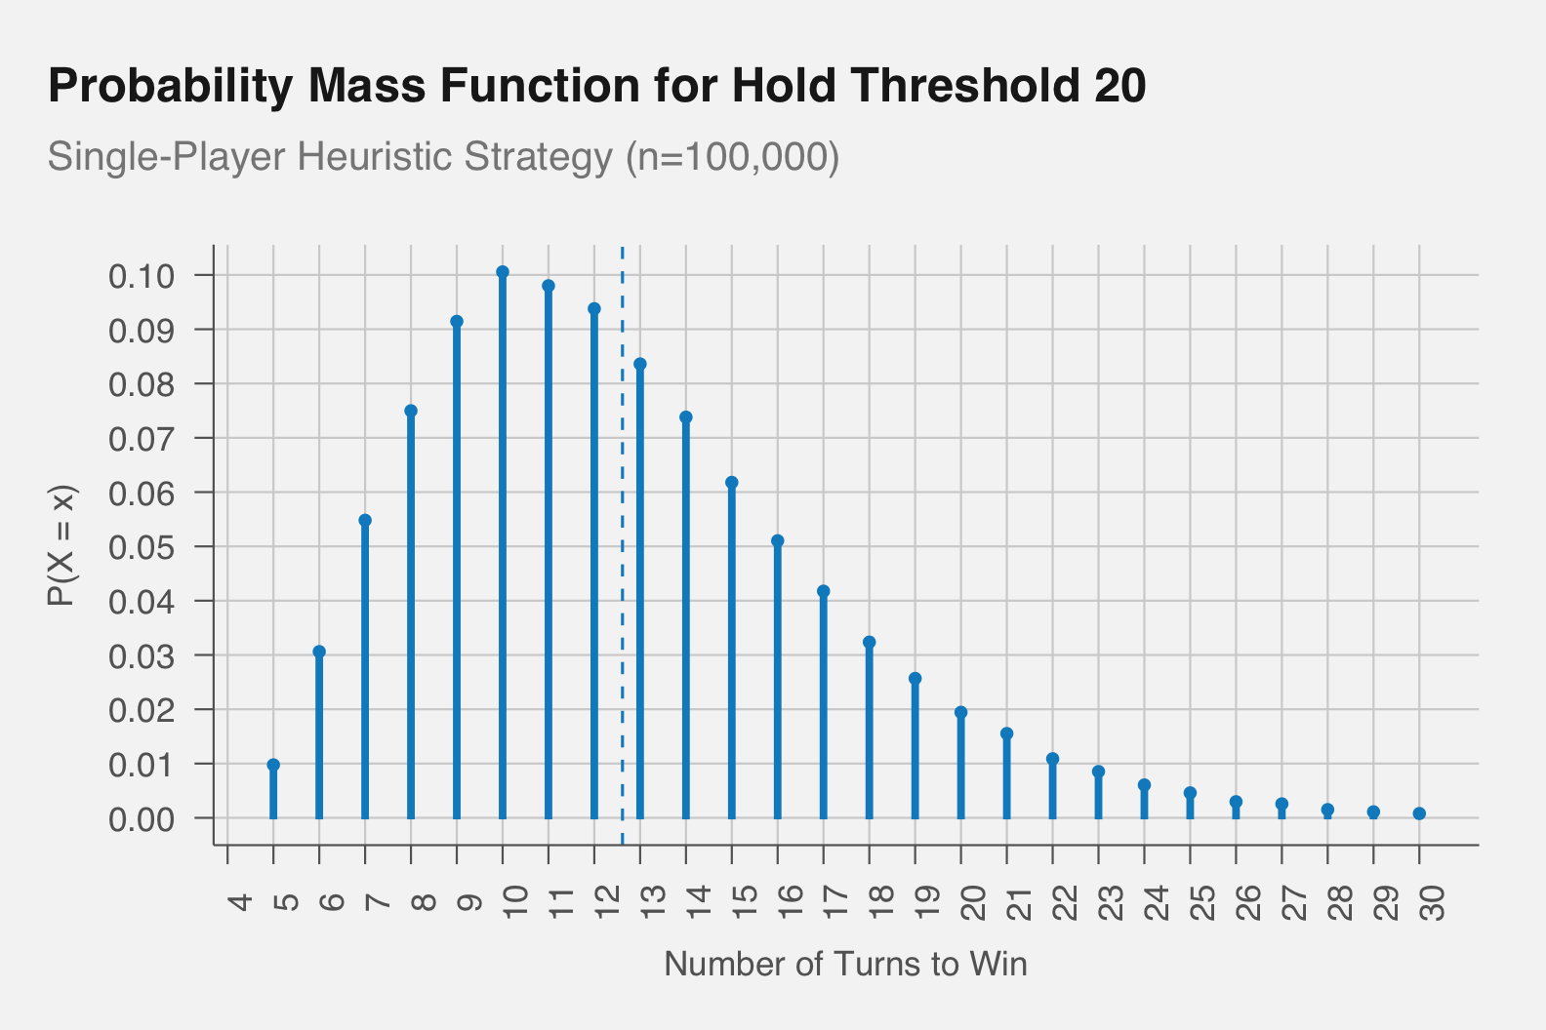
Results of different “Hold” Thresholds
Threshold | Mean | Median | Variance
17 | 13.06 | 12 | 4.03
18 | 12.96 | 12 | 4.25
19 | 12.64 | 12 | 4.38
20 | 12.61 | 12 | 4.43
21 | 12.80 | 12 | 4.58
22 | 13.00 | 12 | 4.81
23 | 12.96 | 12 | 5.06
24 | 12.73 | 12 | 5.23
25 | 12.70 | 12 | 5.28
26 | 12.80 | 12 | 5.39

Slide 6
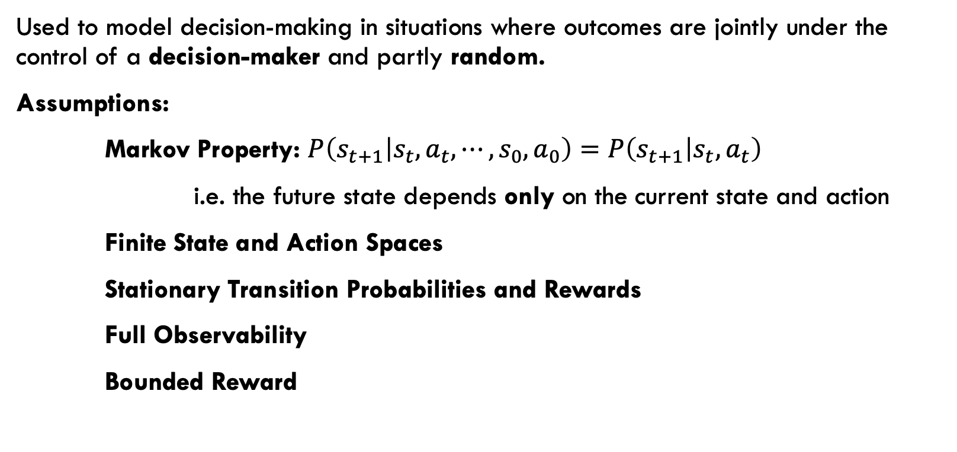
Markov Decision Process (MDP)
Used to model decision-making in situations where outcomes are jointly under the control of a decision-maker and partly random.
Assumptions:
Markov Property: $P\left(s_{t+1} | s_{t},a_{t}, ⋯,s_{0},a_{0}\right)=$ $P\left(s_{t+1} | s_{t},a_{t}\right)$
i.e. the future state depends only on the current state and action
Finite State and Action Spaces
Stationary Transition Probabilities and Rewards
Full Observability
Bounded Reward

Slide 7
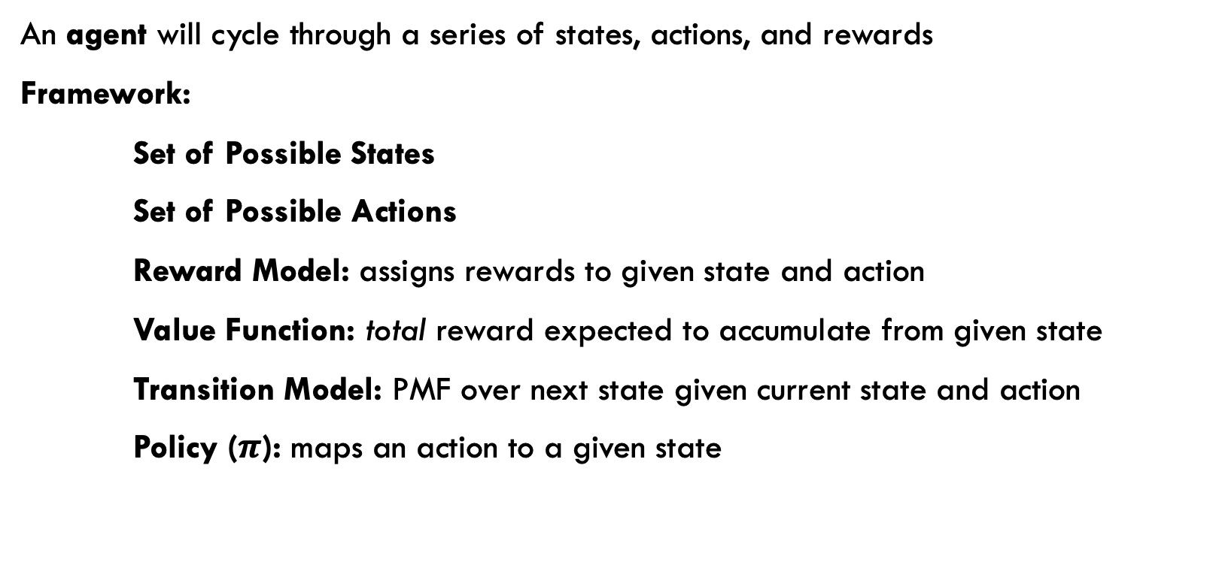
Markov Decision Process (MDP)
An agent will cycle through a series of states, actions, and rewards
Framework:
Set of Possible States
Set of Possible Actions
Reward Model: assigns rewards to given state and action
Value Function: total reward expected to accumulate from given state
Transition Model: PMF over next state given current state and action
Policy ($π$): maps an action to a given state

Slide 8
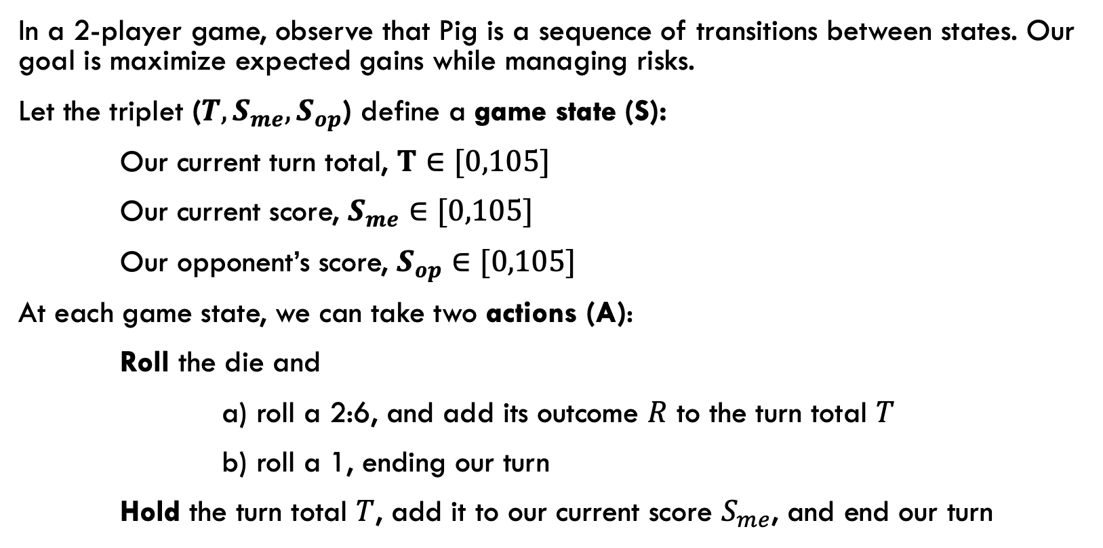
Toward an “optimal” Strategy
In a 2-player game, observe that Pig is a sequence of transitions between states. Our goal is maximize expected gains while managing risks.
Let the triplet (${T,S}_{me},S_{op}$) define a game state (S):
Our current turn total, $T∈[0,105]$
Our current score, $S_{me}∈[0,105]$
Our opponent’s score, $S_{op}∈[0,105]$
At each game state, we can take two actions (A):
Roll the die and
a) roll a 2:6, and add its outcome $R$ to the turn total $T$
b) roll a 1, ending our turn
Hold the turn total $T$, add it to our current score $S_{me}$, and end our turn

Slide 9
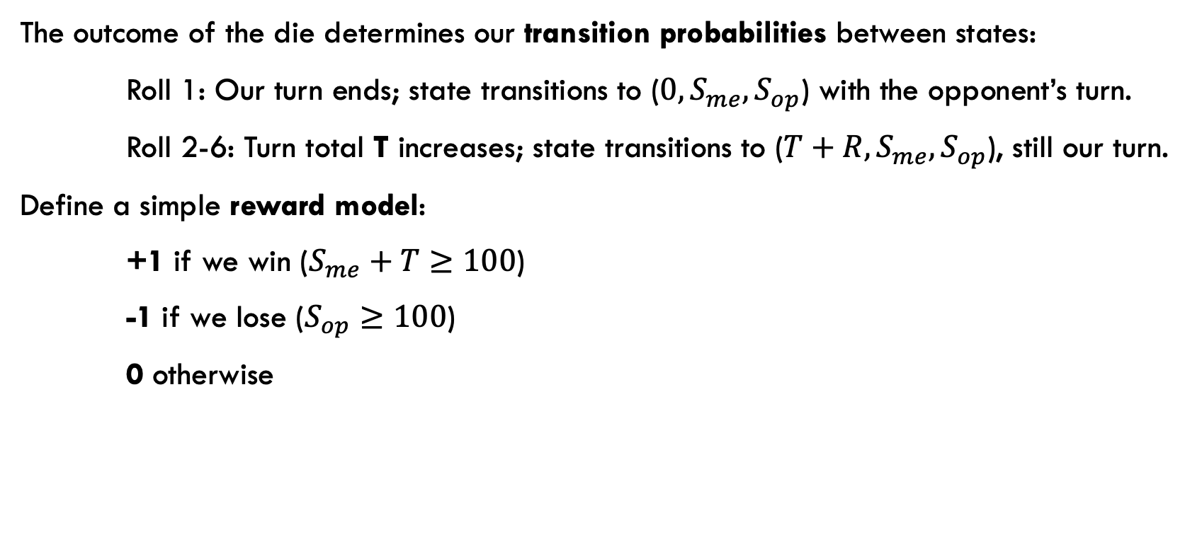
Toward an “optimal” Strategy
The outcome of the die determines our transition probabilities between states:
Roll 1: Our turn ends; state transitions to ($0, S_{me},S_{op}$) with the opponent’s turn.
Roll 2-6: Turn total T increases; state transitions to ($T+R,S_{me},S_{op}$), still our turn.
Define a simple reward model:
+1 if we win ($S_{me}+T≥100$)
-1 if we lose ($S_{op}≥100$)
0 otherwise

Slide 10
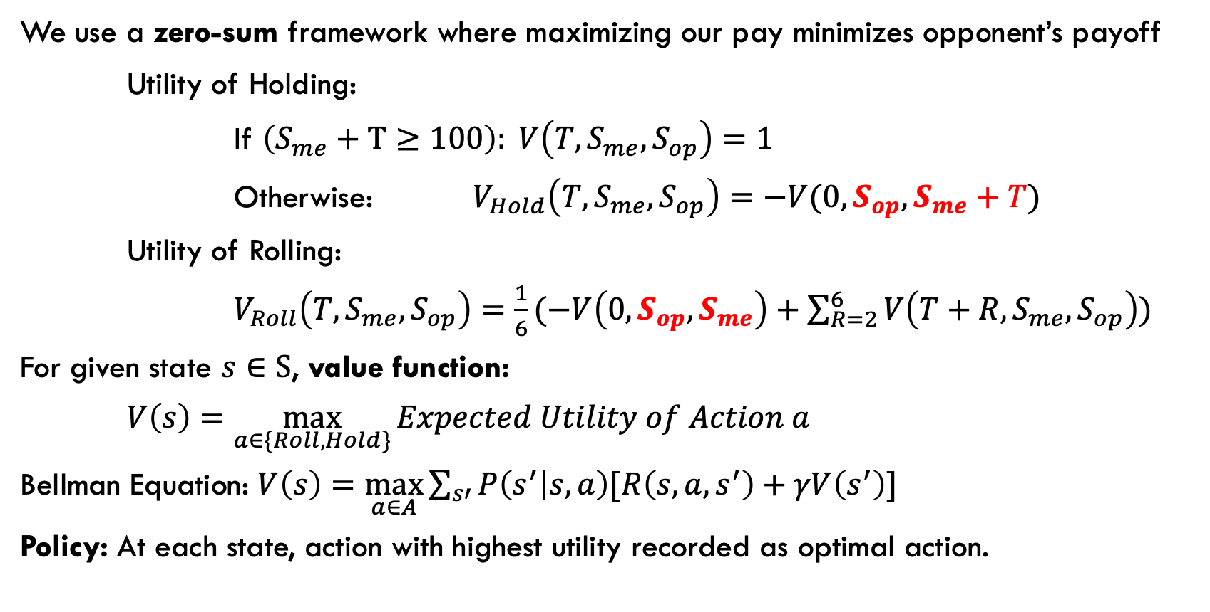
Solving for the “optimal” Strategy
We use a zero-sum framework where maximizing our pay minimizes opponent’s payoff
Utility of Holding:
If $\left(S_{me}+T≥100\right): V\left(T,S_{me},S_{op}\right)=1$
Otherwise: $V_{Hold}\left(T,S_{me},S_{op}\right)=−V(0,S_{op},S_{me}+T)$
Utility of Rolling:
$V_{Roll}\left(T,S_{me},S_{op}\right)=\frac{1}{6}(−V\left(0,S_{op},S_{me}\right)+\sum_{R=2}^{6}{V\left(T+R,S_{me},S_{op}\right)})$
For given state $s∈S$, value function:
$V\left(s\right)=\max_{a∈\{Roll, Hold\}}{Expected Utility of Action a}$
Bellman Equation: $V\left(s\right)=\max_{a∈A}\sum_{s′}{P\left(s^{′} | s,a\right)[R\left(s,a,s^{′}\right)+γV\left(s^{′}\right)]}$
Policy: At each state, action with highest utility recorded as optimal action.

Slide 11
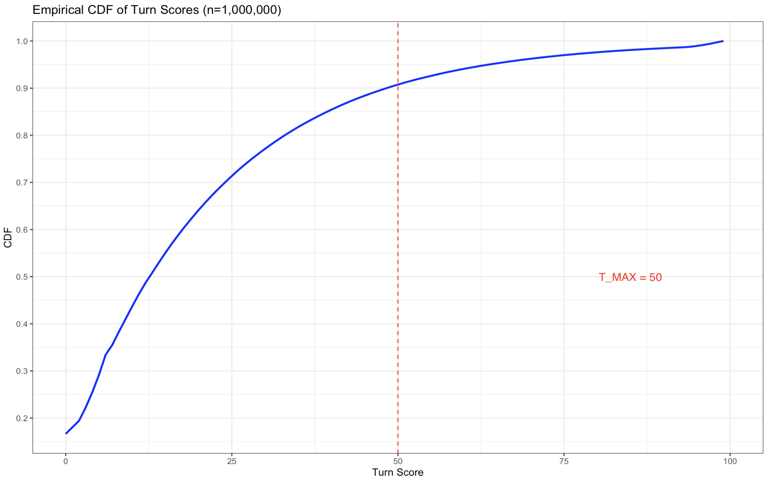
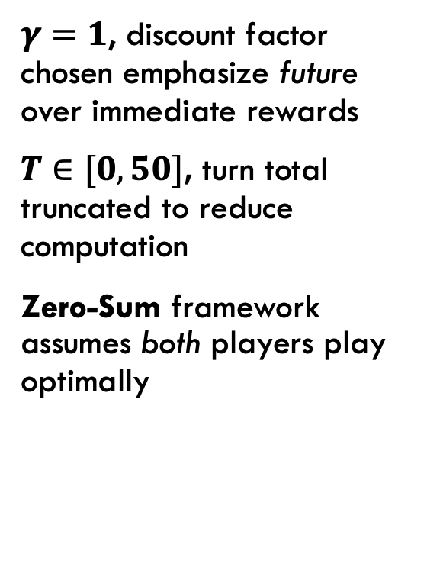
adjustments for convergence
$γ=1$, discount factor chosen emphasize future over immediate rewards
$T∈[0,50]$, turn total truncated to reduce computation
Zero-Sum framework assumes both players play optimally

Slide 12
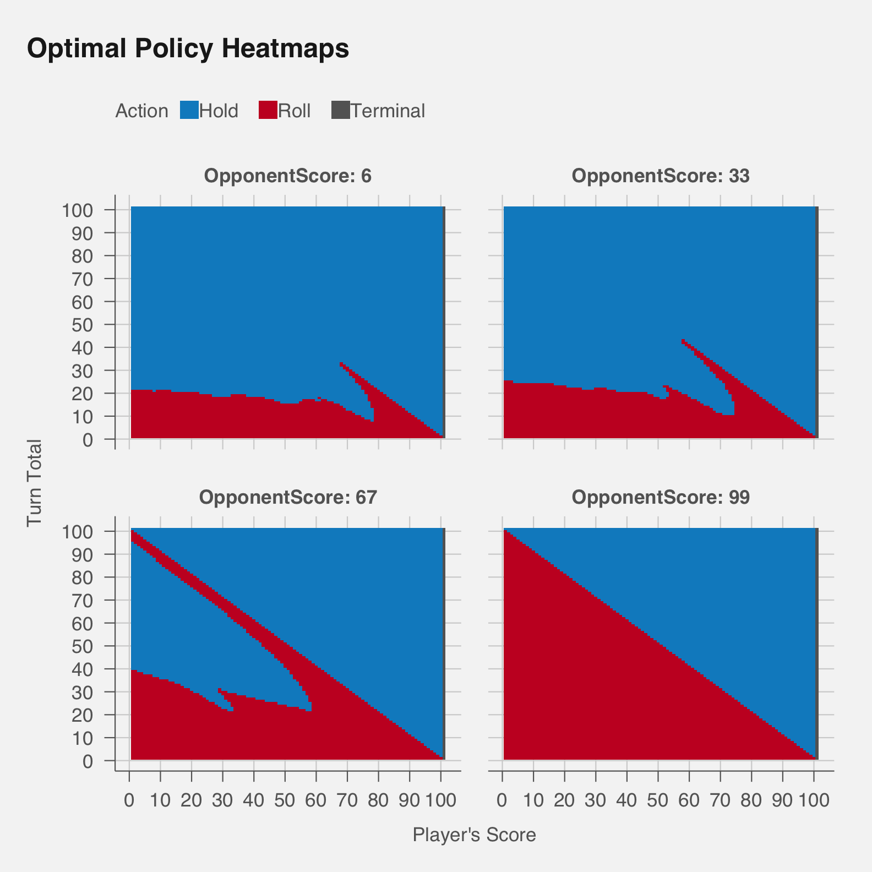
Evidence of sensible OPTIMAL policy

Slide 13
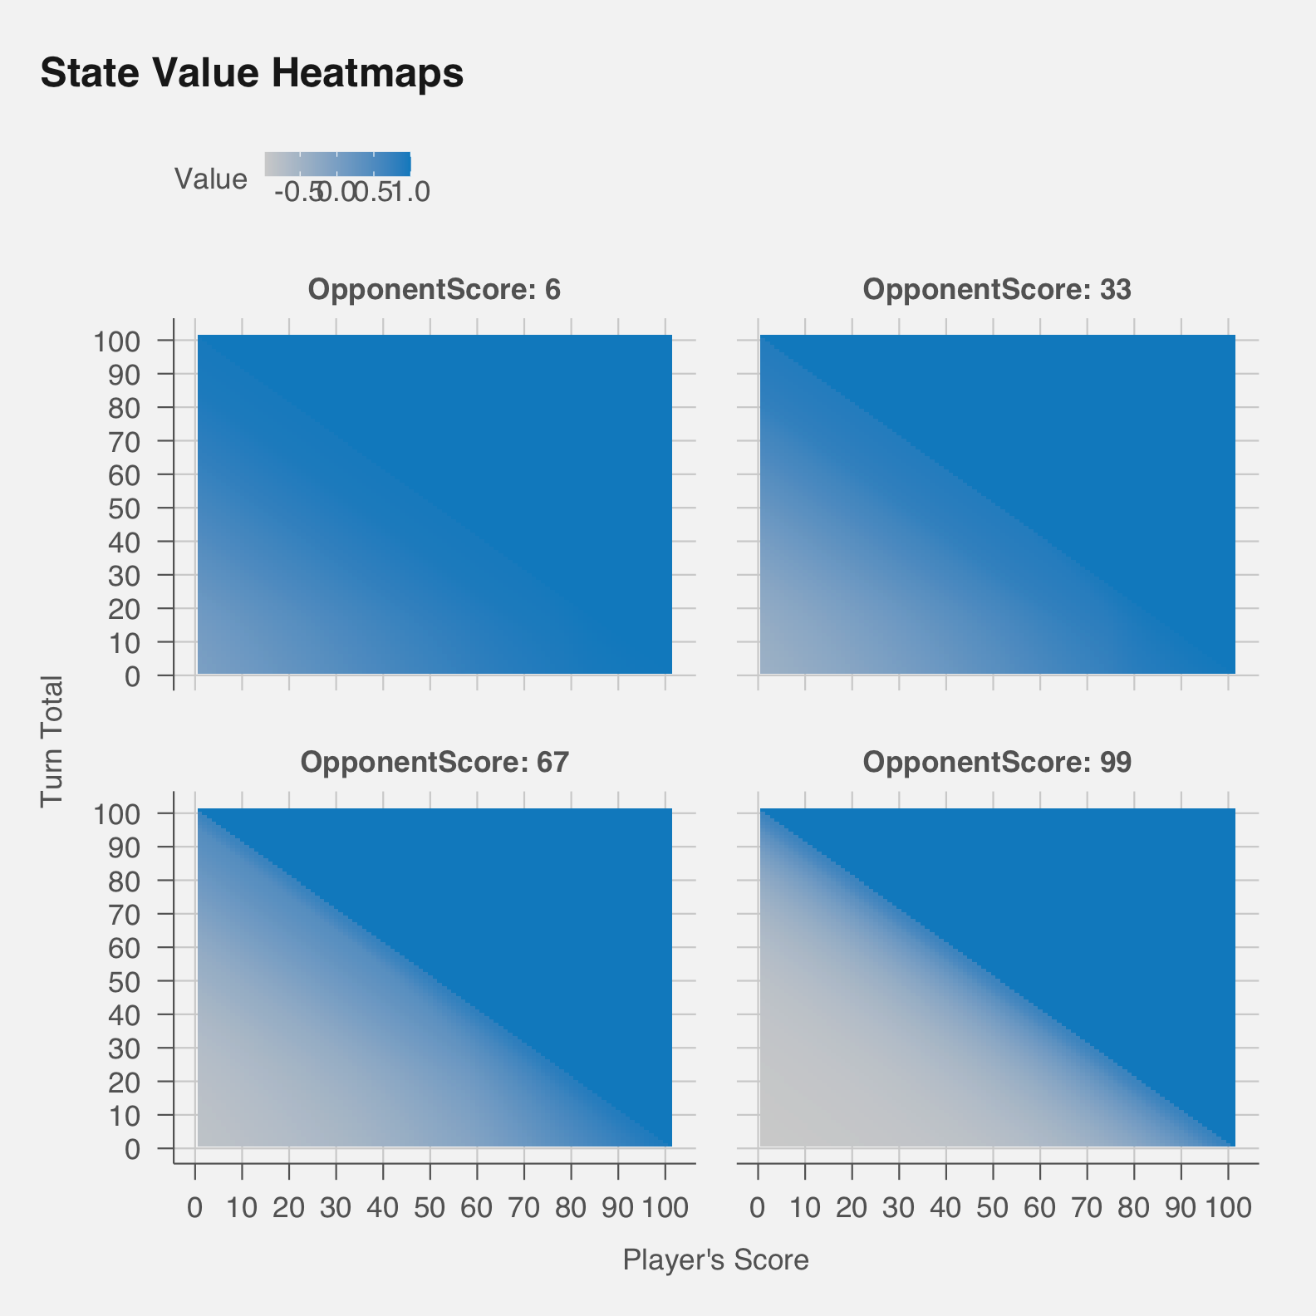
Evidence of sensible STAte values

Slide 14
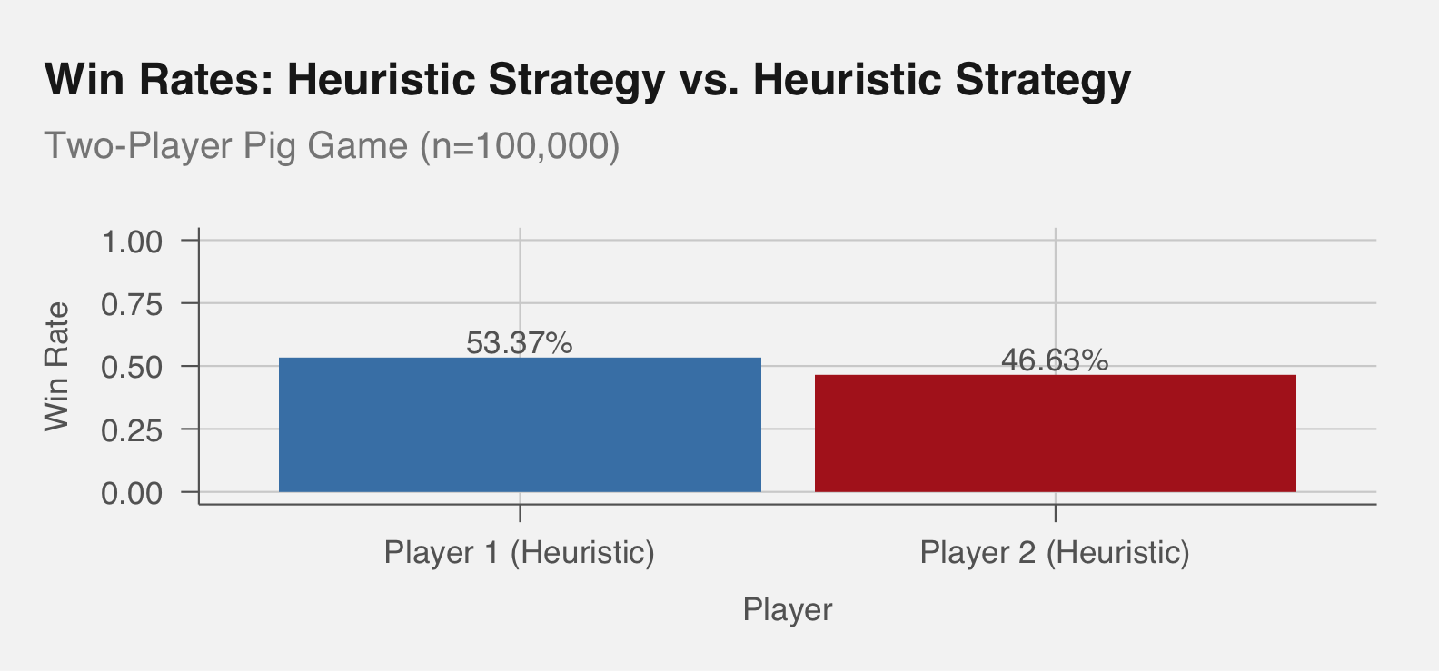
Two Heuristic AGENTS

Slide 15
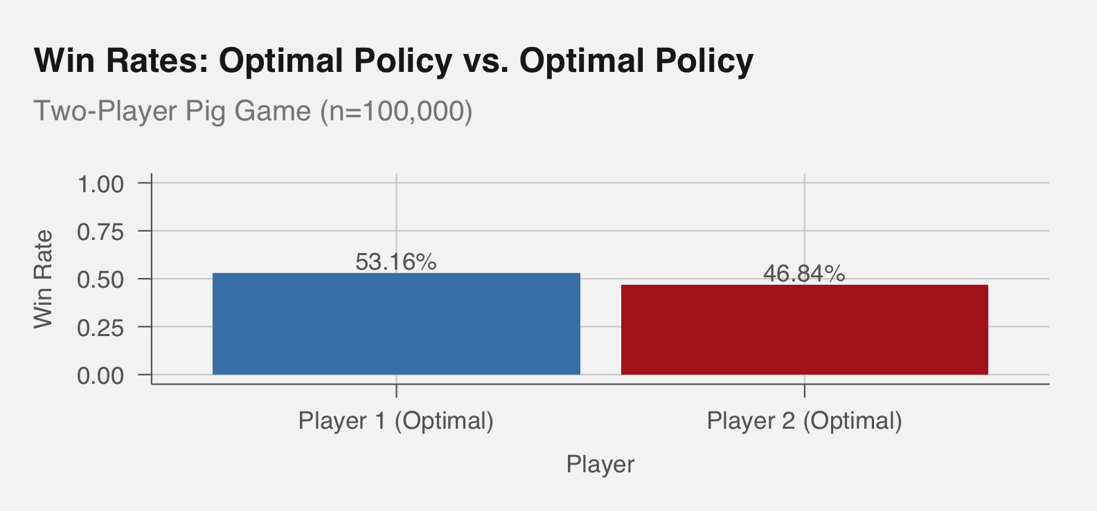
Two optimal AGENTS

Slide 16
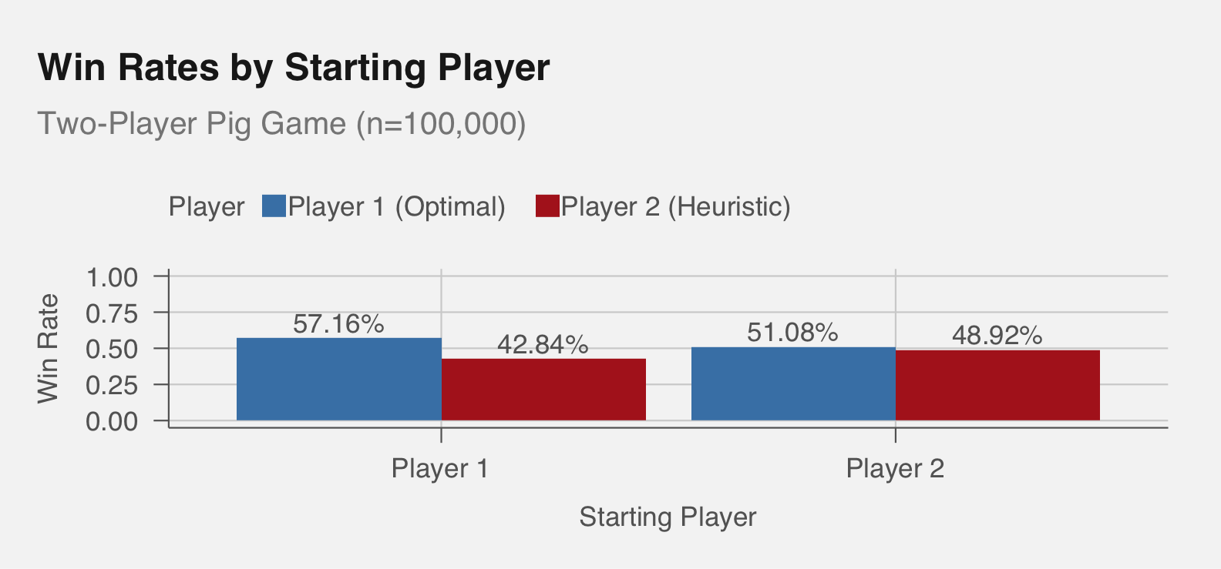
Optimal vs. Heuristic AGENT

Slide 17
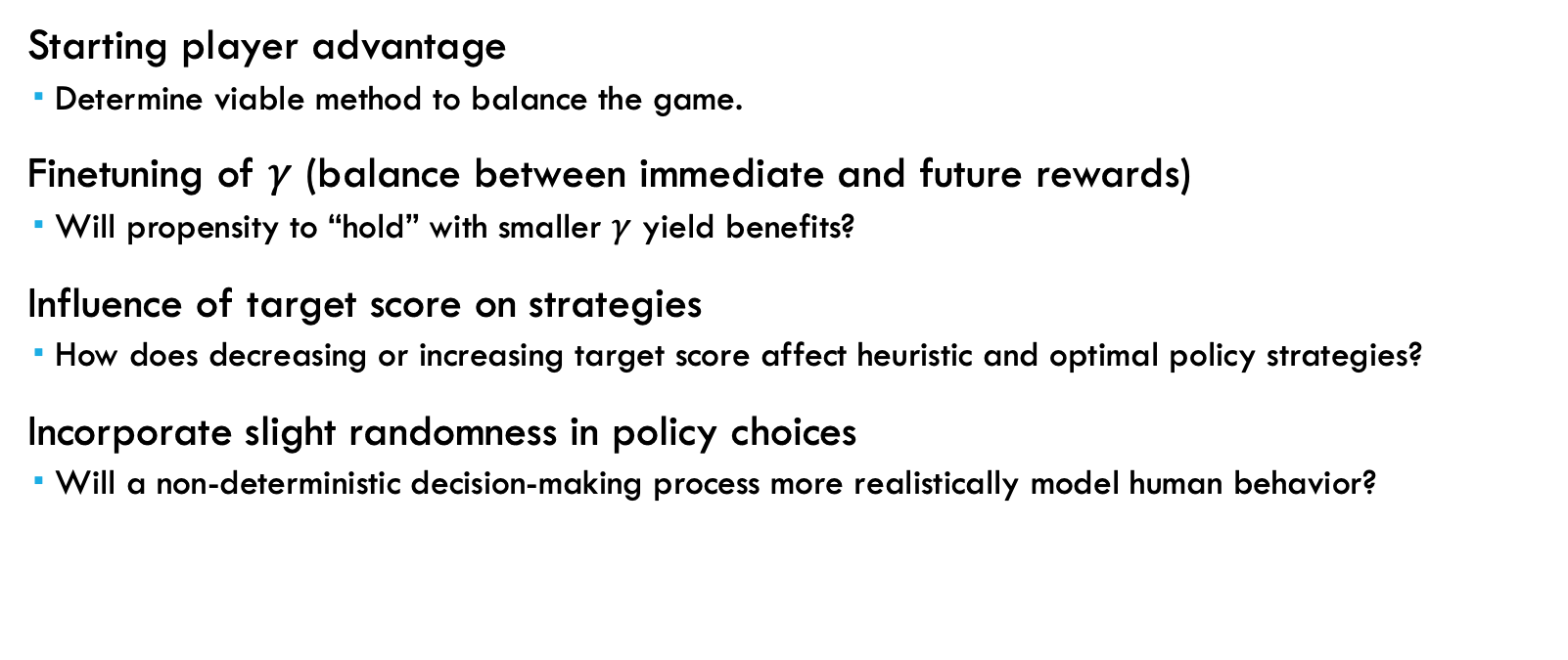
Further investigations
Starting player advantage
Determine viable method to balance the game.
Finetuning of $γ$ (balance between immediate and future rewards)
Will propensity to “hold” with smaller $γ$ yield benefits?
Influence of target score on strategies
How does decreasing or increasing target score affect heuristic and optimal policy strategies?
Incorporate slight randomness in policy choices
Will a non-deterministic decision-making process more realistically model human behavior?

Slide 18
references
Adams, R. P. (2019). Markov Decision Processes. COS324 Elements of Machine Learning, Princeton University. Retrieved from https://www.cs.princeton.edu/courses/archive/spring19/cos324/files/expectimax.pdf
Game On Family, “How to Play the Pig Dice Game,” https://gameonfamily.com/pig-dice/.
Lafferty, J. (2024). Reinforcement Learning: Policy Methods. S&DS 365 Intermediate Machine Learning, Yale University. Retrieved from https://github.com/YData123/sds365-fa24/raw/main/lectures/lecture-oct-30.pdf

