Slide 1

estimation of the 3D rim from the 2D occluding contour
By Kuimou Yu
Supervisor: James H Elder

Slide 2
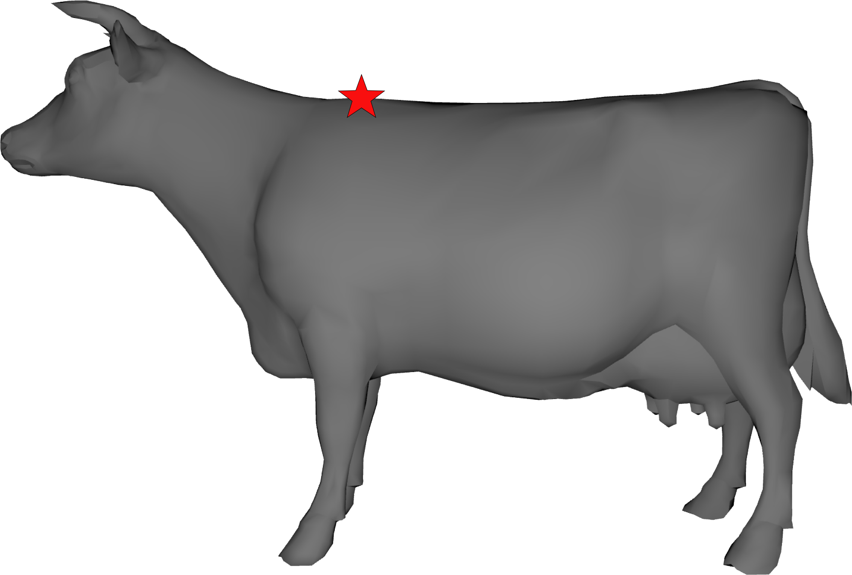
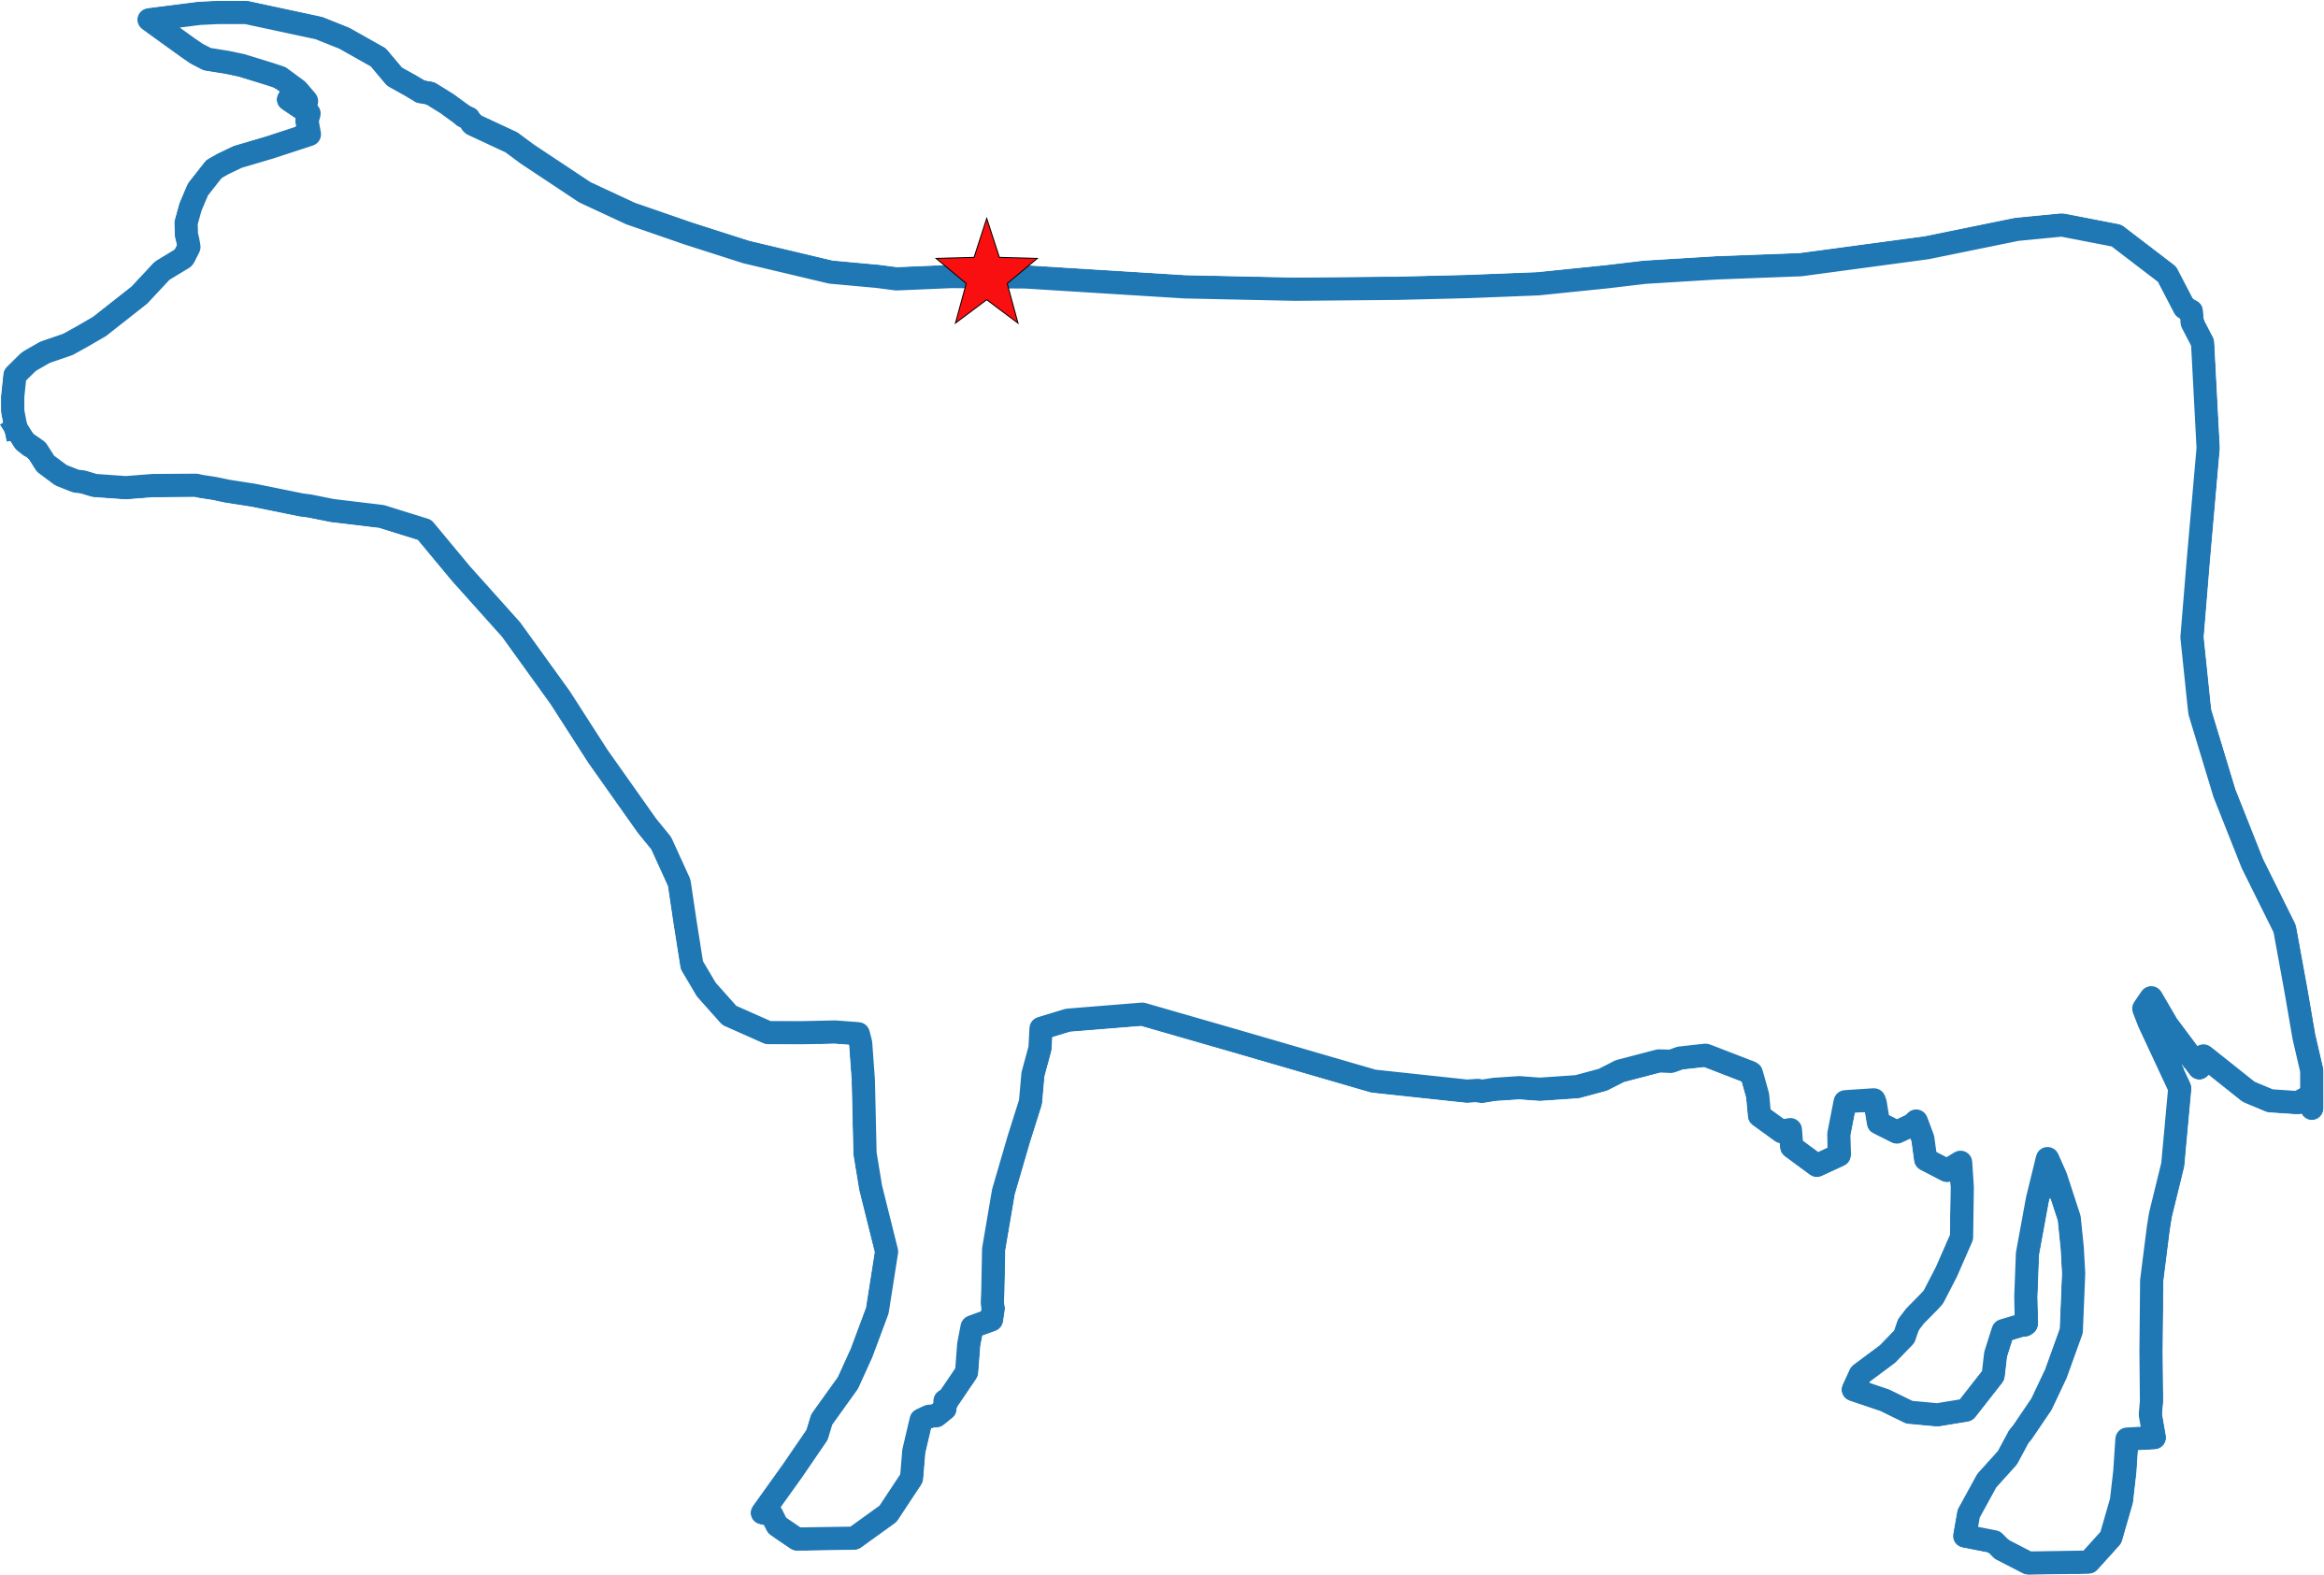
INTRODUCTION & MOTIVATION
Vision clues!
project to
3D object
constrain
2D occluding contour

Slide 3
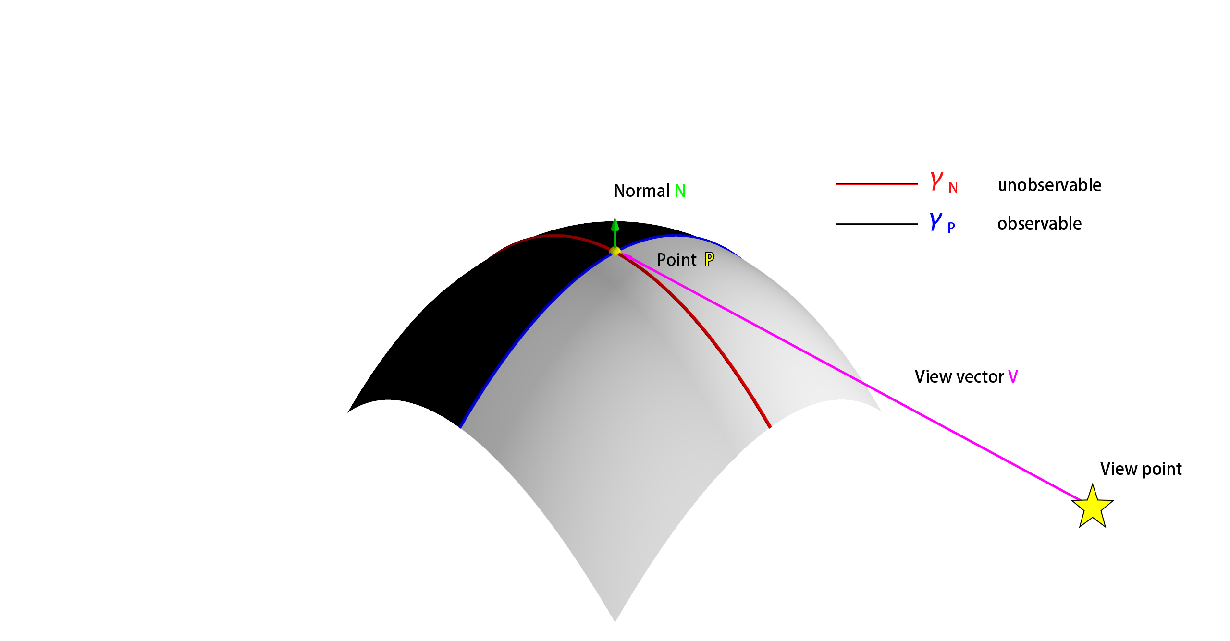
OBJECTIVE
Our research aims to explore how common object regularities and projection rules might facilitate statistical shape estimations from occluding
Generate
Occluding contour
Statistical
Relationship?
Object surface

Slide 4


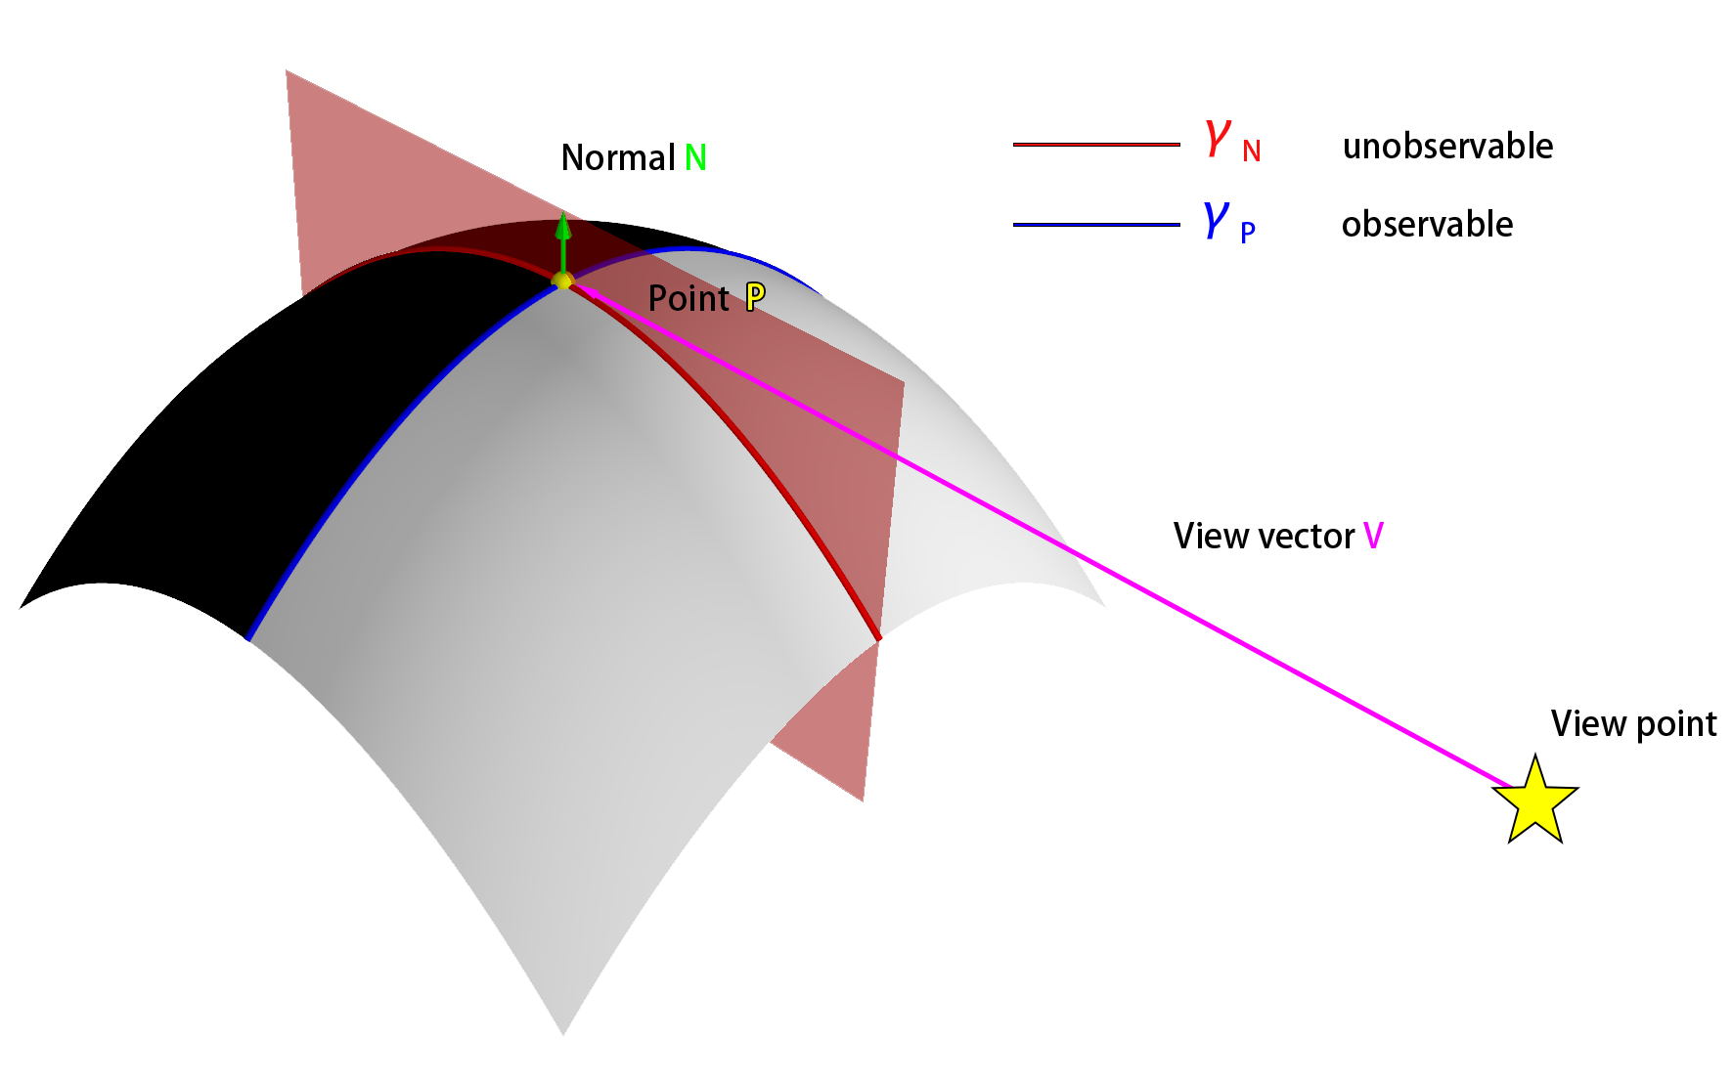
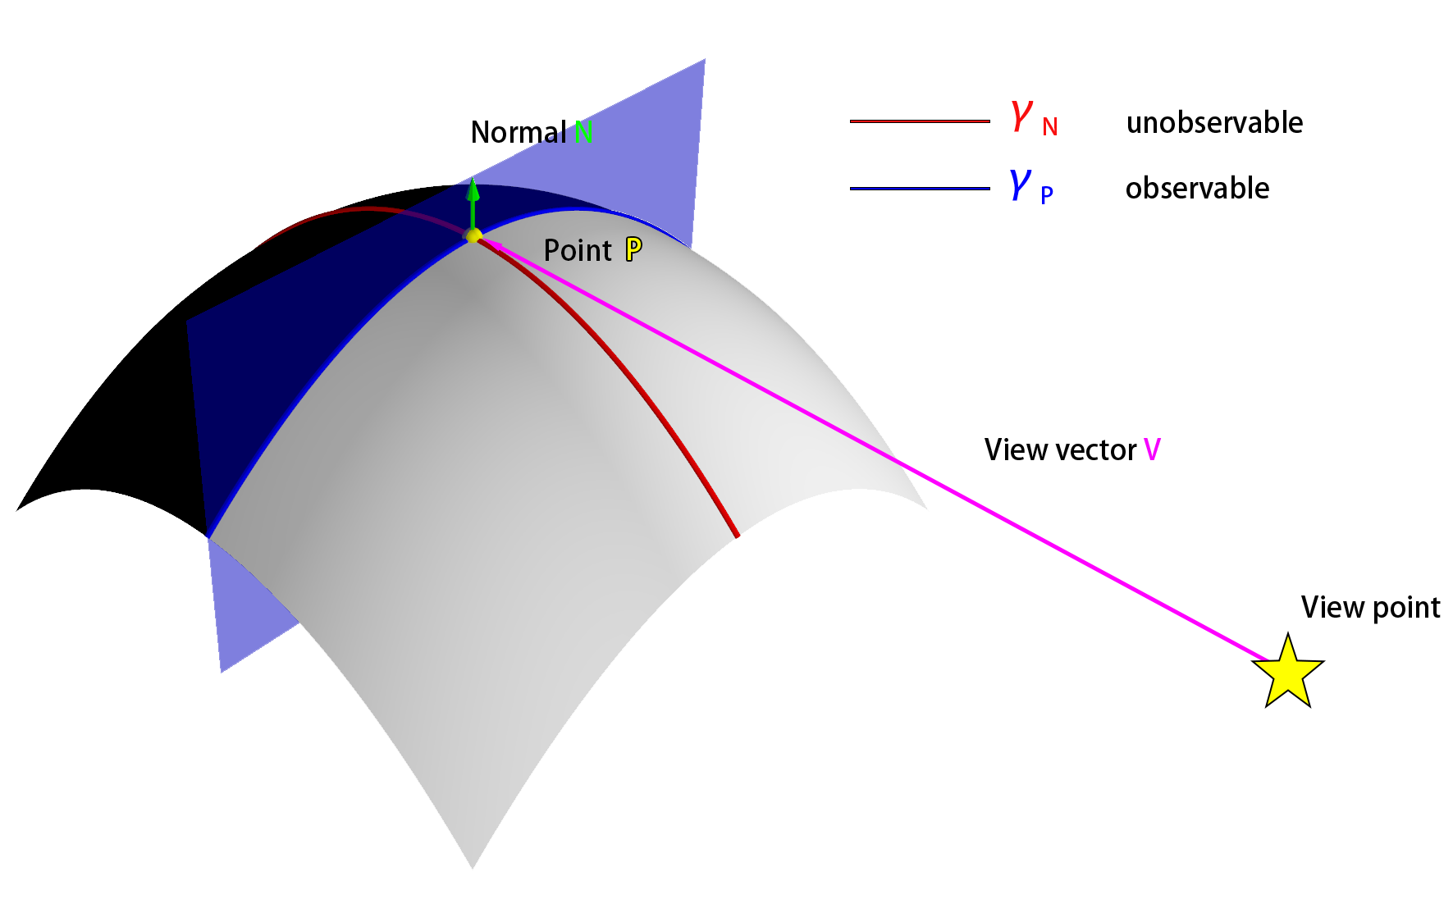
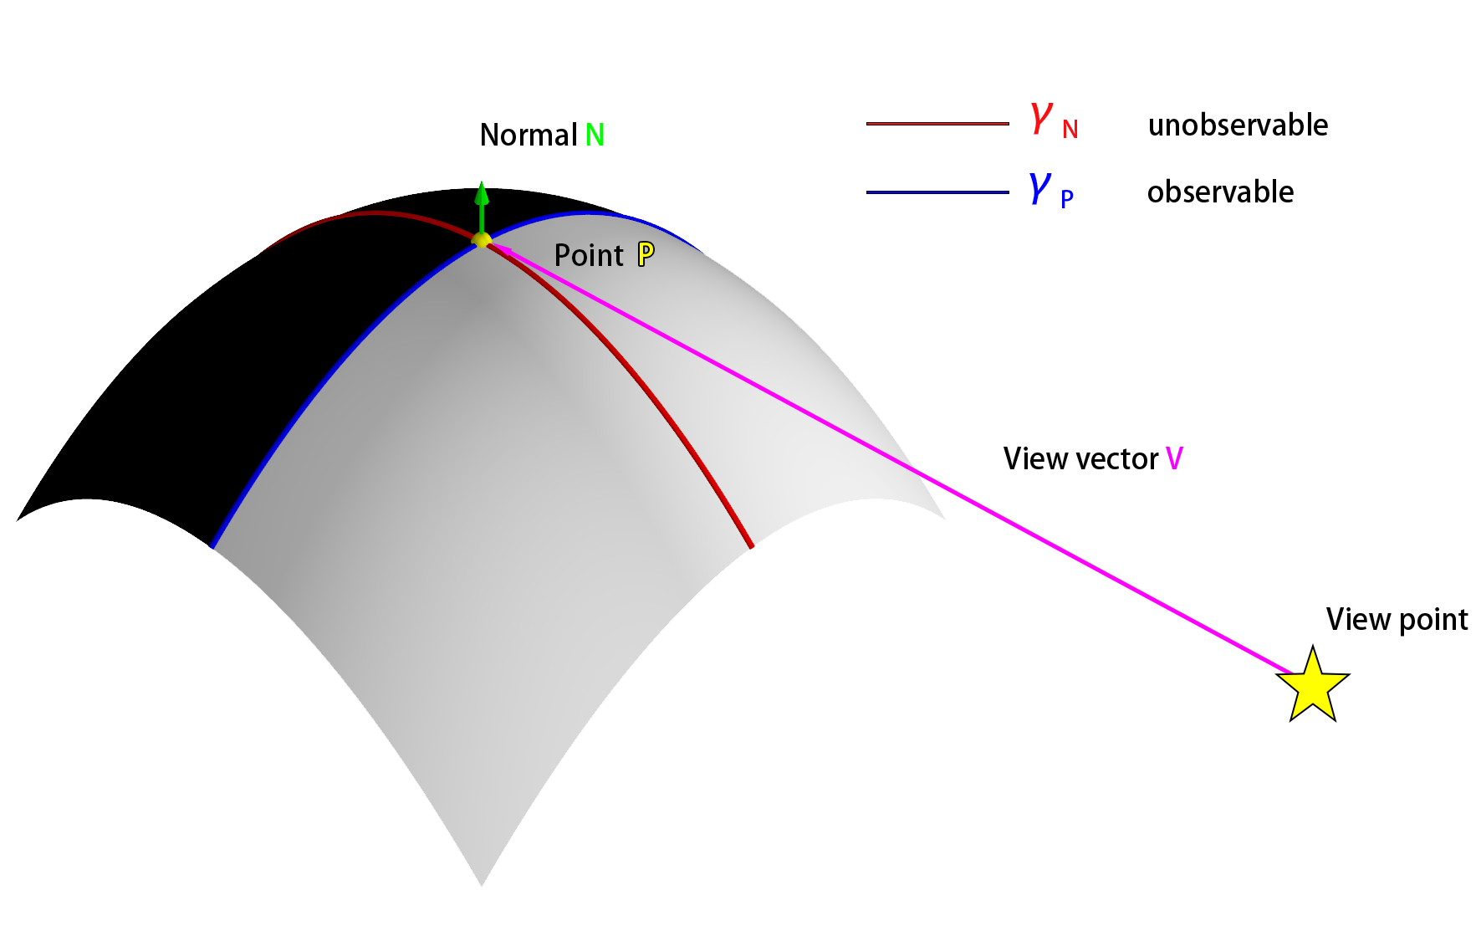
METHOD
Study the local surface curvature γ_{P} and γ_{N}

Slide 5
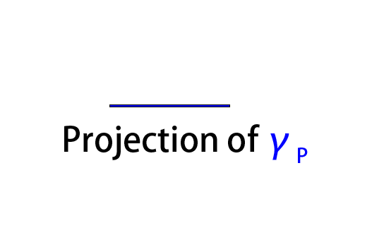
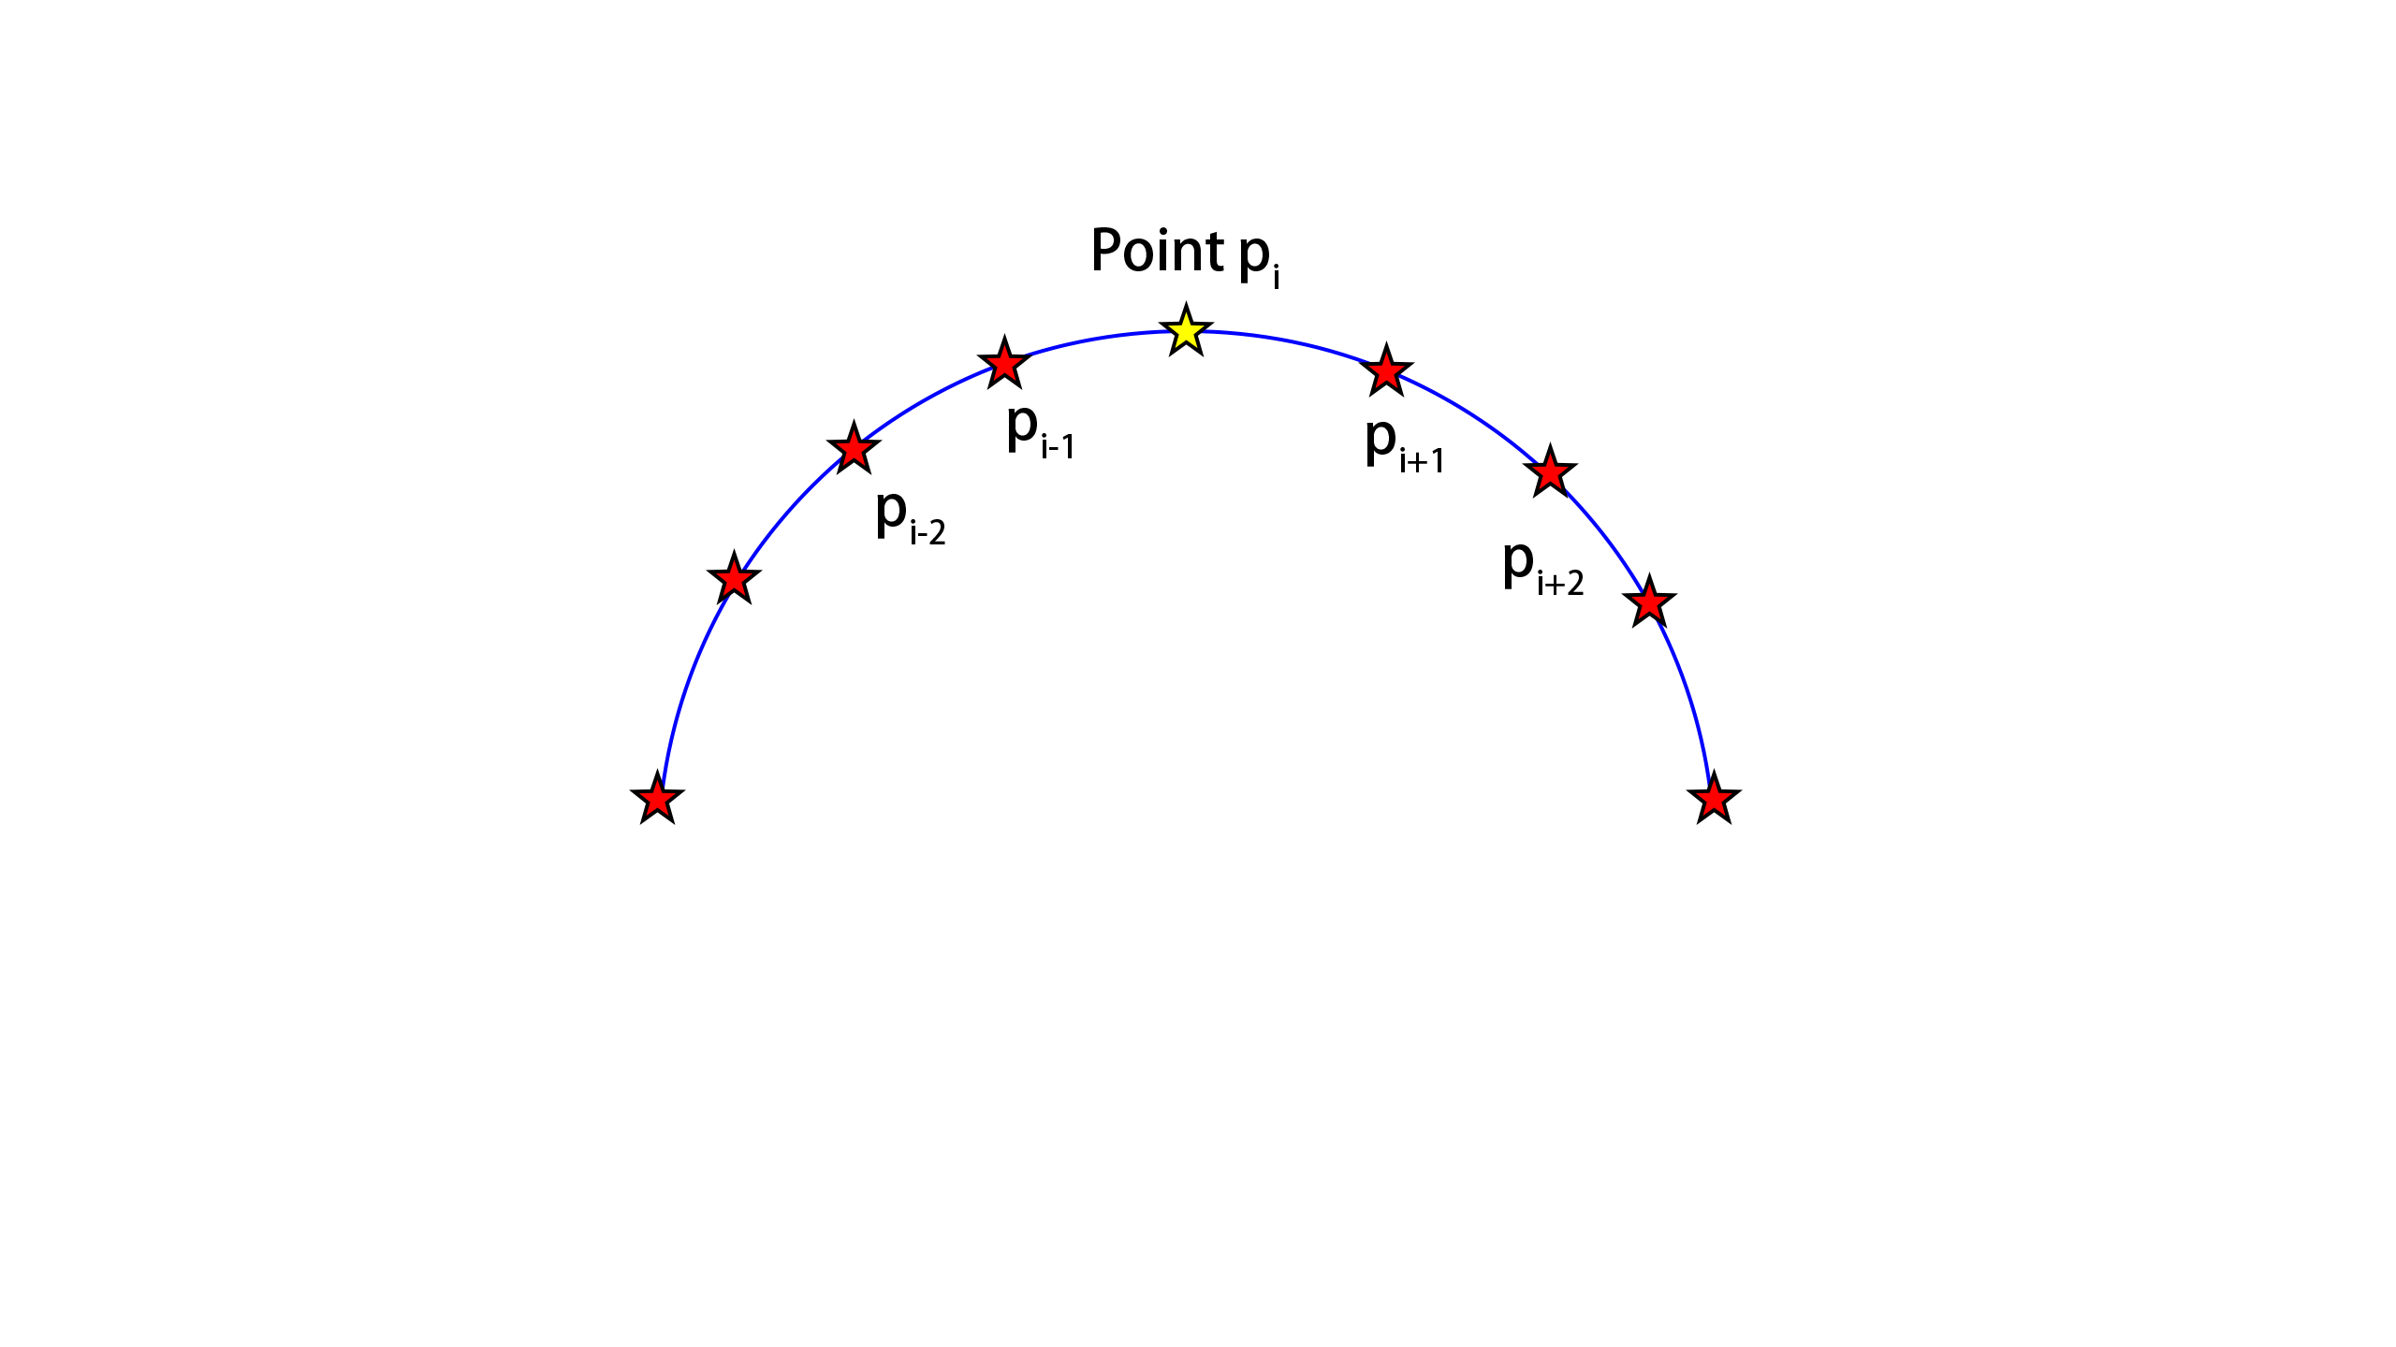
APPARENT CURVATURE
Reproject to plane P
Image plane
Object surface

Slide 6
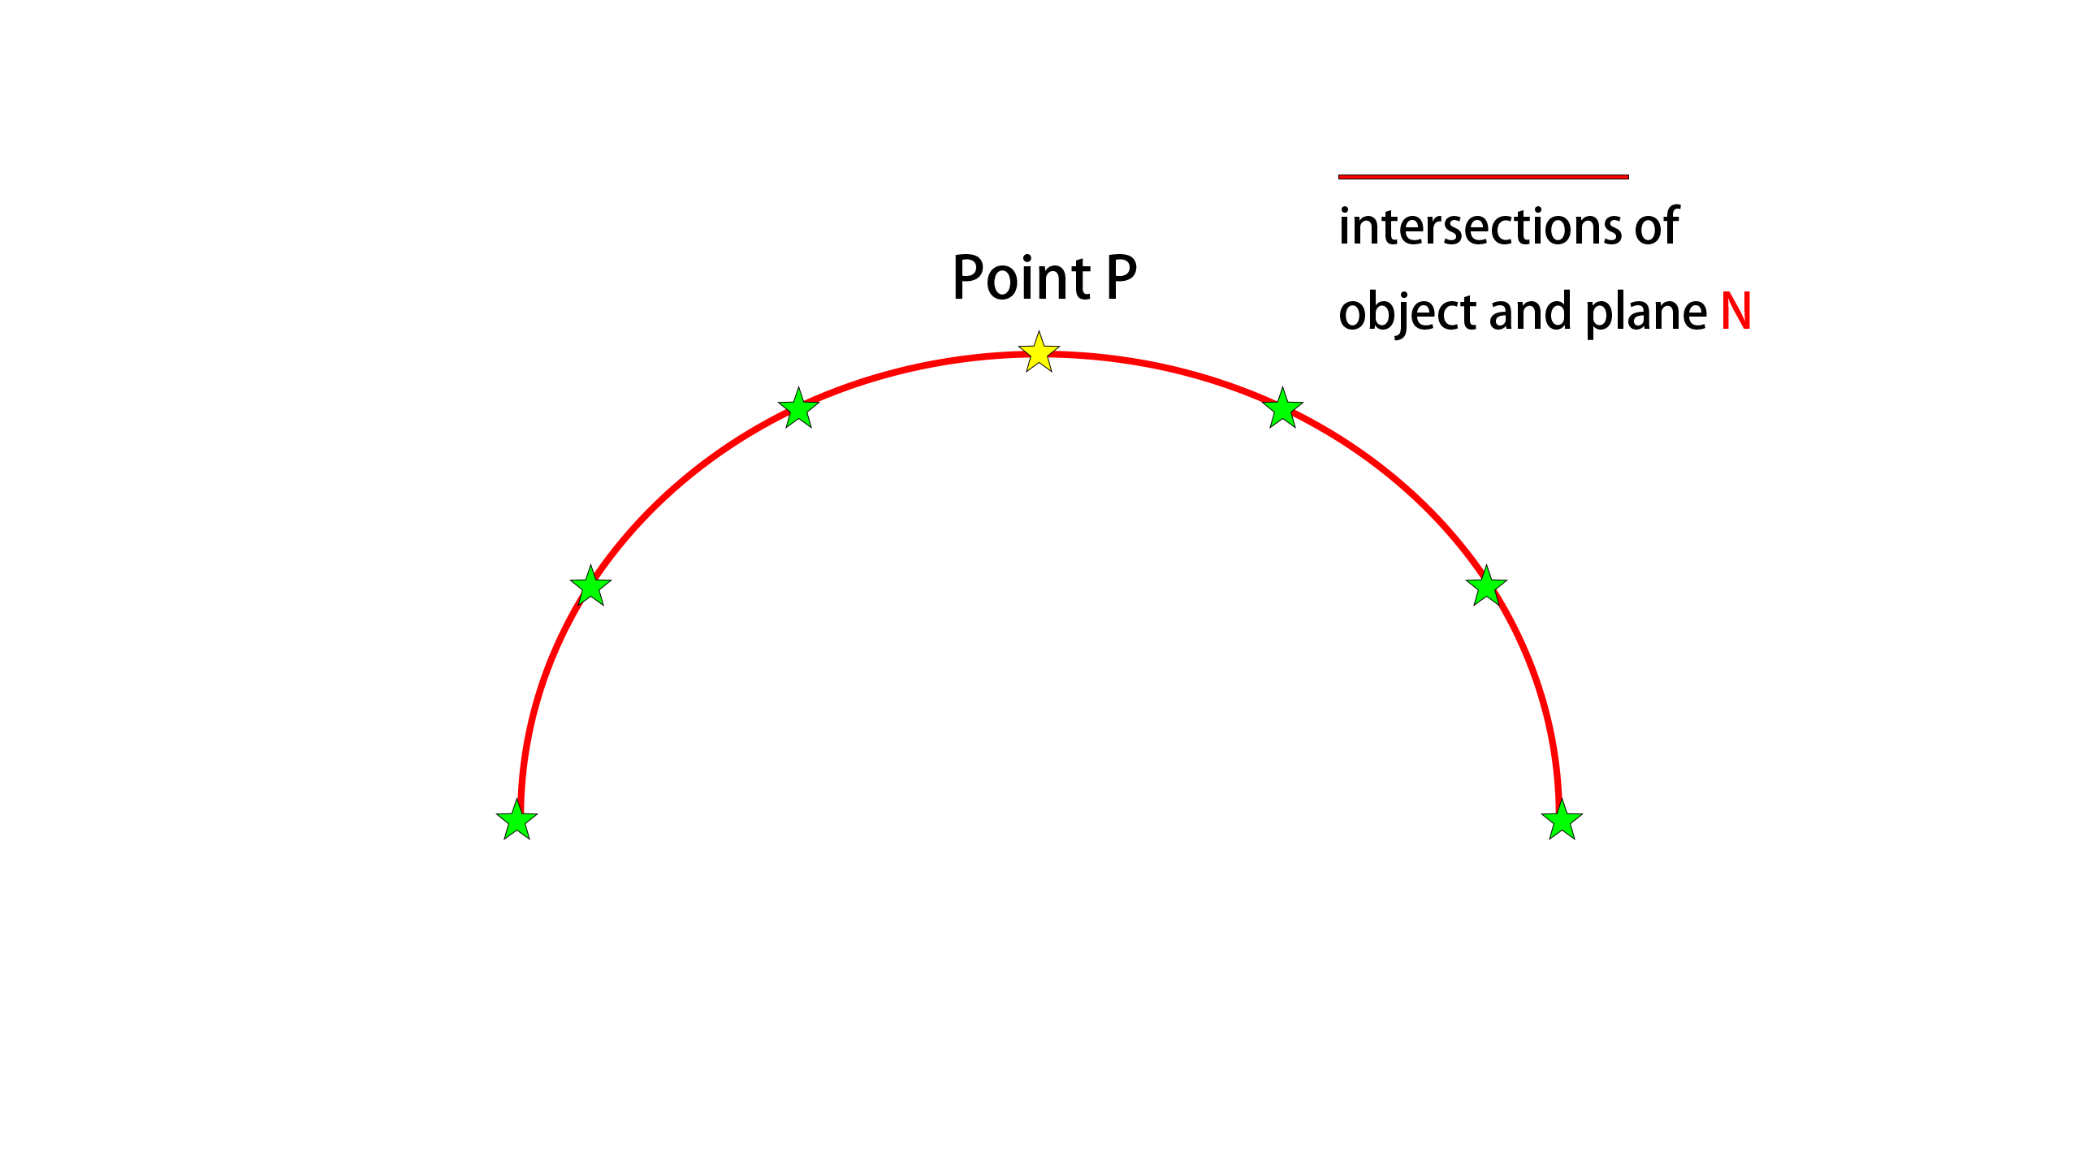
NORMAL CURVATURE
Object surface
Plane N

Slide 7
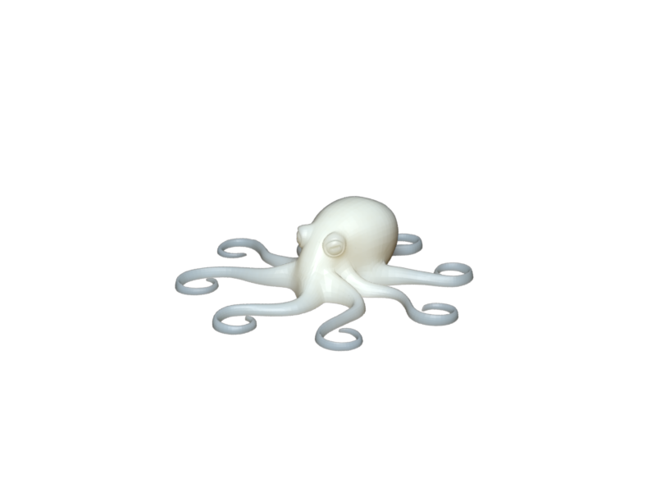
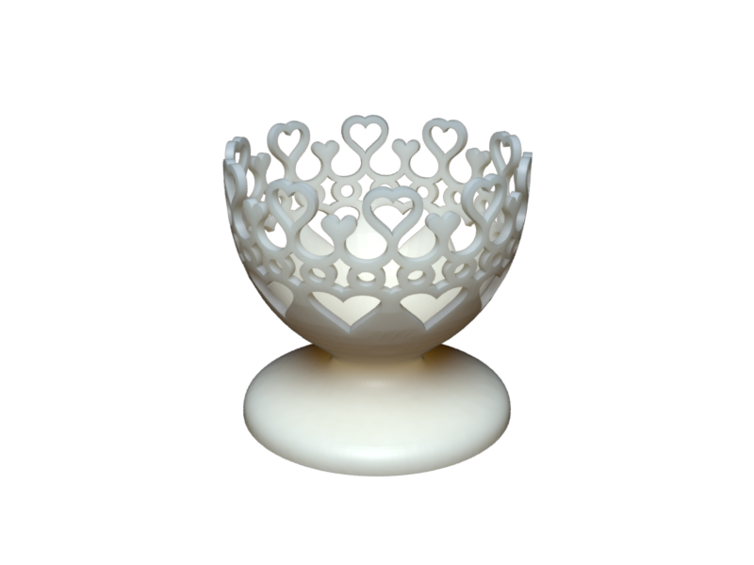
DATA SET
Dataset choose
  Thingi10K dataset
  Good mesh quality: Vertex and edge manifold, No self-intersection
example model from Thingi10K

Slide 8
DATA SET
Sampling 500 object from 4552 synthetic objects
Generate 10 random contour projections from random view angle for each object
Table: 3D objects statistic
 | #Faces | #Vertices | #Contours Vertices
Total | 7,564,995 | 3,778,812 | 758,772
Average (pre object/projection) | 15,130 | 7,557 | 151

Slide 9
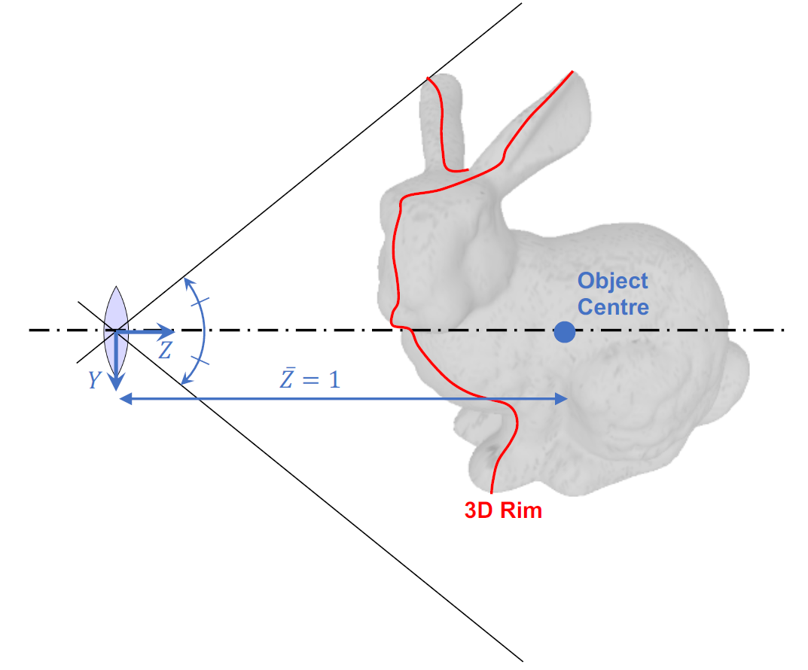
IMAGE PROJECTION
Using a virtual pinhole camera with unit focal length and 45°FOV.
Objects were centered on the optic axis with centroid at 1 unit length from camera.
The size of each object was normalized
The rim and corresponding 2D occluding contours are sampled with the finest detail from the triangular mesh

Slide 10
CURVATURE COMPUTATION
The rim and corresponding 2D occluding contours are sampled with the finest detail from the triangular mesh
Compute Normal and Apparent curvature at different level of detail
# of Points considered
# of point considered | % compare with image projection (on average)
1 | 0.6%
2 | 1.3%
4 | 2.6%
8 | 5.2%

Slide 11
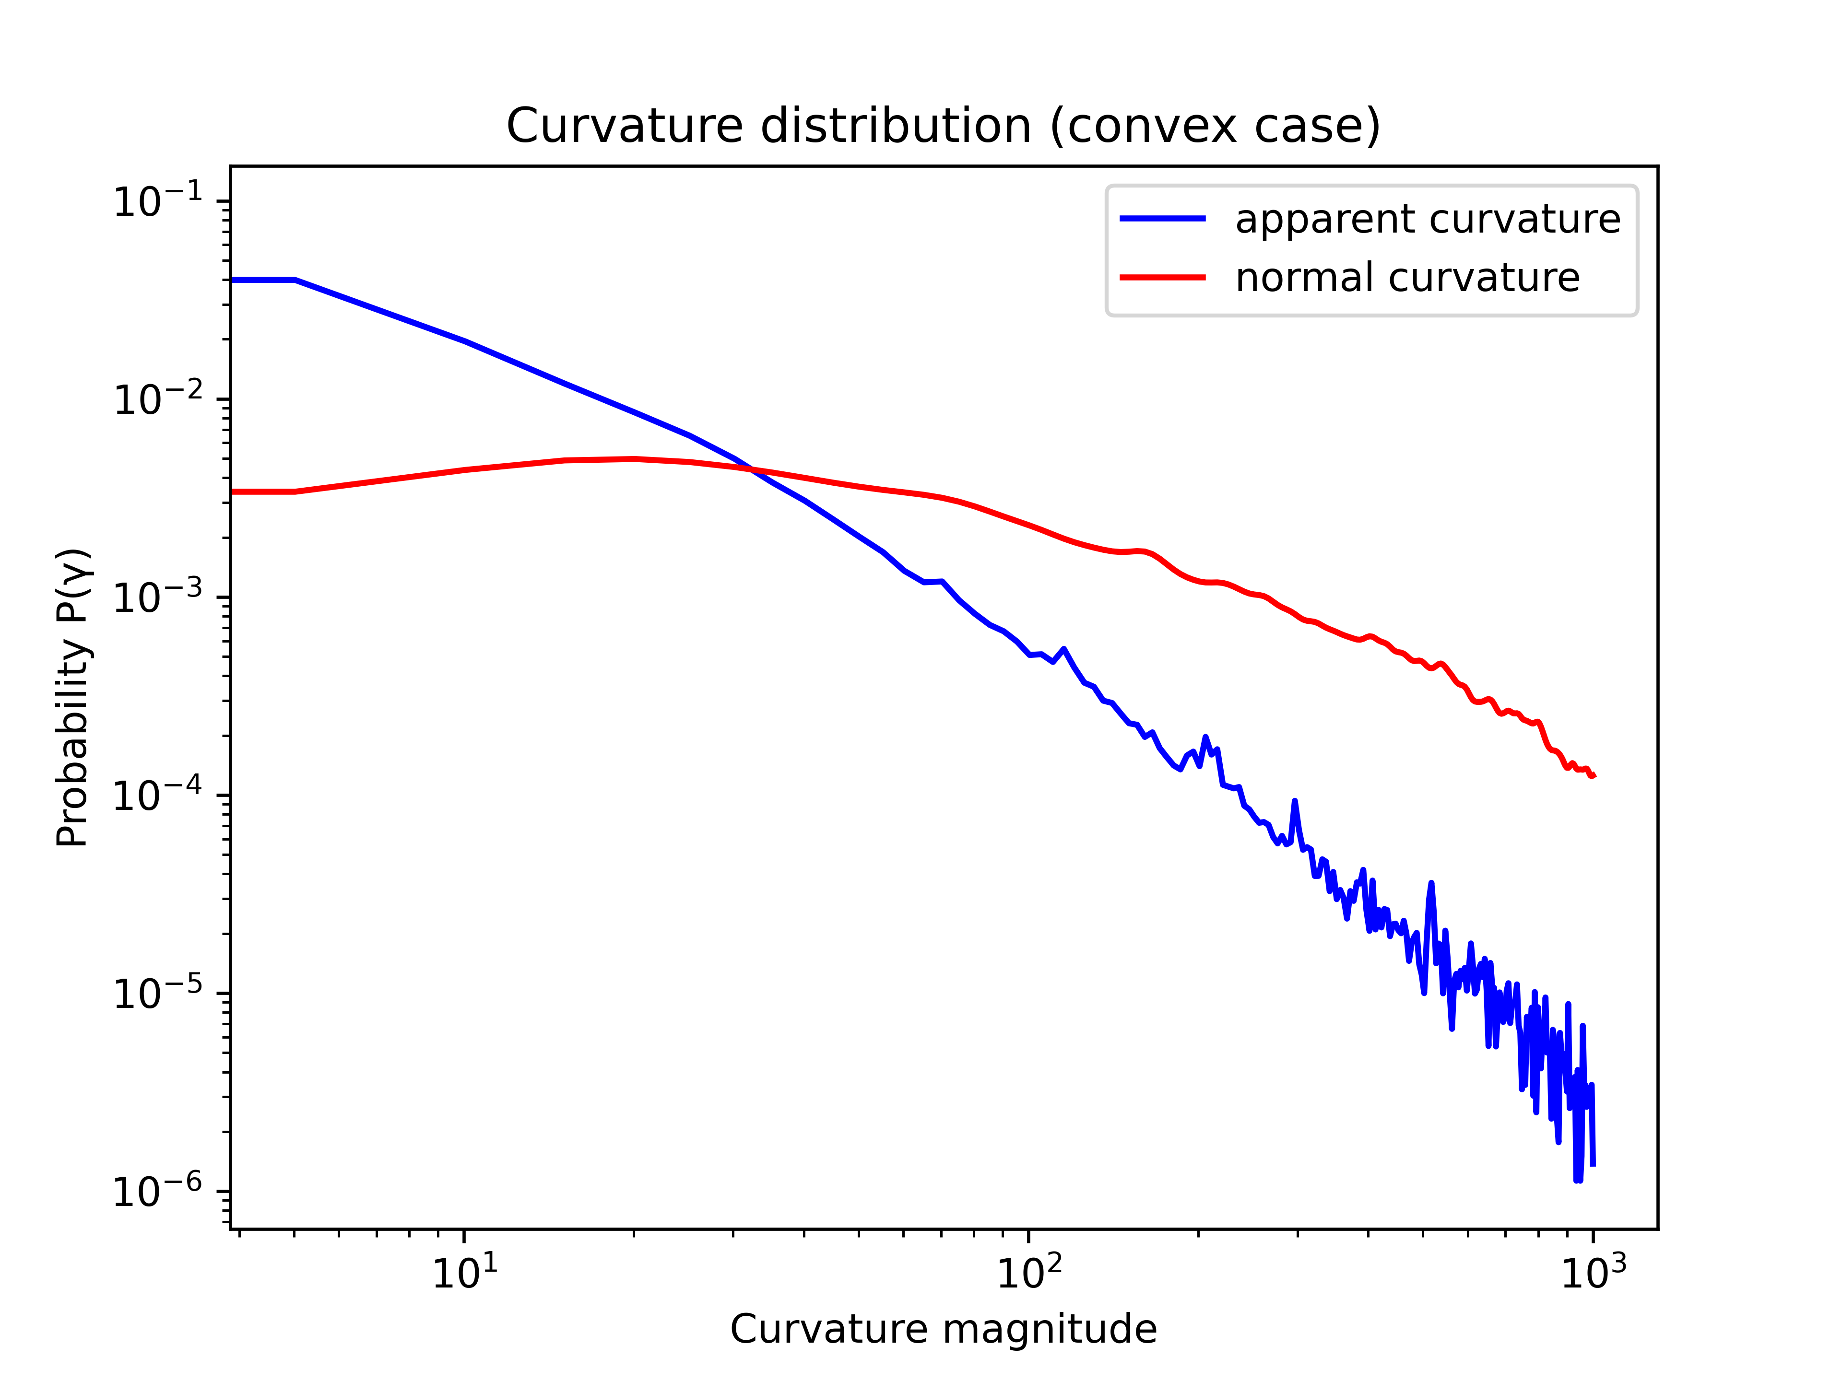
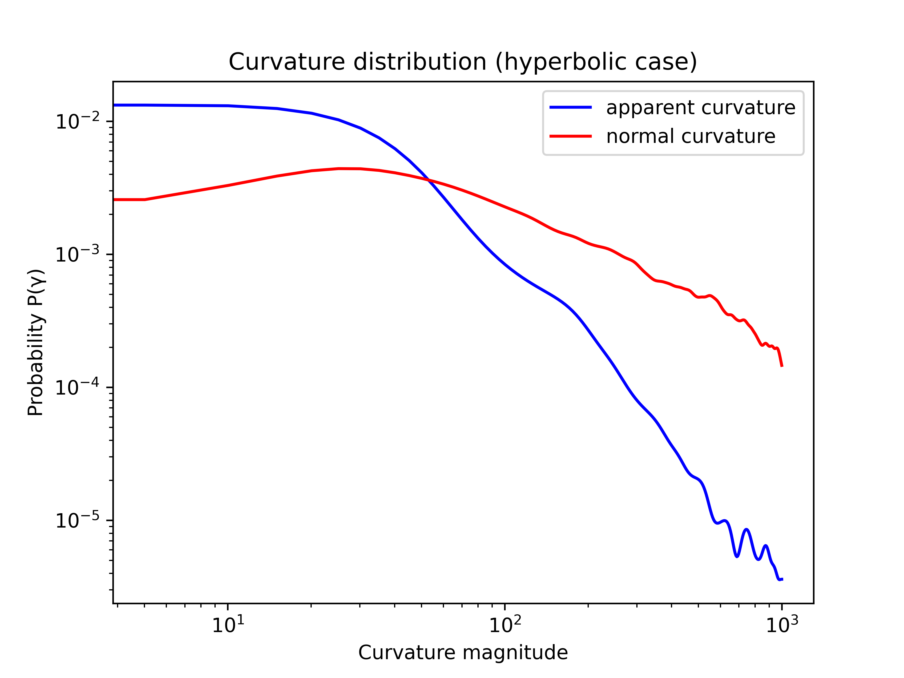
RESULT: DISTRIBUTION OF NORMAL CURVATURE

Slide 12
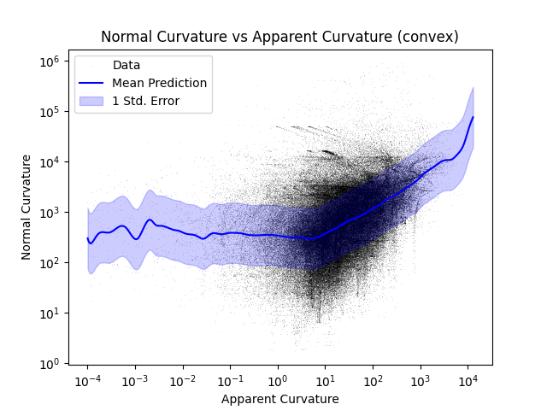
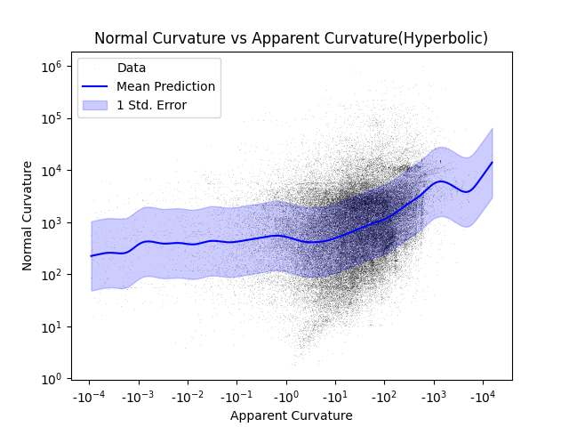
RESULT: apparent curvature vs normal curvature

Slide 13
RESULT: apparent curvature vs normal curvature
Sampling step | Proportion of variance explained (R²) |  | Correlation coefficient (log scale): apparent vs normal curvature
Sampling step | Convex | Hyperbolic | Convex | Hyperbolic
1 | 0.15 | 0.05 | 0.29 | 0.16
2 | 0.18 | 0.10 | 0.38 | 0.25
4 | 0.20 | 0.13 | 0.39 | 0.29
8 | 0.16 | 0.02 | 0.35 | 0.28

Slide 14
CONCLUSION
We demonstrate a statistical connection between the of the 3d rim and its occluding contour
Normal curvatures are higher than apparent curvatures
Apparent curvature is somewhat predictive of normal curvature
  predictive capacity peaks at an intermediate scale
  predictive capacity peaks at convex case
Introduce a novel dataset consisting of 3D object rims and their 2D projections with curvature annotation

Slide 15
REFERENCE
Barron, J., & Malik, J. (2013). Shape, Illumination, and Reflectance from Shading. https://doi.org/10.21236/ada586648
Koenderink, J. J. (1984). What does the occluding contour tell us about solid shape? Perception, 13(3), 321–330. https://doi.org/10.1068/p130321
Mehrani, P., & Elder, J. H. (2017). Estimating coarse 3D shape and pose from the bounding contour. Proceedings of the 12th International Joint Conference on Computer Vision, Imaging and Computer Graphics Theory and Applications. https://doi.org/10.5220/0006190306030610
Zhou, Q., & Jacobson, A. (2016, July 2). Thingi10k: A dataset of 10,000 3D-printing models. arXiv.org. https://arxiv.org/abs/1605.04797

